Slide 1
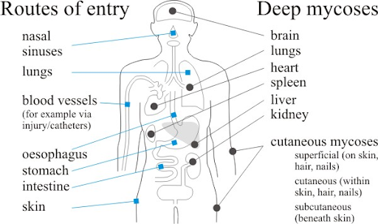
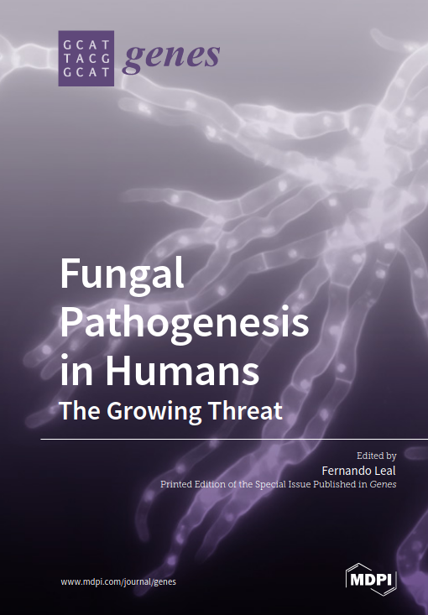
Medical mycology
Topics (just the very basics):
Mycoses are limited to few species
Opportunistic pathogens
Fungal infections are on the rise
Types of infections:
Skin
Systemic
Examples of mycoses
Human mycobiome
Beneficial human fungi
Allergens and toxins
2019 Special Issue

Slide 2
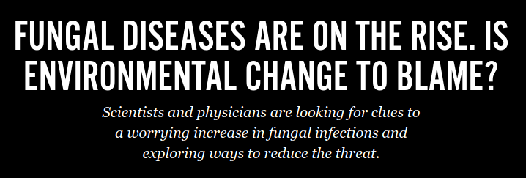
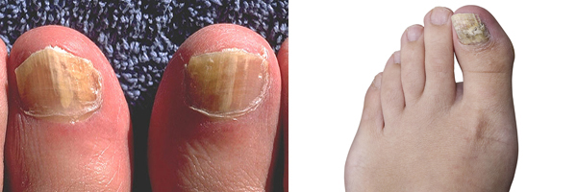
Myths:
Rare
Just for immunocompromised folks
Only in the tropics
Fungi can't handle warm body temp
Facts:
Widespread (and increasing)
Most dangerous mycoses tend to only be a problem for immunocompromised
But fungal infections are quite common
Common everywhere, and those "tropical" diseases are finding their way everywhere lately
Obviously, some fungi are fine with warm temps, though being warm-blooded is our major defense!
So far ~150 species of fungi are known to cause infections in humans
Maybe 20-30 species are potentially major threats to health of the infected
Just because of low numbers of infectious agents, doesn't mean low case counts!
Fungal infections account for 1.5 Million deaths annually worldwide
Many many more times that number of less threatening infections

Slide 3


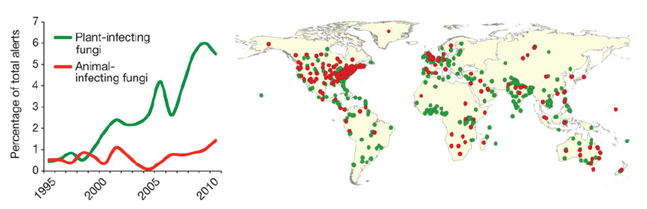
"A major factor protecting us from fungal disease is the difference in temperature between the human body and the outside environment. As fungi adapt to living at higher temperatures, we may begin to lose some of that natural protection”
- Arturo Casadevall
(This guy has really cool hypothesis about fungi being critical to the rise of mammals)
From 1999 - 2009, a bad outbreak of the "tropical" Cryptococcus gatii terrorized Canada's west coast

Slide 4
Other factors that help explain current drastic increase in mycoses:
- Environmental change - Old fungal diseases coming out of the freaking permafrost!
- Population growth in areas with endemic fungal pathogens
- Increase in HIV-related immunosuppressed status

Slide 5
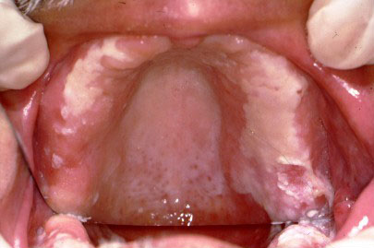
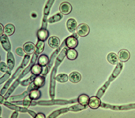
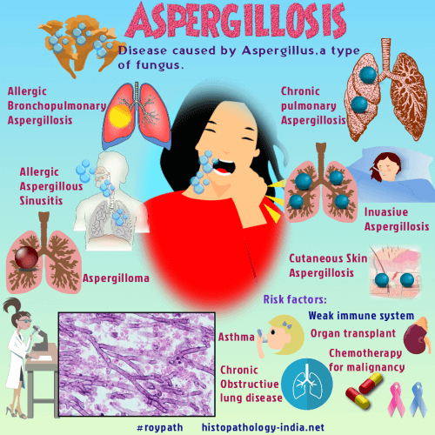
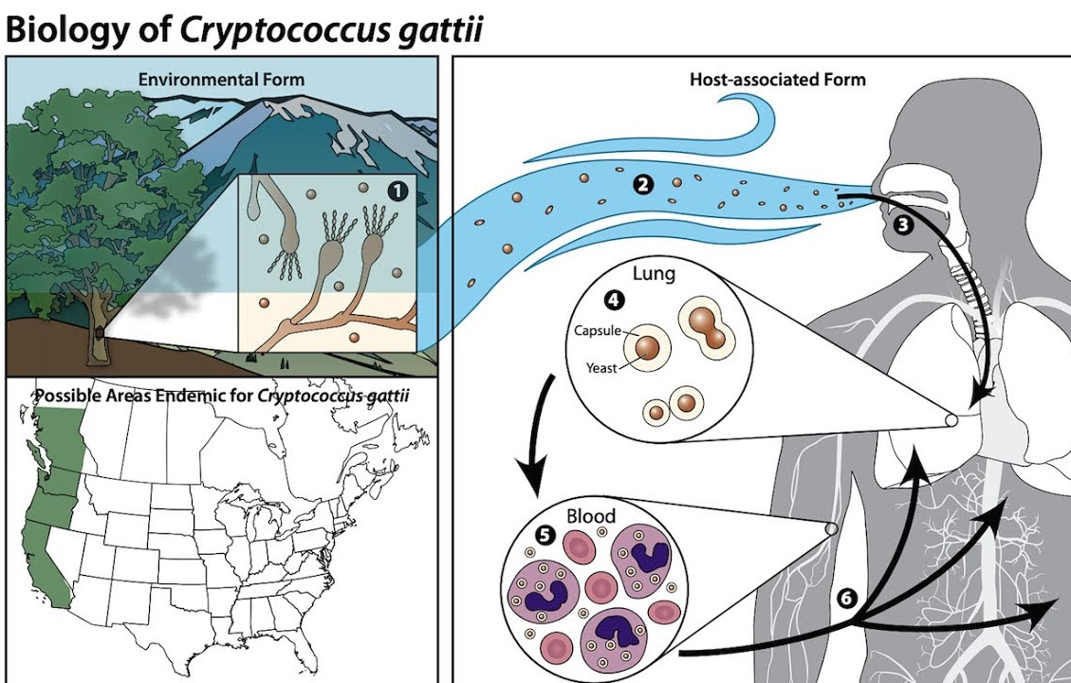
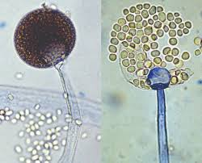
The four most common problem fungi:
Candida Aspergillis
Cryptococcus Mucor
CDC Link
CDC Link
Ascomycete
Opportunistic
Many diseases
Dimorphic basidiomycete
common and imporant part of mycobiome
facultative pathogen
CDC Link
CDC Link
Zygomycete
rare, but very serious infections
That's new!

Slide 6
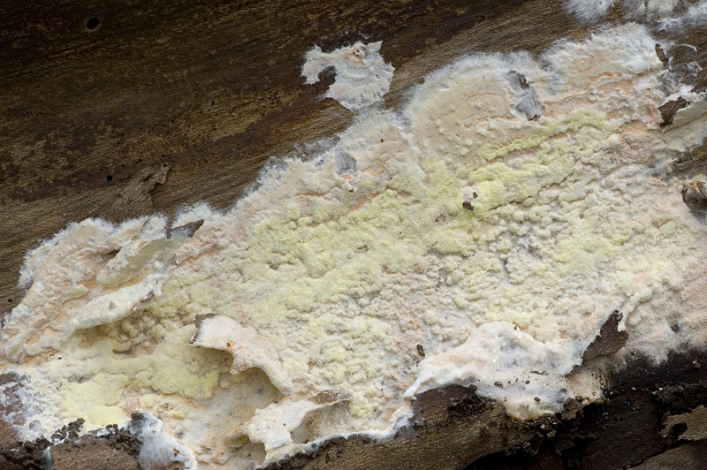
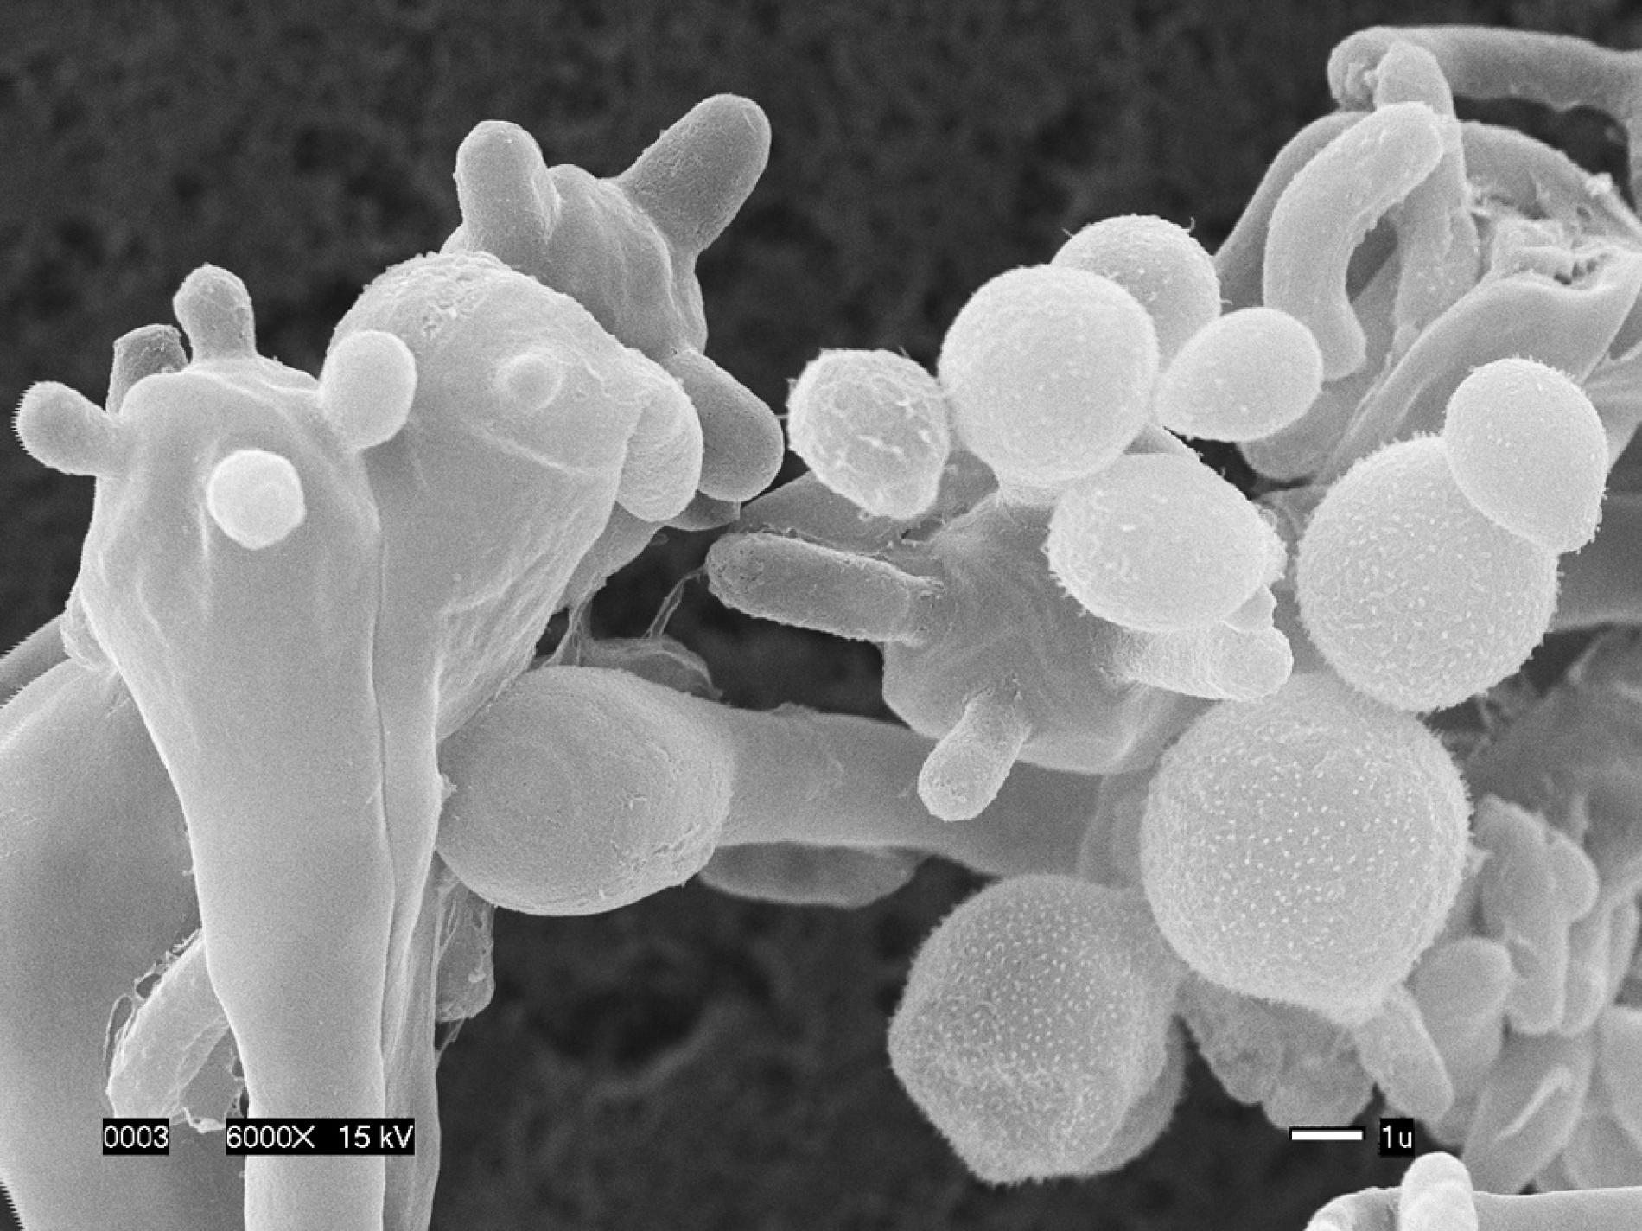
Cryptococcus gatii
It's the anamorph of a jelly fungus...and it wants to kill you
Teleomorph: Filobasidiella
Basidiomycota; Tremellales
Can infect lungs/brain of healthy people
Used to be limited to Papua New Guinea
Anamorph is in yeast form
Soil saprotroph...but also human pathotroph
Basidia

Slide 7
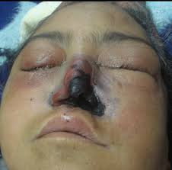
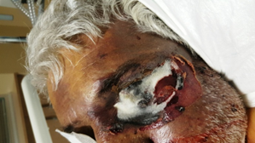
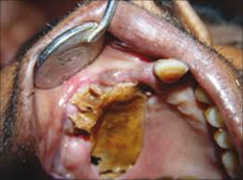
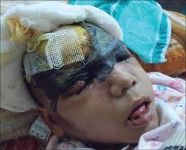


Zygomycete species that can infect humans:
Rhizopus, Mucor, Rhizomucor, Cunninghamella, Apophysomyces, etc.
Mucromycosis is a catch-all term for Zygomycete infections
Tends to be limited to opportunistic infections
Wide range of diseases and symptoms
Very difficult to treat (sometimes surgery is the only option)
Real story -->

Slide 8
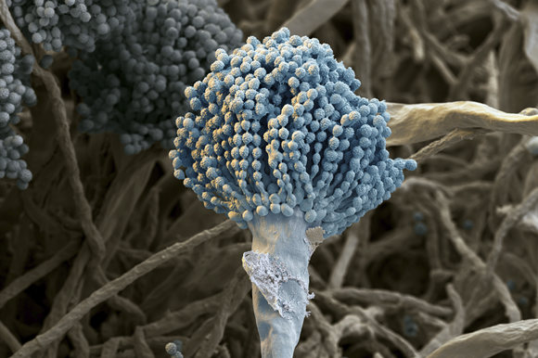
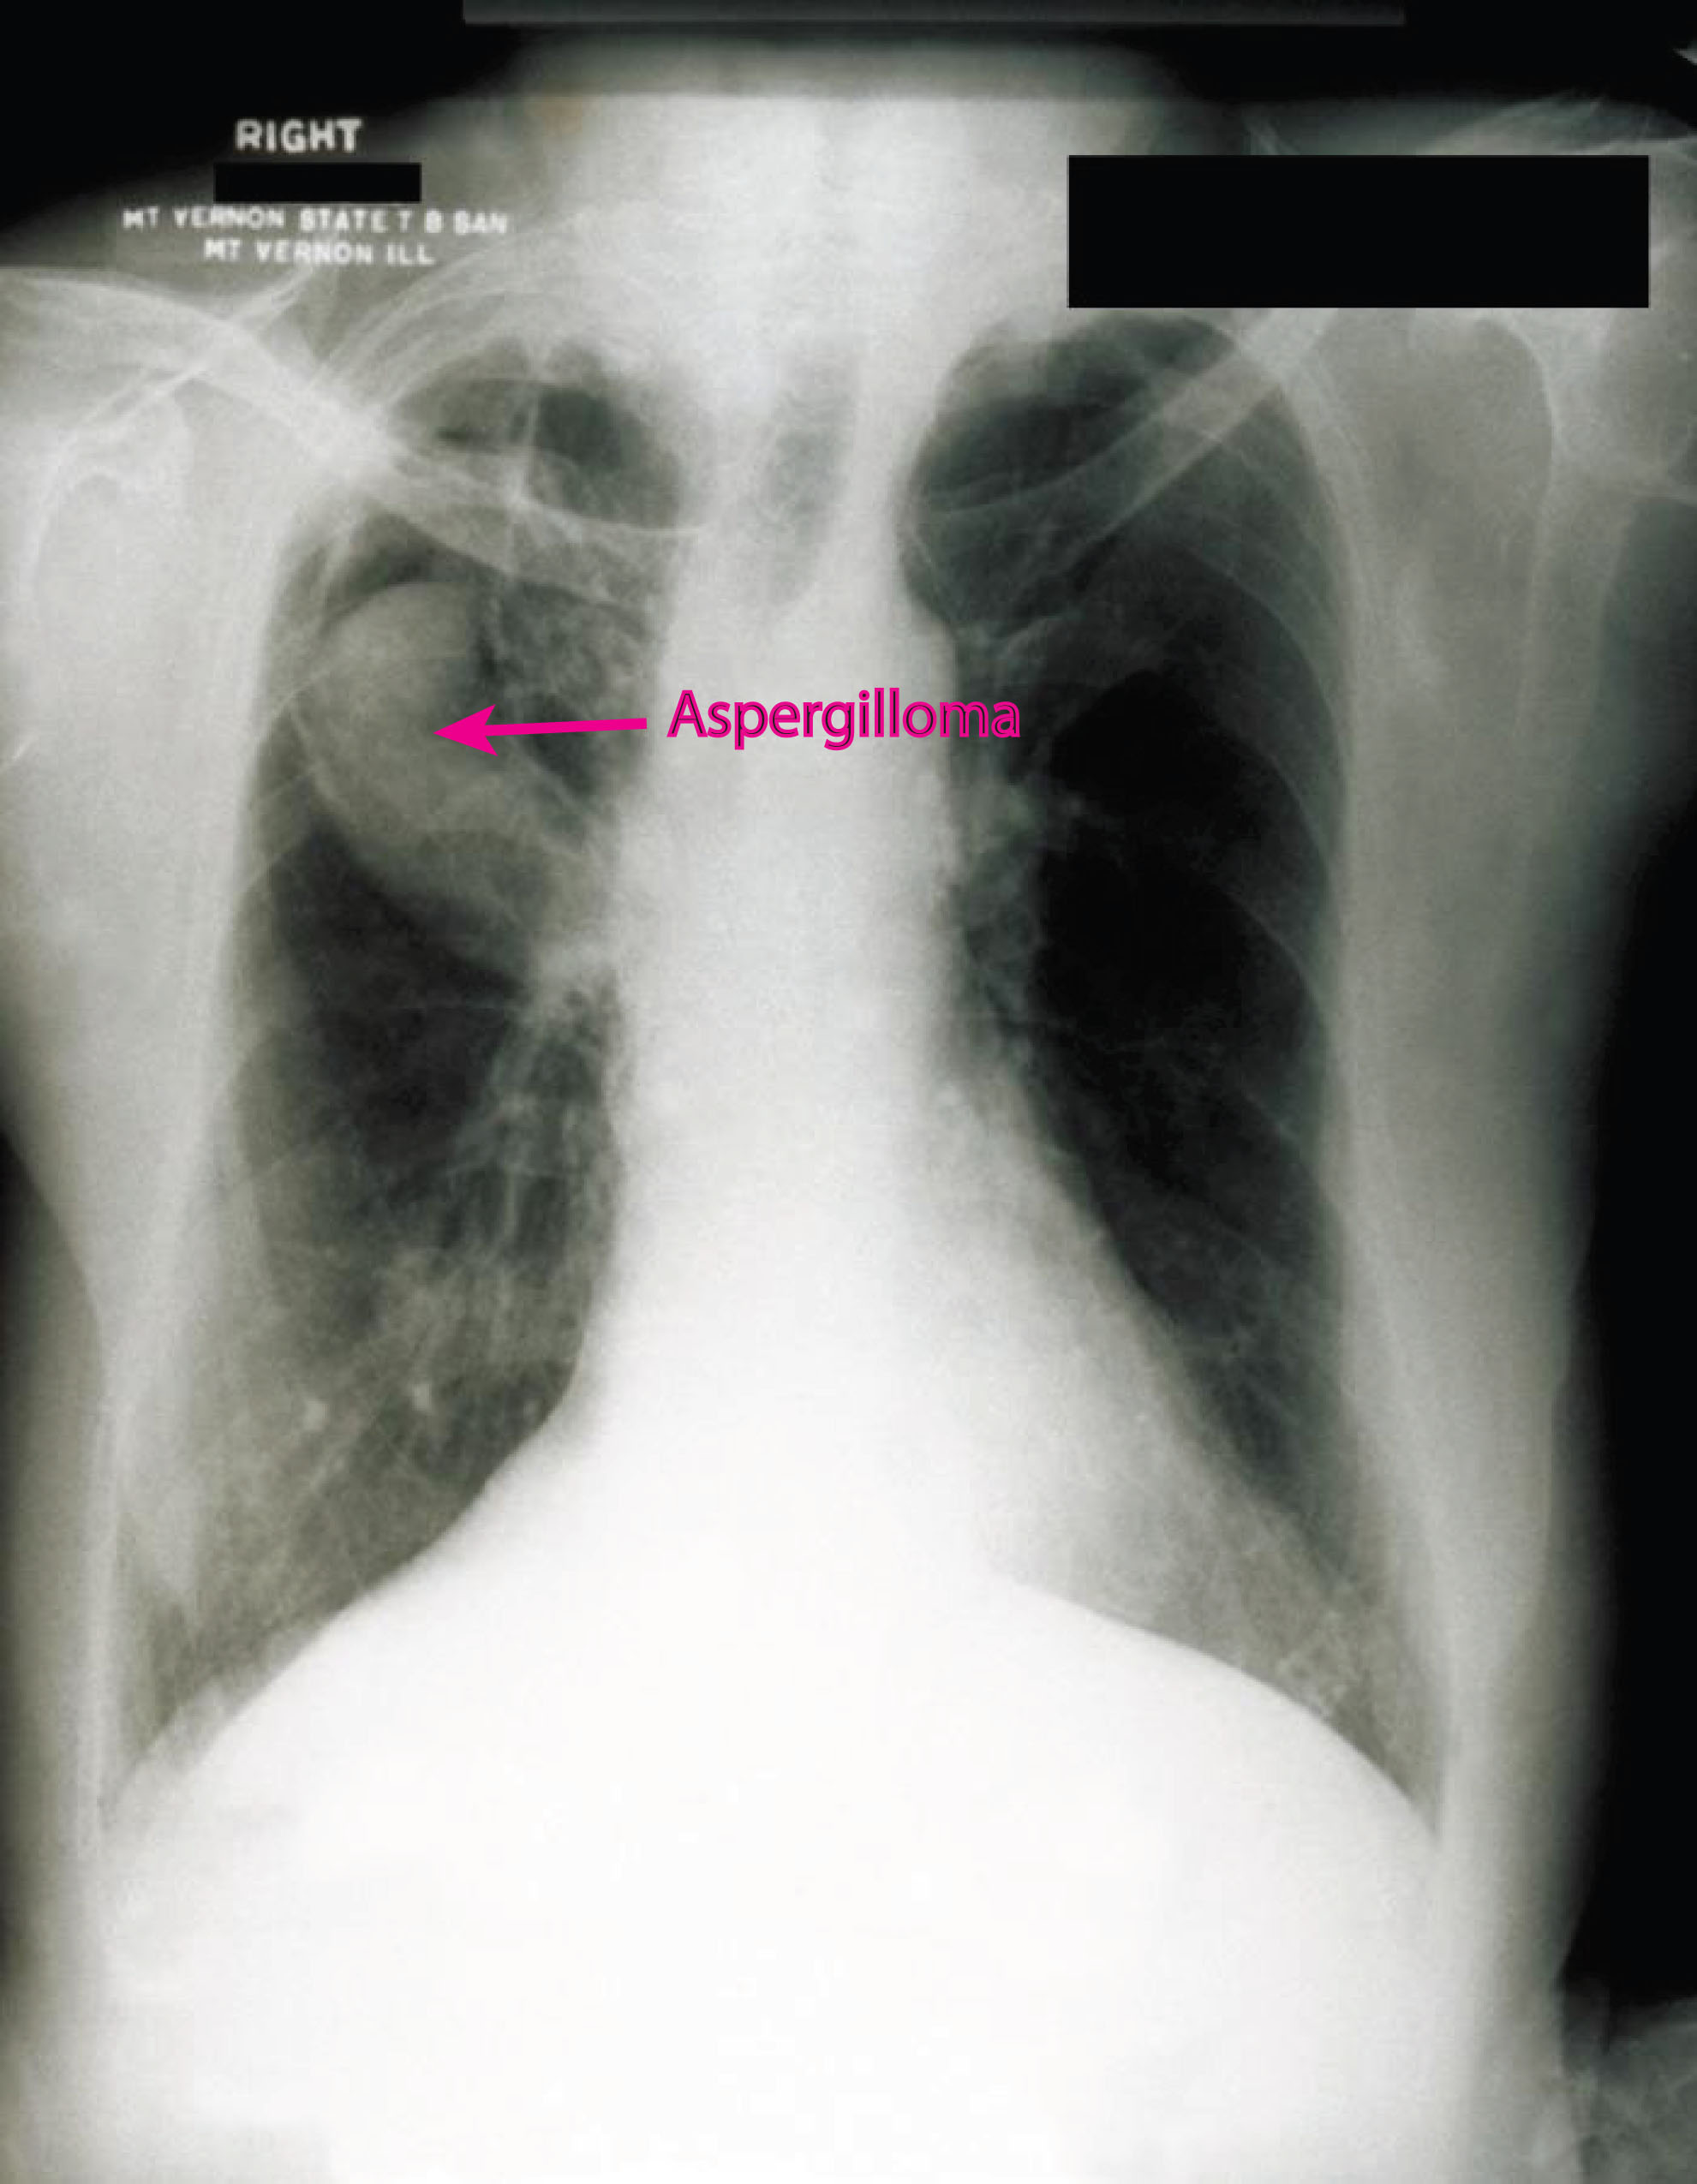
Aspergillosis
Diseases caused by various Aspergillis agents
Lung, sinus, and cutaneous infections
Immunocompromised individuals at greatest risk

Slide 9
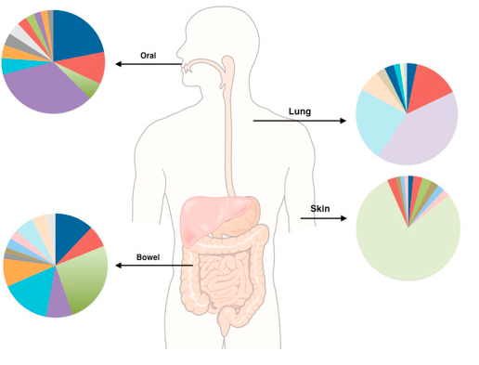
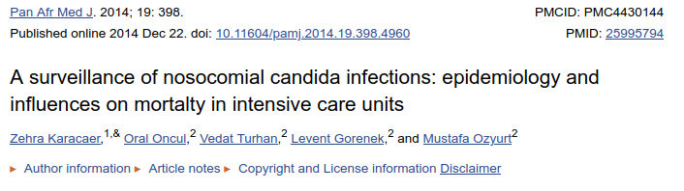
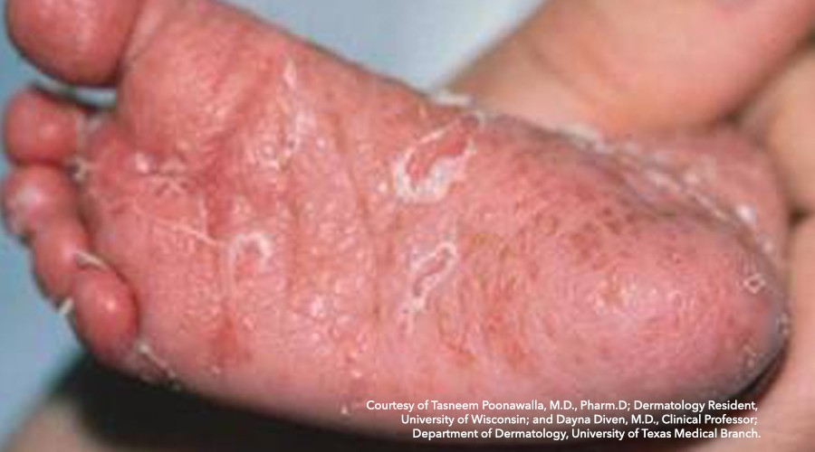
Candidiasis
When your good friend turns on you
Immunocompromised indivs.
Or just normal hospital patients...
Major source of nosocomial infections
Candida
Candida sp. is a major component of healthy skin
But it has no moral qualms about eating you if it gets a chance

Slide 10
Problems treating mycoses
Antibiotics and dysbiosis
Careless medical staff
Drug resistance (largely from agriculture)
Limited fungal targets for drugs that don't affect human cells as well

Slide 11
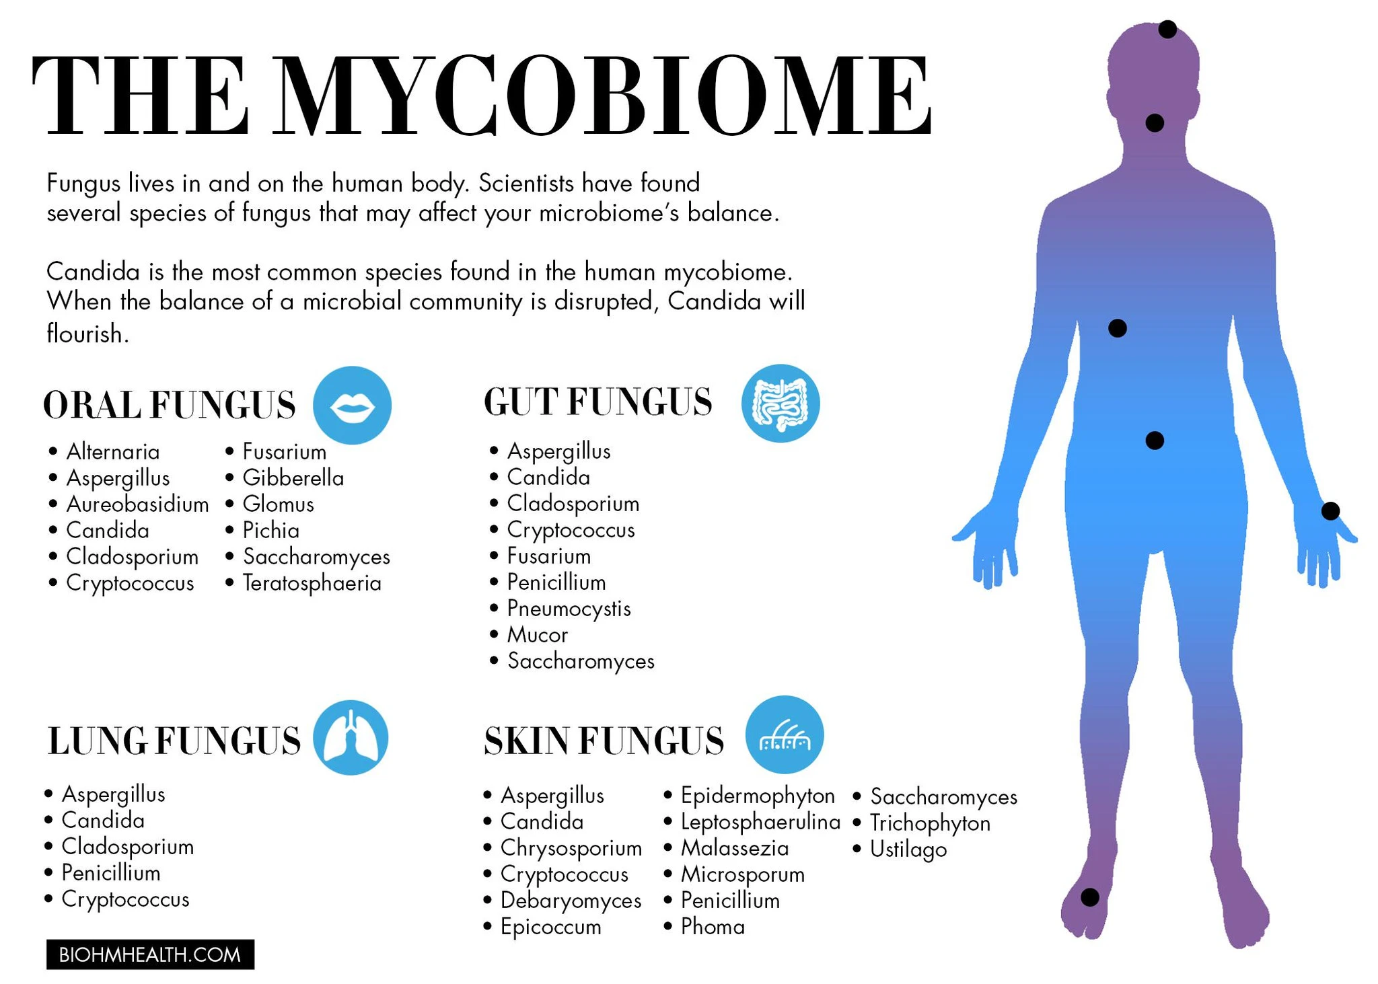

Slide 12
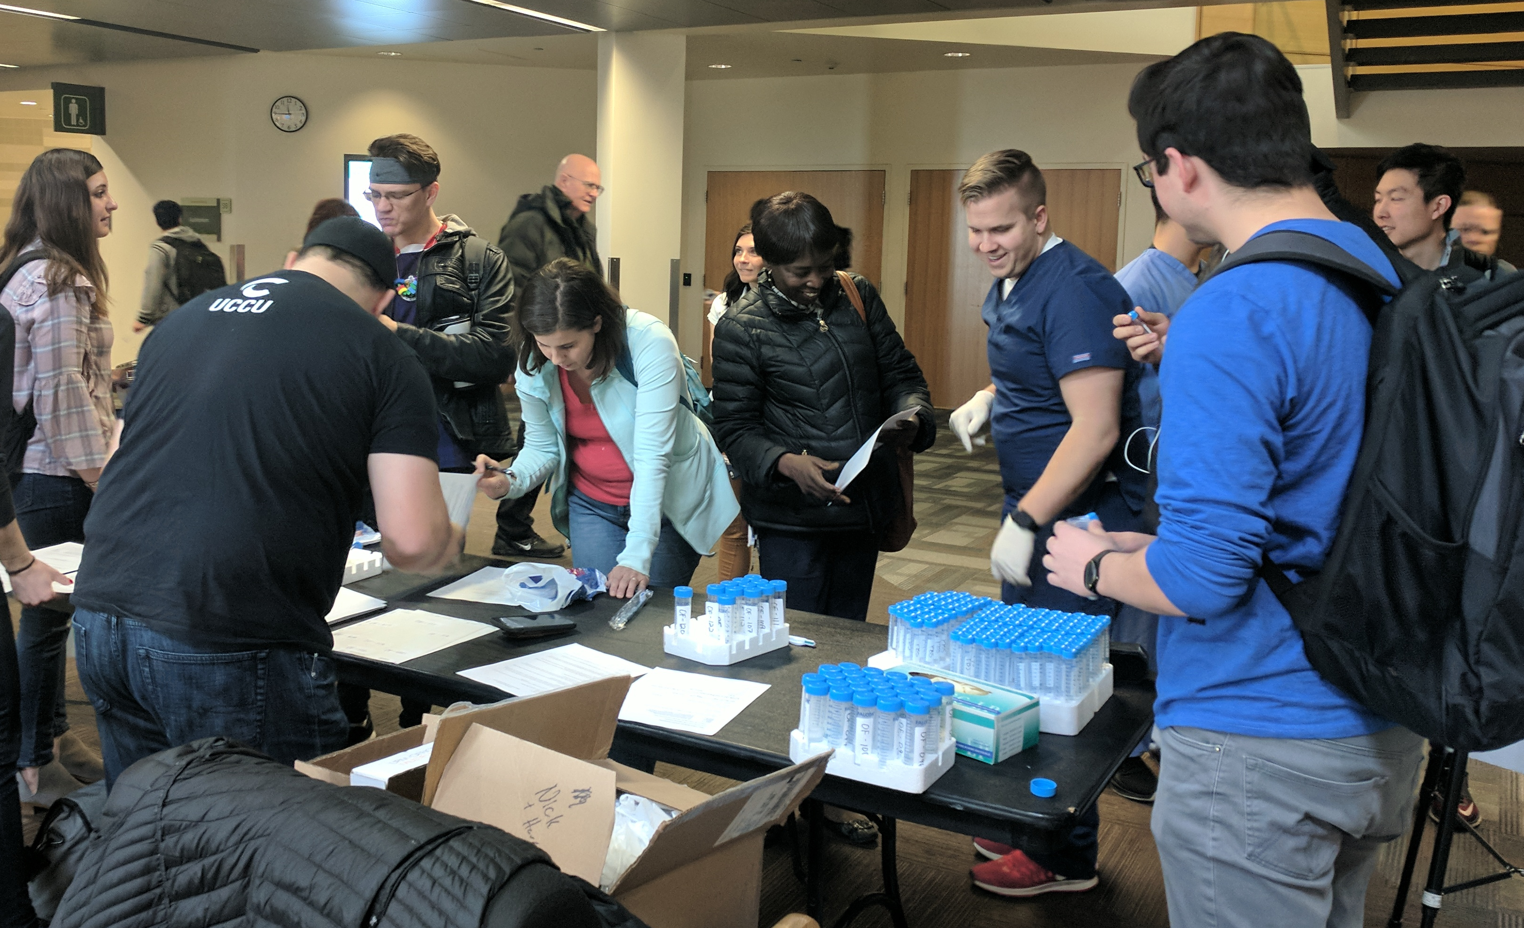
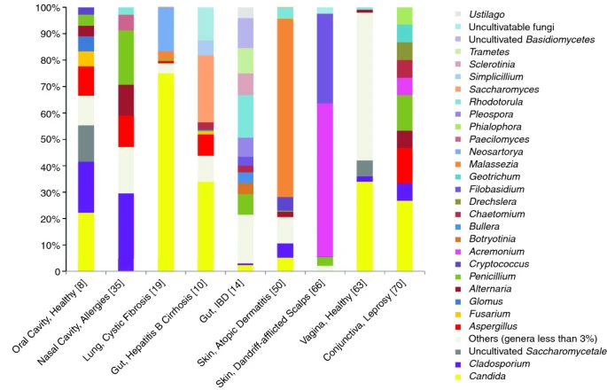
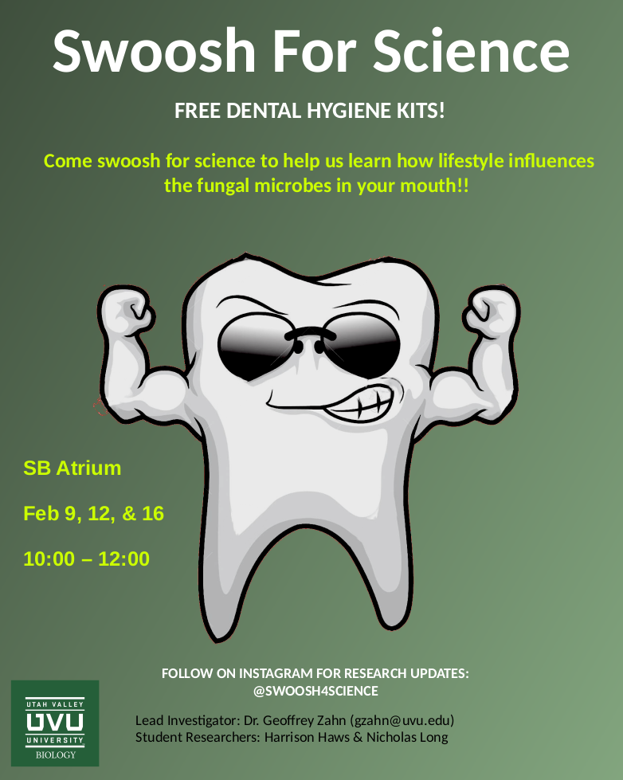
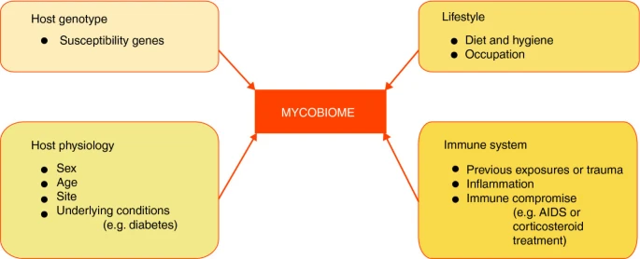
Some of my research students have tried to study the human oral mycobiome ... but then they switched to bacteria

Slide 13
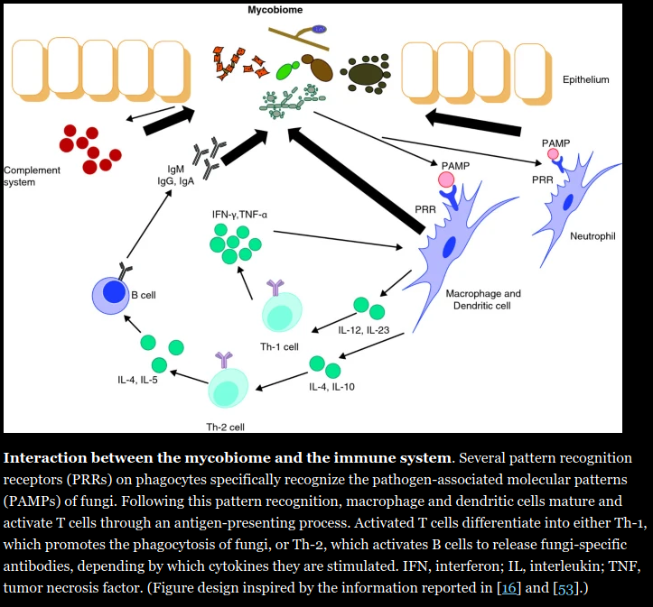

Human mycobiome research is still newish...
Noticing a lot of interesting patterns:
Interaction with immune system
Fungi as disease treatments
Triggers for pathogenicity switch
Effect on bacterial microbiome
Nobody's looked at dysbiosis yet
Maybe less stable than bacterial microbiome? Why?

Slide 14
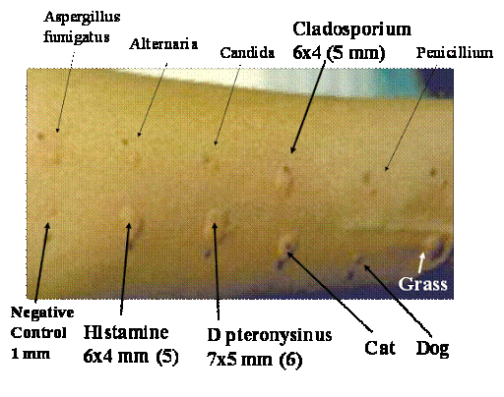
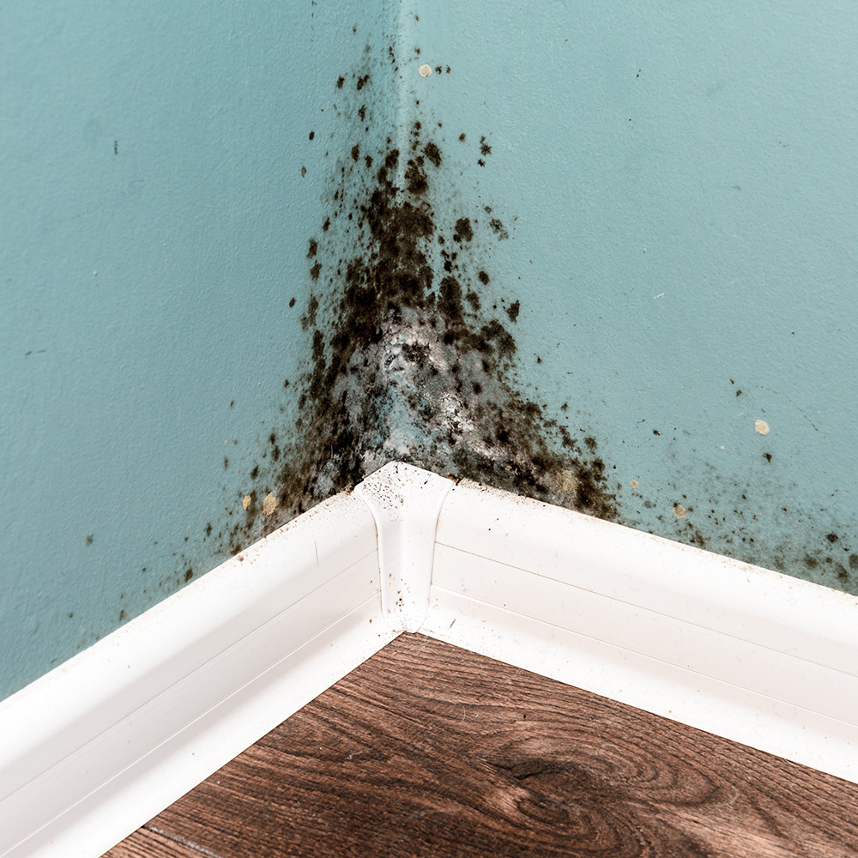
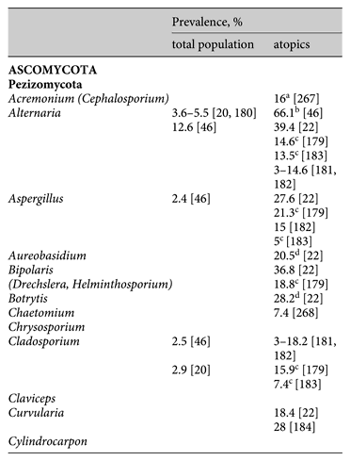
Fungal spores as allergens
Spores often in higher concentrations than pollen grains in air
Estimated 6% of population is allergic to fungal spores
Not reliant on immunocompromization
"Black mold"
Stachybotrys spp.
Ascomyctoa; Sordariomycetes
Not a pathogen...an allergen
Fungal allergens evoke a broad response in sensitive individuals (Type I, II, III, and IV allergies)
Dermatitis, asthma, rhinitis
Good overview paper link

Slide 15
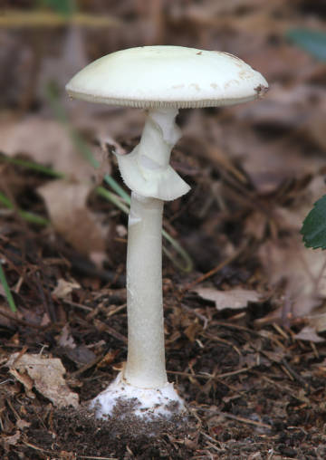
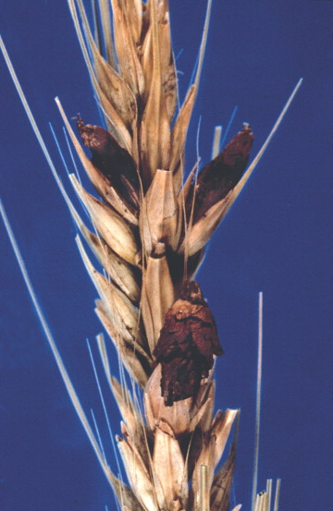
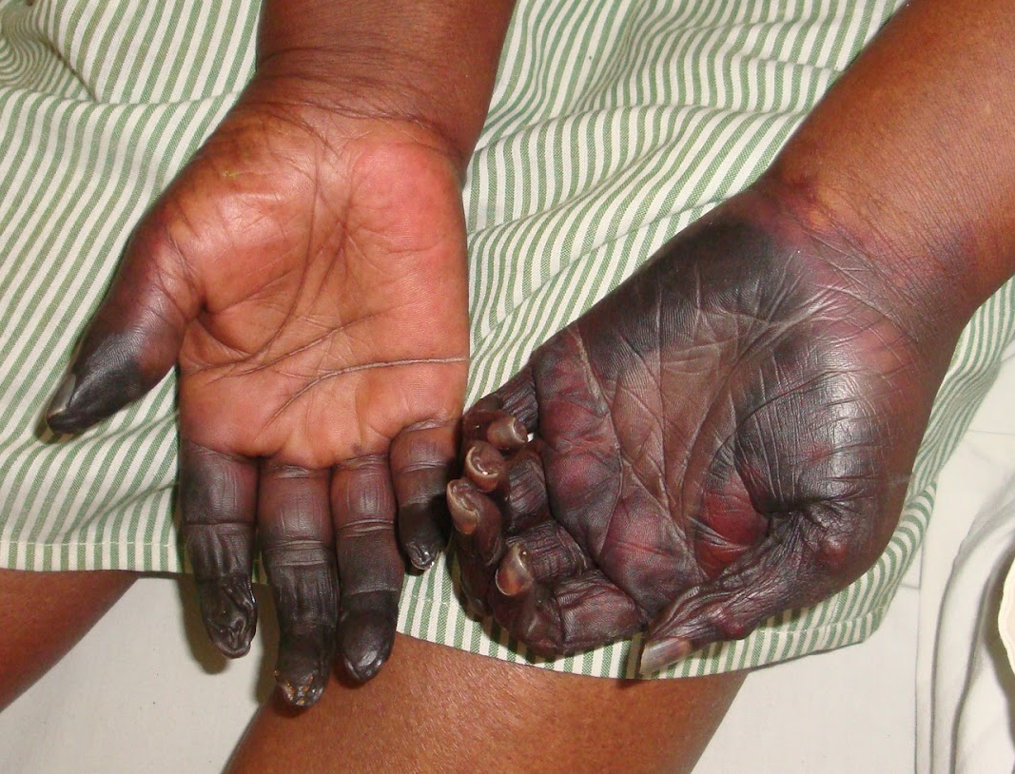
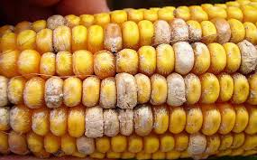
Mycotoxins
Post-harvest food toxins from fungi:
Ochratoxin A
Patulin
deoxynivalenol
nivalenol
T-2 and HT-2 toxins
...the list goes on (Google it)
Claviceps spp.
- Ergot
Amanita spp.
- Destroying angel or Death Cap
(This one mushroom could kill 5-6 people easily)
Eating this corn causes liver damage

Slide 16
Assignments
1. Read Huffnagle & Noverr, 2013
- This is a look at the human mycobiome
2. You will have a Canvas quiz on the assigned readings and will also have to participate in a Slack discussion about them.
3. Go through the CDC website links about fungal infections (found in this slideshow)
- Create a new powerpoint slide about one of the fungal infection types not covered in these slides
- Be sure to find sources outside of the CDC site for more info/pictures etc.
- Turn in on Canvas

