Slide 1
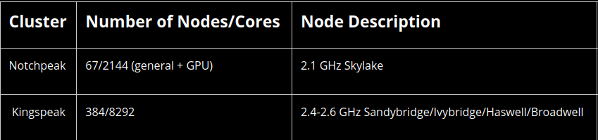
SLURM script (submit job)
Cluster (kingspeak)
This is where jobs are run. You submit a request via SLURM that declares what resources you need and then the commands to run.
#!/bin/bash
#SBATCH --time=30 #mins
#SBATCH --nodes=1
#SBATCH -o slurm-%j.out
#SBATCH -e slurm-%j.err
#SBATCH --ntasks=12 #cpus
#SBATCH --account=uvu
#SBATCH --partition=kingspeak-shared
#SBATCH --mail-type=END,FAIL
#SBATCH --mail-user=zahn.geoff@gmail.com
module load R/4.0.2
Rscript ./R/myscript.R
wait in line...
resources allocated as requested and job is run; any output files will be where you designated, but STDOUT goes to a file, not your screen
sbatch ./jobs/myjob.slurm
STDOUT / ERR
Modules (the software available)
Log-in node
take what you need
bioBakery/1.8
biokevlar/0.7 namd/2.14.verbs-smp-CUDA
bioperl/1.5.1 nanopore/1.0
blast/2.7.1 bowtie/1.1.2 bowtie2/2-2.2.9
. . .
/uufs/chpc.utah.edu/common/home/u6033249
Keep your files and some programs organized here.
Do NOT run jobs like you're on a normal command-line.
Data
jobs
MyModules
programs
R
RLibs
slurm_output
slurm-9031926.out
slurm-9031926.err

