Slide 1
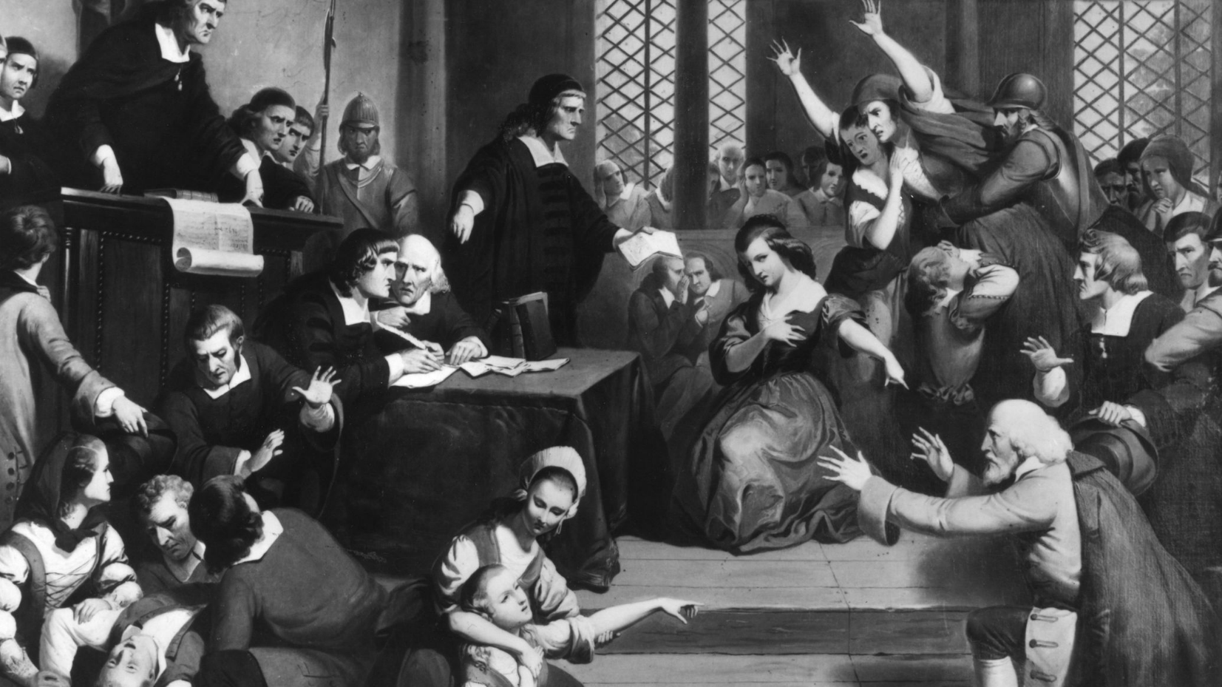
Plant pathogens
Topics (just the very basics):
- Why plant pathogenic fungi have gotten WAY more attention than human pathogenic fungi
- Appreciation for the economic and evnironmental impact of plant pathogenic fungi
- Understanding of "the disease triangle" and how it relates to pathogenicity
- Know a few examples of plant pathogenic species
- Have an idea of the sorts of things that plant pathologists study
2019 Special Issue

Slide 2
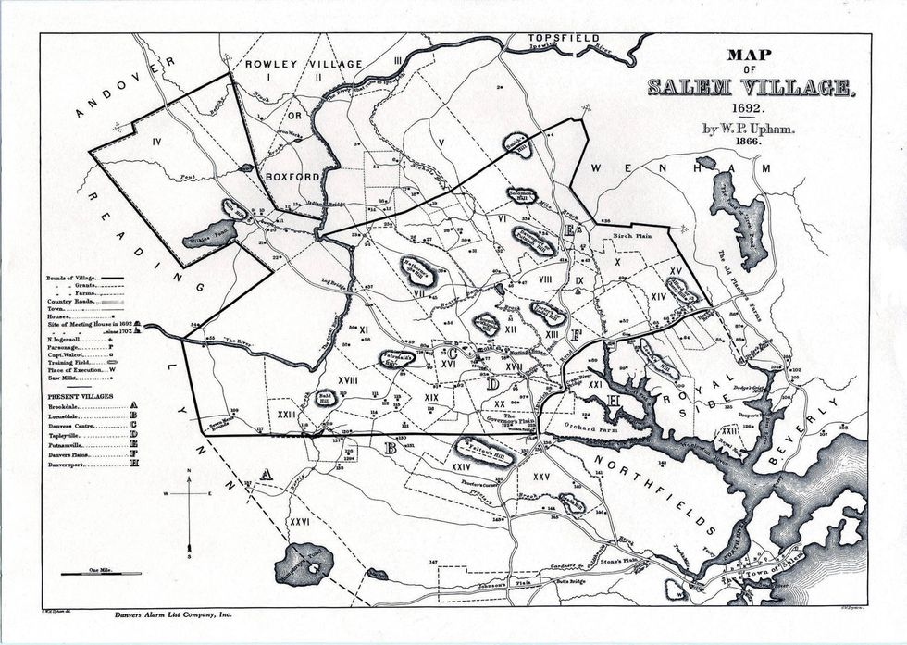
The trouble in Salem began during the cold, dark Massachusetts winter, in January of 1692. Eight young girls began to take ill. The girls suffered from delirium, violent convulsions, incomprehensible speech, trance-like states, and odd skin sensations. The worried villagers searched desperately for an explanation. Their conclusion: the girls were under a spell, bewitched — and, worse yet, by members of their own pious community.
And then the finger pointing began. Ultimately, more than 150 “witches” were taken into custody; by late September 1692, 20 men and women had been put to death, and five more accused had died in jail. None of the executed confessed to witchcraft. Such a confession would have surely spared their lives, but, they believed, condemned their souls.

Slide 3
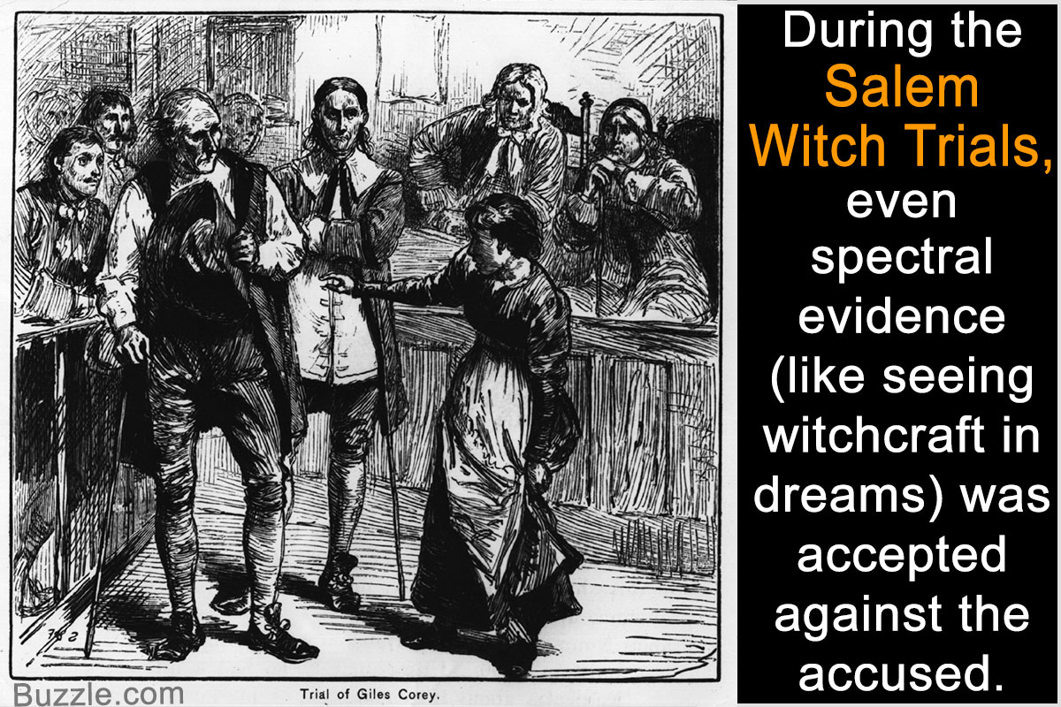

Slide 4
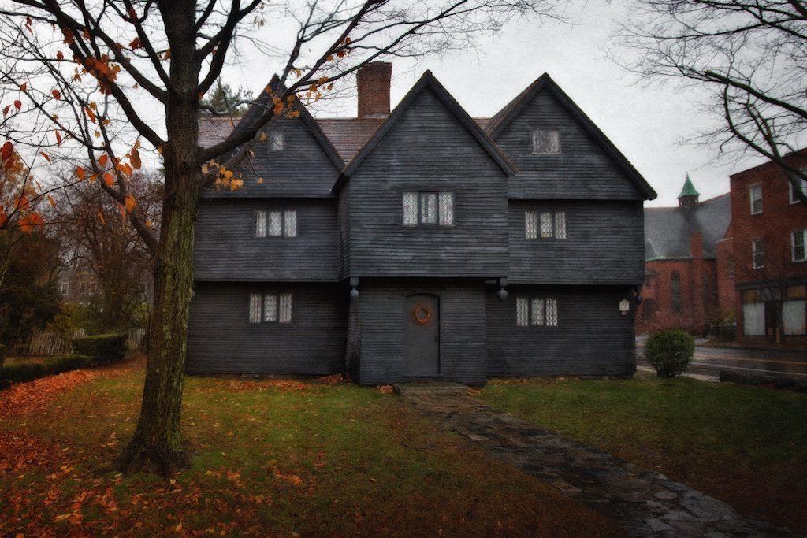
The Witch Hotel, Salem, MA

Slide 5
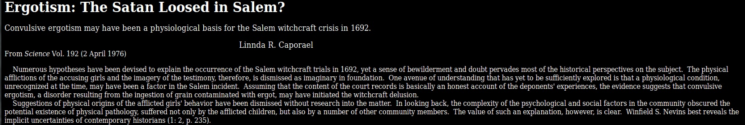
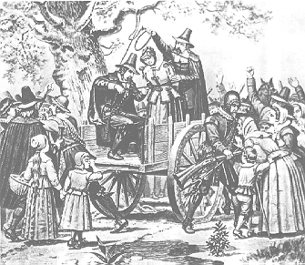
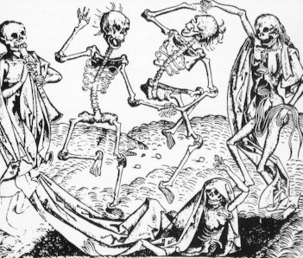
Of course, ridiculous religious hysteria was relatively commonplace back then…
It would be comforting to think there was a rational explanation for stupid human behavior,
but –------->

Slide 6


Of course, ridiculous religious hysteria was relatively commonplace back then…
It would be comforting to think there was a rational explanation for stupid human behavior,
but –------->

Slide 7
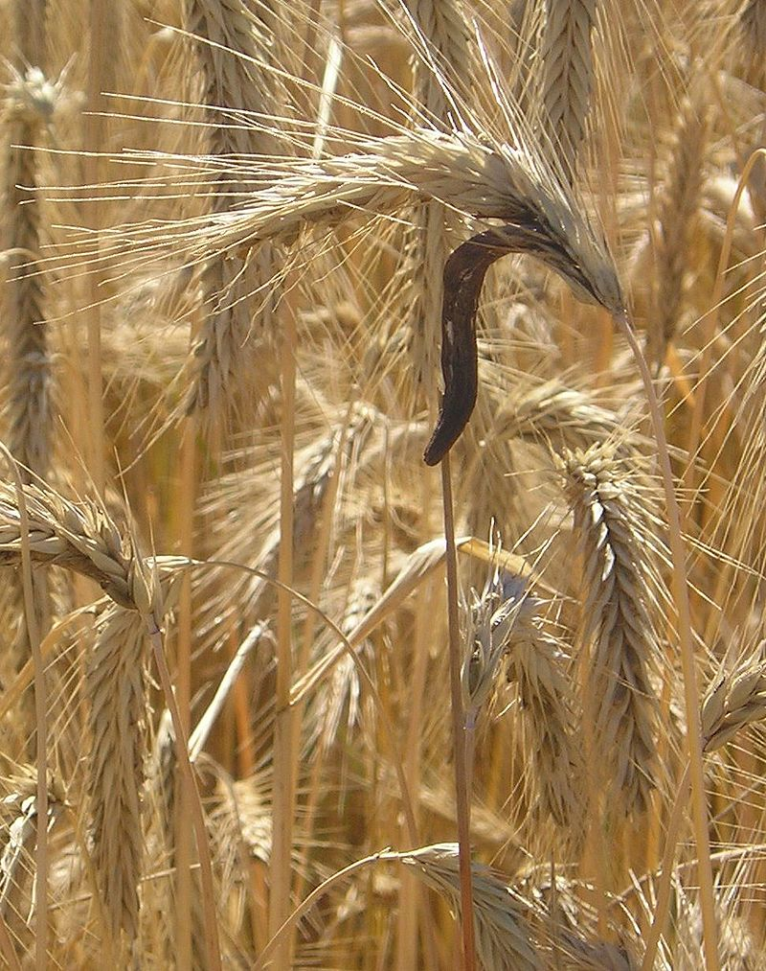
Claviceps purpurea
“Ergot”

Slide 8
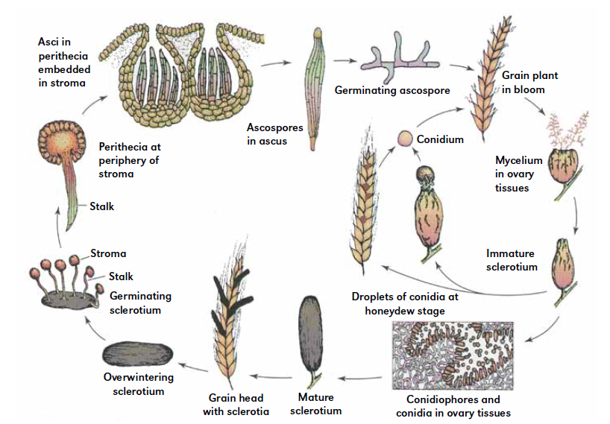

Slide 9
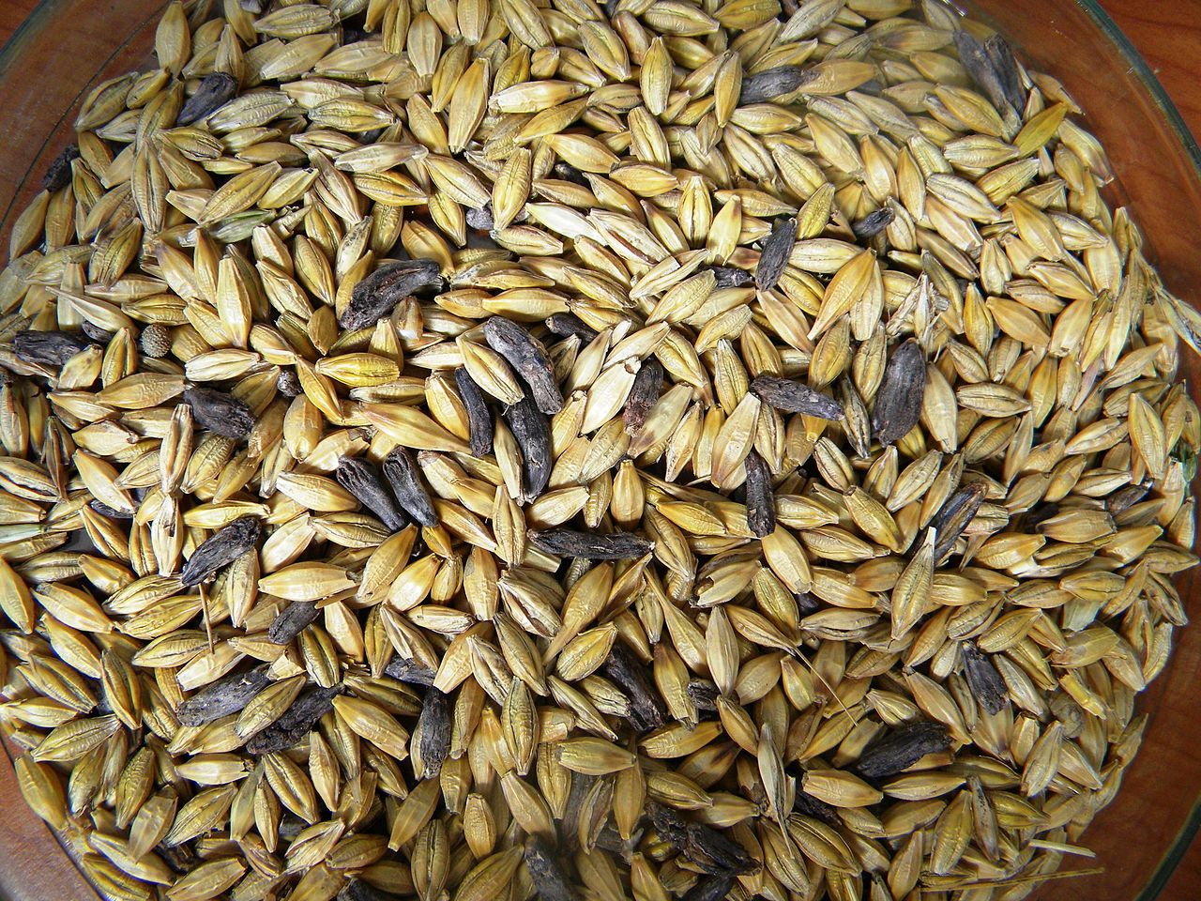

Slide 10
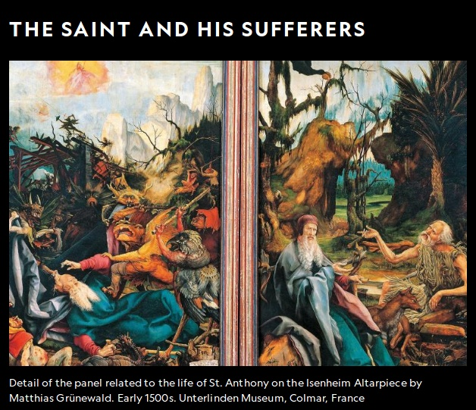
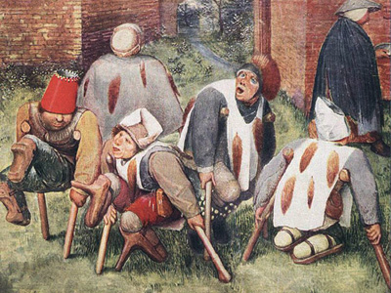
So maybe it’s a stretch to say that ergotism was responsible for starting the Salem witch scare. After all, those people were stone stupid to begin with.
But that’s not to say that ergotism isn’t historically (and currently) important...
“The afflicted thronged to the churches and invoked the saints. The cries of those in pain and the shedding of burned-up limbs alike excited pity; the stench of rotten flesh was unbearable.” -François Eudes de Mézeray 10th century historian

Slide 11
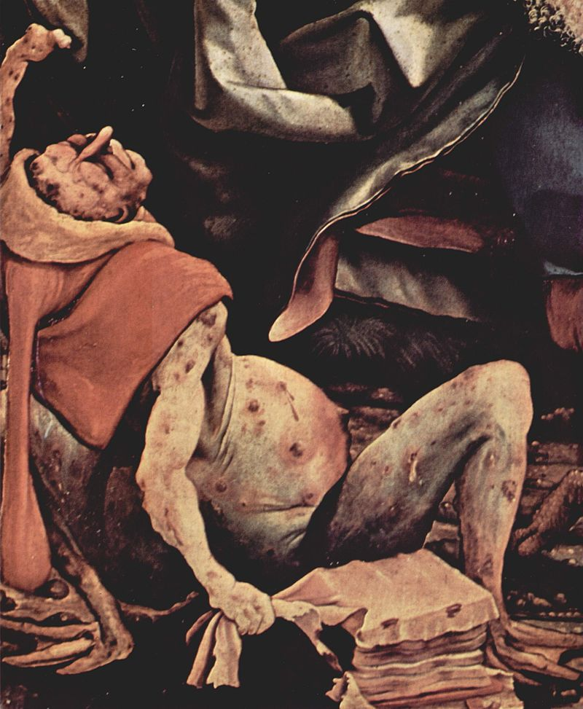
St Anthony’s Fire

Slide 12
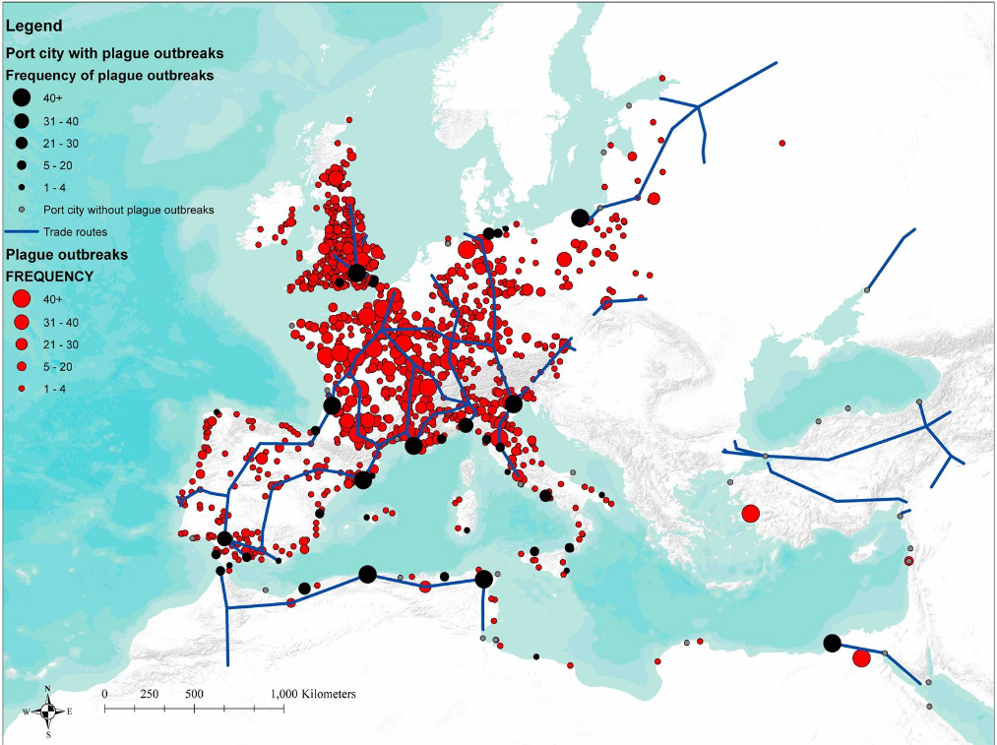
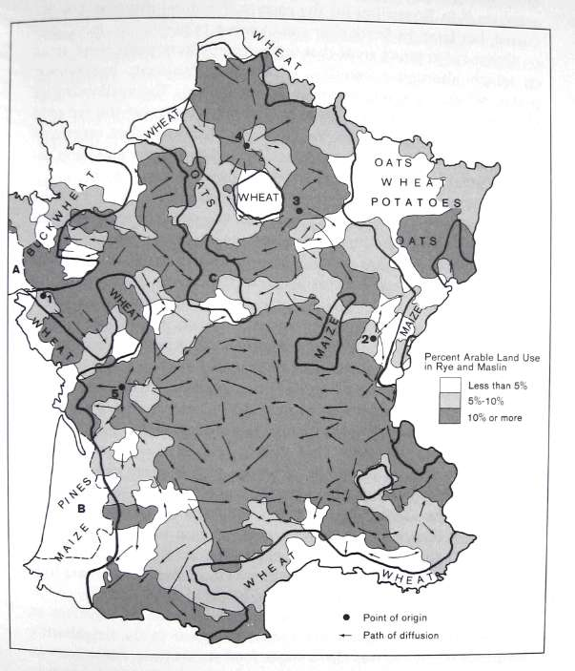
Severity of black plague outbreaks was worse in communities with more rye production.

Slide 13
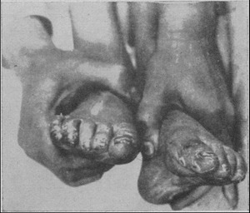
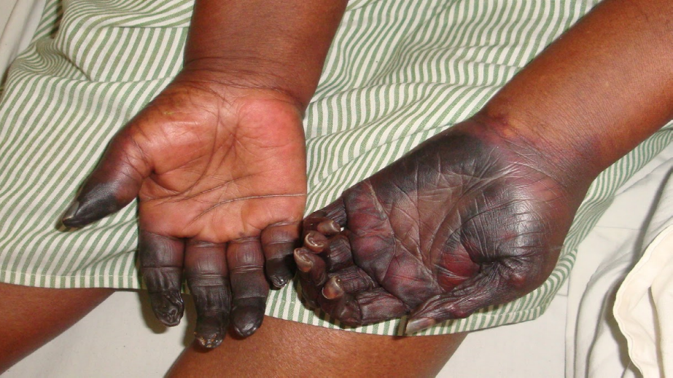
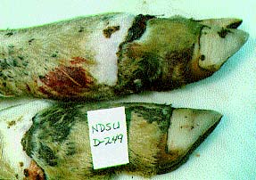
Ergotism still affects human communities today

Slide 14
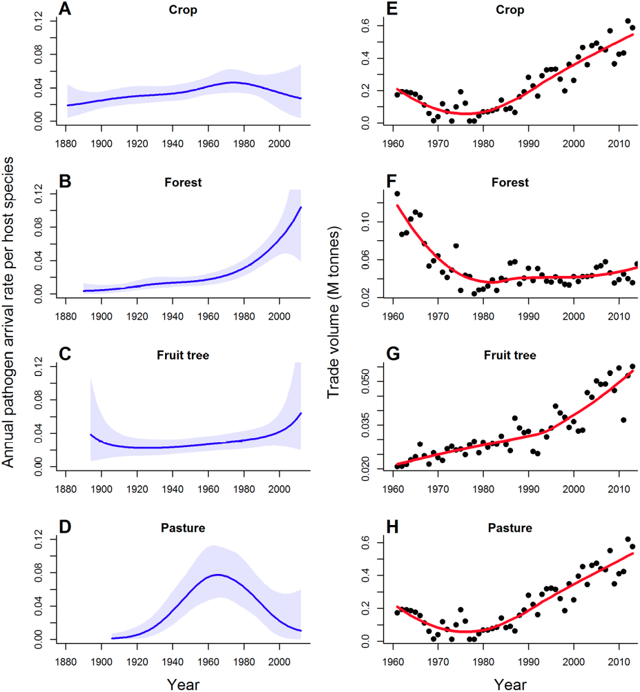
Plant pathogens are becoming a global economic concern
New Zealand imports of plant products (and pathogens)

Slide 15
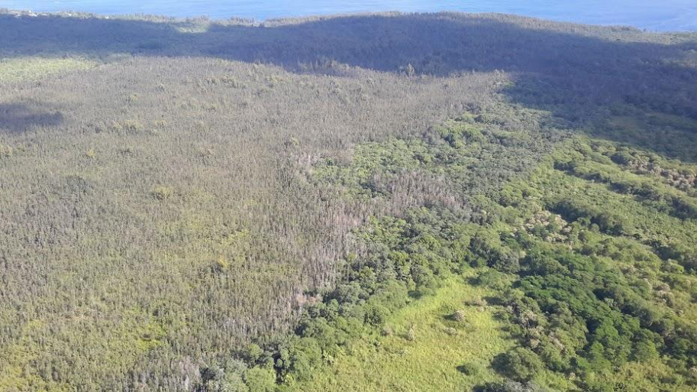
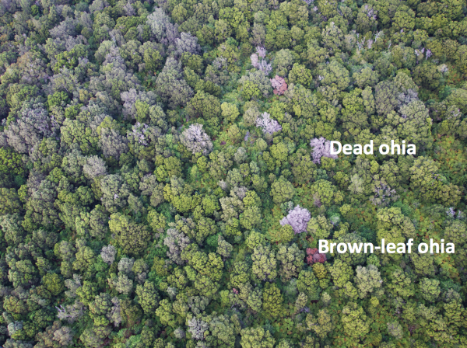
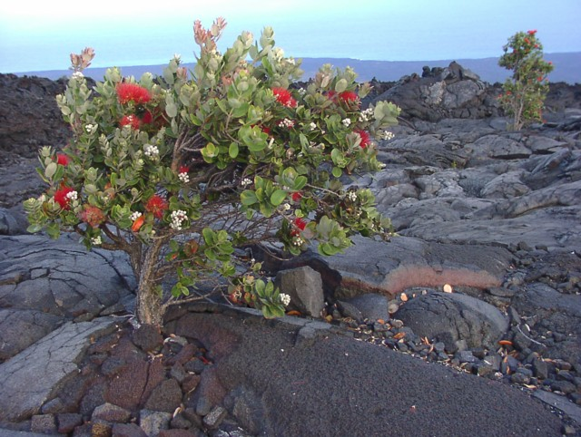
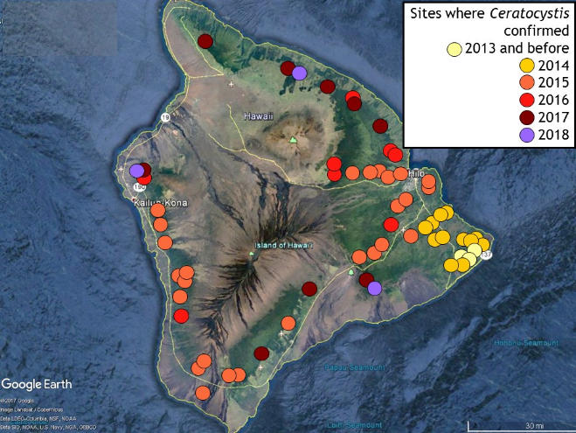
Rapid ʻŌhiʻa death
85% of Big Island land

Slide 16
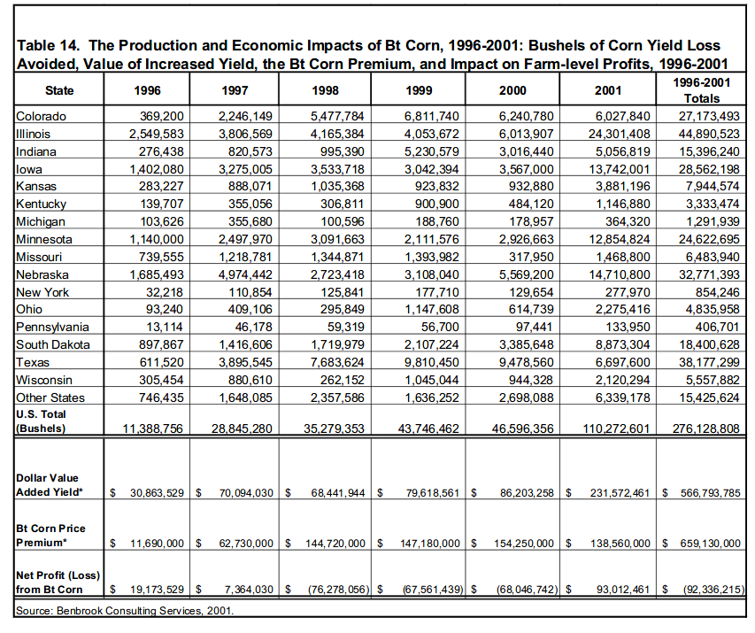

Slide 17
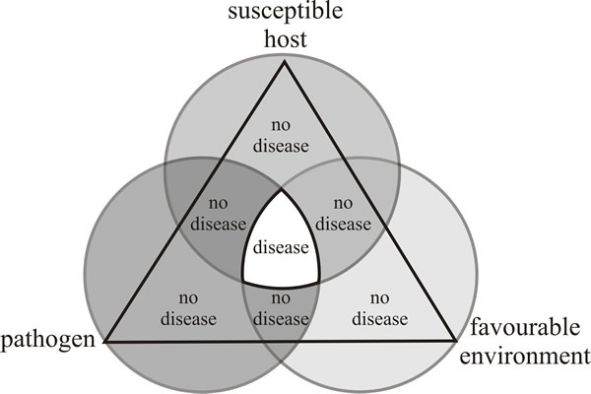
The disease triangle
Three interlocking participants — host, pathogen and environment — determine disease outcome during the life-history of the host
What is the host susceptibility?
Does the environment favor pathogenicity?
Is the pathogen present, and able to infect?

Slide 18
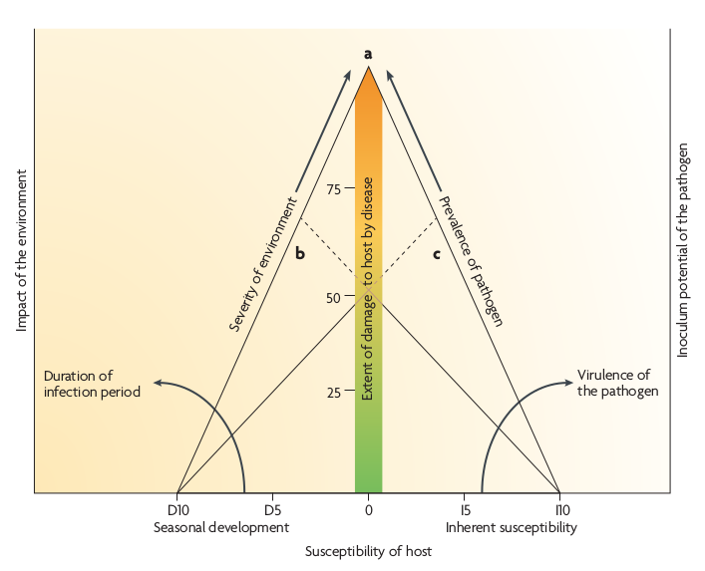
Which corner do you take out to prevent/stop a disease?
Mathematical versions of this concept that incorporate time are used in epiphytotics
(plant epidemiology)

Slide 19
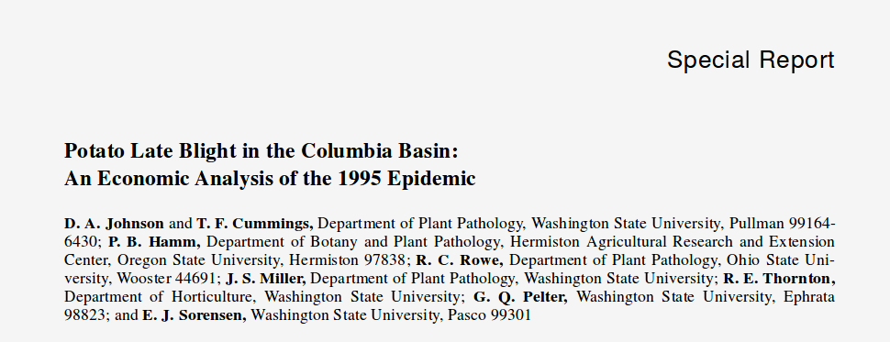
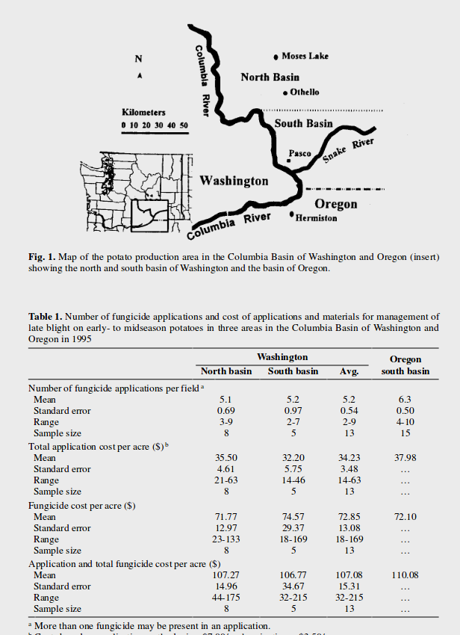
Economic impact of one plant disease in one place in one single year....
$30,000,000 !
This is why plant pathology can be a lucrative science to study

Slide 20
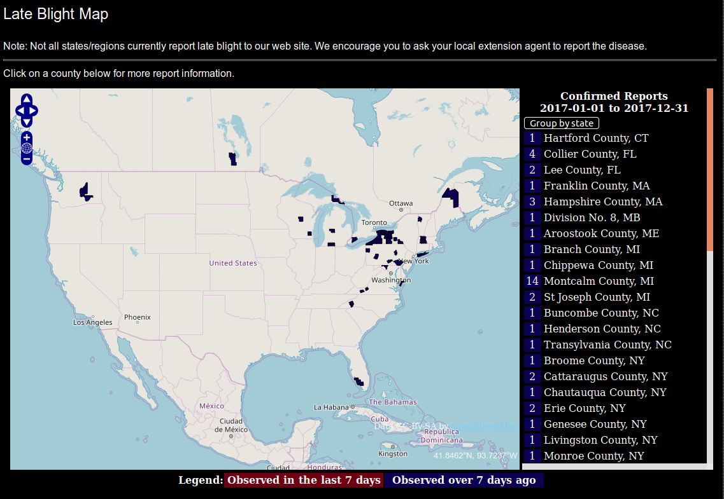
2017

Slide 21
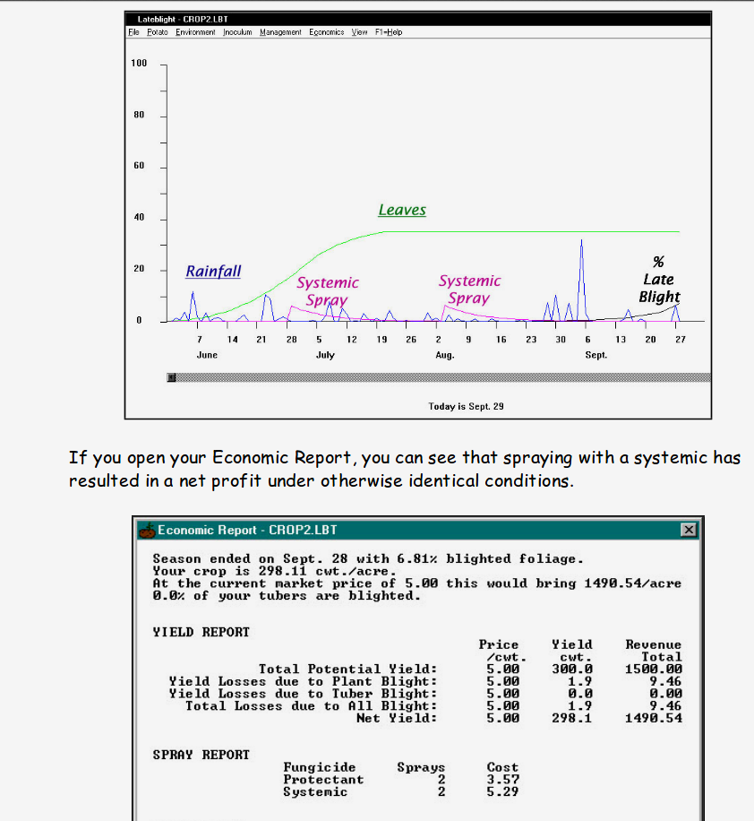
Models incorporating: weather, nearby outbreaks, pesticide applications, potato variety, crop density, etc.
Sound familiar?
LATEBLIGHT Software

Slide 22
Models incorporating: weather, nearby outbreaks, pesticide applications, potato variety, crop density, etc.
Sound familiar?
LATEBLIGHT Software

Slide 23
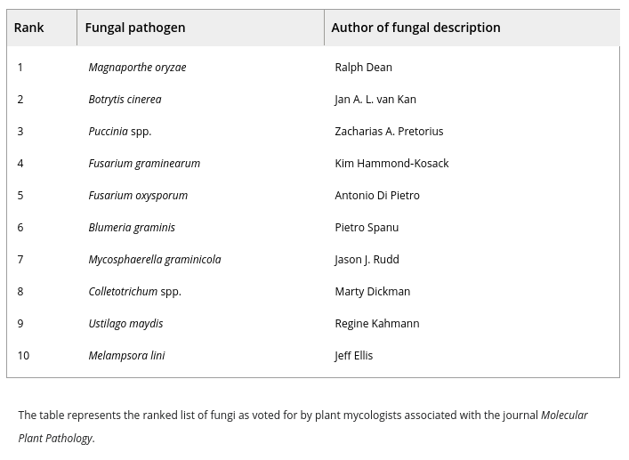
Top 10 most-wanted plant pathogenic fungi

Slide 24
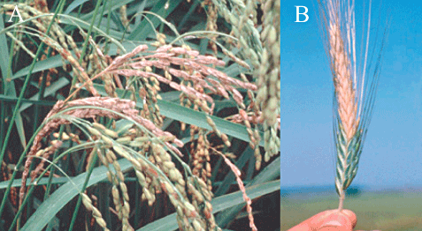
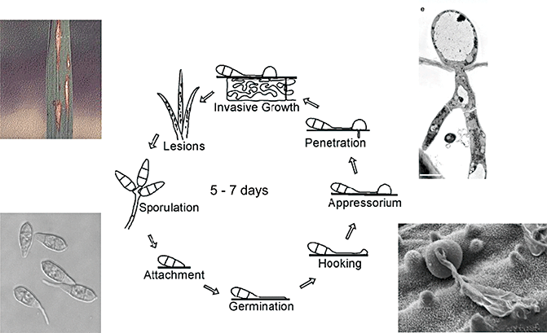
Magnaporthe oryzae, a filamentous ascomycete fungus, is the causal agent of rice blast disease, the most destructive disease of rice worldwide
Disease resulting from the infection of rice and wheat with Magnaporthe oryzae. (A) Classical symptoms of panicle blast on rice, although the fungus can cause disease on all foliar tissues. (B) Head blast on wheat.

Slide 25
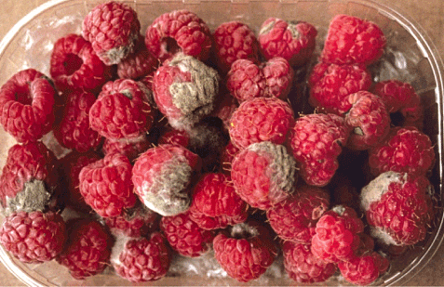
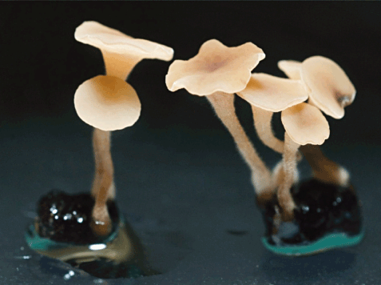
Botrytis cinerea, known as grey mould, can infect more than 200 plant species. The fungus is considered as a typical necrotroph, which co-opts programmed cell death pathways in the host to achieve infection
Anamorph Teliomorph
Altogether, global expenses of Botrytis control (cultural measures, botryticides, broad-spectrum fungicides, biocontrol) easily surmount €1 billion a year.

Slide 26
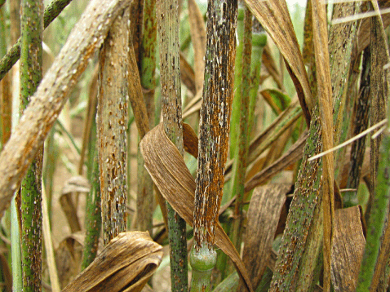
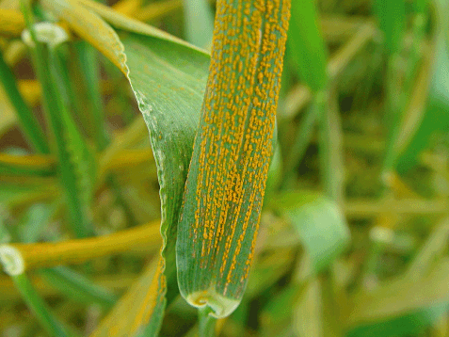
Puccinia spp. Three rust diseases occur on wheat, namely stem (black) rust (caused by Puccinia graminis f. sp. tritici), stripe rust (P. striiformis f. sp. tritici), and leaf rust (P. triticina)
P. graminis P. striiformis
Obligate biotrophs (Urediniomycotina) - Aecial host is Barberry (Berberis vulgaris)
USA and UK began barberry eradication programs in 1918 - major acheivement in plant disease management!

Slide 27
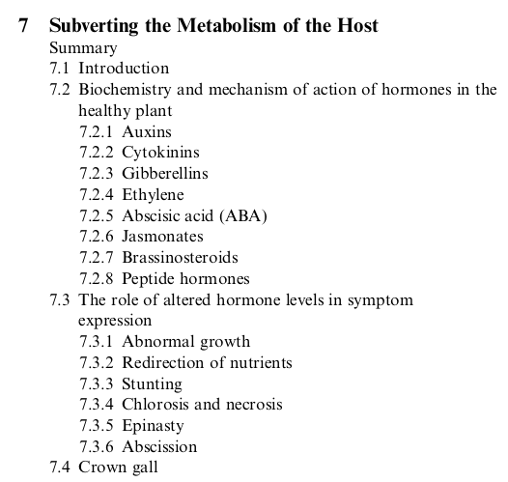
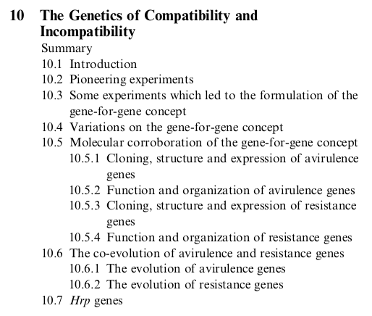
Plant pathology research is a very rich field with a degree of maturity:
- mechanistic hypotheses about how fungi enter and subvert plant denfeses
- molecular pathways for plant responses to disease
- evolutionary theories for co-evolved "zig-zag" responses
Small taste from a Plant Path. textbook table of contents...

Slide 28
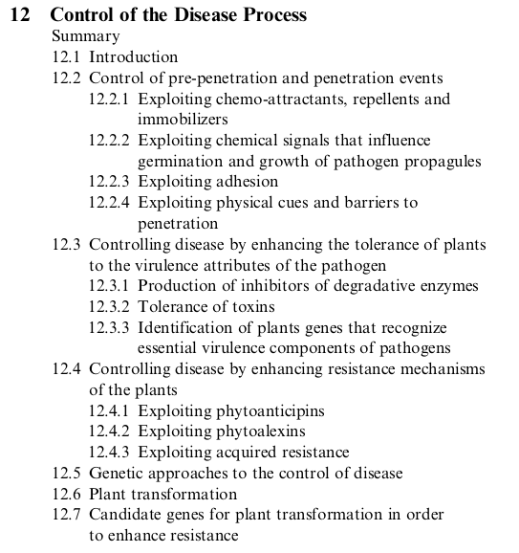
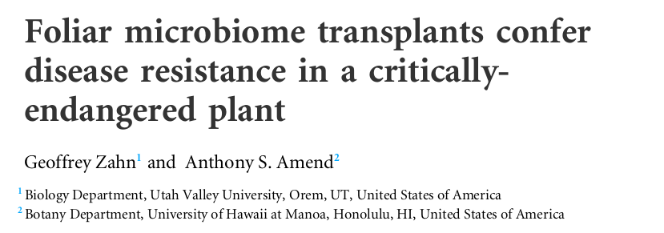
It's a goal-oriented, applied field of biology. Lots of work goes into finding ways to control disease (disease triangle).
<- One of my main research areas.
(manipulating microbiome to prevent disease)

Slide 29
Assignments
1. Read Roy, 1993
- This is a look at flower mimicry in plant pathogenic fungi
2. You will have a Canvas quiz on the assigned reading and will also have to participate in a Slack discussion about it.
3. Keep working on your lab assignments

