Slide 1

USA INCOME ANALYSIS

Slide 2


ABOUT US
We are a team of Data Scientists specializing in statistical analysis, machine learning, and data visualization.
Our goal is to uncover intricate patterns and trends within the broad scope of socioeconomic data, with a focus on gender

Slide 3
PROJECT METHODOLOGY
Data Collection & Cleaning
Exploratory Data Analysis (EDA)
Data Visualization
Insights & Reporting

Slide 4


DATA EXPLORATION
Data collected from 1994
Important features: Gender, Age, Native Country, Education, Occupation, Marital Status
Determine if a person earns over $50K or $50K or less annually.
Gender and Occupation have significant impacts on income levels.

Slide 5
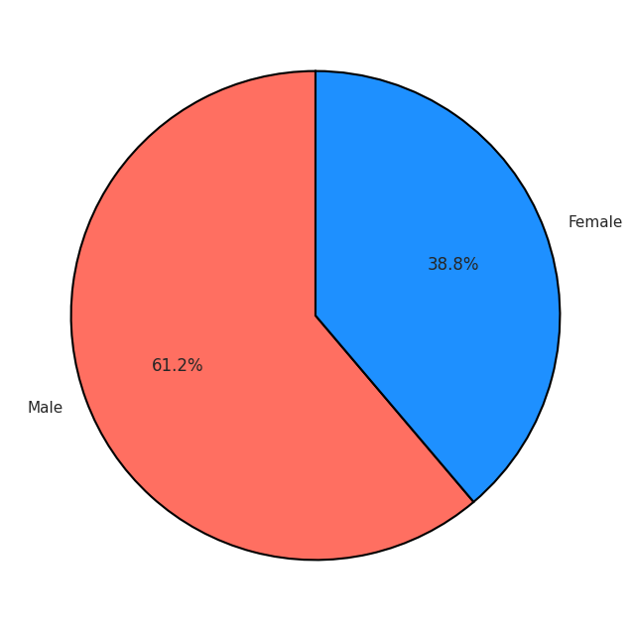
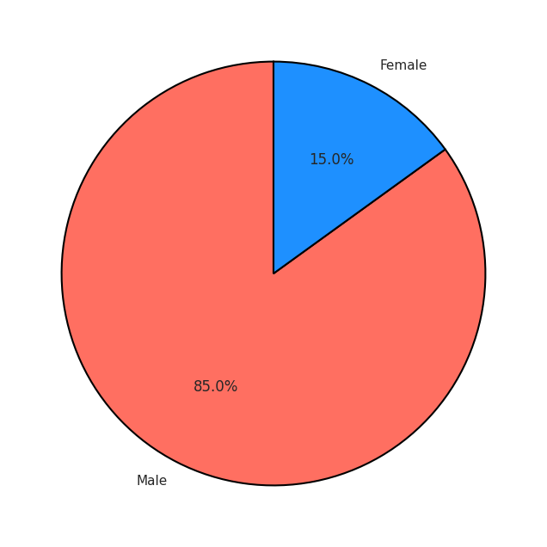
INCOME
Low-Income (<=50K)
distribution by Gender
High-Income (>50K)
distribution by Gender

Slide 6
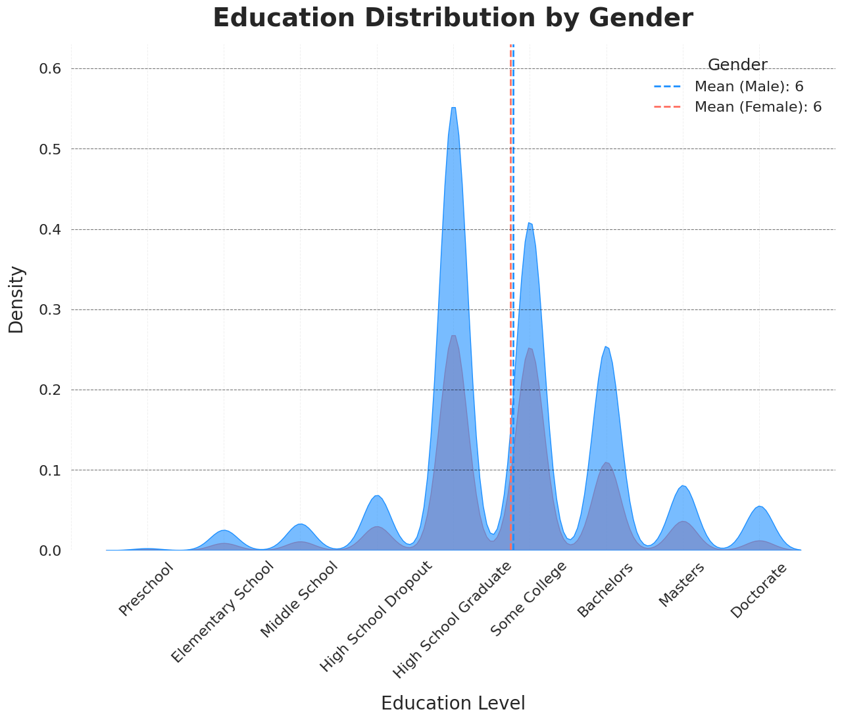
EDUCATION
Income higher than 50K annually

Slide 7
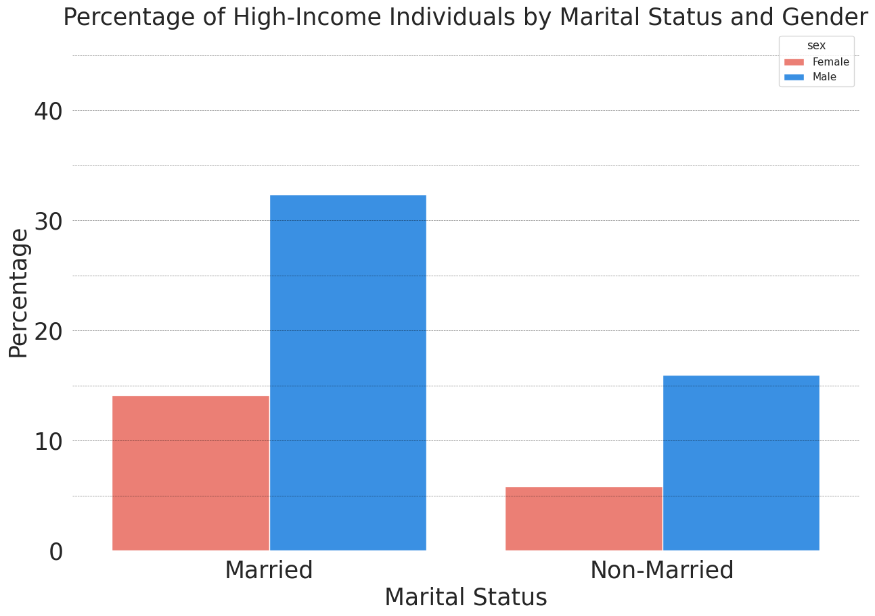
MARITAL STATUS
Percentage of high-income
individuals by marital status
and gender

Slide 8
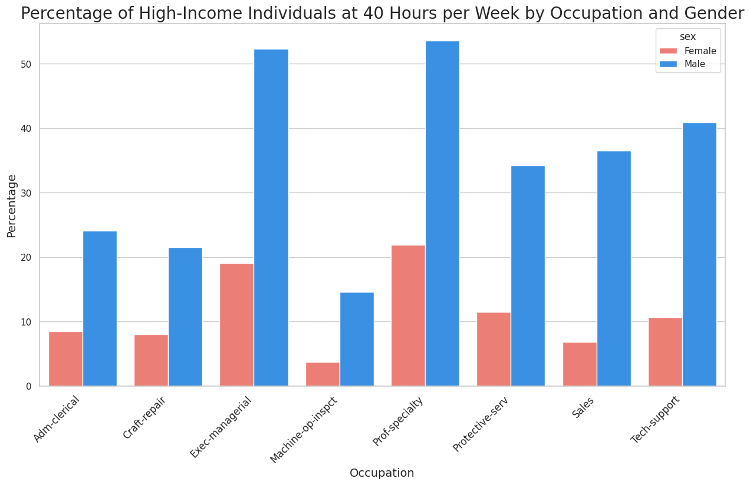
OCCUPATION
Percentage of high-income individuals at
40 hours per week by occupation and gender

Slide 9

CONCLUSION
Across all industries, women’s earnings are lower than those of men.
As education levels increase, the income gap narrows.
Marriage plays a significant role in women’s economic dependence.

Slide 10

QUESTIONS?

