Slide 1

Dynamic Ride Pricing
Ilaria Curzi
Georgia Zavou
Theodoros Lambrou
https://www.kaggle.com/datasets/arashnic/dynamic-pricing-dataset

Slide 2
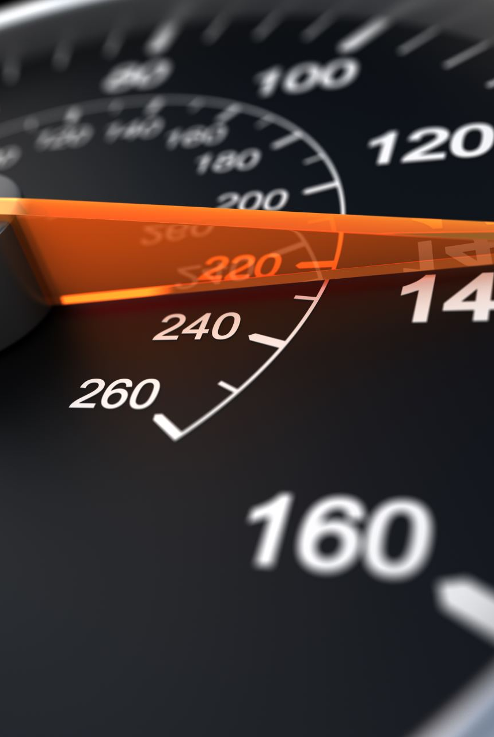
Data
Total number of ride requests at that time (measures demand)
Number of available drivers nearby (measures supply)
Location type where the ride was requested: Urban, Suburban, or Rural
Type of vehicle selected: Standard, Premium
Customer’s loyalty : Regular, Silver, or Premium
Average rating of the customer from previous rides (1 to 5)
Number of rides the customer has taken before
Time of day when the ride was booked (Morning, Afternoon, Evening, or Night)
Price paid for the ride

Slide 3
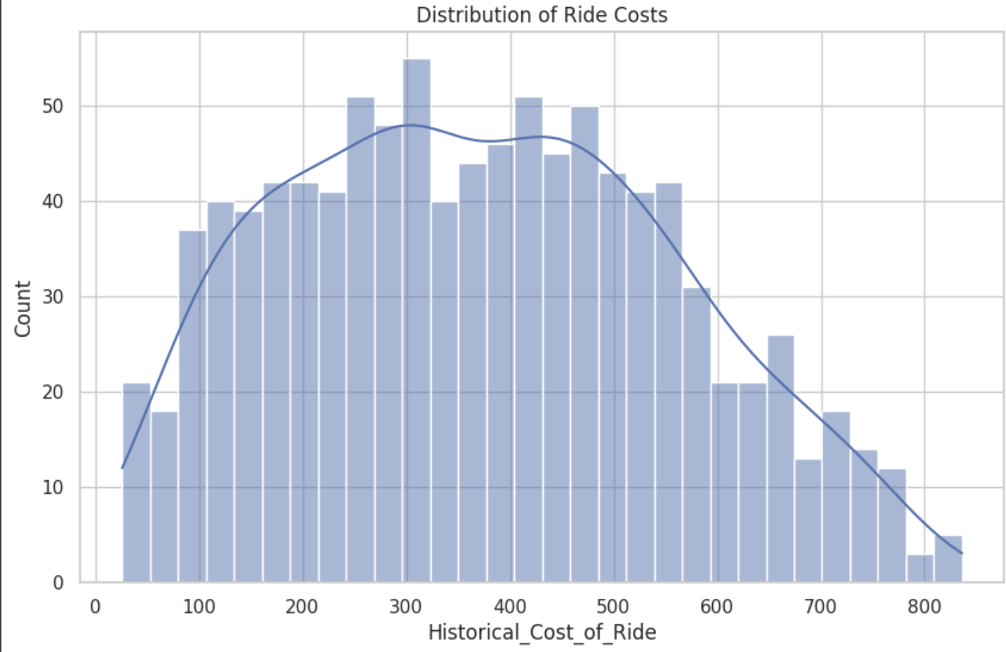

Slide 4
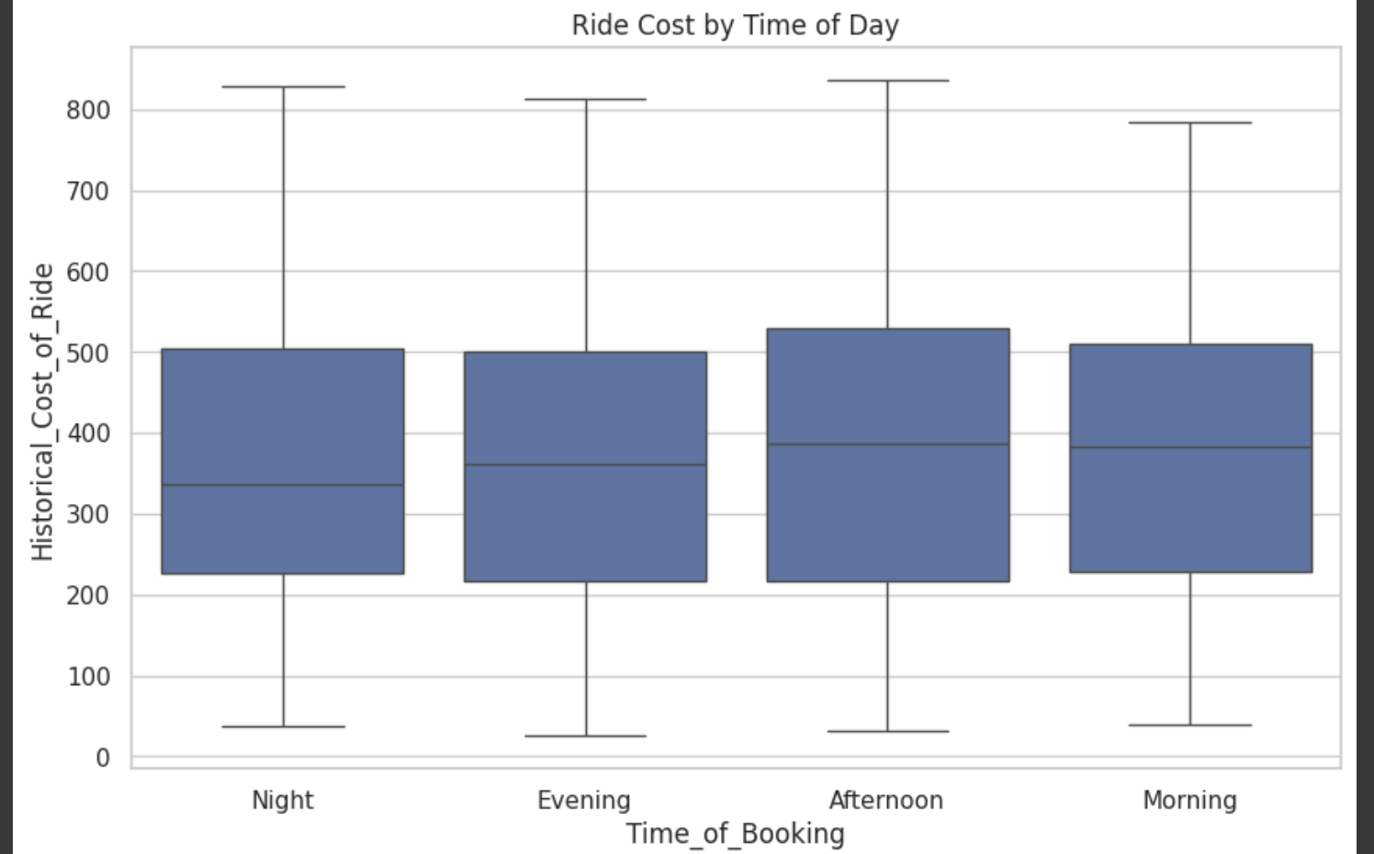

Slide 5
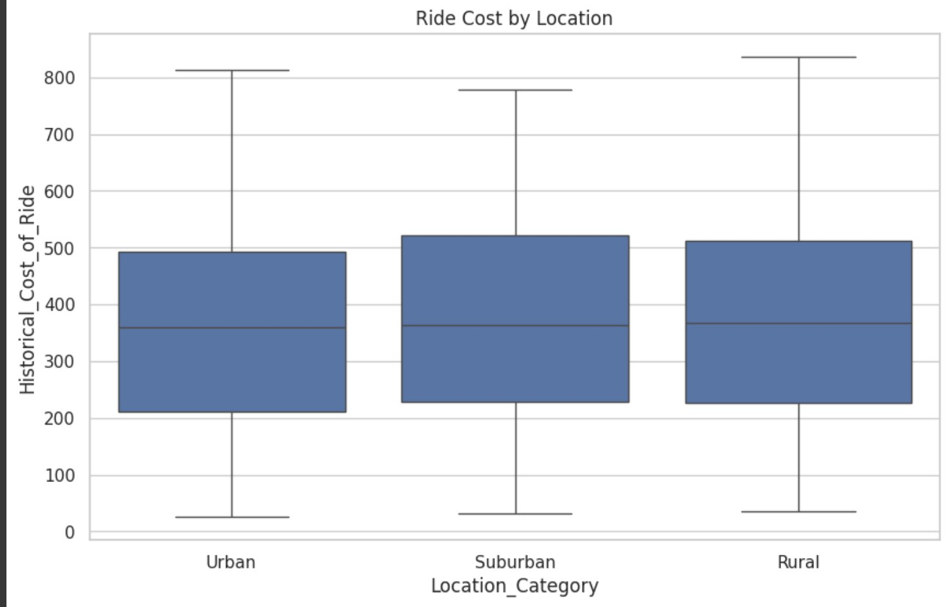

Slide 6
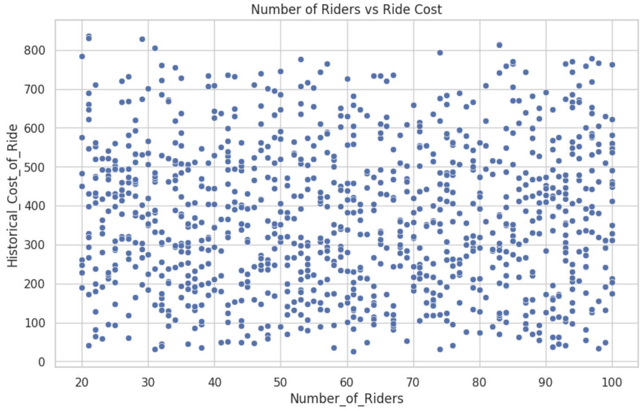

Slide 7
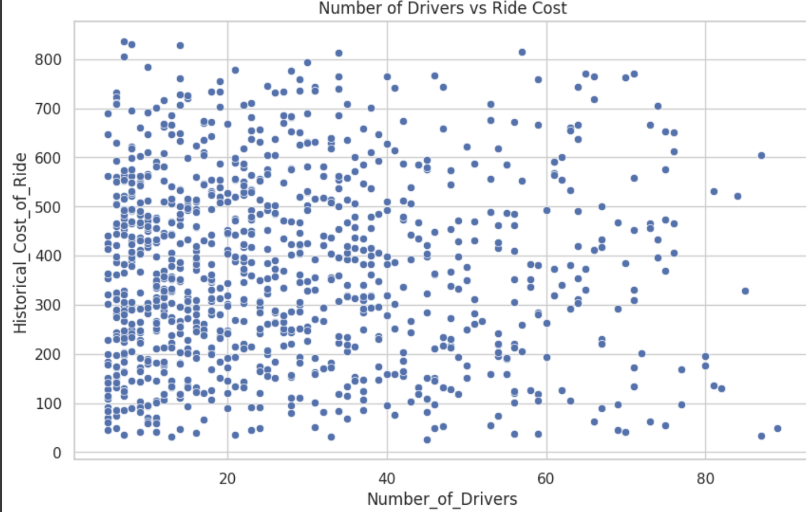

Slide 8
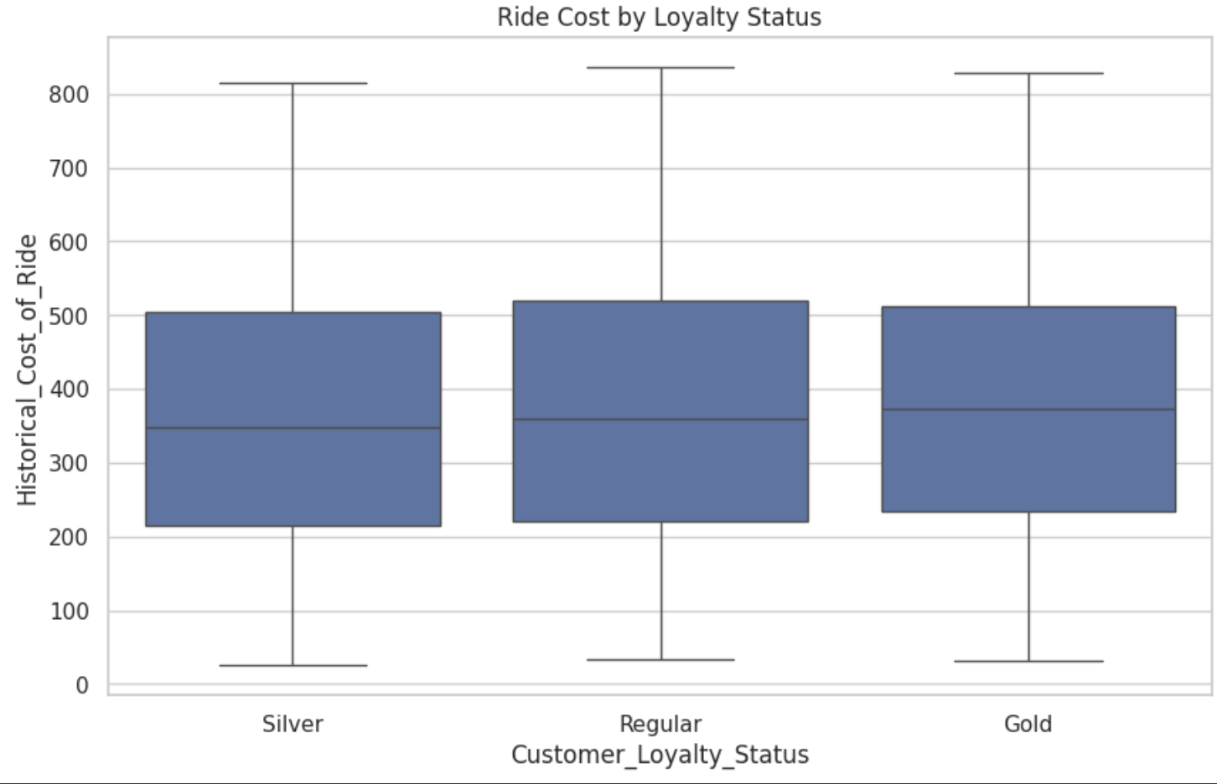

Slide 9

Gold customers have a bit higher median ride cost.
1. Are Gold loyal customers booking more expensive rides maybe with better cars or longer trips?
2. Is the pricing algorithm unintentionally charging more the higher-tier users?

Slide 10
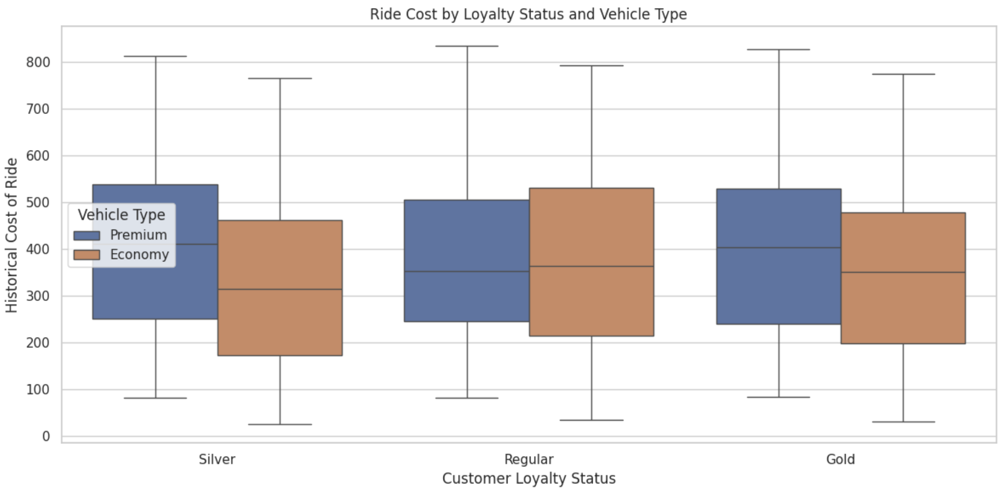

Slide 11
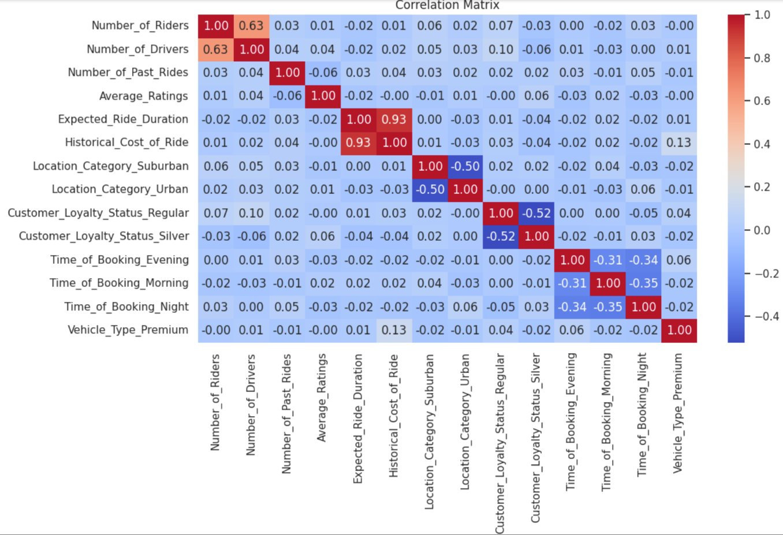

Slide 12
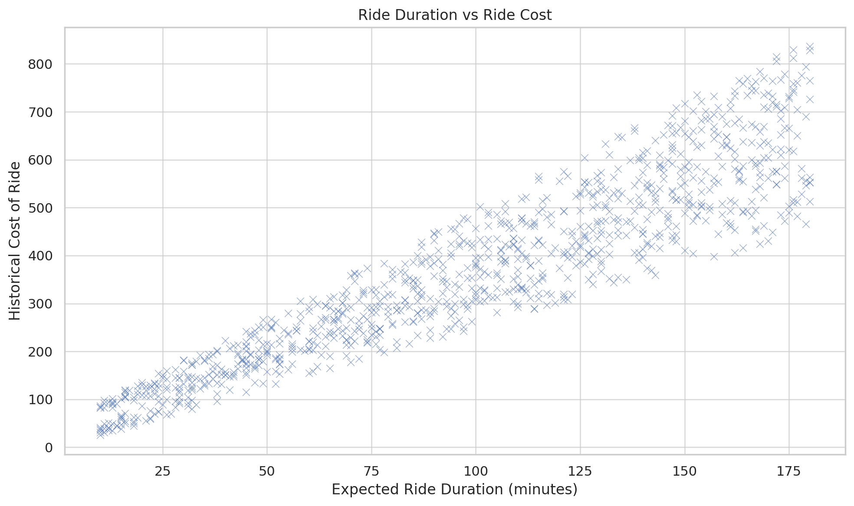

Slide 13
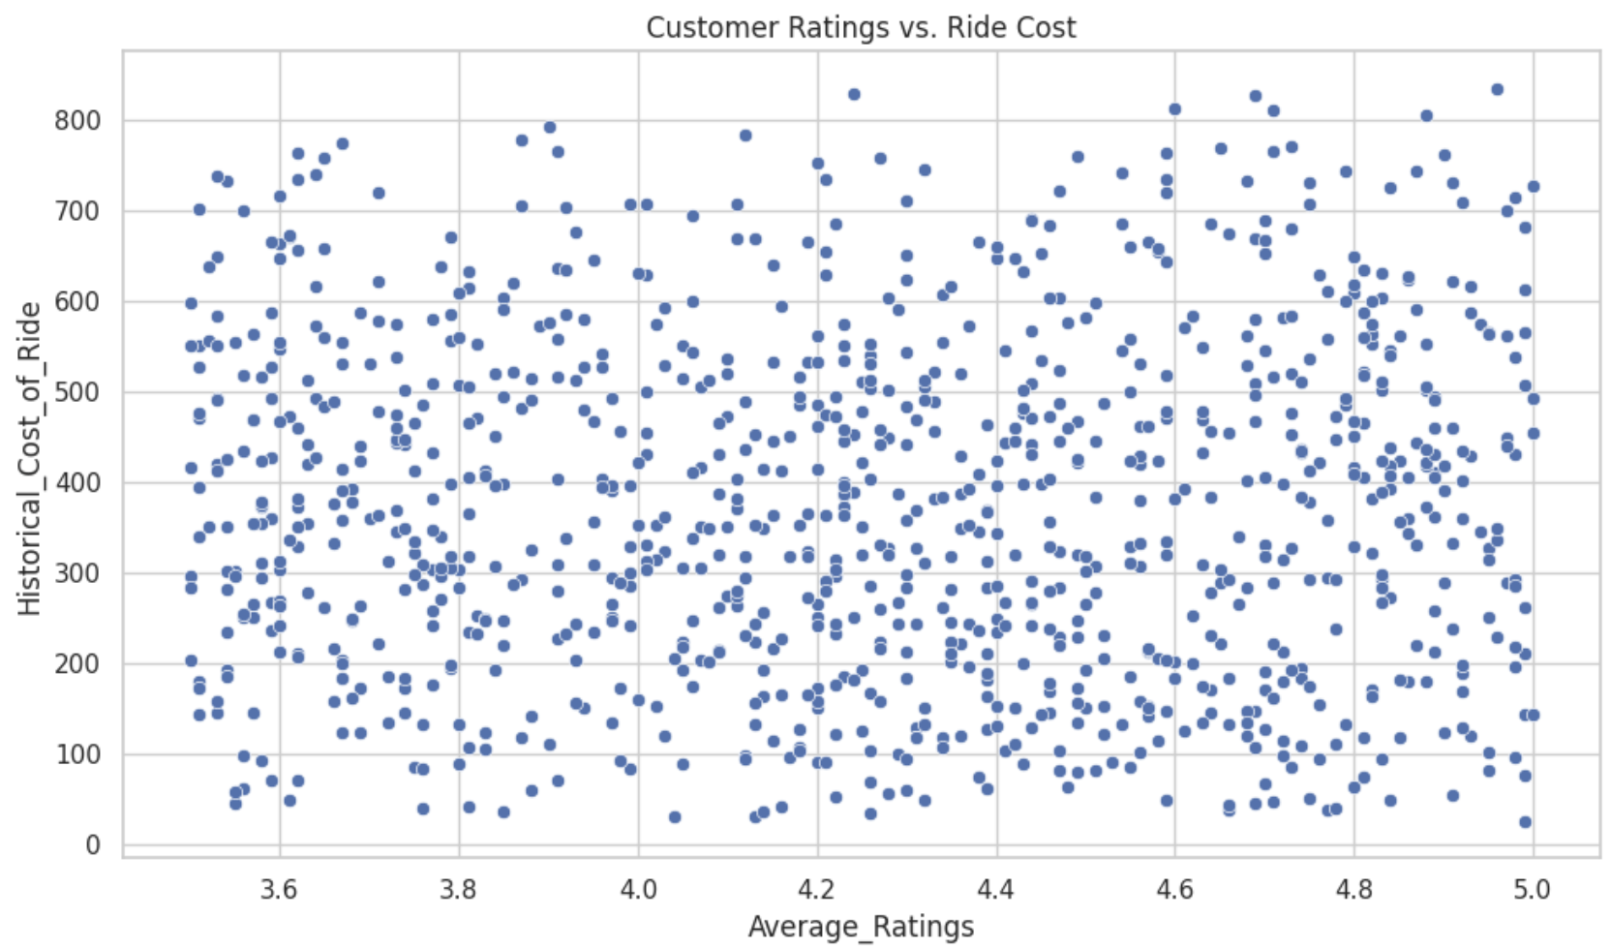

Slide 14
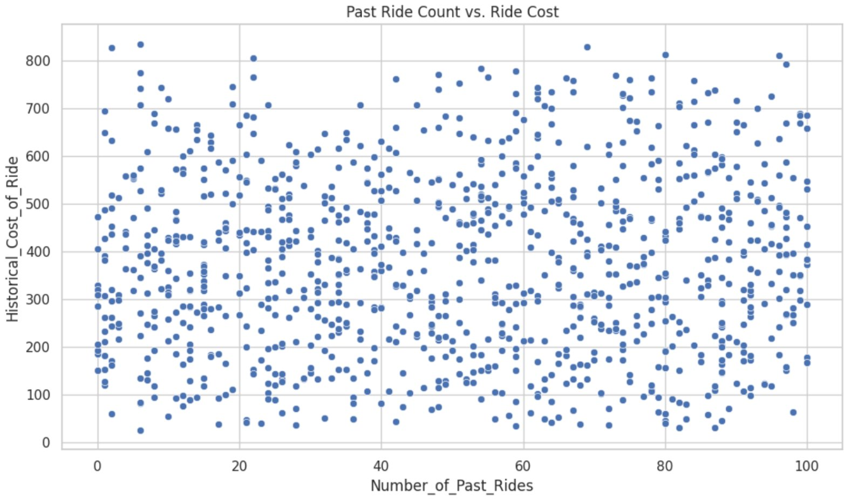

Slide 15
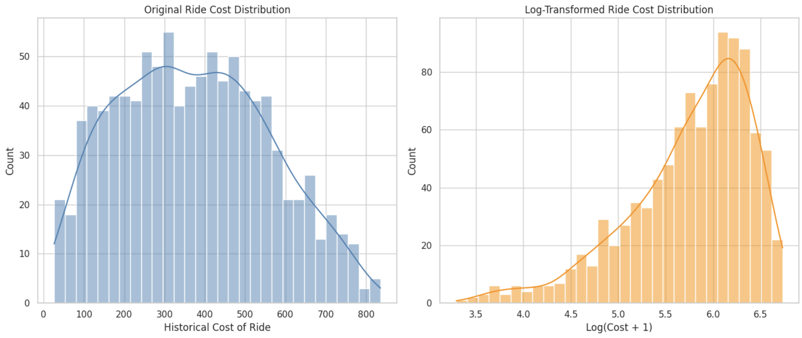
Original ride cost is right-skewed
Most rides cost between 100–500 units.
A smaller number of rides are 600 units or more.
This can affect the performance of some models because outliers pull the average up.
In order to avoid biasing the models we compress high values and even out the distribution, making it more symmetric and normal-like.

Slide 16

Model Fitting
Random Forest
Split data 80% Train and 20% Test
R² Score (How well the model explains the variability in the target (ride cost)): 0.8520 → 85.2% of the variation in ride prices is explained by this model.
Our model explains most of the price variation.
RMSE (average difference between predicted values and the actual ride costs.): 73.46 → on average our predictions are about 73 units off from the true price.
Reasonably accurate predictions with moderate error range.

Slide 17

Testing other models
Random Forest → R²: 0.8520 | RMSE: 73.46
Linear Regression → R²: 0.7478 | RMSE: 73.46
XGBoost → R²: 0.8403 | RMSE: 76.32

Slide 18
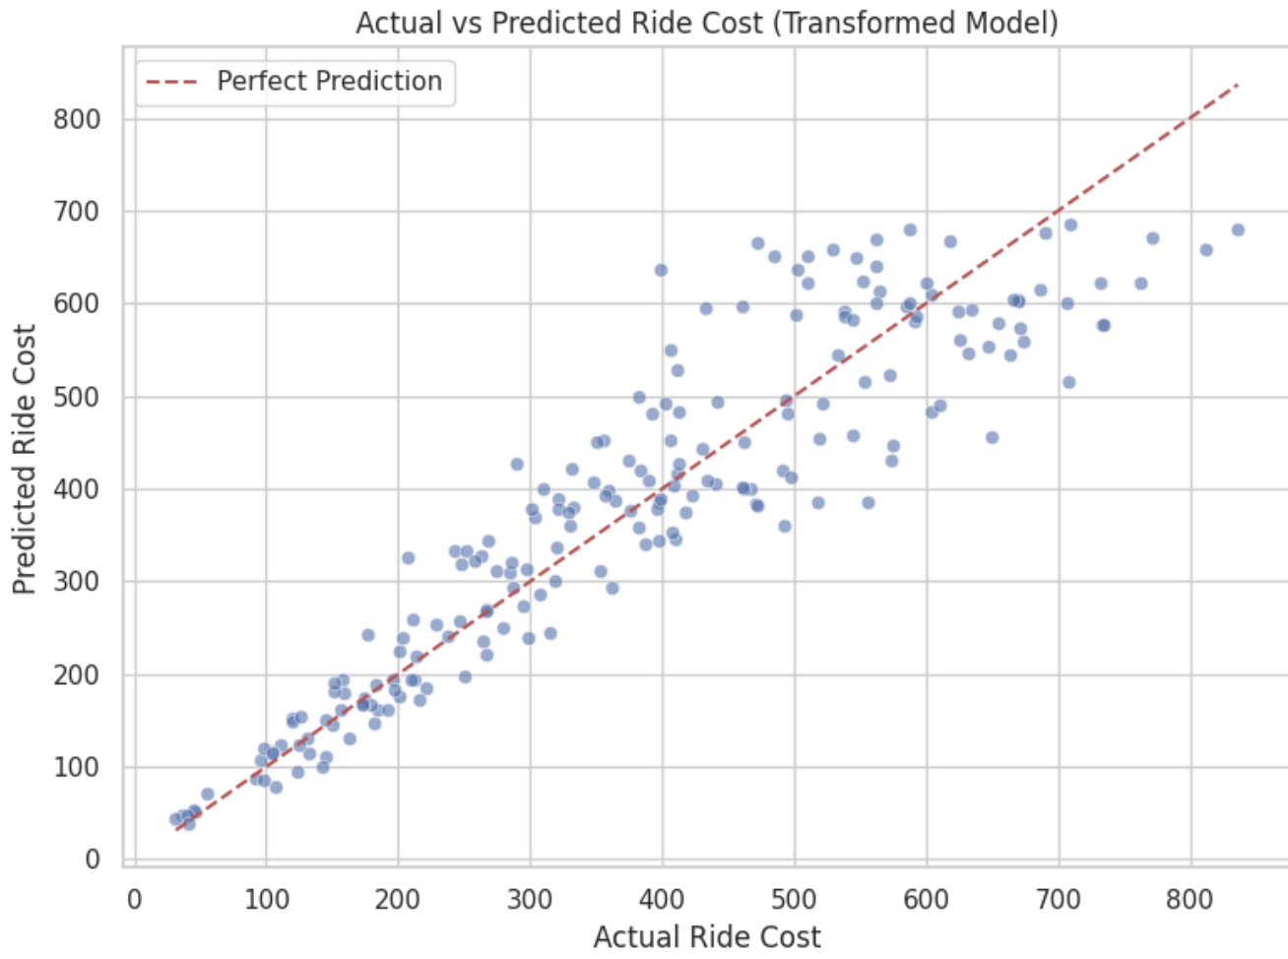

Slide 19
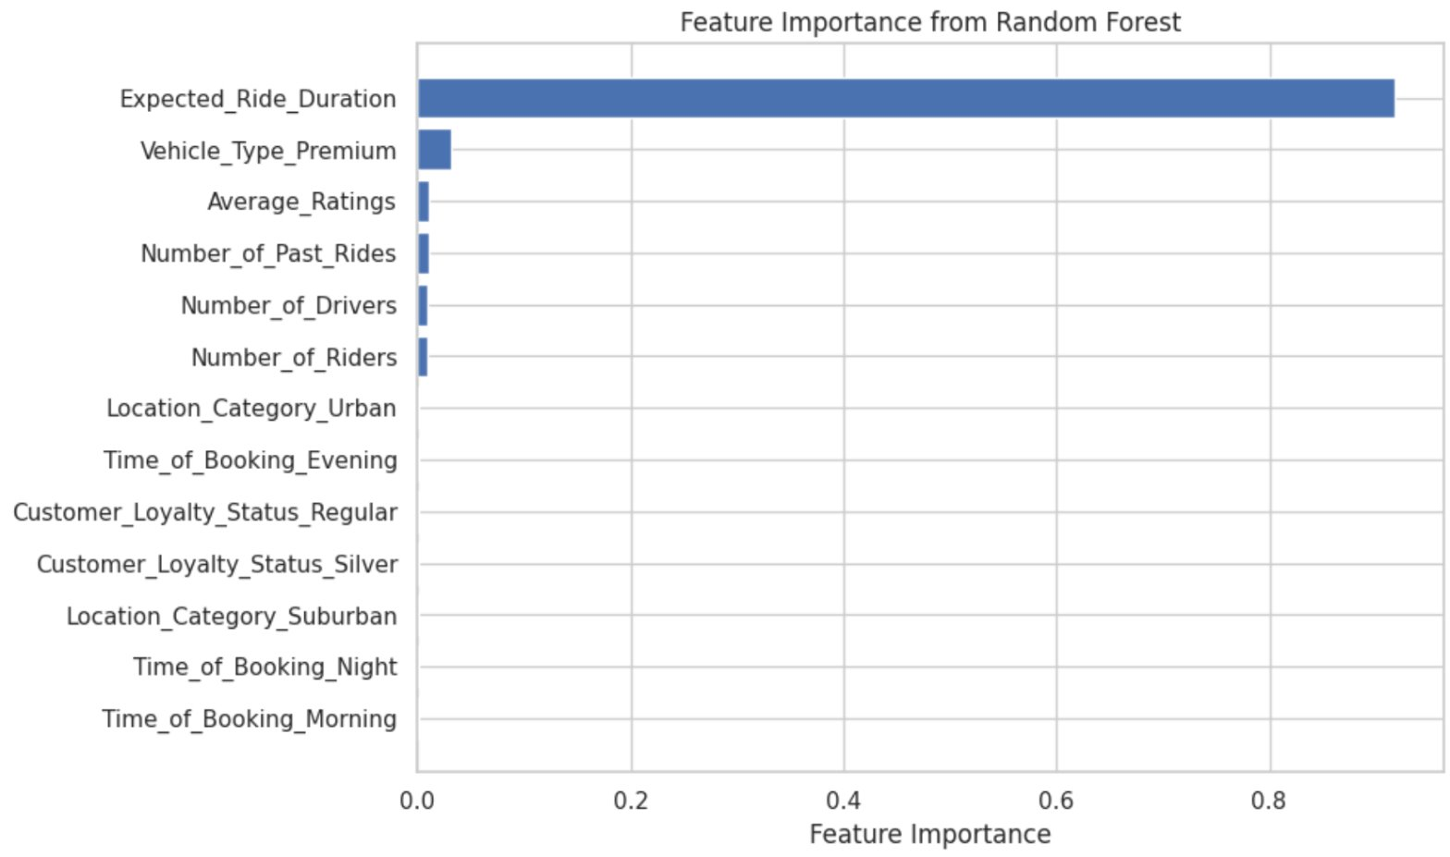

Slide 20
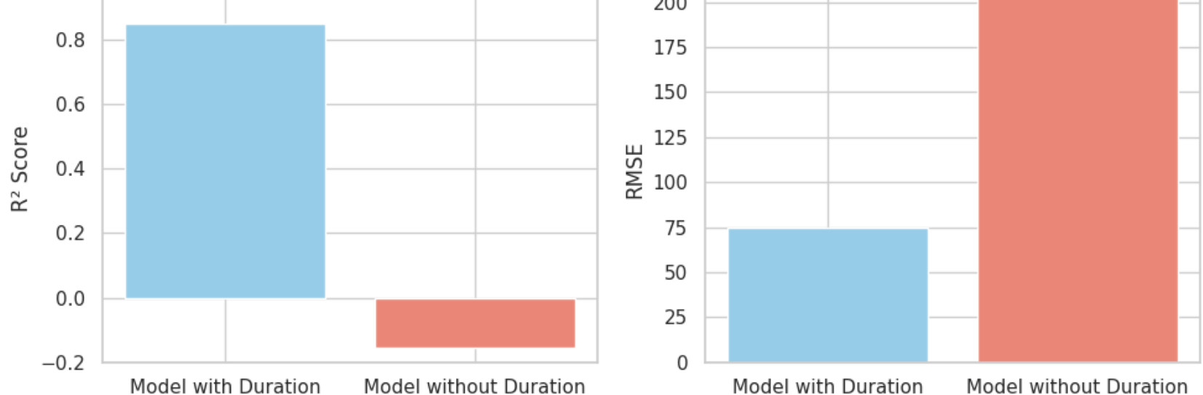
Train the Model Without Duration Feature
Model without Duration → R² Score: -0.1539
RMSE: 205.11

Slide 21

Fairness and Economic Implications
Loyal or premium users might pay more, even though they should be rewarded, they sometimes get higher prices which is unfair.
Cases with fewer drivers and prices are still high. Thia is a problem for people in places with low driver availability like rural areas.
Users don’t know how prices are set, which makes it hard to trust the system.
Rising prices affect people differently because rich people can still pay, but lower-income users might have to find alternative ways to travel.
The model may focus only on profits, not on fairness or helping people who really need rides.
Is it fair across locations? People in cities may get better service and pricing than those in suburbs or rural places.

