Slide 1
COMPARATIVE STRUCTURAL BIOINFORMATICS
Do herbicide-resistance mutations share a structural address?
A cross-site-of-action structural comparison of target-site resistance across seven independently-evolved herbicide targets.
PPO · ALS/AHAS · ACCase · EPSPS · HPPD · FAT · DHODH
Manuscript in preparation · Pest Management Science
Notes:
Welcome. This project sits at the meeting point of three worlds: agronomy in the field, weed science in the lab, and bioinformatics at the computer. Over the next 15 minutes I'll go from the field problem, through the choices we made, into the results, and end on what's new and where we go next. One-line version: we asked whether resistance mutations across seven unrelated herbicide targets sit in the same kind of structural neighborhood, and we built a reproducible pipeline to answer it. Since I last showed this, the whole thing has been reframed after a hard internal review — the yes/no answer turned out to be the expected part, and the real contribution is a typology of HOW those mutations relate to the pocket. We also finished auditing the two emerging targets and got the manuscript to submission-ready for Pest Management Science. I'll flag those changes as we go.

Slide 2
WHY IT MATTERS
Fewer working herbicides, more resistant weeds
Decades
Every class
One mutation
since a major new herbicide site of action reached the market — the toolbox is not being refilled.
of herbicide now has documented resistant weed populations somewhere in the world.
in the target enzyme can spread and retire an entire chemistry across a field.
Notes:
Start with the field. For the agronomists this is daily reality: the chemistry we rely on is running out of road. Very few genuinely new herbicide mechanisms have reached the market in decades, while resistance keeps spreading across every major class. The sharp edge is target-site resistance — when a single mutation in the target enzyme spreads through a population, an entire herbicide chemistry can simply stop working across a field. Understanding those mutations structurally is how we stay ahead of them.

Slide 3
THE SCOPE
Two ways a weed survives a spray
NON-TARGET-SITE (NTSR)
TARGET-SITE (TSR)
The plant works around it
The enzyme itself changes
Enhanced metabolism, reduced uptake, sequestration, or over-expression. Powerful, but diffuse and hard to read from a single structure.
One amino-acid substitution or deletion lowers herbicide binding while keeping the enzyme alive. It lives in the protein structure — so we can map it.
Out of scope here
Our focus
Notes:
A quick framing for the mixed audience. A weed can survive a spray two broad ways. Non-target-site resistance is everything the plant does around the target — metabolizing the herbicide, pumping it out, over-expressing the enzyme. Target-site resistance is a change to the target enzyme itself, often a single amino-acid substitution or a deletion, that reduces herbicide binding while keeping the enzyme functional enough to live. This project is deliberately about the second kind, because that's the part that lives in protein structure and is therefore something we can map and compare.

Slide 4
THE GAP
Resistance is studied one enzyme family at a time.
Each family has its own structures, its own residue numbering, its own literature. No shared, reproducible yardstick had been used to compare where resistance mutations sit across independently-evolved targets.
Notes:
Here's the gap that motivated the whole project. Target-site resistance is real and well-studied — but almost always one enzyme family at a time. The PPO people talk to the PPO people; the ALS people talk to the ALS people. Each community has its own structures, numbering, and conventions. What nobody had done systematically is stand back and ask a comparative question across unrelated targets using one consistent yardstick. That's the space we're working in.

Slide 5
THE QUESTION
Across unrelated targets, do resistance mutations cluster in a distinguishable structural zone near the active site?
One consistent metric, applied the same way to every family — then tested against chance.
Notes:
So the question, stated plainly. If seven herbicide targets evolved resistance completely independently — different enzymes, different chemistries, different weeds — do their resistance mutations nonetheless land in a structurally similar place relative to the active site? A shared 'address'? If yes, that's a general property of target-site resistance we can measure. Keep this sentence in mind; everything after this is how we answered it and what we found.

Slide 6
THE TARGET FAMILIES
Seven sites of action, one framework
PPO
ALS/AHAS
ACCase
EPSPS
Protoporphyrinogen oxidase · pilot family
Acetohydroxyacid synthase
Acetyl-CoA carboxylase · CT domain
Shikimate pathway · glyphosate target
1Z8N ↗
1SEZ ↗
1UYS ↗
8UMJ ↗
HPPD
FAT
DHODH
CONTRAST
PHASE 5
PHASE 5
Negative control — no verified weed TSR
Acyl-ACP thioesterase · emerging
Dihydroorotate dehydrogenase · no plant structure yet
5YWG ↗
8P8K ↗
audit pending
Notes:
These are the seven sites of action. Four are the pooled, fully-validated core of the analysis: PPO, ALS/AHAS, ACCase, and EPSPS — household names to any weed scientist. HPPD is kept deliberately as a contrast case; I'll explain why later. FAT and DHODH are emerging targets on the Phase 5 roadmap. Each maps to a real, herbicide-relevant protein structure — the four-letter codes are Protein Data Bank IDs and the links open the actual 3D models you can rotate in a browser.

Slide 7
A CHOICE, BEFORE THE METHODS
We chose a static structural map — not a dynamics simulation
STATIC MAPPING CAN SAY
IT DOES NOT CLAIM
Where a residue sits relative to the active-site core · how exposed it is (RSA) · how conserved it is across species — computed identically for every family, and testable against chance.
Binding free energy · induced-fit cost · loop breathing · mutant-state thermodynamics. For those we cite published kinetic, docking, and MD work — we don't reinvent it.
Notes:
Before any methods, the most important decision we made. We could have chased molecular dynamics and binding free-energy simulations — the glamorous, expensive route. We deliberately did not. We built a static structural resource: it tells you where a residue sits, how buried it is, how conserved it is. It does not claim to compute binding energy. That's a scope boundary, and stating it up front is what keeps the whole project honest. Static mapping answers a tractable question well; dynamics answers a different, harder one and we lean on published dynamics studies for that.

Slide 8
THE PIPELINE
Six stages, one reproducible command
01
02
03
04
05
06
Curate
Map
Define core
Measure
Test
Annotate
Primary-source mutations only
Onto a herbicide-relevant structure
Active site from ligand contacts
Distance · RSA · conservation
Permutation vs random residues
Mechanism typology
$ python scripts/rebuild_all.py # regenerates every table + figure, deterministically
Notes:
Here's the whole pipeline on one slide — bioinformaticians, this is your map. Six stages, fully scripted and deterministic: curate mutations from primary sources; map each onto a herbicide-relevant structure; define the active-site core from ligand contacts; compute three residue-level metrics; run a within-family permutation test against random residues; and finally annotate the mechanism class. One command regenerates every table and figure downstream. Each of the next few slides zooms into one of these stages and the choice behind it.

Slide 9
CHOICE 1 · CURATION
Evidence-gated, or it doesn't go in
✓
Every mutation traced to primary literature or accession-level evidence.
✗
No accessions inferred by length-matching, pattern-guessing, or elimination.
✗
Engineered / lab-selected mutations never pooled as weed-evolved TSR.
17
✓
Repeated rows collapsed to unique structural positions before testing.
accepted mutation rows across PPO (6), ALS/AHAS (5), ACCase (6), EPSPS (2) — every one source-verified.
Notes:
Stage one, and a choice we're proud of: evidence discipline. Every mutation row has to be backed by a primary source. We refused to infer accessions by sequence-length matching or guesswork — if a paper didn't give an accession, we kept the residue as literature-supported but never invented a database ID. We also refused to pool engineered or lab-selected mutations as if they were weed-evolved. This is boring and unglamorous and it's exactly what makes the downstream statistics trustworthy. Nineteen mutation rows survived this gate across four families.

Slide 10
CHOICE 2 · STRUCTURES
Real structures, chosen for herbicide relevance
FAMILY
STRUCTURE / LIGAND STATE
SPECIES
3D MODEL
PPO
Mitochondrial PPO2
Tobacco
1SEZ ↗
ALS/AHAS
Herbicide-bound, interface-aware core
Arabidopsis
1Z8N ↗
EPSPS
+ glyphosate + shikimate-3-P
Maize
8UMJ ↗
ACCase
CT-domain homodimer SWISS-MODEL on 1UYS
Black-grass model
1UYS ↗
Honest caveat: no experimentally solved weed ACCase complex exists — its metrics are homology-model-derived (GMQE 0.76), flagged everywhere they appear. Homology built via SWISS-MODEL ↗.
Notes:
Stage two: which structure represents each family. We picked real, herbicide-relevant structures — ligand-bound where possible, plant or plant-like where possible. The PDB codes here are live links to the 3D models. One honest caveat sits on ACCase: there's no experimentally solved weed ACCase complex, so we built a SWISS-MODEL homology model of the black-grass CT domain on the yeast 1UYS template. That means ACCase numbers are homology-model-derived, not crystal-observed — and we flag that everywhere it appears rather than hiding it.

Slide 11
A RIGOR UPGRADE · REVIEWER-DRIVEN
Are we measuring the weed's residue — or the template's?
THE CATCH
THE FIX
Mapping a weed mutation onto a distantly-related crystal can land it on a different amino acid — in ACCase the yeast template even carried the resistant residue at two positions. Backbone distance survives that; side-chain exposure does not.
Every row now carries a template_matches_weed flag, and ACCase was rebuilt on a SWISS-MODEL black-grass CT-domain model (GMQE 0.76) so its metrics describe the weed sequence, not yeast.
The mismatch is now visible in the data — not buried in a footnote.
Notes:
This slide is new, and it's here because a reviewer caught something important. When you map a weed's mutation onto a crystal structure from a distantly-related organism, you can end up measuring the wrong amino acid — the template may carry a different residue at that exact position. In our ACCase case the yeast template actually carried the RESISTANT residue at two of the positions. Backbone distance is robust to that, but any side-chain measurement like solvent exposure is not. So we did two things. First, every mutation row now carries an explicit flag for whether the template residue matches the weed residue — the mismatch is visible in the data, not hidden. Second, we rebuilt ACCase entirely on a SWISS-MODEL homology model of the black-grass sequence, so its numbers describe the weed, not yeast. This is exactly the kind of honesty that makes a reviewer trust the rest of the numbers.

Slide 12
CHOICE 3 · THE THREE METRICS
What we measure at every residue
METRIC 1
METRIC 2
METRIC 3
Distance-to-core percentile
Relative solvent accessibility
Conservation
Shannon-entropy across a curated multi-species alignment. High = structurally constrained.
How close to the active site, ranked within the protein. Low = close. Makes different enzymes comparable.
How exposed vs buried the residue is — normalized by residue type (Tien 2013).
Within-family percentiles let a 465-residue enzyme and a 2,000-residue one be compared on the same scale.
Notes:
Stage four: the three metrics, in plain language, because this room spans specialties. Distance-to-core percentile: how close a residue is to the active site, ranked within its own protein so a big enzyme and a small one are comparable — low percentile means close. RSA, relative solvent accessibility: how exposed the residue is to solvent, normalized by residue type. Conservation: how unchanged the position is across many species, from a multiple sequence alignment. Together they describe the structural context of a mutation without pretending to be a binding-energy model.

Slide 13
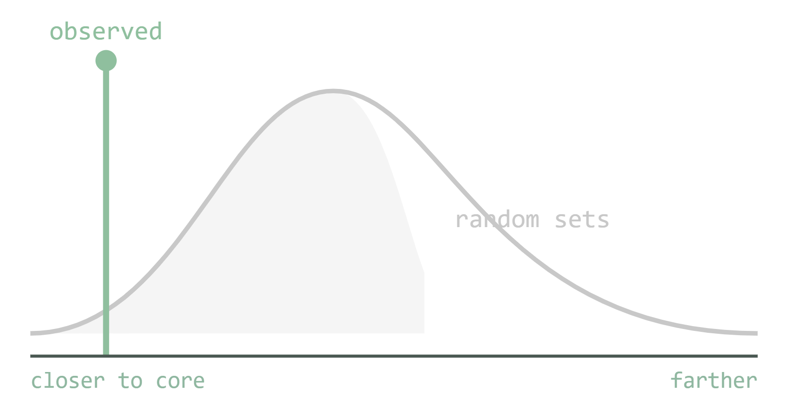
CHOICE 4 · THE TEST
Closer than chance? Ask 10,000 random residue sets
For each family, compare the observed mean distance-to-core percentile against 10,000 random same-size residue sets drawn from the same structure. The empirical p-value is how often chance does as well as reality. Seed 20260704 — fully reproducible.
Notes:
Stage five: the statistical test, and it's simple to explain. For each family we take the observed resistance positions and ask: how close to the active-site core are they, on average? Then we draw ten thousand random sets of residues of the same size from the same structure and ask the same thing. If the real positions are consistently closer than almost all random sets, that's enrichment, and the empirical p-value is just the fraction of random draws that beat the real ones. Seed is fixed so it's fully reproducible. This is the honest way to ask 'is this closer than chance?'

Slide 14
THE TOOLCHAIN
What we used, and for what
Analysis core
Structure & surface
Alignment & stats
Metrics, tables, permutation
Distance, SASA, 3D handling
Conservation, mixed models
Biopython ↗
UCSF ChimeraX ↗
MAFFT ↗
pandas ↗
RCSB PDB ↗
R ↗
NumPy ↗
SWISS-MODEL ↗
lme4 ↗
pyKVFinder ↗
AI coding assistants
Used for scripting, refactoring, and documentation — Claude ↗ & code agents. Every claim still passes the primary-source evidence gate and is recorded in the verification log.
Notes:
You asked specifically what tools were used and for what — here they are, grouped and linked. The analysis core is Python: biopython, pandas, numpy, plus pyKVFinder for cavity work and pypdf. Structure and surface work runs through ChimeraX, with a pure-Python fallback so the pipeline runs without it. Alignments use MAFFT. The ACCase homology model came from SWISS-MODEL. Mixed-effects stats use R with lme4. And yes — AI coding assistants (Claude / Codex) were used for scripting, refactoring, and documentation, always with the evidence gate and verification logs as the backstop. Every link here is live.

Slide 15
RESULT 1 · ENRICHMENT — THE EXPECTED BASELINE
Resistance positions sit far closer to the core than chance
ALS/AHAS
obs 4.6 · p=0.0001
Three unrelated enzyme families, the same signal:
PPO
obs 8.0 · p=0.0004
p < 0.001
ACCase
obs 13.2 · p=0.0003
for PPO, ALS/AHAS, and ACCase — resistance positions land far nearer the active-site core than random residues.
EPSPS n=2
obs 9.4 · p=0.0147
random mean ≈ 50
0 = closest to core
Notes:
Start by being honest about what this result is: it's the EXPECTED baseline, not the headline. In PPO, ALS/AHAS, and ACCase, real resistance positions sit dramatically closer to the active-site core than random residues. Read the bars: grey is the random mean, always around the 50th percentile by construction; the colored bar is what we observed. ALS positions average the 5th percentile, PPO the 8th, ACCase the 13th — all with p-values well under 0.001. EPSPS now has two accepted positions after adding Thr102Ile, and is itself statistically significant, though it's still the smallest pooled family. The pattern is real and it's strong.

Slide 16
RESULT 2 · THE HONEST STRESS-TEST
Remove the “obvious” residues — the signal still holds
PPO non-core, n=3
p = 0.004
The skeptic: “Direct-contact residues score zero distance by construction — of course they're near the core.”
Our answer: drop every direct-core position and re-run on non-core positions only.
ACCase non-core, n=4
p = 0.010
The enrichment is not an artifact of the core definition. It's real structure.
Notes:
This slide is the intellectual heart of the paper, so slow down here. A skeptic will say: of course resistance positions are near the active site — direct-contact residues score zero distance by definition, so the enrichment is baked in. Fair. So we ran the test again with all the direct-contact residues removed, testing only the non-core positions. The enrichment survives: PPO non-core p=0.004, ACCase non-core p=0.010. That's the non-tautological result — the signal is not just the definition talking. This is what makes the finding a finding rather than a restatement.

Slide 17
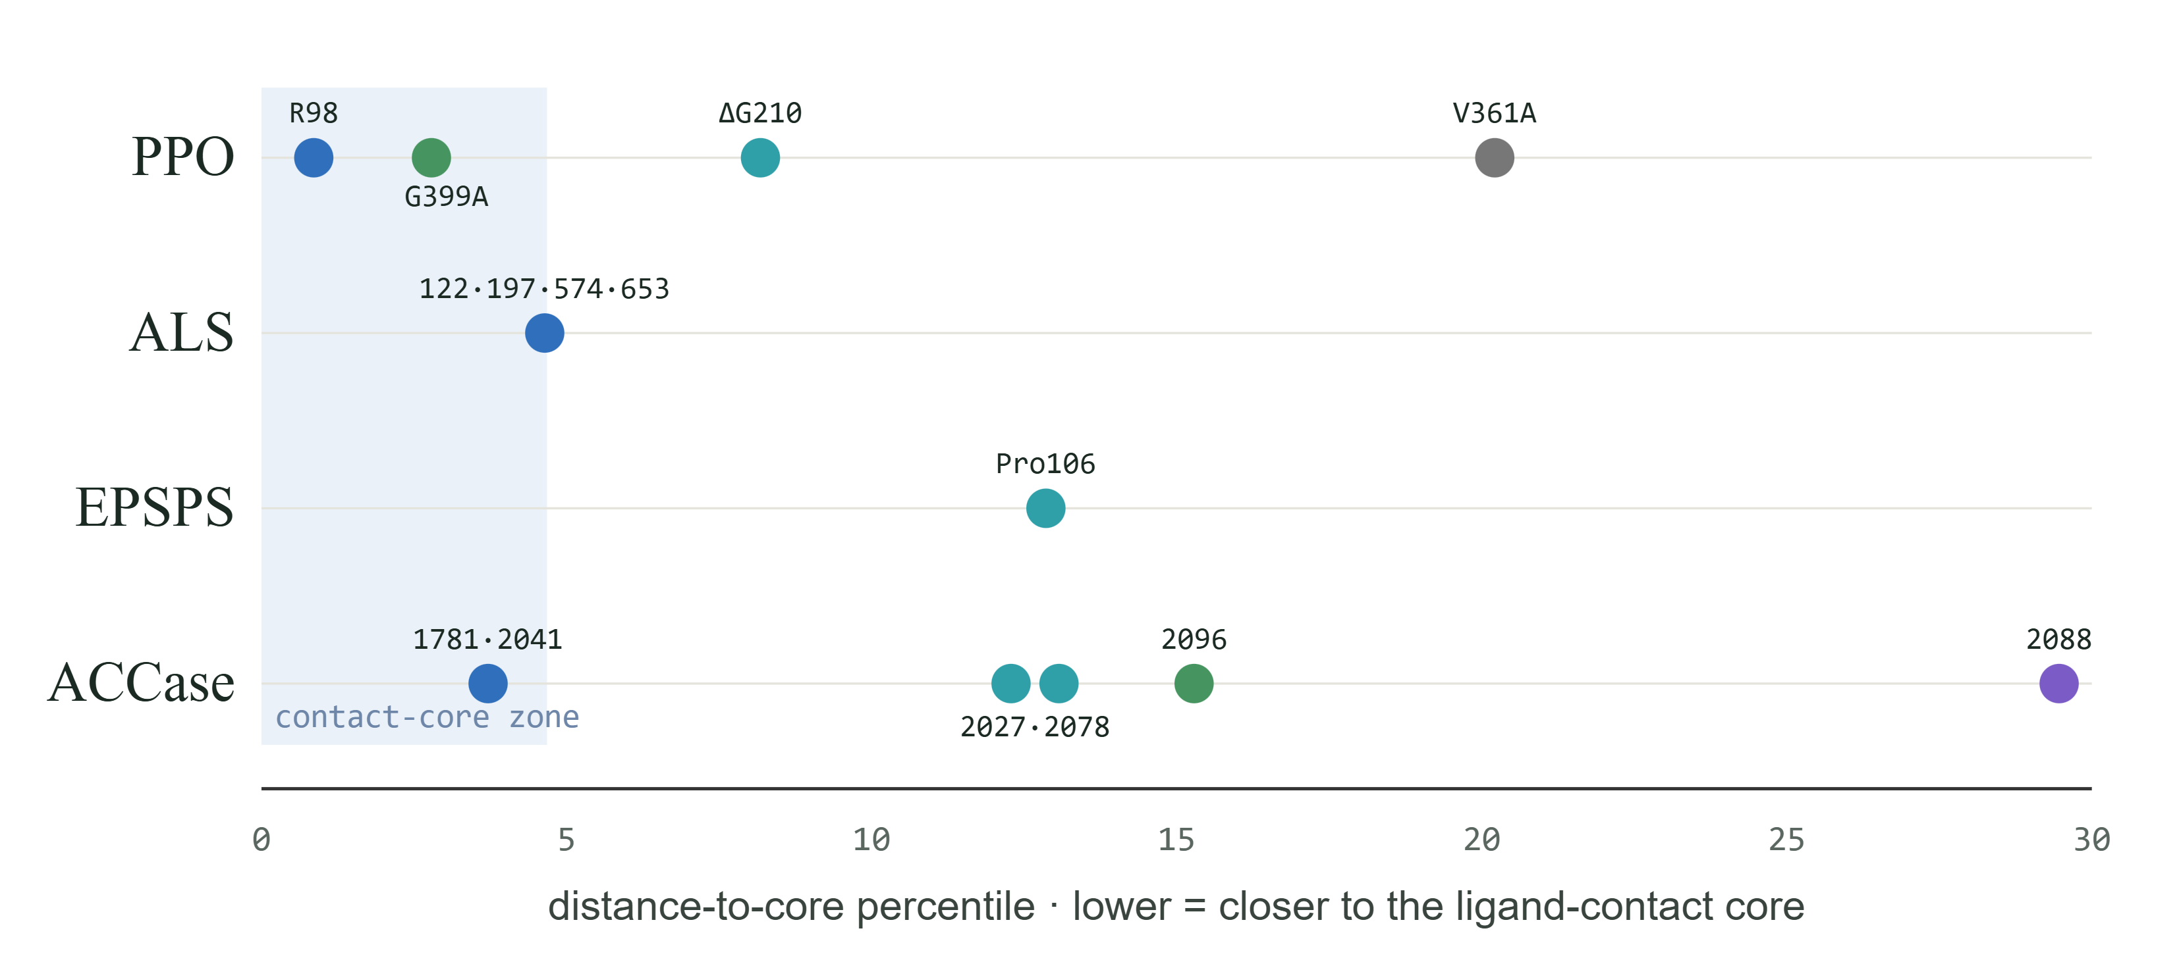
RESULT 3 · RESISTANCE-ZONE MAP
Every accepted position, placed by proximity
direct core
adjacent
second-shell / channel
interface induced-fit
unresolved
Notes:
This is the resistance-zone map — one lane per family, each dot a resistance position placed by its distance-to-core percentile, left meaning closest. The shaded band on the left is the direct-contact core. Color encodes mechanism class. Read it left to right: ALS positions pile up right at the contact core; PPO and ACCase spread from the core outward through adjacent and second-shell positions to more distal interface sites; EPSPS Pro106 sits just outside the contact cutoff. This single picture is the typology the paper is really about — not whether positions are near the pocket, but how they relate to it.

Slide 18
THE CONTRIBUTION
A shared vocabulary for how mutations meet the pocket
Direct core
Adjacent
Second-shell
Allosteric hinge
Interface fit
FLAGSHIP · PPO
FLAGSHIP · ACCase
ΔG210 deletion
Cys2088Arg
Near the active-site zone, but its effect is helix destabilization and cavity expansion — a mechanism distance alone can't see. Why we pair mapping with literature.
The most distal accepted position — out in the dimer-interface resistance zone, yet confers broad APP + CHD resistance. Structure explains what a pocket-only view misses.
Notes:
Let me name the typology and give the two flagship non-obvious cases, because these are what a weed scientist will remember. Five classes: direct-core contact, adjacent, second-shell or channel, allosteric hinge, and interface induced-fit. The flagship is PPO Delta-G210 — a glycine deletion whose effect isn't distance at all but helix destabilization and cavity expansion; distance alone would under-rate it, which is why we pair mapping with literature mechanism. The other is ACCase Cys2088Arg — the most distal accepted position, sitting out in the dimer-interface resistance zone yet still conferring broad resistance. The non-contact cases are where structural mapping earns its keep.

Slide 19
THE NEGATIVE CONTROL
HPPD is kept as a contrast — not forced into the story
The source audit found no verified weed-evolved HPPD target-site mutation — resistance there is largely metabolic and expression-driven. So HPPD carries zero pooled mutation rows. A framework that correctly reports “nothing here” is a framework you can trust when it reports something.
0
accepted TSR rows — retained only for structural context ( 5YWG ↗)
Notes:
A word on credibility. HPPD is a real herbicide target, but when we audited the literature we found no accepted weed-evolved target-site amino-acid mutation for it — resistance there runs through metabolism and over-expression instead. A weaker project would have forced a mutation in to keep the story tidy. We kept HPPD as an explicit contrast case with zero pooled mutation rows. Showing where the framework correctly says 'nothing here' is what tells a reviewer the positive results aren't manufactured.

Slide 20
LIMITATIONS — STATED PLAINLY
Where this map stops
01
Static context, not binding free energy or mutant-state dynamics.
02
EPSPS now has two accepted positions (was one) and is statistically significant, though still the smallest pooled family.
03
ACCase uses a homology model (GMQE 0.76), not a solved weed structure.
04
Structure & core choices matter — so all are scripted, seeded, and logged.
Every limitation is a boundary on the claim — not a crack in it.
Notes:
Being explicit about limits, because this room includes people who will and should push back. This is a static structural resource. It does not model mutant-state ensembles, free-energy changes, metabolism, expression, copy number, or field-level evolution. Distance percentile is context, not causation. EPSPS now has two accepted positions, not one, and is statistically significant, though still the smallest pooled family. ACCase rests on a homology model, not a solved weed structure. And structure choice and core definition influence the output — which is exactly why everything is scripted, seeded, documented, and run both with and without the direct-core residues. The limits are stated so the claims stay inside them.

Slide 21
WHY IT'S DIFFERENT & WHY IT'S USEFUL
The first shared yardstick — and a triage lens for new mutations
WHAT'S NEW
WHAT IT'S FOR
One reproducible metric across unrelated targets — not family-by-family.
Place a newly-reported mutation in the framework in minutes.
Get a structurally-informed first read: contact vs second-shell vs interface.
Focus follow-up assays and alternative-chemistry decisions.
Moves past “near the pocket” to a tested typology of how positions relate to it.
Enrichment shown to survive removal of direct-contact residues.
Notes:
Pulling it together — why this is different from prior work, and what it's good for. Different: prior work is family-by-family; this is the first reproducible cross-family yardstick, and it moves past the obvious 'mutations are near the pocket' to a tested typology of how they relate to it. Practically: it's a triage lens. When a new resistance mutation is reported, you can place it in the shared framework in minutes and get a structurally-informed first read — is this a direct-contact, a second-shell, or an interface case — which shapes what assay or which alternative chemistry to try next. It's a starting map for a new mutation, not the final word.

Slide 22
PHASE 5 · THE EMERGING TARGETS, AUDITED
We audited FAT and DHODH — and held both out
FAT
DHODH
ENGINEERED, NOT WEED-EVOLVED
LAB-SELECTED, NOT PUBLIC
R171K is a lab construct with a huge resistance index — but it needs three simultaneous nucleotide changes , so the authors call field evolution unlikely. Real cinmethylin resistance in Lolium does exist — but it's metabolic (P450), not target-site.
G198E and A141T come from EMS-mutagenised Arabidopsis lines, not weeds. A real rice DHODH structure exists but was never publicly deposited — so we say “no public plant structure,” not “none at all.”
A numbering check even refuted our own prior hypothesis: black-grass R171 and Arabidopsis Arg176 are most likely different residues , ~70 positions apart.
Notes:
Now the part that changed the most since last time. We had FAT and DHODH pencilled in as 'coming to the pipeline soon.' We actually audited both against primary sources this round — and the honest answer is: neither belongs in the pooled analysis yet, and I want to tell you why, because the reasoning is the point. FAT: the strong resistance mutation, R171K, is a lab construct. It has a big resistance index on paper, but it needs three simultaneous nucleotide changes to arise from the wild-type codon, so the authors themselves conclude field evolution is extremely unlikely. Meanwhile there IS real cinmethylin resistance out in Australian ryegrass — but it's metabolic, P450-driven, not a target-site mutation, so it isn't the mechanism our structural framework measures. DHODH: the two mutations we found, G198E and A141T, come from EMS-mutagenised Arabidopsis in the lab, not from weeds. And a real rice DHODH structure exists, but it was never publicly deposited, so we're careful to say 'no PUBLIC plant structure' rather than 'none at all.' We even ran a numbering check that refuted our own earlier hunch: the black-grass R171 and the Arabidopsis Arg176 in the crystal are most likely different residues, about seventy positions apart. Better to catch that ourselves than have a referee catch it.

Slide 23
WHY THEY'RE HELD OUT — THE DISCIPLINE
Nothing joins the pooled analysis until it's weed-evolved
Both targets have verified mutation evidence — but engineered and EMS-lab variants are not the same thing as resistance that evolved in a field. They live in a separate Phase 5 risk table, never in the Phase 4 pooled test.
FAT
audit_first
DHODH
hold_model_source
The same six-point gate that kept HPPD honest now gates the roadmap.
Notes:
So here's the principle that ties the whole project together, and it's worth stating out loud because it's what makes the positive results credible. Nothing enters the pooled statistical test until it is shown to be weed-evolved. Engineered mutants and EMS lab lines are perfectly good science, but they are not the same thing as resistance that arose in a real field under real selection. So FAT and DHODH go into a separate Phase 5 risk table — fully cited, fully characterised — but they never touch the Phase 4 enrichment analysis. It's the exact same six-point evidence gate that made us keep HPPD as a zero-mutation contrast case. FAT is flagged 'audit first,' DHODH 'hold for a model source.' The roadmap is disciplined, not opportunistic — and that discipline is the reason you can trust the enrichment result when it does fire.

Slide 24
STATUS & WHERE TO DIG IN
Submission-ready, and everything open to inspect
MANUSCRIPT STATUS
OPEN & REPRODUCIBLE
Target journal: Pest Management Science. Abstract trimmed to length, citations in PMS superscript style, 22 references each cited once, figures vector-ready.
$ python scripts/rebuild_all.py
Full repository (data · code · logs) ↗
Reproducibility scaffolding done — pinned environment, CITATION.cff , MIT license, one-command rebuild, 20 passing tests. Remaining: Zenodo release & ORCID at submission.
RCSB PDB — all 3D structures ↗
Délye 2005 — ACCase TSR ↗
Dayan 2010 — PPO ΔG210 ↗
Thank you — questions welcome.
links above are live · full reference list in the repo
Notes:
To close: where this stands and where you can dig in. The manuscript is now built for Pest Management Science — abstract trimmed to their length, citations converted to their style, every reference cited once, figures in vector format. The reproducibility scaffolding is done: a pinned environment, a citation file, an MIT license, one command that regenerates every table and figure, and a passing test suite. What's left is genuinely just submission-day housekeeping — cutting a Zenodo release for a data DOI and adding ORCID. Everything is open: the full repository, the data, the decision log, and the verification log are all linked here, along with the key papers and the 3D models, so you can chase anything in the Q and A. Thank you — I'm happy to take questions.

