Slide 1
Deciding to Invest in New Movies
Notes:
Template version: 11/20/2012, for PowerPoint 2007 & 2010

Slide 2
Problem

Slide 3


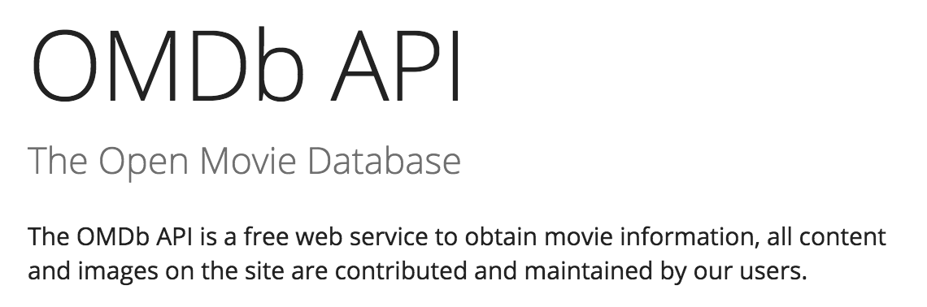
Data Sources

Slide 4
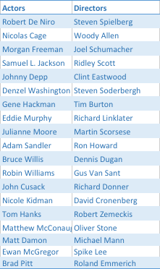
Data
Target Variable:
Domestic Gross
Predictor Inputs:
Genre
Director
Actors
Year

Slide 5
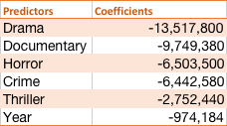
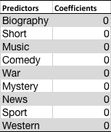
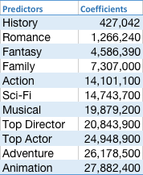
Lasso Model Coefficients

Slide 6
Model Performance

Slide 7
Examination of coefficients: Year

Slide 8
Next Steps
Test more variables through the movie production process
Original plan was a moving estimate
Broaden data sources to include older movies to remove bias from sample
Include a legitimate inflation adjustment
Add more features and interaction features
Try other models
Score our model

