Slide 1

Control Units and Control Signals
ELEC2350 Lab 3
Zhicheng Guo
9 November 2026
Department of Electronic & Computer Engineering
Hong Kong University of Science and Technology
Notes:
Hello everyone. My name is Guo Zhicheng, and I am a TA for this course. First, I will introduce the Lab 3 “Control Units and Control Signals”. Then, I will present my research.

Slide 2
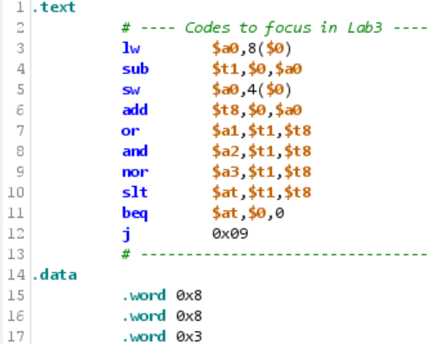
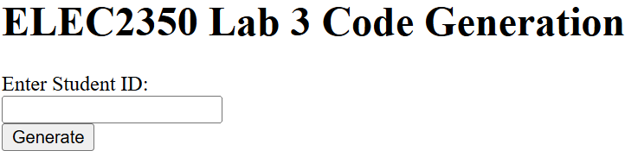
Preparation
Download the Lab 3 Code Generator from Canvas.
Open the lab3_CodeGen.html file in a browser.
Generate your lab3 assembly code according to your student ID.
Download the ASM File from the browser,
for example, 21181883_lab3.asm.

Slide 3
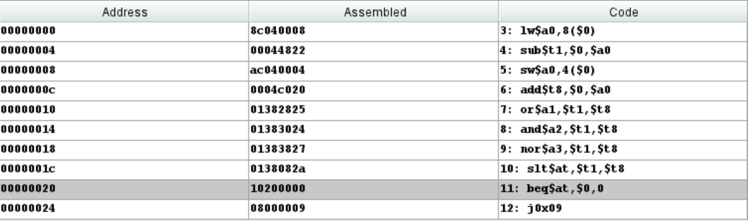
Procedure
Software Settings:
“Internal Windows” checkbox is unchecked.
“Arrows in wire” checkbox is checked.
In“Data in inputs and outputs”,“Enable” checkbox is unchecked.
“Control path” is checked.
Load Files:
To load CPU from file, choose the file “cpu\unicycle.cpu” and click the “Open” button.
Choose the assembly code file (21181883_lab3.asm) and click the “Open”button.
Translate your assembly codes to machine codes.
Pulldown menu “Execute” and click “Assemble”.

Slide 4
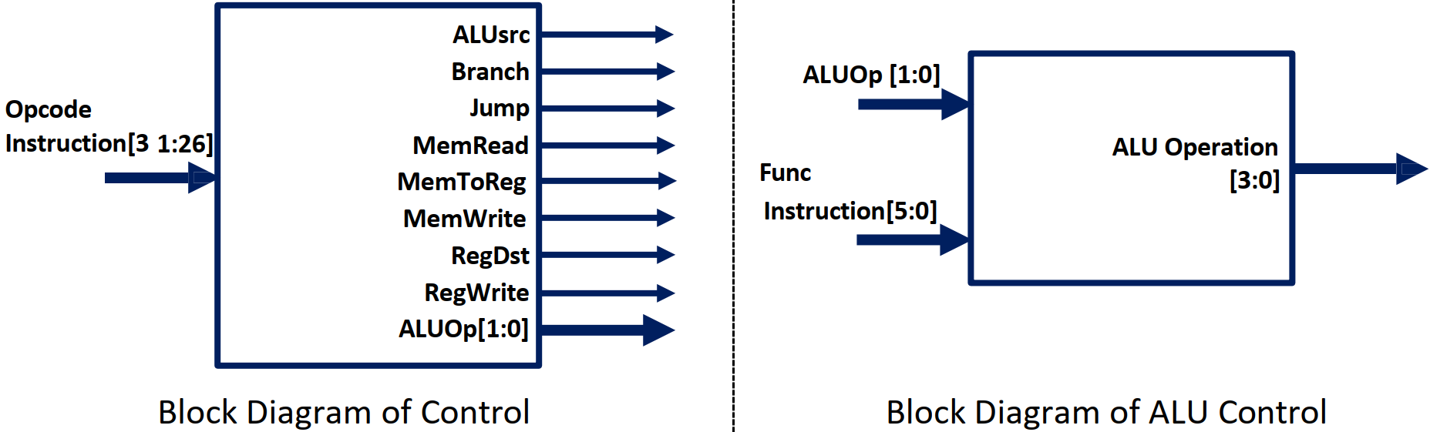
Control and ALU Control
Control signals are used to select the operation of the ALU (addition or substation), by two control units.
The first control unit, simply called Control, generates nine control signals based on the opcode field (e.g. bit 31 – bit 26) of an assembly instruction.
The second control unit, called ALU Control, generates a 4-bit control signal based on the 2-bit signal generated by Control and the func field (e.g. bit 5 – bit 0) of an assembly instruction.

Slide 5
Main control signals by instruction class
Read one row for each opcode. All six register-to-register instructions use the R-type row.
Class | Opcode | ALUSrc | Branch | Jump | MemRead | MemToReg | MemWrite | RegDst | RegWrite | ALUOp
R-type | 000000 | 0 | 0 | 0 | 0 | 0 | 0 | 1 | 1 | 10
lw | 100011 | 1 | 0 | 0 | 1 | 1 | 0 | 0 | 1 | 00
sw | 101011 | 1 | 0 | 0 | 0 | X | 1 | X | 0 | 00
beq | 000100 | 0 | 1 | 0 | 0 | X | 0 | X | 0 | 01
j | 000010 | X | 0 | 1 | 0 | X | 0 | X | 0 | XX
All fields are binary. X means either bit value gives the same architectural result.
Notes:
This table follows the main Control truth table and includes RegWrite from R-type covers sub, add, or, and, nor and slt. A don’t-care value need not appear literally as X in every simulator.

Slide 6
ALU control for all ten instructions
PC | Instruction | Opcode | ALUOp | Bits [5:0] | ALU operation | Action
0x00 | lw | 100011 | 00 | 001000 | 0010 | Address addition
0x04 | sub | 000000 | 10 | 100010 | 0110 | Subtract
0x08 | sw | 101011 | 00 | 000100 | 0010 | Address addition
0x0C | add | 000000 | 10 | 100000 | 0010 | Add
0x10 | or | 000000 | 10 | 100101 | 0001 | Bitwise OR
0x14 | and | 000000 | 10 | 100100 | 0000 | Bitwise AND
0x18 | nor | 000000 | 10 | 100111 | 1100 | Bitwise NOR
0x1C | slt | 000000 | 10 | 101010 | 0111 | Signed less than
0x20 | beq | 000100 | 01 | 000000 | 0110 | Compare by subtracting
0x24 | j | 000010 | XX | 001001 | XXXX | ALU result unused
Bit fields are binary. Only R-type instructions use bits [5:0] as a function code. For j, the ALU result is unused, so its control bits are don’t-care (X).
Notes:
Bits [5:0] are the actual low six bits of each machine word. For lw, sw, and beq they come from the immediate. For j they come from the target index. The control logic ignores those six bits for these four opcodes.

Slide 7

The ten instructions in memory
Each instruction occupies four bytes. The first instruction is at byte address 0x00.
PC | Assembly | Machine word | PC | Assembly | Machine word
0x00 | lw $a0, 8($0) | 0x8C040008 | 0x14 | and $a2, $t1, $t8 | 0x01383024
0x04 | sub $t1, $0, $a0 | 0x00044822 | 0x18 | nor $a3, $t1, $t8 | 0x01383827
0x08 | sw $a0, 4($0) | 0xAC040004 | 0x1C | slt $at, $t1, $t8 | 0x0138082A
0x0C | add $t8, $0, $a0 | 0x0004C020 | 0x20 | beq $at, $0, 0 | 0x10200000
0x10 | or $a1, $t1, $t8 | 0x01382825 | 0x24 | j 0x09 | 0x08000009
Notes:
Addresses follow the zero-based instruction-memory layout shown in the handout. The words shown here encode the user’s program; instruction and data memories are separate.

Slide 8
The two control units
For sub $t1, $0, $a0 at 0x04, two fields of the instruction determine the ALU operation.
Control
ALU Control
ALUOp = 10
Reads opcode 000000
Reads funct 100010
and identifies an R-type instruction.
and selects subtraction (0110).
Where does the result go?
RegDst = 1 selects the rd field ($t1). RegWrite = 1 enables the register write.
Notes:
Control decodes instruction[31:26]. Its two-bit ALUOp and instruction[5:0] enter ALU Control. The four-bit ALU Operation code for subtraction is 0110.

Slide 9
How lw and sw change memory
Both instructions use the ALU to add the sign-extended byte offset to the base register $0.
Data address | Initial word | After sw | Memory access
0x00 | 0x00000008 | 0x00000008 | Neither instruction accesses this word.
0x04 | 0x00000008 | 0x00000003 | sw writes $a0 to address 0 + 4.
0x08 | 0x00000003 | 0x00000003 | lw reads address 0 + 8 into $a0.
The enable signals change with the instruction
lw asserts MemRead and RegWrite. sw asserts MemWrite and stores the value 3.
Notes:
Data memory is byte-addressed. The words in the .data section begin at 0x00, 0x04, and 0x08. The store changes the middle word after the load.

Slide 10
Signed operands in $t1 and $t8
The load sets $a0 to 3. The next arithmetic instructions use $0 to create −3 and +3.
Instruction | Signed calculation | 32-bit register result
sub $t1, $0, $a0 | 0 − 3 = −3 | $t1 = 0xFFFFFFFD
add $t8, $0, $a0 | 0 + 3 = 3 | $t8 = 0x00000003
The same bits support two kinds of operation
The logical instructions operate on the 32-bit patterns. The later slt interprets them as signed integers, so it compares −3 with +3.
Notes:
The three logical instructions and slt all read the same $t1 and $t8 values. The 32-bit two’s complement encoding for −3 is FFFFFFFD.

Slide 11
Bitwise results for OR, AND and NOR
Each instruction reads $t1 = 0xFFFFFFFD and $t8 = 0x00000003.
Instruction | Lowest four bits (binary) | 32-bit register result
or $a1, $t1, $t8 | 1101 OR 0011 = 1111 | $a1 = 0xFFFFFFFF
and $a2, $t1, $t8 | 1101 AND 0011 = 0001 | $a2 = 0x00000001
nor $a3, $t1, $t8 | NOT (1101 OR 0011) = 0000 | $a3 = 0x00000000
Why NOR gives zero
OR produces a 1 in every bit position. NOR inverts all 32 bits, so $a3 contains zero.
Notes:
The upper 28 bits of the two operands are all ones and all zeros, respectively. This accounts for the high bits of all three full-width results.

Slide 12
Does beq take the branch?
No. At 0x1C, slt $at, $t1, $t8 compares −3 with 3 and sets $at to 1.
At 0x20, beq $at, $0, 0 compares 1 with 0.
The equality test fails, so the processor selects the sequential address.
Possible next PC | Address calculation | Byte address
Fall-through (selected) | PC + 4 = 0x20 + 4 | 0x24
Branch target | PC + 4 + (0 × 4) = 0x24 + 0 | 0x24
The offset is zero. Both paths lead to 0x24, so the PC value alone cannot identify the selected path.
Notes:
For beq, the signed immediate is scaled by four bytes and added to PC+4. The register operands of beq hold 1 and 0. This slide reports a result derived from the supplied listing.

Slide 13
Which signals show the branch decision?
At beq, inspect the Branch output from Control and the Zero flag from the ALU.
Branch = 1
PCSrc = 0
Control decodes beq.
AND
The PC multiplexer
selects PC + 4.
Zero = 0
The ALU computes 1 − 0 = 1.
Reading the AND gate in DrMIPS
With beq current, hover over the AND gate. Its output is 1 only when Branch and Zero are both 1.
Here the output is 0, confirming fall-through to j 0x09.
Notes:
In the single-cycle MIPS datapath, the AND output is the branch-address multiplexer select, commonly called PCSrc. Jump=0 for beq. A zero result from subtraction would set Zero=1, selecting the target in that case.

Slide 14
The final jump loops at 0x24
The instruction j 0x09 uses the encoded word index 0x09 to form its jump address.
0x09 × 4 = 0x24
word index × bytes per instruction = byte address
What happens on the next step?
Jump = 1 selects 0x24 as the next PC. The jump itself is at 0x24, so each subsequent step fetches the same instruction.
Notes:
Jump format combines the upper four bits of PC+4 with the 26-bit word index followed by two zero bits. Here the upper bits are zero. The target equals the address of j itself.

Slide 15
Expected state at the final jump
At the first execution of j, compare these calculated values with the Registers and Data Memory tabs.
Register | Hexadecimal value | Signed decimal
$a0 | 0x00000003 | 3
$t1 | 0xFFFFFFFD | −3
$t8 | 0x00000003 | 3
$a1 | 0xFFFFFFFF | −1
$a2 | 0x00000001 | 1
$a3 | 0x00000000 | 0
$at | 0x00000001 | 1
Data address | 32-bit word
0x00 | 0x00000008
0x04 | 0x00000003
0x08 | 0x00000003
Program counter
PC = 0x24
The jump leaves the registers and data memory unchanged.
Notes:
All register and data-memory values on this page are calculated from the user’s program, not transcribed from a run. Jump does not write registers or data memory.

Slide 16
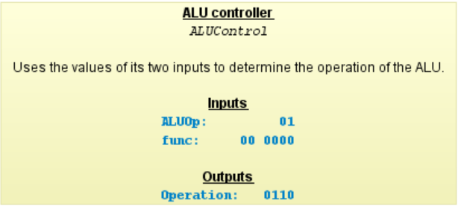
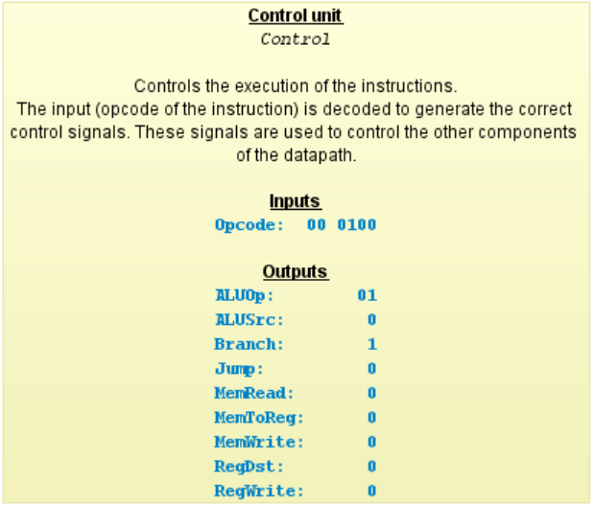
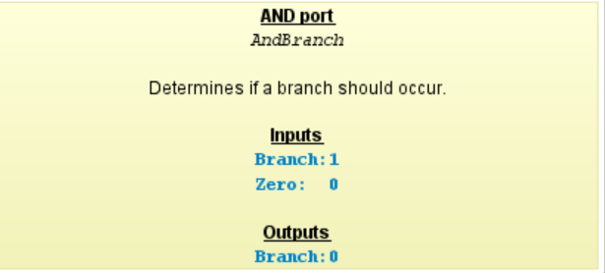
How to fill the table?
Use the Binary Format in the “Datapath”, and hovering your mouse pointer over the below blocks.

Slide 17
Facility Location Submodular Optimization on GPU for Token Subset Selection
Under Review at ICLR 2027
Zhicheng Guo
9 November 2026
Department of Electronic & Computer Engineering
Hong Kong University of Science and Technology
Notes:
Now, I will talk about my research - facility location submodular optimization on GPU for token subset selection.

Slide 18
Token Subset Selection
Vision-language models prune ~80% of visual tokens before the LLM (SCOPE, MMTok, CDPruner, FLoC)
In-context learning picks a few unlabeled examples to annotate (Selective Annotation ICLR 2023)
Many strong selectors share one objective: Facility Location Maximization
But the greedy solver is slow: hundreds of ms on the GPU, seconds on the CPU
1,296
2,880
tokens per image, Qwen2.5-VL
tokens per image set, LLaVA-NeXT
10,816
~80%
tokens for 64 video frames, LLaVA-Video
visual tokens dropped before the LLM
Goal of this work: make the greedy selection itself fast on the GPU, while returning exactly the same subset as the standard greedy algorithm.
Examples: SCOPE (NeurIPS 2025), MMTok (ICLR 2026), CDPruner (NeurIPS 2025), FLoC (ICLR 2026).
Notes:
In ML conference papers, vision-language models prune around 80 percent of visual tokens before the LLM. In-context learning pipeline such as Selective Annotation choose which unlabeled examples to annotate. Many strong selectors use the same objective - facility location maximization. This problem is scale: Qwen2.5-VL outputs 1,296 tokens per image, LLaVA-NeXT outputs 2,880 tokens per image set, LLaVA-Video outputs 10,816 tokens for 64 video frames. But the greedy solver is slow: the greedy selection will take hundreds of milliseconds on the GPU and seconds on the CPU. Therefore, the goal of this work is to make the greedy selection itself fast on the GPU, while returning exactly the same subset as the standard greedy algorithm.

Slide 19
Token Subset Selection
Keep a small, informative subset of visual or text tokens.
Why it matters
Where it applies
Existing research
Lower computation,
less GPU memory,
faster responses.
Vision-language models
for image and video
understanding.
Attention ranking (FastV ECCV 2024), diversity selection (DivPrune CVPR 2025),
coverage method (SCOPE NeurIPS 2025).
Open challenge
Preserve important details while achieving real speedups.
Notes:
Token Subset Selection Task is to keep a small, informative subset of visual or text tokens. Why it matters? Reducing the token sequence can reduce inference computation and GPU memory and improve response latency. Where it applies? For example, many vision-language models use the Token Subset Selection for image and video understanding. To complete this task, there are 3 methods: attention ranking, diversity selection, coverage method. The open challenge is to preserve important details while achieving the runtime improvements.

Slide 20
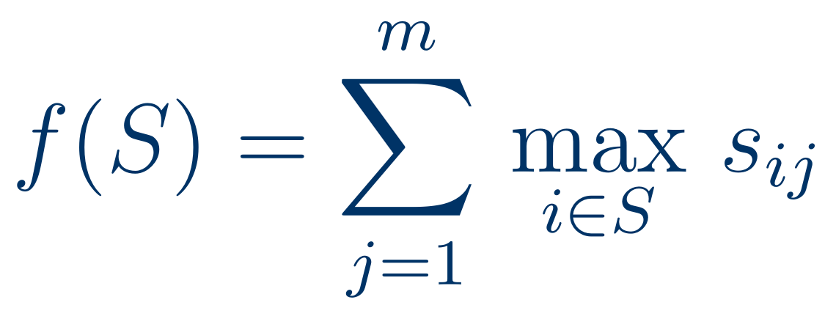
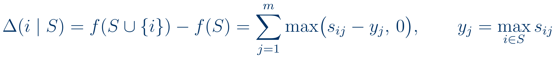
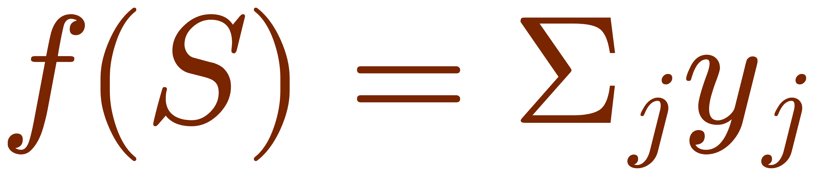
Facility Location Maximization
m target tokens
Objective
Pick k of n source tokens that best cover m target tokens under the similarity matrix s ∈ ℝ^{n×m}.
← selected
n source tokens
Marginal Gain
With the memoized coverage vector y;
after selecting v, update y ← max(y, s_{v}).
← selected
Guarantee
f is monotone submodular: exact maximization is NP-hard,
and greedy attains the best possible ratio.
y = max over selected rows
Notes:
In the facility location maximization, we have a n*m similarity matrix s between n source tokens and m target tokens, for example, cosine similarity. The objective is to pick k of n source tokens that best cover m target tokens under the similarity matrix s. Facility location sums, for every target token, its max similarity to the chosen subset with k tokens. We keep a memoized coverage vector y, so the marginal gain of a token is this equation. After selecting the token v, we can update y with a max operation. This function is monotone submodular, so greedy algorithm has this fixed guarantee. We repeatedly add the largest-gain token to the output set.

Slide 21
Why Existing Greedy Solvers Are Slow
Naive Greedy
Lazy Greedy
PyTorch loops on GPU (MMTok, SCOPE, SelAnn)
submodlib (C++) and apricot (Python) on CPU
Recomputes all n gains every iteration: O(knm) complexity
Reads s, writes max(s − y, 0), reads it back: 12nm HBM bytes per token
8–16 kernel launches per selected token
Memory-bound, linear in k
Stale gains are upper bounds, kept in a priority queue
Pops the top, re-reads one row, admits it if still the largest
Reads few rows, but each pop depends on the previous one
Latency-bound serial chain, confined to the CPU
Neither exploits that the similarity matrix fits on the GPU chip
Notes:
Why Existing Greedy Solvers Are Slow? There are two common algorithms. Naive greedy is the PyTorch loops on the GPU. It recomputes all n marginal gains at every iteration. PyTorch loops read s, write the temporary, and read it back. It is 12nm HBM bytes and 8 to 16 kernel launches per selected token.
So, naive greedy is memory-bound on the GPU and linear complexity in k. By contrast, lazy greedy can read very few rows, but each pop depends on the previous one. So it is a serial, latency-bound chain, and its priority queue keeps it on the CPU. Overall, neither one uses the fact that the similarity matrix could fit on the GPU chip.

Slide 22
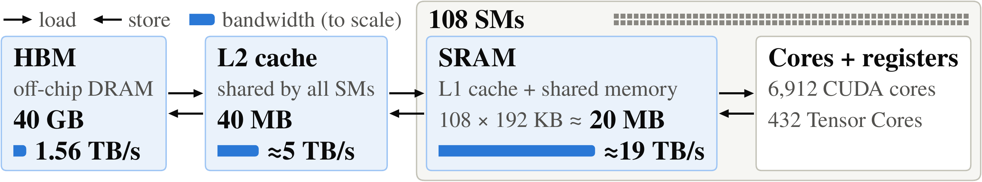
Key Observation: The GPU Memory Hierarchy
NVIDIA A100 (40 GB) memory hierarchy: capacity vs. bandwidth
1
Memory-bound kernel
2
The matrix fits on chip
3
IO-aware design
A gain does 3 ops per 4 bytes read, so its time = time to move the row
n = m = 2,880 in float32 is 33 MB < 40 MB L2; for n = 1296 a 12-row tile (62 KB) fits one SM's SRAM
As in FlashAttention: decide where every byte lives, read s from HBM once, never write a temporary
Notes:
This is the memory levels of NVIDIA A100 GPU. HBM is large but the slowest, 1.56 TB per second. The 40 MB L2 cache is shared by all SMs at about 5 TB per second. Each of the 108 SMs has its own SRAM, about 20 MB in total at about 19 TB per second. A marginal gain does only 3 operations per 4 bytes, so its time is simply the time to move the row from wherever it lives. For the similarity matrix sizes: a 2,880 by 2,880 float matrix is 33 MB and fits in L2 cache. For 1,296 tokens each SM's tile is 62 KB, which fits in SRAM. Inspired by FlashAttention, our idea is to decide where every byte lives, read the similarity matrix from HBM once, and never write a temporary.

Slide 23
Proposed Algorithm: Flash Greedy
1
Lines 1–7
2
Lines 9–15
3
Lines 16–27
4
Lines 28–30
Initialize & tile
Parallel gain
Multi-token admission
Update gains
Exact gains for the first token; split s into T = 108 row tiles; place in SRAM / L2 / HBM by size
Each SM re-evaluates the top candidate of its tile with one row read
Admit candidates while they beat the global upper bound and their bool vectors do not overlap
Write refreshed exact gains back to the gain tiles; mark selected tokens
One launch
persistent cooperative kernel, one block per SM, a grid barrier per step
Exact
returns exactly the naive greedy subset, with IO complexity per placement regime
Simple interface
takes only s and k; T, tile width and placement follow from the GPU
Notes:
Our proposed algorithm is called Flash Greedy, which has 4 phases. Phase 1 initializes the gains like lazy greedy and places the tiles in SRAM, L2 or HBM by size. Phase 2: each SM re-evaluates only the single best candidate of its tile, so 108 rows are read in the time of one. Phase 3 admits possibly several tokens per iteration, using a bool position vector to certify that gains are still exact. Phase 4 writes back the refreshed gains. Flash Greedy replaces the priority queue of lazy greedy with T gain tiles, one per streaming multiprocessor. The whole selection runs in one persistent kernel launch, with one thread block per SM. Flash Greedy returns exactly the naive greedy subset. The input of CUDA kernel only has similarity matrix s and selected budget k.

Slide 24
Phases 1–2: Tiling and Parallel Gains
tile s¹ → SM 1
Placement by data size (A100)
SRAM if a tile (4wm bytes) fits one SM (n = 1,296: 12 rows, 62 KB of 164 KB)
L2 if the whole matrix fits in 40 MB (n = 2,880: 33 MB)
HBM otherwise (n ≥ 5,184)
tile s² → SM 2
tile s³ → SM 3
Each SM t in every outer iteration
⋮
Candidate cᵗ = argmax of cached gains xᵗ; bound uᵗ = next-largest cached gain
One row read: zᵗ = max(sc − y, 0), exact gain gᵗ = Σⱼ zᵗⱼ
Bool vector: positions where zᵗ > 0, stored as m bits
Publish a 12-byte record (gᵗ, cᵗ, uᵗ) + m-bit vector through L2
T = 108 rows are read in the time of one
tile sᵀ → SM T
■ candidate cᵗ: top cached gain of each tile
Notes:
Here is phase 1 and 2 in more detail. The rows of s and the gain vector x are cut into T contiguous tiles, one per SM. Placement is by data size of matrix s. In every outer iteration, each SM takes the token with the largest cached gain in its tile as its candidate c, and also records the largest cached gain u among the rest. Then it reads the candidate's row once, and computes the exact gain g against the current y. The positions where the gain is positive become an m-bit bool vector z. Each SM publishes just a 12-byte record, g, c, u, plus this bit vector through L2 cache.

Slide 25
Phase 3: Exact Multi-Token Admission
Inner loop (replicated on every SM)
Example: m = 13 target positions
u* = $\max_{t}$uᵗ ; b = 0
while $\max_{t}$ gᵗ ≥ u* and |S| < k:
a = ${argmax}_{t}$ gᵗ
if (b & zᵃ) == 0:
S ∪= {a}; y = max(y, sᵃ); b |= zᵃ
else: break
b (admitted so far)
z of next candidate
b & z
All zero ⇒ admit next candidate too
Cached gains are upper bounds, so u* bounds every non-candidate
Admitting $a$ changes other gains only where zᵃ > 0
No overlap ⇒ gain unchanged ⇒ admit with no row read
Result: several tokens per iteration, and the admitted sequence is exactly the naive greedy sequence
Notes:
Every cached gain is an upper bound of the true current gain. So u* bounds the exact gain of every token that is not a candidate. If the best candidate a has exact gain at least u*, it is the true greedy choice, and we admit it. Admitting a only changes other gains at the target positions where z a is positive. So we save those positions in a bool vector b. The next best candidate keeps exactly its gain if its own positive positions do not intersect b, which is a single bitwise AND on m bits. If it overlaps, we stop. With several tokens per iteration, the admitted sequence is exactly the naive greedy sequence.

Slide 26
IO Complexity
Solver | HBM traffic (bytes) | Grows with k?
PyTorch loops (naive greedy) | 12·k·n·m | Linearly
Flash Greedy, SRAM regime | 4·n·m | No
Flash Greedy, L2 regime | 4·n·m | No
Flash Greedy, HBM regime | 8·n·m + 4·m·(T·r + k) | Only through r and k
224×
less HBM traffic than the PyTorch loops (predicted), selecting 1,024 of 10,816 video tokens
215×
r = number of outer iterations, T = 108 tiles. In the SRAM and L2 regimes the matrix crosses HBM once, independent of k.
measured speedup over the PyTorch loops on the same matrix
The PyTorch loops are limited by HBM bandwidth; Flash Greedy is no longer IO-bound.
Initialization reads s twice; afterwards every outer iteration reads T rows plus one broadcast row per admitted token.
Notes:
We can bound the HBM traffic. PyTorch loops have 12knm bytes. In the SRAM and L2 regimes, Flash Greedy moves the matrix through HBM once, so its HBM traffic does not depend on k at all. In the HBM regime it moves 8nm for the two initialization passes plus 4m(Tr + k) for candidate rows and coverage updates. For 1,024 of 10,816 video tokens this predicts 224x less traffic, and we measure a 215x speedup over the PyTorch loops, so the model tracks reality. In short, PyTorch loops are limited by HBM bandwidth; Flash Greedy is no longer IO-bound.

Slide 27
Experimental Setup
1
Benchmarks
2
Baselines
3
Hardware & protocol
MMTok & SCOPE (visual token pruning): Qwen2.5-VL-7B, n = 1,296, and LLaVA-NeXT-7B, n = 2,880, on TextVQA and POPE
LongVideoBench with LLaVA-Video-7B: 64 frames, n = 10,816
Selective Annotation: 6 datasets, Sentence-BERT, 3,000 instances (up to 20,000 for scaling)
submodlib lazy greedy (C++, CPU)
apricot naive and lazy greedy (Python with Numba, CPU)
Original PyTorch loops of MMTok, SCOPE and Selective Annotation (naive greedy, GPU)
NVIDIA A100 40GB, CUDA 12.8, PyTorch 2.11
AMD EPYC 7B13 for CPU solvers (64 cores, 128 threads)
Budget 128 ≤ k ≤ 2,048, following the original papers
Metric: selection time for a float32 similarity matrix already in memory, averaged over all samples of each dataset.
Notes:
We take the similarity matrix from three real pipelines. MMTok and SCOPE prune visual tokens: Qwen2.5-VL gives 1,296 tokens per image and LLaVA-NeXT 2,880, on TextVQA and POPE. Moreover, LLaVA-Video gives 10,816 tokens for 64 frames in LongVideoBench. Selective Annotation uses six text datasets embedded with Sentence-BERT. We compare with submodlib lazy greedy, apricot naive and lazy greedy, and the original PyTorch loops of each paper. GPU runs are on the A100 40GB, CPU runs on the 64 cores. All solvers return the same subsets.

Slide 28
Main Results: Fastest in All 73 Configurations
Setting | Data | n | k | Regime | submodlib lazy | apricot naive | apricot lazy | PyTorch loops | Flash Greedy | Speedup
MMTok | TextVQA | 1,296 | 128 | SRAM | 54.6 | 76.5 | 58.4 | 10.7 | 1.17 | 9.14×
MMTok | TextVQA | 2,880 | 320 | L2 | 266 | 665 | 183 | 73.3 | 3.31 | 22.1×
MMTok | TextVQA | 2,880 | 1,280 | L2 | 494 | 12 s | 1.2 s | 292 | 8.23 | 35.4×
SCOPE | TextVQA | 1,296 | 128 | SRAM | 52.3 | 90.6 | 53.4 | 29.6 | 1.18 | 25.0×
SCOPE | TextVQA | 2,880 | 320 | L2 | 306 | 671 | 197 | 169 | 3.39 | 49.8×
SCOPE | TextVQA | 5,184 | 1,024 | HBM | 1.5 s | 10.0 s | 2.0 s | 1.4 s | 10.5 | 133×
SCOPE | Video | 10,816 | 1,024 | HBM | 5.7 s | 26 s | 4.6 s | 5.4 s | 25.1 | 183×
SCOPE | Video | 10,816 | 2,048 | HBM | 7.0 s | 63 s | 17 s | 11 s | 27.6 | 253×
SelAnn | MNLI | 3,000 | 128 | L2 | 471 | 214 | 267 | 39.3 | 2.33 | 16.8×
SelAnn | MNLI | 20,000 | 1,024 | HBM | 31 s | 63 s | 14 s | 9.6 s | 40.3 | 238×
≥ 9×
faster than the PyTorch loops on the same GPU
≥ 26×
faster than the best CPU library
40 ms
for 1,024 of 20,000 instances; the baselines take 9.6–63 s
Time in ms unless marked (s = seconds); m ≈ n. Bold = fastest baseline; speedup is over it.
10 of the 73 configurations shown; the other 63 are in the paper.
Speedup over the fastest baseline grows with matrix size (placement regime)
SRAM 9–32×
L2 15–64×
HBM 25–253×
Notes:
Flash Greedy is the fastest solver in all 73 configurations; ten are shown here. The last column is the speedup over the fastest baseline in each row. Overall: at least 9 times faster than the PyTorch loops and at least 26 times faster than the best CPU library. 1,024 of 20,000 instances take 40 ms, while the baselines take 9.6 to 63 seconds. The speedup grows with matrix size, that is with the placement regime: 9 to 32 times in SRAM, 15 to 64 in L2, 25 to 253 in HBM. Because the baselines' traffic grows with n and m while ours grows much more slowly.

Slide 29
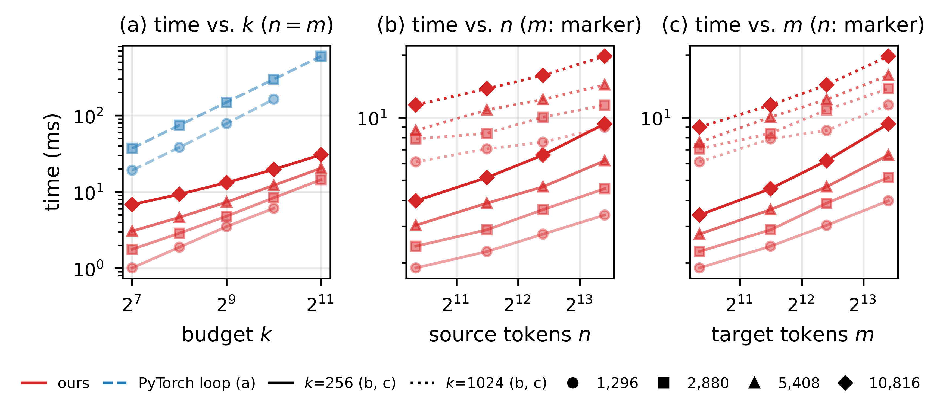
Scaling with Budget k and Matrix Size
(a) Budget k
16× larger k costs only 4.5–8.1× more time; the PyTorch loops are linear in k (gap grows from 21× to 41× at n = m = 2,880)
(b) Source tokens n
8.3× more n costs 1.5–2.3× more time: every iteration still reads T rows
Red: ours (solid k = 256, dotted k = 1,024). Blue dashed: PyTorch
(c) Target tokens m
Smooth across the SRAM, L2 and HBM regimes: 6.1–19.7 ms at k = 1,024 while the matrix grows 70×
8.3× more m costs 1.9–2.7× more time: every row read scales with m
Notes:
How does the time scale?
- (a) A 16 times larger budget costs Flash Greedy only 4.5 to 8.1 times more time. While the PyTorch loops widen the gap from 21 to 41 times.
- (b) 8.3 times more source tokens cost only 1.5 to 2.3 times more time, because each iteration still reads just T rows.
- (c) 8.3 times more target tokens cost 1.9 to 2.7 times more time, because every row read gets longer.
- The curves are smooth across regimes.

Slide 30
Ablations: Tiles T and Bool Position Vector
Number of tiles T: one tile per SM is best
Bool position vector: multi-token vs. one-token
T = 108 (= #SMs) is fastest in all 9 cases (5 shown); T = 14 is 1.9–4.2× slower
T = 216 is 4–18% slower although it cuts iterations (from 326 to 210 on MMTok): two blocks share one SM and every barrier waits for twice the blocks
Across all 13 settings (6 shown, n = 2,880): 1.34–2.86× fewer outer iterations and 1.10–1.57× faster; the gain grows with k
An AND of two m-bit vectors decides overlap without a row read; overlaps hit only 3–16% of candidate–admission pairs
Notes:
Which design choices matter?
- Left, the number of tiles. T = 108, the number of SMs, is fastest in all nine cases. Fewer tiles leave SMs idle and test fewer candidates per iteration. T = 216 cuts iterations further, from 326 to 210 but is 4 to 18% slower.
- Right, the bool position vector. Without it, at most one token can be admitted per iteration. With it, across all 13 settings, Flash Greedy needs 1.34 to 2.86 times fewer iterations and is 1.10 to 1.57 times faster, and the gain grows with k.

Slide 31
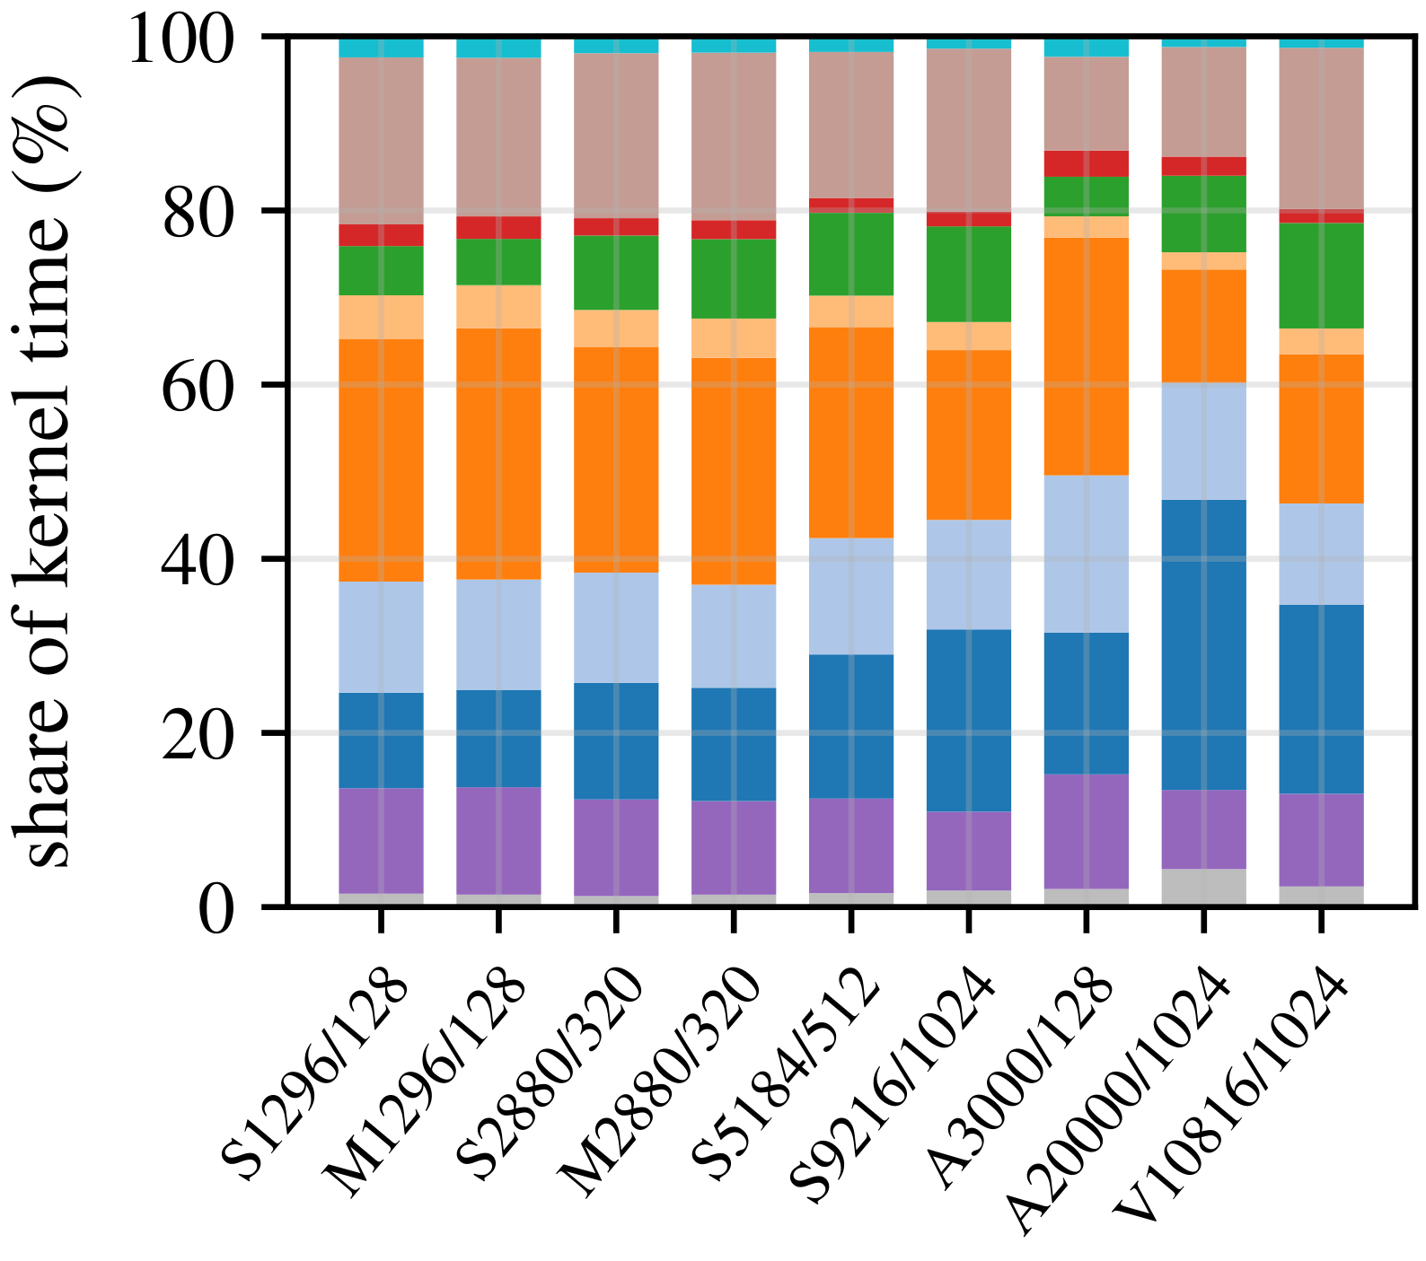
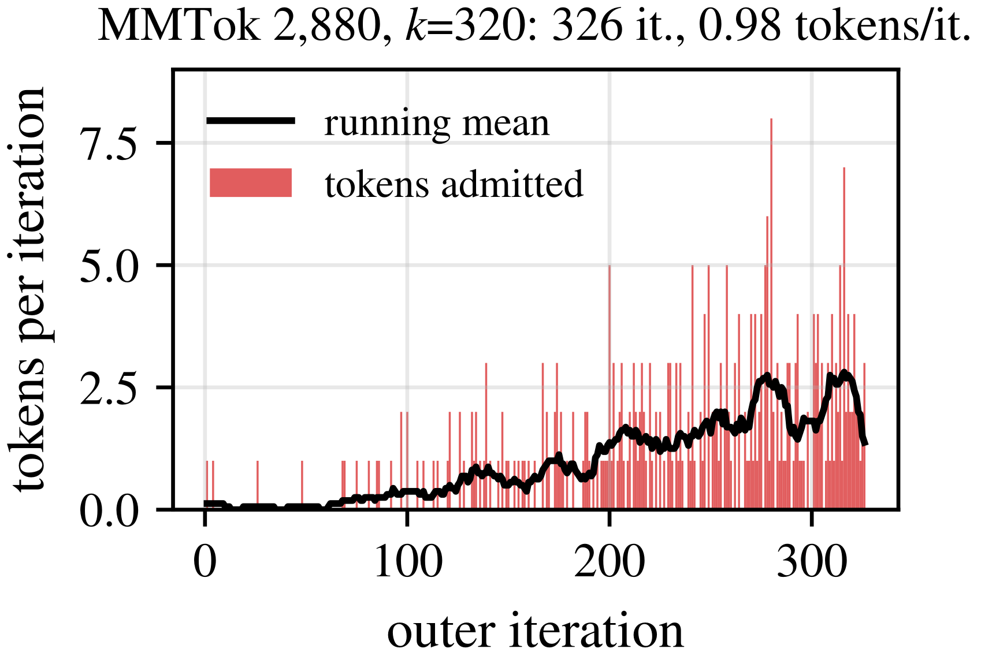
Where Does the Time Go?
Phase 1
initialize
Phase 2 (every SM)
tile argmax
candidate row read
Phase 3 (selection)
record scan + argmax
bool vector test
y broadcast
Synchronization
barrier per step
barrier per admitted token
Phase 4 and rest
write-back
other
Share of kernel time (S/M/A/V = SCOPE/MMTok/SelAnn/video; n/k)
Tokens admitted per outer iteration
Row reads are cheap
Synchronization dominates
Admissions accelerate
Initialization takes 1–4%; reading the candidate rows takes 11–16% (SRAM, L2) and 17–33% (HBM)
Record scan + argmax and grid barriers (per step and per admitted token) take 56–60% (SRAM, L2) and 39–54% (HBM)
Few tokens early (loose initial bounds); the running mean reaches ≈ 2 per iteration (up to 8); multi-token iterations supply 73–76% of tokens
Notes:
Where Does the Time Go?
- Initialization takes 1 to 4%, and reading the candidate rows 11 to 16% in the SRAM and L2, 17 to 33% in HBM.
- The bottleneck is synchronization: the record scan and argmax take 56 to 60% in the SRAM and L2 and 39 to 54% in HBM.
- Right: tokens admitted per outer iteration. Early iterations admit few tokens. As the gains decrease and the coverage, the running mean reaches about two tokens per iteration, up to 8. And multi-token iterations supply 73 to 76% of all tokens.

Slide 32

THANKS
Notes:
My presentation is over. Thanks for your time!

