Slide 1
Explaining the Golden State Warriors’ Historic Season
Michael Woo, George Zhang, Jeffrey Zhao

Slide 2
Topic: Sports Analytics
Much more data in the world of sports today than a decade ago
Richer analysis of players / teams
Consequences of big data in sports
Changing roster construction / contract negotiations
Ability to adapt game strategies to specific teams / styles of play
Goal: produce visualizations to view data to determine what makes a team successful

Slide 3
Case Study: Golden State Warriors
Why basketball?
Smaller team sizes - less variability in interaction among players
Huge audience and fan interest
Generates readership of data-driven analytics
Large amounts of data freely available
Why Warriors?
On track for historic season
Goal: investigate why they are so successful and what distinguishes them from other teams
Data from stats.nba.com and basketball-reference.com

Slide 4
Goals - Want to Determine:
What makes a team successful?
Who are the star players in each position according to the data?
What kind of style in the NBA is trending?
How might coaches / teams respond to new styles of play?

Slide 5
Tasks
Obtaining data / finding additional sources
Coming up with an overall storyline for the website
Writing content that contextualizes visualizations
Design/CSS for the website outside of the visualizations
Design/implementation of visualizations
Putting website on production

Slide 6
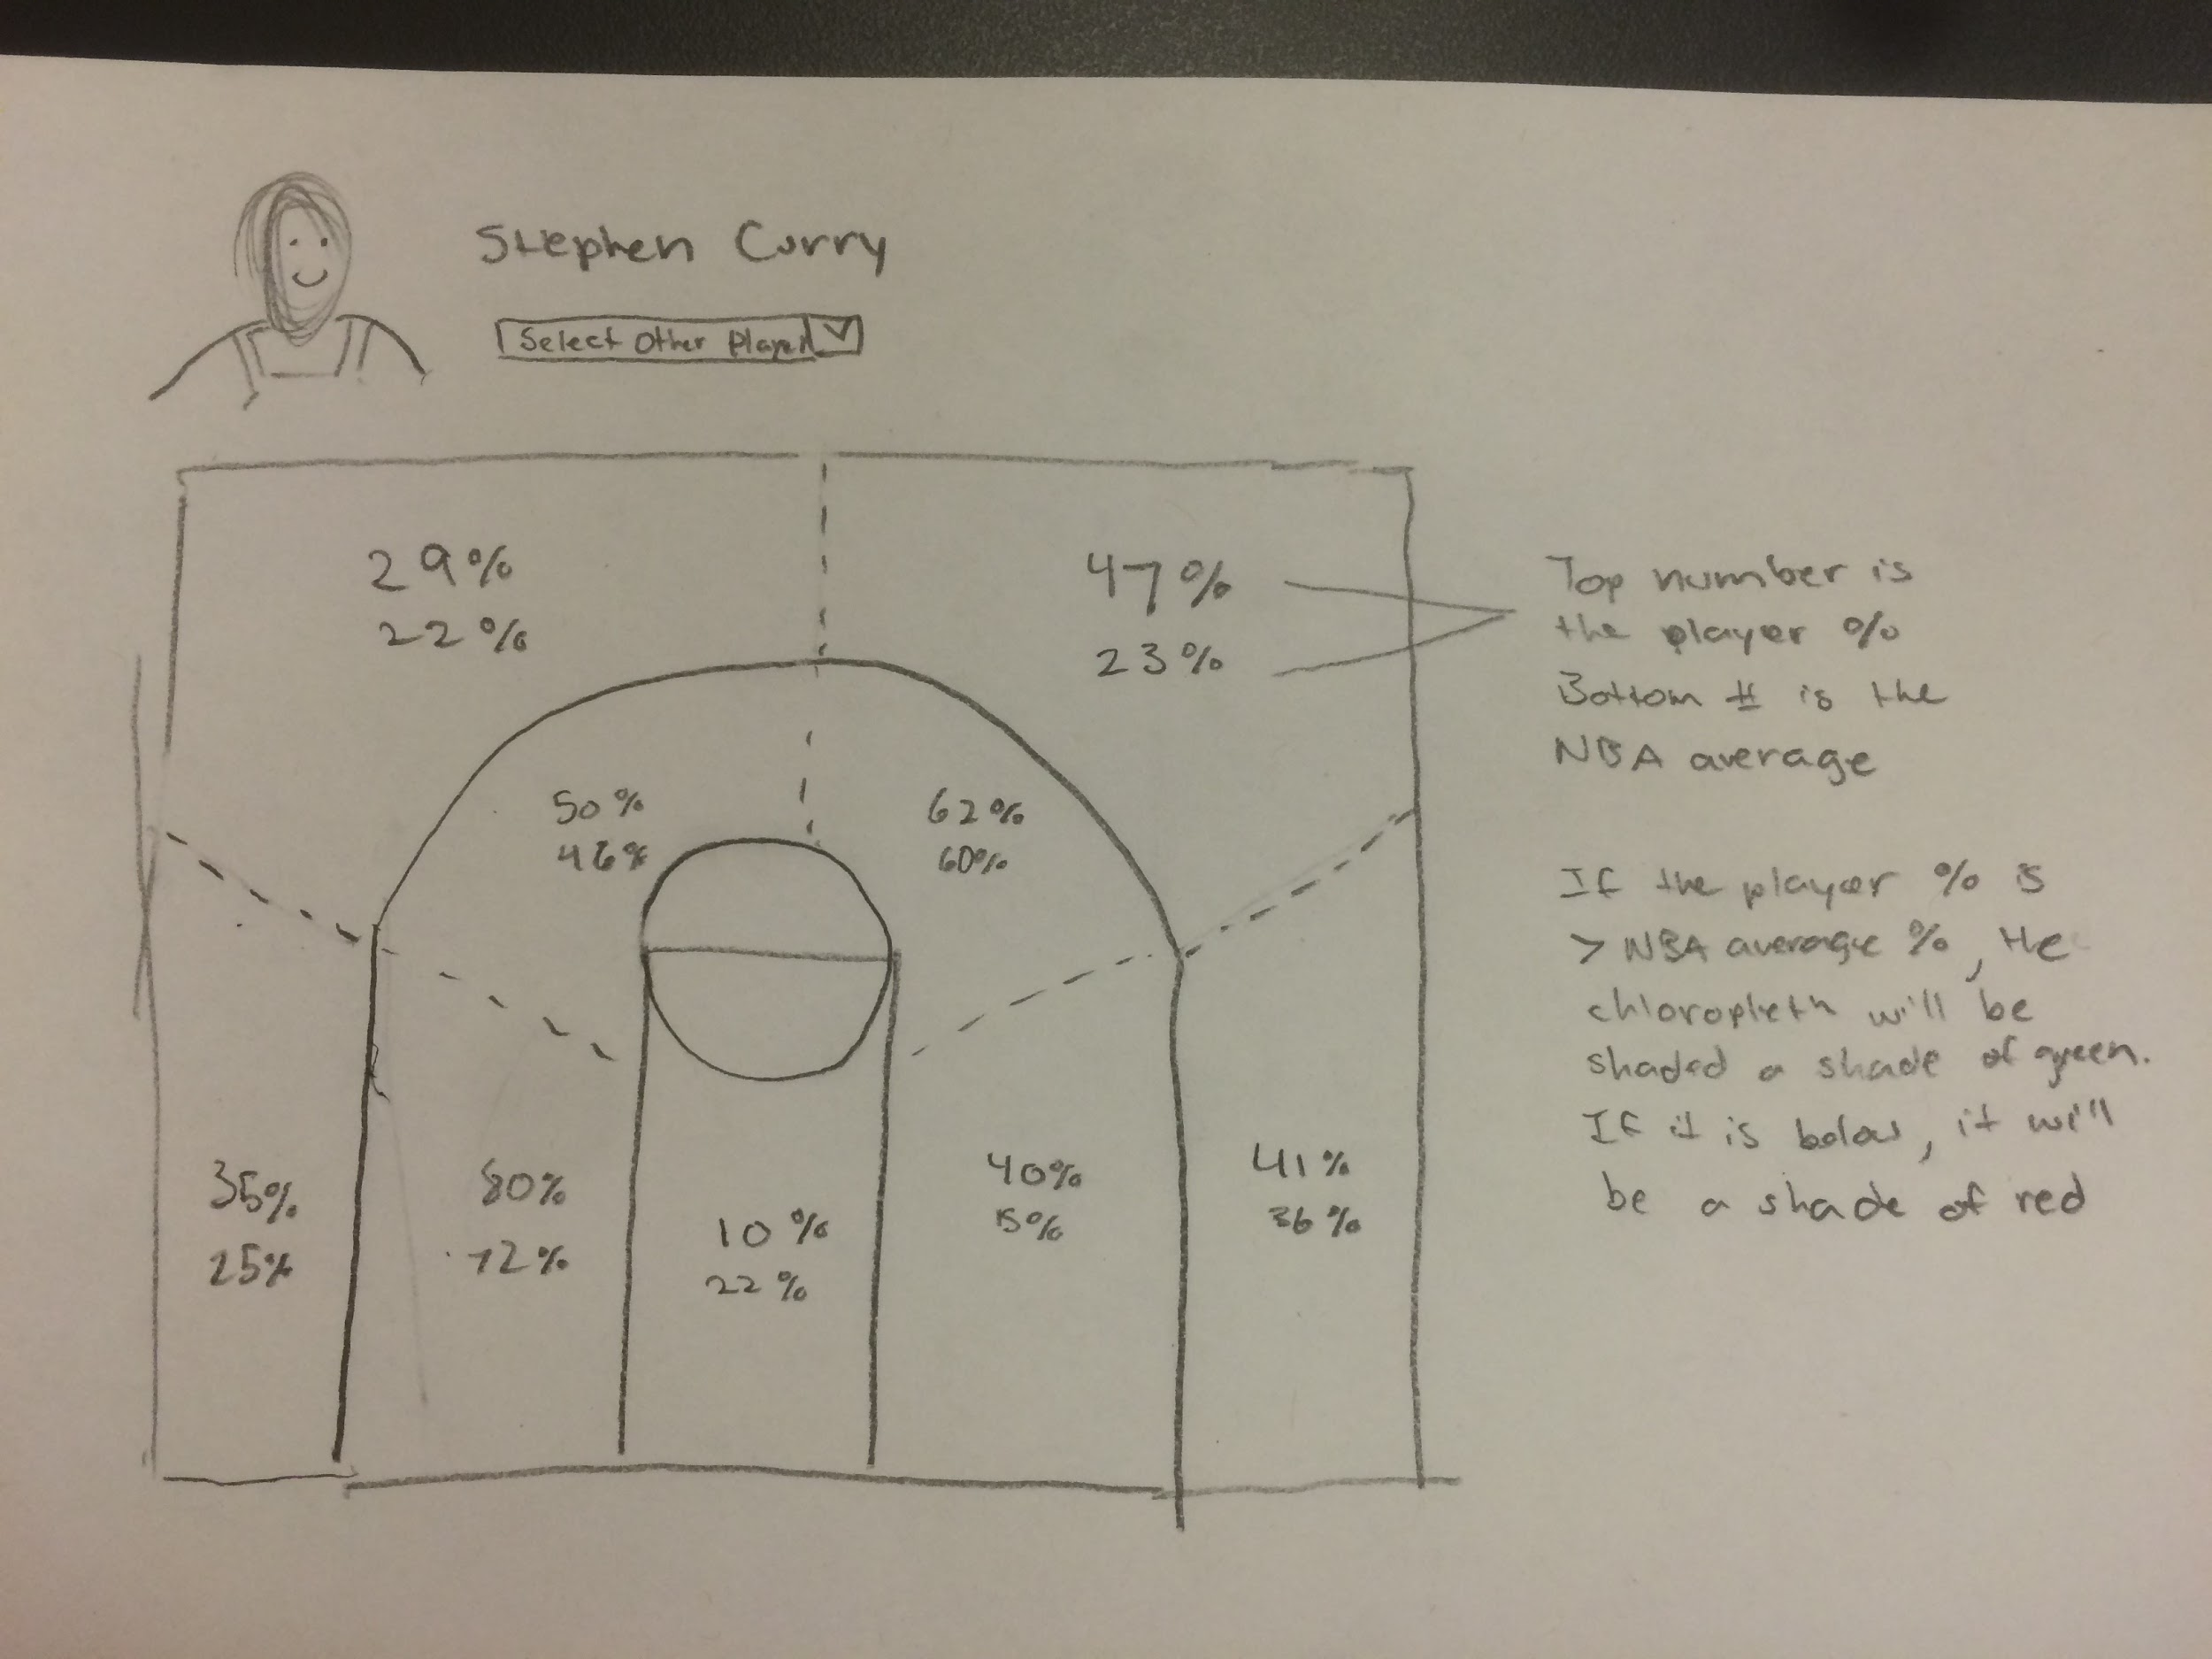
Visualization #1

Slide 7
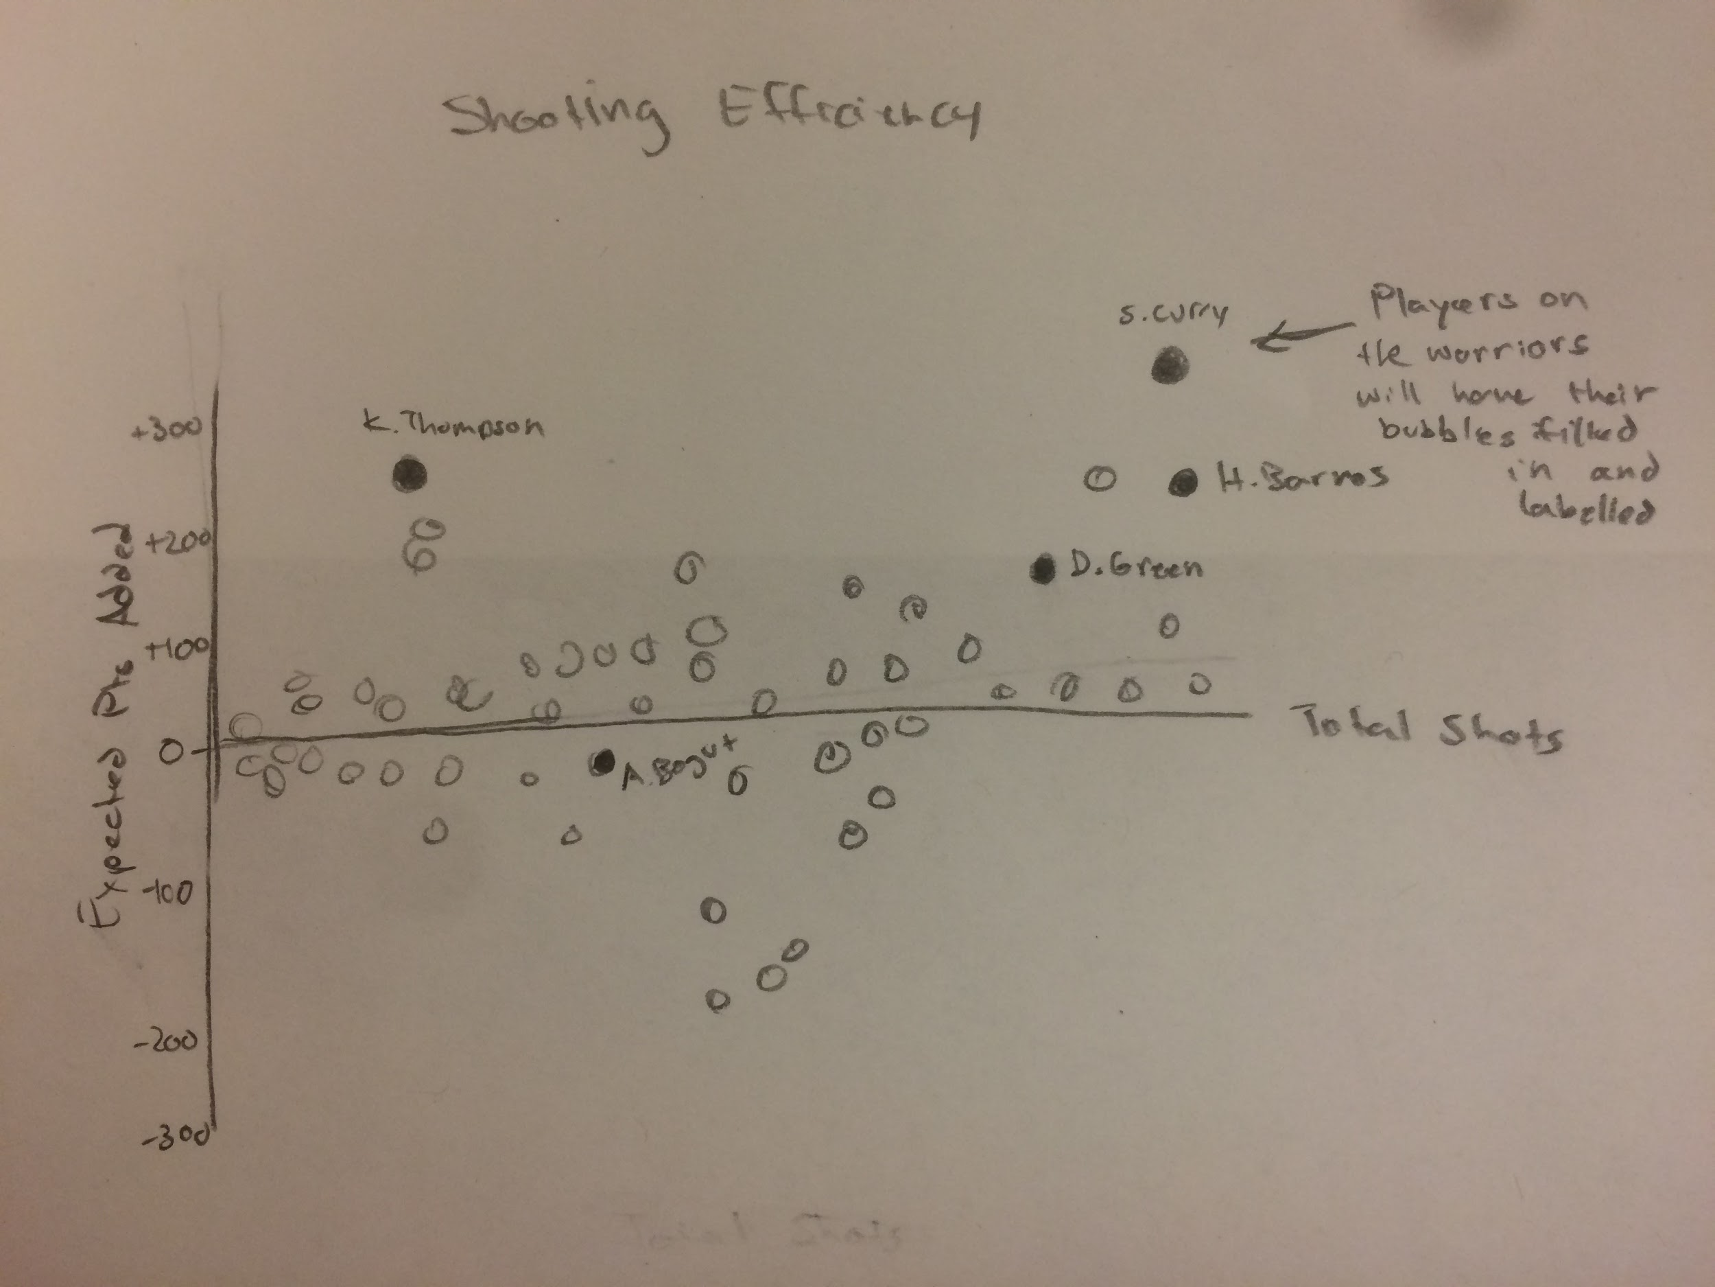
Visualization #2

Slide 8
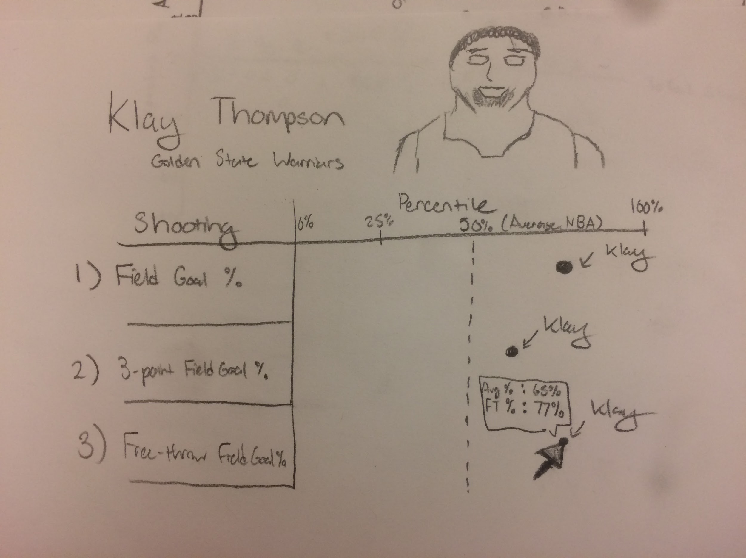
Visualization #3

