Slide 1
Differentially Private Stochastic Gradient Descent
George Zhang
Harvard University – CS227
Spring 2017

Slide 2
Gradient Descent

Slide 3
Gradient Descent
Goal: Approximating argmin of loss function

Slide 4

Gradient Descent
Goal: Approximating argmin of loss function
Example: linear regression

Slide 5
Gradient Descent
Goal: Approximating argmin of loss function
Example: linear regression
Idea: max decrease in direction opposite gradient

Slide 6
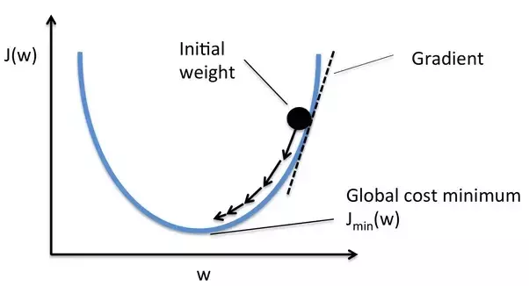
Gradient Descent
Goal: Approximating argmin of loss function
Example: linear regression
Idea: max decrease in direction opposite gradient
Image from: https://www.quora.com/Whats-the-difference-between-gradient-descent-and-stochastic-gradient-descent

Slide 7

Gradient Descent
Goal: Approximating argmin of loss function
Example: linear regression
Idea: max decrease in direction opposite gradient
η is the step size
Image from: https://www.quora.com/Whats-the-difference-between-gradient-descent-and-stochastic-gradient-descent

Slide 8
Types of Gradient Descent

Slide 9
Types of Gradient Descent
Batch Gradient Descent
Gradient calculated for all training points
True gradient
Unfeasible for large datasets

Slide 10
Types of Gradient Descent
Batch Gradient Descent
Gradient calculated for all training points
True gradient
Unfeasible for large datasets
Stochastic (“Online”) Gradient Descent
Approximate true gradient using single datapoint

Slide 11
Types of Gradient Descent
Batch Gradient Descent
Gradient calculated for all training points
True gradient
Unfeasible for large datasets
Stochastic (“Online”) Gradient Descent
Approximate true gradient using single datapoint
“Mini-batch”
Use a small subset of datapoints

Slide 12
Goal of the Project

Slide 13
Goal of the Project
Compare private/non-private gradient descent

Slide 14
Goal of the Project
Compare private/non-private gradient descent
Setup: classification using logistic regression

Slide 15

Goal of the Project
Compare private/non-private gradient descent
Setup: classification using logistic regression
Loss function:

Slide 16
Goal of the Project
Compare private/non-private gradient descent
Setup: classification using logistic regression
Loss function:
Methods:
Non-private batch gradient descent
Private stochastic gradient descent: noisy gradient
Objective perturbation: noisy objective function

Slide 17
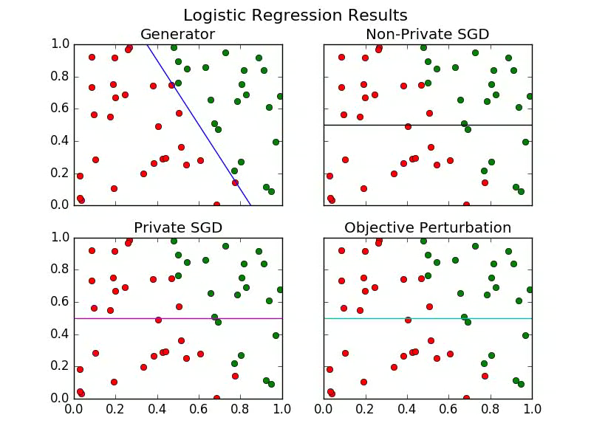
Preliminary Results

Slide 18
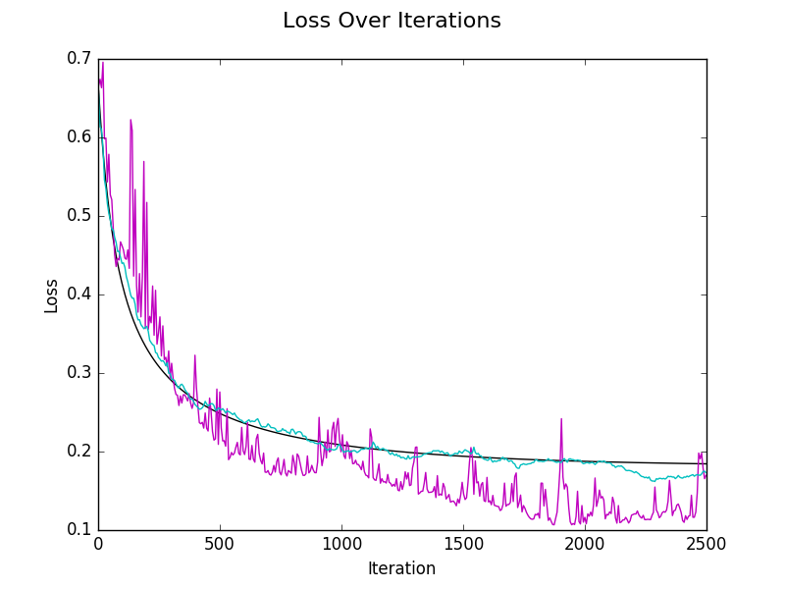
Preliminary Results

Slide 19
Caveat in Private Version

Slide 20


Caveat in Private Version
Recall at every step, we add noise
Where

Slide 21

Caveat in Private Version
Recall at every step, we add noise
Where
Bassily, Smith, Thakurta used:

Slide 22
Caveat in Private Version
Recall at every step, we add noise
Where
Bassily, Smith, Thakurta used:
With n=50, ε=1, δ=0.1, σ²≈10⁶

Slide 23

Caveat in Private Version
Recall at every step, we add noise
Where
Bassily, Smith, Thakurta used:
With n=50, ε=1, δ=0.1, σ²≈10⁶
Currently, I’m using:

Slide 24
Caveat in Private Version
Recall at every step, we add noise
Where
Bassily, Smith, Thakurta used:
With n=50, ε=1, δ=0.1, σ²≈10⁶
Currently, I’m using:
Much worse privacy!

Slide 25
Another Issue
Loss function:

Slide 26
Another Issue
Loss function:
Note that correctly classified points still contribute nonzero loss!

Slide 27
Another Issue
Loss function:
Note that correctly classified points still contribute nonzero loss!
With many data points, this is negligible
With n=50, not so much (as we saw)

Slide 28
Next Steps

Slide 29
Next Steps
Address above issues
Reconsider privacy / determine privacy loss
Utilize different loss function / more data points

Slide 30
Next Steps
Address above issues
Reconsider privacy / determine privacy loss
Utilize different loss function / more data points
Noisy data (i.e. no clear boundary)
Generating data with nonzero probability of “incorrect” class near boundary

Slide 31
Next Steps
Address above issues
Reconsider privacy / determine privacy loss
Utilize different loss function / more data points
Noisy data (i.e. no clear boundary)
Generating data with nonzero probability of “incorrect” class near boundary
Extension to multinomial logistic regression?

Slide 32
Questions?

