Slide 1
Internet of Things CC3200 wifi_Launchpad Tutorial REKAM1-Rapid Prototyping Guang Zhou
http://energia.nu/cc3200guide/
http://energia.nu/download/
https://github.com/gzhou358/CS6308-Realtime-system

Slide 2

Why?
FAST and EASY
No Tools/Manuals
Text code from your phone(wireless)
Small
Size
Cost
Energy
100% Arduino Compatible
Energia
Open Source

Slide 3

What?
REKAM1
Mobile Device/PC
Interpreter
(Serial ISR)
Application or
Terminal Emulator
Virtual State Machine
(Input ISR)
(BT/BLE/UART)
Remote
Procedure
Calls/Data
(BT/
BLE)
(Wi-Fi/
Cloud)
(XML/
JSON)
Other
Bluetooth Devices
Other
Connected Devices
Virtual
State
Machine
Time To
Prototype
Virtual
Machine(Android)
RTOS Embedded
System(C Compiler)

Slide 4
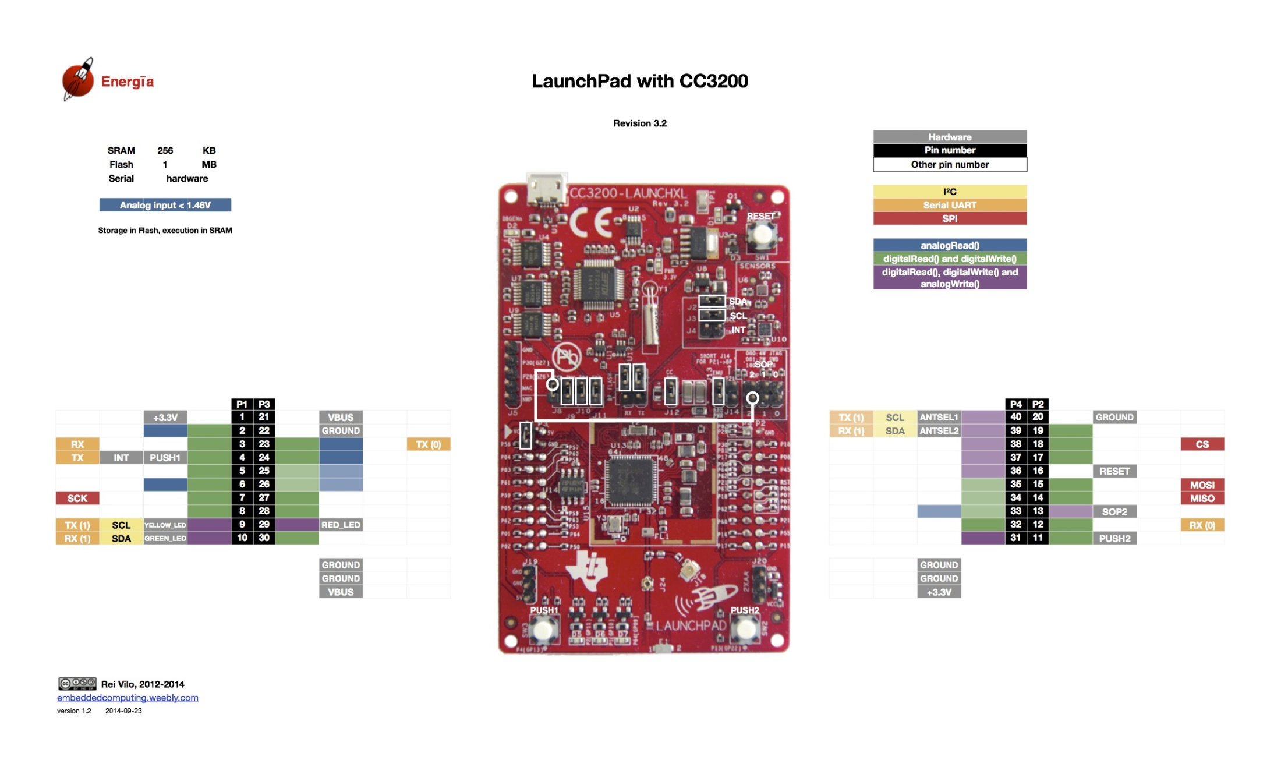
Hardware_CC3200 wifi LaunchPad

Slide 5
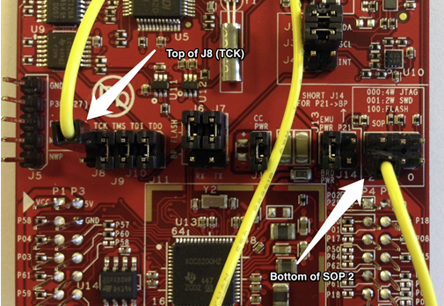
Jumper Setting

Slide 6
Software Installation
download energia from website.
http://energia.nu/download/
Choose the latest version for your operation system.
No driver needs.

Slide 7
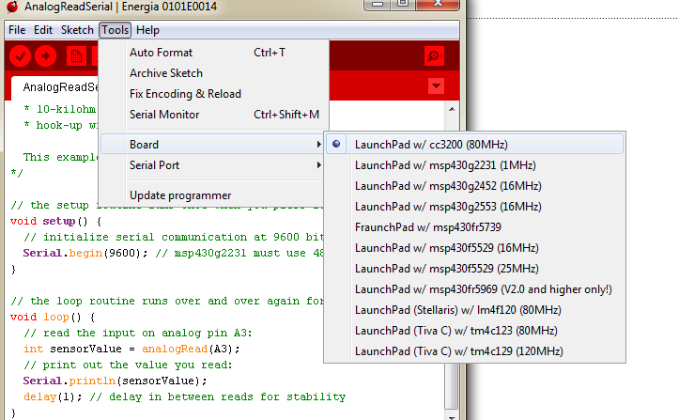
Board Setup1

Slide 8
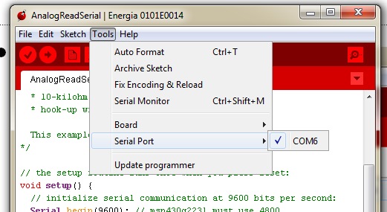
Board Setup2
There should be only 1 port and choose that one.

Slide 9
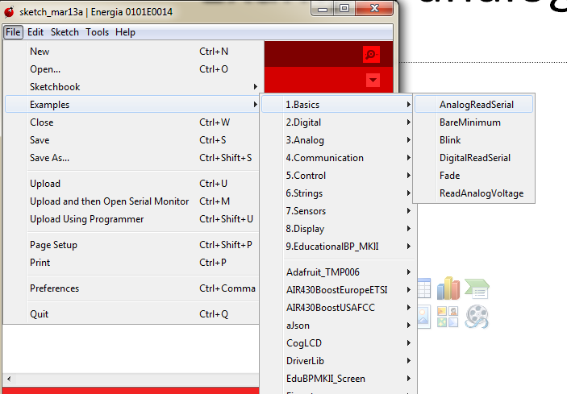
Example analog read

Slide 10
Example analog read
// the setup routine runs once when you press reset:
void setup() {
// initialize serial communication at 9600 bits per second:
Serial.begin(9600); // msp430g2231 must use 4800
}
// the loop routine runs over and over again forever:
void loop() {
// read the input on analog pin A3:
int sensorValue = analogRead(A3);
// print out the value you read:
Serial.println(sensorValue);
delay(1); // delay in between reads for stability (miliseconds)
}

Slide 11
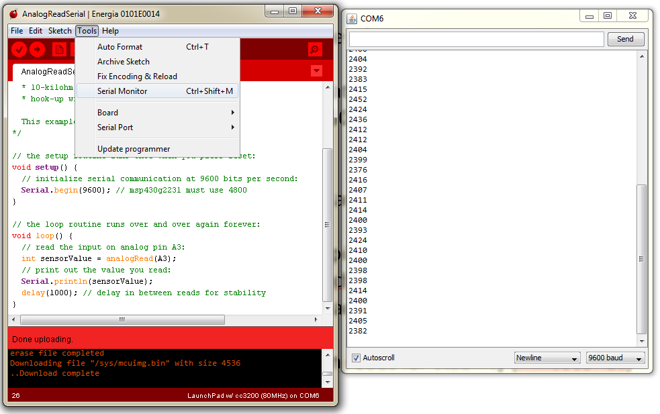
Example analog read
Open Serial Monitor to see results

Slide 12
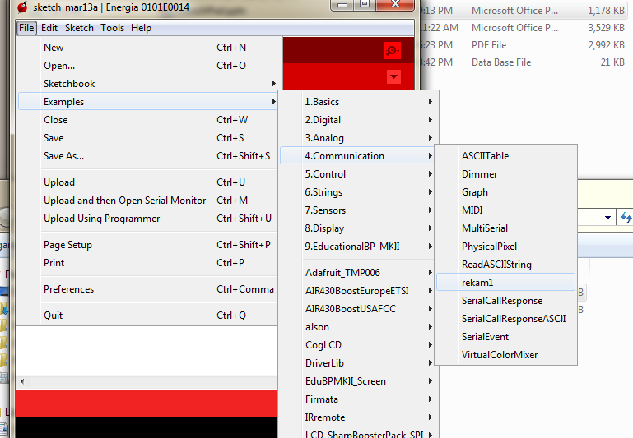
Example rekam1

Slide 13
Or use the reduced version
#ifdef CCx
char ssid[] = "asd123"; // your network SSID (name)
char pass[] = "12345678"; // your network password
uint16_t port = 1200; // port number of the server
IPAddress server(192, 168, 10, 102); // IP Address of the server
WiFiClient client;
int status = WL_IDLE_STATUS; // the Wifi radio's status
#endif
void setup() {
//Initialize serial and wait for port to open:
Serial.begin(9600);
// These Pin Modes are specific to each Launchpad and can be reconfigured here. To Use a different Launchpad/Uncomment Relevant Code here and in get/put functions
pinMode(2, INPUT); //analogread
pinMode(3, INPUT); //digitalread
pinMode(5, INPUT); //digitalread
pinMode(6, INPUT); //analogread
pinMode(7, OUTPUT); //digitalwrite
pinMode(8, OUTPUT); //digitalwrite
pinMode(9, OUTPUT); //analogwrite
pinMode(10, OUTPUT); //analogwrite

Slide 14
Or use the reduced version
int get(int pin){
//Read multi time to get correct data.
if ((pin==2)||(pin==6)){ // you can change the pin setting.
analogRead(pin);
analogRead(pin);
analogRead(pin);
analogRead(pin);
analogRead(pin);
value = analogRead(pin);
Serial.print("analogRead ");
Serial.println(value);
return value;
}
else if ((pin==3)||(pin==5)){ // you can change the pin setting.
digitalRead(pin);
digitalRead(pin);
digitalRead(pin);
digitalRead(pin);
digitalRead(pin);
value = digitalRead(pin);
Serial.print("digitalRead ");
Serial.println(value);
return value;
}
else {
Serial.println("choose correct pin");
return -1;
}
}

Slide 15
Or use the reduced version
// Puts an analog or digital value on a pin from 0 100 percent of VCC
int put(int pin, int value){
if(value<0){value=0;}
if ((pin==9)||(pin==10)){
analogWrite(pin,value);
Serial.print("analogWrite ");
Serial.println(value);
return value;
}
else if ((pin==7)||(pin==8)){
digitalWrite(pin,value);
Serial.print("digitalWrite ");
Serial.println(value);
return value;
}
else {
Serial.println("choose correct pin");
return -1;
}
}

Slide 16
Chat between pc and IoT board code
import java.net.*;
import java.io.*;
import java.util.Scanner;
public class CC3200_Controller{
private static Socket socket;
public static void main(String[] args) {
try{
int port = 1200;
ServerSocket serverSocket = new ServerSocket(port);
System.out.println("Server Started and listening to the port 1200");
while(true){
socket = serverSocket.accept();
System.out.println("Clinet connected to the server");
InputStream is = socket.getInputStream();
InputStreamReader isr = new InputStreamReader(is);
BufferedReader br = new BufferedReader(isr);
OutputStream os = socket.getOutputStream();
OutputStreamWriter osw = new OutputStreamWriter(os);
BufferedWriter bw = new BufferedWriter(osw);
String rmessage;
String smessage;
Scanner s = new Scanner(System.in);
while(true){
smessage = s.nextLine();
bw.write(smessage);
bw.flush();
rmessage = br.readLine();
System.out.println(rmessage);
}
}
}catch (Exception e){
e.printStackTrace();
}finally
{
try{
socket.close();
}
catch(Exception e){
}
}
}
}

