Slide 1

Ubuntu, a potent new force in mobile – David Planella, Joey Chan
Notes:
Introduce yourself. (Update slide with your name and date/name of the event)
Explain, what the talk is going to be about:
Ubuntu Touch, a beautiful open source platform for all form factors (phone, tablet, laptop, desktop, TV)
Choice of technologies (Ubuntu, Qt/QML, Mir, ...)
Solid Ubuntu base.
Great app ecosystem (QML, HTML5, ...)

Slide 2

Ubuntu
移动市场上的生力军
Notes:
This talk serves as an introduction to Ubuntu Touch and its app ecosystem.

Slide 3
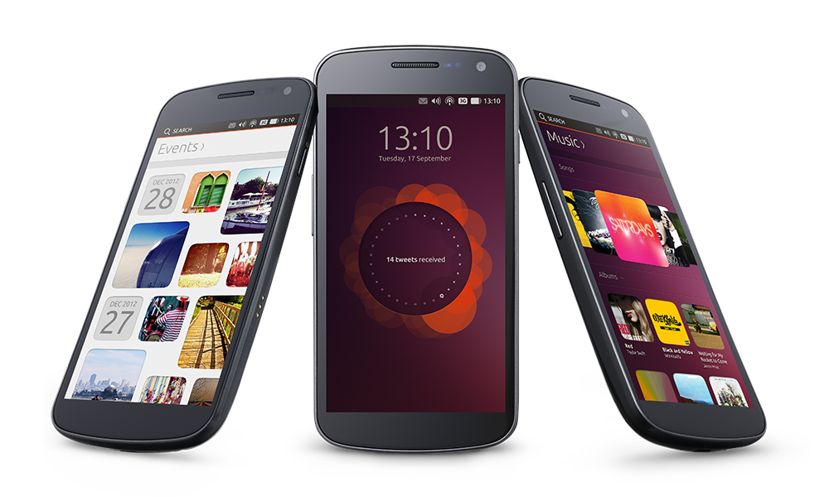
Mobile industry ready
移动市场上生力军的诞生
> Ubuntu现在已经运行于手机、桌面、服务器甚至是云
> 为手机带来了一个快速、美丽的用户体验
> 以质量为核心的应用与快速发展的生态系统
> Ubuntu SDK 带来完整的本地代码和HTML的支持
> 差异性，而非碎片化
(c) 2013 Canonical
Notes:
The Ubuntu operating system is the same, no matter where you run it: improvements immediately benefit all form factors.
Canonical and the Ubuntu community work together on design and implementation.
Daily quality, speed, beauty and consistency were always the focus.
The SDK makes it really easy to put apps together and get them ready for publishing.

Slide 4

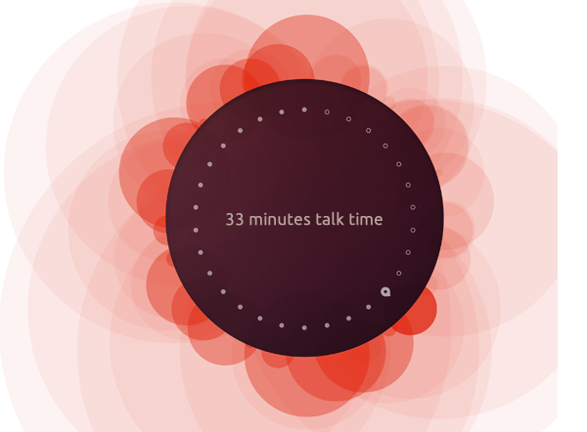
Design vision
一个手机就可以
看到自己在。。
关键设计有哪些？
> 关注内容
> 快而自然的交互
> 精致的风格
(c) 2013 Canonical
Notes:
The thinking behind Ubuntu for phones considers three important design themes and when you build your apps
Focus on the content
Ubuntu’s gestural interface gives the content or task at hand undivided attention. Everything else is peripheral yet readily available around the edges of the screen.
Fast and natural interactions
Ubuntu’s interactions are based on gestures and the edges of the screen. They give a very natural feel to touch screen interactions and require minimal effort from the user.
Sophisticated style
Smooth, well performing transitions and purposeful animations help the user to understand where they are going and what is happening.

Slide 5
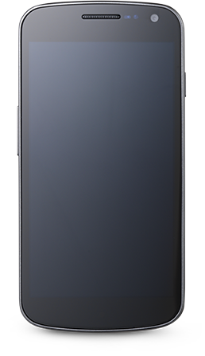
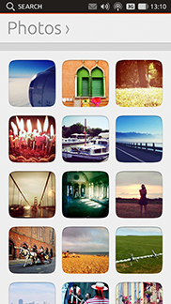
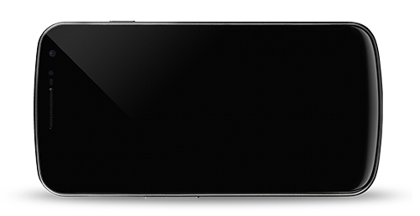

Content, not controls
设计以及用户体验的核心在于：
> 内容最大化
> 轻松而高效的导航
> 手势界面：滑动与边缘
> 智能搜索带来相关的内容
> Scopes 已经把这些内容整齐的组织起来
(c) 2013 Canonical
Notes:
Room for content: no chrome, just content.
The swipe and edge navigation is obvious and users are familiar with it in no time.
The smart search is always available, powered by scopes and it's continuously improving.

Slide 6
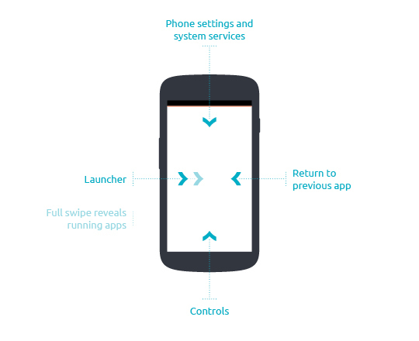
The Ubuntu user experience
> 内容才是王道， 留给内容更多的空间
> 简单 和 直观的手势，
利用四个边缘来导航
> 右边缘 用来解锁屏幕
和在活动应用之间切换
> 左边缘 滑出启动栏
来快速启动应用程序
> 上边缘 用于系统状态指示
和显示系统通知
> 下边缘 用于应用程序内
操作
> 提示： 完整地从左滑向右将看到所有正在运行的应用
(c) 2013 Canonical
Notes:
Indicators and Menu bar - The menu bar holds the system status icons – time and date, volume, network, messaging and battery. These setting indicators can be accessed directly from the top edge.
Return to previous app - A swipe from the right edge of the phone takes you back to the last app you were using. Another swipe takes you back to the application you used before that.
Controls - Swiping up from the bottom edge of the phone reveals app controls. You can hide or reveal them instantly, which means they don’t take up room on the screen.
Launcher and Dash app lens - A short swipe from the left edge of the screen reveals your favourite apps. A full left-to-right swipe reveals a screen showing all your running apps.

Slide 7
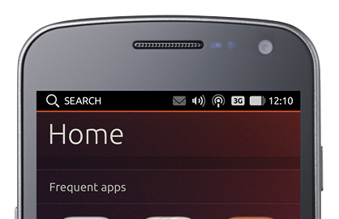
Unity
> Unity 正是当前使用的桌面环境
> 用户看来，它给提供了一种简单且支持触控的体验，同时带来新潮又自然的
工作流程
> 开发者看来，它提供了一套整合技术和应用程序的系统融合方案
> Ubuntu SDK 为Unity的轻松整合
带来了一套清晰明了的
应用程序接口
(c) 2013 Canonical
Notes:
Unity is the Ubuntu shell: Unity provides a consistent interface across a variety of form factors. On a new device, users will instantly feel familiar.
Unity integration: As an app developer, you can hook up your application with Unity easily and make your app well-integrated into the general exerience.

Slide 8
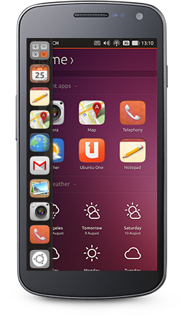
Unity
> The Launcher 任务栏可由左边缘滑出
> 可快速启动喜爱的应用程序
> 可以看到当前正在运行的程序
并快速切换它们
> 应用可以通过长按来重新整理
或锁定在任务栏
> 额外的功能整合
> 数量指示
> 进度指示
> 紧急指示
(c) 2013 Canonical
Notes:
The launcher is intuitive and provides fast access to apps and can be adapted easily by the user.
Integration: Relevant status information (progress of an operation, message count, urgency of a request by the app) is visible in one glance at the launcher.

Slide 9
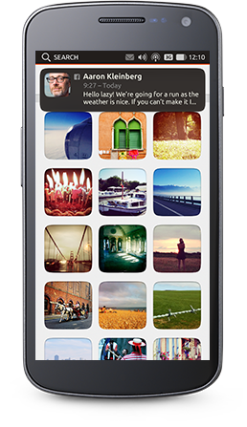
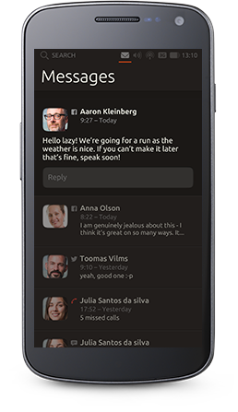
Unity
> Indicators 状态栏提供了方便快捷的
系统功能访问
> 来自不同来源的消息将统一显示在消息栏
> 通知 OSD 带来非占用式，不丢失和易操作
的通知系统
> 其它整合点
> 消息数量
> 活动通知
(c) 2013 Canonical
Notes:
Indicators are always and easily accessible at the top of the screen.
The collection of indicators includes: messages, battery, network, bluetooth, date/time, location, sound.
Apps can issue notifications and show messages in the message indicator, which are immediately actionable.

Slide 10
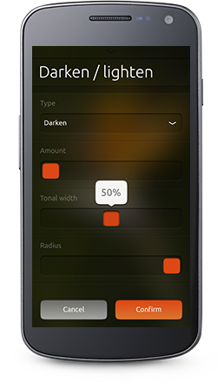
Unity
> 抬头显示 (HUD)是一种能表达用户的意图，
并有适当的应用程序响应的方式
> 它超越了常规的用户界面并成为了
一个意愿驱动的界面
> HUD 可以被声音或者用触碰控制
> HUD可以帮助修改、个性化
那些搜索出来的内容
> 集成点
> 操作
(c) 2013 Canonical
Notes:
Instead of displaying a multitude of actions in nested submenus, users can easily trigger them via the HUD via voice or touch.

Slide 11
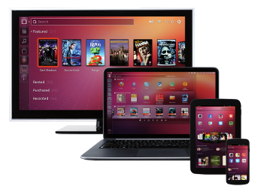
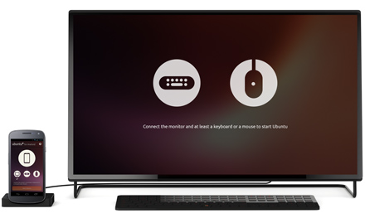
Convergence
Ubuntu无所不在
> “掌上电脑”
是未来的个人计算中心
> 今天的智能手机与平板
将能与轻量级的笔记本电脑相提并论
> Ubuntu已经被设计为能够在不同设备上
运行
> 用户界面与用户体验能自然地
适应不同的屏幕分辨率
> Ubuntu为新的超级手机
铺平了道路
> 只需要将手机放在底座上
连接鼠标、键盘和显示器
(c) 2013 Canonical
Notes:
With Ubuntu, the industry’s first fully converged device will be a high-end smartphone that can be docked to a monitor and keyboard to become a powerful desktop PC.
This is made possible because we have a very deep level of integration between the services on the phone and the desktop – underneath, it is really the same OS. This is a real strength of Ubuntu.

Slide 12
一个快速发展的
应用生态系统

Slide 13
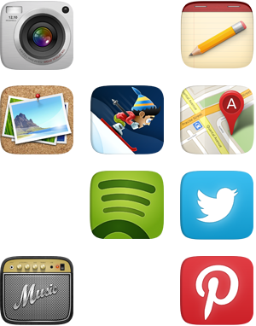
App developers are key
Ubuntu 提供了一个一步到位的开发环境
> 完整的 Ubuntu SDK
> 本地和网页程序将获得首先支持
> 全方位的开发者网站
和教程，API文档等
> 详细的在线应用程序设计向导
让你的程序更“Ubuntu”
> 简单且安全的应用商店上传流程
> 通过应用板块能无缝地分发与安装应用程序
> 一个充满活力和热情的开发者社区
(c) 2013 Canonical
Notes:
Despite being a young player, full developer story.
Along with a strong design vision, the app developer story has been a driver behind Ubuntu Touch.
Getting information and help for writing Ubuntu apps is easy and getting it into the store is even easier.

Slide 14
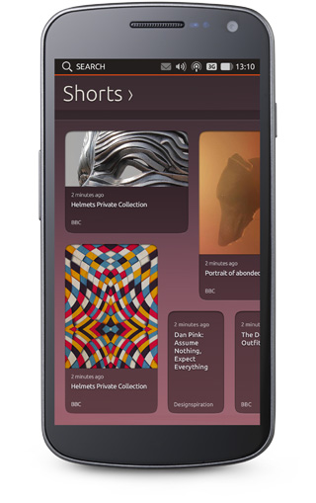
A quality core of apps
Ubuntu 内置应用包括了：
> 从浏览器到照相机等常见应用
> 内置约20款核心应用
> 内置核心应用包含了
日常使用的大部分功能
> 社区主导的开发
与Canonical的设计团队共同协作
> Ubuntu 生态系统的成长
带来了更多符合需求的第三方程序
(c) 2013 Canonical
Notes:
Ubuntu on any device is instantly functional. All the standard needs of users are catered to by core apps.
Large community brings apps in daily quality.
More apps being published in the app store every day.

Slide 15
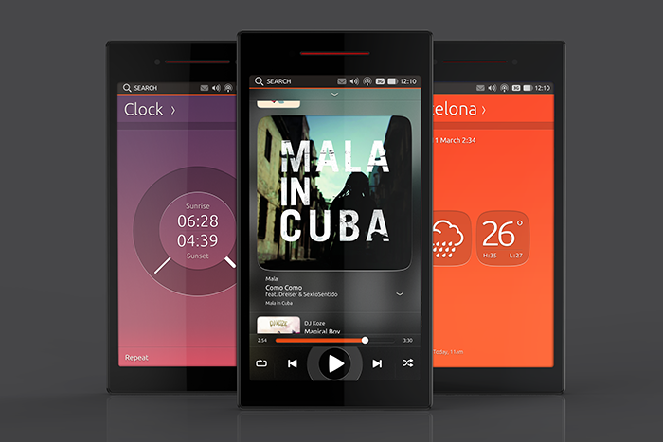
Ubuntu is community
> Ubuntu 的开发是开放的，任何人都能参与其中！
> 12个核心应用由社区自愿者开发完成
(c) 2013 Canonical
Notes:
Ubuntu is very special in the mobile world. Plans are put together in public discussions every three months. Specifications, code, review, QA and everything else is done publicly by a passionate community.

Slide 16



The Ubuntu SDK
一个功能全面的Ubuntu SDK
> SDK允许开发人员在应用程序的整个生命周期内，
从开始到发布，都能进行开发和维护的工作。
> 整体上看：它是一个包含了几乎所有开发者都可能用得到
的功能，包括图形组件和文档等。
> 基于成熟和流行的Qt应用程序框架
> 本地编程语言包括QML，Javascript和C++
> HTML程序一样得到首要的支持，包括网页程序，
HTML5 cordova（PhoneGap） 的支持
(c) 2013 Canonical
Notes:
Installing the Ubuntu SDK is easy. It comes with documentation, examples, tools to test on the device, publish your app and lots more.
The choice of technologies makes it easy for newcomers. Use QML (a simple but powerful, declarative language) and JavaScript and put your app together in next to no time.
Use HTML5 if that's your thing, or use C++ if you're comfortable with that and/or want to access low-level libraries.

Slide 17
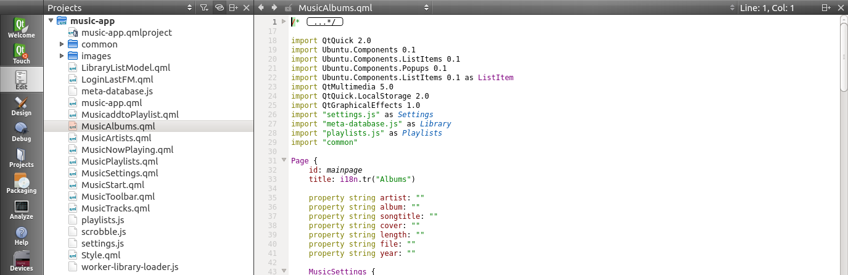
The Ubuntu SDK
Qt Creator 正是Ubuntu SDK的集成开发环境 (IDE)
> 一个功能丰富的代码编辑器
> 直观的图形调试器
> 设备连接：开发过程中就能直接在设备上允许应用程序
> 图形化打包工具
> 集成了API文档
(c) 2013 Canonical
Notes:
The SDK makes development easy:
Find available attributes and functions of object easily
Run apps on a device through just a click
Package apps easily
It comes with example apps and API documentation.
You can easily use version control for your projects.
The debugger is easy to use.

Slide 18
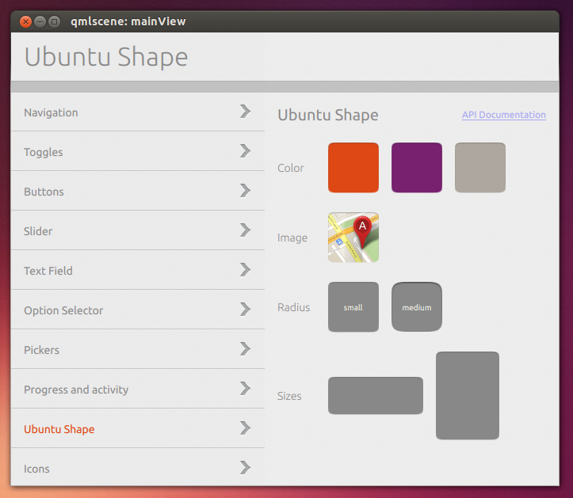
The Ubuntu SDK
用户界面组件集带来了独特的 Ubuntu 风格样式
> “积木”式的组件使得能轻易
开发 Ubuntu 应用
> Ubuntu图形组件集成了
外观样式和内部行为
> 虽然这些组件不是必须的
但我们高度推荐使用它们
来达到最好的用户体验
> 支持QML和HTML5
> 可以用我们的官方示例程序来预览效果
(c) 2013 Canonical
Notes:
Some use cases for the terminal:
Read logs of a running app on the phone
Quickly run an app on the desktop without starting Qt Creator
Flash a device with a development image

Slide 19

Native and web-based apps
您可以自由选择原生或web开发方式
> 完整支持原生和HTML5
> 选择原生能更高效的使用资源
更好的用户体验
> 选择HTML则能使用网页技术和
易于移植已有的网页程序
> 能直接打包一个“网站”
> HTML5 应用程序也能够访问本地的硬件资源
(相机，传感器等等)
(c) 2013 Canonical
Notes:
HTML5 and native apps are “equal citizens”
An application written in HTML as a web application will have its own UI context running Ubuntu meaning it can run independently of the browser (so if the main browser is closed, the web application will continue to run).
Ubuntu also defines different levels of UI integration which web applications can benefit from to give the user a more integrated experience – this is especially useful for social media and multimedia web applications.
It means the web app can surface alerts and notifications using standard Ubuntu UI elements such as the notifications menu.
As “equal citizens” we allow web apps to behave in the same way as native applications, so they may share the same system resources to ensure performance and share the same customisations.

Slide 20
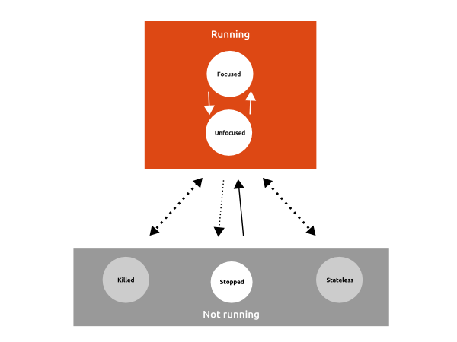
The Ubuntu application model
新的应用程序模型，高度优化且安全
> 应用程序之间互相完全隔离
> 应用程序需要取得授权
才能获取用户的数据
> 为应用程序的计算资料做了高度优化
包括CPU和内存
后台程序会暂停运作
除非使用了一些必须保持运行的接口
> 已经简化的打包和安装方式
应用程序将必须与所需的库一起打包
(c) 2013 Canonical
Notes:
The picture shows the application lifecycle. Every app is treated the same. Only one app is considered to be running at a time. Everything that is running “in the background” is done by a service provided by the platform.
Permissions of apps are specified in a manifest, which are approved during the submission to the app store.

Slide 21
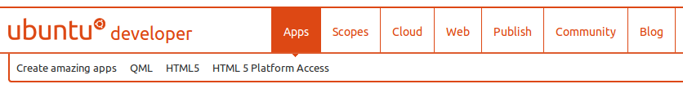
The Ubuntu SDK
developer.ubuntu.com 网站存放了所有的开发者所需资料
> 包含了大量有关编写程序，使用范畴网页集成等学习资料
> 每个区域都包含了概述，向导，提示和详细的API文档
> 开发者博客能经常带来一下有趣的消息和有关Ubuntu的
开发，升级等提示
> 同时也是Ubuntu商店（面向开发者）的其中一个入口
> 也能在这提问题或与别的开发者进行交流
(c) 2013 Canonical
Notes:
developer.ubuntu.com is a great resource for everyone who wants to create content for Ubuntu.
Written by experts
All sections follow a similar layout: learn the basics, get set up, work through a simple tutorial, find more examples and find more in-depth articles about advanced topics.
Offers different ways to get in touch with other developers and creators of the platform.

Slide 22

The Ubuntu SDK
设计向导帮助开发者们设计一个更有“Ubuntu”味道的应用
> 在线资源集合，包括来自不同地方设计师的示例等
> 还有一些有用的设计模板供开发者使用
> design.ubuntu.com/apps
(c) 2013 Canonical

Slide 23
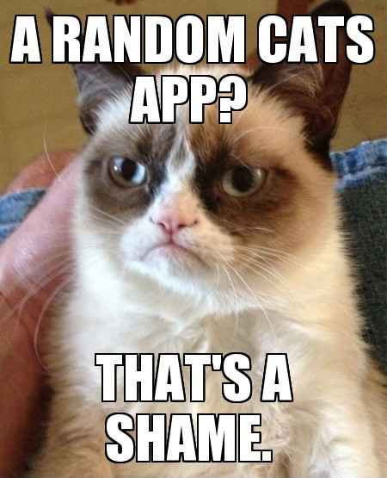
The Ubuntu Software Store
> 2013十月： 应用商店居然收到了一个叫“随机出现的猫”的应用。。
(c) 2013 Canonical

Slide 24

谢谢！
保持联系!
> joeychan.ubuntu@gmail.com
@敲代码的Joey_Chan
> developer.ubuntu.com
> ubuntu.com/phone

