Slide 1

Group Project
Presentation
COMP 2021
Zhejun HE Alibek Kuantkhan
Gao Zhi Lin QI Shi Hao

Slide 2
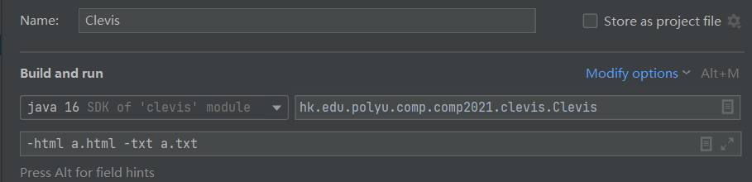
Preparation before Running CLEVIS
After you input file name in “Edit Configuration” -> the second line in “Build and run” as format in picture. You can start running file “Clevis” .
But please remember, if you want to restart the program, please delete the two files “a.html” and “a.txt” or change the files’ name in the line. E.g:
-html b.html -txt b.txt As this is required in REQ1.

Slide 3
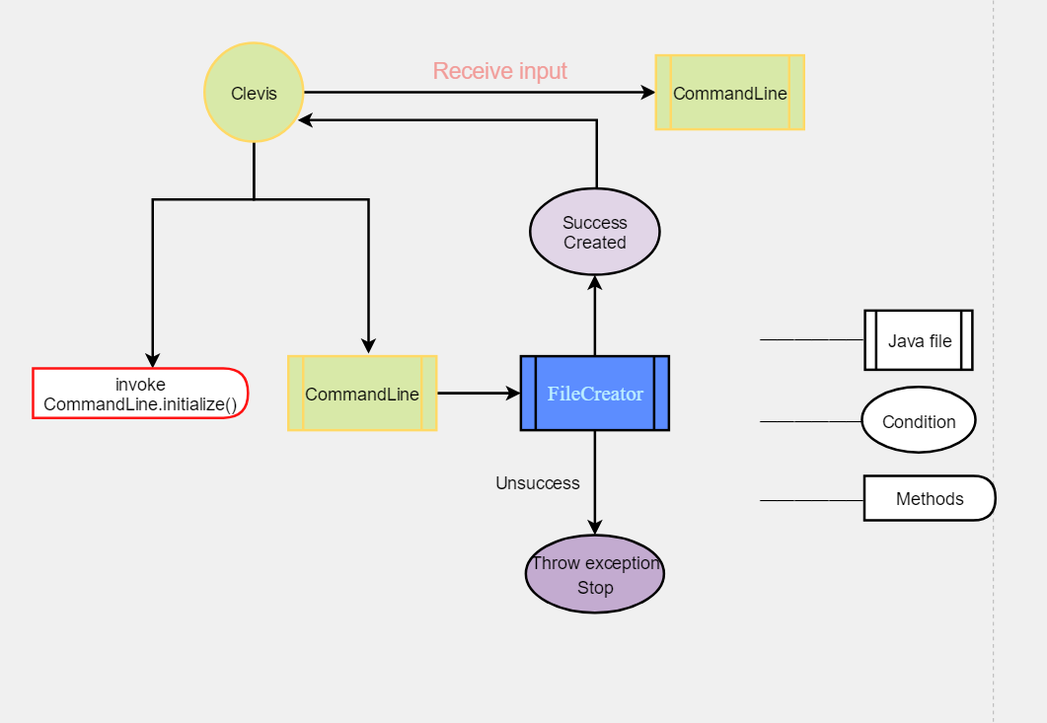
Overview of Clevis
Clevis is initiator file of our program.
This is only an initialization stage of our program. After we receive the order, CommandLine will invoke other methods or java files to execute it.

Slide 4
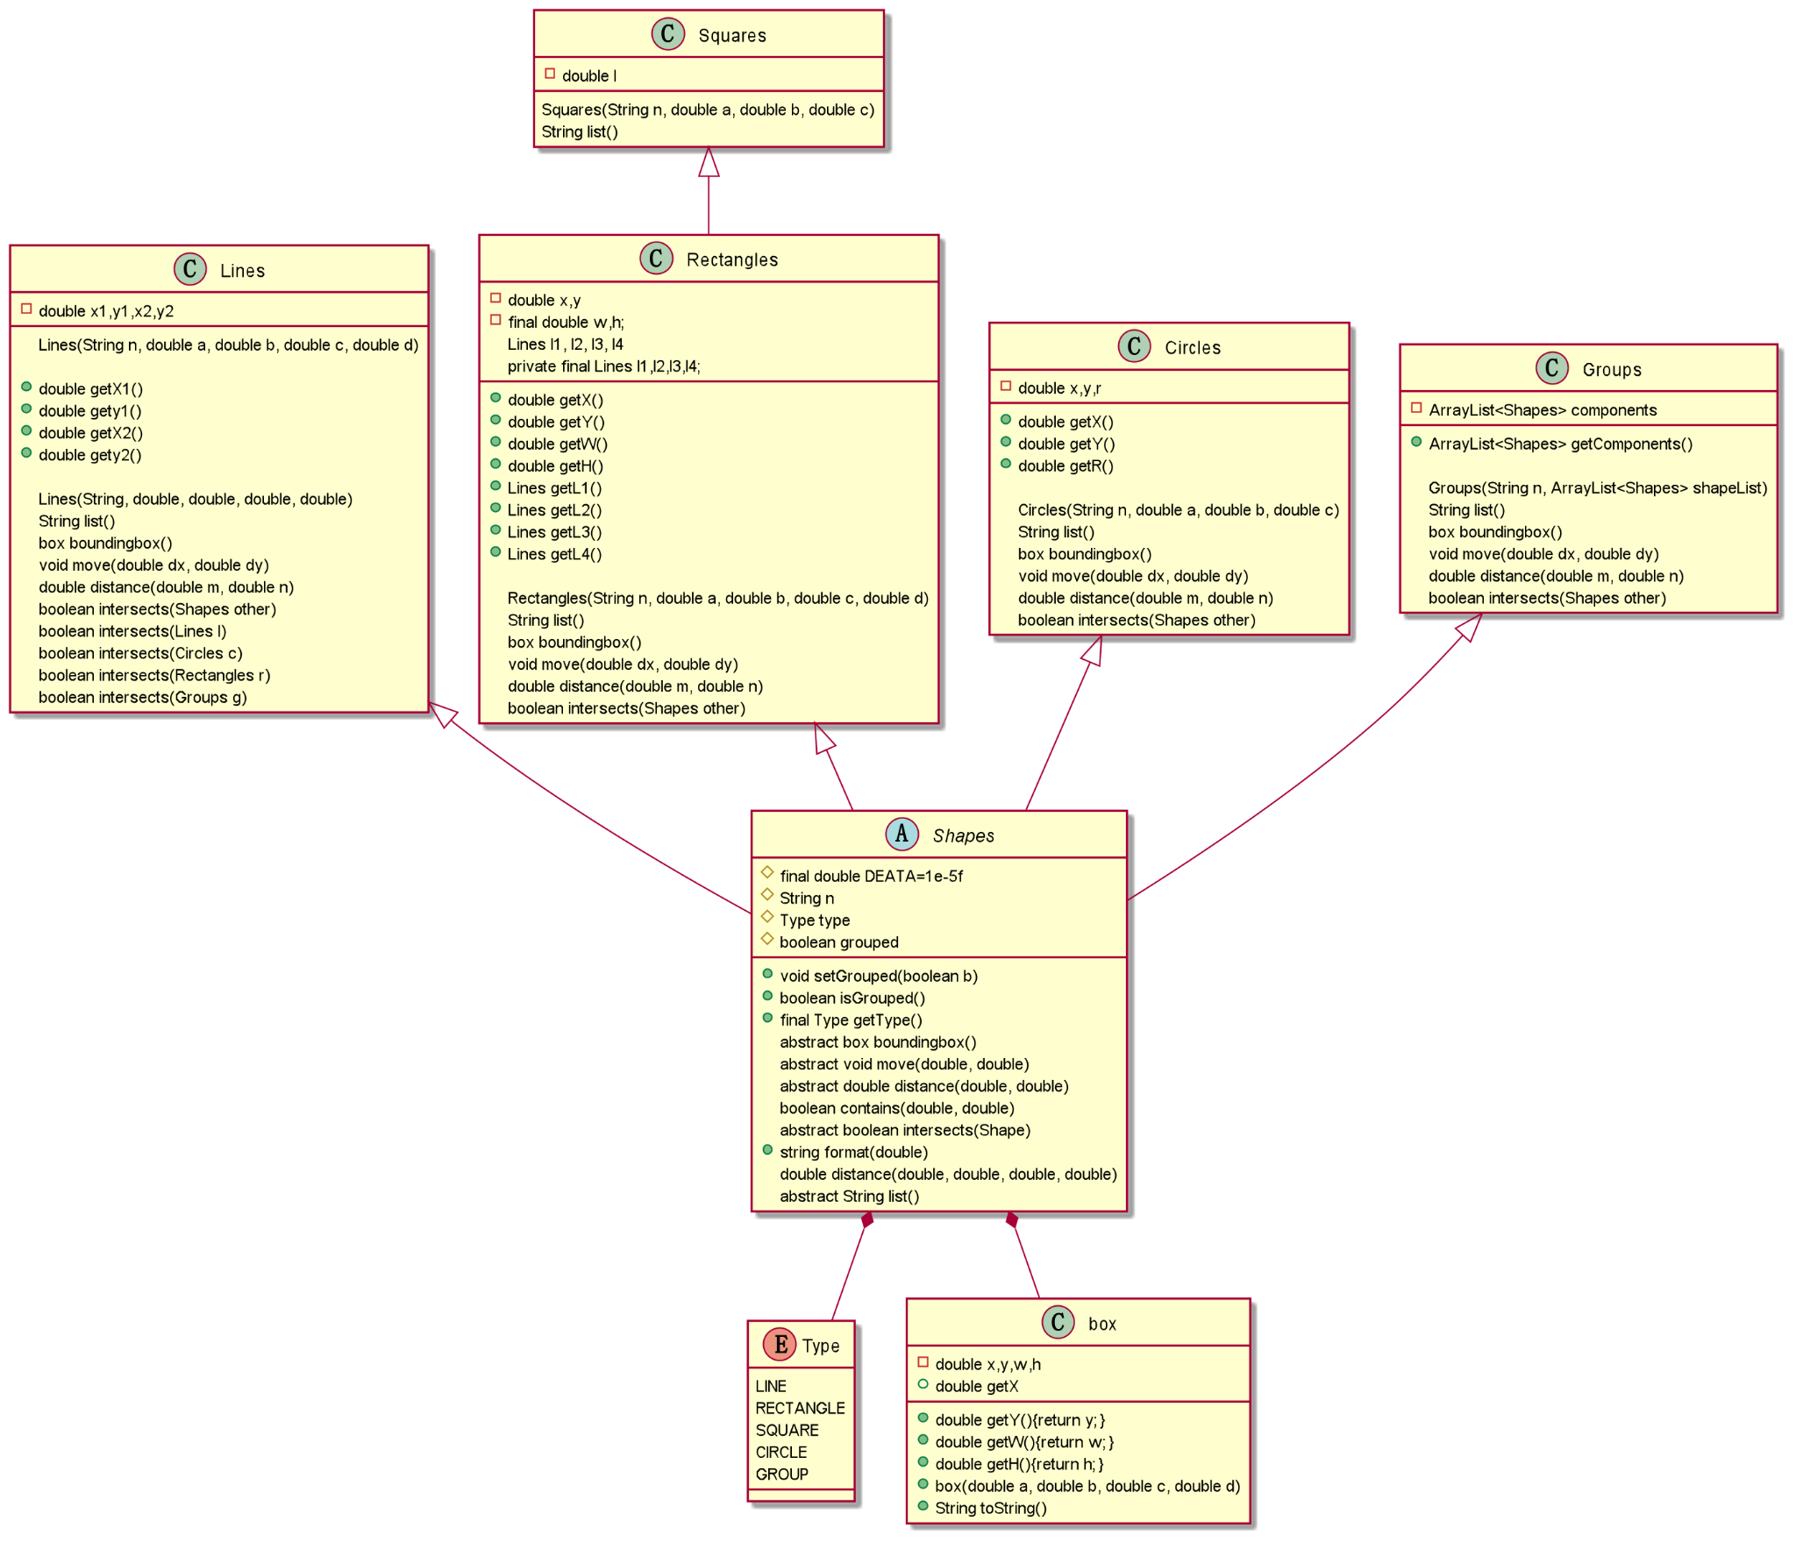
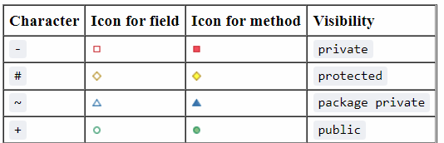
Overview of Shapes

Slide 5
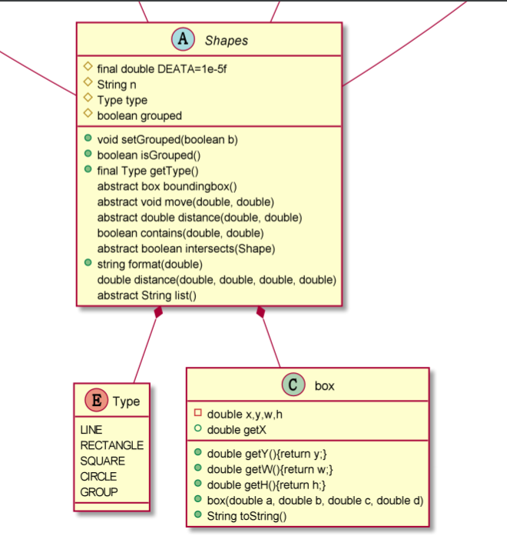

Slide 6
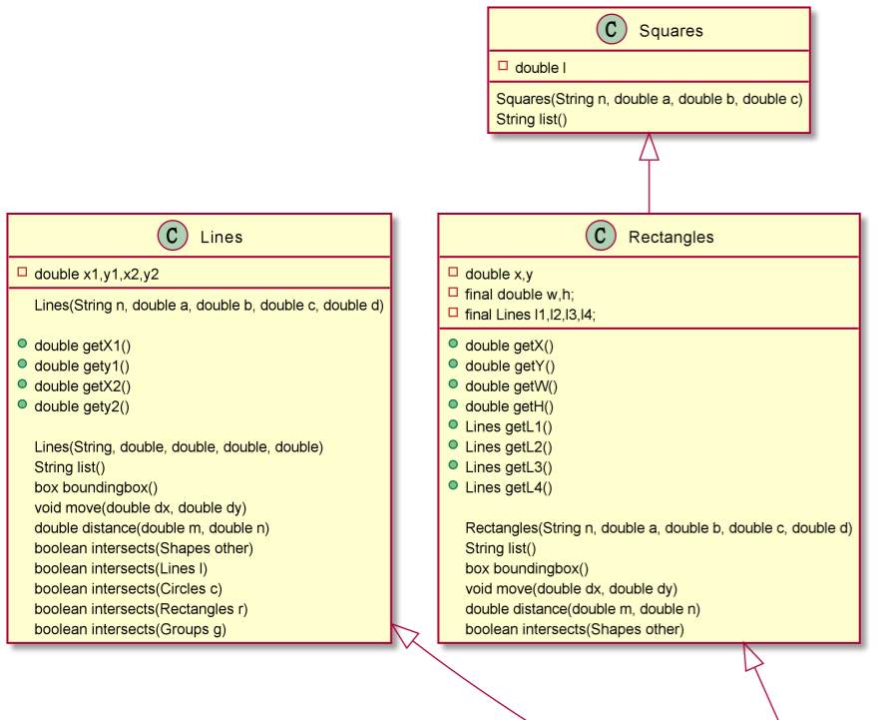

Slide 7
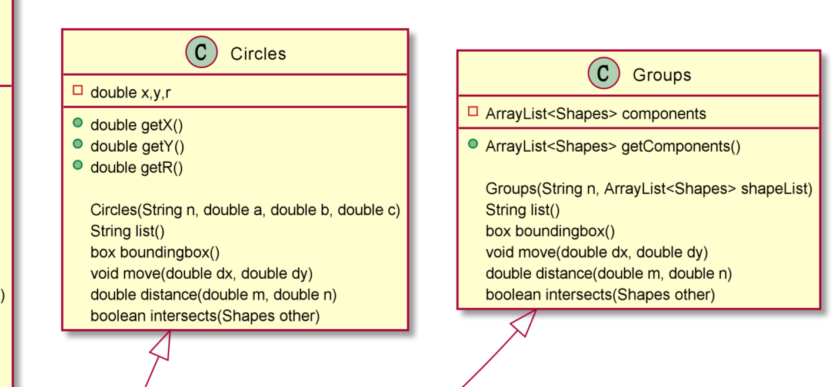

Slide 8
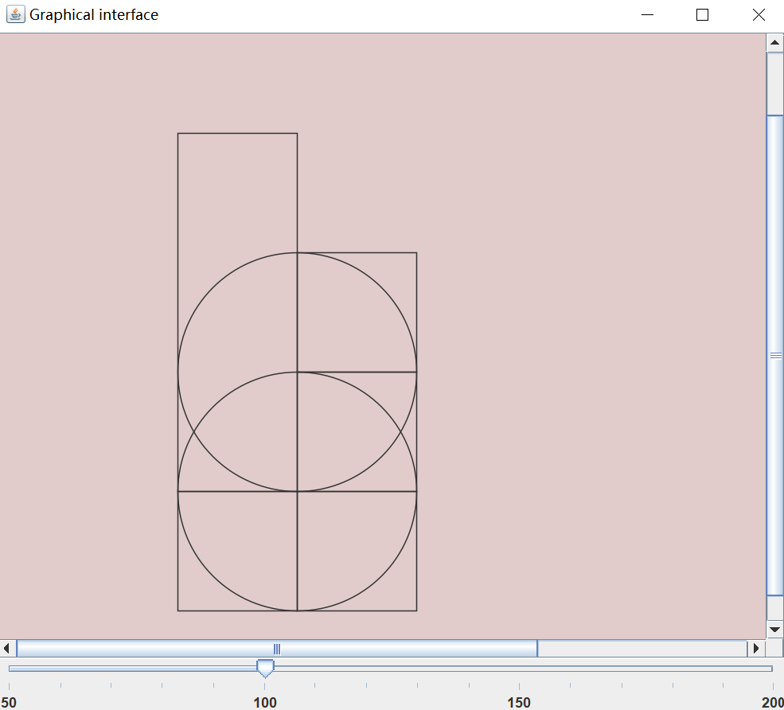


The design of MyWindow
Java Swing
Components
1. JFrame
2. JPanel
3. JSlider
...

Slide 9

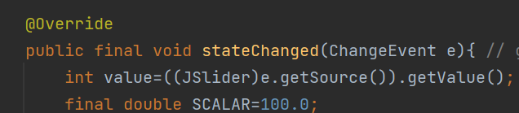
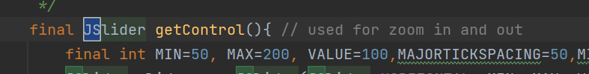
Implementation
The idea of inheritance
1. Graphical Components that make up the Graphical User Interface.
2. Listener methods that receive the events and respond to them.
3. Application methods that do useful work for the user.

Slide 10
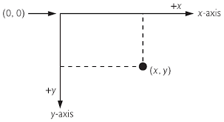
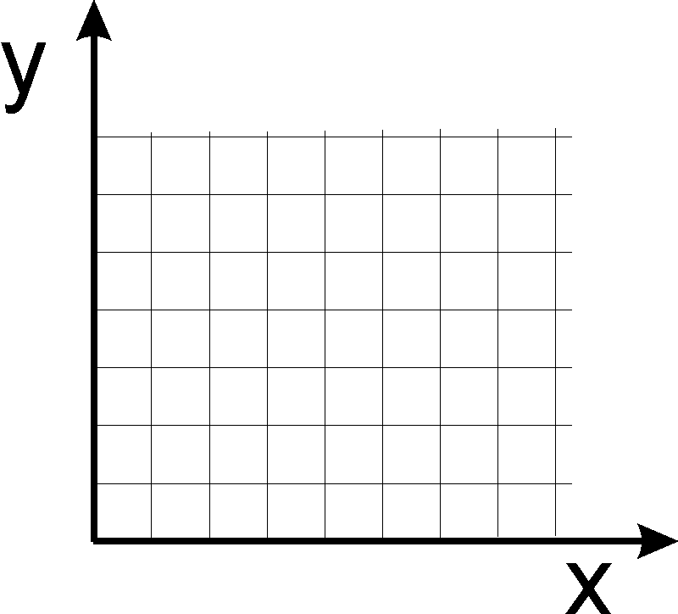
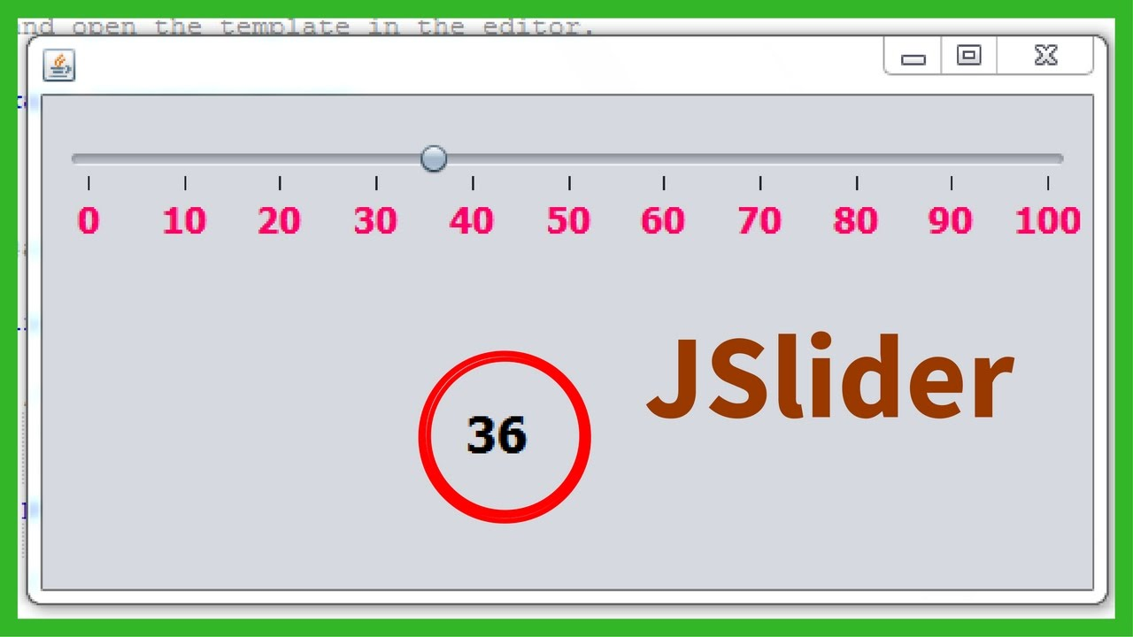
Modification of the Coordinate System in plain JPanel
Coordinate System in plain JPanel
Zoom in/out

Slide 11
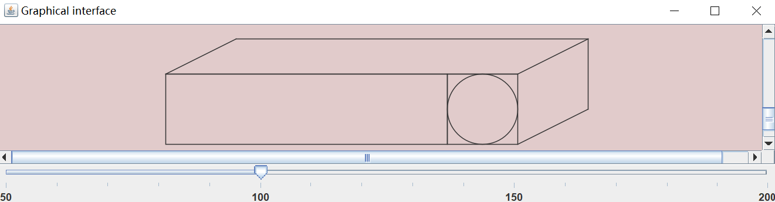
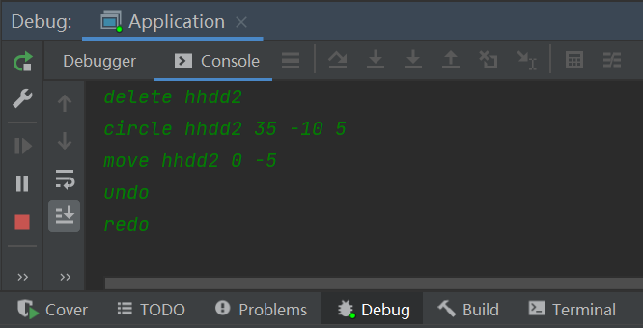
Set scales to enable preferred size for the viewer
undo/redo

Slide 12
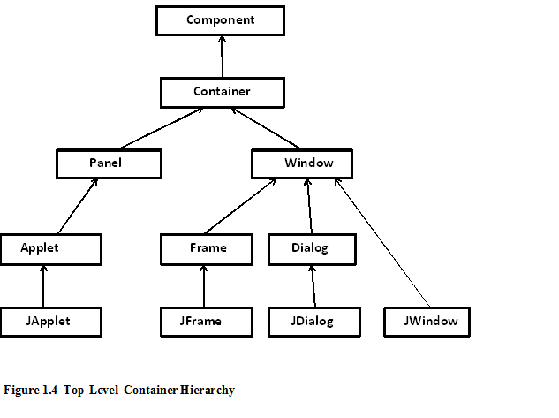
Meet Swing containers
JPanel serves as a general purpose container

Slide 13

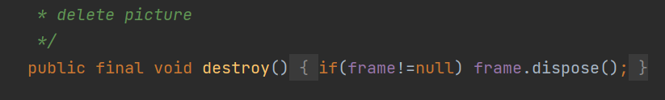
Destroy the old window and create a new one
Every time the user inputs a new command, the old window will be destroyed automatically and a new window is created. (We implement it as much as we can, though there is room for improvement)

Slide 14
REQ1
The CommandLine is the order intermediate center of our project
We set conditions for every order in requirements. And before it, we would also check whether it is legal.
In general, if you input some wrong methods name, we will ask you to input again. However, if you try to cause/test overflow or underflow of our program(we used stack to store proper orders), you will be kicked out from program. :)

Slide 15
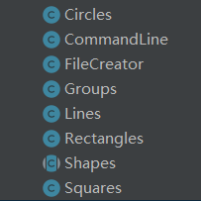
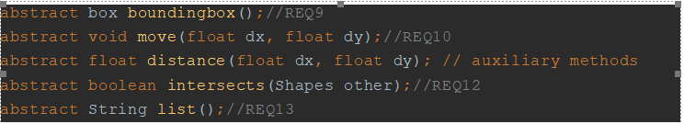
REQ2-6, 9-10, 12-13
We put these REQs in every shape class.
In our design, every shape will extend from a Class Shape, which defines the structure and methods of every shape class. From the screenshots of the code, we can see the fundamental design.
And among these fundamental graphic processing files, because most of the shapes consist of Lines, we attach great importance to implementing methods in Line.
REQ9-10, 12-13

Slide 16
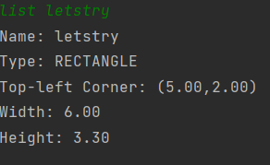
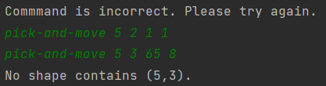
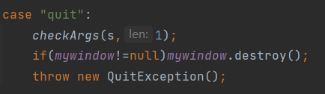
REQ7-8
We put these REQ in file CommandLine.
In our design, this could increase the processing and executing speed of the program. Meanwhile, we also add a method called listDetail to better print out shapes’ information.
REQ11, 14-15
And these REQs have also been put in file CommandLine. For “pick-and-move”, we will first check whether the point in/inside the shape then executes the “move” method.
Here we show execution result of “pick and move” and codes of “quit”

Slide 17
Bonus 2
Bonus 1 is shown on slide 8-11
Undo:
After inputting “undo”, the program will first check whether there are any changes in the current order, and restore the change. Then delete this order from executing stack.
Redo:
Once receiveing “redo”, the program will run the method “Execute” again, but it won’t clear the order that has been input before.
But both two orders won’t restore/clear order stored in html and txt.

