Slide 1

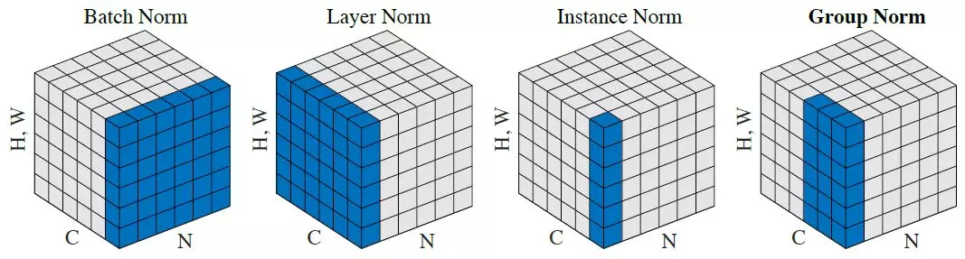
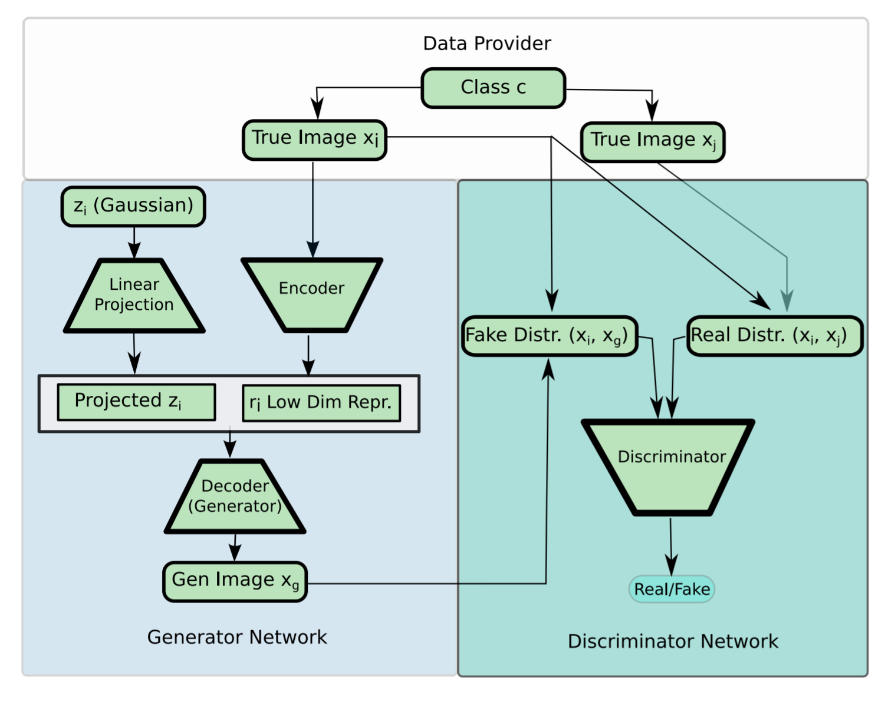
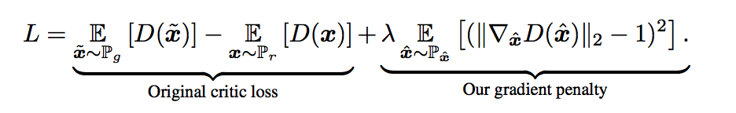
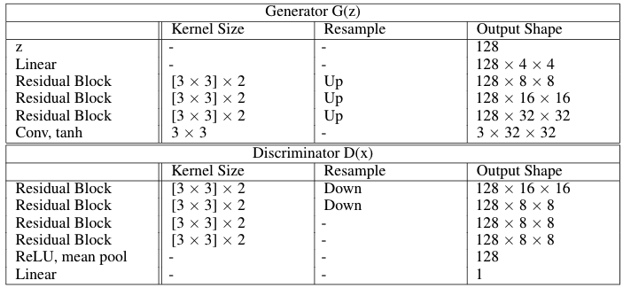
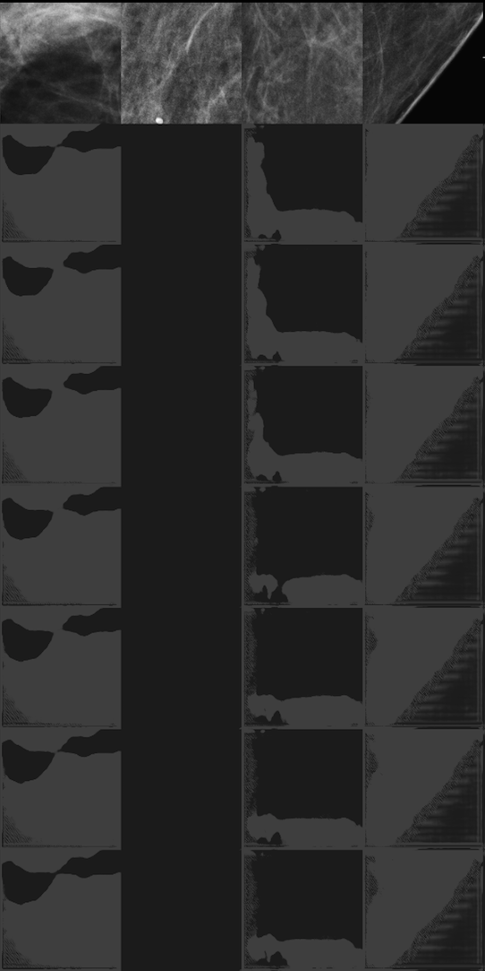
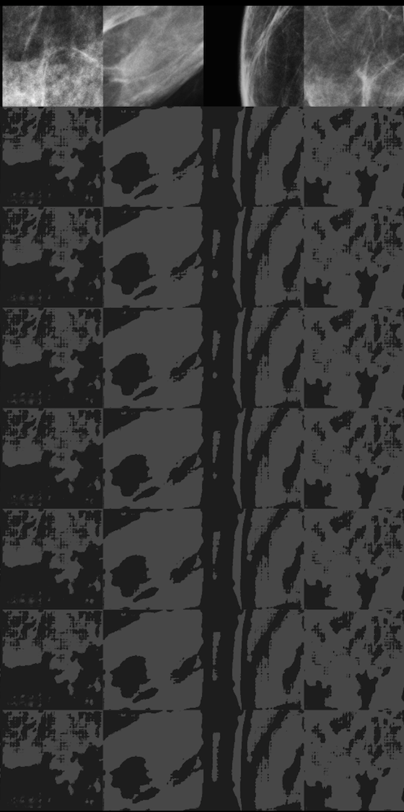
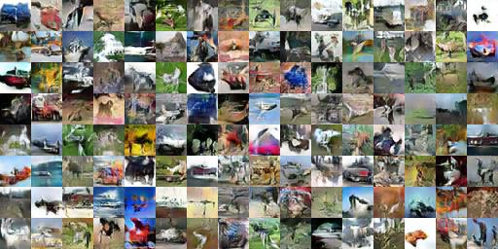



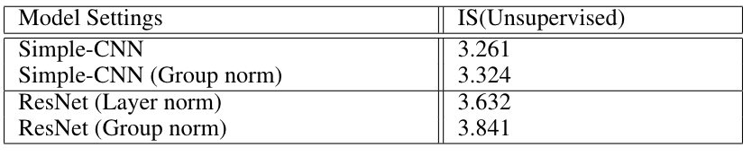
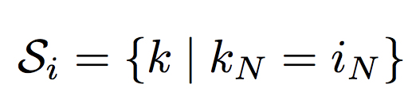
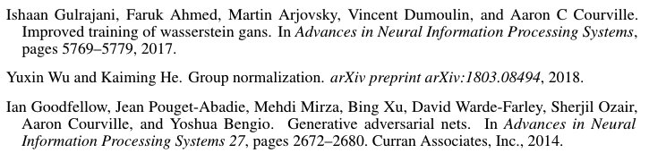

Improve Wasserstein GAN-GP with Group Normalization
Nan Wu, Qianyu Cheng, Zhiming Guo
Center for Data Science, NYU
BACKGROUND
DATA AUGMENTATION WITH WGAN
Generative Adversarial Network, estimated generative models by using an adversarial process
WGAN further developed the model by introducing Wasserstein distance as a metric to optimize discriminator
As the model still appears slow to converge and hard to train, improved WGAN-GP with a gradient penalty in loss to achieve better learning result
We explored the ability of DAGAN in augmenting patch level mammograms and improved its performance by introducing group normalization in the architecture. Patches with a resolution of 256 * 256 are sampled from a clinically realistic mammography data set which is provided by Medical School of New York University.
Figure 1: Different Types of Normalization
ARCHITECTURE & METHODOLOGY
Design of architecture
RESNET is used for generator and discriminator.
Figure 2: ResNet Architecture used in WGAN-GP for CIFAR-10
Design of discriminator
There are 6 normalization operation in discriminator: the discriminator has 3 residual blocks; each residual block includes 2 convolutional layers; each convolutional layer has an operation
MOTIVATION & INTRODUCTION
Figure 5: DAGAN Architecture
Issue with batch normalization (BN) in WGAN-GP
WGAN-GP penalizes the norm of the gradient to individual data input, not the entire batch of data
Batch normalization, however, maps whole batch of inputs for a batch of outputs
Layer normalization (LN )and instance normalization (IN)
Both don’t suffer from BN’s issues but didn’t perform well as expected
Group normalization (GN)
GN divides the channels into groups and within each group computes the mean and variance and therefore overcomes the BN’s issues
Goal: we embedded GN in WGAN-GP and DAGAN. Quality of image generation is evaluated by inception score
EXPERIMENT RESULTS ON CIFAR-10
Dataset: CIFAR-10
32x32 color images in 10 classes
50,000 training and 10,000 test
Figure 6: Original DAGAN
Figure 7: DAGAN with GN
DISCUSSION & FUTURE WORK
We visualized samples generated from ResNet with layer normalization and group normalization, (here we took the best setting of number of groups in each layer according to our experiment)
Due to the low resolution of images in CIFAR 10, it is hard to tell the classes of images. However, model with group normalization does give raise sharper and more realistic samples
Group Normalization did show better result for WGAN-GP, we will try out more combination of groups for group normalization layers in future work
NORMALIZATION
General Normalization Formula
where N is the batch axis, C is the channel axis, and H and W are the spatial height and width axes.
Batch Normalization
where i_{c} (and k_{c} ) denotes the sub-index of i (and k) along the C axis
Layer Normalization
Group Normalization
where G is the number of groups, C/G is the number of channels per group
Figure 3: Generated samples from ResNet with Group Norm
The images in figure 3 can be roughly classified to a class.
However, due to the low resolution of CIFAR 10 makes
difficulty to tell if the generated images are shaper.
REFERENCES
Figure 4: Inception Score
Group Normalization improves inception score a little bit for both Simple-CNN and ResNet over baseline mode.

