Slide 1
3.2-（1）
1180300727 张泽源

Slide 2
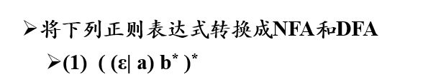
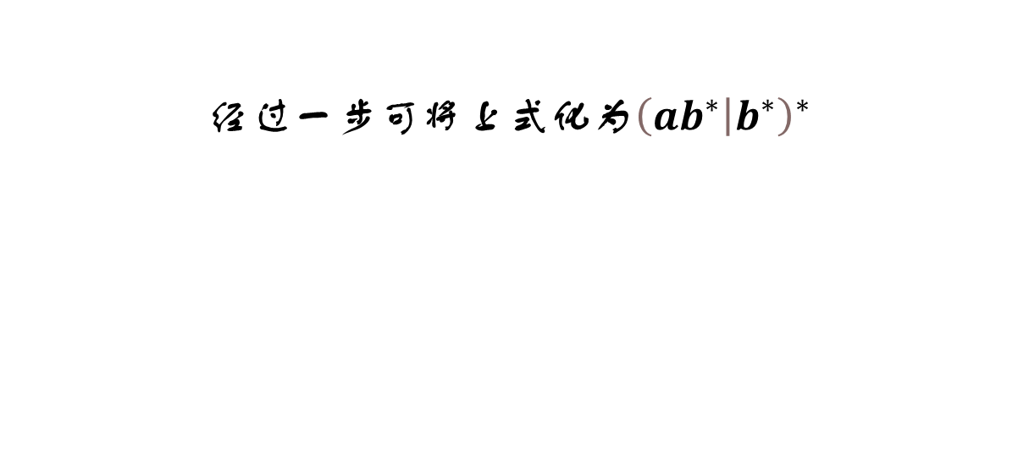
经过一步可将上式化为${\left(a\left.b^{∗}\right|b^{∗}\right)}^{∗}$

Slide 3

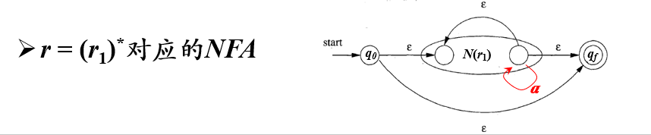
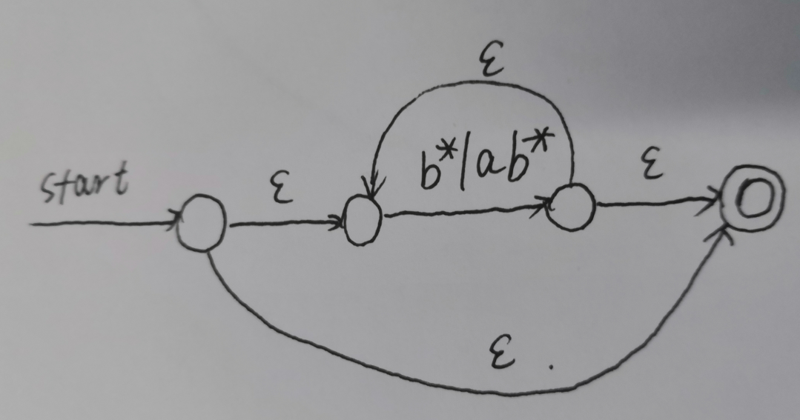

Slide 4
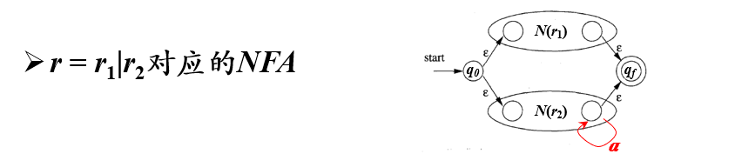
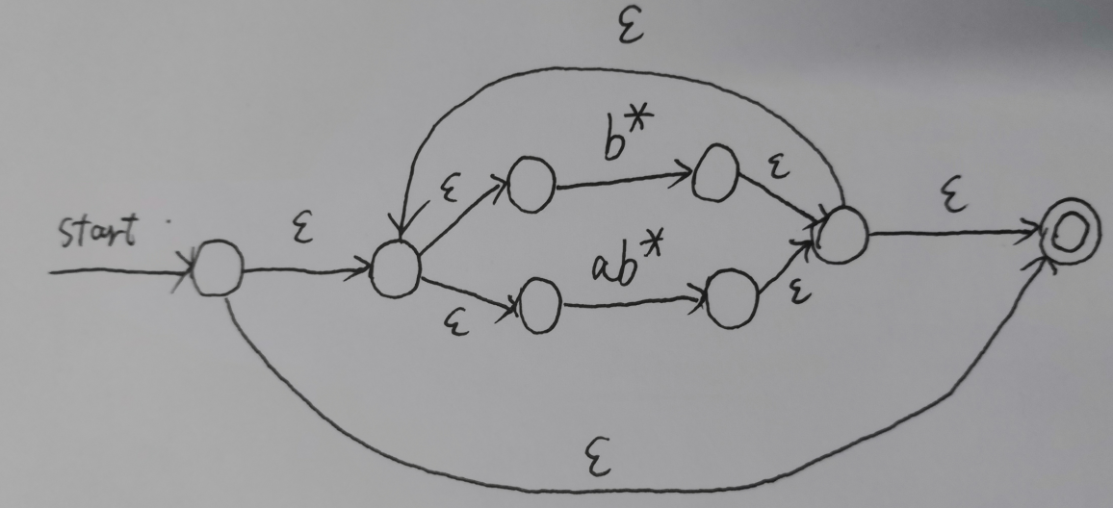

Slide 5
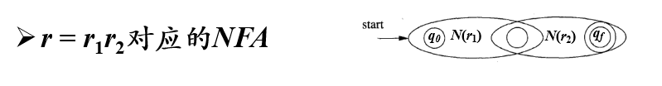
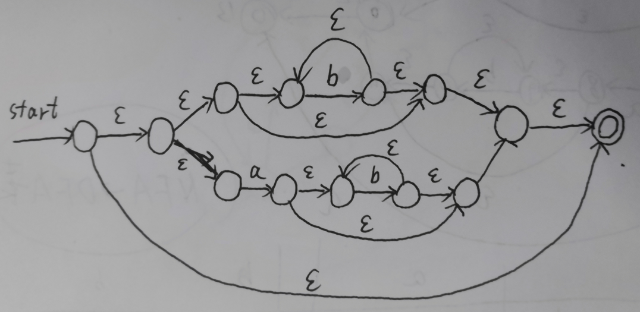

Slide 6
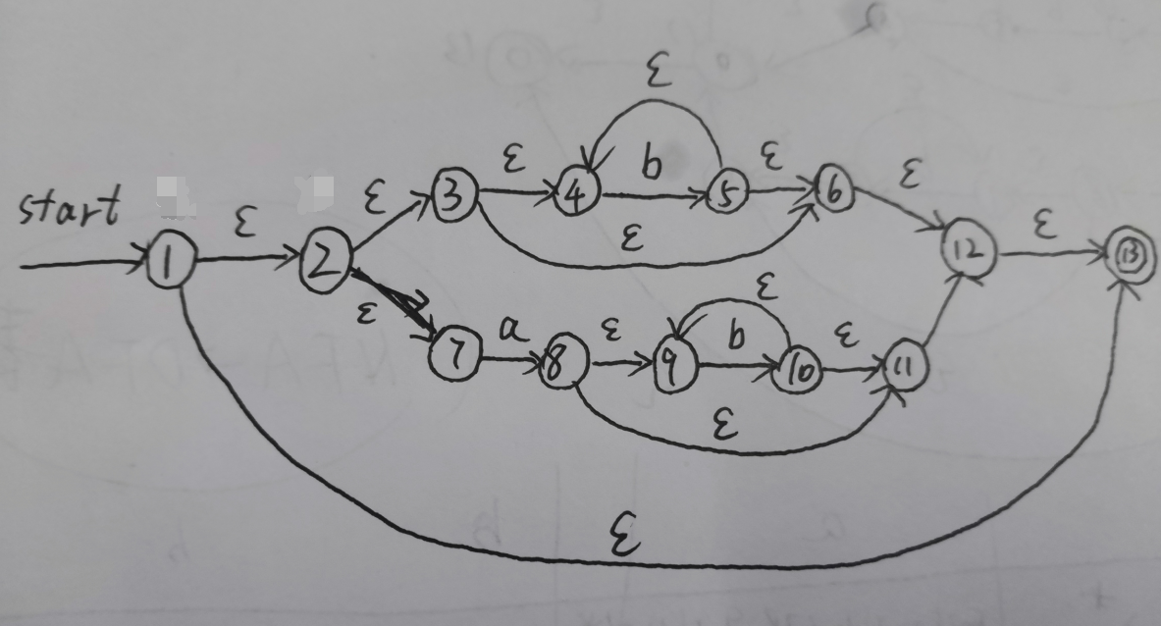
 | a | b
{1,2,3,4,6,7,12,13}* (开始状态) | {2,3,4,6,7,8,9,11,12,13}* | {2,3,4,5,6,7,12,13}*
{2,3,4,6,7,8,9,11,12,13}* | {2,3,4,6,7,8,9,11,12,13}* | {2,3,4,5,6,7,9,10,11,12,13}*
{2,3,4,5,6,7,12,13}* | {2,3,4,6,7,8,9,11,12,13}* | {2,3,4,5,6,7,12,13}*
{2,3,4,5,6,7,9,10,11,12,13}* | {2,3,4,6,7,8,9,11,12,13}* | {2,3,4,5,6,7,9,10,11,12,13}*

Slide 7
 | a | b
A | B | C
B | B | D
C | B | C
D | B | D
a
B
a
b
start
b
A
D
a
a
C
b
b

Slide 8
a
start
A
b

Slide 9
感谢聆听

