Slide 1
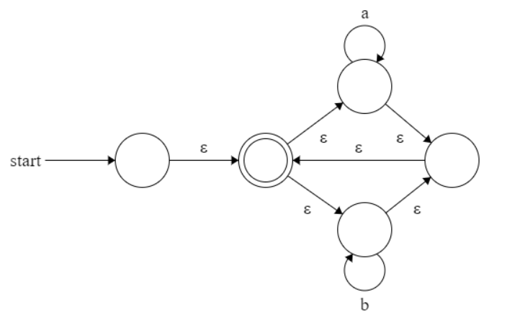
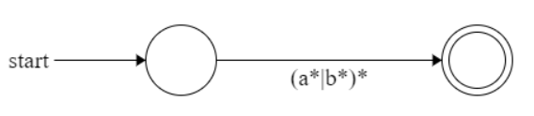
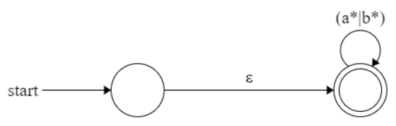
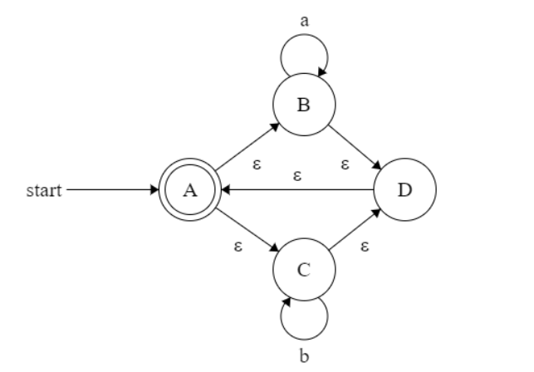
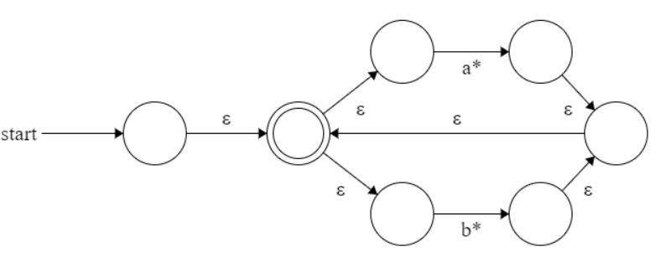

Slide 2
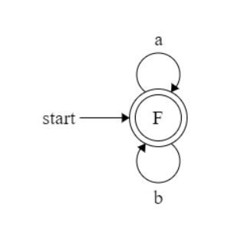
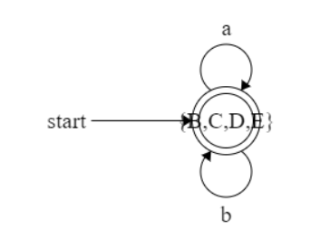
 | a | b
A | {A,B,C,D} | {A,B,C,D}
B | {A,B,C,D} | {A,B,C,D}
C | {A,B,C,D} | {A,B,C,D}
D | {A,B,C,D} | {A,B,C,D}

Slide 3
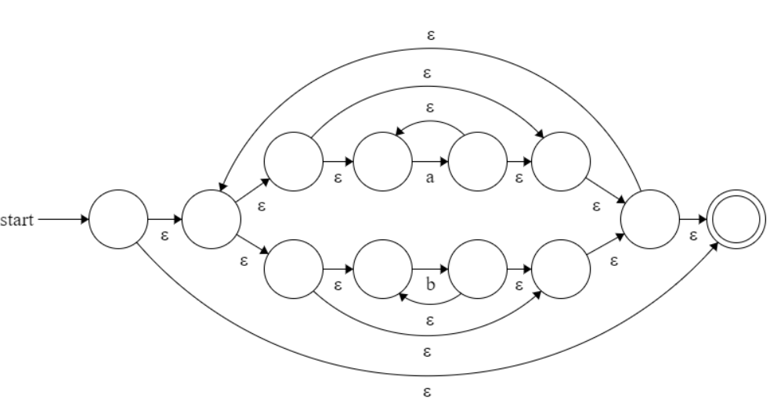
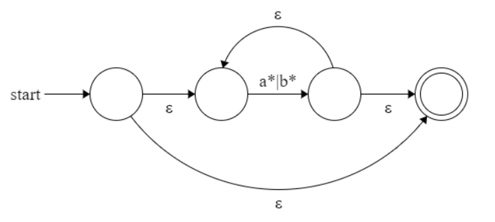
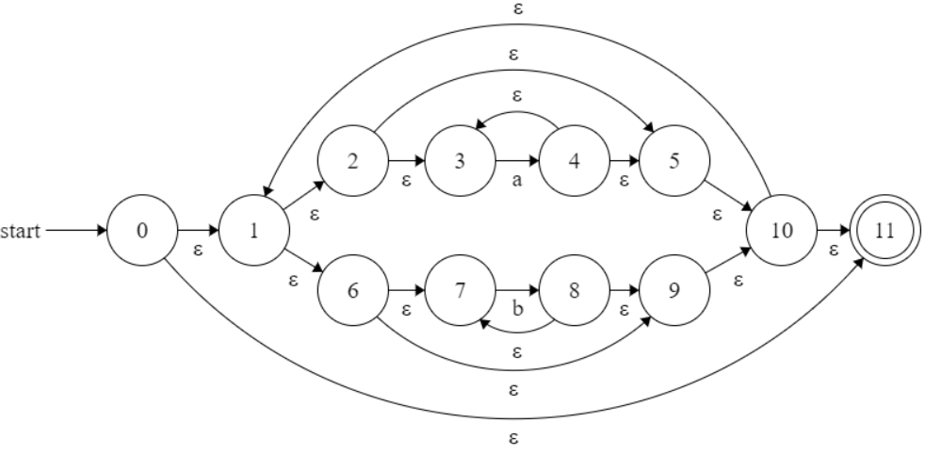
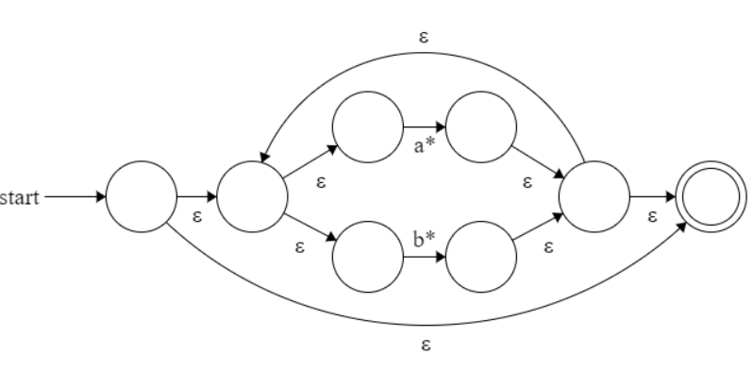

Slide 4
3.2(2) ( a* | b* )*

Slide 5
3.2(2) ( a* | b* )*

Slide 6
3.2(2) ( a* | b* )*

Slide 7
3.2(2) ( a* | b* )*

Slide 8
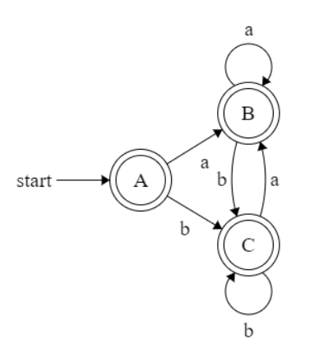
3.2(2) ( a* | b* )*
 |  | a | b
A | {0,1,2,3,5,6,7,9,10,11} | {1,2,3,4,5,6,7,9,10,11} | {1,2,3,5,6,7,8,9,10,11}
B | {1,2,3,4,5,6,7,9,10,11} | {1,2,3,4,5,6,7,9,10,11} | {1,2,3,5,6,7,8,9,10,11}
C | {1,2,3,5,6,7,8,9,10,11} | {1,2,3,4,5,6,7,9,10,11} | {1,2,3,5,6,7,8,9,10,11}

