Slide 1
习题3.2
将下列正则表达式转换成NFA和DFA
(1) ( (ε| a) b* )*
(2) ( a* | b* )*
(3) ( a* | b* )b (ba)*
(4) (a*b)* ba(a|b)*
Notes:
(3) ( a* | b* )b (ba)*
(4) (a*b)* ba(a|b)*
From MOOC

Slide 2
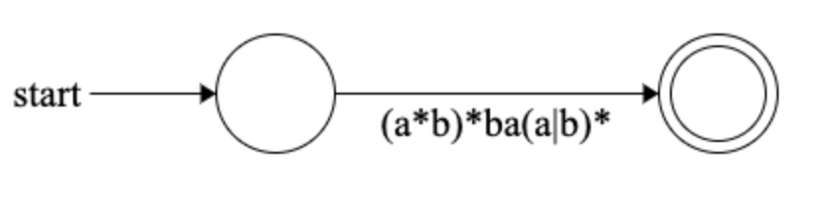
1. Regex to NFA
1. 初始状态

Slide 3
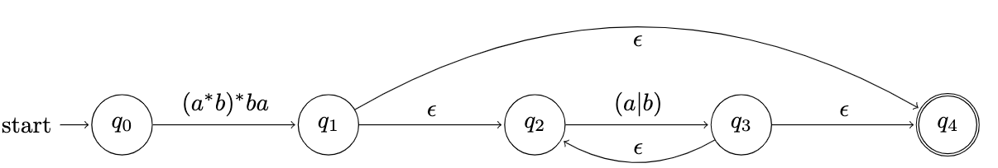
1. Regex to NFA
2 转换了(a|b)*中的Kleene闭包

Slide 4
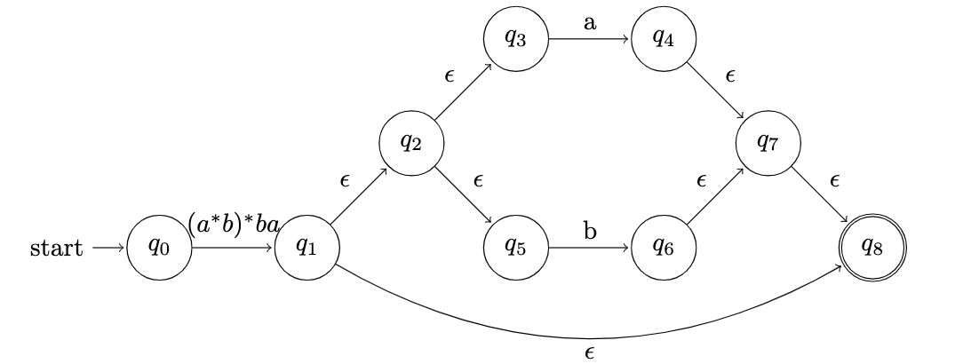
1. Regex to NFA
3 转换了(a|b)

Slide 5
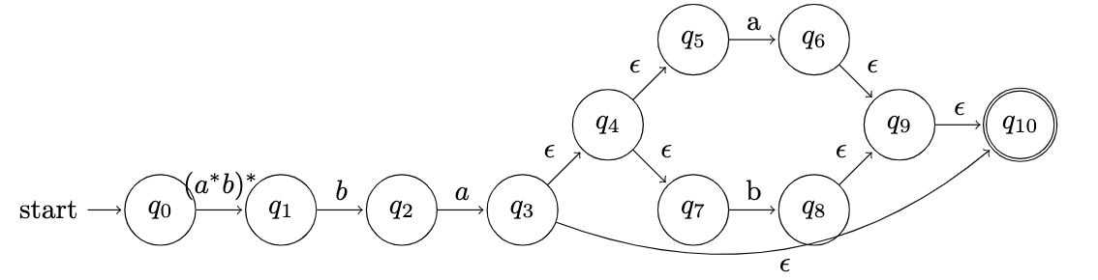
1. Regex to NFA
4 转换了ba

Slide 6
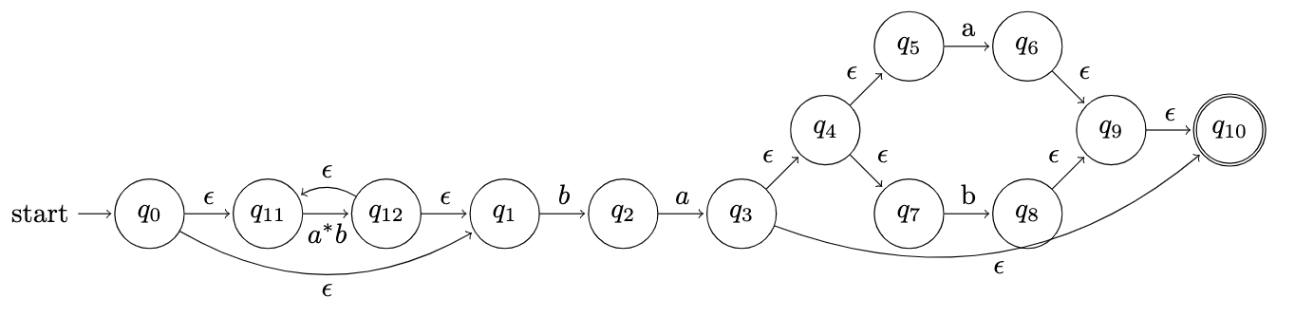
1. Regex to NFA
5 转换了(a*b)*的外层Kleene闭包

Slide 7
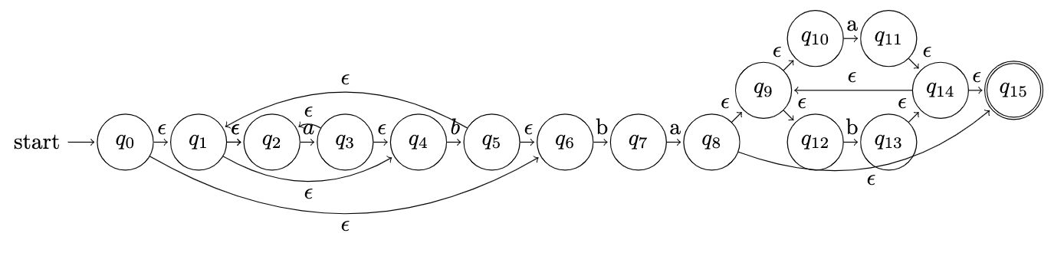
1. Regex to NFA
6 转换剩余部分

Slide 8
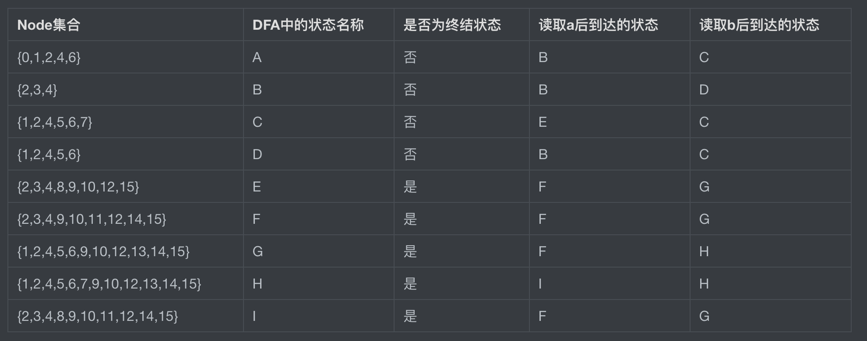
2. NFA to DFA

Slide 9
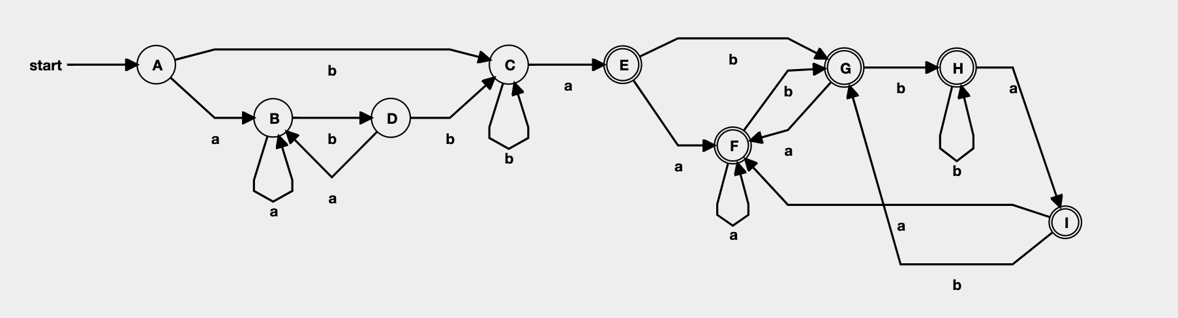
2. NFA to DFA

