Slide 1
7.5(1)
1180300617

Slide 2
习题7.5
对于下列各（增广）文法，构造
① 规范LR项集族
② LALR项集族
(1) S → S S + | S S * | a
扩展文法：
S’->S
S->SS+
S->SS*
S->a

Slide 3
首先求S’->.S,$的闭包，
根据A->α.Bβ,a和B->γ,b可等价于B->γ，FIRST(βa）可得
α=ε,B=S,β=ε
S->.SS+,$
S->.SS*,$
S->.a,$
(根据S->.SS+,$，S->.SS*,$可得）
S->.SS+,a
S->.SS*,a
S->.a,a
State 0
S’->.S,$
S->.SS+,$/a
S->.SS*,$/a
S->.a,$/a

Slide 4
GOTO(I₀,S）
S’->S.,$
S->S.S+,$/a
S->S.S*,$/a
(S->S.S+,$/a)
S->.SS+,+
S->.SS*,+
S->.a,+
(S->S.S*,$/a)
S->.SS+,*
S->.SS*,*
S->.a,*
(S->.SS+,+ S->.SS*,+)
(S->.SS+,* S->.SS*,*)
S->.SS+,a
S->.SS*,a
S->a,a
State 0
S’->.S,$
S->.SS+,$/a
S->.SS*,$/a
S->.a,$/a
State 1
S’->S.,$
S->S.S+,$/a
S->S.S,$/a
S->.SS+,+/*/a
S->.SS*,+/*/a
S->.a,+/*/a
S

Slide 5
GOTO(I₁,S）
S->SS.+,$/a
S->SS.*,$/a
S->S.S+,+/*/a
S->S.S*,+/*/a
(S->S.S+,+/*/a)
S->.SS+,+
S->.SS*,+
S->.a,+
(S->S.S*,+/*/a)
S->.SS+,*
S->.SS*,*
S->.a,*
(S->.SS+,+ S->.SS*,+)
(S->.SS+,* S->.SS*,*)
S->.SS+,a
S->.SS*,a
S->a,a
State 1
S’->S.,$
S->S.S+,$/a
S->S.S,$/a
S->.SS+,+/*/a
S->.SS*,+/*/a
S->.a,+/*/a
State 0
S’->.S,$
S->.SS+,$/a
S->.SS*,$/a
S->.a,$/a
S
State 2
S->SS.+,$/a
S->SS.*,$/a
S->S.S+,+/*/a
S->S.S*,+/*/a
S->.SS+,+/*/a
S->.SS*,+/*/a
S->.a,+/*/a
S

Slide 6
State 0
S’->.S,$
S->.SS+,$/a
S->.SS*,$/a
S->.a,$/a
State 1
S’->S.,$
S->S.S+,$/a
S->S.S,$/a
S->.SS+,+/*/a
S->.SS*,+/*/a
S->.a,+/*/a
GOTO(I₂,S)
S->SS.+,+/*/a
S->SS.*,+/*/a
S->S.S+,+/*/a
S->S.S*,+/*/a
(S->S.S+,+/*/a)
S->.SS+,+
S->.SS*,+
S->.a,+
(S->S.S*,+/*/a)
S->.SS+,*
S->.SS*,*
S->.a,*
(S->.SS+,+ S->.SS*,+)
(S->.SS+,* S->.SS*,*)
S->.SS+,a
S->.SS*,a
S->.a,a
S
S
State 3
S->SS.+,+/*/a
S->SS.*,+/*/a
S->S.S+,+/*/a
S->S.S*,+/*/a
S->.SS+,+/*/a
S->.SS*,+/*/a
S->.a,+/*/a
S
State 2
S->SS.+,$/a
S->SS.*,$/a
S->S.S+,+/*/a
S->S.S*,+/*/a
S->.SS+,+/*/a
S->.SS*,+/*/a
S->.a,+/*/a
S

Slide 7
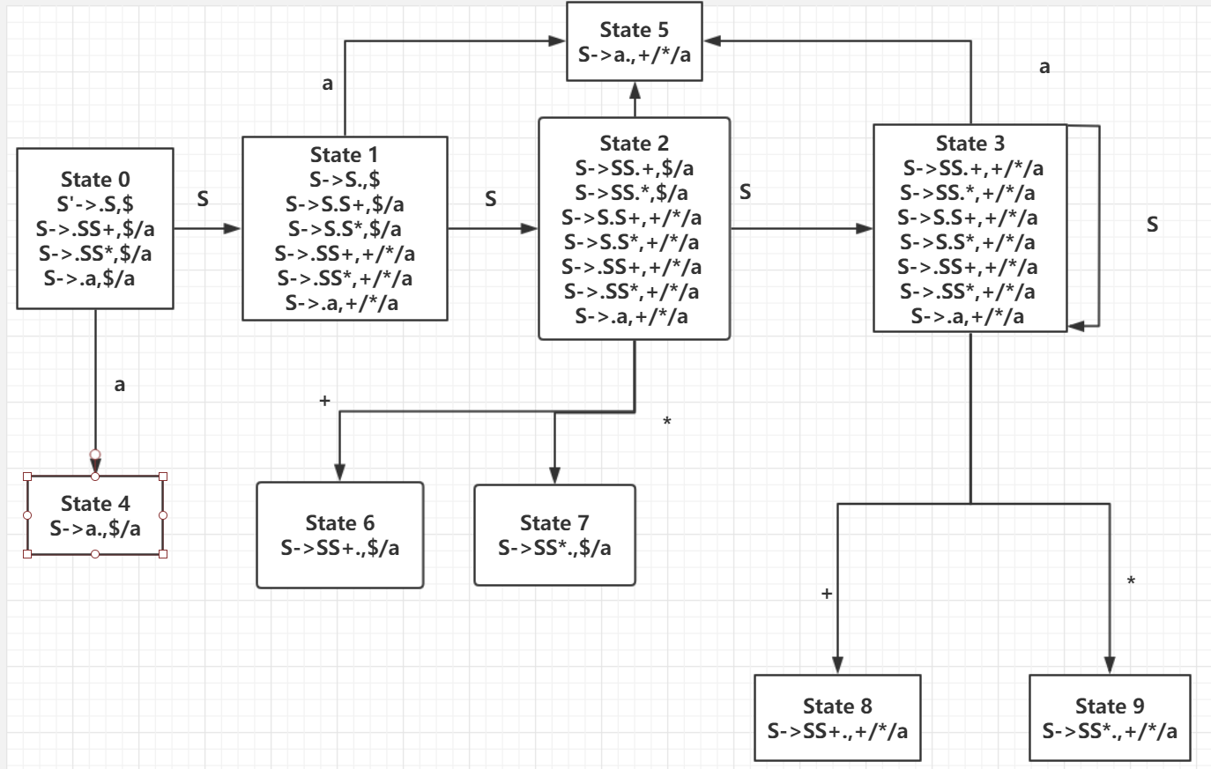
LR项集族

Slide 8
LALR项集族
合并具有相同核心的集族，即State2和State3，State4和State5，State6和State8，State7和State9

Slide 9
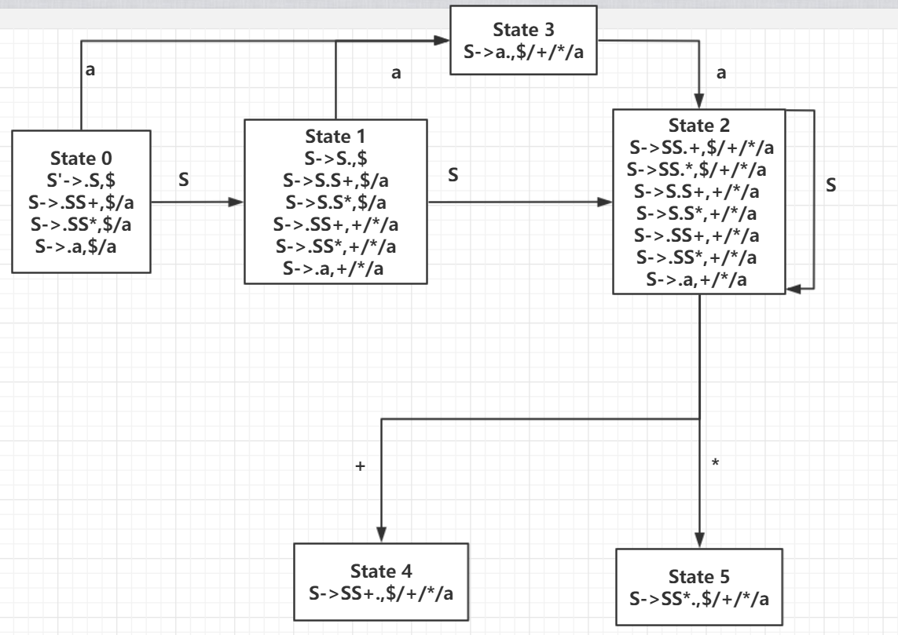
LALR项集族

