Slide 1
习题7.1
对于下列各（增广）文法：
①构造SLR项集和它们的GOTO函数。
②指出你的项集中有没有动作冲突。
③如果存在SLR语法分析表，构造出这个语法分析表。
(2) S → a | S + S | S S | S * | (S) 输入样例：( a + a ) * a

Slide 2
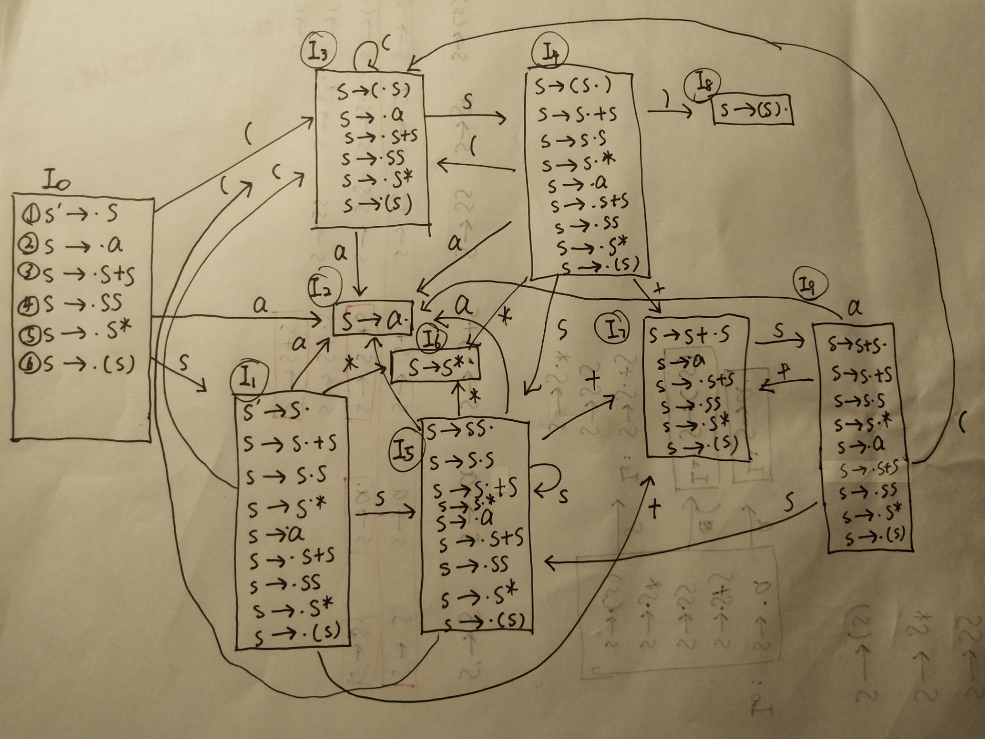

Slide 3
状态 | ACTION |  |  |  |  |  | GOTO
 | a | + | * | ( | ) | $ | S
0 | s2 |  |  | s3 |  |  | 1
1 | s2 | s7 | s6 | s3 |  | acc | 5
2 | r1 | r1 | r1 | r1 | r1 | r1
3 | s2 |  |  | s3 |  |  | 4
4 | s2 | s7 | s6 | s3 | s8 |  | 5
5 | s2/r3 | s7/r3 | s6/r3 | s3/r3 | r3 | r3 | 5
6 | r4 | r4 | r4 | r4 | r4 | r4
7 | s2 |  |  | s3 |  |  | 9
8 | r5 | r5 | r5 | r5 | r5 | r5
9 | s2/r2 | s7/r2 | s6/r2 | s3/r2 | r2 | r2 | 5
文法
(0) S’→ S
(1) S → a
(2) S → S+S
(3) S → SS
(4) S → S*
(5) S → (S)
产生冲突
FOLLOW(S)={ a , + , * , ( , ) , $ }

Slide 4
状态 | ACTION |  |  |  |  |  | GOTO
 | a | + | * | ( | ) | $ | S
0 | s2 |  |  | s3 |  |  | 1
1 | s2 | s7 | s6 | s3 |  | acc | 5
2 | r1 | r1 | r1 | r1 | r1 | r1
3 | s2 |  |  | s3 |  |  | 4
4 | s2 | s7 | s6 | s3 | s8 |  | 5
5 | s2/r3 | s7/r3 | s6/r3 | s3/r3 | r3 | r3 | 5
6 | r4 | r4 | r4 | r4 | r4 | r4
7 | s2 |  |  | s3 |  |  | 9
8 | r5 | r5 | r5 | r5 | r5 | r5
9 | s2/r2 | s7/r2 | s6/r2 | s3/r2 | r2 | r2 | 5
文法
(0) S’→ S
(1) S → a
(2) S → S+S
(3) S → SS
(4) S → S*
(5) S → (S)
步骤 | 状态栈 | 符号栈 | 输入符号 | 产生式
1 | s0 | $ | (a+a)*a$
2 | s0s3 | $( | a+a)*a$
3 | s0s3s2 | $(a | +a)*a$
4 | s0s3s4 | $(S | +a)*a$ | r1(S→a)
5 | s0s3s4s7 | $(S+ | a)*a$

Slide 5
状态 | ACTION |  |  |  |  |  | GOTO
 | a | + | * | ( | ) | $ | S
0 | s2 |  |  | s3 |  |  | 1
1 | s2 | s7 | s6 | s3 |  | acc | 5
2 | r1 | r1 | r1 | r1 | r1 | r1
3 | s2 |  |  | s3 |  |  | 4
4 | s2 | s7 | s6 | s3 | s8 |  | 5
5 | s2/r3 | s7/r3 | s6/r3 | s3/r3 | r3 | r3 | 5
6 | r4 | r4 | r4 | r4 | r4 | r4
7 | s2 |  |  | s3 |  |  | 9
8 | r5 | r5 | r5 | r5 | r5 | r5
9 | s2/r2 | s7/r2 | s6/r2 | s3/r2 | r2 | r2 | 5
文法
(0) S’→ S
(1) S → a
(2) S → S+S
(3) S → SS
(4) S → S*
(5) S → (S)
步骤 | 状态栈 | 符号栈 | 输入符号 | 产生式
6 | s0s3s4s7s2 | $(S+a | )*a$
7 | s0s3s4s7s9 | $(S+S | )*a$ | r1(S→a)
8 | s0s3s4 | $(S | )*a$ | r2(S→S+S)
9 | s0s3s4s8 | $(S) | *a$
10 | s0s1 | $S | *a$ | r5(S → (S))

Slide 6
状态 | ACTION |  |  |  |  |  | GOTO
 | a | + | * | ( | ) | $ | S
0 | s2 |  |  | s3 |  |  | 1
1 | s2 | s7 | s6 | s3 |  | acc | 5
2 | r1 | r1 | r1 | r1 | r1 | r1
3 | s2 |  |  | s3 |  |  | 4
4 | s2 | s7 | s6 | s3 | s8 |  | 5
5 | s2/r3 | s7/r3 | s6/r3 | s3/r3 | r3 | r3 | 5
6 | r4 | r4 | r4 | r4 | r4 | r4
7 | s2 |  |  | s3 |  |  | 9
8 | r5 | r5 | r5 | r5 | r5 | r5
9 | s2/r2 | s7/r2 | s6/r2 | s3/r2 | r2 | r2 | 5
文法
(0) S’→ S
(1) S → a
(2) S → S+S
(3) S → SS
(4) S → S*
(5) S → (S)
步骤 | 状态栈 | 符号栈 | 输入符号 | 产生式
11 | s0s1s6 | $S* | a$
12 | s0s1 | $S | a$ | r4(S→S*)
13 | s0s1s2 | $Sa | $
14 | s0s1s5 | $SS | $ | r3(S→SS)
15 | s0s1 | $S | $ | acc

Slide 7
结论：虽然出现了动作冲突，但是不会对输入样例的规约过程造成影响
状态 | ACTION |  |  |  |  |  | GOTO
 | a | + | * | ( | ) | $ | S
0 | s2 |  |  | s3 |  |  | 1
1 | s2 | s7 | s6 | s3 |  | acc | 5
2 | r1 | r1 | r1 | r1 | r1 | r1
3 | s2 |  |  | s3 |  |  | 4
4 | s2 | s7 | s6 | s3 | s8 |  | 5
5 | s2/r3 | s7/r3 | s6/r3 | s3/r3 | r3 | r3 | 5
6 | r4 | r4 | r4 | r4 | r4 | r4
7 | s2 |  |  | s3 |  |  | 9
8 | r5 | r5 | r5 | r5 | r5 | r5
9 | s2/r2 | s7/r2 | s6/r2 | s3/r2 | r2 | r2 | 5

