Slide 1
习题7.4
下面是一个二义性文法：
S → A S | b
A → S A | a
构造出这个文法的规范LR项集族。如果我们试图为这个文法构造出一个LR语法分析表，必然会存在某些冲突动作。都有哪些冲突动作？假设我们使用这个语法分析表，并且在出现冲突时不确定地选择一个可能的动作。给出处理输入abab时的所有可能的动作序列。

Slide 2
构造此文法的LR(0)集族
S → A S | b
A → S A | a
I₀:
S′ → · S
S→ · AS
S→ · b
A→ · SA
A→ · a
I₁:
S′ → S ·
A→ S · A
A→ · SA
A→ · a
S→ · AS
S→ · b
I₂:
S → A · S
S→ · AS
S→ · b
A→ · SA
A→ · a
I₃:
A→ a ·
I₄:
S→ b ·
文法
(0) S′ → S
(1) S → AS
(2) S → b
(3) A → SA
(4) A → a
I₅:
A → S · A
A→ · SA
A→ · a
S→ · AS
S→ · b
I₆:
A→ SA ·
S→A · S
S→ · AS
S→ · b
A→ · SA
A→ · a
I₇:
S→ AS ·
A→ S · A
A→ · SA
A→ · a
S→ · AS
S→ · b

Slide 3
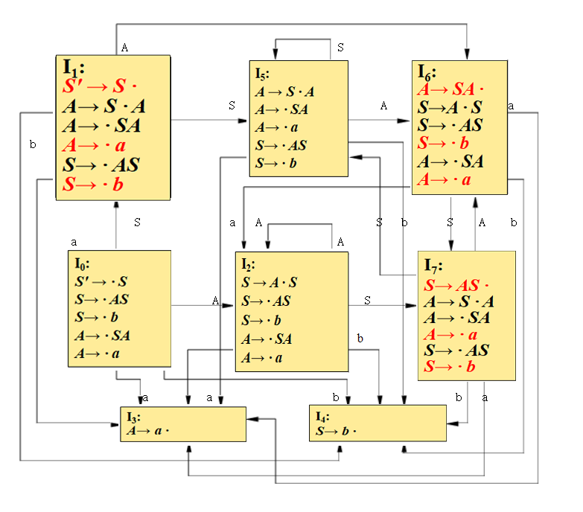
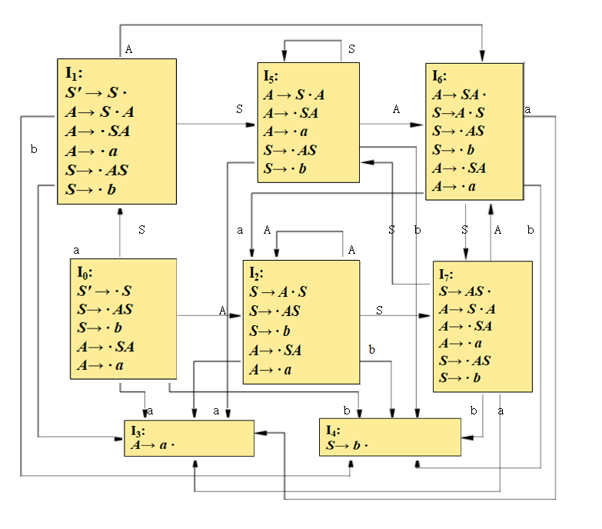
构造此文法的LR(0)自动机

Slide 4
构造此文法的LR(0)预测分析表
状态 | ACTION |  |  | GOTO
 | a | b | $ | S | A
0 | s3 | s4 |  | 1 | 2
1 | s3 | s4 | acc | 5 | 6
2 | s3 | s4 |  | 7 | 2
3 | r4 | r4 | r4
4 | r2 | r2 | r2
5 | s3 | s7 |  | 5 | 6
6 | s3/r3 | s4/r3 | r3 | 7 | 2
7 | s3/r1 | s4/r1 | r2 | 5 | 6

Slide 5
LR (1)集族
文法
(0) S′ → S
(1) S → AS
(2) S → b
(3) A → SA
(4) A → a
I₀:
S′ → · S, $
S→ · AS, $/a/b
S→ · b, $/a/b
A→ · SA , a/b
A→ · a , a/b
I₃:
A→ a · , a/b
I₈:
S→ AS · , $/a/b
A→ S · A , a/b
A→ · SA , a/b
A→ · a , a/b
S→ · AS , a/b
S→ · b , a/b
I₄:
S→ b · , $/a/b
I₅:
A → S · A , a/b
A→ · SA , a/b
A→ · a , a/b
S→ · AS , a/b
S→ · b , a/b
I₁:
S′ → S · , $
A→ S · A, a/b
A→ · SA , a/b
A→ · a , a/b
S→ · AS , a/b
S→ · b , a/b
I₉:
S→ AS · , a/b
A→ S · A , a/b
A→ · SA , a/b
A→ · a , a/b
S→ · AS , a/b
S→ · b , a/b
I₆:
A→ SA · , a/b
S→A · S , a/b
S→ · AS , a/b
S→ · b , a/b
A→ · SA , a/b
A→ · a , a/b
I₂:
S → A · S , $/a/b
S→ · AS , $/a/b
S→ · b , $/a/b
A→ · SA , a/b
A→ · a , a/b
I₁₀:
S→A · S , a/b
S→ · AS , a/b
S→ · b , a/b
A→ · SA , a/b
A→ · a , a/b
I₇:
S→ b · , a/b

Slide 6
构造此文法的LR(1)预测分析表
状态 | ACTION |  |  | GOTO
 | a | b | $ | S | A
0 | s3 | s4 |  | 1 | 2
1 | s3 | s7 | acc | 5 | 6
2 | s3 | s4 |  | 8 | 2
3 | r4 | r4
4 | r2 | r2 | r2
5 | s3 | s7 |  | 5 | 6
6 | s3/r3 | s7/r3 |  | 9 | 10
7 | r2 | r2
8 | s3/r1 | s7/r1 | r1 | 5 | 6
9 | s3/r1 | s7/r1 |  | 5 | 6
10 | s3 | s7 |  | 9 | 10

Slide 7
1
步骤 | 状态栈 | 符号栈 | 输入串 | ACTION
1 | 0 | # | abab# | s3
2 | 03 | #a | bab# | r4
3 | 02 | #A | bab# | s4
4 | 024 | #Ab | ab# | r2
5 | 028 | #AS | ab# | s3/r1

Slide 8
1-1
步骤 | 状态栈 | 符号栈 | 输入串 | ACTION
1 | 0 | # | abab# | s3
2 | 03 | #a | bab# | r4
3 | 02 | #A | bab# | s4
4 | 024 | #Ab | ab# | r2
5 | 028 | #AS | ab# | r1
6 | 01 | #S | ab# | s3
7 | 013 | #Sa | b# | r4
8 | 016 | #SA | b# | r3
9 | 02 | #A | b# | s4
10 | 024 | #Ab | # | r2
11 | 028 | #AS | # | r1
12 | 01 | #S | # | acc

Slide 9
1-2
步骤 | 状态栈 | 符号栈 | 输入串 | ACTION
1 | 0 | # | abab# | s3
2 | 03 | #a | bab# | r4
3 | 02 | #A | bab# | s4
4 | 024 | #Ab | ab# | r2
5 | 028 | #AS | ab# | r1
6 | 01 | #S | ab# | s3
7 | 013 | #Sa | b# | r4
8 | 016 | #SA | b# | s7
9 | 0167 | #SAb | # | r2
10 | 0169 | #SAS | # | r1
12 | 01 | #S | # | acc

Slide 10
2
步骤 | 状态栈 | 符号栈 | 输入串 | ACTION
1 | 0 | # | abab# | s3
2 | 03 | #a | bab# | r4
3 | 02 | #A | bab# | s4
4 | 024 | #Ab | ab# | r2
5 | 028 | #AS | ab# | s3
6 | 0283 | #ASa | b# | r4
7 | 0286 | #ASA | b# | S7/r3

Slide 11
2-1
步骤 | 状态栈 | 符号栈 | 输入串 | ACTION
1 | 0 | # | abab# | s3
2 | 03 | #a | bab# | r4
3 | 02 | #A | bab# | s4
4 | 024 | #Ab | ab# | r2
5 | 028 | #AS | ab# | s3
6 | 0283 | #ASa | b# | r4
7 | 0286 | #ASA | b# | r3
8 | 02 | #A | b# | s4
9 | 024 | #Ab | # | r2
10 | 028 | #AS | # | r1
11 | 01 | #S | # | aac

Slide 12
2-2
步骤 | 状态栈 | 符号栈 | 输入串 | ACTION
1 | 0 | # | abab# | s3
2 | 03 | #a | bab# | r4
3 | 02 | #A | bab# | s4
4 | 024 | #Ab | ab# | r2
5 | 028 | #AS | ab# | s3
6 | 0283 | #ASa | b# | r4
7 | 0286 | #ASA | b# | s7
8 | 02867 | #ASAb | # | r2
9 | 02869 | #ASAS | # | r1
10 | 028 | #AS | # | r1
11 | 01 | #S | # | aac

