Slide 1
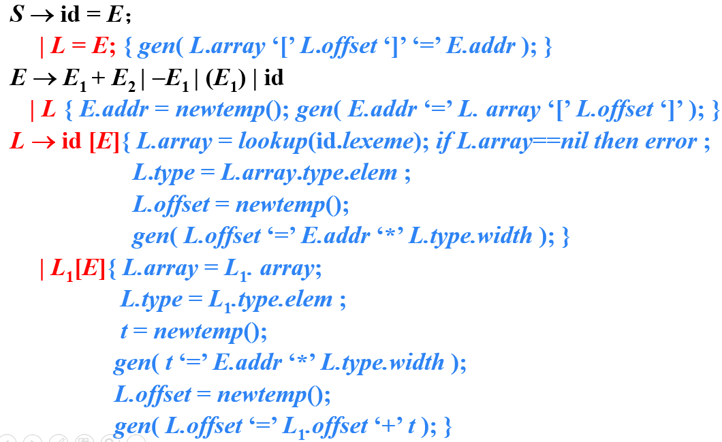
习题12.3(2)
使用讲义中的翻译方案（如下图所示）翻译下列赋值语句。假设a和b的类型表达式都是 array(3, array(5, real))，数组c中每个元素（real类型）占8个存储单元
x = a[b[i][j]][c[k]]
Notes:
12.3

Slide 2
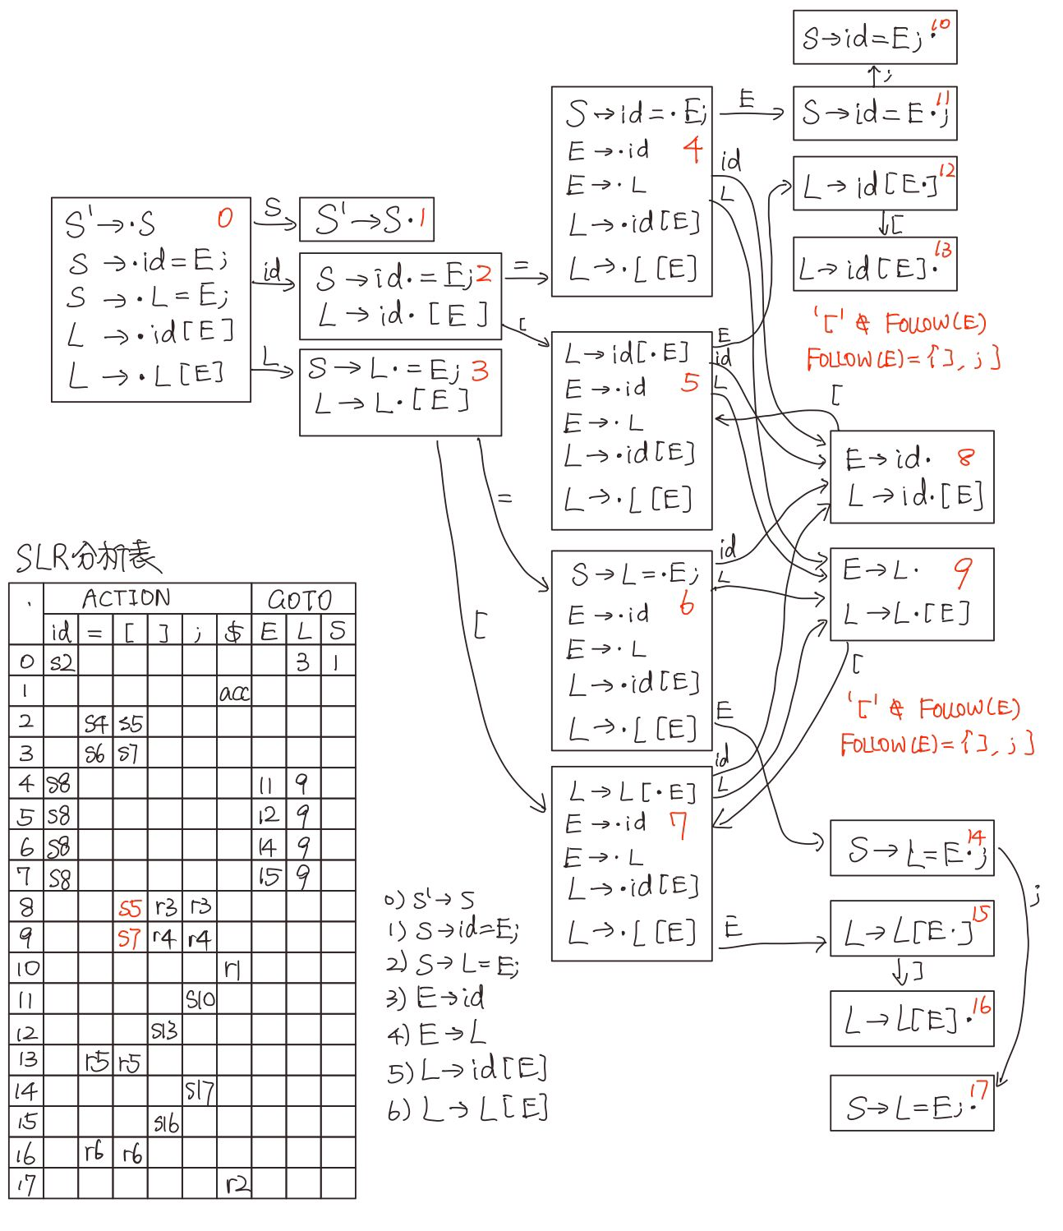
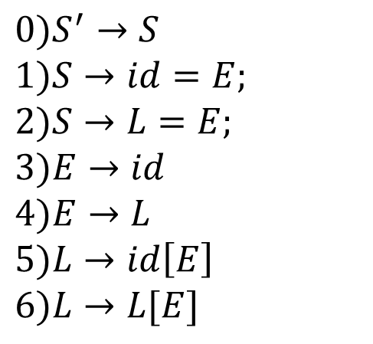
$0)S^{′}→S$
$1)S→id=E;$
$2)S→L=E;$
$3)E→id$
$4)E→L$
$5)L→id\left[E\right]$
$6)L→L[E]$

Slide 3

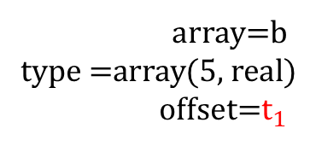
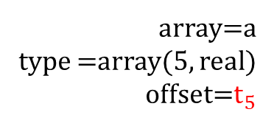
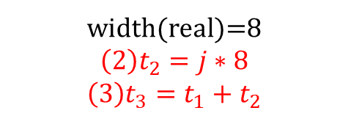
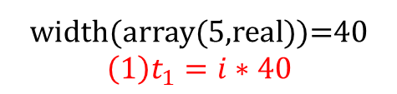

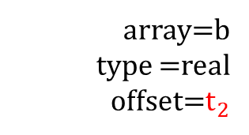
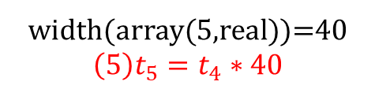
x = a[b[i][j]][c[k]]
S
x
= E ;
L
array=a
type =array(5, real)
offset=$t_{5}$
L
[ E ]
a
[ E ]
$$t_{4}$$
L
width(array(5,real))=40
$${\left(1\right)t}_{1}=i∗40$$
array=b
type =real
offset=$t_{2}$
L
c
[ E ]
width(real)=8
$${\left(2\right)t}_{2}=j∗8$$
$${\left(3\right)t}_{3}=t_{1}+t_{2}$$
array=b
type =array(5, real)
offset=$t_{1}$
L
[ E ]
k
b
[ E ]
j
$${\left(4\right)t}_{4}=b[t_{3}]$$
width(array(5,real))=40
$${\left(5\right)t}_{5}=t_{4}∗40$$
i

Slide 4

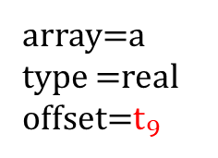

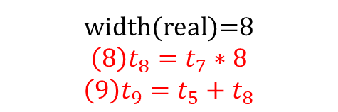



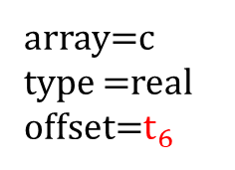

x = a[b[i][j]][c[k]]
S
$$t_{10}$$
x
= E ;
array=a
type =real
offset=$t_{9}$
L
array=a
type =array(5, real)
offset=$t_{5}$
L
[ E ]
$$t_{7}$$
array=c
type =real
offset=$t_{6}$
a
[ E ]
L
width(real)=8
$${\left(6\right)t}_{6}=k∗8$$
L
c
[ E ]
$${\left(7\right)t}_{7}=c[t_{6}]$$
L
[ E ]
k
width(real)=8
$${\left(8\right)t}_{8}=t_{7}∗8$$
$${\left(9\right)t}_{9}=t_{5}+t_{8}$$
b
[ E ]
j
$${\left(10\right)t}_{10}=a[t_{9}]$$
i
$$\left(11\right)x=t_{10}$$

