Slide 1
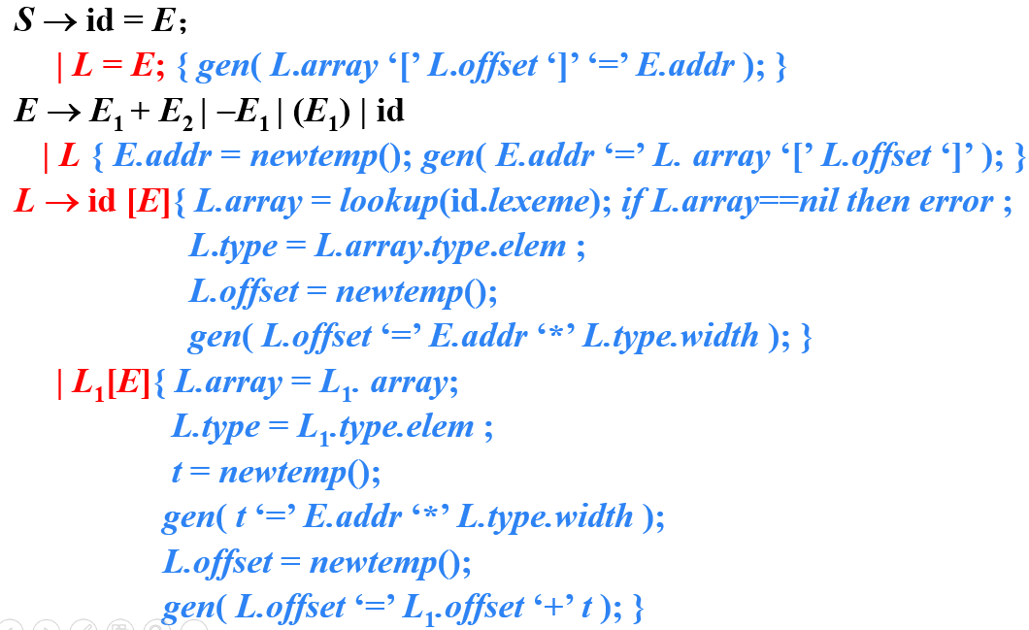
习题12.3
使用讲义中的翻译方案（如下图所示）翻译下列赋值语句。假设a和b的类型表达式都是 array(3, array(5, real))，数组c中每个元素（real类型）占8个存储单元
(1) x = a[i][j] + b[i][j]
Notes:
12.3

Slide 2
x = a[i][j] + b[i][j]
a[i][j]
E
E
E
+
E
L
L
L
L
[ E ]
id
(j)
L
[ E ]
L
[ E ]
id
(a)
id
(j)
id
(j)
[ E ]
id
(a)
[ E ]
id
(b)
[ E ]
id
(i)
id
(i)
id
(i)

Slide 3
addr(a[i][j]) =base+i×w₁+j×w₂
x = a[i][j] + b[i][j]
addr(b[i][j]) =base+i×w₁+j×w₂
addr=t₉
E
三地址码
t₁ = i*40
t₂ = j*8
t₃ = t₁+t₂
t₄= a[t₃]
t₅ = i*40
t₆ = j*8
t₇ = t₅+t₆
t₈= b[t₃]
t₉= t₄+t₈
x= t₉
addr=t₄
E
+
E
addr=t₈
array=a
array=b
type=real
L
L
type=real
offset=t₃
offset=t₇
addr=j
array=a
L
[ E ]
array=b
[ E ]
type=array(5,real))
addr=j
L
type=array(5,real))
offset=t₁
offset=t₅
id
(j)
id
(j)
id
(a)
[ E ]
id
(b)
addr=i
addr=j
[ E ]
id
(i)
id
(i)

