Slide 1
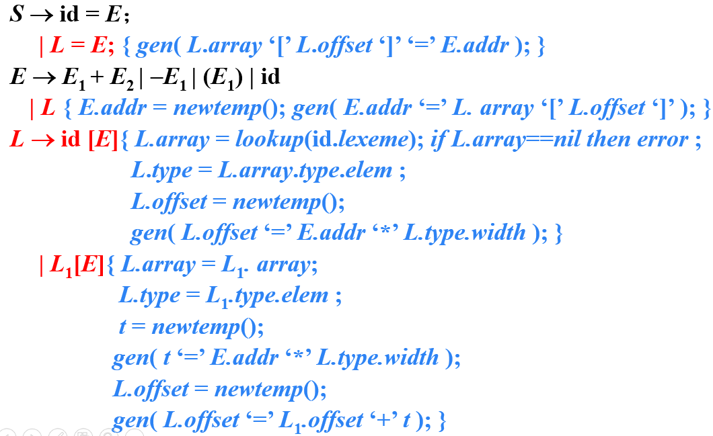
习题12.3
使用讲义中的翻译方案（如下图所示）翻译下列赋值语句。假设a和b的类型表达式都是 array(3, array(5, real))，数组c中每个元素（real类型）占8个存储单元
(2) x = a[b[i][j]][c[k]]

Slide 2
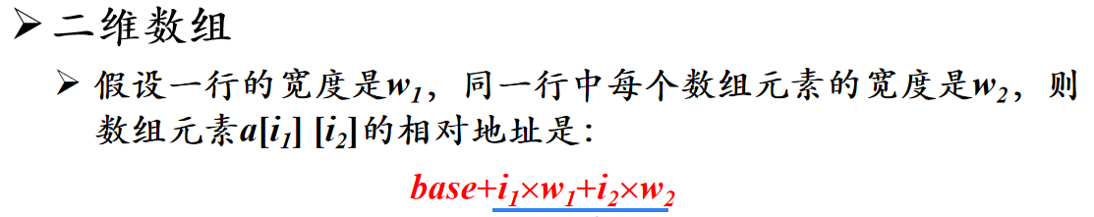
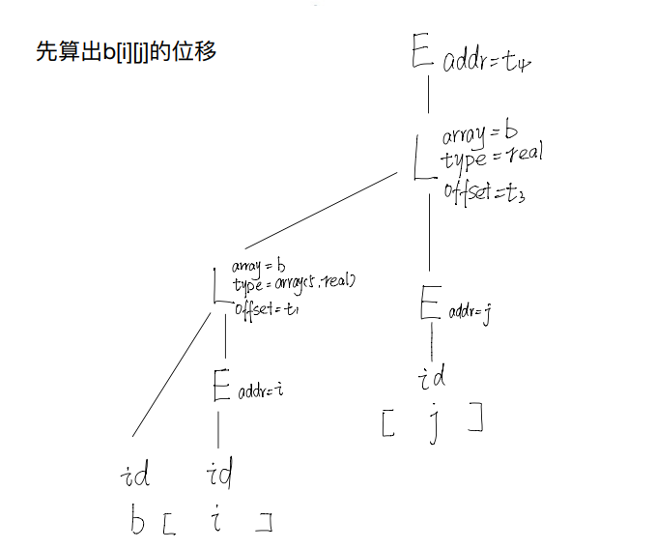
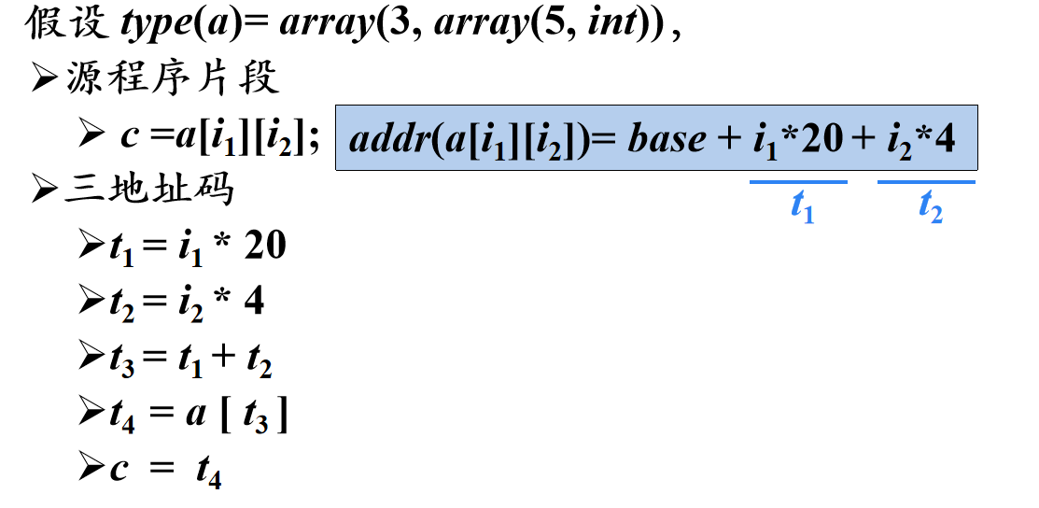
(2) x = a[b[i][j]][c[k]]

Slide 3
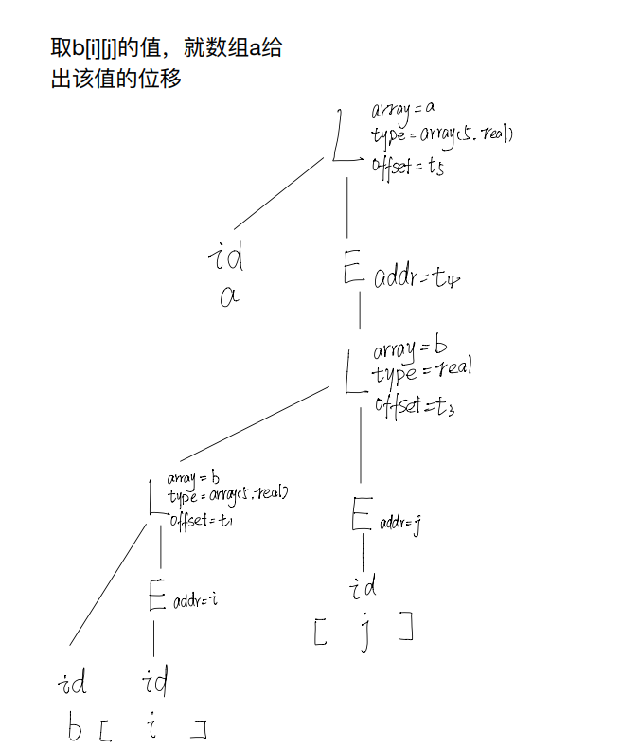
(2) x = a[b[i][j]][c[k]]

Slide 4
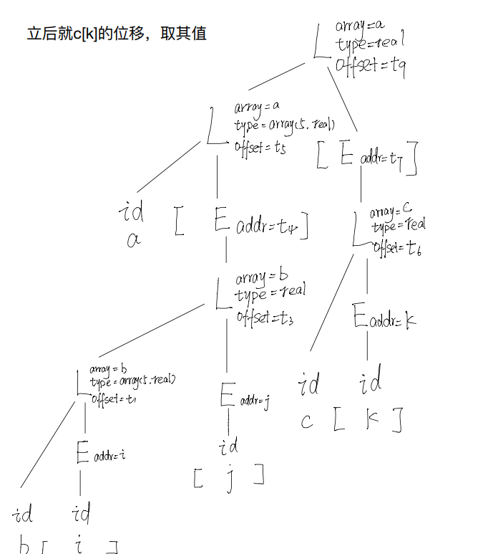
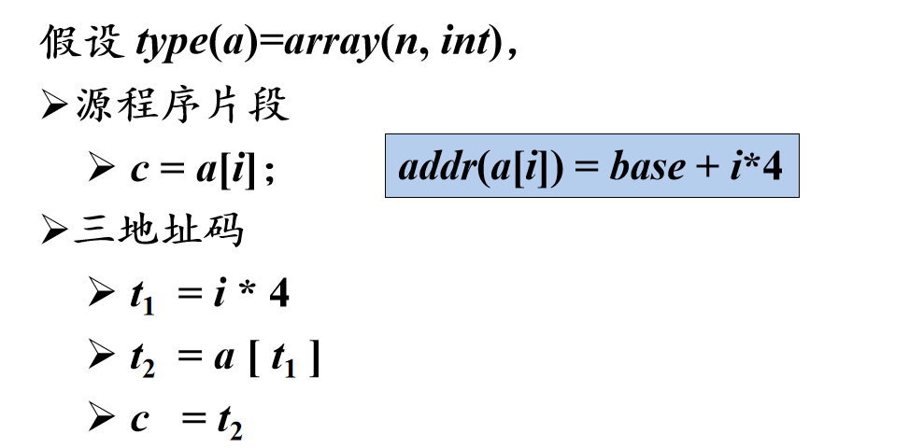
(2) x = a[b[i][j]][c[k]]

Slide 5
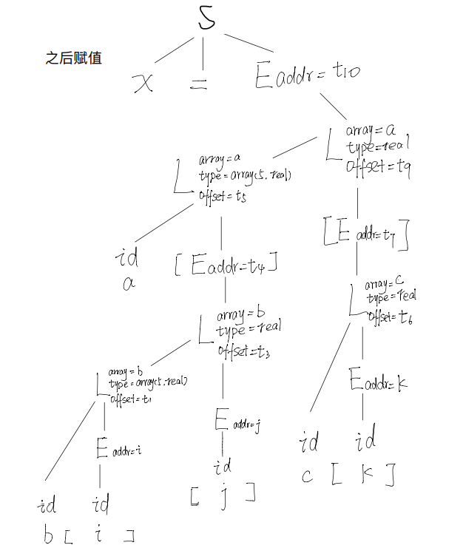
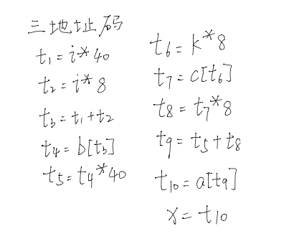
(2) x = a[b[i][j]][c[k]]

