Slide 1
习题13.1
在SPOC讲义6.3节（控制语句的翻译）所示的SDT中添加处理下列控制流构造的翻译方案
(1) repeat语句： S → repeat S₁ while B
(2) for循环语句：S → for (S₁ ; B ; S₂ ) S₃
_{魏子淇 1180300911}

Slide 2
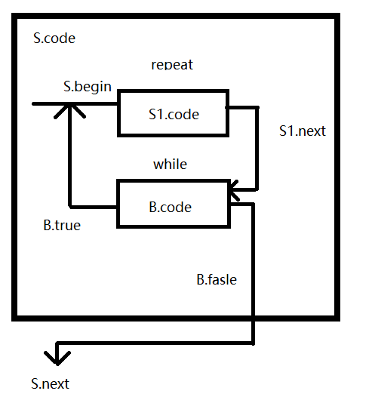
(1)Repeat语句
S->repeat S1 while B

Slide 3
(1)Repeat语句
S->repeat
{S.begin=newlable();
Lable(S.begin);
S1.next=newlable();}S1
While
{Lable(S1.next);
B.true=S.begin;
B.false=S.next;}B

Slide 4
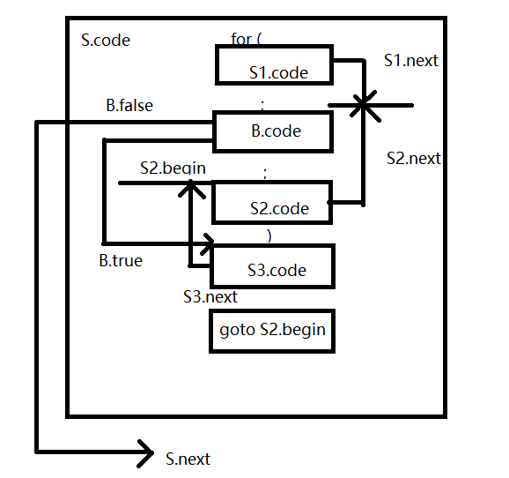
(2)for循环语句
S → for (S₁ ; B ; S₂ ) S₃

Slide 5
(2)for循环语句
S->for(
{S1.next=newlable();}S1;
{Lable(S1.next);
B.true=newlable();
B.false=S.next();}B;
{S2.next=S1.next;
S2.begin=newlable();
Lable(S2.begin):}S2)
{Lable(B.true);
S3.next=S2.begin;}S3
{gen(‘goto’,S2.begin);}

