Slide 1
习题13.1（2）
1180200525-彭杰

Slide 2
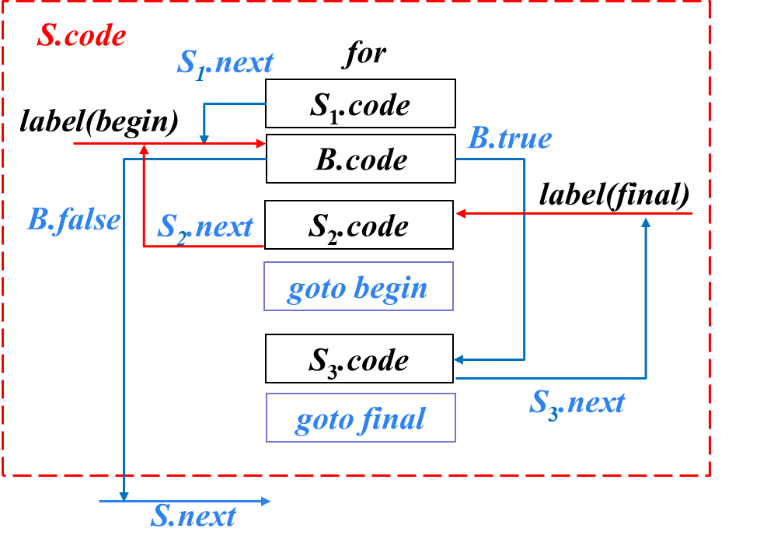
习题13.1(2)
1180200525-彭杰
在SPOC讲义6.3节（控制语句的翻译）所示的 SDT中添加处理下列控制流构造的翻译
(2) for循环语句：S → for (S1 ; B ; S2 ) S3
Notes:
12.4

Slide 3
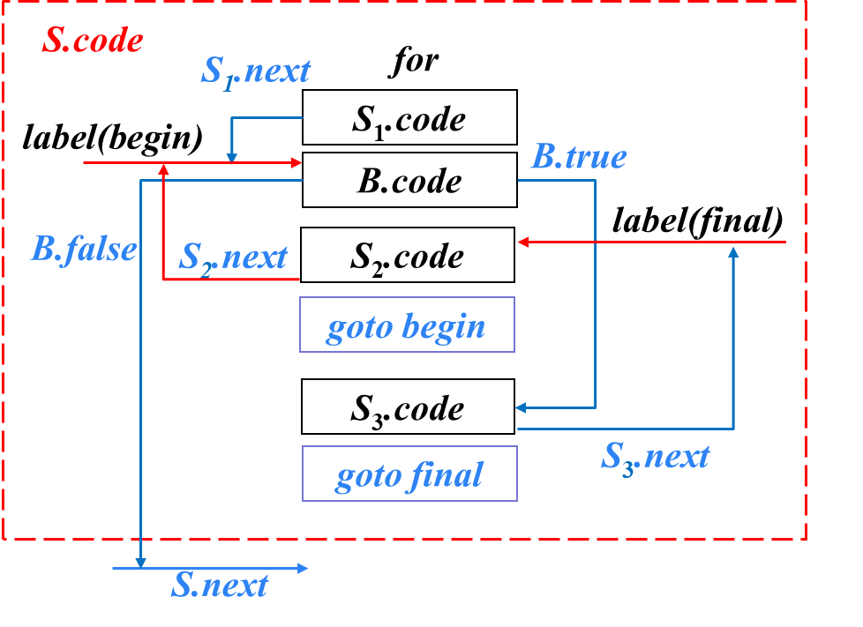
习题13.1(2)
1180200525-彭杰
S → for (S1 ; B ; S2 ) S3
SDT:
S → for ({begin = newlabel();
S₁.next = begin;} S1 ;
{label(begin);
B.true = newlabel();
B.false = S.next;}B ;
{S₂.next = begin;
final = newlabel();
label(final)} S2
{gen(‘goto’ begin )} )
{S₃.next = final;
label(B.true)} S3
{gen(‘goto’ final ) }
Notes:
12.4

Slide 4
谢谢！
1180200525-彭杰

