Slide 1
习题13.4
莫开宝 1180300701
Pascal语言的标准将for语句
for v := E1 to E2 do S1
定义成和下面的代码序列有同样的含义：
begin
v := E1;
while v <= E2 do begin
S1;
v := succ(v);
end
end
请为for语句设计一种合理的中间代码结构，并写出产生中间代码的翻译方案

Slide 2
for v := E1 to E2 do S1
begin
v := E1;
while v <= E2 do begin
S1;
v := succ(v);
end
end
for (v := E1) to (E2) do (S1)
S→for M to E' do N

Slide 3
S→for M to E' do N
M→id=E;
E'→E1+E2| -E1| (E1)| id| L
N→S
构造while语句
begin
v := E1;
while v <= E2 do begin
S1;
v := succ(v);
end
end
增加属性：
M.v 变量名
E'.v 变量名
N.v 变量名
E'.true
E'.false

Slide 4
S→for M to E' do N
M→id=E;{ p = lookup(id.lexeme);
if p==nil then error;
gen( p ‘=’ E.addr );
M.v = id.lexeme;}
E'→E1+E2| -E1| (E1)| id| L
N→S
构造while语句

Slide 5
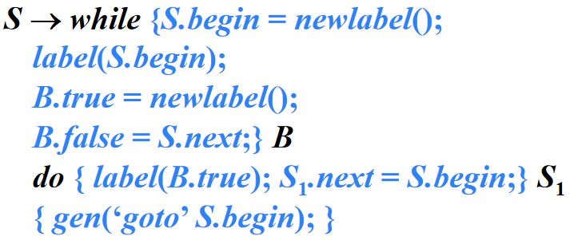
S→for M to{E'.v = M.v;
S.begin = newlabel();
label(S.begin);
E'.true = newlabel();
E'.false = S.next;}E'
do{N.v = M.v;
label(E'.true);
N.next = S.begin;}N
{gen(‘goto’ S.begin);
M→id=E;{a'}
E'→E1+E2| -E1| (E1)| id| L
N→S

Slide 6
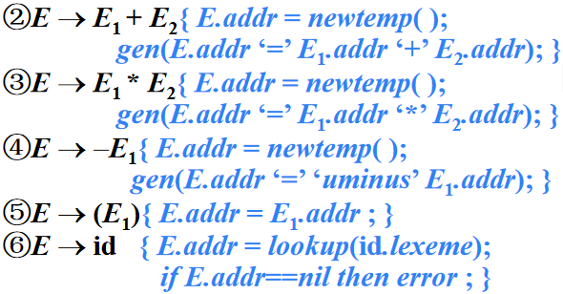
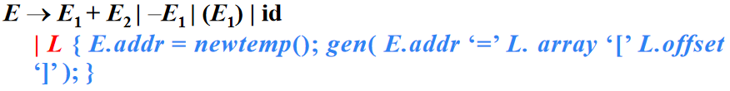
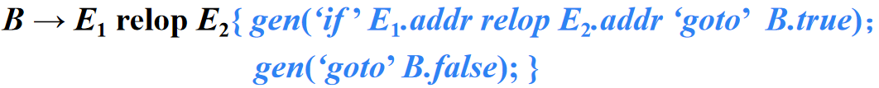
S→for M to{x}E' do{x}N{x}
M→id=E;{a'}
E'→E1+E2| -E1| (E1)| id| L
{b;
t = lookup(E'.v);
if p==nil then error ;
gen(‘if ’ t <= E'.addr ‘goto’ E'.true)；
gen(‘goto’ E'.false);}
N→S
构造while语句
为方便表示，上面的语义动作皆用b标识

Slide 7
S→for M to{x}E' do{x}N{x}
M→id=E;{a'}
E'→E1+E2| -E1| (E1)| id| L{a'}
N→{S.next = N.next}S{p = lookup(N.v);
if p==nil then error ;
gen( p ‘=’ N.v + 1);}
(这个指令可能不准确)
构造while语句

Slide 8
P → {a}S{a}
S → {a}S₁{a}S₂
S → id=E;{a} | L=E;{a}
E → E₁+E₂{a} | −E₁{a} | (E₁){a}| id{a}| L{a}
L → id[E]{a} | L₁[E]{a}
S → if {a}B then {a}S₁| if {a}B then {a}S₁ else {a}S₂| while {a}B do {a}S₁{a}
for M to{E'.v = M.v;S.begin = newlabel();label(S.begin);E'.true = newlabel();
E'.false = S.next;}E'do{N.v = M.v;label(E'.true);N.next = S.begin;}N
{gen(‘goto’ S.begin);
B → {a}B or {a}B | {a}B and {a}B | not {a}B | ({a}B) | E relop E{a} | true{a} | false{a}
M→id=E;{p = lookup(id.lexeme);if p==nil then error;gen( p ‘=’ E.addr );
M.v = id.lexeme;}
E'→E1+E2| -E1| (E1)| id| L{b;t = lookup(E'.v);if p==nil then error ;
gen(‘if ’ t <= E'.addr ‘goto’ E'.true);gen(‘goto’ E'.false);}
N→{S.next = N.next}S{p = lookup(N.v); if p==nil then error ; gen( p ‘=’ N.v + 1);}

