Slide 1
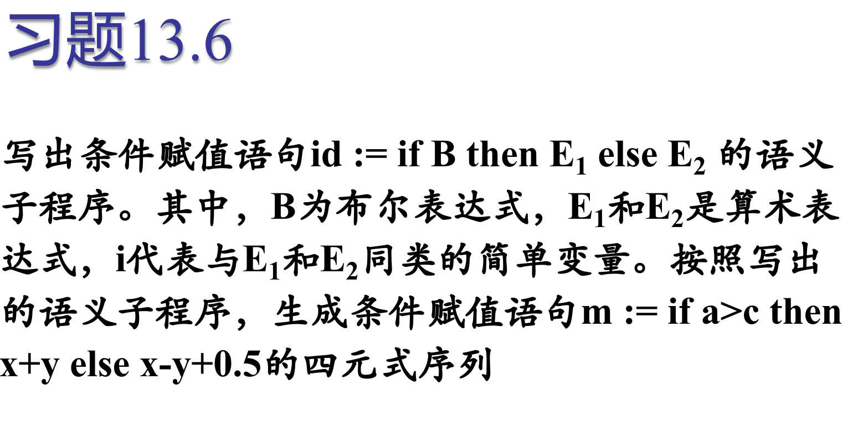
1180300725 叶楠轩
1180300724 王许睿

Slide 2
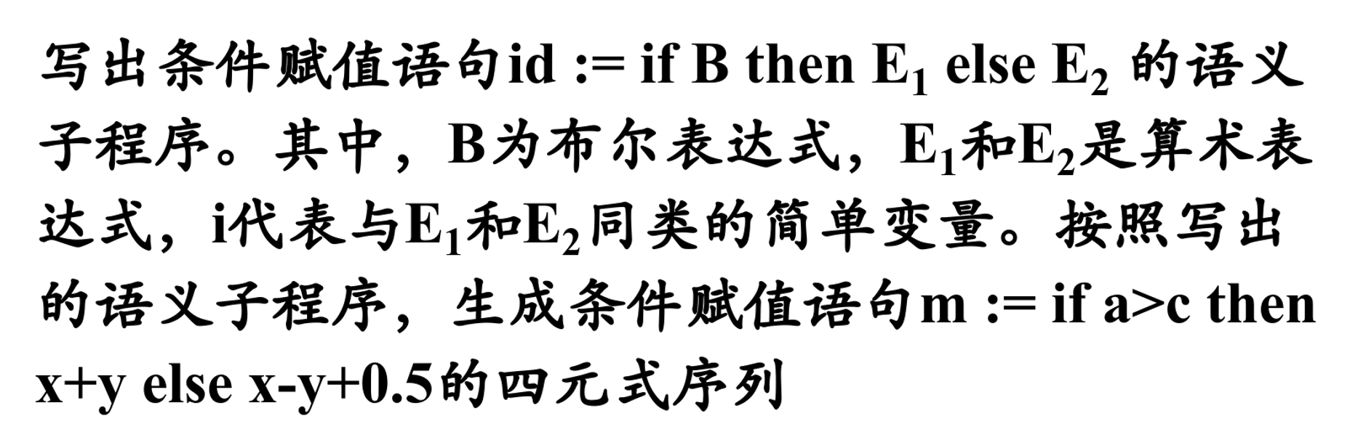
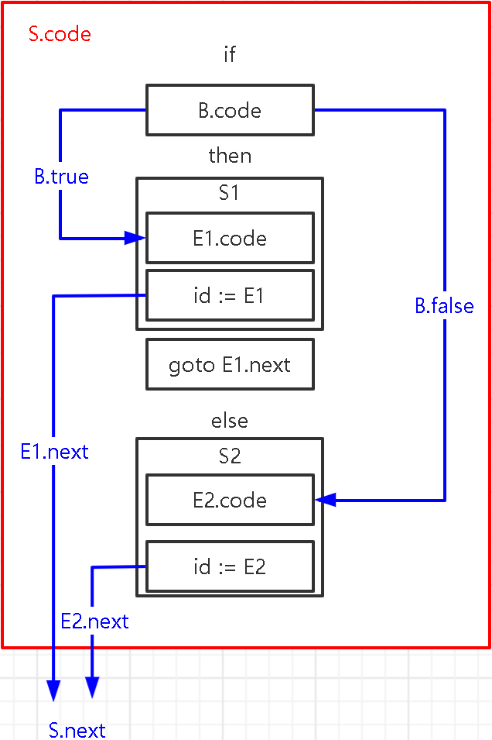
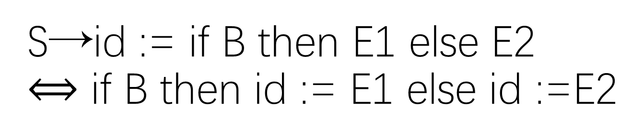
S→id := if B then E1 else E2 $⟺$ if B then id := E1 else id :=E2

Slide 3
S→id:=if{B.true=fall;B.false=newlabel();}B
then { E1.next = S.next; } E1 {
p = lookup( id.lexeme );
if p == nil then error;
gen( p ‘=’ E1.addr );
gen( “goto” S.next ); }
else{label(B.false); E2.next=S.next;} E2
{ p = lookup( id.lexeme );
if p == nil then error;
gen( p ‘=’ E2.addr ); }

Slide 4
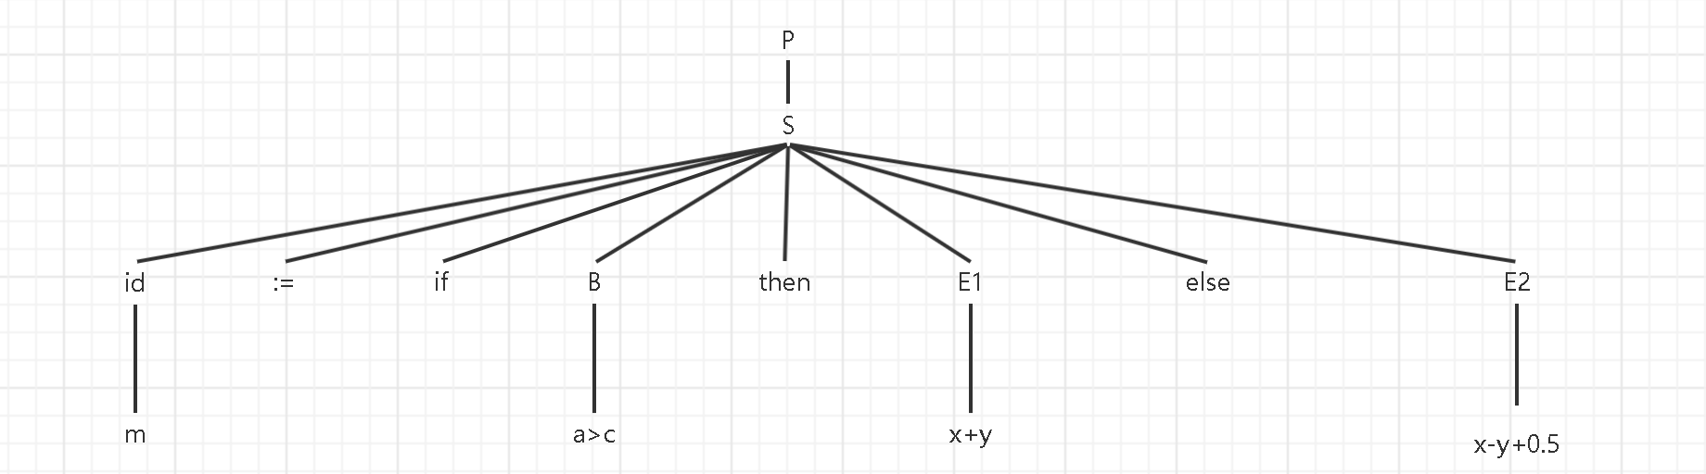
m := if a>c then x+y else x-y+0.5的语法分析树
题目:写出条件赋值语句 id := if b then E1 else E2 的语义子程序。其中，b为布尔表达式，E1和E2 是算术表达式，id代表与e1和e2类型相同的简单变量。按找写出的语义子程序，生成条件赋值语句 m := if a>c then x+y else x-y+0.5 的四元式序列。

Slide 5
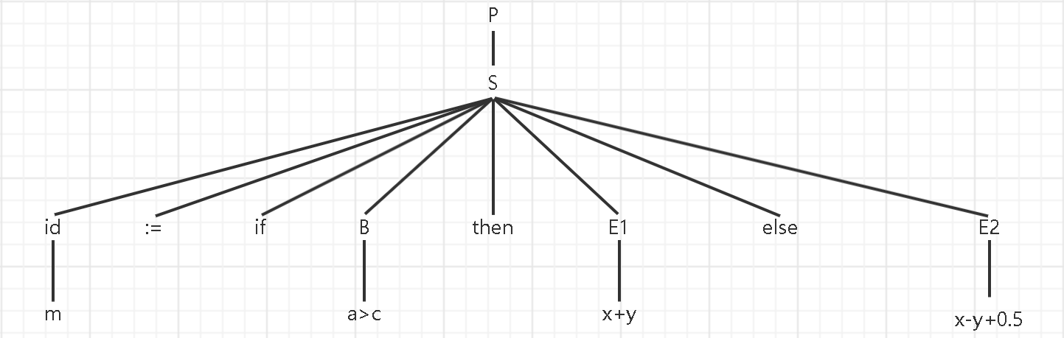
P → { S.next = newlabel(); } S { label( S.next ); }
S.next = L1

Slide 6
S→id:=if{B.true=fall;B.false=newlabel();}B
then { E1.next = S.next; } E1 { p = lookup( id.lexeme );
if p == nil then error;gen( p ‘=’ E1.addr ); gen( “goto” S.next ); }
else{label(B.false); E2.next=S.next;} E2{ p = lookup( id.lexeme );
if p == nil then error;gen( p ‘=’ E2.addr ); }
S.next = L1
B.true = fall
B.false= L2

Slide 7
B→E1 relop E2{ gen ( ‘if’ E1.addr relop E2.addr ‘goto’ B.true);
gen( ‘goto’ B.false ); }
1: if False a>c , goto L2
S.next = L1
B.true = fall
B.false= L2

Slide 8
S→id:=if{B.true=fall;B.false=newlabel();}B
then { E1.next = S.next; } E1 { p = lookup( id.lexeme );
if p == nil then error;gen( p ‘=’ E1.addr ); gen( “goto” S.next ); }
else{label(B.false); E2.next=S.next;} E2{ p = lookup( id.lexeme );
if p == nil then error;gen( p ‘=’ E2.addr ); }
1: if False a>c , goto L2
S.next = L1
B.true = fall
B.false= L2
E1.next = L1

Slide 9
E→E1 + E2 { E.addr = newtemp();
gen(E.addr ‘=‘ E1.addr ‘+’ E2.addr );}
1: if False a>c , goto L2
2: t1 = x+y
S.next = L1
B.true = fall
B.false= L2
E1.next = L1

Slide 10
S→id:=if{B.true=fall;B.false=newlabel();}B
then { E1.next = S.next; } E1 { p = lookup( id.lexeme );
if p == nil then error;gen( p ‘=’ E1.addr ); gen( “goto” S.next ); }
else{label(B.false); E2.next=S.next;} E2{ p = lookup( id.lexeme );
if p == nil then error;gen( p ‘=’ E2.addr ); }
1: if False a>c , goto L2
2: t1 = x+y
3: m = t1
4: goto L1
S.next = L1
B.true = fall
B.false= L2
E1.next = L1

Slide 11
S→id:=if{B.true=fall;B.false=newlabel();}B
then { E1.next = S.next; } E1 { p = lookup( id.lexeme );
if p == nil then error;gen( p ‘=’ E1.addr ); gen( “goto” S.next ); }
else{label(B.false); E2.next=S.next;} E2{ p = lookup( id.lexeme );
if p == nil then error;gen( p ‘=’ E2.addr ); }
1: if False a>c , goto L2
2: t1 = x+y
3: m = t1
4: goto L1
5:
S.next = L1
B.true = fall
B.false= L2
E1.next = L1
E2.next = L1
= 5

Slide 12
E→E1 - E2 { E.addr = newtemp();
gen(E.addr ‘=‘ E1.addr ‘-’ E2.addr );}
E→E1 + E2 { E.addr = newtemp();
gen(E.addr ‘=‘ E1.addr ‘+’ E2.addr );}
1: if False a>c , goto L2
2: t1 = x+y
3: m = t1
4: goto L1
5: t2 = y + 0.5
6: t3 = x – t2
S.next = L1
B.true = fall
B.false= L2 = 5
E1.next = L1
E2.next = L1

Slide 13
S→id:=if{B.true=fall;B.false=newlabel();}B
then { E1.next = S.next; } E1 { p = lookup( id.lexeme );
if p == nil then error;gen( p ‘=’ E1.addr ); gen( “goto” S.next ); }
else{label(B.false); E2.next=S.next;} E2{ p = lookup( id.lexeme );
if p == nil then error;gen( p ‘=’ E2.addr ); }
1: if False a>c , goto L2
2: t1 = x+y
3: m = t1
4: goto L1
5: t2 = y + 0.5
6: t3 = x – t2
7: m = t3
8:
S.next = L1
=8
B.true = fall
B.false= L2 = 5
E1.next = L1
E2.next = L1

Slide 14
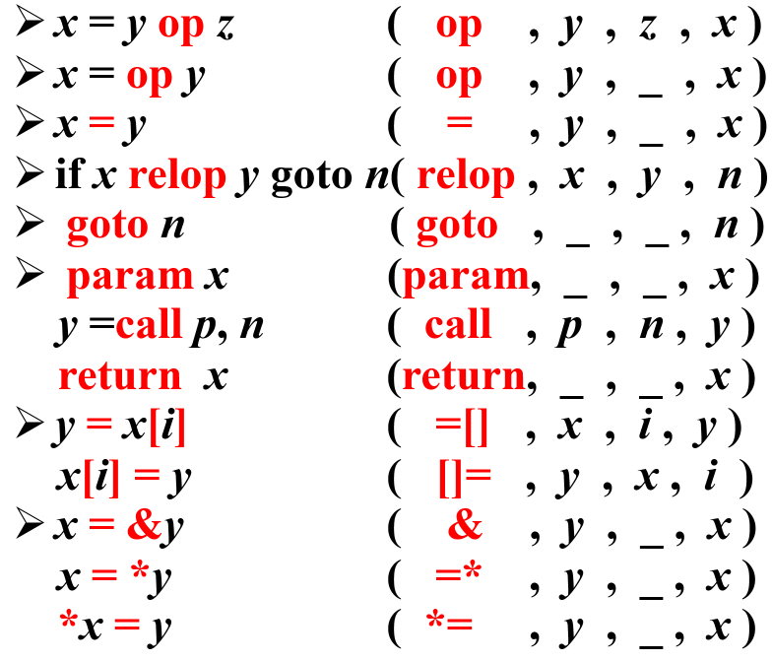
题目:写出条件赋值语句 id := if b then E1 else E2 的语义子程序。其中，b为布尔表达式，E1和E2 是算术表达式，id代表与e1和e2类型相同的简单变量。按找写出的语义子程序，生成条件赋值语句 m := if a>c then x+y else x-y+0.5 的四元式序列。
三地址码：
1: if False a>c , goto L2
2: t1 = x+y
3: m = t1
4: goto L1
5: t2 = y + 0.5
6: t3 = x – t2
7: m = t3
8:
L1 = 8
L2 = 5
四元式序列
1: ( <=, a, c, 5 )
2: ( +, x, y, t1 )
3: ( =, t1, _, m )
4: ( goto, _, _, 8)
5: ( +, y, 0.5, t2 )
6: ( -, x, t2, t3 )
7: ( =, t3, _, m )
8:

