Slide 1
习题14.1
使用SPOC讲义6.4节（回填）中的翻译方案翻译下列表达式。给出每个子表达式的truelist和falselist。你可以假设第一条被生成的指令的地址是100。
(1) a == b && ( c == d || e == f )
(2) ( a == b || c == d ) || e == f
(3) ( a == b && c == d ) && e == f

Slide 2
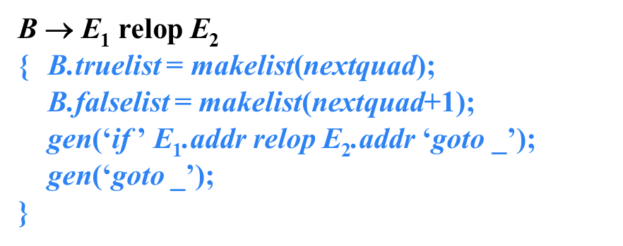
解答
(2) ( a == b || c == d ) || e == f
(
B
a == b

Slide 3
解答
(2) ( a == b || c == d ) || e == f
100: if a==b goto __
101: goto __
(
B.t={100}
B.f={101}
B
a == b

Slide 4
解答
(2) ( a == b || c == d ) || e == f
100: if a==b goto __
101: goto __
(
B.t={100}
B.f={101}
B
||
M.i=102
a == b
c == d

Slide 5
解答
(2) ( a == b || c == d ) || e == f
100: if a==b goto __
101: goto __
102: if c==d goto __
103: goto __
(
B.t={100}
B.f={101}
B
||
M.i=102
B
B.t={102}
B.f={103}
a == b
c == d

Slide 6
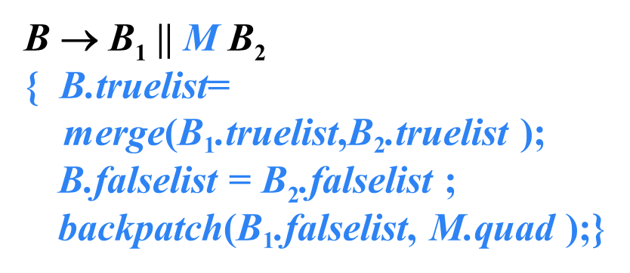
解答
(2) ( a == b || c == d ) || e == f
100: if a==b goto __
101: goto 102
102: if c==d goto __
103: goto __
(
B.t={100,102}
B.f={103}
B
B.t={100}
B.f={101}
B
||
M.i=102
B
B.t={102}
B.f={103}
a == b
c == d

Slide 7
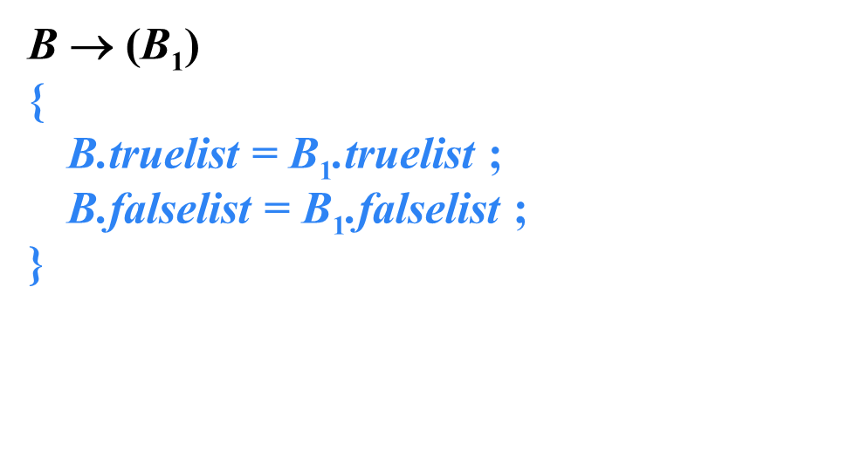
解答
(2) ( a == b || c == d ) || e == f
100: if a==b goto __
101: goto 102
102: if c==d goto __
103: goto __
B.t={100,102}
B.f={103}
B
(
B.t={100,102}
B.f={103}
B
)
B.t={100}
B.f={101}
B
||
M.i=102
B
B.t={102}
B.f={103}
a == b
c == d

Slide 8
解答
(2) ( a == b || c == d ) || e == f
100: if a==b goto __
101: goto 102
102: if c==d goto __
103: goto __
B.t={100,102}
B.f={103}
B
||
M.i=104
e == f
(
B.t={100,102}
B.f={103}
B
)
B.t={100}
B.f={101}
B
||
M.i=102
B
B.t={102}
B.f={103}
a == b
c == d

Slide 9
解答
(2) ( a == b || c == d ) || e == f
100: if a==b goto __
101: goto 102
102: if c==d goto __
103: goto __
B.t={100,102}
B.f={103}
B.t={104}
B.f={105}
104: if e==f goto __
B
||
M.i=104
B
105: goto __
e == f
(
B.t={100,102}
B.f={103}
B
)
B.t={100}
B.f={101}
B
||
M.i=102
B
B.t={102}
B.f={103}
a == b
c == d

Slide 10
解答
(2) ( a == b || c == d ) || e == f
100: if a==b goto __
101: goto 102
B.t={100,102,104}
B.f={105}
102: if c==d goto __
B
103: goto 104
B.t={100,102}
B.f={103}
B.t={104}
B.f={105}
104: if e==f goto __
B
||
M.i=104
B
105: goto __
e == f
(
B.t={100,102}
B.f={103}
B
)
B.t={100}
B.f={101}
B
||
M.i=102
B
B.t={102}
B.f={103}
a == b
c == d

