Slide 1
习题14.3
吴添钦1180300515

Slide 2
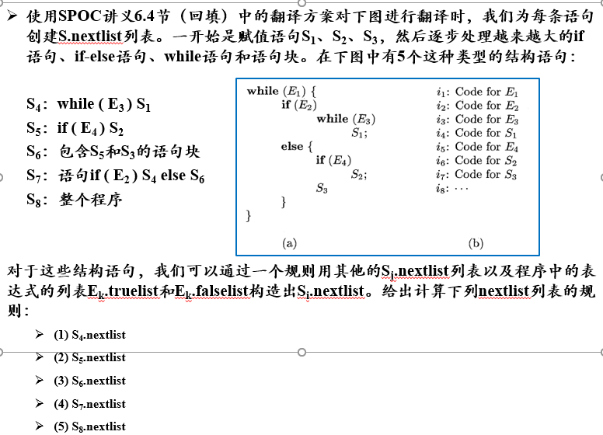

Slide 3
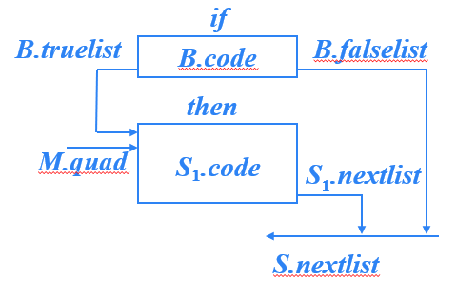
S → if B then S₁ _{代码结构图}
S.nextlist={S1.nextlist,B.falselist}

Slide 4
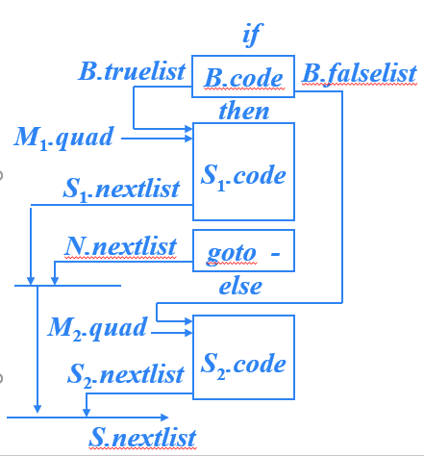
S → if B then S₁ else S₂
S.nextlist={S1.nextlist,N.nextlist,S2.nextlist}

Slide 5
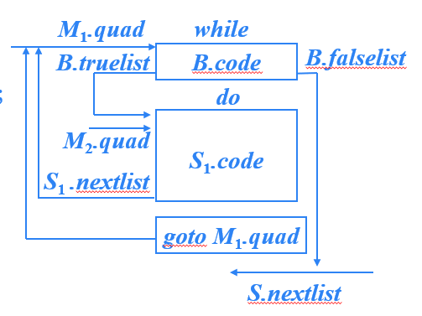
S → while B do S₁
S.nextlist={B.falselist}

Slide 6
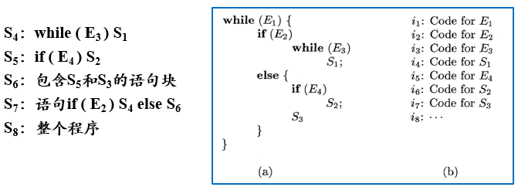
S4.nextlist={E3.falselist}
S5.nextlist={E4.falselist,S2.nextlist}
S6.nextlist={S3.nextlist}
S7.nextlist={S4.nextlist,S6.nextlist}
S8.nextlist={E1.falselist}
E4
E4.truelist
S2
E4.falselist
S2.nextlist
S3
S3.nextlist
S6.nextlist

