Slide 1
习题15.8
1180300217袁楠皓

Slide 2
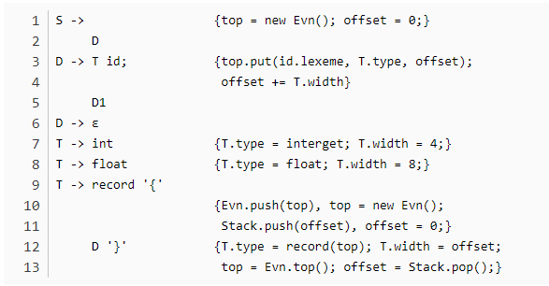

float x ;
record {float x; float y;} p;
record {int tag; float x; float y;} q;
top.put(x,float,0)
S
{a}
D
type=float
width=8
T
id
;
{a}
D1
float
{a}
T
id
{a}
D1
record
{
{a}
D
}
{a}

Slide 3
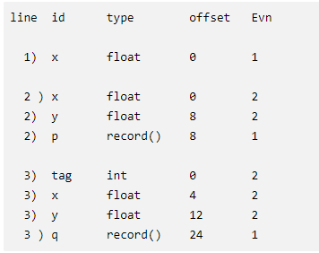
float x ; record {}p; record {}q;
float x ; offset=0
float y ; offset=8
int tag; offset=0
float x; offset=4
float y; offset=12
offset=0
offset=0+8
offset=0+8+8+8

Slide 4


