Slide 1

习题16.3
2
+
2
+
1170300203 雷乐其

Slide 2

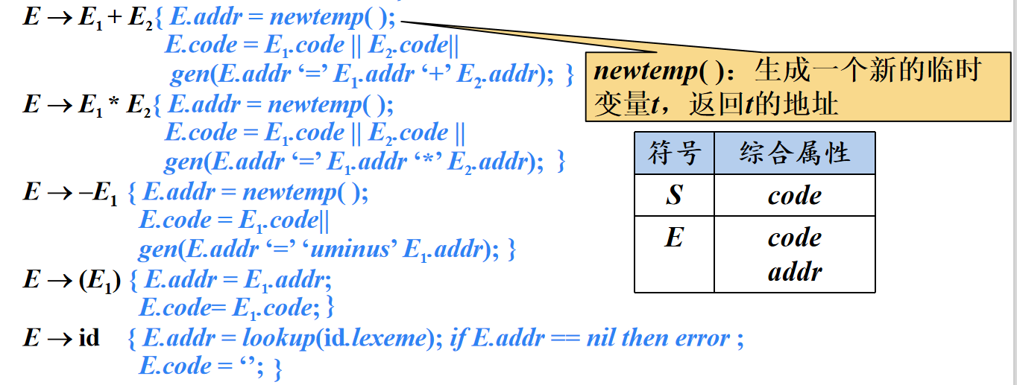
2
+
为下面的表达式构造DAG
((x + y) - ((x +y) * (x -y))) + ((x+y) * (x -y))
生成临时变量存储中间结果
$
((x + y) - ((x +y) * (x -y))) + ((x+y) * (x -y)) $

Slide 3
2
+
((x + y) - ((x +y) * (x -y))) + ((x+y) * (x -y))
t1 = x + y
t2 = x + y
t3 = x – y
t4 = t2 * t3
t5 = t1 – t4
t6 = x + y
t7 = x – y
t8 = t6 * t7
t9 = t5 + t8
E
E
E
E
E
E
E
E
E
E
E
E
E
E
E
E
E
E
E
E
E
E
E
E
E
E
E
(
(
x
+
y
)
-
(
(
x
+
y
)
*
(
x
-
y
)
)
）
+
(
(
x
+
y
)
*
(
x
-
y
)
)

Slide 4
2
+
t1 = x + y
t2 = x + y
t3 = x – y
t4 = t2 * t3
t5 = t1 – t4
t6 = x + y
t7 = x – y
t8 = t6 * t7
t9 = t5 + t8
t1 = x + y
t3 = x – y
t4 = t1 * t3
t5 = t1 – t4
t9 = t5 + t4
每个节点保留
一个变量即可
t5
+
t9
-
*
t4
t8
-
t3
t7
+
t1
t2
t6
y0
x0

Slide 5
以上，谢谢！
2
+
2
+
敬请斧正

