Slide 1
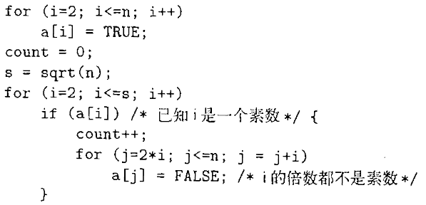
习题16.2
下图中是计算从2~n之间素数个数的代码。
(1) 假设数组的元素是需要4个字节存放的的整数，把程序翻译成三地址语句。
(2) 为(1)中得到的代码构造流图。
(3) 找出在(2)中得到的流图的循环。
1183710102-张欣玥
1180300422-吴仁龙

Slide 2
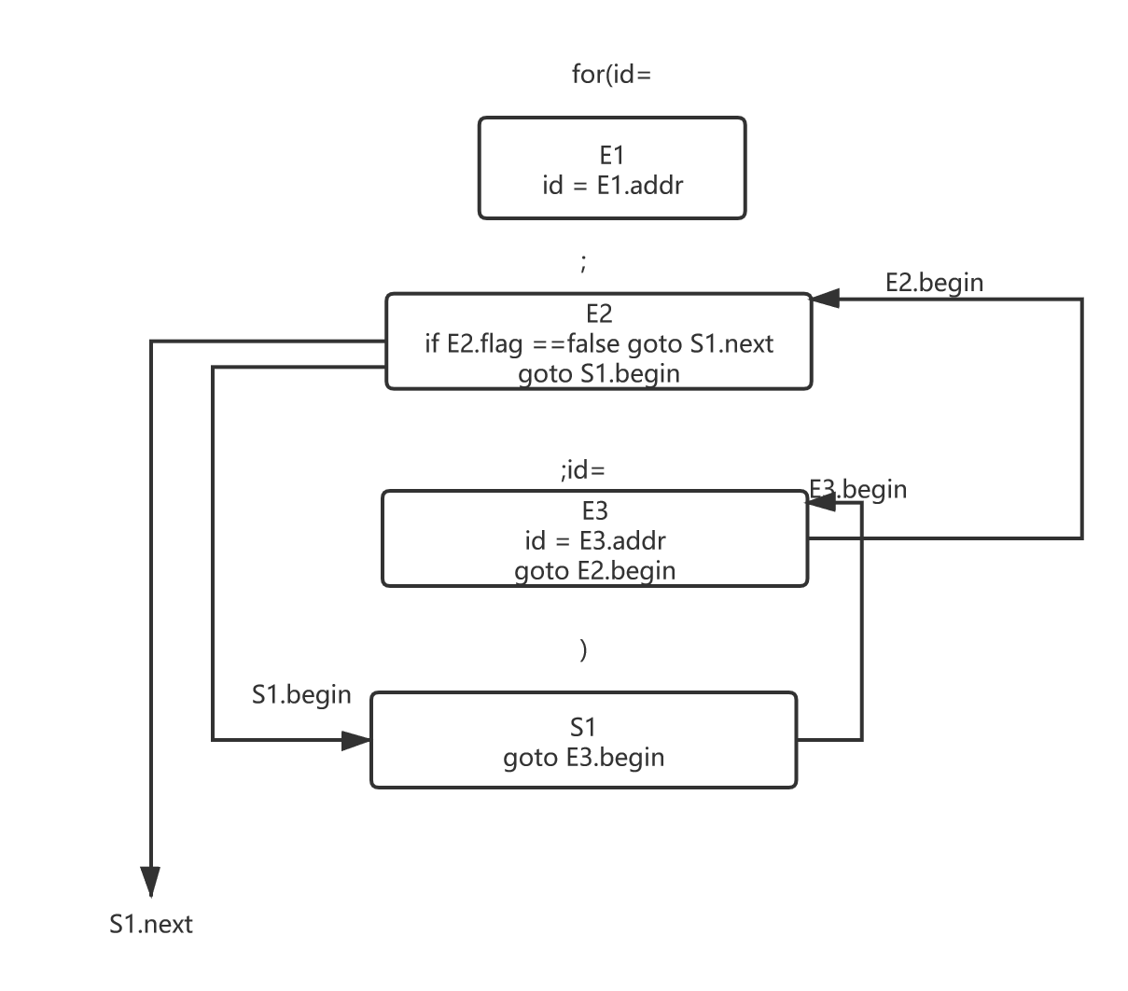

Slide 3
(1) i = 2
(2) if i>n, goto (9) ###E2.begin
(3) goto (6)
(4) i = i+1 ###E3.begin
(5) goto (2)
(6) t1 = 4*i ###S1.begin
(7) a[t1] = TRUE
(8) goto (4)
(9) count = 0 ###S1.next
(10) param n
(11) s = call sqrt,1

Slide 4
(12)i = 2 ###RE1.begin (13) if i>s,goto (30) ###RE2.begin (14) goto (17) (15) i = i+1 ###RE3.begin (16) goto (13) (17) t3 = 4*i ###RS1.begin ME1.begin (18) t4 = a[t3] (19) if t4!=TRUE, goto (29) (20)count = count+1 ###ME2.begin (21) j = 2*i ###BE1.begin (22)if j>n,goto (29) ###BE2.begin (23)goto (26) (24)j = j+i ###BE3.begin (25)goto (22) (26)t5 = j *4 ###BS1.begin (27)a[t5] = FALSE (28)goto (24) (29)goto (15) ###BS1.next (30) ###RS1.next

Slide 5
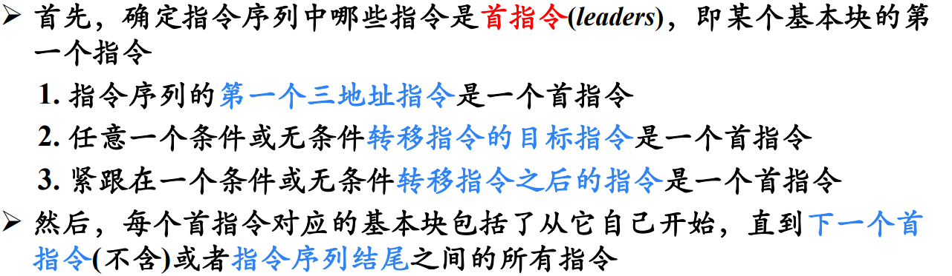
(1) i = 2
(2) if i>n, goto (9)
(3) goto (6)
(4) i = i+1
(5) goto (2)
(6) t1 = 4*i
(7) a[t1] = TRUE
(8) goto (4)
(9) count = 0
(10) param n
(11) s = call sqrt,1
(12)i = 2
(13) if i>s,goto (30)
(14) goto (17)
(15) i = i+1
(16) goto (13)
(17) t3 = 4*i
(18) t4 = a[t3]
(19) if t4!=TRUE, goto (29)
(20)count = count+1
(21) j = 2*i
(22)if j>n,goto (29)
(23)goto (26)
(24)j = j+i
(25)goto (22)
(26)t5 = j *4
(27)a[t5] = FALSE
(28)goto (24)
(29)goto (15)
(30)

Slide 6
(1) i = 2
(2) if i>n, goto (9)
(3) goto (6)
(4) i = i+1
(5) goto (2)
(6) t1 = 4*i
(7) a[t1] = TRUE
(8) goto (4)
(9) count = 0
(10) param n
(11) s = call sqrt,1
(12)i = 2
(13) if i>s,goto (30)
(14) goto (17)
(15) i = i+1
(16) goto (13)
(17) t3 = 4*i
(18) t4 = a[t3]
(19) if t4!=TRUE, goto (29)
(20)count = count+1
(21) j = 2*i
(22)if j>n,goto (29)
(23)goto (26)
(24)j = j+i
(25)goto (22)
(26)t5 = j *4
(27)a[t5] = FALSE
(28)goto (24)
(29)goto (15)
(30)

Slide 7
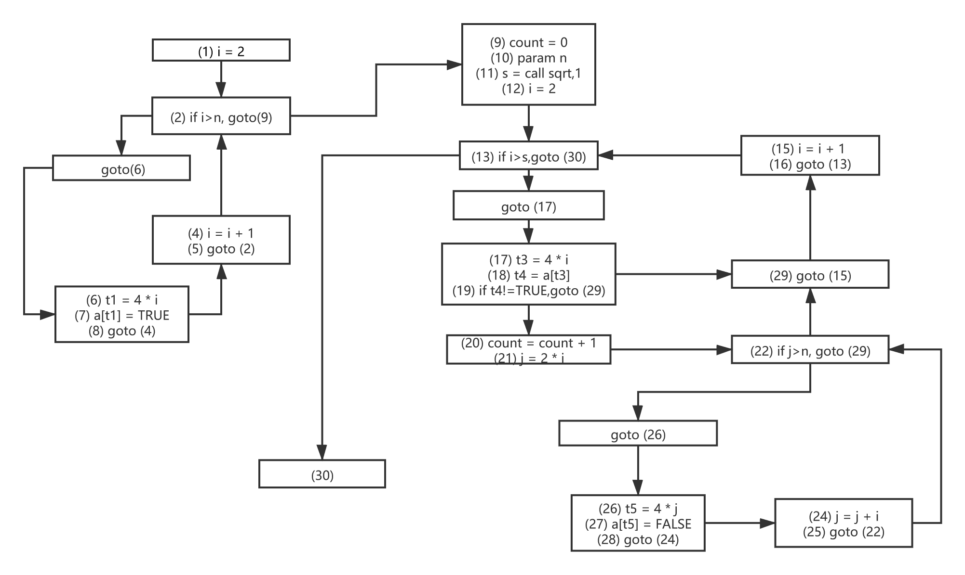
B6
B1
B2
B7
B13
B3
B5
B8
B12
B9
B10
B11
B4
B14
B1
B16
B15

Slide 8
B1
Entry
寻找流图中的循环：
1.计算支配节点
2.找回边
3.找组成循环的节点
B2
B6
B5
B3
B7
13
B4
B8
B9
12
10
11
16
14
15

Slide 9
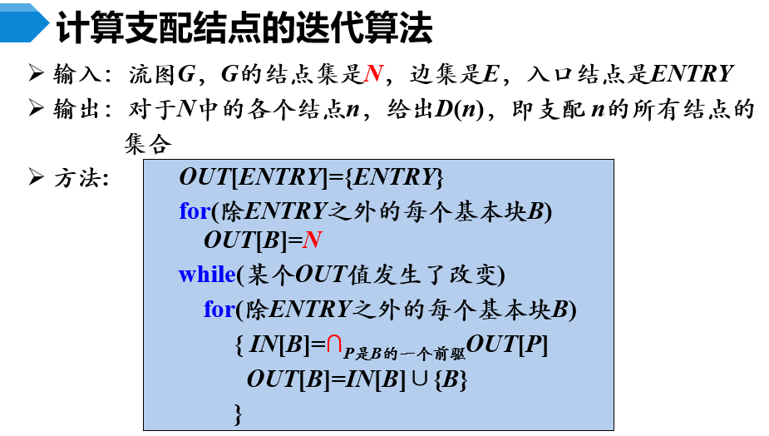
1
 | OUT ⁰[B] | IN¹[B] | OUT¹[B]
E | { E }
1 | N | {E | {E,1
2 | N | {E,1 | {E,1,2
3 | N | {E,1,2 | {E,1,2,3
4 | N | {E,1,2,3 | {E,1,2,3,4
5 | N | {E,1,2,3,4 | {E,1,2,3,4,5
6 | N | {E,1,2 | {E,1,2,6
7 | N | {E,1,2,6 | {E,1,2,6,7
8 | N | {E,1,2,6,7 | {E,1,2,6,7,8
9 | N | {E,1,2,6,7,8 | {E,1,2,6,7,8,9
10 | N | {E,1,2,6,7,8,9 | {E,1,2,6,7,8,9,10
2
6
5
3
7
4
8
13
9
12
10
11
16
14
15
11 | N | {E,1,2,6,7,8,9,10 | {E,1,2,6,7,8,9,10,11
12 | N | {E,1,2,6,7,8,9 | {E,1,2,6,7,8,9,12
13 | N | {E,1,2,6,7,8,9,12 | {E,1,2,6,7,8,9,12,13
14 | N | {E,1,2,6,7,8,9,10,11 | {E,1,2,6,7,8,9,10,11,12
15 | N | {E,1,2,6,7,8,9,10,11,14 | {E,1,2,6,7,8,9,10,11,14,15
16 | N | {E,1,2,6,7,8,9,10,11,14,15 | {E,1,2,6,7,8,9,10,11,14,15,16
Notes:
如果从流图的入口结点到结点n的每条路径都经过结点d，则称结点d支配(dominate)
前驱
Out(B)0
In(B)1
Out(B)1
In(B)2
Out(B)2
E
{E}
1
E
N
{E
{E,1
{E,1
{E,1
2
1\5
N
{E,1
{E,1,2
{E,1,2
{E,1,2
3
2
N
{E,1,2
{E,1,2,3
{E,1,2
{E,1,2,3
4
3
N
{E,1,2,3
{E,1,2,3,4
{E,1,2,3
{E,1,2,3,4
5
4
N
{E,1,2,3,4
{E,1,2,3,4,5
{E,1,2,3,4
{E,1,2,3,4,5
6
2
N
{E,1,2
{E,1,2,6
{E,1,2
{E,1,2,6
7
6\13
N
{E,1,2,6
{E,1,2,6,7
{E,1,2,6
{E,1,2,6,7
8
7
N
{E,1,2,6,7
{E,1,2,6,7,8
{E,1,2,6,7
{E,1,2,6,7,8
9
8
N
{E,1,2,6,7,8
{E,1,2,6,7,8,9
{E,1,2,6,7,8
{E,1,2,6,7,8,9
10
9
N
{E,1,2,6,7,8,9
{1,2,6,7,8,9,10
{E,1,2,6,7,8,9
{E,1,2,6,7,8,9,10
11
10\16
N
{E,1,2,6,7,8,9,10
{E,1,2,6,7,8,9,10,11
{E,1,2,6,7,8,9,10
{E,1,2,6,7,8,9,10,11
12
9\11
N
{E,1,2,6,7,8,9
{E,1,2,6,7,8,9,12
{E,1,2,6,7,8,9
{E,1,2,6,7,8,9,12
13
12
N
{E,1,2,6,7,8,9,12
{E,1,2,6,7,8,9,12,13
{E,1,2,6,7,8,9,12
{E,1,2,6,7,8,9,12,13
14
11
N
{E,1,2,6,7,8,9,10,11
{E,1,2,6,7,8,9,10,11,14
E,1,2,6,7,8,9,10,11
E,1,2,6,7,8,9,10,11,14
15
14
N
{E,1,2,6,7,8,9,10,11,14
{E,1,2,6,7,8,9,10,11,14,15
E,1,2,6,7,8,9,10,11,14
E,1,2,6,7,8,9,10,11,14,15
16
15
N
{E,1,2,6,7,8,9,10,11,14,15
{E,1,2,6,7,8,9,10,11,14,15,16
E,1,2,6,7,8,9,10,11,14,15
E,1,2,6,7,8,9,10,11,14,15,16
结点n，记为d dom n
每个结点都支配它自己

Slide 10
1
 | OUT ⁰[B] | IN¹[B] | OUT¹[B]
E | { E }
1 | N | {E | {E,1
2 | N | {E,1 | {E,1,2
3 | N | {E,1,2 | {E,1,2,3
4 | N | {E,1,2,3 | {E,1,2,3,4
5 | N | {E,1,2,3,4 | {E,1,2,3,4,5
6 | N | {E,1,2 | {E,1,2,6
7 | N | {E,1,2,6 | {E,1,2,6,7
8 | N | {E,1,2,6,7 | {E,1,2,6,7,8
9 | N | {E,1,2,6,7,8 | {E,1,2,6,7,8,9
10 | N | {E,1,2,6,7,8,9 | {E,1,2,6,7,8,9,10
2
6
5
3
7
4
8
13
9
12
10
11
16
14
15
11 | N | {E,1,2,6,7,8,9,10 | {E,1,2,6,7,8,9,10,11
12 | N | {E,1,2,6,7,8,9 | {E,1,2,6,7,8,9,12
13 | N | {E,1,2,6,7,8,9,12 | {E,1,2,6,7,8,9,12,13
14 | N | {E,1,2,6,7,8,9,10,11 | {E,1,2,6,7,8,9,10,11,12
15 | N | {E,1,2,6,7,8,9,10,11,14 | {E,1,2,6,7,8,9,10,11,14,15
16 | N | {E,1,2,6,7,8,9,10,11,14,15 | {E,1,2,6,7,8,9,10,11,14,15,16
假定流图中存在两个结点d和n满足d dom n。如果存在从结点n到d的有向边n→d，那么这条边称为回边.
OUT(Bn)已经给出了支配节点n的所有点集合，所以只需要找n->Out(Bn)这样的边。
Notes:
如果从流图的入口结点到结点n的每条路径都经过结点d，则称结点d支配(dominate)
前驱
Out(B)0
In(B)1
Out(B)1
In(B)2
Out(B)2
E
{E}
1
E
N
{E
{E,1
{E,1
{E,1
2
1\5
N
{E,1
{E,1,2
{E,1,2
{E,1,2
3
2
N
{E,1,2
{E,1,2,3
{E,1,2
{E,1,2,3
4
3
N
{E,1,2,3
{E,1,2,3,4
{E,1,2,3
{E,1,2,3,4
5
4
N
{E,1,2,3,4
{E,1,2,3,4,5
{E,1,2,3,4
{E,1,2,3,4,5
6
2
N
{E,1,2
{E,1,2,6
{E,1,2
{E,1,2,6
7
6\13
N
{E,1,2,6
{E,1,2,6,7
{E,1,2,6
{E,1,2,6,7
8
7
N
{E,1,2,6,7
{E,1,2,6,7,8
{E,1,2,6,7
{E,1,2,6,7,8
9
8
N
{E,1,2,6,7,8
{E,1,2,6,7,8,9
{E,1,2,6,7,8
{E,1,2,6,7,8,9
10
9
N
{E,1,2,6,7,8,9
{1,2,6,7,8,9,10
{E,1,2,6,7,8,9
{E,1,2,6,7,8,9,10
11
10\16
N
{E,1,2,6,7,8,9,10
{E,1,2,6,7,8,9,10,11
{E,1,2,6,7,8,9,10
{E,1,2,6,7,8,9,10,11
12
9\11
N
{E,1,2,6,7,8,9
{E,1,2,6,7,8,9,12
{E,1,2,6,7,8,9
{E,1,2,6,7,8,9,12
13
12
N
{E,1,2,6,7,8,9,12
{E,1,2,6,7,8,9,12,13
{E,1,2,6,7,8,9,12
{E,1,2,6,7,8,9,12,13
14
11
N
{E,1,2,6,7,8,9,10,11
{E,1,2,6,7,8,9,10,11,14
E,1,2,6,7,8,9,10,11
E,1,2,6,7,8,9,10,11,14
15
14
N
{E,1,2,6,7,8,9,10,11,14
{E,1,2,6,7,8,9,10,11,14,15
E,1,2,6,7,8,9,10,11,14
E,1,2,6,7,8,9,10,11,14,15
16
15
N
{E,1,2,6,7,8,9,10,11,14,15
{E,1,2,6,7,8,9,10,11,14,15,16
E,1,2,6,7,8,9,10,11,14,15
E,1,2,6,7,8,9,10,11,14,15,16
结点n，记为d dom n
每个结点都支配它自己

Slide 11
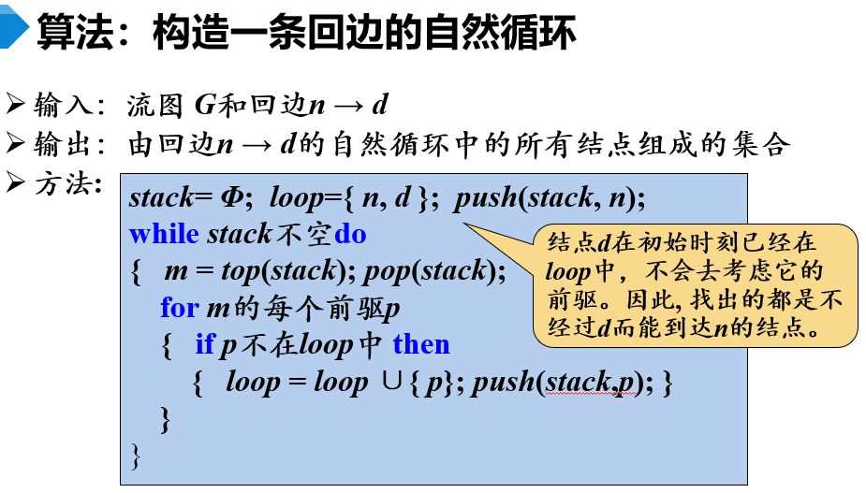
回边 | 自然循环
5->2 | 2\5\4\3
13->7 | 7\13\12\9\8\10\11\16\15\14
16->11 | 11\16\15\14
1
2
6
5
3
7
4
8
13
9
12
10
11
16
14
15

