Slide 1
Towards Scalable and Generalizable
Video Retrieval
PhD Thesis Defense
Zhuoning Guo
Thrust of Artificial Intelligence, HKUST(GZ)
Advisors: Prof. Xiaowen Chu & Prof. Renjing Xu
July 29, 2026

Slide 2
Contents
02
Contents
01
Background & Motivation
04
Search Scaling
Retrieval pipeline, benchmark–production gap, thesis framework.
GMP-GR: metric, graph traversal and production-scale ANNS.
02
Semantic Scaling
05
Synthesis & Outlook
GVE: capability diagnosis, synthetic curriculum, general video embedding.
Cross-study insights, limitations, future directions and conclusion.
03
Observational Scaling
MG-LVR + VEterfall: granularity, sampling density, efficient inference.

Slide 3
Background
03
Video Retrieval: the Big Picture
Given a query, find semantically relevant videos from a massive collection — instantly.
Query
Embedding
Search
Ranking
Display
Text · image · composed
Align query and video
Billion-scale ANNS
DNN relevance
Real-time feed
500 hrs/min
1B+
100M+
3 stages
YouTube upload scale
TikTok active users
daily-scale traffic
covered in this thesis
Core Question
How can video retrieval generalize beyond controlled benchmarks to real-world scale?

Slide 4
Background
04
The Benchmark–Production Gap
Academic protocols stress isolated capabilities; real systems compound all constraints.
Benchmark World
Production Reality
Structural Gap
• Short clips (10–30s)
• Single query type
• 1K–10K candidates
• Single capability
• Minutes-to-hours videos
• Text / image / composed queries
• Billion-scale corpus
• Sub-ms to few-ms budget
• Heterogeneous queries
• Multi-granular evidence
• Efficient observation
• Scalable retrieval
Thesis Position
The gap is structural rather than incremental: increasing data, parameters, frames or metric AUC alone exposes new bottlenecks downstream.

Slide 5
Background
05
Three Sequential Scaling Challenges
Representation → observation → deployment; each stage has its own bottleneck.
Semantic Scaling
Observational Scaling
Search Scaling
What capabilities must the model possess?
How should long videos be observed efficiently?
How can embeddings be searched at web scale?
GVE · UVRB · UVRD
MG-LVR · VEterfall
GMP-GR · MUIRML · HiPANNS
Serving constraints shape observation budget
Observed evidence bounds representation quality

Slide 6
Background
06
Why Existing Approaches Fall Short
Each stage fails for a different structural reason.
Semantic Scaling
Observational Scaling
Search Scaling
Fragmented benchmarks and misleading model rankings: capability breadth does not follow parameter count monotonically.
Short-clip protocols hide the interaction between frame sampling, spatial resolution and query granularity.
Neural metrics violate metric assumptions needed by graph ANNS, degrading traversal under tight latency budgets.
Unified Observation
The remedy is structure-aware scaling: design the data, observation strategy and search space around the bottleneck actually exposed at each stage.

Slide 7
Contributions
07
Thesis Contributions at a Glance
Study 1 · Semantic Scaling · GVE
Study 2 · Observational Scaling
Study 3 · Search Scaling · GMP-GR
• UVRB: 14 models × 16 datasets × 3 task types
• V-SynFlow → UVRD: 1.55M targeted training pairs
• GVE-7B: SOTA zero-shot, +6.5 pp over Unite-7B
• MG-LVR: 12K videos, 400K clips, 9,971 queries
• Scaling laws reveal frame-count anchoring and S-T trade-off
• VEterfall: +20% fine-grained R@1 at 4–16× token efficiency
• MUIRML: metric regularization for graph compatibility
• HiPANNS: hierarchical parallel ANNS on GPU
• Deployed at Baidu: 20+ apps, 100M+ users/day

Slide 8
Related Work
08
Related Work: Two Model Families & Open Problems
Video Embedding Models
Benchmarks
Large-Scale Search
• CLIP-based: fast dual encoders, strong standard retrieval
• MLLM-based: unified multimodal representations
• Open gap: fair comparison across task types
• MSR-VTT, DiDeMo, LoVR, CoVR: each covers one dimension
• No benchmark combines long video with multi-granular queries
• Open gap: controlled protocols miss production bottlenecks
• HNSW graph index dominates practical ANNS
• Neural ranking metrics break triangle inequality
• Open gap: no metric–graph–hardware co-design

Slide 9
01
Semantic Scaling: the core question
What capabilities must a video retrieval model possess to generalize?
Semantic Scaling
Diagnosis
General Video Embedder (GVE)
UVRB evaluates 14 models on 16 datasets and 8 ability dimensions.
Synthesis
V-SynFlow converts diagnosed gaps into targeted training data.
Result
GVE achieves SOTA zero-shot performance across textual, visual and composed retrieval.

Slide 10
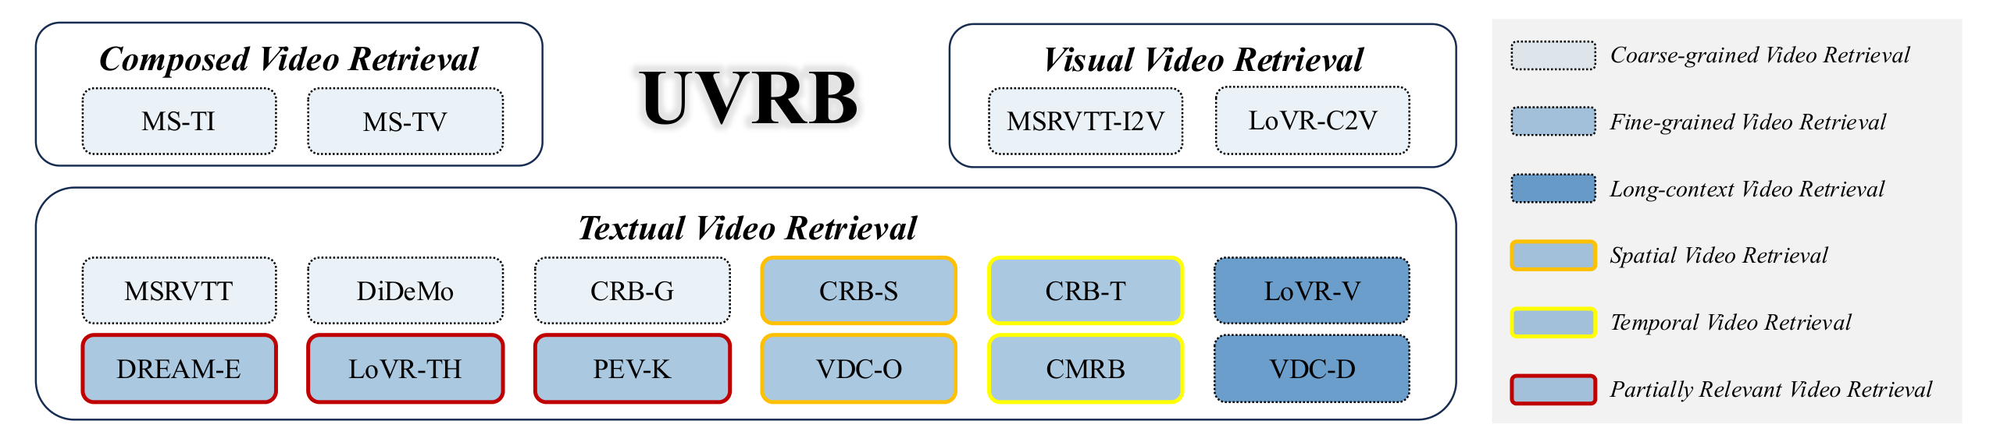
Study 1 · Semantic Scaling
10
UVRB: A Unified Benchmark to Diagnose Video Retrieval
Three Task Families
• Textual retrieval
• Visual I2V / V2V retrieval
• Composed multimodal retrieval
Ability Coverage
• Fine / coarse granularity
• Temporal / spatial reasoning
• Partially relevant matching
Why Unified?
Identical evaluation conditions remove dataset-specific preprocessing artifacts and expose transferable capability gaps.

Slide 11
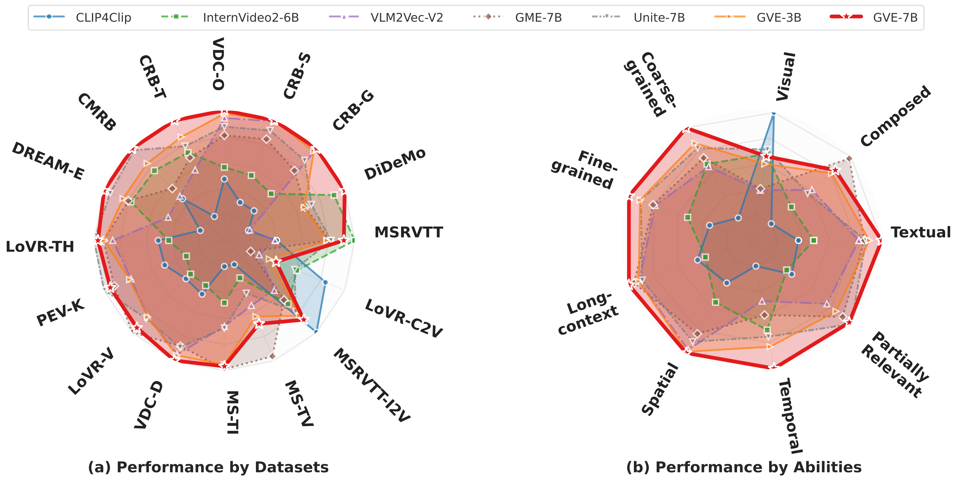
Study 1 · Semantic Scaling
11
UVRB Results: GVE-7B Leads Across Datasets and Abilities
Left Radar
Performance across 16 individual datasets; GVE-7B occupies the largest area.
Right Radar
Performance across 8 ability dimensions; temporal and fine-grained axes remain difficult.
Implication
The remaining gaps motivate capability-targeted synthetic data rather than uniform data scaling.

Slide 12
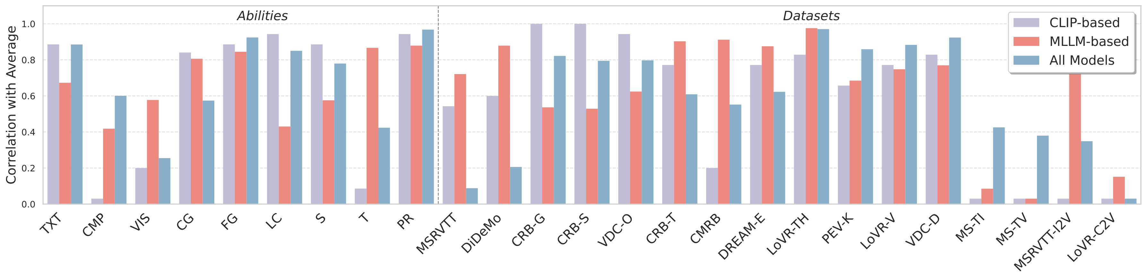
Study 1 · Semantic Scaling
12
Finding 1: Partially-Relevant Retrieval Predicts Universality
ρ ≈ 0.94
highest correlation with overall average
Interpretation
PR retrieval measures whether a model can match partial evidence without relying on exact one-to-one captions.
Practical Use
PR can serve as a lightweight diagnostic proxy for video retrieval universality.

Slide 13
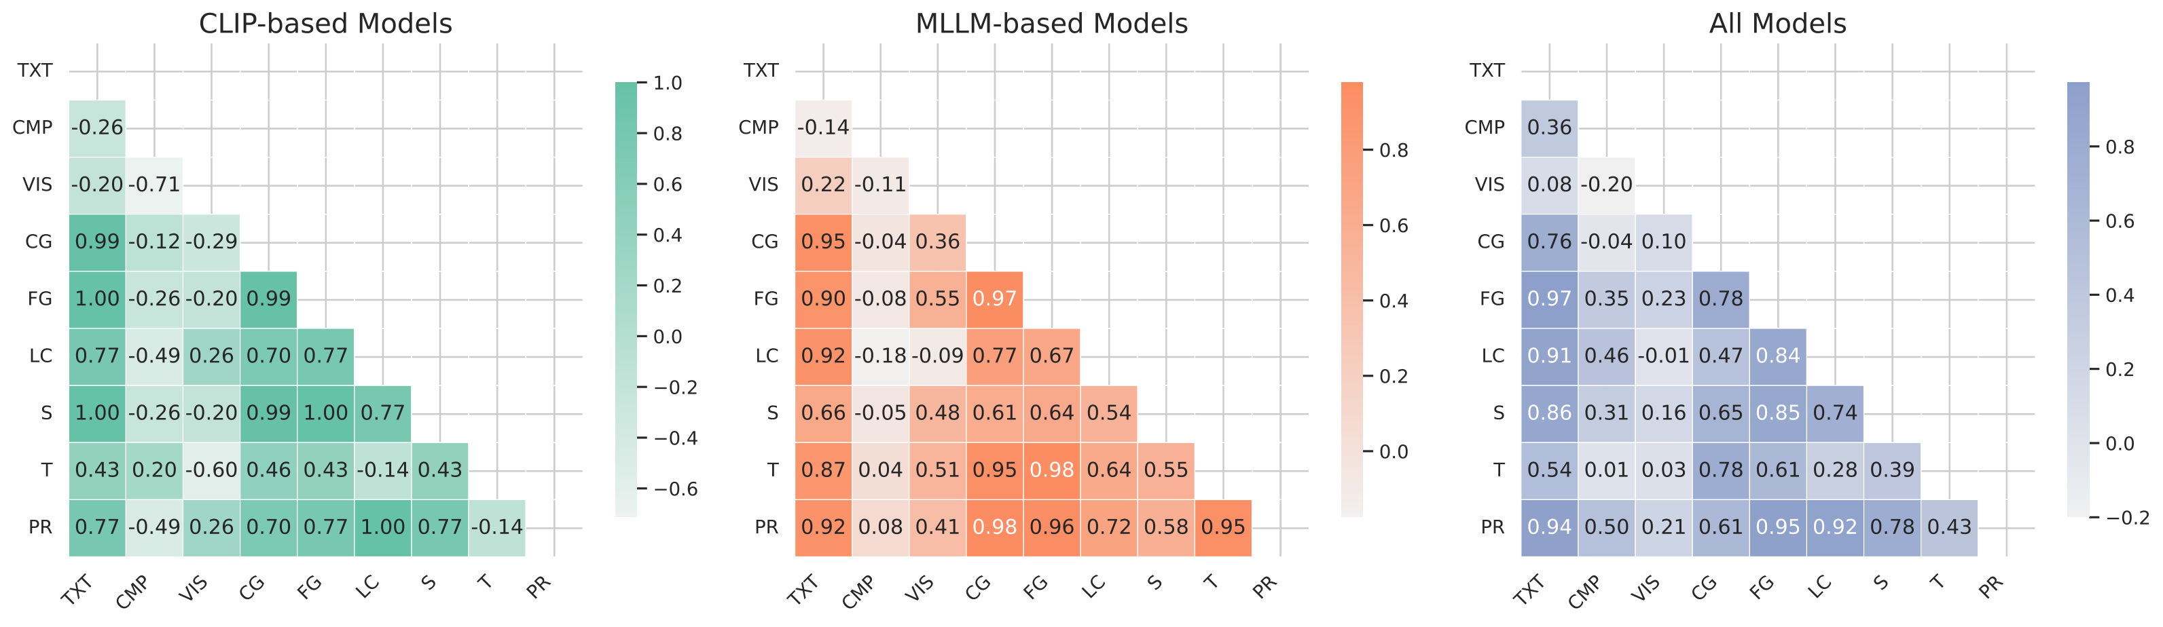
Study 1 · Semantic Scaling
13
Findings 2 & 3: S–T Decoupling and the Scaling Paradox
Finding 2 · S–T Decoupling
Spatial and temporal abilities show weak correlation (ρ < 0.15), requiring targeted data instead of generic scaling.
Finding 3 · Scaling Paradox
A small CLIP model can outperform 8B MLLM models on visual-only queries, showing capacity is not perceptual breadth.
Design Consequence
GVE must be modality-aware and capability-guided.

Slide 14
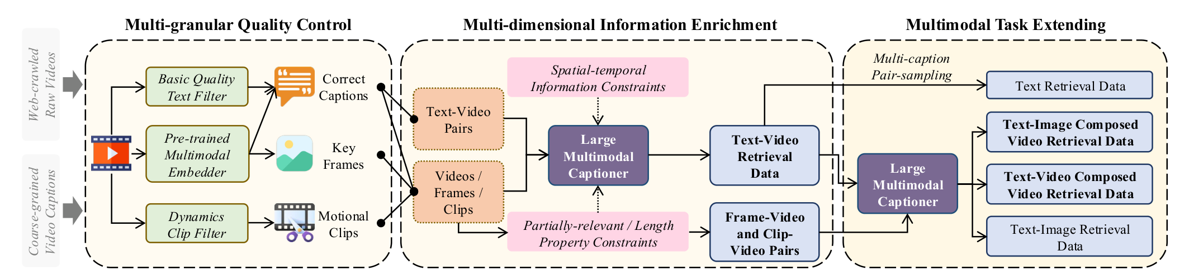
Study 1 · Semantic Scaling
14
V-SynFlow: Capability-Guided Data Synthesis
Quality Control
Information Enrichment
Task Extension
Text filtering, video–text alignment, key-frame extraction
Multimodal captioning with spatial-temporal constraints
T2V, TI2V, VT2V and T2I-style retrieval pairs
Principle
Data is synthesized according to diagnosed gaps, not raw collection size.

Slide 15
Study 1 · Semantic Scaling
15
UVRD: Targeted Data Rather than Naive Scale
1.55M
95%
60%
30%
10%
training pairs
human-verified quality
temporal-focused
spatial-focused
partial / abstract
Dataset | Pairs | Task Types | Quality | Capability Skew
WebVid-2M | 2.5M | T2V only | No | No
HD-VILA | 0.7M | T2V only | No | No
UVRD (ours) | 1.55M | 4 retrieval types | Yes (95%) | Yes
Design Principle
UVRD is not the largest dataset; it is the most capability-targeted dataset, aligned with the UVRB gap profile.

Slide 16
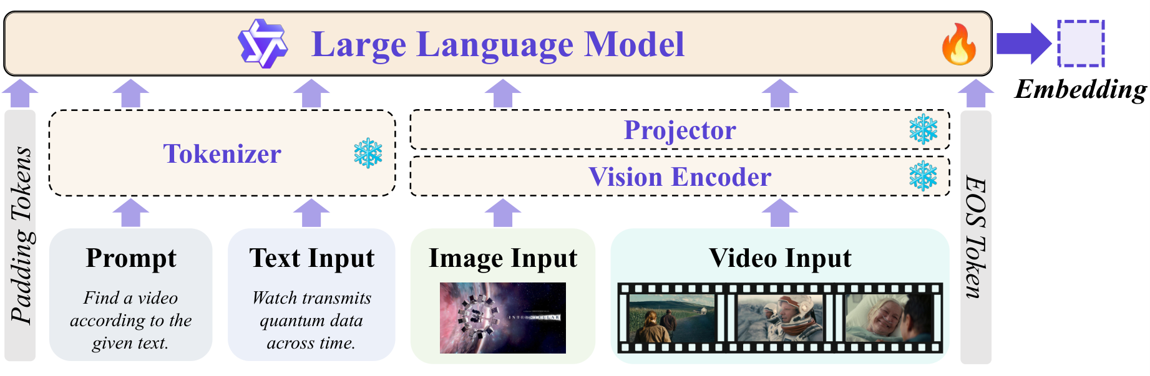
Study 1 · Semantic Scaling
16
GVE Architecture: Unified Multi-Modal Encoder
Foundation
Qwen2.5-VL backbone with a frozen tokenizer and trained vision encoder.
Inputs
Prompt + text, image, and video frames are handled in a single unified encoder.
Output
The EOS token embedding serves as the retrieval vector for all query/video types.

Slide 17
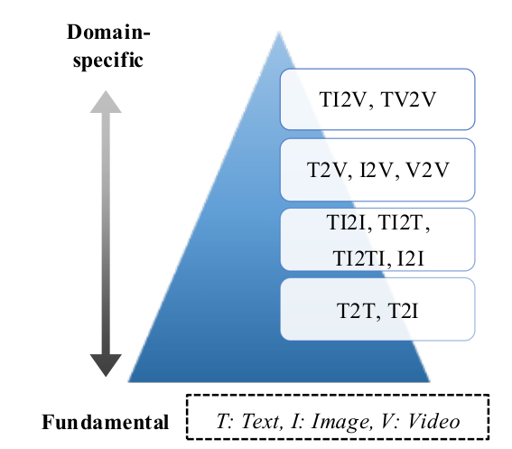
Study 1 · Semantic Scaling
17
Modality Pyramid: From Grounding to Video Retrieval
Level 1 · Base
Text–text and text–image alignment provide broad cross-modal grounding.
Level 2 · Composition
Image composition tasks teach multi-input visual reasoning.
Level 3 · Video
T2V, I2V and V2V introduce temporal dynamics and video modality.
Level 4 · Domain-Specific
TI2V and TV2V cover complex composed video retrieval.

Slide 18
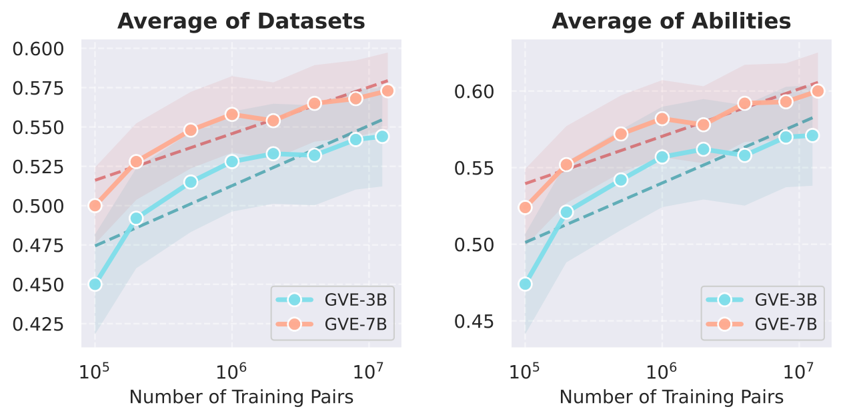
Study 1 · Semantic Scaling
18
GVE Scaling Law: Log-Linear Growth with Targeted Data
Datasets
Average R@1 across 16 datasets improves steadily as training pairs increase.
Abilities
Both GVE-3B and GVE-7B scale across ability dimensions without saturation at 10M pairs.
Implication
More capability-targeted data is likely to continue improving retrieval generalization.

Slide 19
Study 1 · Semantic Scaling
19
GVE Results: SOTA Zero-Shot Performance Across Dimensions
Model | Params | AVG | TXT | VIS | CMP | FG | T | PR
CLIP4Clip | 87M | 0.441 | 0.497 | 0.384 | 0.162 | 0.438 | 0.321 | 0.702
InternVideo2 | 6B | 0.502 | 0.562 | 0.371 | 0.198 | 0.479 | 0.381 | 0.726
Unite-7B | 7B | 0.559 | 0.609 | 0.401 | 0.254 | 0.539 | 0.412 | 0.746
GME-7B | 7B | 0.562 | 0.604 | 0.415 | 0.341 | 0.507 | 0.373 | 0.788
GVE-3B | 3.8B | 0.571 | 0.619 | 0.422 | 0.304 | 0.541 | 0.430 | 0.764
GVE-7B ★ | 7.8B | 0.600 | 0.657 | 0.451 | 0.312 | 0.570 | 0.469 | 0.814
+6.5 pp
over Unite-7B
3.8B
GVE-3B beats 7B+ baseline
All
ability dimensions led
Takeaway
Capability-targeted data and curriculum explain the gain more convincingly than raw parameter count.

Slide 20
Study 1 · Semantic Scaling
20
Ablation: Data Composition and Curriculum Both Matter
Setting | AVG | TXT | CMP | FG | T | ΔAVG
No UVRD, no Pyramid | 0.541 | 0.592 | 0.231 | 0.521 | 0.398 | base
+ UVRD data only | 0.564 | 0.614 | 0.292 | 0.548 | 0.426 | +2.3%
+ Modality Pyramid only | 0.571 | 0.621 | 0.258 | 0.551 | 0.441 | +3.0%
Full GVE-7B ★ | 0.600 | 0.657 | 0.312 | 0.570 | 0.469 | +5.9%
ΔAVG contribution
base
data
pyramid
full
Data Contribution
Curriculum Contribution
Combined Effect
UVRD improves average performance and especially composed retrieval by targeting uncovered task types.
The pyramid prevents gradient submergence and progressively introduces video-specific tasks.
The full model shows additive gains, indicating complementary mechanisms.

Slide 21
02
Observational Scaling: the core question
How does visual observation density interact with query granularity?
Observational Scaling
Benchmark
MG-LVR Benchmark & VEterfall
MG-LVR evaluates long videos with fine, medium and coarse queries.
Scaling Laws
Frame count, spatial density and token budget reveal different optima.
Method
VEterfall transfers dense knowledge to sparse inference by self-distillation.

Slide 22
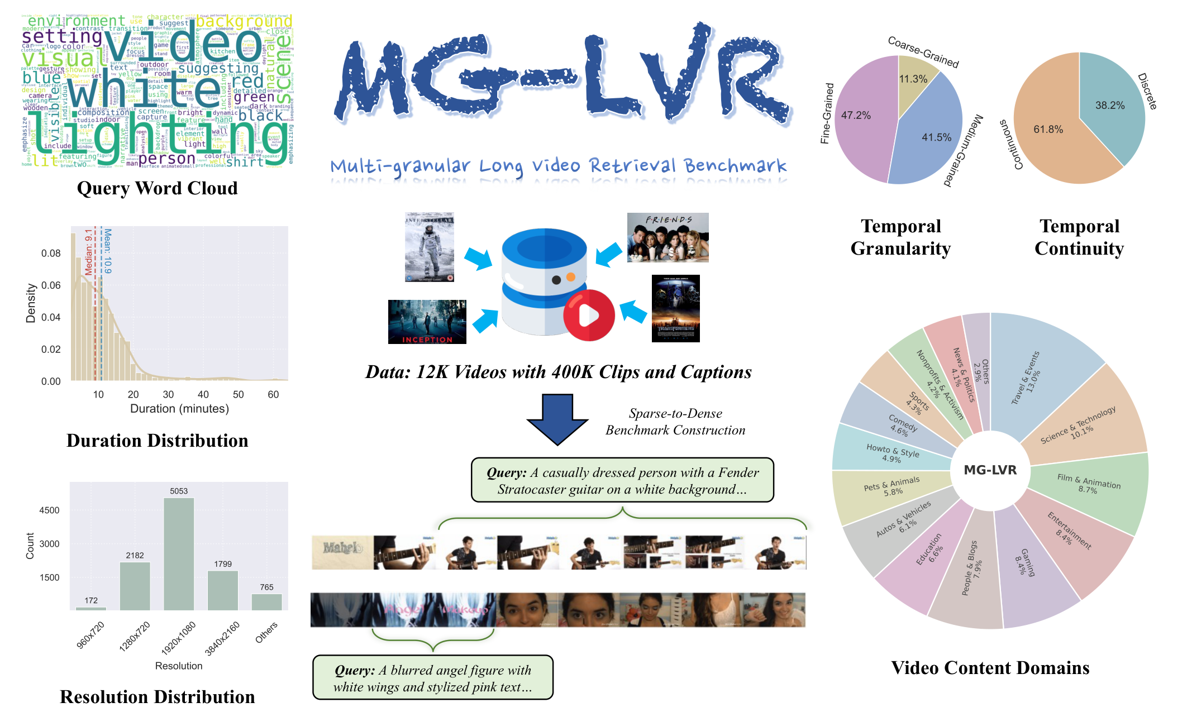
Study 2 · Observational Scaling
22
MG-LVR: Multi-Granular Long-Video Retrieval Benchmark
12K
videos
400K
clips
9,971
queries
Novelty
Long video and multi-granular queries are evaluated jointly, which prior benchmarks do not cover.

Slide 23
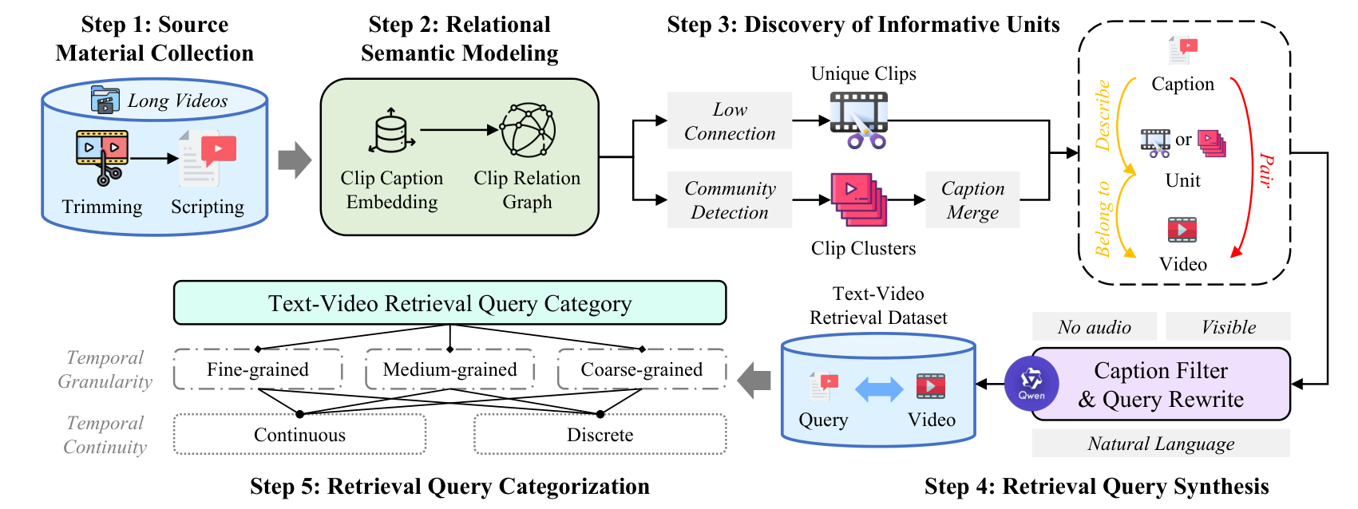
Study 2 · Observational Scaling
23
MG-LVR Construction and Query Granularity
Sparse-to-Dense Construction
Full videos are decomposed into clips and caption-level semantic units at multiple temporal resolutions.
Fine-Grained Query
Requires identifying specific objects, attributes or actions within a particular short interval.
Coarse-Grained Query
Can often be answered from video-level topic, title or thumbnail semantics.

Slide 24
Study 2 · Observational Scaling
24
The Granularity Gap: Fine-Grained R@1 Lags Far Behind Coarse
Model | Overall | Fine ↓ | Medium | Coarse
LanguageBind (8F) | 0.419 | 0.200 | 0.553 | 0.752
InternVideo2 (8F) | 0.431 | 0.204 | 0.576 | 0.783
Qwen3-VL-Emb-8B (8F) | 0.449 | 0.210 | 0.589 | 0.856
GVE-7B (128F) | 0.508 | 0.266 | 0.647 | 0.845
Qwen3-VL-Emb-8B (128F) ★ | 0.549 | 0.287 | 0.672 | 0.903
0.903
best coarse R@1
0.287
best fine R@1
< 8 pp
gain from 8F to 128F on fine queries
Core Finding
Simply adding more frames cannot close the granularity gap; sampling strategy must adapt to query granularity.

Slide 25
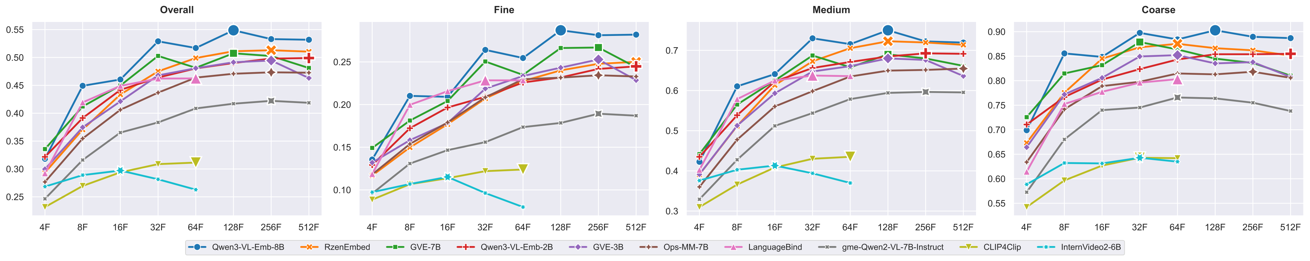
Study 2 · Observational Scaling
25
Temporal Scaling Law: MLLMs Improve, CLIP Models Anchor
MLLM Encoders
Qwen3-VL-Emb-8B and GVE-7B improve continuously from low to high frame counts.
CLIP Encoders
CLIP-based models plateau near 16–32 frames and can degrade beyond 64 frames.
Frame-Count Anchoring
Fixed-frame training anchors the model to its training density, limiting test-time temporal scaling.

Slide 26
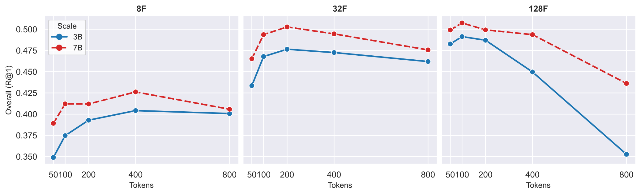
Study 2 · Observational Scaling
26
Spatial Scaling: Resolution vs. Token Budget Trade-off
Fixed Budget
Higher resolution consumes more tokens per frame, leaving fewer frames under the same total budget.
Granularity Dependence
Coarse queries prefer higher resolution; fine queries prefer more temporal coverage.
Implication
No single spatial setting is universally optimal.

Slide 27
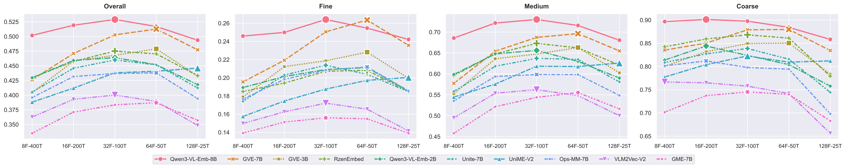
Study 2 · Observational Scaling
27
Spatial–Temporal Trade-off: Same Tokens, Different Optima
X-axis
Configurations such as 8F–400T, 16F–200T, 32F–100T and 64F–50T under the same token budget.
Pareto Frontiers
Fine-grained retrieval benefits from more frames; coarse retrieval benefits from spatial detail.
Lesson
Granularity-adaptive observation is necessary for efficient long-video retrieval.

Slide 28
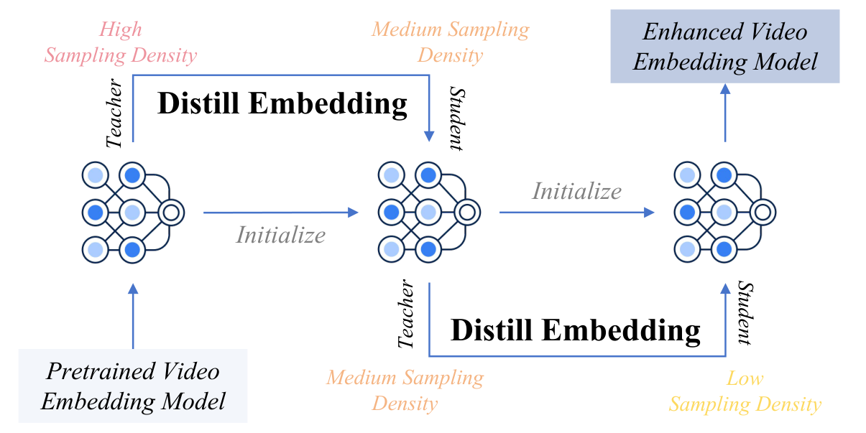
Study 2 · Observational Scaling
28
VEterfall: Dense-to-Sparse Self-Distillation Cascade
Dense Teacher
Medium Student
Sparse Student
High-density model captures rich temporal knowledge
8F–200T mimics dense embeddings through distillation
4F–100T inherits knowledge for efficient inference
Key Idea
Knowledge is acquired dense, but deployed sparse.

Slide 29
Study 2 · Observational Scaling
29
Why Dense-to-Sparse Distillation?
Problem with Direct Sparse Training
VEterfall Solution
• Sparse inputs miss fine-grained evidence entirely
• The model never observes dense temporal patterns
• Performance ceiling is determined by input sparsity
• Train dense first to build knowledge
• Make the sparse student imitate dense embeddings
• Transfer fine-grained knowledge without dense inference
Core Insight
VEterfall decouples knowledge acquisition from inference cost: the embedding space carries dense knowledge into sparse observation.

Slide 30
Study 2 · Observational Scaling
30
VEterfall Results: +20% Fine-Grained R@1 at 4–16× Token Efficiency
Model Setting | Overall | Fine ↑ | Medium | Coarse | Fine Gain
8F–200T no distill | 0.369 | 0.148 | 0.508 | 0.782 | —
8F–200T VEterfall ★ | 0.402 | 0.188 | 0.543 | 0.777 | +27.0%
4F–100T no distill | 0.300 | 0.132 | 0.391 | 0.664 | —
4F–100T VEterfall ★ | 0.325 | 0.158 | 0.423 | 0.667 | +19.7%
+27%
fine gain at 8F
+20%
fine gain at 4F
16×
fewer tokens vs dense
Observation
Fine-grained retrieval gains most from distillation, while coarse-grained performance remains stable.

Slide 31
Study 2 · Observational Scaling
31
VEterfall Efficiency: Better Accuracy with Less Compute
Relative compute
Approach | Training Pairs | Compute | Fine R@1 | Overall
Direct sparse (4F–100T) | 2.0M | 1.0× | 0.132 | 0.300
Dense-to-sparse finetune | 2.0M | 2.4× | 0.149 | 0.318
VEterfall (2-stage) ★ | 200K | 0.1× | 0.158 | 0.325
sparse
finetune
VEterfall
Less Data
No Architecture Change
Study 2 Takeaway
Two rounds × 100K pairs = 200K total.
The method can be applied to pretrained video embedding models.
Sampling density must be learned and transferred, not simply increased.

Slide 32
03
Search Scaling: the core question
How can neural ranking signals be searched at billion scale under real latency constraints?
Search Scaling
Metric
GMP-GR at Baidu
MUIRML regularizes learned relevance into a graph-compatible space.
Graph
HiPANNS expands candidate exploration and GPU batching.
Deployment
The system serves large-scale production traffic across Baidu applications.

Slide 33
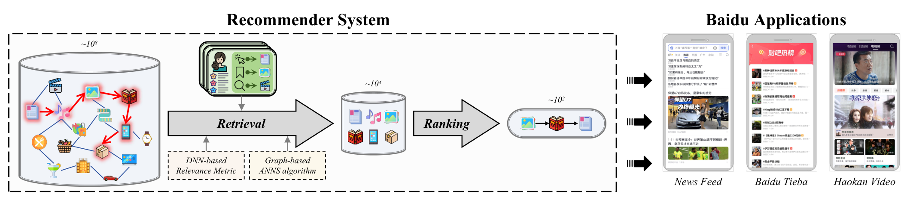
Study 3 · Search Scaling
33
Retrieval at Baidu Scale: Production Context
Billion
item corpus
20+
applications
100M+
users / day
Core Challenge
Neural metrics and graph traversal are structurally incompatible at this scale.

Slide 34
Study 3 · Search Scaling
34
Metric–Search Tension: Why Neural Metrics Break Graph ANNS
Neural Metric Violation
HNSW Assumption
Practical Consequence
DNN scoring functions are expressive but can violate triangle inequality, weakening geometric pruning.
Greedy graph traversal relies on the idea that moving closer to the query leads to better neighborhoods.
At fixed traversal budget, graph search misses relevant items because shortcut paths are unreliable.
GMP-GR Solution
Make learned relevance graph-compatible rather than abandoning either DNN scoring or graph search.

Slide 35
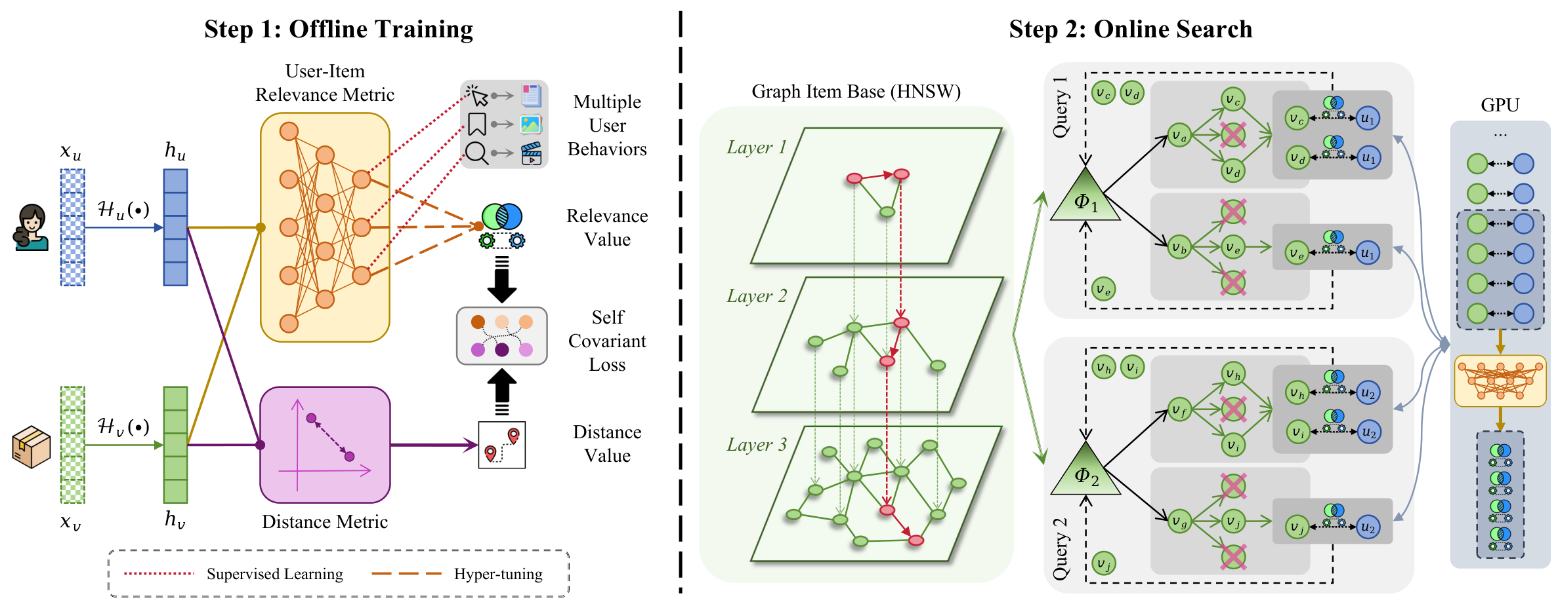
Study 3 · Search Scaling
35
GMP-GR Framework: Metric–Graph–Hardware Co-Design
Offline Training
MUIRML combines multi-relational behavior signals with self-covariant loss.
Online Search
HiPANNS uses HNSW layers plus parallel candidate and query expansion.
System View
Accuracy, graph traversal and GPU throughput are optimized jointly.

Slide 36
Study 3 · Search Scaling
36
MUIRML: Multi-Relational Metric Learning with Self-Covariant Loss
Architecture
Training Objective
SCL Intuition
• MLP + multi-head attention over behavior signals
• Inputs: click, dwell-time, skip, engagement and share
• Two heads: relevance and distance
• Supervised ranking loss for relevance accuracy
• Self-Covariant Loss aligns neural ordering with Euclidean distance
• Joint optimization balances accuracy and graph compatibility
• If the DNN ranks v+ above v− for query q
• then Euclidean distance should satisfy d(q,v+) < d(q,v−)
• This reduces dead ends during graph traversal
L_SCL = max(0, d_E(q, v+) − d_E(q, v−) + margin)

Slide 37
Study 3 · Search Scaling
37
HiPANNS: Hierarchical Parallel ANNS for GPU-Accelerated Search
C-HiPANNS · Inter-Candidate Parallelism
Q-HiPANNS · Inter-Query Parallelism
• k parallel search threads share one max-heap
• Each thread explores a different candidate neighbor set
• Expands effective search space at the same traversal depth
• Improves accuracy without increasing graph hops
• Adaptive GPU aggregation through queue-based batching
• Queries batched according to current GPU utilization
• Adaptive slicing matched to CUDA thread configurations
• Improves throughput at high concurrency
Combined Benefit
C-HiPANNS improves recall at fixed compute; Q-HiPANNS improves queries per second at fixed accuracy.

Slide 38
Study 3 · Search Scaling
38
Offline Results: 20%+ Improvement over NANN Across Metrics
Method | Video Cov | Video R@10 | MVideo Cov | Explore Cov | Explore R@10 | Fresh Cov
C-NSW | 0.339 | 0.383 | 0.298 | 0.329 | 0.349 | 0.401
SL2G | 0.441 | 0.578 | 0.412 | 0.408 | 0.525 | 0.490
NANN | 0.537 | 0.672 | 0.515 | 0.503 | 0.604 | 0.581
GMP-GR ★ | 0.649 | 0.824 | 0.624 | 0.628 | 0.800 | 0.698
+21%
coverage improvement
+22%
recall improvement
+13.8%
throughput gain
Takeaway
GMP-GR improves accuracy and speed together by co-designing the metric, graph traversal and hardware execution.

Slide 39
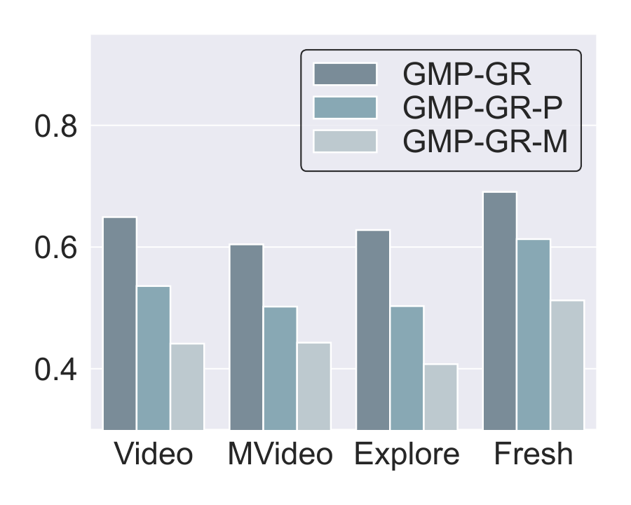
Study 3 · Search Scaling
39
Ablation: MUIRML and HiPANNS Contribute Independently
Coverage trend (illustrative from reported ablations)
NANN
M only
P only
Full
MUIRML
HiPANNS
Full GMP-GR
Regularizes the learned space so graph shortcuts remain meaningful.
Searches more candidates and processes more queries in parallel.
Combines both effects and wins consistently across four domains.

Slide 40
Study 3 · Search Scaling
40
Online A/B Tests: Consistent Engagement Lift Across Services
Service | Time-on-Page Δ | DAU Δ | Significance
News Feed | +1.13% | +0.23% | p < 0.001
Short Video | +1.19% | +0.50% | p < 0.001
+1%
matters at 100M+ users
Engineering Gains
Production Reach
Deployment Result
TensorRT compilation improves throughput by roughly 74–75%; FP16 quantization adds another 25–26%.
20+ applications with large daily traffic validate system stability beyond offline retrieval metrics.
Cumulative production lift reaches approximately +3% engagement after system rollout.

Slide 41
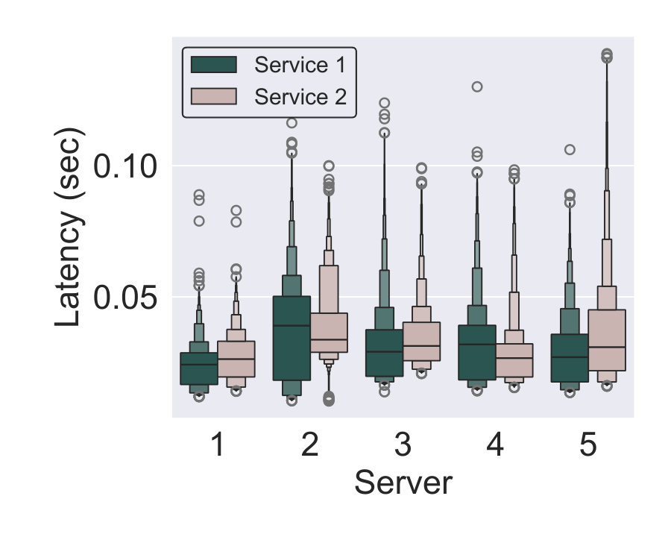
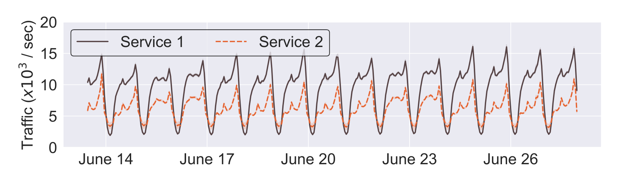
Study 3 · Search Scaling
41
Production Traffic and Latency: Reliability After Deployment
Traffic
Latency
Traffic ramp-up stays stable after deployment, without abnormal spikes.
P99 latency remains within SLA, showing that quality gains do not introduce serving regression.

Slide 42
Cross-Study Insights
42
Unified Insight: Structure-Aware Scaling Across All Stages
Stage | Naive Scaling | Structural Bottleneck | Thesis Solution
Semantic | ↑ parameters | Capability gaps across task types | UVRB → UVRD + Modality Pyramid
Observational | ↑ frame count | Query–granularity alignment | MG-LVR scaling laws + VEterfall
Search | ↑ metric AUC | Metric–graph–hardware incompatibility | SCL regularization + HiPANNS
Core Thesis
Generalizability is the empirical criterion for effective scaling. Each pipeline stage requires diagnosing its structural bottleneck before scaling capacity.
Study 1: capability taxonomy
Study 2: granularity alignment
Study 3: metric compatibility

Slide 43
Discussion
43
Thesis Strengths
End-to-End Coverage
Principled Methodology
Reproducible Benchmarks
Representation, observation and deployment are studied as a connected retrieval pipeline.
Evaluation diagnoses gaps; synthesis and algorithms directly target the diagnosed bottlenecks.
UVRB and MG-LVR provide public protocols for fair comparison and future research.
Production Validation
Actionable Field Insights
GMP-GR is deployed at Baidu scale with measurable online engagement gains.
PR proxy, frame-count anchoring, and metric–graph incompatibility are reusable lessons.

Slide 44
Discussion
44
Limitations and Honest Assessment
Study 1 · Synthesized Data Quality
Study 2 · Caption-Level Grounding
UVRD quality validation is sampled; synthetic captions may contain systematic biases not present in natural queries.
MG-LVR uses dense captions as semantic proxies; it does not provide pixel-level or action-level annotations.
Study 3 · Platform Specificity
Cross-Study · No Fully Integrated System
GMP-GR is validated on Baidu infrastructure and traffic distributions; external hardware and corpora remain open.
The three stages have not yet been jointly optimized as a single end-to-end retrieval system.
Why This Matters
Each limitation is also a concrete research direction for the next generation of video retrieval systems.

Slide 45
Future Work
45
Future Directions
Retrieval-Native Foundation Models
Video Retrieval as Agent Memory
Pre-train models with retrieval-first objectives so hidden states and EOS embeddings are naturally aligned for search.
Use video retrieval as long-horizon visual memory for embodied and web agents operating over growing streams.
Self-Evolving Data and Curriculum
Generative Multi-Granular Representations
Close the evaluation–synthesis–curriculum loop so models identify and repair their own capability gaps.
Explore diffusion denoising states as representations for coarse-to-fine retrieval without task-specific heads.
Long-term Direction
A retrieval system that jointly learns capability, observation and search rather than optimizing them separately.

Slide 46
Conclusion
46
Conclusion
Thesis in One Sentence
Video retrieval has three sequential scaling bottlenecks; each requires structure-aware, not capacity-naive, solutions.
Study 1 · Semantic Scaling
Study 2 · Observational Scaling
Study 3 · Search Scaling
• GVE: capability-guided synthesis
• SOTA zero-shot across 16 datasets
• PR as a universality proxy
• MG-LVR: long-video granularity
• Frame-count anchoring discovered
• VEterfall: +20% fine-grained R@1
• GMP-GR: metric–graph co-design
• +20% offline accuracy
• Production A/B gains at Baidu scale
Open question for the field: Can a single end-to-end system jointly optimize all three stages?

Slide 47
HKUST(GZ)
Thank You
Zhuoning Guo
Thrust of AI · HKUST(GZ)
Towards Scalable and Generalizable Video Retrieval

