Slide 1
PhD Thesis Defense
Towards Scalable and
Generalizable Video Retrieval
Zhuoning Guo
How can video retrieval generalize from controlled benchmarks to messy, large-scale production deployment?
Thrust of Artificial Intelligence, HKUST(GZ)
Advisors: Prof. Xiaowen Chu & Prof. Renjing Xu
July 29, 2026
HKUST(GZ)
01

Slide 2
OPENING
A Pipeline View of Video Retrieval
01
Background & Motivation
Why video retrieval becomes a pipeline-level scaling problem.
02
Study 1: Semantic Scaling
GVE: diagnosis → synthesis → curriculum → universal embedding.
03
Study 2: Observational Scaling
MG-LVR + VEterfall: long videos, query granularity, sparse inference.
04
Study 3: Search Scaling
GMP-GR: metric–graph–GPU co-design for production retrieval.
05
Conclusion & Future Work
Structure-aware scaling as the unifying principle.
TAKEAWAY
The talk follows the retrieval pipeline: representation → observation → billion-scale search.
Towards Scalable and Generalizable Video Retrieval
02

Slide 3
THESIS NARRATIVE
Structure-Aware Scaling Is the Core Thesis
Video retrieval is not a single benchmark task; it is a sequence of scaling bottlenecks along the retrieval pipeline.
Scaling capacity
Structural bottleneck
Generalizability criterion
• Parameters, frames, data volume, and offline AUC can all increase.
• But gains may not transfer beyond the optimized condition.
• Each pipeline stage fails for a different reason.
• The failure mode must be diagnosed before scaling.
• Scaling is meaningful only when it transfers across tasks, densities, and serving contexts.
• This is the evaluation lens of the thesis.
TAKEAWAY
The thesis contribution is a methodology: diagnose the structural bottleneck, then scale along the right axis.
Towards Scalable and Generalizable Video Retrieval
03

Slide 4
BACKGROUND
Video Retrieval Selects Relevant Videos from a Large Corpus
Formal retrieval objective
Query formats
Semantic domains
• Given query q and corpus V={v₁,…,vₙ}, retrieve videos relevant to q.
• Embedding form: s(q,v)=cos(Eq(q), Ev(v)).
• The system returns a compact candidate set for ranking or user display.
• Textual: text-to-video retrieval.
• Visual: image-to-video or video-to-video retrieval.
• Composed: text + image / text + video reference.
• Coarse-grained: overall themes and topics.
• Fine-grained: spatial, temporal, partially relevant details.
• Long-context: narrative-level or event-sequence matching.
Query
Embedding
ANNS Search
Ranking
Display
TAKEAWAY
Modern video retrieval has evolved from short-clip matching into a multi-format, multi-scale retrieval-and-ranking system.
Towards Scalable and Generalizable Video Retrieval
04

Slide 5
BACKGROUND
Modern Video Retrieval Now Operates at Production Scale
500 hrs/min
1B+
Prod-scale
<10 ms
YouTube upload scale
short-video users
production-scale Baidu retrieval traffic
latency budget for candidate retrieval
Field-level pressure
Research-level gap
• Video collections grow in scale, duration, modality, and semantic complexity.
• Short-clip datasets no longer represent real retrieval workloads.
• The dominant architecture is retrieval-and-ranking: billion-scale corpus → thousand-scale candidates.
• Benchmarks isolate one dimension at a time.
• Leaderboard gains do not reveal whether models generalize across query formats and domains.
• Production requires representation, observation, and search to work together.
TAKEAWAY
The field needs to move from fixed benchmark matching to understanding how retrieval scales.
Towards Scalable and Generalizable Video Retrieval
05

Slide 6
BACKGROUND
Modern Retrieval Goes Beyond Short-Clip Matching
Benchmark world
Production reality
• Short clips: usually 10–30 seconds.
• Single query type, often text only.
• Small corpora: 1K–10K videos.
• One capability measured at a time.
• Long videos: minutes to hours.
• Heterogeneous queries: text, image, composed.
• Billion-scale candidate pools.
• Sub-10ms retrieval and strict serving budget.
The gap is structural: each downstream stage exposes a bottleneck invisible in controlled short-clip benchmarks.
TAKEAWAY
A model optimized for a clean benchmark can still fail when query diversity, video length, and corpus scale increase together.
Towards Scalable and Generalizable Video Retrieval
06

Slide 7
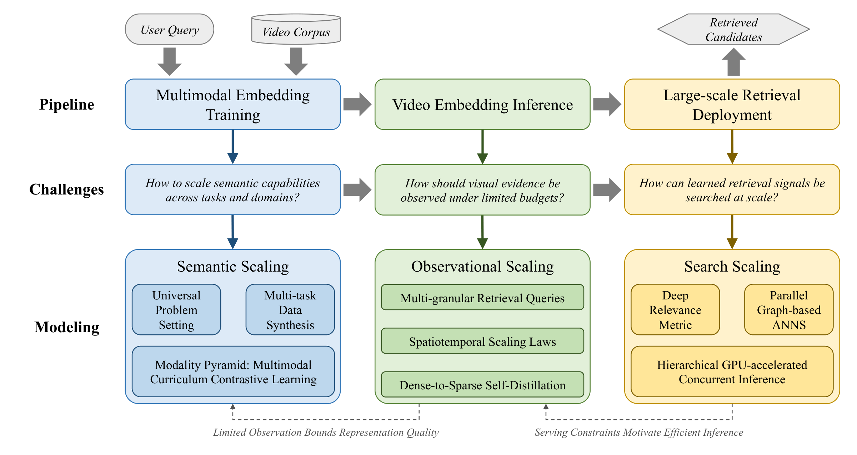
BACKGROUND
Three Bottlenecks Structure the Thesis
① Semantic scaling
• What capabilities must the model possess?
• Fragmented evaluation hides capability gaps.
• Solution requires diagnostic-guided synthesis.
② Observational scaling
• How should visual evidence be acquired?
• Long videos make frame sampling a structural decision.
• Optimal density depends on query granularity.
③ Search scaling
• How are learned signals searched at scale?
• DNN metrics must remain compatible with graph traversal and GPU serving.
TAKEAWAY
The three challenges follow the information flow but remain independent bottlenecks.
Towards Scalable and Generalizable Video Retrieval
07

Slide 8
BACKGROUND
Naive Scaling Fails at Each Pipeline Stage
Semantic bottleneck
Observation bottleneck
Search bottleneck
• Scaling model size/data alone does not ensure broader capability.
• Conventional MSR-VTT performance correlates weakly with holistic retrieval (ρ≈0.58).
• Models lack unified multi-task diagnosis.
• Short clips are too brief for sampling to matter.
• Existing long-video benchmarks do not jointly test multiple query granularities.
• Sampling × granularity interaction remains unknown.
• Optimizing metric, graph traversal, or hardware in isolation fails.
• Neural metrics violate triangle inequality.
• High concurrency exposes GPU kernel-launch overhead.
TAKEAWAY
Each bottleneck requires a targeted solution, not a larger version of the same component.
Towards Scalable and Generalizable Video Retrieval
08

Slide 9
CONTRIBUTIONS
Three Studies Address Three Pipeline Bottlenecks
Study 1 — Semantic Scaling: GVE
Study 2 — Observational Scaling: MG-LVR + VEterfall
Study 3 — Search Scaling: GMP-GR
• UVRB: unified evaluation across 16 datasets and 14 models.
• V-SynFlow: capability-guided synthesis → UVRD (1.55M pairs).
• GVE-7B: SOTA zero-shot; +6.5% over Unite-7B.
• MG-LVR: 9,971 queries, 4,844 long videos, avg 706s.
• Scaling laws across 23 models reveal frame-count anchoring.
• VEterfall: +20% fine-grained gain at 4–16× token efficiency.
• MUIRML: self-covariant metric regularization.
• HiPANNS: candidate + query parallel graph search.
• Deployed at Baidu: 20+ apps, production-scale traffic, +3% time-on-page.
TAKEAWAY
Three artifacts address successive retrieval stages under one principle: structure-aware scaling.
Towards Scalable and Generalizable Video Retrieval
09

Slide 10
RELATED WORK
Two Model Families Require Unified Diagnosis
CLIP-based dual encoders
MLLM-based unified encoders
• Examples: CLIP4Clip, ViCLIP, VideoCLIP-XL, LanguageBind, InternVideo2.
• Strength: fast retrieval and strong standard T2V performance.
• Limitation: modality-specific encoders and weak language/composed-query handling.
• Examples: LLaVE, UNITE, GME, BGE-VL, UniME, VLM2Vec-V2, Qwen3-VL-Embedding.
• Strength: shared multimodal reasoning and more balanced learning.
• Challenge: heterogeneous supervision causes gradient interference and task submergence.
TAKEAWAY
Architecture shapes capability development, but fair comparison requires a unified evaluation protocol.
Towards Scalable and Generalizable Video Retrieval
10

Slide 11
RELATED WORK
Benchmarks and Search Systems Each Miss One Dimension
Benchmark evolution
Missing benchmark dimension
• MSR-VTT / DiDeMo: short clips and text-to-video retrieval.
• CaReBench: fine-grained retrieval.
• LoVR: long-video retrieval.
• CoVR: composed retrieval.
• Each benchmark covers one dimension.
• No benchmark jointly tests long-form video + multi-granular queries.
• No controlled testbed for sampling density × query granularity.
ANNS infrastructure
• Tree-based search suffers in high dimension; hashing trades accuracy for speed.
• Graph-based HNSW dominates industrial retrieval.
• SL2G and NANN combine DNN metrics with graph search, but metric-search tension remains unresolved.
TAKEAWAY
Video retrieval and recommender systems share the same infrastructure: embeddings, graph indexes, and GPU serving.
Towards Scalable and Generalizable Video Retrieval
11

Slide 12
01
Semantic Scaling: General Video Embedder
Study 1
Addressing what capabilities a video retrieval model should possess, and how to scale toward them.
PhD Thesis Defense
12

Slide 13
STUDY 1 · SEMANTIC SCALING
Universal Video Retrieval Defines the Capability Target
Definition
Two axes of evaluation
Key difficulty
• Learn an embedding model Eθ such that s(q→v)=cos(Eθ(q),Eθ(v)) is higher for relevant pairs.
• The same model should work across query formats, semantic domains, and relevance granularities.
• Query format: TXT / CMP / VIS.
• Data domain: CG / FG / LC.
• Fine-grained dimensions: spatial, temporal, partially relevant.
• Existing datasets report isolated leaderboard scores.
• A model can look strong on MSR-VTT but fail on composed, visual, temporal, or partially relevant retrieval.
Semantic scaling means scaling toward capability coverage, not only more parameters or more generic pairs.
TAKEAWAY
The first step is a diagnostic benchmark that measures where models actually fail.
Towards Scalable and Generalizable Video Retrieval
13

Slide 14
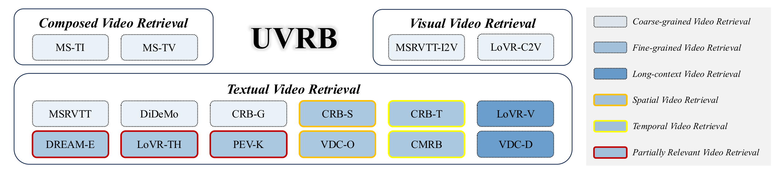
STUDY 1 · UVRB
UVRB Organizes Retrieval into a Unified Capability Space
Three query families
• Textual retrieval: text-to-video over 12 datasets.
• Visual retrieval: image/video query to video target.
• Composed retrieval: multimodal query combining text + visual input.
Capability labels
• CG: coarse-grained theme matching.
• FG: fine-grained spatial / temporal / partially relevant retrieval.
• LC: long-context understanding.
Why it matters
• This taxonomy lets us diagnose not only which model wins, but which capability is missing.
TAKEAWAY
UVRB turns video retrieval evaluation into a capability diagnosis.
Towards Scalable and Generalizable Video Retrieval
14

Slide 15
STUDY 1 · UVRB
UVRB Evaluates Frozen Models Under One Protocol
Unified evaluation protocol
Baseline range
What UVRB reveals
• 16 public datasets under identical preprocessing.
• Frozen embeddings + cosine similarity.
• No task-specific post-processing or in-domain adaptation.
• 14 baselines from 87M to 8.3B parameters.
• CLIP-based: CLIP4Clip, ViCLIP, VideoCLIP-XL, LanguageBind, InternVideo2.
• MLLM-based: GME, Unite, VLM2Vec-V2, BGE-VL, UniME, B3.
• Model families have structured weakness patterns.
• Capability gaps persist even at larger parameter scale.
• Fine-grained temporal, composed, and PR retrieval remain challenging.
Family
Representative models
Typical strength
Typical limitation
CLIP-based
CLIP4Clip / InternVideo2
Fast; strong T2V
Modality-specific gaps
MLLM-based
GME / Unite / VLM2Vec
Unified reasoning
Gradient interference
GVE
Qwen2.5-VL based
Targeted capability coverage
Requires synthesized curriculum
TAKEAWAY
The protocol removes benchmark bias and exposes true capability coverage.
Towards Scalable and Generalizable Video Retrieval
15

Slide 16
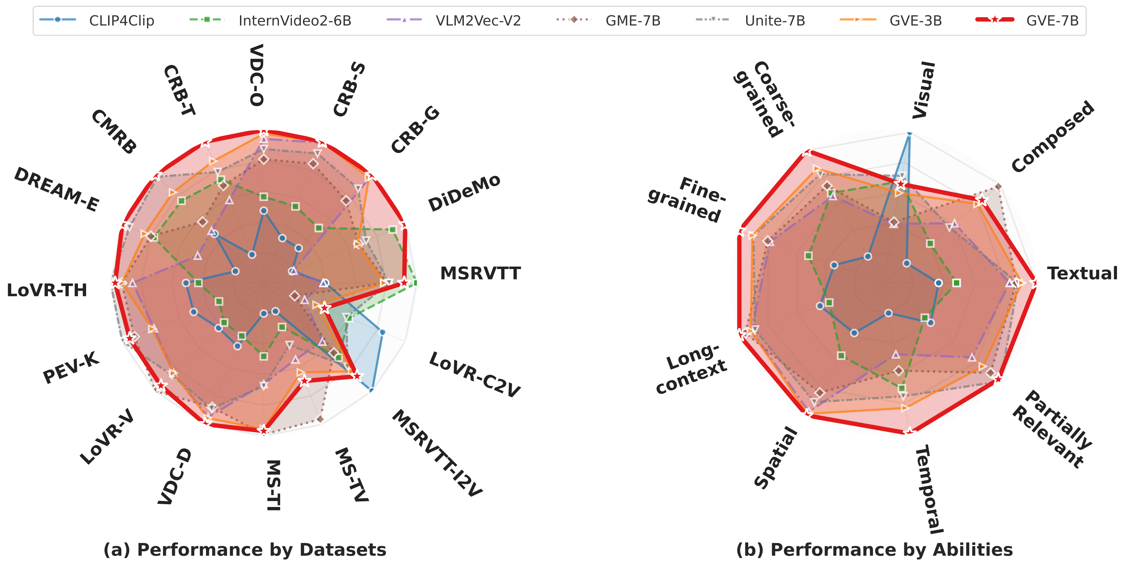
STUDY 1 · UVRB
Current Models Show Structured Capability Gaps
Dataset view
• Left radar: performance across 16 datasets.
• GVE-7B covers the largest area overall.
• Underperforming axes remain visible.
Ability view
• Right radar: 8 capability dimensions.
• Temporal and fine-grained dimensions remain hard.
• Composed queries show large headroom.
Interpretation
• Capability gaps are structured, not random.
• Models cluster around their training distribution.
TAKEAWAY
GVE must be trained to fill specific missing capabilities, not merely to improve average retrieval.
Towards Scalable and Generalizable Video Retrieval
16

Slide 17
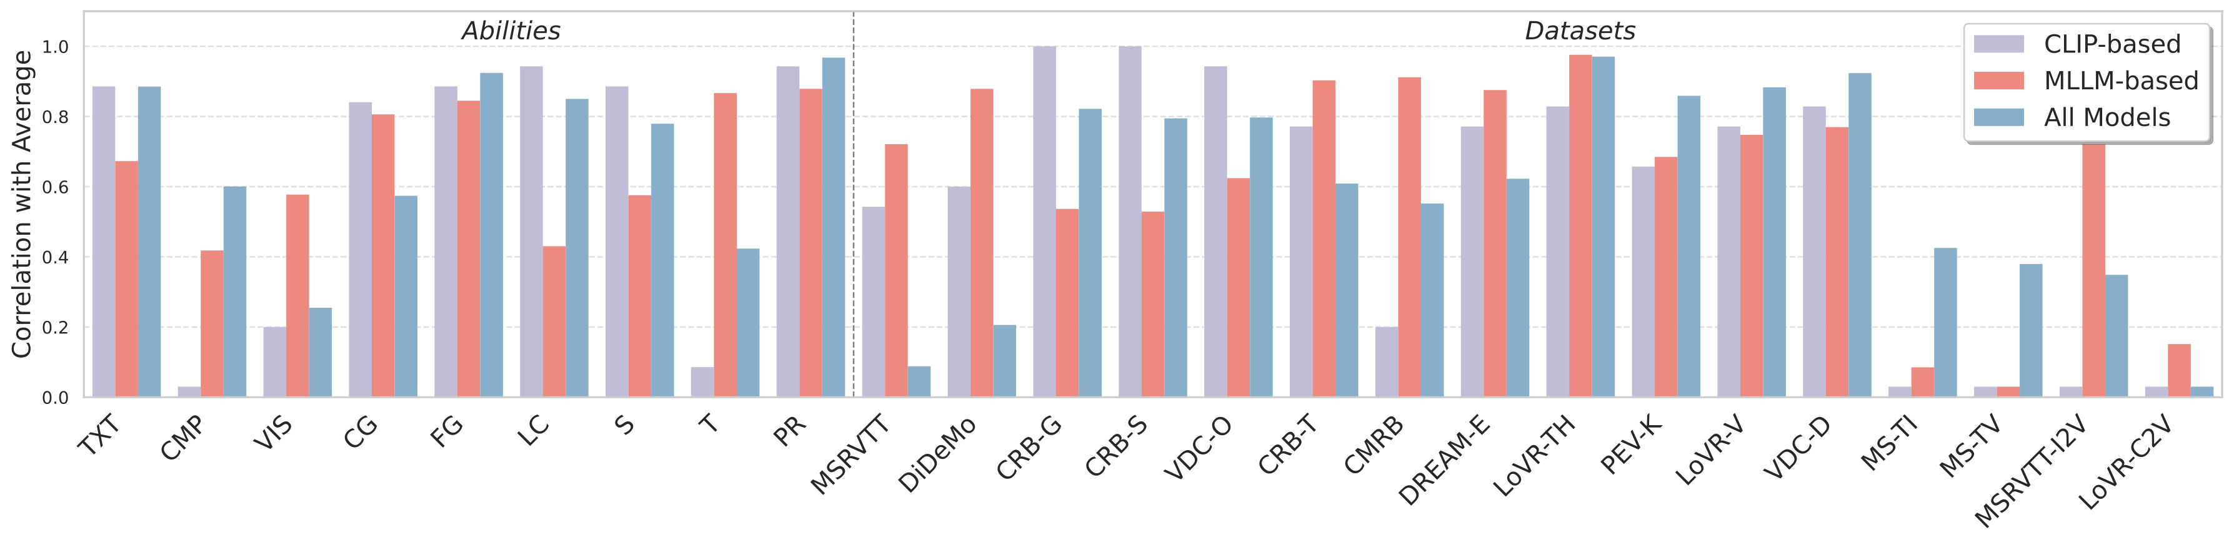
STUDY 1 · FINDING 1
Partially Relevant Retrieval Predicts Universality
Quantitative finding
• PR retrieval achieves the highest average correlation with overall UVR performance (ρ≈0.97).
• Conventional MSR-VTT correlates poorly with holistic retrieval (ρ≈0.58).
Why PR is difficult
• A partially relevant video contains matching and non-matching content.
• The model must localize what is relevant and avoid collapsing the video to one gist.
PR is a fast universality proxy
TAKEAWAY
A model that handles partial relevance tends to generalize better across the full retrieval space.
Towards Scalable and Generalizable Video Retrieval
17

Slide 18
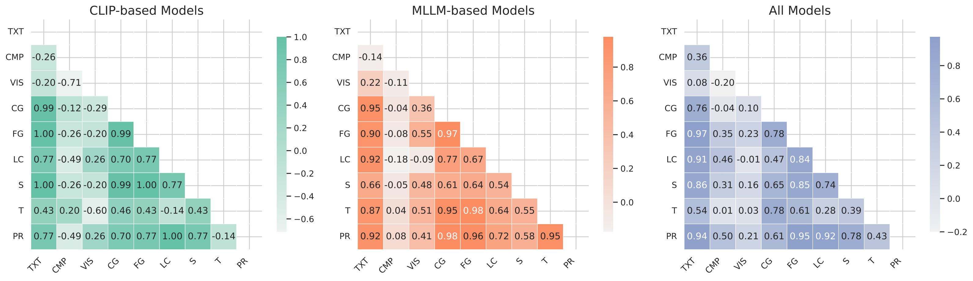
STUDY 1 · FINDING 2
Spatial and Temporal Capabilities Are Decoupled
Key correlation
• Spatial–temporal correlation is only ρ≈0.12.
• Temporal skills dominate fine-grained understanding: ρ(T,FG)≈0.98 vs ρ(S,FG)≈0.39.
Interpretation
• “Where” and “when” are not learned together automatically.
• A visually strong model may still fail temporal ordering and event localization.
Design implication
• Training data must explicitly supply temporal supervision, not only more spatial image-text pairs.
TAKEAWAY
Targeted temporal data is necessary because spatial strength does not imply temporal retrieval capability.
Towards Scalable and Generalizable Video Retrieval
18

Slide 19
STUDY 1 · FINDING 3
Bigger Models Do Not Guarantee Visual Fidelity
Counterintuitive observation
Why this happens
• 87M CLIP4Clip can outperform 8B-class MLLM models on visual-only retrieval.
• Visual capability is weakly correlated with overall success: ρ(AVG,VIS)≈0.26.
• MLLM pretraining is language-heavy.
• Hidden states are optimized for generation and instruction following.
• Visual matching without text can suffer from language-dominated representations.
CLIP vs. MLLM pattern
• CLIP models are spatially biased but temporally weak.
• MLLMs show more balanced PR and coarse-grained learning.
• Neither family covers the full capability space by default.
TAKEAWAY
Capacity alone cannot fix a mismatch between pretraining objective and retrieval capability.
Towards Scalable and Generalizable Video Retrieval
19

Slide 20
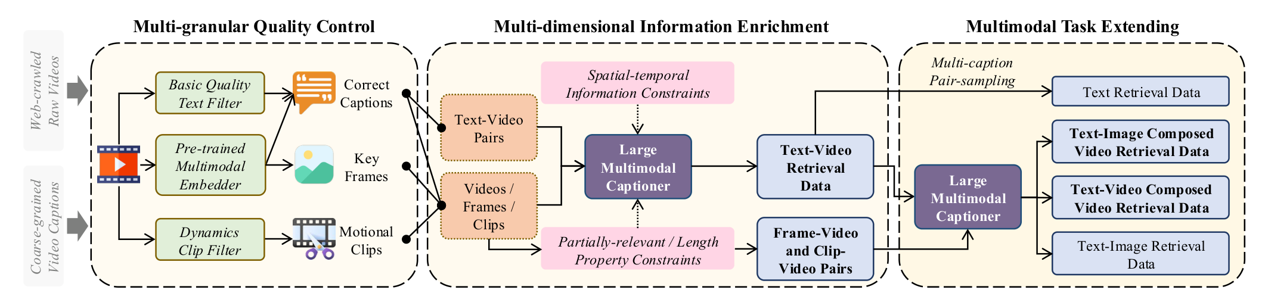
STUDY 1 · V-SYNFLOW
V-SynFlow Generates Data for Missing Capabilities
Design principle
• V-SynFlow is guided by UVRB diagnostics.
• Data distribution is intentionally skewed toward missing capabilities.
• The goal is not maximum dataset size, but maximum capability coverage.
Output
• UVRD = 1.55M unified training pairs.
• Covers text-video, visual, and composed retrieval formats.
• 95% factual accuracy in human validation.
TAKEAWAY
Synthesis becomes a controlled intervention: fill the measured holes in the capability map.
Towards Scalable and Generalizable Video Retrieval
20

Slide 21
STUDY 1 · V-SYNFLOW
Quality Control Protects Retrieval Supervision
Filtering cascade
Why this stage matters
• Annotation rectification removes non-descriptive text and artifacts.
• Cross-modal consistency filtering keeps pairs above similarity threshold 0.25.
• Temporal dynamics filtering removes static or visually uninformative clips.
• Synthesized data can amplify noise if raw captions are wrong.
• Retrieval training is sensitive to false positives and false negatives.
• Quality control protects contrastive learning from corrupted alignment signals.
Output asset pool
• Validated clips, key frames, motional clips, and coarse video-level material.
• This pool supports both atomic and composed retrieval synthesis.
TAKEAWAY
High-quality synthesis starts by removing unreliable alignment before asking MLLMs to enrich the data.
Towards Scalable and Generalizable Video Retrieval
21

Slide 22
STUDY 1 · V-SYNFLOW
Enrichment Extends Data into Multi-Task Retrieval
Information enrichment
Task extension
• Keye-VL-8B generates richer captions with spatial-temporal constraints.
• Skewed distribution: 60% temporal, 30% spatial, 10% PR/abstract.
• Constructs frame-to-video and clip-to-video pairs.
• Text-to-video retrieval pairs.
• Text-image composed video retrieval pairs.
• Video-text composed retrieval pairs.
• Text-image retrieval pairs for fundamental grounding.
Human validation
• 100 randomly sampled examples show 95% factual accuracy.
• Quality validation is combined with downstream zero-shot improvements across 16 datasets.
TAKEAWAY
UVRD is smaller than some web-scale datasets, but more precisely targeted to retrieval capabilities.
Towards Scalable and Generalizable Video Retrieval
22

Slide 23
STUDY 1 · UVRD
UVRD Is Capability-Targeted, Not Merely Large
1.55M
95%
60%
4
training pairs in UVRD
human-verified factual accuracy
temporal-focused pairs
task families covered
Dataset
Scale
Task types
Quality
Capability skew
WebVid-2M
2.5M
T2V only
No
No
HD-VILA
0.7M
T2V only
No
No
UVRD ★
1.55M
4 types
95%
Yes
The target is not the largest dataset; the target is the most diagnostic and capability-aligned dataset.
TAKEAWAY
Dataset scale matters only when the additional data covers missing retrieval capabilities.
Towards Scalable and Generalizable Video Retrieval
23

Slide 24
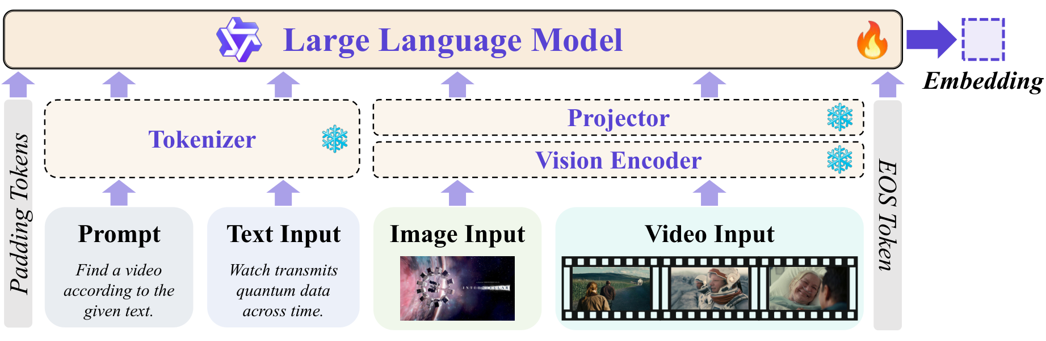
STUDY 1 · GVE
GVE Unifies Text, Image, and Video Embeddings
Backbone and inputs
• Qwen2.5-VL multimodal backbone.
• Input formats: text, image, video, and composed queries.
• Prompt + text tokens fuse with projected visual tokens.
Embedding extraction
• Last-token pooling followed by ℓ₂ normalization.
• One embedding space for query and video.
• No task-specific retrieval heads.
Training configuration
• Vision encoder frozen; LLM fine-tuned.
• Two sizes: GVE-3B and GVE-7B.
TAKEAWAY
GVE adapts a generative MLLM into a unified retrieval embedder.
Towards Scalable and Generalizable Video Retrieval
24

Slide 25
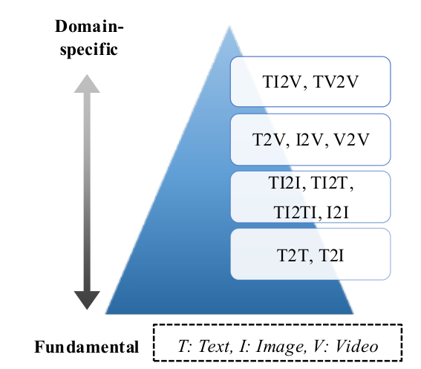
STUDY 1 · MODALITY PYRAMID
The Modality Pyramid Stabilizes Heterogeneous Training
Problem
• Naive task mixing causes easy and abundant tasks to dominate gradients.
• Complex composed video tasks are drowned by simpler text-image or text-video pairs.
Empirical hierarchy
• Text-image alignment ≈ 0.65 after 1 epoch.
• Text-video ≈ 0.46.
• Composed video ≈ 0.43.
Scheduling rule
• At epoch t, a prober estimates task alignment Rk.
• Sampling P(k) ∝ exp(Rk / σ(t)); σ grows from 0.1 to 1.0.
• Training moves from atomic to composite tasks.
TAKEAWAY
The curriculum follows empirical task difficulty rather than a manually fixed order.
Towards Scalable and Generalizable Video Retrieval
25

Slide 26
STUDY 1 · TRAINING
Hard Negatives Sharpen Fine-Grained Retrieval
Symmetric InfoNCE
Hard negatives
• Bidirectional contrastive training over query-video pairs.
• Encourages relevant pairs to be close and irrelevant pairs to be separated.
• Works uniformly across text, image, video, and composed queries.
• Mined from external corpus to improve discrimination.
• Similarity threshold 0.90 avoids false negatives.
• Particularly important for fine-grained and partially relevant retrieval.
Why this is retrieval-specific
• Generative MLLMs optimize next-token likelihood; retrieval requires compact discriminative geometry.
• GVE explicitly shapes the embedding space while preserving multimodal reasoning.
TAKEAWAY
GVE turns a generative multimodal backbone into a retrieval-first embedding model.
Towards Scalable and Generalizable Video Retrieval
26

Slide 27
STUDY 1 · RESULTS
GVE Improves Zero-Shot Retrieval Generalization
Model
Params
Ability
AVG
TXT
CMP
FG
T
LC
Key results
CLIP4Clip
87M
0.441
0.497
0.162
0.438
0.321
0.702
• Dataset AVG: 0.573 vs Unite-7B 0.538 (+6.5%).
• Ability AVG: 0.600 vs Unite-7B 0.559 (+7.3%).
• GVE-3B beats Unite-7B with fewer parameters.
InternVideo2
6B
0.502
0.562
0.198
0.479
0.381
0.726
Unite-7B
7B+
0.559
0.609
0.254
0.539
0.412
0.746
GVE-3B
3.8B
0.571
0.619
0.304
0.541
0.430
0.764
Data + curriculum,
not parameter scale
GVE-7B ★
8.3B
0.600
0.657
0.312
0.570
0.469
0.814
TAKEAWAY
Capability-targeted scaling beats parameter-naive scaling.
Towards Scalable and Generalizable Video Retrieval
27

Slide 28
STUDY 1 · ABLATION
UVRD and Curriculum Provide Complementary Gains
Setting
Ability
AVG
CMP
FG
T
ΔAbility
AVG
Data effect
Baseline
0.541
0.231
0.521
0.398
—
• UVRD improves average performance and strongly improves composed retrieval.
• Targeted examples fill missing task types.
+ UVRD data
0.564
0.292
0.548
0.426
+2.3%
+ Pyramid
0.571
0.258
0.551
0.441
+3.0%
Full GVE-7B ★
0.600
0.312
0.570
0.469
+5.9%
Curriculum effect
• Pyramid scheduling improves temporal and fine-grained dimensions.
• It stabilizes learning under heterogeneous supervision.
Complementarity
• UVRD fixes task coverage; the Pyramid fixes learning dynamics.
TAKEAWAY
Both the data source and the training schedule are necessary for broad retrieval capability.
Towards Scalable and Generalizable Video Retrieval
28

Slide 29
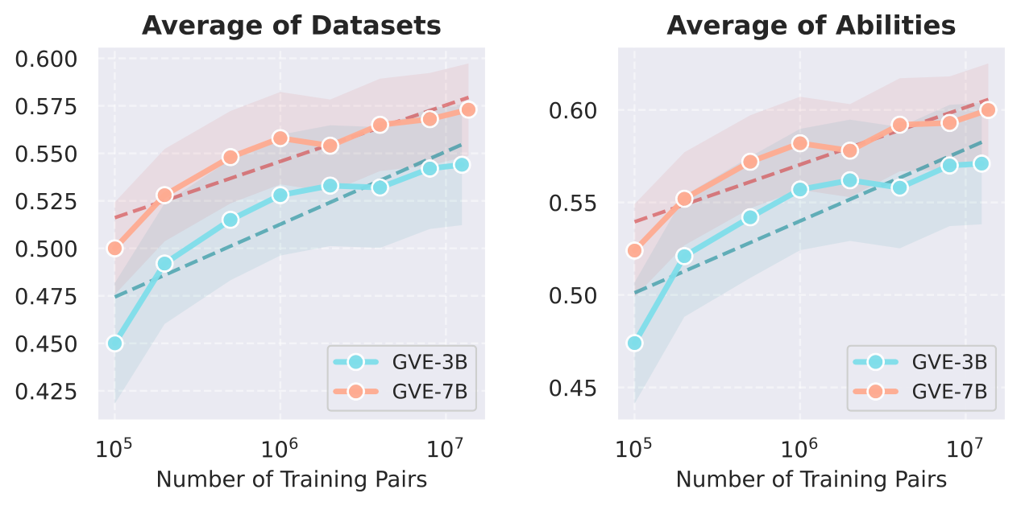
STUDY 1 · SCALING LAW
Targeted Data Scaling Remains Log-Linear
Observed trend
• Performance improves log-linearly from 10⁵ to 10⁷ pairs.
• GVE-7B starts higher and stays higher.
• No saturation is observed at 10M pairs.
Scaling rate
• GVE-3B: +7.4% per 10× data.
• GVE-7B: +5.4% per 10× data.
• Smaller model benefits more from added targeted supervision.
Study 1 takeaway: diagnosis → synthesis → curriculum
TAKEAWAY
Semantic scaling is effective when additional data is aligned with diagnosed capability gaps.
Towards Scalable and Generalizable Video Retrieval
29

Slide 30
02
Observational Scaling: MG-LVR + VEterfall
Study 2
Addressing how visual observation should adapt to video length and query granularity.
PhD Thesis Defense
30

Slide 31
STUDY 2 · MOTIVATION
Observation Determines What the Embedding Can Know
Why observation matters
Core question
• A video embedding can only represent what the model observes.
• In long videos, processing every frame is infeasible.
• Frame sampling determines whether the relevant evidence is visible at all.
• How many frames should a model sample?
• How many spatial tokens per frame are needed?
• Does the answer depend on query granularity?
Fine-grained retrieval is a needle-in-a-video problem: more frames help only if the needle is actually observed.
TAKEAWAY
Study 2 builds the benchmark and scaling analysis needed to answer this question.
Towards Scalable and Generalizable Video Retrieval
31

Slide 32
STUDY 2 · MG-LVR
Granularity Measures How Much Video the Query Covers
Temporal granularity G
Temporal continuity C
• G = |S(v*,q)| / d_video.
• Measures the fraction of the target video covered by relevant moments.
• Fine: [0.001, 0.01]; Medium: [0.1, 0.3]; Coarse: overall theme.
• C = Σ(eᵢ−sᵢ) / (eₖ−s₁).
• C=1 means one contiguous event.
• C<1 means relevant evidence is fragmented across segments.
Why these definitions matter
• They convert query difficulty into measurable temporal structure.
• They separate “brief evidence” from “fragmented evidence”.
• They enable controlled evaluation of sampling strategies.
TAKEAWAY
MG-LVR makes the observation problem measurable rather than anecdotal.
Towards Scalable and Generalizable Video Retrieval
32

Slide 33
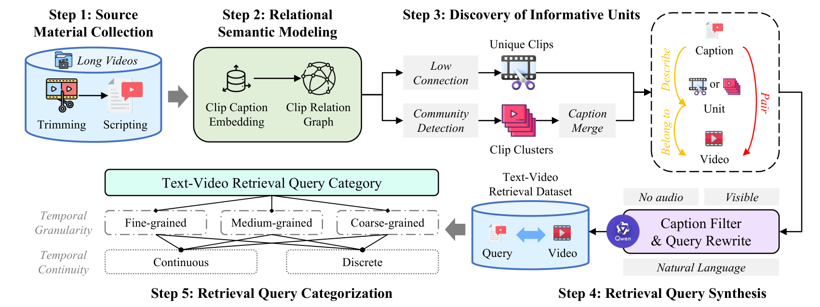
STUDY 2 · MG-LVR
MG-LVR Builds Queries from Sparse-to-Dense Evidence
Pipeline
• Material curation from long Vript videos (>120s).
• Clip Relation Graph: nodes=clips, edges=caption-embedding similarity.
• Unit discovery: isolated nodes and Louvain communities.
Query synthesis
• Qwen3-32B generates three candidate queries per unit.
• Queries are filtered for ambiguity and categorized by computed G.
Validation: 96% accuracy (50 pairs)
TAKEAWAY
The construction links semantic units to temporal coverage, enabling granularity-aware evaluation.
Towards Scalable and Generalizable Video Retrieval
33

Slide 34
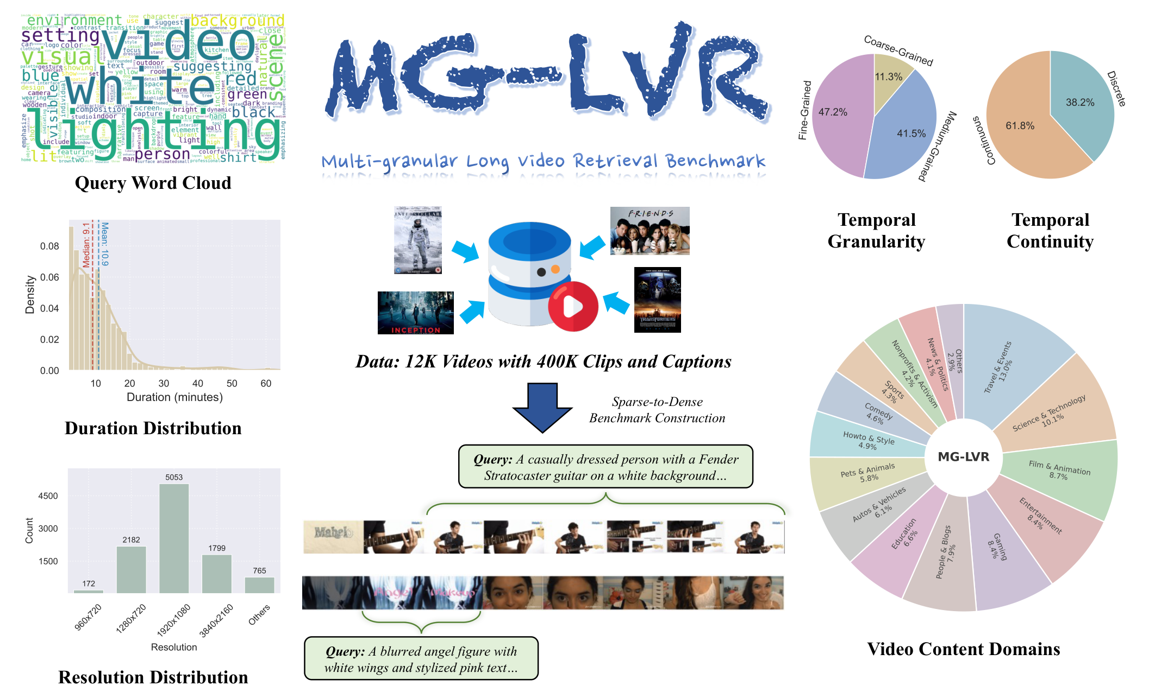
STUDY 2 · MG-LVR
MG-LVR Makes Observation Bottlenecks Measurable
9,971
queries: 4,706 FN + 4,142 MD + 1,123 CR
4,844
long videos, average duration 705.9 seconds
23
state-of-the-art models evaluated
18
content categories with diverse domains
TAKEAWAY
MG-LVR is the first benchmark jointly covering long videos and multi-granular retrieval queries.
Towards Scalable and Generalizable Video Retrieval
34

Slide 35
STUDY 2 · RESULTS
Fine-Grained Retrieval Suffers the Largest Drop
Model
Frames
Overall
Fine ↓
Medium
Coarse
Key finding
LanguageBind
8F
0.419
0.200
0.553
0.752
• Best model: Coarse R@1=0.903, Fine R@1=0.287.
• The gap persists across all 23 evaluated models.
• 16× more frames improves FN by less than 8 pp.
InternVideo2
8F
0.431
0.204
0.576
0.783
Qwen3-VL-Emb-8B
8F
0.449
0.210
0.589
0.856
GVE-7B
128F
0.508
0.266
0.647
0.845
Why fine is hard
Qwen3-VL-Emb-8B ★
128F
0.549
0.287
0.672
0.903
• Fine queries require objects/actions at a specific moment.
• Sparse sampling may miss the only relevant evidence.
TAKEAWAY
The model must know which frames to attend to, not merely process more frames.
Towards Scalable and Generalizable Video Retrieval
35

Slide 36
STUDY 2 · EVALUATION
23 Models Reveal Architecture-Dependent Observation
Model coverage
Best performers at 8 frames
• 6 CLIP-based models and 17 MLLM-based models.
• Evaluated at 8 frames and 128 frames.
• Families differ in how they respond to added temporal context.
• CLIP family: LanguageBind overall 0.419.
• MLLM ≤2B: Qwen3-VL-Emb-2B overall 0.391.
• MLLM ≤8B: Qwen3-VL-Emb-8B overall 0.449.
GVE as zero-shot model
• GVE-7B scores 0.412 overall at 8 frames and 0.508 at 128 frames.
• Qwen3-VL-Embedding is stronger on MG-LVR because it benefits from newer supervised embedding data.
• GVE contribution remains zero-shot generalization and semantic scaling.
TAKEAWAY
Observation scaling must be analyzed separately from semantic embedding capability.
Towards Scalable and Generalizable Video Retrieval
36

Slide 37
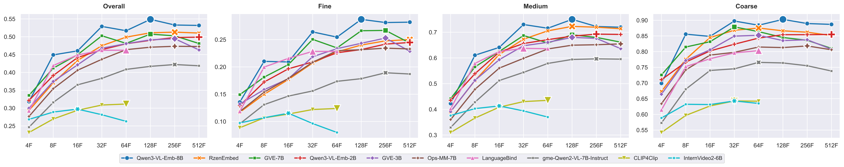
STUDY 2 · TEMPORAL SCALING
MLLMs Use More Frames; CLIP Models Often Anchor
MLLM trend
• Qwen3-VL-Emb-8B and similar MLLM models continue improving up to 512 frames.
• Largest gains appear on fine-grained queries.
CLIP trend
• CLIP-based models plateau around 16–32 frames.
• Performance can degrade beyond 64 frames on FN/MD.
Mechanism
• Mean pooling dilutes discriminative signals.
• Fixed-frame training anchors temporal representation length.
TAKEAWAY
More frames help only when the architecture can integrate variable-length temporal evidence.
Towards Scalable and Generalizable Video Retrieval
37

Slide 38
STUDY 2 · TRAINING-TIME SCALING
Temporal Scaling Anchors; Spatial Scaling Transfers
Training-time temporal scaling
Asymmetric mismatch
• Post-train Qwen2.5-VL-3B on 500K instances with different F_train.
• Performance peaks when F_test = F_train.
• Mismatch causes degradation in both directions.
• F_train=32 → F_test=4 drops Fine R@1 by ≈0.0104.
• F_train=4 → F_test=32 drops Fine R@1 by ≈0.0083.
• Low-frame training better preserves fine-grained discriminability under mismatch.
Spatial robustness
• Higher T_train consistently improves performance.
• A model trained at T=400 can still outperform at evaluation T=50.
• Spatial representations generalize across resolutions better than temporal representations generalize across frame counts.
TAKEAWAY
Temporal scaling is anchored; spatial scaling is more transferable. This asymmetry drives VEterfall.
Towards Scalable and Generalizable Video Retrieval
38

Slide 39
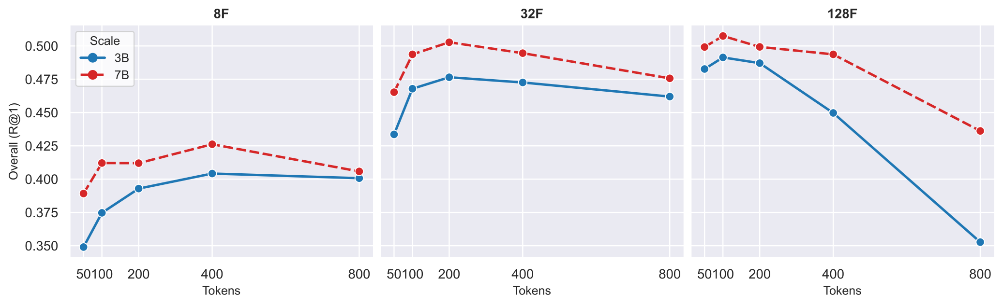
STUDY 2 · SPATIAL SCALING
Resolution Helps Only Under the Right Frame Budget
Main pattern
• When frame count is low, higher spatial resolution improves performance.
• When F>32, marginal spatial gains diminish.
• For coarse queries, too much temporal expansion can even reverse gains.
Interpretation
• Spatial tokens preserve texture and object details.
• Temporal tokens preserve event coverage.
• The best allocation depends on the semantic evidence needed.
TAKEAWAY
Spatial and temporal observation are complementary but not independently additive.
Towards Scalable and Generalizable Video Retrieval
39

Slide 40
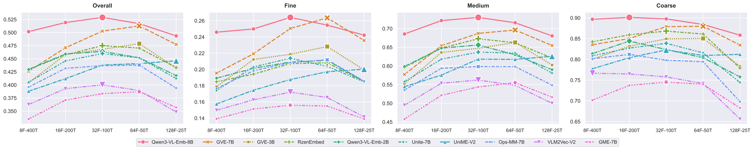
STUDY 2 · S–T TRADE-OFF
Fixed Token Budgets Require Query-Aware Allocation
Fixed budget
• Total tokens N_total = F × T.
• Moving right means more frames with fewer tokens per frame.
Granularity-specific optimum
• Coarse queries favor high resolution and fewer frames.
• Fine queries favor more frames and lower resolution.
• Medium queries fall between the two extremes.
Practical consequence
• One fixed sampler leaves performance on the table.
• Serving systems need query-aware observation policies.
TAKEAWAY
There is no universally optimal sampling strategy for long-video retrieval.
Towards Scalable and Generalizable Video Retrieval
40

Slide 41
STUDY 2 · DIAGNOSIS
More Frames Alone Cannot Close the Granularity Gap
Information loss
Optimization mismatch
• If relevant evidence is never sampled, the embedding cannot represent it.
• Fine-grained queries often depend on brief, localized evidence.
• Models trained at one frame count learn position- and density-specific temporal patterns.
• Simply increasing F_test can create distribution shift rather than better observation.
Compute constraint
Desired property
• High-density inference is expensive and not always allowed in production.
• A practical solution must retain dense knowledge while running sparse.
• Acquire knowledge densely during training or adaptation.
• Deploy with sparse inference under the same architecture and serving budget.
TAKEAWAY
VEterfall is designed to decouple knowledge acquisition from inference density.
Towards Scalable and Generalizable Video Retrieval
41

Slide 42
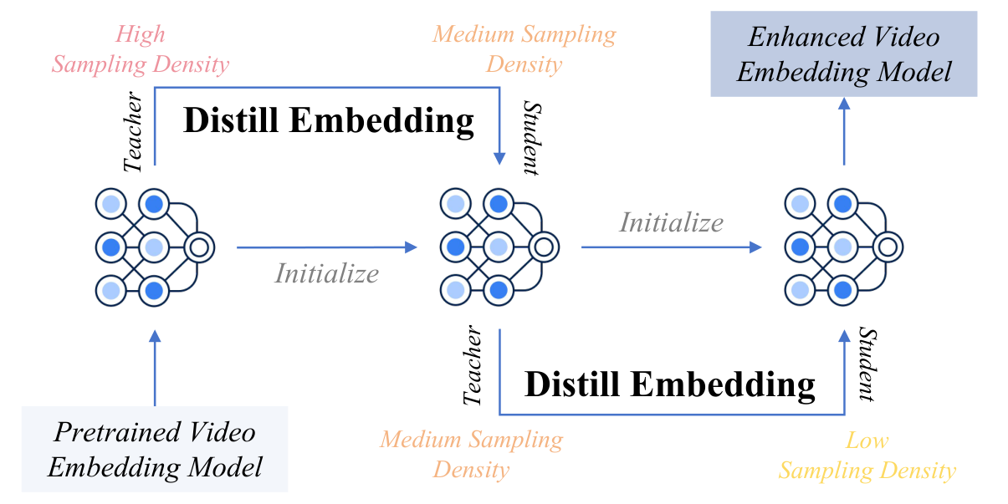
STUDY 2 · VETERFALL
VEterfall Transfers Dense Knowledge to Sparse Inference
Waterfall idea
• Start from a dense teacher at (16F, 400T).
• Distill to a medium model at (8F, 200T).
• Use the medium model as teacher for a sparse model at (4F, 100T).
Efficiency
• K=2 rounds.
• 100K InternVid pairs per round.
• 16× token reduction with no architecture change.
Why cascade: avoid abrupt mismatch
TAKEAWAY
Knowledge cascades from high sampling density to low sampling density.
Towards Scalable and Generalizable Video Retrieval
42

Slide 43
STUDY 2 · VETERFALL
Distillation Aligns Sparse Embeddings with Dense Teachers
Teacher-student alignment
Contrastive regularization
• Teacher is frozen at higher sampling density.
• Student observes fewer frames/tokens.
• MSE loss aligns student embeddings with teacher embeddings.
• InfoNCE loss maintains video-text alignment.
• λ=0.5 balances distillation and retrieval discrimination.
• Ablation shows λ=0 is already competitive; InfoNCE adds marginal but consistent gains.
What is transferred
• The student learns what a dense model would output, not only what sparse frames directly show.
• This transfers latent temporal knowledge without dense inference.
TAKEAWAY
VEterfall transfers representation behavior, not labels or architecture components.
Towards Scalable and Generalizable Video Retrieval
43

Slide 44
STUDY 2 · RESULTS
VEterfall Recovers Fine-Grained Sparse Performance
Setting
Overall
Fine ↑
Medium
Coarse
Fine gain
Where gains appear
8F-200T baseline
0.369
0.148
0.508
0.782
—
• Largest gains on Fine and Medium queries.
• Coarse performance remains stable because global semantics already survive sparse observation.
8F-200T VEterfall ★
0.402
0.188
0.543
0.777
+27.0%
4F-100T baseline
0.300
0.132
0.391
0.664
—
Efficiency context
4F-100T VEterfall ★
0.325
0.158
0.423
0.667
+19.7%
• 4F-100T uses 16× fewer tokens than 16F-400T.
• Only 100K pairs per round are needed.
TAKEAWAY
VEterfall selectively recovers the fine-grained knowledge most damaged by sparse inference.
Towards Scalable and Generalizable Video Retrieval
44

Slide 45
STUDY 2 · EFFICIENCY
VEterfall Is More Efficient Than Sparse Retraining
Approach
Training pairs
Relative compute
Fine R@1
Overall R@1
Frame efficiency
Direct sparse training
2.0M
1.0×
0.132
0.300
• At fixed T=200, V^(1) outperforms V^(0) at 8F and below.
• Gains grow as the frame budget becomes tighter.
Dense-to-sparse finetune
2.0M
2.4×
0.149
0.318
VEterfall ★
200K
0.1×
0.158
0.325
Token efficiency
• At fixed F=8, V^(1) improves consistently but margins are smaller.
• Spatial compression is a secondary factor relative to frame budget.
Study 2 takeaway
• MG-LVR reveals granularity-dependent observation.
• VEterfall provides dense knowledge with sparse inference.
TAKEAWAY
Observation scaling is about allocating evidence, not simply maximizing frames.
Towards Scalable and Generalizable Video Retrieval
45

Slide 46
03
Search Scaling: GMP-GR
Study 3
Addressing how learned retrieval signals scale to large candidate collections under serving constraints.
PhD Thesis Defense
46

Slide 47
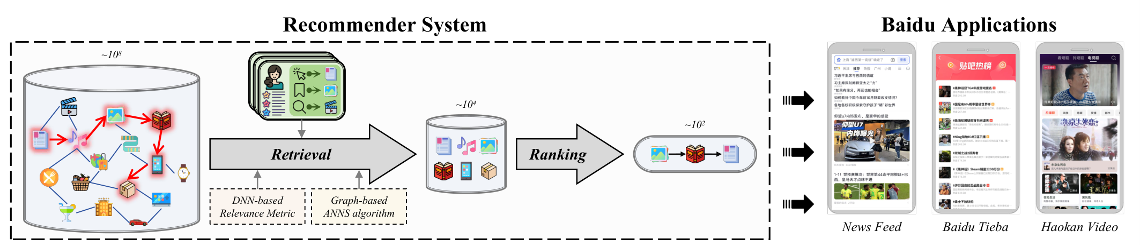
STUDY 3 · PRODUCTION CONTEXT
Search Scaling Turns Retrieval into Infrastructure
Application ecosystem
• 20+ internet products: news feed, short video, search engine, online advertising, Tieba.
• Hundreds of millions of users and production-scale request traffic.
Retrieval role
• Reduce billion-item corpus to thousand-level candidates.
• Ranking models then score a manageable set.
• Retrieval errors cannot be fixed if relevant items never enter the candidate pool.
TAKEAWAY
At this scale, retrieval quality directly determines downstream ranking quality and user engagement.
Towards Scalable and Generalizable Video Retrieval
47

Slide 48
STUDY 3 · PIPELINE
Retrieval Must Reduce Billion-Scale Corpora Under Latency
Offline features
Embedding projection
DNN metric
user/item behavior
dense vector space
neural relevance
HNSW item base
Online traversal
Ranking
graph index
top-K candidates
final feed
Serving: metric + graph + GPU under latency
TAKEAWAY
Search scaling is an infrastructure problem: metric, graph, and hardware interact.
Towards Scalable and Generalizable Video Retrieval
48

Slide 49
STUDY 3 · CHALLENGES
Production Search Has Metric, Graph, and GPU Bottlenecks
Multi-behavior modeling
Metric-search mismatch
GPU concurrency
• Click, dwell-time, skip, share, and engagement encode different semantics.
• Independent metrics fail to capture inter-behavior dependencies.
• Maintaining multiple metrics increases system update effort.
• DNN metrics are expressive but non-Euclidean.
• Triangle inequality violations make greedy HNSW traversal unreliable.
• Relevant items can be missed due to local graph traps.
• Online graph traversal triggers many irregular neural computations.
• Frequent small GPU kernel launches create fixed overhead.
• Throughput becomes bounded by launch and batching inefficiency.
TAKEAWAY
GMP-GR addresses all three bottlenecks as one co-designed system.
Towards Scalable and Generalizable Video Retrieval
49

Slide 50
STUDY 3 · METRIC–SEARCH TENSION
Expressive Neural Metrics Can Break Graph Traversal
Triangle inequality
DNN metric violation
• For metric distance: d(a,c) ≤ d(a,b)+d(b,c).
• This property supports greedy pruning in graph traversal.
• Euclidean distance satisfies it by construction.
• Neural relevance functions learn nonlinear scoring surfaces.
• Random triplets in production can violate metric regularity.
• Violation makes graph shortcuts unreliable.
Practical consequence
• HNSW assumes moving to a closer neighbor is a safe path.
• With non-metric DNN scores, greedy traversal can enter local subgraphs.
• At billion scale, missed relevant items become a candidate-generation failure.
TAKEAWAY
The solution is not to abandon DNN metrics or graph search, but to make the metric graph-compatible.
Towards Scalable and Generalizable Video Retrieval
50

Slide 51
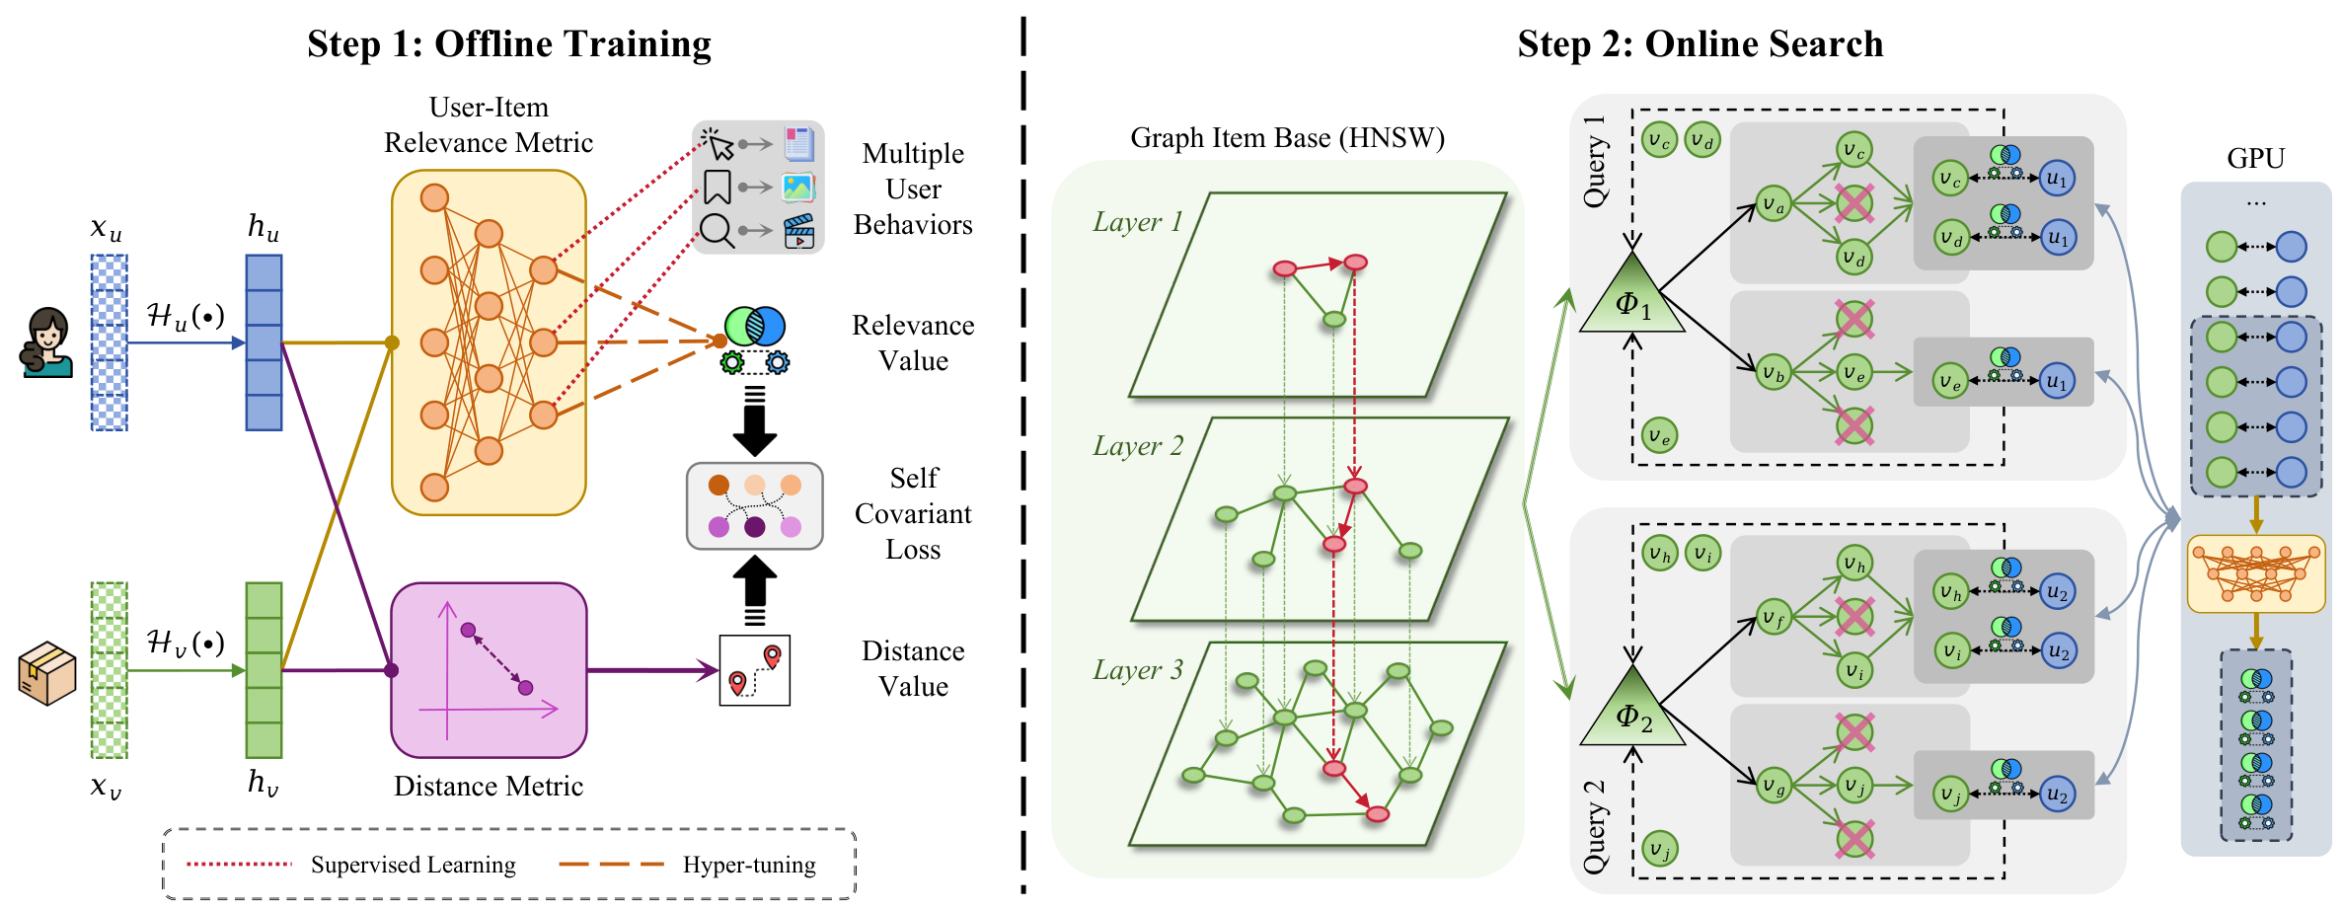
STUDY 3 · GMP-GR
GMP-GR Co-designs Metric, Graph Search, and GPU Execution
MUIRML
• Multi-relational user-item metric learning.
• DNN relevance + Euclidean-compatible distance regularity.
• Self-Covariant Loss aligns ranking regularity.
HiPANNS
• C-HiPANNS: inter-candidate parallel graph traversal.
• Q-HiPANNS: inter-query GPU batching and adaptive slicing.
System layer
• Traffic dispersal, compilation, FP16 quantization, timely stream update.
TAKEAWAY
MUIRML creates a metric HiPANNS can traverse efficiently; HiPANNS executes it at production throughput.
Towards Scalable and Generalizable Video Retrieval
51

Slide 52
STUDY 3 · MUIRML
MUIRML Learns Accurate and Searchable Relevance
Input behavior signals
Two objectives
• Click, browse, dwell-time, skip, share, and engagement.
• A serendipity vector h̃~N(0,1) supports exploration and diversity.
• User and item embeddings are combined through an MLP.
• Prediction loss minimizes relevance estimation error.
• Self-Covariant Loss maximizes metric regularity.
• The combined loss learns accurate and searchable embeddings.
Why multi-relational
• User behaviors are not independent.
• Joint modeling captures cross-behavior semantics without maintaining many behavior-specific metrics.
TAKEAWAY
MUIRML turns multiple engagement signals into one graph-compatible retrieval metric.
Towards Scalable and Generalizable Video Retrieval
52

Slide 53
STUDY 3 · SCL
SCL Aligns Ranking Regularity, Not Raw Scores
What SCL does NOT do
What SCL does
• It does not force DNN scores to equal Euclidean distances.
• It does not remove neural expressiveness.
• It is a soft regularization, not a hard constraint.
• It aligns the ranking order induced by DNN relevance with the order induced by Euclidean distance.
• Maximizing covariance correlation ρ makes graph navigation paths shorter and more reliable.
SCL transfers the navigability of Euclidean space into an expressive neural metric space.
Loss intuition
• L = prediction_loss + Σ 1/(ρ+1).
• Higher ρ means DNN and Euclidean rankings agree more.
• Agreement reduces pathological graph traversal cases.
TAKEAWAY
SCL is the bridge between relevance accuracy and graph-search efficiency.
Towards Scalable and Generalizable Video Retrieval
53

Slide 54
STUDY 3 · C-HIPANNS
C-HiPANNS Broadens Graph Search
Standard HNSW issue
C-HiPANNS strategy
• Greedy traversal follows a small set of promising nodes.
• With imperfect metric regularity, one path can get trapped.
• Increasing depth alone is expensive.
• Launch k parallel search processes with different seeds.
• Each process explores different neighbor regions.
• A shared max heap Φu maintains top candidates across processes.
Benefit
• k-fold search-space expansion at each layer.
• Higher recall at the same traversal depth.
• Works especially well after MUIRML improves metric regularity.
TAKEAWAY
C-HiPANNS improves candidate quality by reducing path dependence in graph traversal.
Towards Scalable and Generalizable Video Retrieval
54

Slide 55
STUDY 3 · Q-HIPANNS
Q-HiPANNS Improves GPU Throughput
Concurrency problem
Adaptive batching
• Graph traversal produces irregular neural computation requests.
• Each request can be small and divergent in shape.
• Naive execution creates frequent GPU kernel launches.
• Queue Ψ listens for computation requests from C-HiPANNS.
• Requests are aggregated into GPU-ready batches.
• Oversized batches are sliced according to remaining GPU capacity.
Benefit
• Reduces fixed launch overhead under high concurrency.
• Improves throughput without changing per-query retrieval semantics.
• Complements C-HiPANNS: one improves recall, one improves throughput.
TAKEAWAY
Q-HiPANNS turns irregular neural graph traversal into efficient batched GPU execution.
Towards Scalable and Generalizable Video Retrieval
55

Slide 56
STUDY 3 · OFFLINE RESULTS
GMP-GR Improves Coverage, Recall, and Speed
Method
Video Cov
Video R@10
MVideo Cov
Explore Cov
Fresh Cov
Improvement over NANN
C-NSW
0.339
0.383
0.298
0.329
0.401
• Video Coverage: 0.649 vs 0.537 (+20.9%).
• Video R@10: 0.824 vs 0.672 (+22.7%).
• Consistent gains across Video, MVideo, Explore, and Fresh.
SL2G
0.441
0.578
0.412
0.408
0.490
NANN
0.537
0.672
0.515
0.503
0.581
GMP-GR ★
0.649
0.824
0.624
0.628
0.698
Speed
• 321K items/sec vs NANN 282K on Video.
• Accuracy and speed improve together.
TAKEAWAY
Co-design avoids the usual accuracy-speed trade-off.
Towards Scalable and Generalizable Video Retrieval
56

Slide 57
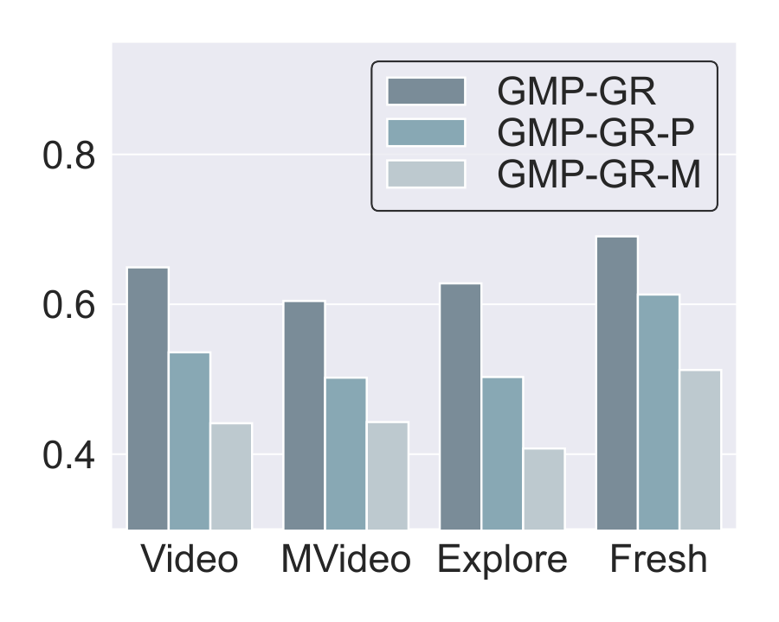
STUDY 3 · ABLATION
MUIRML and HiPANNS Solve Complementary Bottlenecks
Ablation variants
• GMP-GR: full system.
• GMP-GR-P: HiPANNS only with standard metric.
• GMP-GR-M: MUIRML only with standard graph traversal.
Observed pattern
• Full GMP-GR wins across Video, MVideo, Explore, and Fresh.
• Each ablation loses a meaningful portion of the gain.
• Removing HiPANNS causes major speed degradation.
Interpretation: both parts are needed
TAKEAWAY
The full gain requires both a searchable metric and a scalable search engine.
Towards Scalable and Generalizable Video Retrieval
57

Slide 58
STUDY 3 · ONLINE DEPLOYMENT
Online A/B Tests Show Production Engagement Gains
Service
Time-on-Page Δ
DAU Δ
Significance
Why 1% matters
Service 1: main feed
+1.13%
+0.23%
p < 0.001
• At hundreds-of-millions user scale, even a 1% lift has large aggregate impact.
• Retrieval improvements affect what ranking can even see.
Service 2: short video
+1.19%
+0.50%
p < 0.001
System optimization
Deployment scale
• Compilation: +74% / +75% throughput.
• FP32→FP16 quantization: +26% / +25%.
• Combined serving optimization roughly doubles throughput.
• Baidu Mobile APP, 2 services, 5 servers, 2-week testing.
• Extended across 20+ applications serving hundreds of millions of users.
TAKEAWAY
GMP-GR demonstrates real-world retrieval impact beyond offline benchmarks.
Towards Scalable and Generalizable Video Retrieval
58

Slide 59
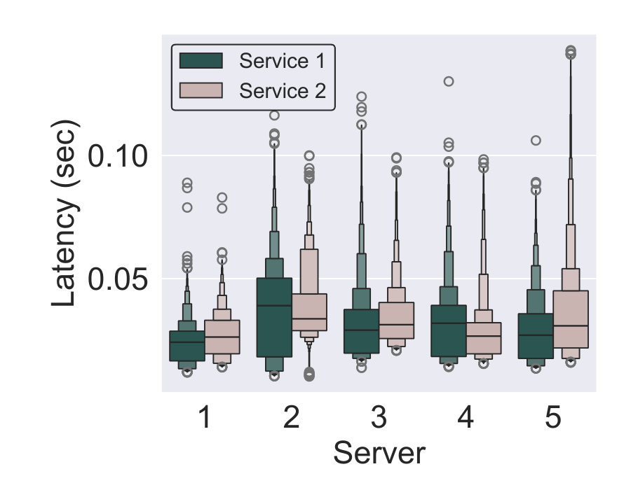
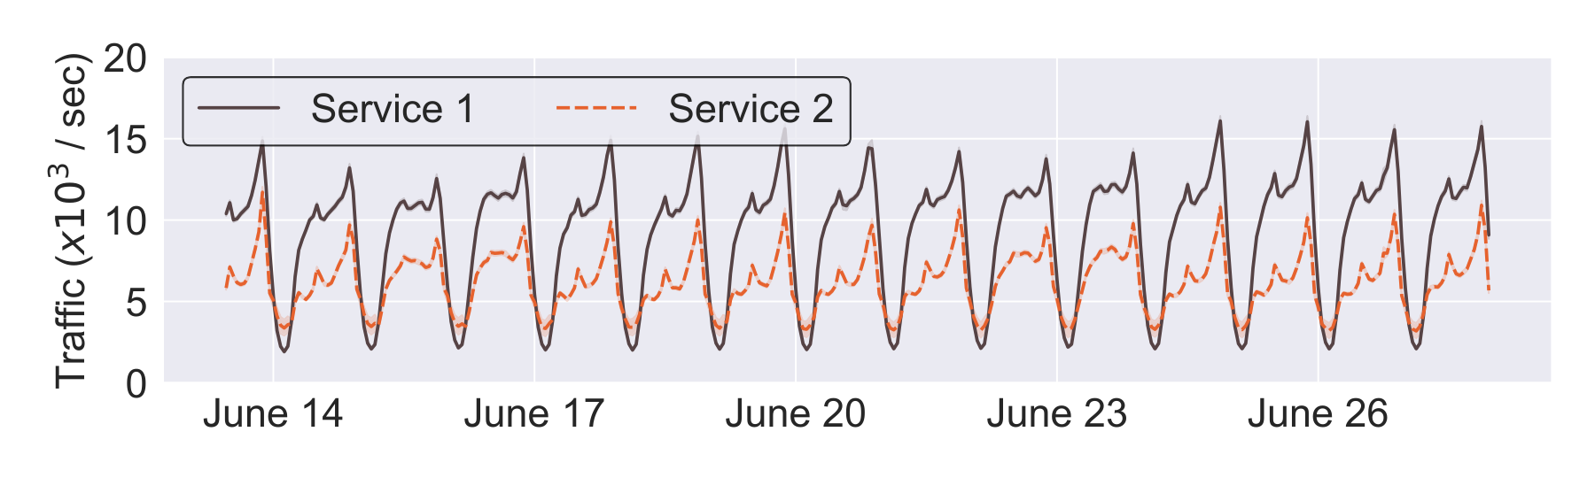
STUDY 3 · PRODUCTION MONITORING
Traffic and Latency Remain Stable After Rollout
Traffic volume over the deployment period
P99 latency stays within serving expectations
TAKEAWAY
Production-quality retrieval must improve relevance without causing latency regressions.
Towards Scalable and Generalizable Video Retrieval
59

Slide 60
CROSS-STUDY INSIGHT
Scalable Retrieval Requires Structure-Aware Scaling
Stage
Naive scaling
Structural bottleneck
Thesis solution
Semantic
↑ parameters / generic pairs
Capability gaps across tasks
UVRB → V-SynFlow → GVE
Observation
↑ frame count / tokens
Granularity-aware evidence acquisition
MG-LVR scaling laws → VEterfall
Search
↑ offline metric AUC
Metric–graph–GPU incompatibility
MUIRML + HiPANNS
Generalizability is the empirical criterion for effective scaling.
Connecting thread
• Study 1: structure = capability taxonomy.
• Study 2: structure = temporal/spatial granularity.
• Study 3: structure = metric-graph compatibility.
TAKEAWAY
Scaling helps only when aligned with the stage-specific structure that controls transfer.
Towards Scalable and Generalizable Video Retrieval
60

Slide 61
CROSS-STUDY INSIGHT
Generalization Appears at Semantic, Observational, and Search Stages
Semantic generalization
Observational generalization
Search generalization
• Across query modalities: TXT / CMP / VIS.
• Across retrieval domains: CG / FG / LC.
• Across relevance granularities including PR.
• Across sampling densities: frames F and tokens T.
• Across video durations and temporal structures.
• Across query granularities: FN / MD / CR.
• Across deployment contexts and traffic patterns.
• Across item domains: Video / MVideo / Explore / Fresh.
• Across hardware-constrained serving regimes.
TAKEAWAY
The thesis extends retrieval generalization from model outputs to the entire system pipeline.
Towards Scalable and Generalizable Video Retrieval
61

Slide 62
DISCUSSION
The Thesis Contributes Pipeline Coverage and Reusable Artifacts
Pipeline coverage
Diagnostic methodology
Reproducible artifacts
• Representation learning → observation-aware inference → production-scale search.
• Few theses study all three stages under one narrative.
• Evaluation identifies gaps.
• Synthesis fills gaps.
• Curriculum and distillation stabilize transfer.
• UVRB and MG-LVR establish reusable evaluation protocols.
• UVRD and GVE provide data/model resources for future comparison.
Production validation
• GMP-GR is deployed in a real industrial environment with 20+ applications and large-scale A/B testing.
• This connects academic retrieval research to real serving constraints.
TAKEAWAY
The thesis contributes methods, benchmarks, and production evidence—not only isolated model improvements.
Towards Scalable and Generalizable Video Retrieval
62

Slide 63
DISCUSSION
Limitations Clarify the Boundary of Semantic and Observation Claims
Study 1 — Semantic scaling
Study 2 — Observational scaling
• UVRD relies on synthesized data with 95% accuracy, leaving a nontrivial error rate.
• Composed retrieval still lags behind textual retrieval (CMP 0.312 vs TXT 0.657).
• Visual-only retrieval remains challenging for MLLM-based embedding models.
• MG-LVR relies on dense captions, so quality is bounded by caption accuracy.
• Temporal grounding is at clip level, not pixel/action-level annotation.
• VEterfall is validated mainly on the GVE-3B backbone; broader backbone testing remains future work.
Why state these limitations
• They clarify where the conclusions are strongest and where future validation is needed.
• Each limitation motivates a specific research direction rather than weakening the thesis narrative.
TAKEAWAY
The current studies establish strong stage-level findings but leave room for broader validation and finer annotations.
Towards Scalable and Generalizable Video Retrieval
63

Slide 64
DISCUSSION
Integration and Platform Generalization Remain Future Work
Study 3 — Search scaling
Cross-study limitation
• GMP-GR is evaluated primarily in Baidu infrastructure and recommendation context.
• Throughput numbers depend on hardware, traffic distribution, and implementation details.
• Online A/B evidence covers two services, not every deployed application.
• The three studies are validated at successive stages, but not jointly optimized end-to-end.
• GVE embeddings, VEterfall sparse inference, and GMP-GR graph search have not yet been combined into one full retrieval system.
The natural next step is end-to-end integration: semantic capability, observation policy, and searchability should be co-optimized.
TAKEAWAY
The thesis provides the pieces; a unified system is the next research frontier.
Towards Scalable and Generalizable Video Retrieval
64

Slide 65
FUTURE WORK
Future Direction: Retrieval-Native Multimodal Models
Current limitation
Future direction
• MLLMs are trained for generation.
• Hidden states are optimized for next-token prediction, not compact discriminative retrieval.
• EOS-token embedding extraction is an adaptation, not an ideal retrieval design.
• Pre-train with retrieval-first objectives.
• Introduce retrieval-specific tokens and task-decoupled routing.
• Use lightweight adapters to preserve generative ability while shaping retrieval geometry.
Open problem
• How can retrieval-native representation be learned without degrading the generative abilities that make MLLMs useful?
TAKEAWAY
Future video embedders should be retrieval-native, not retrieval-adapted after generation pretraining.
Towards Scalable and Generalizable Video Retrieval
65

Slide 66
FUTURE WORK
Future Direction: Video Retrieval as Agent Memory
Motivation
New system setting
• Embodied and web agents need long-horizon visual memory.
• They must recall past observations, object locations, and event context.
• Video retrieval is the natural interface for querying episodic memory.
• Streaming visual memory grows continuously.
• Queries arrive in real time and may depend on hours of past observation.
• VEterfall-style efficiency becomes critical for on-device or edge environments.
Evaluation shift
• Beyond Recall@K: measure downstream task success, decision latency, and memory usefulness.
• This connects observational scaling with search scaling.
TAKEAWAY
Video retrieval can become a foundational memory mechanism for multimodal intelligence.
Towards Scalable and Generalizable Video Retrieval
66

Slide 67
FUTURE WORK
Future Direction: Self-Evolving Data and Curriculum
Current pipeline
Closed-loop future
• UVRB diagnoses gaps.
• V-SynFlow generates targeted data.
• Modality Pyramid schedules learning.
• This is currently a one-shot process.
• Evaluator diagnoses new weaknesses.
• Synthesizer generates targeted examples.
• Curriculum scheduler adjusts task distribution.
• Model is re-evaluated and the loop repeats.
Why this matters
• New query formats, video domains, and relevance patterns emerge continuously.
• Self-evolving systems reduce dependence on manually curated benchmarks and static curricula.
TAKEAWAY
The evaluation-synthesis-curriculum loop can become an automatic capability expansion engine.
Towards Scalable and Generalizable Video Retrieval
67

Slide 68
FUTURE WORK
Future Direction: Continuous Multi-Granular Representations
Why single embeddings may be insufficient
Generative hypothesis
• A single pooled vector must represent global themes and local details simultaneously.
• Coarse and fine-grained queries may require different abstraction levels.
• This creates tension in one-vector retrieval.
• Diffusion or flow trajectories encode different granularities over time.
• Early trajectory states capture global structure.
• Later states expose fine-grained details.
• Intermediate states may serve as granularity-specific embeddings.
Research challenge
• Generative representations must become discriminative and searchable.
• The key difficulty is connecting generation trajectories with retrieval geometry.
TAKEAWAY
Generative representations may unify coarse and fine-grained retrieval without task-specific heads.
Towards Scalable and Generalizable Video Retrieval
68

Slide 69
CONCLUSION
Structure-Aware Scaling Connects the Three Studies
Video retrieval has three sequential scaling bottlenecks, each requiring structure-aware rather than capacity-naive solutions.
Study 1: semantic scaling
Study 2: observational scaling
Study 3: search scaling
• UVRB + V-SynFlow + GVE.
• SOTA zero-shot across 16 datasets.
• Capability-targeted data beats parameter-naive scaling.
• MG-LVR + VEterfall.
• Frame-count anchoring and S–T trade-off.
• +20% fine-grained R@1 at 4–16× efficiency.
• MUIRML + HiPANNS.
• +20% offline accuracy and +3% engagement.
• Production deployment at Baidu scale.
TAKEAWAY
The open question: can a single system jointly optimize representation, observation, and search?
Towards Scalable and Generalizable Video Retrieval
69

Slide 70
ARTIFACTS
Research Outputs and Reusable Artifacts
Thesis chapter
Artifact
Venue / status
Core contribution
Ch.3
GVE / UVRB / UVRD
ACM MM 2026
submitted
Semantic scaling by diagnosis and synthesis
Ch.4
MG-LVR / VEterfall
ECCV 2026
submitted
Observation scaling and dense-to-sparse inference
Ch.5
GMP-GR
ACM WebConf 2026
published
Production search scaling at Baidu
Reusable outputs
Industrial impact
• UVRB: unified evaluation protocol.
• UVRD: capability-targeted training corpus.
• MG-LVR: multi-granular long-video retrieval benchmark.
• GVE and VEterfall: methods for semantic and observational scaling.
• GMP-GR is deployed across Baidu products.
• Demonstrates that retrieval research can improve real user engagement under production constraints.
TAKEAWAY
The thesis delivers reusable academic artifacts and one validated production-scale system.
Towards Scalable and Generalizable Video Retrieval
70

Slide 71
Questions?
Structure-aware scaling for scalable and generalizable video retrieval
Thank you
HKUST(GZ) · July 29, 2026
71

Slide 72
A
Backup Slides for Q&A
Appendix
Optional slides for committee questions.
PhD Thesis Defense
72

Slide 73
APPENDIX · Q&A
Q1–Q2: GVE and Synthesized Data Quality
Q1: How does GVE compare to GPT-4o / Gemini retrieval?
Q2: Is 100-sample validation enough?
• Those models are optimized for generation, not embedding retrieval.
• Using hidden states as embeddings would be comparable to evaluated MLLM embedders.
• GVE differs by explicit UVRD retrieval supervision and Modality Pyramid training.
• It is a limitation; 95% accuracy gives a wide confidence interval.
• Downstream consistency across 16 UVRB datasets is functional evidence that synthesized data is useful.
• If noise were systematic, broad zero-shot gains would be unlikely.
Answering strategy
• Acknowledge uncertainty first, then point to downstream validation and future larger-scale audit.
TAKEAWAY
The strongest defense is not that synthesis is perfect, but that diagnostic-guided synthesis improves broad zero-shot transfer.
Towards Scalable and Generalizable Video Retrieval
73

Slide 74
APPENDIX · Q&A
Q3–Q4: MG-LVR and VEterfall
Q3: Is the granularity gap a benchmark artifact?
Q4: How would GVE + VEterfall combine?
• The gap appears across all 23 evaluated models.
• The theoretical reason is clear: fine queries require brief frame-level evidence.
• Short-clip benchmarks cannot reveal this because nearly all evidence is observed.
• Not yet evaluated as an integrated published experiment.
• Hypothesis: a stronger GVE dense teacher should produce better sparse distillation signals.
• This is a concrete future integration experiment.
Answering strategy
• Separate validated results from plausible next steps.
• Avoid overclaiming the end-to-end system integration.
TAKEAWAY
The stage-level findings are validated; cross-stage integration remains a clear future work item.
Towards Scalable and Generalizable Video Retrieval
74

Slide 75
APPENDIX · Q&A
Q5–Q6: SCL and GMP-GR Generalization
Q5: Does SCL hurt DNN metric expressiveness?
Q6: Can GMP-GR generalize beyond Baidu?
• SCL is a soft regularizer, not a hard equality constraint.
• It aligns ranking regularity rather than raw score values.
• It removes pathological graph-navigation cases while preserving fine-grained relevance.
• Algorithmic components are general to HNSW-compatible infrastructure.
• Exact throughput numbers are hardware- and traffic-dependent.
• Accuracy gains should generalize more readily than engineering throughput gains.
Answering strategy
• Distinguish algorithmic generality from platform-specific measurements.
TAKEAWAY
GMP-GR is a general co-design principle, while the reported serving numbers are Baidu-specific.
Towards Scalable and Generalizable Video Retrieval
75

Slide 76
APPENDIX · Q&A
Q7–Q8: Surprising Findings and Openness
Q7: Most surprising finding?
Q8: What will be open-sourced?
• Study 1 scaling paradox: 87M CLIP can outperform 8B MLLM on visual-only retrieval.
• Study 2 frame-count anchoring: CLIP models can degrade when more frames are added.
• Both challenge the intuition that “larger input/model always helps.”
• UVRB and MG-LVR are designed for public release with protocols and splits.
• GVE release depends on compatibility with the Qwen2.5-VL license.
• GMP-GR production system is proprietary, but algorithm components are fully described.
Answering strategy
• Use surprising findings to reinforce the thesis: structural bottlenecks matter more than naive capacity.
TAKEAWAY
The most important findings are the ones that force the field to rethink naive scaling assumptions.
Towards Scalable and Generalizable Video Retrieval
76

