Slide 1
Towards Scalable and Generalizable
Video Retrieval
PhD Thesis Defense
Zhuoning Guo
Thrust of Artificial Intelligence, HKUST(GZ)
Advisors: Prof. Xiaowen Chu & Prof. Renjing Xu
July 29, 2026
“How can video retrieval stay generalizable as semantic capability, visual observation, and search scale all grow?”
Notes:
Good morning. I am Zhuoning Guo. This thesis studies video retrieval as a pipeline-level scaling problem, advised by Prof. Xiaowen Chu and Prof. Renjing Xu.

Slide 2
Introduction
Semantic Scaling
Observational Scaling
Search Scaling
Conclusion & Future Work
1
Video Retrieval Underpins Modern Multimedia Systems
Search, recommendation, and discovery all reduce to matching a query to a video corpus.
Search
Recommendation
Discovery & personalization
Find videos from text, an image, or a clip across a massive corpus.
Match evolving user intent to a fast-growing item catalog.
Surface relevant long-form content under strict latency.
The shift
As corpora, query forms, and serving traffic all grow, retrieval stops being a single benchmark task and becomes a pipeline-level scaling problem — the subject of this thesis.
Towards Scalable and Generalizable Video Retrieval
Zhuoning Guo · HKUST(GZ)
Notes:
Video retrieval is foundational to search, recommendation, and discovery — and it is scaling.

Slide 3
Introduction
Semantic Scaling
Observational Scaling
Search Scaling
Conclusion & Future Work
2
Roadmap: From Representation to Observation to Search
One pipeline, three sequential scaling bottlenecks, three studies.
01
Motivation
Video retrieval is a pipeline-level scaling problem
02
Study 1 · Semantic Scaling — GVE
Diagnose capabilities → synthesize data → unified embedding
03
Study 2 · Observational Scaling — MG-LVR & VEterfall
Granularity-aware evidence → scaling laws → distillation
04
Study 3 · Search Scaling — GMP-GR
Search-compatible metric → graph traversal → GPU execution
05
Conclusion & Future Work
Structure-aware scaling across the pipeline
Towards Scalable and Generalizable Video Retrieval
Zhuoning Guo · HKUST(GZ)
Notes:
The talk follows the retrieval pipeline; three studies attack three successive bottlenecks.

Slide 4
Introduction
Semantic Scaling
Observational Scaling
Search Scaling
Conclusion & Future Work
3
Video Retrieval Is a Pipeline, Not a Single Benchmark Task
A query is answered by a chain of decisions, each with its own scaling pressure.
Query
Representation
Observation
Search
Candidates
→
→
→
→
text / image /
composed
embed query
& video
sample frames
& tokens
billion-scale
ANNS
ranked
result set
↓
↓
↓
semantic
capability gap
visual
evidence gap
searchability
gap
Modern retrieval fails not because one benchmark is hard, but because different pipeline stages expose different scaling bottlenecks.
Towards Scalable and Generalizable Video Retrieval
Zhuoning Guo · HKUST(GZ)
Notes:
Retrieval is a chain: represent, observe, search — each stage has a distinct bottleneck.

Slide 5
Introduction
Semantic Scaling
Observational Scaling
Search Scaling
Conclusion & Future Work
4
Problem Formulation: Embedding-Based Video Retrieval
A shared embedding space ranks a corpus by similarity to any query form.
Objective
Two axes of universality
Learn an encoder E_θ mapping a query q (text, visual, or composed) and every video v into a shared space, so relevant pairs rank above irrelevant ones and a compact candidate set is returned for downstream ranking.
• Query format: Textual (TXT), Composed (CMP), Visual (VIS)
• Data domain: Coarse-grained (CG), Fine-grained (FG), Long-context (LC)
• Fine-grained splits: Spatial (S), Temporal (T), Partial Relevance (PR)
Relevance score
s(q → v) = cos( E_θ(q), E_θ(v) )
Scope
Why it is hard
Studies 1–2 target text/visual→video retrieval; Study 3 targets web-scale user→item retrieval under the same searchable-signal principle.
A model may excel on one axis (e.g. text–video) yet fail on composed, visual-only, or partially-relevant retrieval — leaderboards hide this.
Towards Scalable and Generalizable Video Retrieval
Zhuoning Guo · HKUST(GZ)
Notes:
Formal setup: one embedding space, cosine relevance, evaluated across query formats and domains.

Slide 6
Introduction
Semantic Scaling
Observational Scaling
Search Scaling
Conclusion & Future Work
5
The Benchmark–Reality Gap Is Structural
Leaderboard conditions differ from deployment along every axis that matters.
BENCHMARK WORLD
PRODUCTION REALITY
Video length
Short clips (10–30 s)
Minutes to hours
Query form
Single type (text)
Text · image · composed
Corpus size
1K–10K videos
Billion-scale pools
Serving
Offline evaluation
Sub-10 ms latency budget
Each production stage exposes a bottleneck that short-clip benchmarks make invisible.
Towards Scalable and Generalizable Video Retrieval
Zhuoning Guo · HKUST(GZ)
Notes:
The gap is structural — along length, query form, corpus size, and serving.

Slide 7
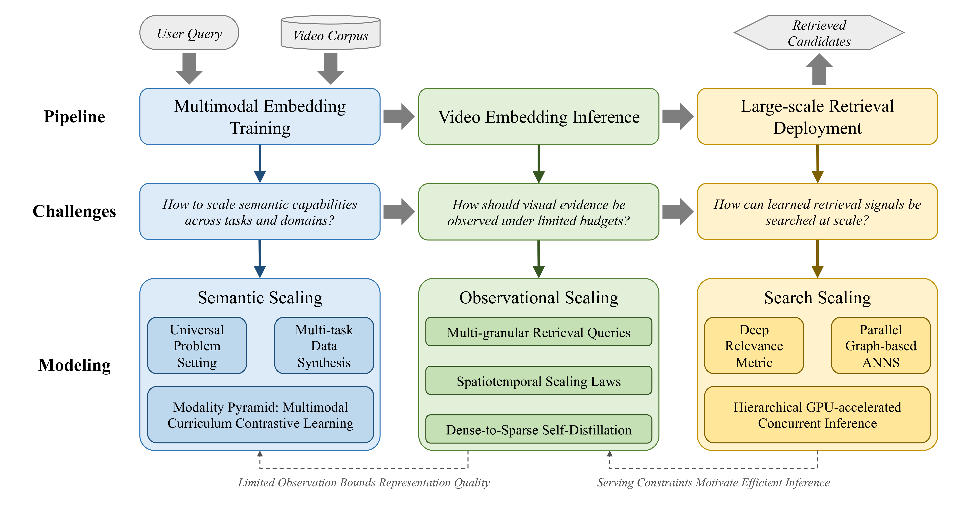
Introduction
Semantic Scaling
Observational Scaling
Search Scaling
Conclusion & Future Work
6
Three Bottlenecks Structure the Thesis
Representation, observation, and search each need structure-aware scaling.
Semantic Scaling
Observational Scaling
Search Scaling
Capability gaps across query forms & relevance types
Evidence gaps under limited frame/token budgets
Metric–graph–GPU incompatibility at scale
Takeaway Generalizability is the evidence that scaling has addressed the right bottleneck.
Towards Scalable and Generalizable Video Retrieval
Zhuoning Guo · HKUST(GZ)
Notes:
Thesis Figure 1.1: three-stage pipeline with structural bottlenecks and structure-aware solutions.

Slide 8
Introduction
Semantic Scaling
Observational Scaling
Search Scaling
Conclusion & Future Work
7
Naive Scaling Fails Differently at Each Stage
More parameters, more frames, or higher offline AUC each hit a different wall.
Stage
Naive scaling
Why it fails
Structure-aware fix
Semantic
More params /
generic data
Capability gaps persist even at 8B parameters
Diagnose → synthesize → curriculum
Observation
More frames /
tokens
Fine recall barely moves with 16× more frames
Granularity-aware allocation + distillation
Search
Higher offline
metric AUC
Neural metrics break greedy graph traversal
Metric–graph–GPU co-design
Towards Scalable and Generalizable Video Retrieval
Zhuoning Guo · HKUST(GZ)
Notes:
Failure modes are qualitatively different, so no single scaling recipe fixes all three.

Slide 9
Introduction
Semantic Scaling
Observational Scaling
Search Scaling
Conclusion & Future Work
8
Three Studies Address Three Pipeline Bottlenecks
Each study delivers a diagnosis, a method, and generalization evidence.
Study 1 · Semantic Scaling
Study 2 · Observational Scaling
Study 3 · Search Scaling
• UVRB: unified diagnosis, 16 datasets × 14 models
• V-SynFlow → UVRD: 1.55M capability-targeted pairs
• GVE: SOTA zero-shot generalization (0.573 / 0.600)
• MG-LVR: 9,971 queries over 4,844 long videos (706 s)
• Spatiotemporal scaling laws for frame/token budgets
• VEterfall: +20% fine-grained at 4–16× efficiency
• MUIRML + SCL: search-compatible neural metric
• HiPANNS: parallel graph traversal on GPU
• GMP-GR: +20.9% coverage; validated in two A/B services
Towards Scalable and Generalizable Video Retrieval
Zhuoning Guo · HKUST(GZ)
Notes:
Three studies, one argument: structure-aware scaling along the retrieval pipeline.

Slide 10
9
01
GUIDING QUESTION
What capabilities should a video retrieval model possess, and how do we scale toward them?
STUDY 1 · SEMANTIC SCALING
General Video
Embedding (GVE)
Chapter 3 · submitted to ACM MM 2026
Notes:
What capabilities should a video retrieval model possess, and how do we scale toward them?

Slide 11
Introduction
Semantic Scaling
Observational Scaling
Search Scaling
Conclusion & Future Work
10
Universal Video Retrieval Requires Capability Coverage
Generalization means covering query forms, domains, and relevance types.
Query formats
Domains & relevance
• Textual (TXT) — natural-language prompts
• Composed (CMP) — text + visual reference
• Visual (VIS) — reference frame or clip
• Coarse (CG) vs. fine-grained (FG) vs. long-context (LC)
• Fine-grained splits: Spatial (S), Temporal (T)
• Partial Relevance (PR) — only part of a video matches
The trap
A model can top MSR-VTT yet fail on composed, visual-only, or partially-relevant retrieval — a single leaderboard score hides the capabilities that matter.
Core insight
Semantic scaling means scaling toward broader capability coverage across formats, domains, and relevance types — not merely adding parameters or generic pairs.
Towards Scalable and Generalizable Video Retrieval
Zhuoning Guo · HKUST(GZ)
Notes:
Universal retrieval is defined by capability coverage, not a single benchmark.

Slide 12
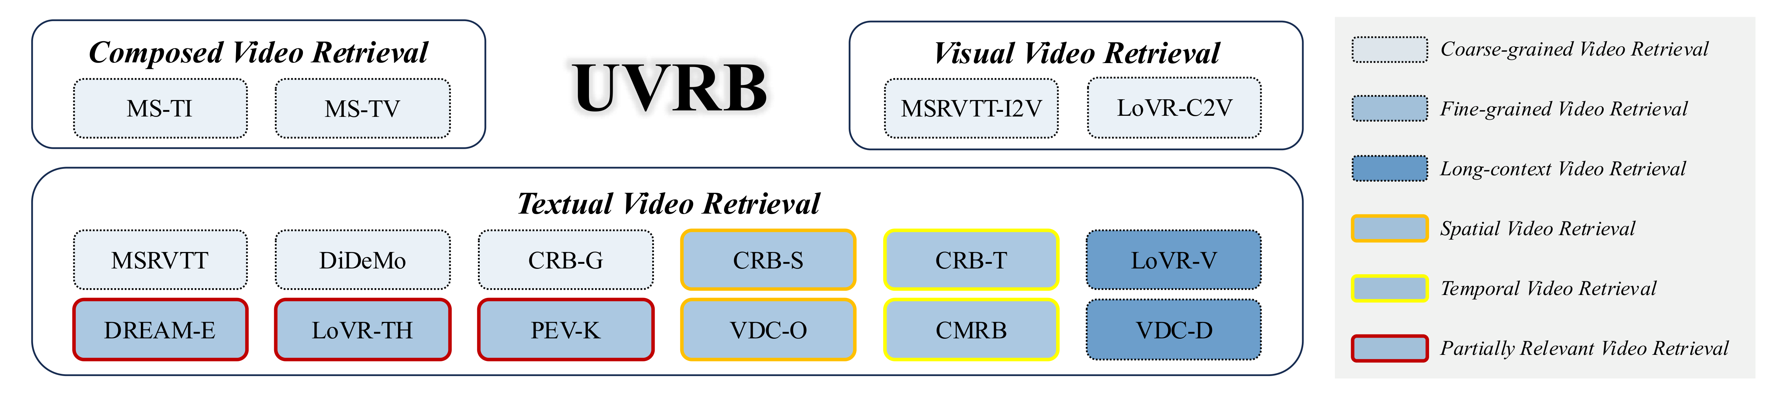
Introduction
Semantic Scaling
Observational Scaling
Search Scaling
Conclusion & Future Work
11
UVRB: One Protocol to Diagnose 14 Models on 16 Datasets
A standardized diagnostic that measures what a model lacks, not just its rank.
UVRB unifies 16 public datasets into one evaluation space with six capability labels.
Unified protocol
14 baselines
Diagnostic power
• 16 datasets, identical preprocessing
• Frozen embeddings, cosine similarity
• No task-specific fine-tuning
• 87M → 8.3B parameters
• CLIP- & MLLM-based families
• GME · UNITE · VLM2Vec · UniME · B3
Maps the capability a model is missing — not just its leaderboard rank.
Towards Scalable and Generalizable Video Retrieval
Zhuoning Guo · HKUST(GZ)
Notes:
UVRB is a diagnostic, not a leaderboard: one protocol isolating six capability dimensions.

Slide 13
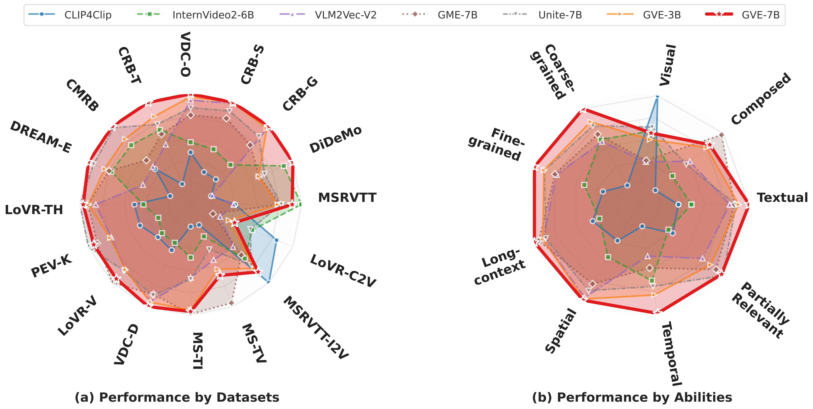
Introduction
Semantic Scaling
Observational Scaling
Search Scaling
Conclusion & Future Work
12
UVRB Reveals Structured, Not Random, Capability Gaps
Weaknesses track the training distribution and cluster on the same hard skills.
GVE-7B
Fills the largest area across both datasets and abilities.
Shared blind spots
Temporal, composed, and partial-relevance retrieval stay weak across all 14 models — even at 8.3B parameters.
Structured, not random
Gaps can be diagnosed and targeted, not scaled away by size.
Per-dataset (left) and per-ability (right) coverage; GVE-7B forms the outer envelope.
Towards Scalable and Generalizable Video Retrieval
Zhuoning Guo · HKUST(GZ)
Notes:
The radar is the evidence: gaps are systematic and tied to data coverage.

Slide 14
Introduction
Semantic Scaling
Observational Scaling
Search Scaling
Conclusion & Future Work
13
Three Non-Trivial Capability Gaps Emerge
Diagnosis surfaces one proxy, one decoupling, and one scaling paradox.
ρ ≈ 0.97
ρ ≈ 0.12
87M > 8B
PR predicts universality
Spatial ⟂ Temporal
Scaling paradox (VIS)
Partial-relevance retrieval correlates with overall UVR far more than MSR-VTT (ρ ≈ 0.58) — a lightweight universality proxy.
Spatial and temporal skills are near-independent; temporal drives fine-grained recall (ρ ≈ 0.98), spatial does not (ρ ≈ 0.39).
On visual-only retrieval an 87M CLIP model (0.714) beats an 8B MLLM (0.702) — perceptual breadth over raw capacity.
Takeaway Bigger is not broader — targeted, diverse data, not parameter count, closes these gaps.
Towards Scalable and Generalizable Video Retrieval
Zhuoning Guo · HKUST(GZ)
Notes:
Three findings: PR proxy, spatial/temporal decoupling, and the visual-only scaling paradox.

Slide 15
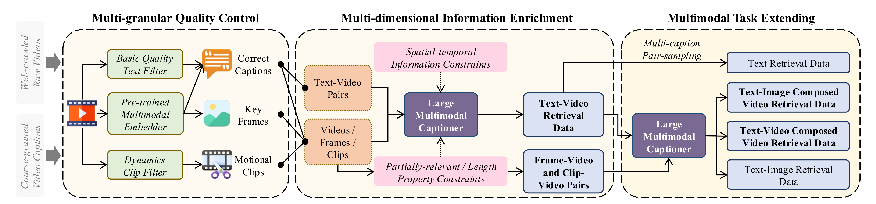
Introduction
Semantic Scaling
Observational Scaling
Search Scaling
Conclusion & Future Work
14
V-SynFlow: Capability-Guided Data Synthesis
A three-stage pipeline synthesizes exactly the skills diagnosis flagged as weak.
① Quality control
② Information enrichment
③ Task extension
Filter web video by quality, cross-modal consistency, and temporal dynamics.
MLLM captioning skewed to under-represented temporal & spatial skills.
Synthesize composed and visual tasks covering all UVRB dimensions.
Capability-skewed synthesis — 60% temporal · 30% spatial · 10% partial/abstract — targets diagnosed gaps.
Towards Scalable and Generalizable Video Retrieval
Zhuoning Guo · HKUST(GZ)
Notes:
V-SynFlow turns the diagnosis into data: control quality, enrich toward gaps, extend tasks.

Slide 16
Introduction
Semantic Scaling
Observational Scaling
Search Scaling
Conclusion & Future Work
15
UVRD Is Capability-Targeted, Not Merely Large
1.55M synthetic pairs, skewed to diagnosed gaps and audited for quality.
UVRD task | Pairs
T2V text→video | 879K
T2I text→image | 210K
I2V image→video | 200K
T2T / TI2V / TV2V / V2V | 260K
1.55M
95%
60/30/10
Training pairs
Sample audit
Gap-targeted skew
A multi-task corpus built for the capabilities models actually lack.
Factual accuracy on a 100-sample human audit; downstream gains confirm quality at scale.
Temporal / spatial / partial-abstract emphasis over generic coverage.
Design principle
Skew beats naive scale: UVRD is not the largest corpus, but the most effective for filling the capability gaps UVRB diagnosed.
Towards Scalable and Generalizable Video Retrieval
Zhuoning Guo · HKUST(GZ)
Notes:
UVRD embodies capability-first data design: targeted skew plus audited quality.

Slide 17
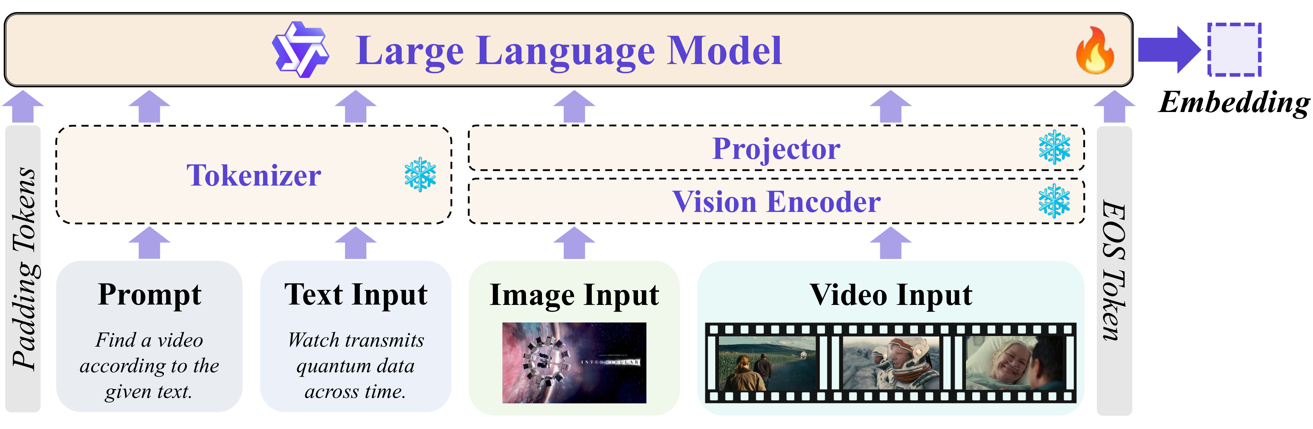
Introduction
Semantic Scaling
Observational Scaling
Search Scaling
Conclusion & Future Work
16
GVE: A Unified Embedding Trained by Contrastive Learning
One Qwen2.5-VL backbone maps every query form into a shared retrieval space.
Backbone
Qwen2.5-VL MLLM; parameter-efficient LoRA fine-tuning; last-token pooling + ℓ2 norm.
Symmetric InfoNCE
ℒ = −log exp(s⁺/τ)
———————————
Σ exp(s/τ) + Σ exp(s⁻/τ)
GVE encodes text, image, video, and composed queries into one aligned embedding space.
Objective
Align matched pairs against in-batch + mined hard negatives (τ = 0.03), symmetrized q↔v.
Towards Scalable and Generalizable Video Retrieval
Zhuoning Guo · HKUST(GZ)
Notes:
GVE is one unified embedding model; training is symmetric InfoNCE with hard negatives.

Slide 18
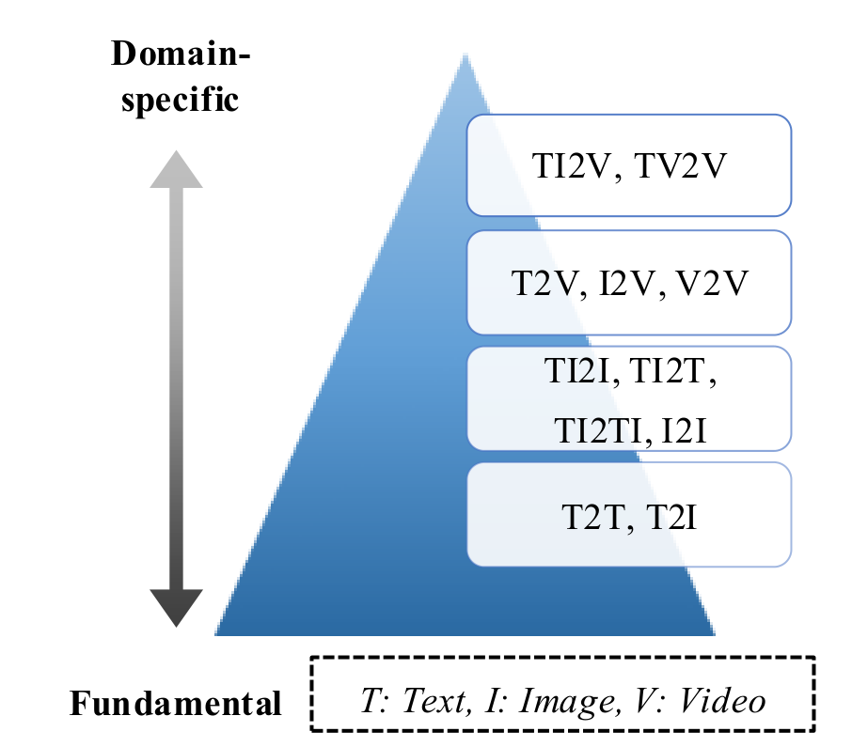
Introduction
Semantic Scaling
Observational Scaling
Search Scaling
Conclusion & Future Work
17
The Modality Pyramid Curriculum Stabilizes Training
A difficulty-ordered schedule prevents gradient interference across tasks.
Bottom-up curriculum
Text–image alignment → text–video matching → composed video retrieval, building capability incrementally rather than mixing all tasks at once.
Alignment-aware dynamic scheduling
P⁽ᵗ⁾(k) ∝ exp( R_k⁽ᵗ⁾ / σ(t) ), R_k = (1/Nₚ) Σ cos( Ψ(xᵢ), Ψ(yᵢ) )
Mechanism
A prober Ψ scores per-task alignment; temperature σ(t) rises 0.1→1.0 across epochs, shifting sampling from easy to hard tasks.
Pyramid: easy atomic alignment → text-video → composed retrieval.
Towards Scalable and Generalizable Video Retrieval
Zhuoning Guo · HKUST(GZ)
Notes:
The curriculum orders tasks by measured alignment, stabilizing multi-task training.

Slide 19
Introduction
Semantic Scaling
Observational Scaling
Search Scaling
Conclusion & Future Work
18
GVE Improves Zero-Shot Retrieval Generalization
New SOTA on both dataset-level and ability-level averages across 16 datasets.
Model | Dataset AVG | Ability AVG
CLIP4Clip (87M) | 0.390 | 0.416
Unite-7B (prev. best) | 0.538 | 0.559
GVE-3B (ours, 3.8B) | 0.544 | 0.571
GVE-7B (ours, 8.3B) | 0.573 | 0.600
+6.5%
+7.3%
Dataset AVG
Ability AVG
vs Unite-7B, over 16 datasets.
vs Unite-7B, over 8 abilities.
Efficiency
GVE-3B (3.8B) already outperforms the larger Unite-7B — data quality beats parameter count, while GVE-7B remains the strongest variant.
Takeaway Capability-targeted data lifts a smaller model above a larger baseline.
Towards Scalable and Generalizable Video Retrieval
Zhuoning Guo · HKUST(GZ)
Notes:
GVE sets new SOTA on both averages; GVE-3B beats Unite-7B; GVE-7B is strongest.

Slide 20
Introduction
Semantic Scaling
Observational Scaling
Search Scaling
Conclusion & Future Work
19
Where the Gains Come From: Ability Breakdown
GVE-7B leads on the hard skills UVRB flagged, while staying competitive elsewhere.
Ability | Unite-7B | GVE-7B | Δ
Text (TXT) | 0.609 | 0.657 | +0.048
Composed (CMP) | 0.254 | 0.312 | +0.058
Long-context (LC) | 0.746 | 0.814 | +0.068
Temporal (T) | 0.412 | 0.469 | +0.057
Fine-grained (FG) | 0.539 | 0.570 | +0.031
Visual-only (VIS) | 0.666 | 0.657 | −0.009
Largest gains
Composed, long-context, and temporal — exactly the capabilities diagnosis identified as under-served.
Honest boundary
Visual-only retrieval stays flat: the scaling-paradox skill where a compact CLIP encoder remains hard to beat.
Targeted synthesis raises the diagnosed weak skills without sacrificing the strong ones.
Towards Scalable and Generalizable Video Retrieval
Zhuoning Guo · HKUST(GZ)
Notes:
The gains land on the diagnosed gaps; VIS remains the honest exception.

Slide 21
Introduction
Semantic Scaling
Observational Scaling
Search Scaling
Conclusion & Future Work
20
UVRD and Curriculum Provide Complementary Gains
Targeted data and ordered training each contribute; together they compound.
3B variant | Dataset AVG | Ability AVG | Composed (CMP)
GVE-i (public data) | 0.528 | 0.558 | 0.237
GVE-s (+ UVRD) | 0.537 | 0.564 | 0.301
GVE (+ Modality Pyramid) | 0.544 | 0.571 | 0.304
+27%
on Composed
Relative CMP gain from adding UVRD (0.237 → 0.301).
Reading the table
UVRD lifts overall R@1 by +2.3% and composed retrieval by +27% relative; the Modality Pyramid curriculum adds further ordering gains on top — diagnosis → data → curriculum is additive.
Each component targets a distinct part of the semantic bottleneck.
Towards Scalable and Generalizable Video Retrieval
Zhuoning Guo · HKUST(GZ)
Notes:
Ablations isolate targeted data (UVRD) and curriculum ordering (Modality Pyramid).

Slide 22
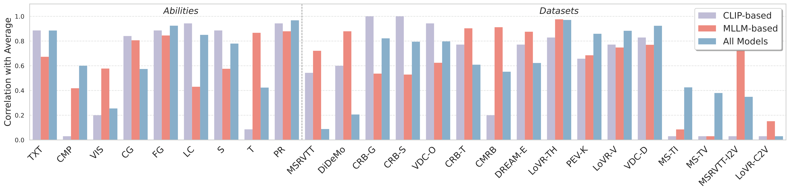
Introduction
Semantic Scaling
Observational Scaling
Search Scaling
Conclusion & Future Work
21
Correlation Analysis Explains the Capability Structure
Partial relevance predicts universality; spatial and temporal skills are decoupled.
Correlation of each ability with overall UVR performance (and with training-data mix).
PR ↔ universality
Spatial ⟂ Temporal
Temporal → fine-grained
Partial-relevance retrieval has the highest correlation with overall UVR (ρ ≈ 0.97).
Spatial and temporal abilities correlate only ρ ≈ 0.12 — learned separately.
Temporal ability drives fine-grained recall (ρ ≈ 0.98); spatial does not (ρ ≈ 0.39).
Towards Scalable and Generalizable Video Retrieval
Zhuoning Guo · HKUST(GZ)
Notes:
The correlation figure is the quantitative backing for the three capability findings.

Slide 23
Introduction
Semantic Scaling
Observational Scaling
Search Scaling
Conclusion & Future Work
22
GVE Transfers to Zero-Shot Video Classification
A retrieval embedding generalizes to classification with no task-specific tuning.
Model | Zero-shot classification AVG
GVE-3B (ours) | 0.476
Unite-7B | 0.519
InternVideo2-6B (video specialist) | 0.526
GVE-7B (ours) | 0.526
Result
GVE-7B matches a specialist 6B video model, zero-shot.
Why it matters
Retrieval-trained geometry is genuinely general, not benchmark-specific.
Reading
Averaged over K700, UCF101, HMDB51, SSV2, and Breakfast: capability-guided retrieval training yields embeddings that transfer beyond retrieval itself.
Towards Scalable and Generalizable Video Retrieval
Zhuoning Guo · HKUST(GZ)
Notes:
GVE's embedding transfers to classification, matching InternVideo2-6B zero-shot.

Slide 24
Introduction
Semantic Scaling
Observational Scaling
Search Scaling
Conclusion & Future Work
23
Study 1 Takeaway: Capability-Guided Semantic Scaling
Scaling begins with diagnosis: build and train for the capabilities the model lacks.
Diagnose
(UVRB)
Synthesize
(V-SynFlow → UVRD)
Curriculum
(Modality Pyramid)
Generalize
(GVE)
→
→
→
Evidence
GVE reaches 0.573 dataset-AVG and 0.600 ability-AVG (SOTA zero-shot across 16 datasets), with GVE-3B already beating the 7B baseline.
Takeaway Semantic scaling needs capability diagnosis, not just more parameters or data.
Towards Scalable and Generalizable Video Retrieval
Zhuoning Guo · HKUST(GZ)
Notes:
Study 1 in one line: capability diagnosis drives effective semantic scaling.

Slide 25
24
02
GUIDING QUESTION
What visual evidence should be observed, under limited frame and token budgets?
STUDY 2 · OBSERVATIONAL SCALING
MG-LVR &
VEterfall
Chapter 4 · submitted to ECCV 2026
Notes:
What visual evidence should be observed, under limited frame and token budgets?

Slide 26
Introduction
Semantic Scaling
Observational Scaling
Search Scaling
Conclusion & Future Work
25
A Video Embedding Can Only Represent What It Observes
For long videos, frame sampling is part of retrieval — not a preprocessing detail.
relevant moment
one 706-second video
gold = sampled frames · red = the few relevant seconds
If the relevant moment is never sampled, retrieval fails before modeling even begins — and encoding every frame of an hour-long video is infeasible.
Open question
How does sampling density interact with query granularity? Standard benchmarks never isolate this, so it has stayed unmeasured — the gap MG-LVR fills.
Towards Scalable and Generalizable Video Retrieval
Zhuoning Guo · HKUST(GZ)
Notes:
The hook: observation bounds representation; sampling decides what evidence exists.

Slide 27
Introduction
Semantic Scaling
Observational Scaling
Search Scaling
Conclusion & Future Work
26
Granularity Defines How Much Evidence a Query Needs
G is the fraction of a video that is relevant — from one moment to the whole clip.
Temporal granularity
Fine (FN)
G = | S(v*, q) | / d_video ∈ (0, 1]
a brief moment · G ∈ [0.001, 0.01]
Medium (MD)
Temporal continuity
several segments · G ∈ [0.1, 0.3]
C = Σ (eᵢ − sᵢ) / (e_k − s₁) ∈ (0, 1]
Coarse (CR)
broad, video-level coverage
Reading the definitions
G measures how localized the evidence is; C measures whether it is one contiguous event or scattered across the video.
Why it matters
Granularity sets the frame/token budget a query truly needs — coarse and fine queries want opposite allocations.
Towards Scalable and Generalizable Video Retrieval
Zhuoning Guo · HKUST(GZ)
Notes:
Granularity G and continuity C make the observation problem measurable.

Slide 28
Introduction
Semantic Scaling
Observational Scaling
Search Scaling
Conclusion & Future Work
27
MG-LVR: A Multi-Granularity Long-Video Benchmark
A long-video benchmark that varies query granularity under controlled sampling.
9,971
4,844
23
96%
Queries
Long videos
Models
Audited
Fine 4,706 · Medium 4,142 · Coarse 1,123.
Average duration ≈ 706 s — genuinely long-form.
6 CLIP-based + 17 MLLM-based, one protocol.
Human-validated on 50 pairs.
Benchmark | #Query | #Corpus | Avg dur | Granularity
MSR-VTT | 1,000 | 1,000 | 15 s | Coarse
ActivityNet Cap. | 18,000 | 4,917 | 118 s | FN, MD
LoVR | 100 | 467 | 1,560 s | Coarse
MG-LVR (ours) | 9,971 | 4,844 | 706 s | All + both C
Towards Scalable and Generalizable Video Retrieval
Zhuoning Guo · HKUST(GZ)
Notes:
MG-LVR is the measurement instrument: only benchmark with all granularities on long videos.

Slide 29
Introduction
Semantic Scaling
Observational Scaling
Search Scaling
Conclusion & Future Work
28
Fine-Grained Retrieval Exposes the Observation Bottleneck
Under sparse sampling, coarse queries are easy and fine queries collapse.
0.856
0.210
Coarse R@1 · 8 frames
Fine R@1 · 8 frames
broad themes are easy to match
a > 75% drop — evidence is missed
Best model (Qwen3-VL-Emb-8B) | Coarse R@1 | Fine R@1
8 frames | 0.856 | 0.210
128 frames (16× more) | 0.903 | 0.287
16× more frames lifts fine R@1 by < 8 points — naive frame scaling cannot close the gap.
Takeaway Fine-grained retrieval fails under sparse sampling and barely recovers with more frames.
Towards Scalable and Generalizable Video Retrieval
Zhuoning Guo · HKUST(GZ)
Notes:
The granularity gap is the core empirical finding of Study 2.

Slide 30
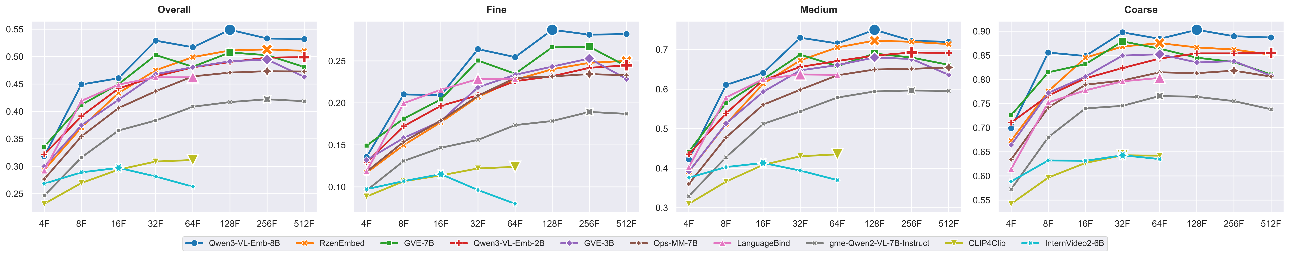
Introduction
Semantic Scaling
Observational Scaling
Search Scaling
Conclusion & Future Work
29
Temporal Scaling Is Architecture-Dependent
MLLMs keep improving with frames; CLIP-style models saturate, then degrade.
Test-time R@1 vs. frame count, by architecture family.
MLLM-based
CLIP-based
Improve up to ~128 frames — useful for fine-grained queries that need dense temporal evidence.
Saturate near 16 frames, then degrade: mean-pooling dilutes the signal as frames grow.
More frames help only architectures that can actually use them.
Towards Scalable and Generalizable Video Retrieval
Zhuoning Guo · HKUST(GZ)
Notes:
There is no single 'more frames is better' law — it depends on the architecture.

Slide 31
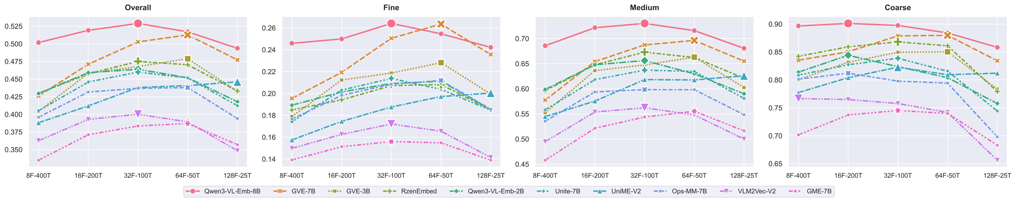
Introduction
Semantic Scaling
Observational Scaling
Search Scaling
Conclusion & Future Work
30
Fixed Token Budgets Require Granularity-Aware Allocation
Under a fixed budget N = F × T, coarse and fine queries prefer opposite splits.
Spatial–temporal trade-off at fixed token budget across query granularities.
Coarse queries
Fine-grained queries
Prefer high spatial resolution with fewer frames — scene-level cues dominate.
Prefer more frames over spatial detail — temporal coverage locates the moment.
Spatial and temporal tokens are not interchangeable; allocation must follow granularity.
Towards Scalable and Generalizable Video Retrieval
Zhuoning Guo · HKUST(GZ)
Notes:
At fixed budget, allocation should be granularity-aware.

Slide 32
Introduction
Semantic Scaling
Observational Scaling
Search Scaling
Conclusion & Future Work
31
Training Choices Constrain What Inference Can Recover
Two training-time laws: resolution transfers, but frame count is anchored.
Resolution robustness
Frame-count anchoring
Training at high spatial resolution transfers to low-resolution inference — models trained at 400 tokens still lead when tested at 50 tokens.
Temporal ability peaks when the inference frame count matches training; a train-32 / test-4 mismatch loses fine-grained recall, and vice-versa.
Consequence for deployment
Efficient serving demands sparse inference, yet anchoring ties fine-grained skill to dense training — motivating an explicit dense-to-sparse transfer method (VEterfall).
Sparse inference must inherit dense-trained temporal skill — not relearn it.
Towards Scalable and Generalizable Video Retrieval
Zhuoning Guo · HKUST(GZ)
Notes:
Training-time laws set rigid inference constraints, motivating VEterfall.

Slide 33
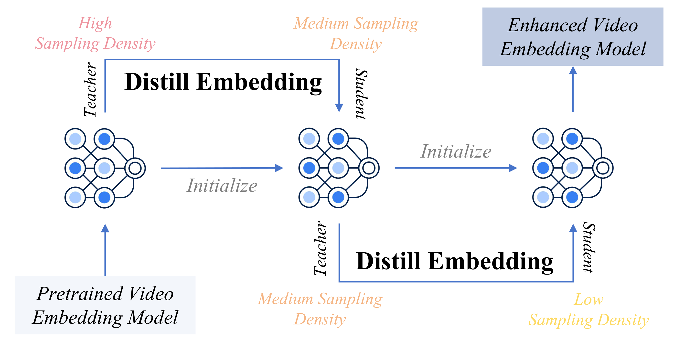
Introduction
Semantic Scaling
Observational Scaling
Search Scaling
Conclusion & Future Work
32
VEterfall: Dense-to-Sparse Self-Distillation
A cascade transfers temporal knowledge down the sampling-density axis.
Per-step distillation objective
ℒ = MSE( zₛ , zₜ ) + λ · InfoNCE
Learn dense, deploy sparse
Skill for low-density inference is latent in dense models but does not transfer automatically — VEterfall distills it explicitly, one step at a time (λ = 0.5, K = 2, 16× fewer tokens).
Dense-to-sparse cascade: temporal knowledge distilled to progressively fewer frames and tokens.
The architecture is unchanged; only observation density decreases.
Towards Scalable and Generalizable Video Retrieval
Zhuoning Guo · HKUST(GZ)
Notes:
VEterfall is cascaded self-distillation: MSE to the denser teacher plus an InfoNCE anchor.

Slide 34
Introduction
Semantic Scaling
Observational Scaling
Search Scaling
Conclusion & Future Work
33
VEterfall Recovers Fine-Grained Sparse Performance
Large fine-grained gains at the tightest budget, over the sparse baseline.
Model · 4F–100T | Overall | Fine | Medium | Coarse
V⁰ (sparse baseline) | 0.300 | 0.132 | 0.391 | 0.664
V¹ | 0.300 | 0.130 | 0.394 | 0.664
V² (VEterfall) | 0.325 | 0.158 | 0.423 | 0.667
+20%
Fine R@1 (relative)
0.132 → 0.158 at 4F–100T, over the sparse baseline.
Reading the result
The +20% relative fine-grained gain is measured over the sparse baseline (V⁰) at the same 4F–100T budget: VEterfall improves sparse inference by transferring dense knowledge at 4–16× efficiency — not by outperforming the dense teacher directly.
Takeaway Dense-trained temporal skill is recovered under a 16× smaller token budget.
Towards Scalable and Generalizable Video Retrieval
Zhuoning Guo · HKUST(GZ)
Notes:
VEterfall lifts fine-grained R@1 ~20% over the sparse baseline at 4–16× efficiency.

Slide 35
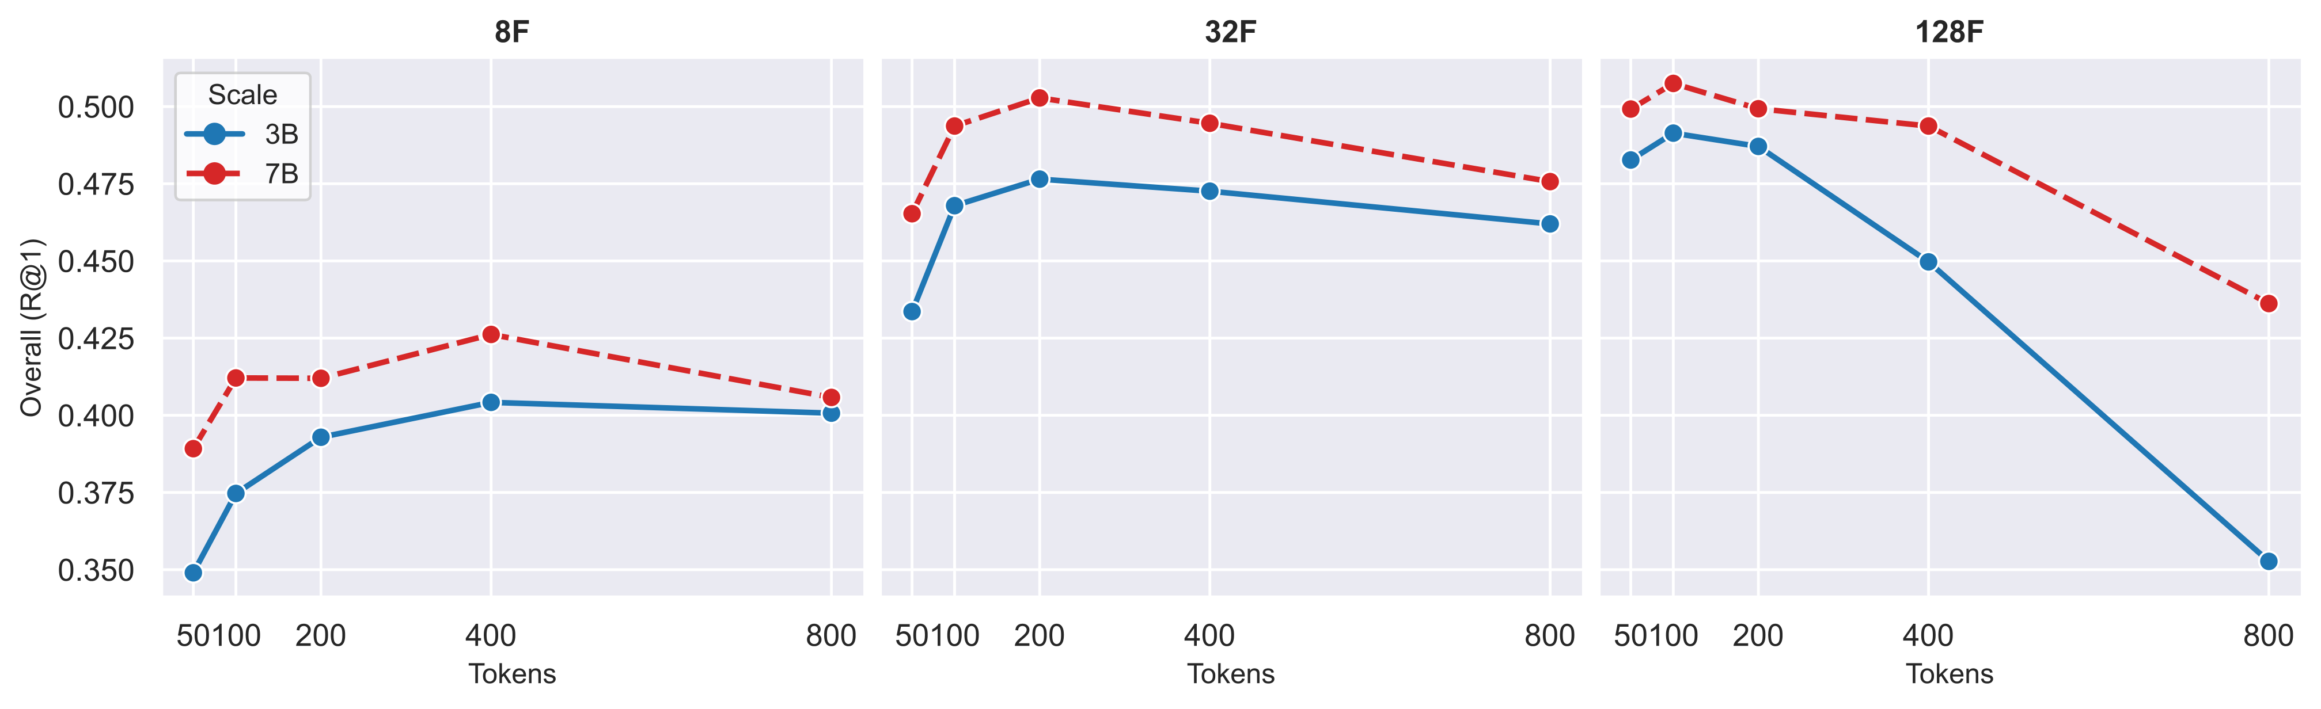
Introduction
Semantic Scaling
Observational Scaling
Search Scaling
Conclusion & Future Work
34
Spatial Resolution Helps Most When Frames Are Scarce
Spatial and temporal budgets are complementary, not interchangeable.
Test-time R@1 vs. spatial tokens per frame, by frame count.
Low frame counts (F ≤ 8)
High frame counts (F > 32)
Spatial resolution is critical — more tokens per frame recover detail sparse frames miss.
Extra spatial tokens add little; coarse queries can even suffer token redundancy.
Spend spatial detail when frames are scarce; spend frames when the query is fine-grained.
Towards Scalable and Generalizable Video Retrieval
Zhuoning Guo · HKUST(GZ)
Notes:
Spatial scaling matters most at low frame counts — complementary to temporal scaling.

Slide 36
Introduction
Semantic Scaling
Observational Scaling
Search Scaling
Conclusion & Future Work
35
Study 2 Takeaway: Observation-Aware Retrieval Scaling
MG-LVR reveals the bottleneck; scaling laws explain it; VEterfall intervenes.
Measure
(MG-LVR)
Explain
(scaling laws)
Intervene
(VEterfall)
→
→
Evidence
Fine-grained retrieval drops > 75% under sparse sampling; VEterfall recovers +20% at 4–16× efficiency by transferring dense knowledge to sparse inference.
Takeaway Observational scaling needs granularity-aware evidence acquisition, not just more frames.
Towards Scalable and Generalizable Video Retrieval
Zhuoning Guo · HKUST(GZ)
Notes:
Study 2 in one line: observe granularity-aware, then distill dense skill into sparse inference.

Slide 37
36
03
GUIDING QUESTION
How can a learned retrieval signal be searched at deployment scale?
STUDY 3 · SEARCH SCALING
GMP-GR
Chapter 5 · published at ACM Web Conference 2026
Notes:
How can a learned retrieval signal be searched at deployment scale?

Slide 38
Introduction
Semantic Scaling
Observational Scaling
Search Scaling
Conclusion & Future Work
37
Web-Scale Retrieval: Reduce Billions to a Searchable Candidate Set
Deployment must return the top candidates under strict latency, from a huge corpus.
Billion-scale
corpus
Learned metric
δ(u, v)
Graph traversal
(ANNS)
GPU serving
< 10 ms
Candidate set
~10³
→
→
→
→
Search objective
The catch
Vᵤ* = arg max Σ δ(u, v)
over candidate sets Vᵤ ⊆ V , v ∈ Vᵤ
A more accurate neural metric δ is worthless if it cannot be searched: expressive metrics can violate the regularity graph traversal relies on.
Reframing
Study 3 is search scaling for a learned signal — making accuracy compatible with graph and GPU execution. (Here queries are users and items; the searchable-signal principle is the same as for video.)
Towards Scalable and Generalizable Video Retrieval
Zhuoning Guo · HKUST(GZ)
Notes:
Search scaling: the learned signal must be accurate AND searchable under latency.

Slide 39
Introduction
Semantic Scaling
Observational Scaling
Search Scaling
Conclusion & Future Work
38
Search Scaling Couples Metric, Graph, and GPU Bottlenecks
Isolated optimization of any one component cannot deliver end-to-end efficiency.
Metric bottleneck
Graph bottleneck
GPU bottleneck
A neural metric captures multi-relational user behavior but can break search regularity.
Metrics that violate the triangle inequality trap greedy HNSW traversal in local optima.
Irregular neural ops trigger many kernel launches; high concurrency underutilizes the GPU.
Why co-design
The three bottlenecks are intertwined: a searchable metric, a broader graph search, and GPU-aware execution must be designed together — GMP-GR does exactly this.
Towards Scalable and Generalizable Video Retrieval
Zhuoning Guo · HKUST(GZ)
Notes:
Three coupled bottlenecks — metric, graph, GPU — demand joint co-design.

Slide 40
Introduction
Semantic Scaling
Observational Scaling
Search Scaling
Conclusion & Future Work
39
Expressive Neural Metrics Can Break Graph Traversal
Greedy graph search relies on distance regularity that neural metrics may violate.
Regular (Euclidean) metric
Expressive neural metric
The triangle inequality holds, so every greedy hop provably moves closer to the target — graph traversal reaches the true nearest neighbors.
Ranking can be inconsistent with distance, so greedy traversal stalls in local optima and misses relevant items — accuracy gains are lost at search time.
Triangle inequality
The fix (SCL)
d(a, c) ≤ d(a, b) + d(b, c)
Transplant Euclidean ranking regularity into the learned metric — accuracy and searchability hold together.
Takeaway Better offline relevance is useless unless the signal stays searchable.
Towards Scalable and Generalizable Video Retrieval
Zhuoning Guo · HKUST(GZ)
Notes:
The core insight: expressive metrics can violate regularity and trap graph traversal.

Slide 41
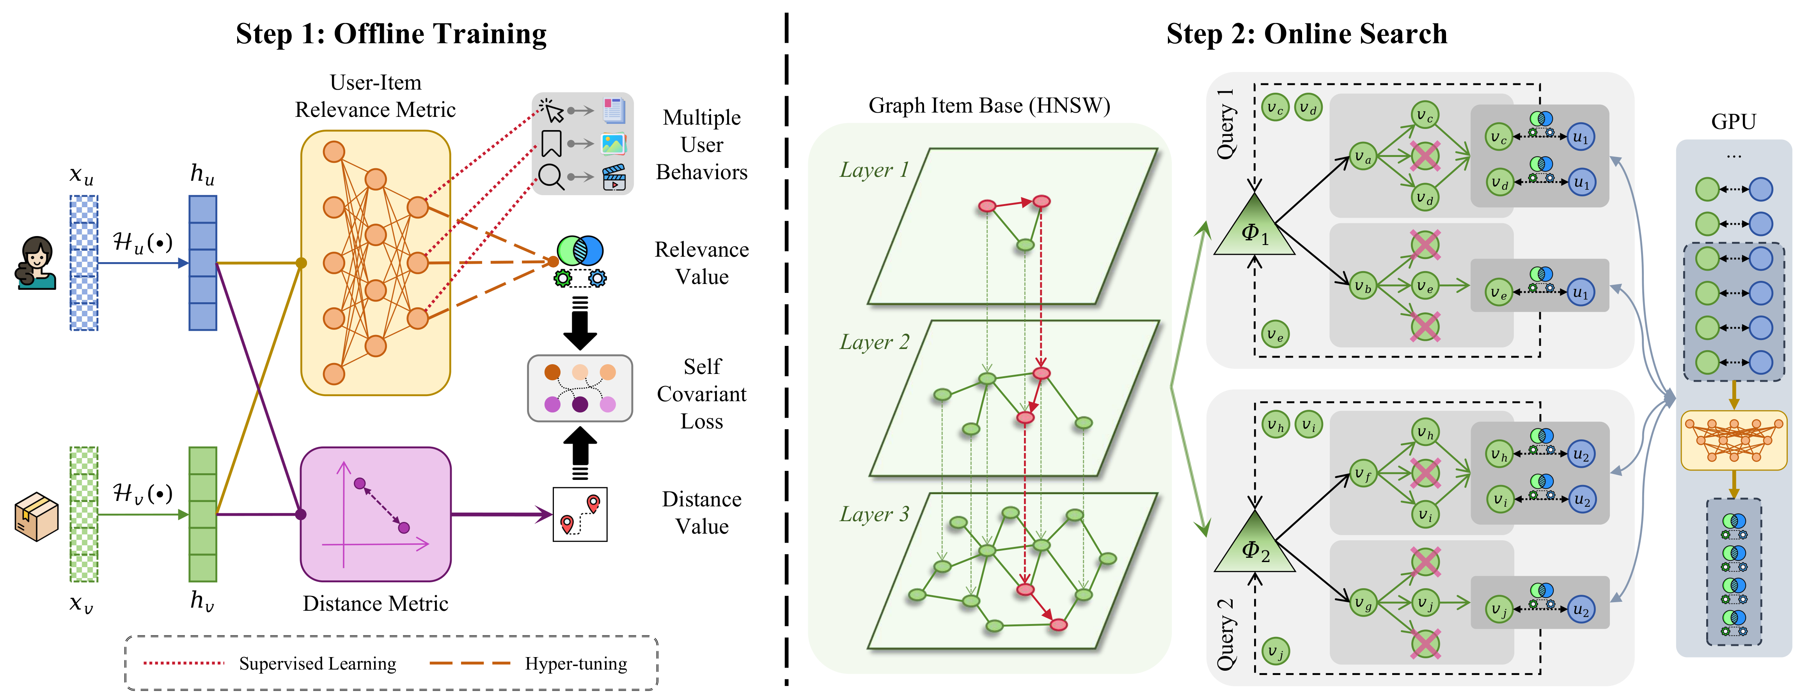
Introduction
Semantic Scaling
Observational Scaling
Search Scaling
Conclusion & Future Work
40
GMP-GR Co-Designs Metric, Graph, and GPU Execution
One framework aligns learned relevance with graph search and GPU serving.
① Metric — MUIRML + SCL
② Graph — C-HiPANNS
③ GPU — Q-HiPANNS + system
Accurate and searchable: SCL enforces rank–distance consistency.
Multi-seed parallel traversal widens the search space, escaping traps.
Query batching, compilation, and quantization cut latency.
Towards Scalable and Generalizable Video Retrieval
Zhuoning Guo · HKUST(GZ)
Notes:
GMP-GR co-design: searchable metric, parallel graph traversal, GPU-aware execution.

Slide 42
Introduction
Semantic Scaling
Observational Scaling
Search Scaling
Conclusion & Future Work
41
MUIRML and the Self-Covariant Loss Make Relevance Searchable
A multi-relational metric, regularized to preserve graph-search regularity.
MUIRML metric
Self-Covariant Loss (SCL)
A lightweight DNN predicts a multi-interaction relevance δ(u, v) from concatenated user/item features (with a serendipity term), capturing behaviors a single dot-product cannot.
ρ(u,v) = Σ (δ − δ̄)(δ′ − δ̄′)
————————————————
VAR(δ) · VAR(δ′)
Multi-objective training
ℒ = Σ ‖ Z − Ẑ ‖₂ + Σ 1 / ( ρ + 1 ) ( δ = learned relevance, δ′ = Euclidean distance )
Takeaway SCL transplants Euclidean ranking regularity into the learned metric, retaining an approximate triangle inequality property.
Towards Scalable and Generalizable Video Retrieval
Zhuoning Guo · HKUST(GZ)
Notes:
MUIRML learns multi-relational relevance; SCL regularizes it toward graph-searchable geometry.

Slide 43
Introduction
Semantic Scaling
Observational Scaling
Search Scaling
Conclusion & Future Work
42
HiPANNS: Parallel Graph Traversal on the GPU
Two levels of parallelism raise recall and throughput together.
C-HiPANNS — inter-candidate
Q-HiPANNS — inter-query
• k parallel searches per query with different seeds
• Share one K-size max-heap across processes
• k-fold search-space expansion escapes local optima → higher recall
• Aggregate irregular neural computations into GPU batches
• Adaptive batch splitting under a max batch size
• Amortizes kernel-launch overhead → higher throughput
Together
C-HiPANNS broadens the search for accuracy while Q-HiPANNS batches computation for speed — the graph and GPU layers reinforce, rather than trade off against, each other.
Towards Scalable and Generalizable Video Retrieval
Zhuoning Guo · HKUST(GZ)
Notes:
HiPANNS parallelizes across candidates (recall) and across queries (throughput).

Slide 44
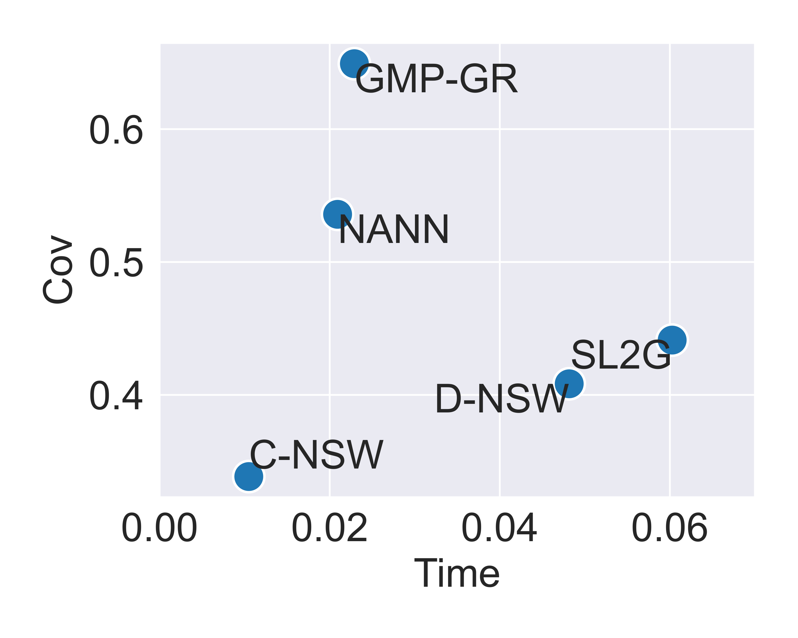
Introduction
Semantic Scaling
Observational Scaling
Search Scaling
Conclusion & Future Work
43
GMP-GR Improves Coverage, Recall, and Speed Together
Search-compatible learning lifts accuracy and throughput at the same time.
Method (Video) | Coverage | Rec@10 | Rec@100
D-NSW | 0.408 | 0.553 | 0.609
SL2G | 0.441 | 0.578 | 0.612
NANN (best baseline) | 0.537 | 0.672 | 0.664
GMP-GR (ours) | 0.649 | 0.824 | 0.805
+20.9%
+22.7%
Recall vs. latency —
GMP-GR sits on the efficient frontier.
Coverage · vs NANN (Video)
Recall@10 · vs NANN (Video)
Takeaway Video dataset shown; full four-dataset results in backup. Metric and graph co-design jointly improve coverage, recall, and speed.
Towards Scalable and Generalizable Video Retrieval
Zhuoning Guo · HKUST(GZ)
Notes:
Offline: GMP-GR jointly improves coverage, recall, and speed across four datasets.

Slide 45
Introduction
Semantic Scaling
Observational Scaling
Search Scaling
Conclusion & Future Work
44
Online A/B Tests Validate Production Impact
Two live services show consistent, significant engagement gains.
Online A/B service | Time-on-page | DAU
Main feed | +1.13% | +0.23%
Short video | +1.19% | +0.50%
Component attribution
MUIRML and HiPANNS add +0.57% and +0.23% time-on-page respectively.
Deployment scope
Validated by two online A/B services (main feed and short video), then subsequently extended across 20+ Baidu applications — the broader rollout is deployment, not a single A/B result.
Interpretation
Retrieval gains matter only when relevance improves without latency regression — which these online tests confirm.
A searchable learned signal delivers measurable, latency-safe engagement gains in production.
Towards Scalable and Generalizable Video Retrieval
Zhuoning Guo · HKUST(GZ)
Notes:
Two-service A/B: +1.13%/+1.19% time-on-page; later deployed across 20+ apps. No p-values in source.

Slide 46
Introduction
Semantic Scaling
Observational Scaling
Search Scaling
Conclusion & Future Work
45
System-Level Execution Makes the Signal Deployable
Engineering co-design turns a searchable metric into a production service.
+74%
+26%
20+
Throughput
Throughput
Baidu apps
from compilation optimization of the serving graph.
from 32→16-bit model quantization.
News, Tieba, Shorts and more, on 165 + 119 A30 GPUs.
Freshness & serving
Streaming index updates keep embeddings current under dynamic catalogs; two services on five servers each sustain production-scale traffic within the P99 latency budget.
Towards Scalable and Generalizable Video Retrieval
Zhuoning Guo · HKUST(GZ)
Notes:
System optimizations (compilation, quantization, streaming) make GMP-GR production-ready.

Slide 47
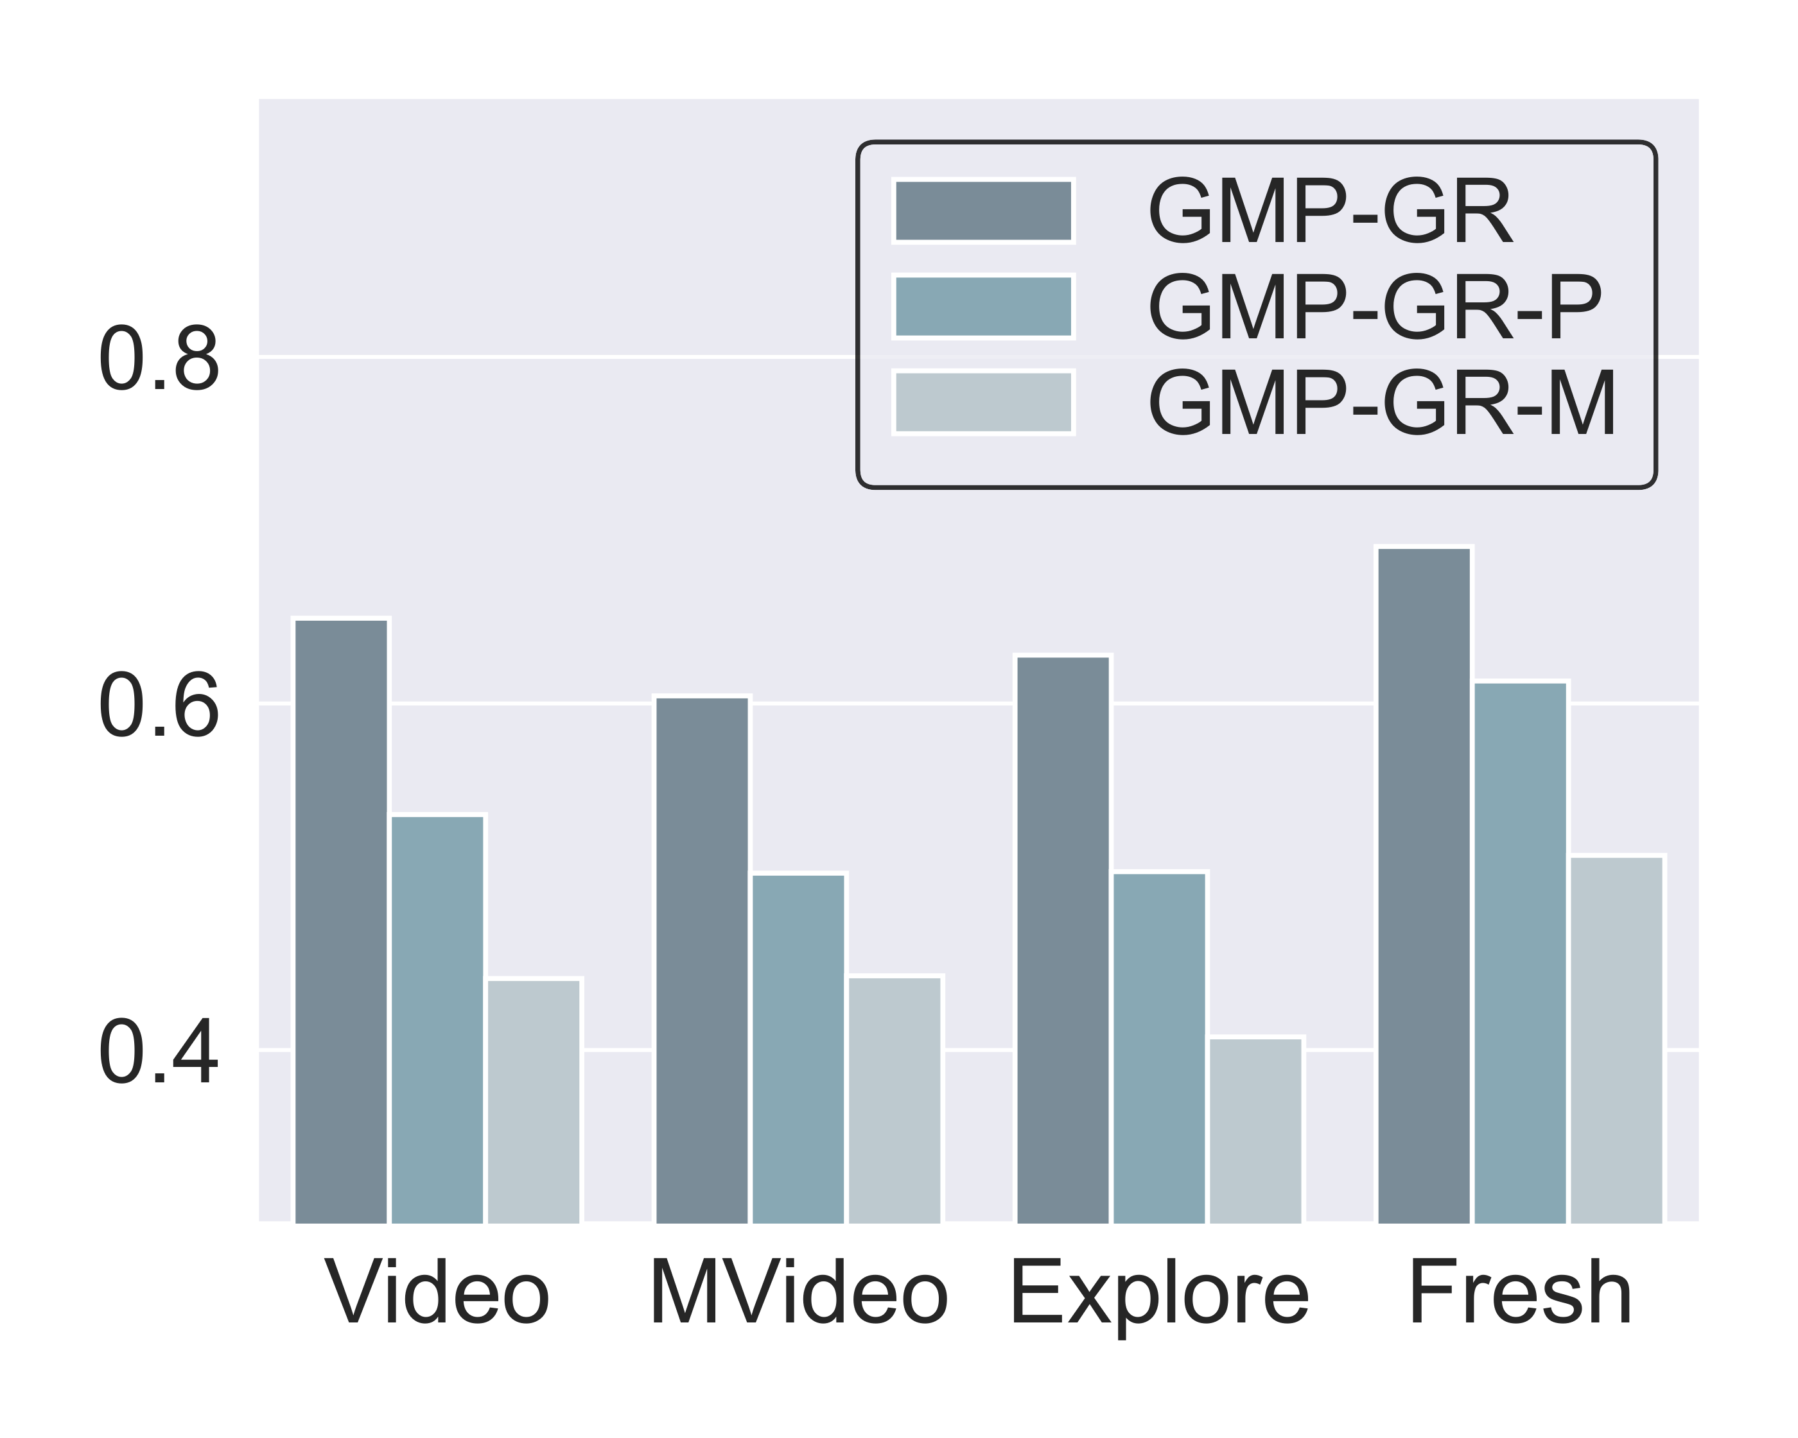
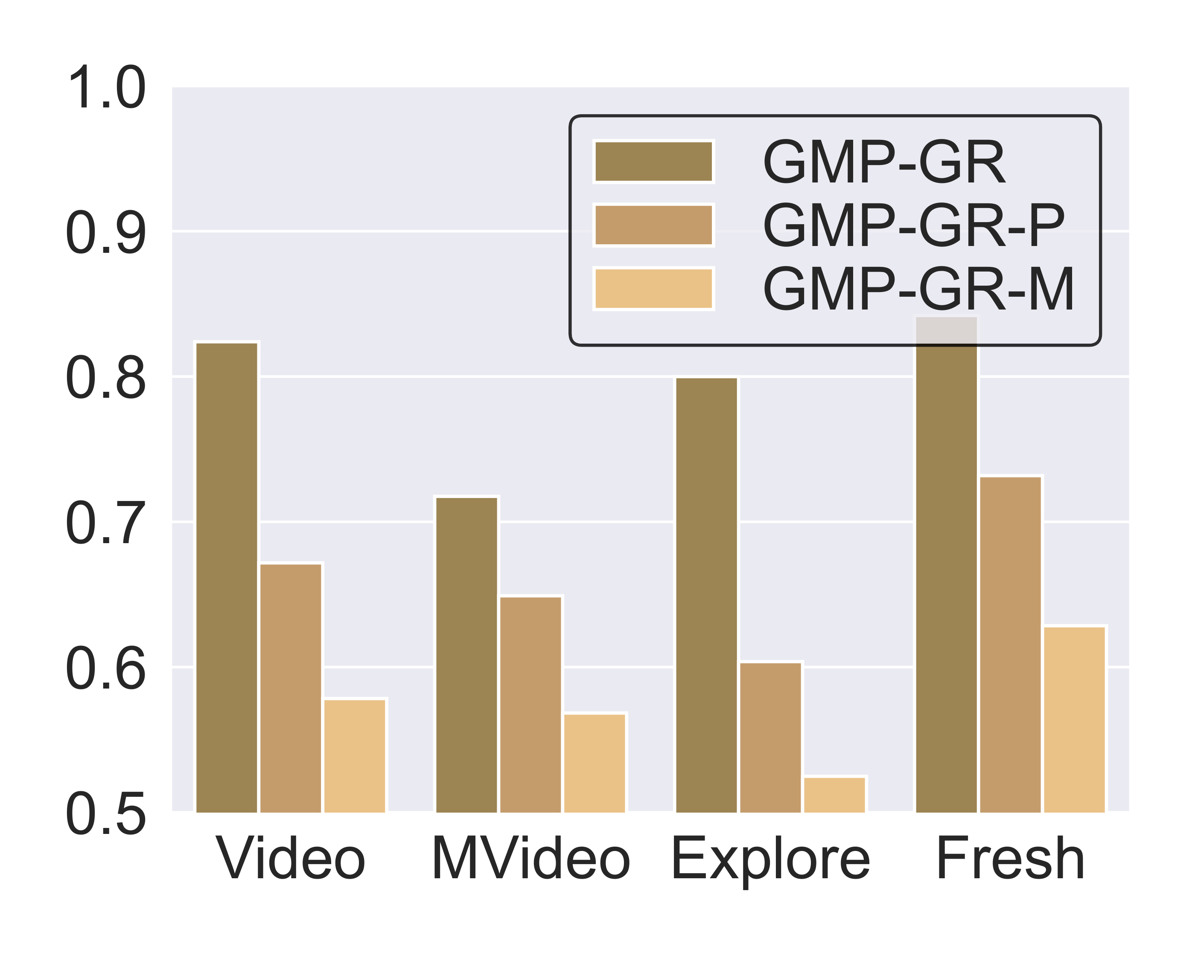
Introduction
Semantic Scaling
Observational Scaling
Search Scaling
Conclusion & Future Work
46
Ablation: Metric and Graph Are Both Necessary
Removing MUIRML or HiPANNS degrades accuracy or throughput.
Coverage under component removal.
Recall@10 under component removal.
Each component is irreplaceable — the metric, graph, and GPU layers reinforce one another.
Towards Scalable and Generalizable Video Retrieval
Zhuoning Guo · HKUST(GZ)
Notes:
Ablation figures: removing MUIRML or HiPANNS drops accuracy and throughput.

Slide 48
Introduction
Semantic Scaling
Observational Scaling
Search Scaling
Conclusion & Future Work
47
Study 3 Takeaway: Search-Compatible Retrieval Scaling
Accuracy, searchability, and throughput must be optimized as one system.
Searchable metric
(MUIRML + SCL)
Parallel graph
(C-HiPANNS)
GPU execution
(Q-HiPANNS)
→
→
Evidence
GMP-GR raises coverage +20.9% and Recall@10 +22.7% while improving throughput, and lifts engagement +1.13%/+1.19% time-on-page in two online A/B services.
Takeaway Search scaling needs metric–graph–GPU compatibility, not just better offline metrics.
Towards Scalable and Generalizable Video Retrieval
Zhuoning Guo · HKUST(GZ)
Notes:
Study 3 in one line: make the learned signal searchable, then execute it efficiently.

Slide 49
Introduction
Semantic Scaling
Observational Scaling
Search Scaling
Conclusion & Future Work
48
Structure-Aware Scaling Explains All Three Studies
The same principle — align scaling with the bottleneck — recurs at every stage.
Stage | Naive scaling | Structural bottleneck | Structure-aware solution
Semantic | More params / generic data | Capability gaps across tasks | Diagnose → synthesize → curriculum
Observation | More frames / tokens | Granularity vs. evidence coverage | Granularity-aware allocation + distillation
Search | Higher offline AUC | Metric–graph–GPU mismatch | Search-compatible metric + GPU co-design
Takeaway Scaling capacity alone is insufficient unless aligned with the structure of the bottleneck.
Towards Scalable and Generalizable Video Retrieval
Zhuoning Guo · HKUST(GZ)
Notes:
One table, one thesis: structure-aware scaling unifies the three studies.

Slide 50
Introduction
Semantic Scaling
Observational Scaling
Search Scaling
Conclusion & Future Work
49
Generalizability Confirms the Right Bottleneck
The opening framework, now filled with evidence from each study.
Semantic Scaling
Observational Scaling
Search Scaling
→
→
GVE
VEterfall
GMP-GR
Evidence
Evidence
Evidence
SOTA zero-shot across 16 datasets
(0.573 dataset · 0.600 ability AVG)
+20% fine-grained recall over the
sparse baseline at 4–16× efficiency
+20.9% coverage, +22.7% recall;
+1.1–1.2% online time-on-page
Takeaway Generalizability is the evidence that scaling has addressed the right bottleneck.
Towards Scalable and Generalizable Video Retrieval
Zhuoning Guo · HKUST(GZ)
Notes:
The framework returns, now backed by concrete generalization evidence per study.

Slide 51
Introduction
Semantic Scaling
Observational Scaling
Search Scaling
Conclusion & Future Work
50
Research Outputs and Reusable Artifacts
Each study leaves behind a benchmark, a method, and a deployable system.
Benchmarks & data
Models & methods
Systems
• UVRB — 16-dataset capability diagnosis
• UVRD — 1.55M targeted pairs
• MG-LVR — long-video, multi-granularity
• GVE — unified video embedding
• V-SynFlow — capability-guided synthesis
• VEterfall — dense-to-sparse distillation
• GMP-GR — search-scaling framework
• MUIRML + SCL — searchable metric
• HiPANNS — parallel graph traversal
Towards Scalable and Generalizable Video Retrieval
Zhuoning Guo · HKUST(GZ)
Notes:
The thesis produces reusable artifacts across all three stages.

Slide 52
Introduction
Semantic Scaling
Observational Scaling
Search Scaling
Conclusion & Future Work
51
Boundaries of Evidence
Where the current evidence stops — and where structure-aware scaling extends next.
Stage-wise validation
Synthetic supervision
Deployment context
The three studies cover successive pipeline stages but are not yet jointly optimized end-to-end — an integration this thesis motivates rather than claims.
UVRD and MG-LVR rely on synthesized and caption-based signals; larger audits and finer temporal grounding are natural extensions.
GMP-GR is validated in Baidu infrastructure; the algorithmic principles are general, but absolute throughput depends on hardware and traffic.
These boundaries define where structure-aware scaling should be extended next — the frontier, not weaknesses.
Towards Scalable and Generalizable Video Retrieval
Zhuoning Guo · HKUST(GZ)
Notes:
Framed as boundaries of evidence: honest, controlled, forward-looking.

Slide 53
Introduction
Semantic Scaling
Observational Scaling
Search Scaling
Conclusion & Future Work
52
Future Work I: Retrieval-Native Multimodal Models
Retrieval should be built into the model, not extracted from generation states.
Shared vision–language backbone
↙
↘
Generative objective
(today's MLLM)
Retrieval objective
+ retrieval token / routing
Direction
MLLM hidden states are optimized for generation, not retrieval geometry. Native architectures with retrieval-specific objectives, tokens, and routing could align generative and retrieval representations from the start — extending semantic scaling into the model design itself.
Towards Scalable and Generalizable Video Retrieval
Zhuoning Guo · HKUST(GZ)
Notes:
Future I: models purpose-built for retrieval, not repurposed generators.

Slide 54
Introduction
Semantic Scaling
Observational Scaling
Search Scaling
Conclusion & Future Work
53
Future Work II: Video Retrieval as Agent Memory
Retrieval becomes the interface to an agent's long-horizon visual experience.
Streaming
observations
Indexed
visual memory
Query
Recalled
episode
Action
→
→
→
→
Direction
Agents need memory that spans long visual histories. Casting retrieval as the memory interface — over past observations, object locations, and event context — turns the embedding and search machinery of this thesis into the substrate for embodied and multimodal agents.
Towards Scalable and Generalizable Video Retrieval
Zhuoning Guo · HKUST(GZ)
Notes:
Future II: retrieval as the memory layer for agents.

Slide 55
Introduction
Semantic Scaling
Observational Scaling
Search Scaling
Conclusion & Future Work
54
Future Work III: Self-Evolving Retrieval Systems
The thesis pipeline can become a self-improving loop.
Evaluate
Diagnose
Synthesize
Train
Deploy
→
→
→
→
↺ re-evaluate on new evidence
Direction
UVRB-style evaluation, V-SynFlow-style synthesis, curriculum scheduling, and model updating can form a closed loop: the system diagnoses its own weaknesses, generates targeted data, and retrains — reducing reliance on static benchmarks.
Towards Scalable and Generalizable Video Retrieval
Zhuoning Guo · HKUST(GZ)
Notes:
Future III: evaluation → synthesis → curriculum → training as an autonomous loop.

Slide 56
55
Structure-Aware Scaling Connects the Three Studies
Modern video retrieval is a pipeline-level scaling problem — solved stage by stage.
Semantic scaling needs capability diagnosis.
Observational scaling needs granularity-aware evidence acquisition.
Search scaling needs metric–graph–GPU compatibility.
Takeaway Scaling becomes effective only when aligned with the structure of the bottleneck it addresses.
Scalable and generalizable video retrieval requires structure-aware scaling across semantic capability, visual observation, and search execution.
Towards Scalable and Generalizable Video Retrieval
Zhuoning Guo · HKUST(GZ)
Notes:
The three sentences to remember, and the unifying thesis statement.

Slide 57
Introduction
Semantic Scaling
Observational Scaling
Search Scaling
Conclusion & Future Work
56
Publications and Research Outputs
The three studies correspond to three papers and reusable public artifacts.
Study 1 · GVE
Study 2 · MG-LVR & VEterfall
Study 3 · GMP-GR
Universal Video Retrieval via
General Video Embedding
Multi-Granularity Long-Video
Retrieval & Scaling Laws
Searchable Learned Metrics for
Web-Scale Retrieval
Submitted · ACM MM 2026
Submitted · ECCV 2026
Published · ACM WebConf 2026
Reusable artifacts
UVRB, UVRD, and MG-LVR benchmarks/data; GVE, VEterfall, and GMP-GR methods — released to support reproducible video-retrieval research.
Towards Scalable and Generalizable Video Retrieval
Zhuoning Guo · HKUST(GZ)
Notes:
Three papers, one per study, plus public benchmarks, data, and methods.

Slide 58
Questions?
Thank you for your time and attention.
Capability diagnosis · granularity-aware evidence · searchable signals
Zhuoning Guo · HKUST(GZ) · July 29, 2026
Notes:
Standby Q&A page — three memorable phrases anchor the thesis.

Slide 59
A
Full tables, protocol details, related work, and prepared answers.
Several slides here are optional material that can be promoted into the main deck.
APPENDIX
Backup &
Q&A
Notes:
Backup: full evidence and prepared committee answers.

Slide 60
APPENDIX · BACKUP
B1
GVE — Full Ability-Level Results (excerpt)
By-ability averages; GVE-7B leads the overall ability average.
Model | AVG | TXT | CMP | VIS | CG | FG | LC | S | T | PR
VideoCLIP-XL | 0.510 | 0.550 | 0.227 | 0.632 | 0.558 | 0.493 | 0.600 | 0.787 | 0.381 | 0.310
VLM2Vec-V2 | 0.538 | 0.587 | 0.263 | 0.613 | 0.498 | 0.502 | 0.762 | 0.809 | 0.348 | 0.348
UniME-7B | 0.542 | 0.561 | 0.308 | 0.702 | 0.500 | 0.518 | 0.664 | 0.785 | 0.396 | 0.373
GME-7B | 0.562 | 0.604 | 0.341 | 0.615 | 0.518 | 0.507 | 0.788 | 0.749 | 0.373 | 0.398
Unite-7B | 0.559 | 0.609 | 0.254 | 0.666 | 0.541 | 0.539 | 0.746 | 0.779 | 0.412 | 0.425
GVE-3B | 0.571 | 0.619 | 0.304 | 0.647 | 0.552 | 0.541 | 0.764 | 0.816 | 0.430 | 0.377
GVE-7B | 0.600 | 0.657 | 0.312 | 0.657 | 0.587 | 0.570 | 0.814 | 0.821 | 0.469 | 0.419
Source: Chapter 3, Table (by abilities). CLIP4Clip retains the best VIS (0.714) — the scaling paradox.
Towards Scalable and Generalizable Video Retrieval
Zhuoning Guo · HKUST(GZ)

Slide 61
APPENDIX · BACKUP
B2
UVRB Protocol and Model Families
Frozen embeddings, one protocol, 14 models across two families.
Family | Representative models | Strengths | Key limitation
CLIP-based | CLIP4Clip, InternVideo2, VideoCLIP-XL | Fast; strong T2V | Modality gaps; limited reasoning
MLLM-based | GME, UNITE, VLM2Vec, B3, UniME | Unified reasoning; balanced | Gradient interference; data-hungry
GVE (ours) | Qwen2.5-VL variants | Targeted coverage; no gaps | Needs high-quality curricula
Protocol
16 public datasets, identical preprocessing, frozen embeddings with cosine similarity, no task-specific fine-tuning. Capability gaps persist even at 8.3B parameters, motivating targeted synthesis rather than pure scale.
Towards Scalable and Generalizable Video Retrieval
Zhuoning Guo · HKUST(GZ)

Slide 62
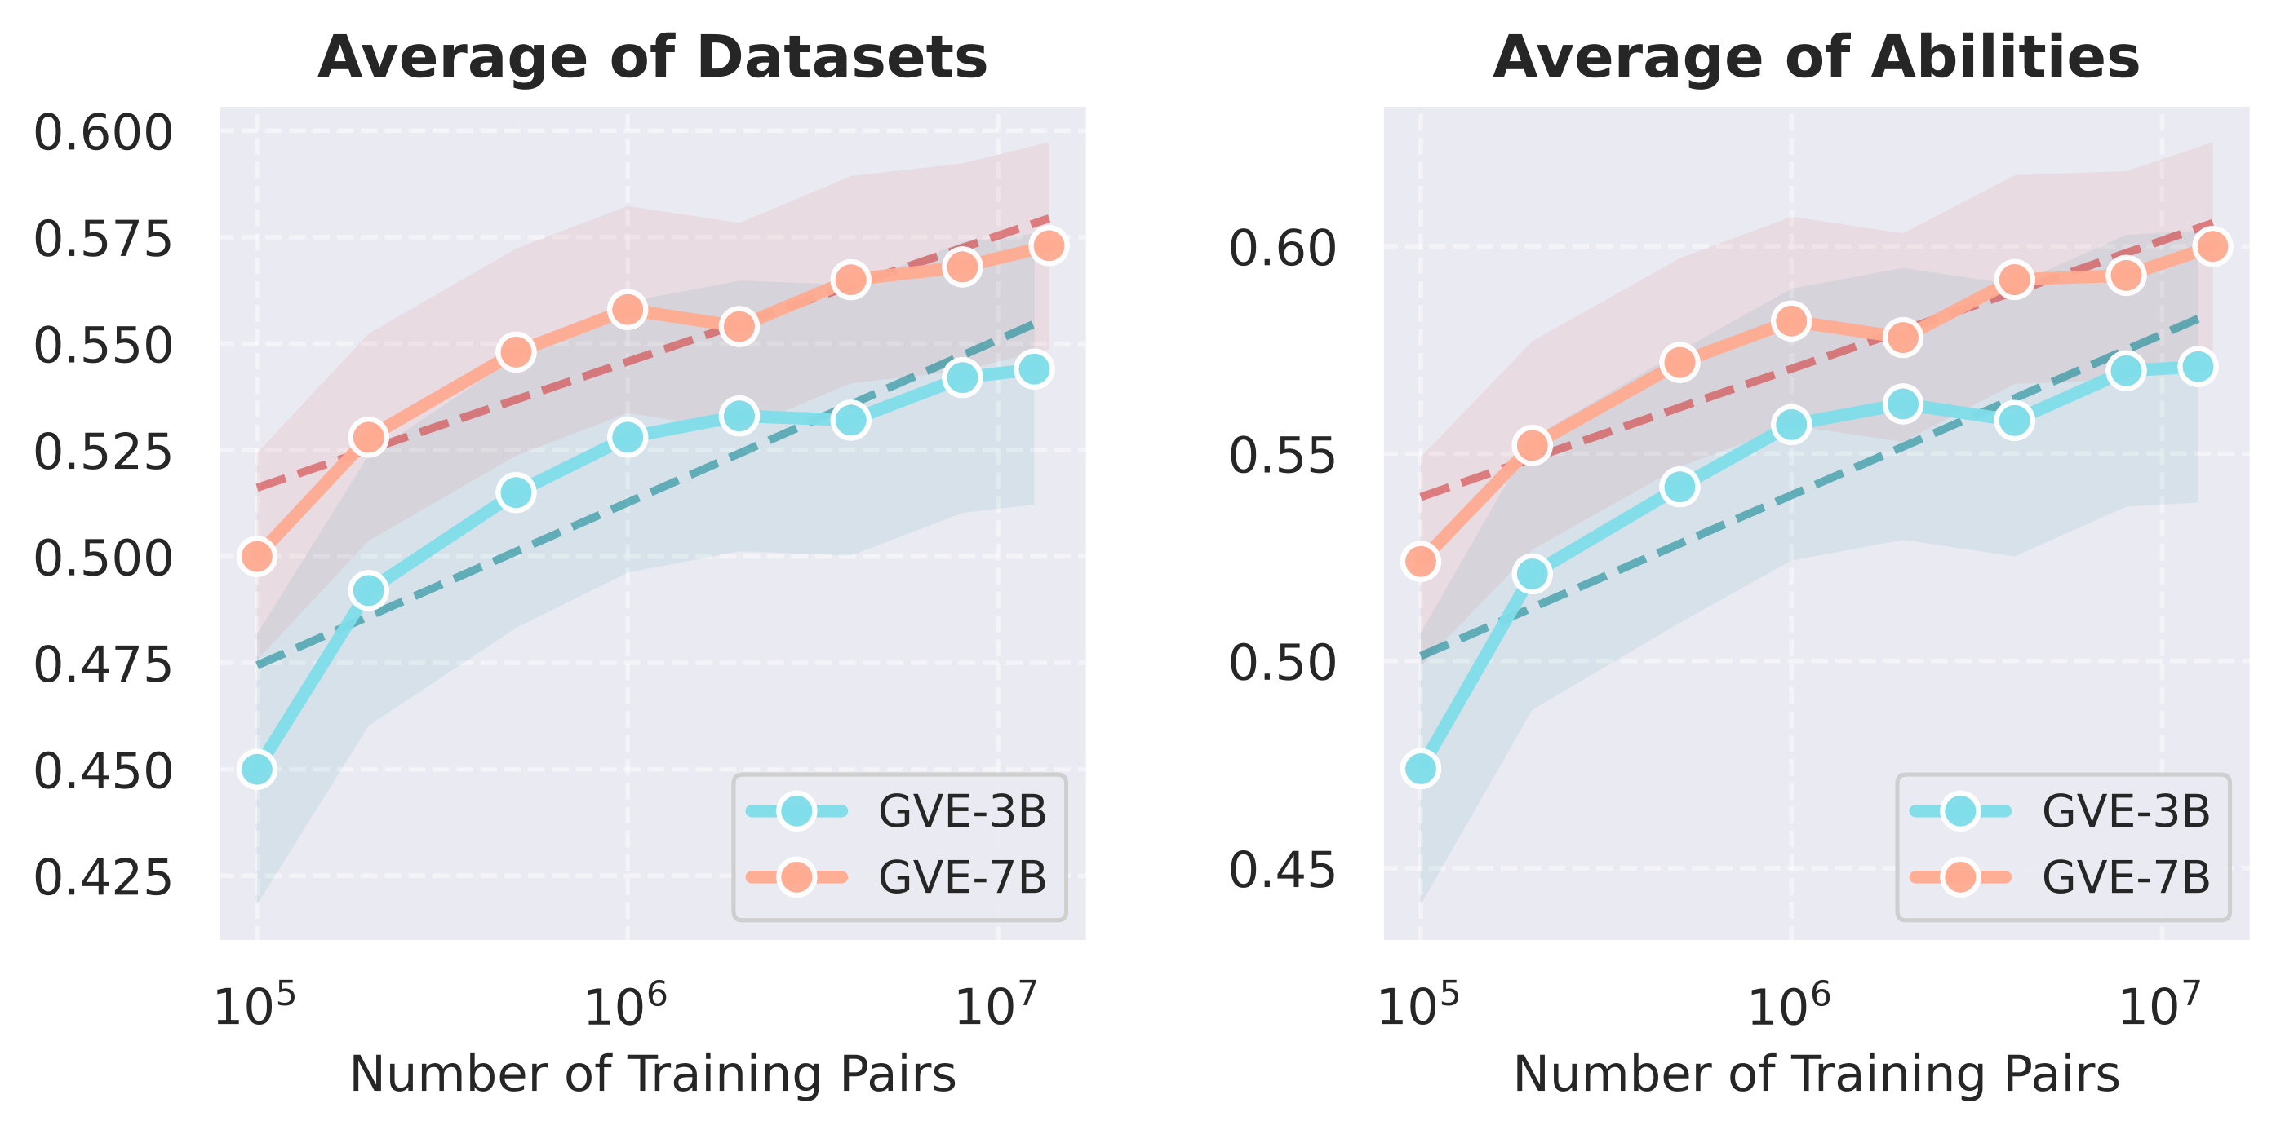
APPENDIX · BACKUP
B3
Targeted Data Scaling Follows a Logarithmic Law
More data helps logarithmically; smaller models gain more per decade.
Data scaling law
y = a · ln(x) + b
Efficiency gap
GVE-3B gains +7.4% per 10× data vs. +5.4% for GVE-7B — smaller models scale more efficiently.
Reading
Gains diminish with scale, so capability-targeted data (UVRD) matters more than sheer volume.
Average performance vs. training-data volume (log scale).
Towards Scalable and Generalizable Video Retrieval
Zhuoning Guo · HKUST(GZ)

Slide 63
APPENDIX · BACKUP
B4
MG-LVR — Results at 128 Frames (excerpt)
Even with 16× more frames, the coarse–fine gap persists across 23 models.
Model · 128 frames | Overall R@1 | Fine R@1 | Coarse R@1
GVE-3B | 0.491 | 0.243 | 0.835
Unite-7B | 0.474 | 0.234 | 0.828
GVE-7B | 0.508 | 0.266 | 0.845
Qwen3-VL-Emb-8B (best) | 0.549 | 0.287 | 0.903
Persistent gap
Best fine R@1 is still 0.287 vs 0.903 coarse — the observation bottleneck is structural, not a capacity issue.
Frame-count anchoring (training-time)
Temporal ability peaks when inference frames match training; a train-32 / test-4 mismatch measurably lowers fine-grained recall — see Chapter 4 scaling tables.
Towards Scalable and Generalizable Video Retrieval
Zhuoning Guo · HKUST(GZ)

Slide 64
APPENDIX · BACKUP
B5
VEterfall — Frame and Token Efficiency (excerpt)
Distillation gains hold under both frame and token compression.
Frame-eff. (T=200) | Overall | Fine | Coarse
8F V⁰ | 0.369 | 0.148 | 0.782
8F V¹ | 0.398 | 0.182 | 0.780
4F V⁰ | 0.303 | 0.125 | 0.677
4F V¹ | 0.319 | 0.138 | 0.706
Token-eff. (F=8) | Overall | Fine | Coarse
400T V⁰ | 0.404 | 0.179 | 0.801
400T V¹ | 0.412 | 0.191 | 0.800
100T V⁰ | 0.375 | 0.158 | 0.772
100T V¹ | 0.380 | 0.171 | 0.758
Takeaway
Reducing frames or tokens with VEterfall beats the un-distilled model at the same budget; the advantage widens as budgets tighten (λ = 0.5, K = 2 rounds).
Towards Scalable and Generalizable Video Retrieval
Zhuoning Guo · HKUST(GZ)

Slide 65
APPENDIX · BACKUP
B6
GMP-GR — Full Offline Results (four datasets)
Coverage / Recall@10 across all evaluated datasets vs. the best baseline.
Coverage | Video | MVideo | Explore | Fresh
NANN (best baseline) | 0.537 | 0.502 | 0.503 | 0.613
GMP-GR (ours) | 0.649 | 0.604 | 0.628 | 0.691
Recall@10 | Video | MVideo | Explore | Fresh
NANN (best baseline) | 0.672 | 0.649 | 0.604 | 0.732
GMP-GR (ours) | 0.824 | 0.718 | 0.800 | 0.842
Speed
GMP-GR retrieves 321K items/s on Video — fastest among DNN-based methods; C-NSW is faster only by dropping to a lightweight cosine metric with far lower accuracy.
Towards Scalable and Generalizable Video Retrieval
Zhuoning Guo · HKUST(GZ)

Slide 66
APPENDIX · BACKUP
B7
Q1 · GVE vs. GPT-4o / Gemini for retrieval
Generation vs. retrieval geometry
Foundation models optimize open-ended generation, not dense retrieval embeddings. GVE is trained with retrieval objectives and capability-targeted data, aligning query and video geometry rather than reusing generic hidden states.
Response strategy
Acknowledge the limit honestly, then redirect to the empirical evidence that answers the underlying concern.
Towards Scalable and Generalizable Video Retrieval
Zhuoning Guo · HKUST(GZ)
Notes:
Foundation models optimize open-ended generation, not dense retrieval embeddings. GVE is trained with retrieval objectives and capability-targeted data, aligning query and video geometry rather than reusing generic hidden states.

Slide 67
APPENDIX · BACKUP
B8
Q2 · Is a 100-sample validation enough?
Statistical limit vs. functional evidence
A 100-sample audit has a wide confidence interval, which we acknowledge. The functional proof is downstream: consistent zero-shot gains across 16 UVRB datasets — systematic noise would not produce broad, cross-dataset improvements.
Response strategy
Acknowledge the limit honestly, then redirect to the empirical evidence that answers the underlying concern.
Towards Scalable and Generalizable Video Retrieval
Zhuoning Guo · HKUST(GZ)
Notes:
A 100-sample audit has a wide confidence interval, which we acknowledge. The functional proof is downstream: consistent zero-shot gains across 16 UVRB datasets — systematic noise would not produce broad, cross-dataset improvements.

Slide 68
APPENDIX · BACKUP
B9
Q3 · Is the granularity gap a benchmark artifact?
Universal across 23 models
The gap persists across all 23 evaluated models and both continuity types. Its cause is structural — sparse sampling misses brief frame-level evidence — and short-clip benchmarks simply mask it.
Response strategy
Acknowledge the limit honestly, then redirect to the empirical evidence that answers the underlying concern.
Towards Scalable and Generalizable Video Retrieval
Zhuoning Guo · HKUST(GZ)
Notes:
The gap persists across all 23 evaluated models and both continuity types. Its cause is structural — sparse sampling misses brief frame-level evidence — and short-clip benchmarks simply mask it.

Slide 69
APPENDIX · BACKUP
B10
Q4 · How would GVE + VEterfall combine?
Promising, not yet evaluated
Open future work. Hypothesis: a stronger dense teacher (GVE) yields higher-quality sparse distillation signals for VEterfall, improving fine-grained efficiency — a concrete cross-model experiment.
Response strategy
Acknowledge the limit honestly, then redirect to the empirical evidence that answers the underlying concern.
Towards Scalable and Generalizable Video Retrieval
Zhuoning Guo · HKUST(GZ)
Notes:
Open future work. Hypothesis: a stronger dense teacher (GVE) yields higher-quality sparse distillation signals for VEterfall, improving fine-grained efficiency — a concrete cross-model experiment.

Slide 70
APPENDIX · BACKUP
B11
Q5 · Does SCL hurt DNN metric expressiveness?
Soft rank regularizer
SCL constrains ranking order, not raw score magnitudes. It aligns output ranking with Euclidean distance to remove degenerate graph-navigation cases while preserving fine-grained relevance — regularizing relative order, not absolute expressiveness.
Response strategy
Acknowledge the limit honestly, then redirect to the empirical evidence that answers the underlying concern.
Towards Scalable and Generalizable Video Retrieval
Zhuoning Guo · HKUST(GZ)
Notes:
SCL constrains ranking order, not raw score magnitudes. It aligns output ranking with Euclidean distance to remove degenerate graph-navigation cases while preserving fine-grained relevance — regularizing relative order, not absolute expressiveness.

Slide 71
APPENDIX · BACKUP
B12
Q6 · Can GMP-GR generalize beyond Baidu?
Algorithmic generality vs. platform metrics
The core logic is HNSW-compatible and architecture-agnostic, so accuracy gains transfer. Absolute throughput depends on hardware and traffic — we separate universal algorithmic value from platform-specific engineering numbers.
Response strategy
Acknowledge the limit honestly, then redirect to the empirical evidence that answers the underlying concern.
Towards Scalable and Generalizable Video Retrieval
Zhuoning Guo · HKUST(GZ)
Notes:
The core logic is HNSW-compatible and architecture-agnostic, so accuracy gains transfer. Absolute throughput depends on hardware and traffic — we separate universal algorithmic value from platform-specific engineering numbers.

Slide 72
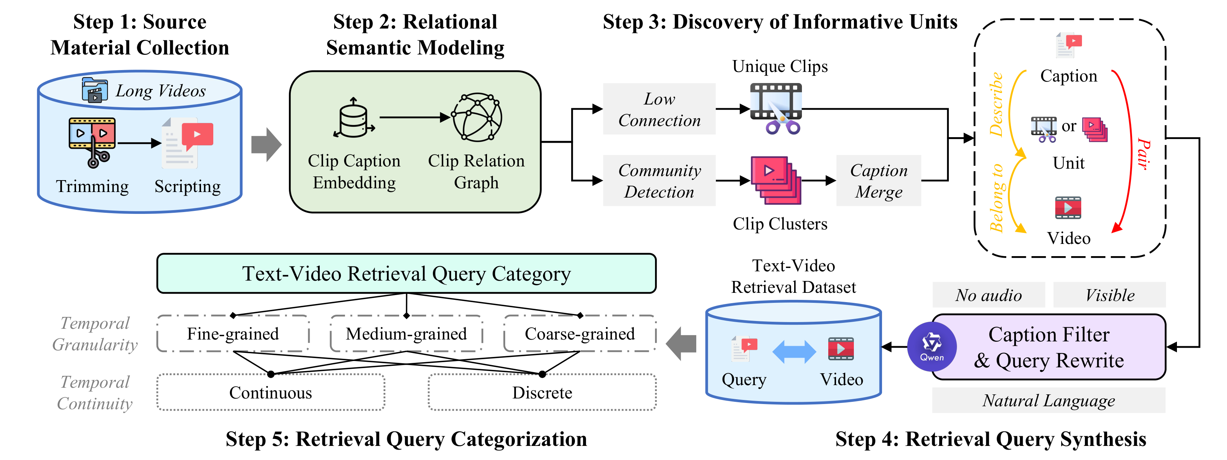
APPENDIX · BACKUP
B13
MG-LVR Controls Granularity Through Clip Relation Graphs
Clip Relation Graph makes query granularity measurable, not manually assumed.
Isolated nodes → Fine queries (G) · Louvain communities → Coarse queries (C) · Granularity made measurable, not assumed.
Towards Scalable and Generalizable Video Retrieval
Zhuoning Guo · HKUST(GZ)
Notes:
Backup (promotable): Figure 4.2 — MG-LVR construction pipeline. Isolated nodes = semantically unique clips → fine-grained retrieval targets (G label). Louvain communities = thematically connected multi-clip groups → coarse-grained targets (C label). This structural approach makes granularity measurable rather than manually assumed.

