Slide 1

Texas Tech University
Department of Computer Science
Research seminar · Oak Ridge National Laboratory
Quantum Computing and Circuit Simulation
A co-designed quantum–HPC stack, from simulation to trust
Ziqing Guo
Ph.D. candidate, Department of Computer Science, Texas Tech University · Advisor: Dr. Ziwen Pan
Oak Ridge, Tennessee · 2026 · date TBD
Notes:
Thank you for having me. I am a Ph.D. candidate at Texas Tech, and this talk is the HPC-facing half of my dissertation: how classical high-performance computing surrounds a quantum processor at every layer, from GPU simulation of 42-qubit circuits on a thousand A100s to the cost accounting that says when the quantum step is worth it. About 35 minutes of material, then I would like to spend the rest on how this maps onto Frontier and OLCF.

Slide 2
Quantum Computing and Circuit Simulation
2 / 40
Thesis statement
Useful quantum computation in the coming decade will be delivered not by a quantum processor alone but by a co-designed stack in which classical high-performance computing surrounds the QPU at every layer.
Introduction
Notes:
This is the thesis in one sentence, taken verbatim from the dissertation. The word to underline is co-designed: HPC is not a stopgap until hardware improves, it is a permanent part of how quantum programs are developed, run and trusted. Each of the following sections adds one layer to that stack.

Slide 3
The co-designed stack · roadmap for this talk
3 / 40
Five layers around the QPU
01 · Scale
02 · Noise
03 · Data
04 · Synthesis
05 · Trust
Simulation
Algorithms
Data encoding
Synthesis
Trust
GPU simulation beyond hardware reach
Structure from problem and device, not black-box search
Vectorized, learnable data loading
AI/HPC synthesis within fault-tolerant budgets
Auditable QEC and post-quantum cryptography
Introduction
Notes:
These five cards are the map for the talk; they come back as a rail on every section divider. I will spend the most time on the two layers where the HPC facility does the heavy lifting: simulation and synthesis. Algorithms, data encoding and trust each get one headline result; the rest is in the backup slides.

Slide 4
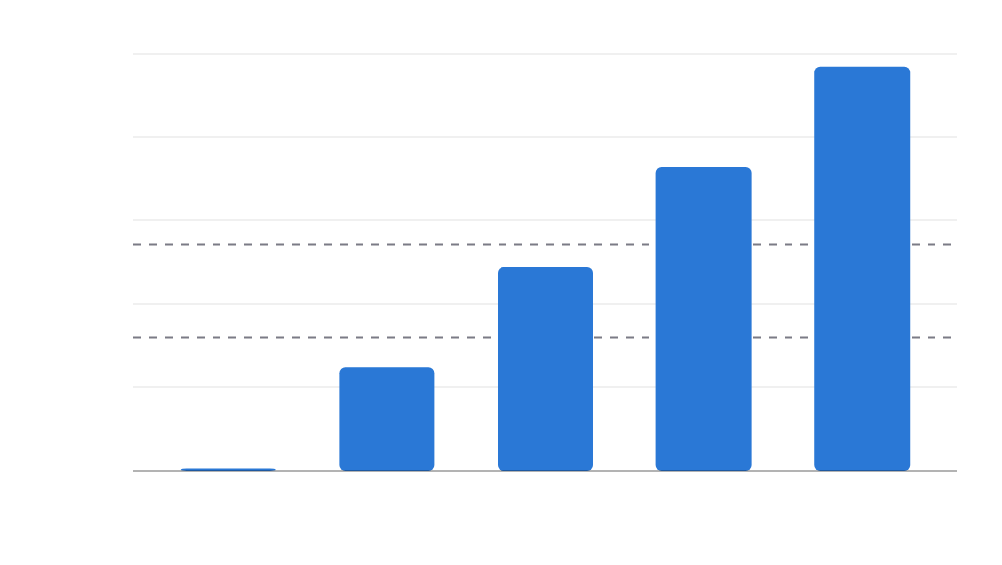
Motivation · Scale
4 / 40
The simulation wall
state-vector memory (2ⁿ × 16 B, log scale)
2^{n} × 16 B
100 TB
70 TB
10 TB
4.4 TB
state-vector memory doubles with every qubit
1 TB
CPU node · 512 GB
275 GB
100 GB
A100 · 40 GB
42 q ≈ 70 TB
17 GB
10 GB
one 40 GB A100: 32 qubits · one CPU node: 34 qubits in ≈24 h
1.1 GB
1 GB
26
30
34
38
42
qubits n
Introduction
Notes:
Exact state-vector simulation is the reference tool for developing and verifying circuits, but its memory doubles per qubit. At 42 qubits the state alone is about seventy terabytes in double precision, far beyond any single node. The question for RQ1 is how far HPC can push this and whether a Qiskit program can use that capability without being rewritten.

Slide 5
5 / 40
Layer 1 · Scale
Q-GEAR
GPU-accelerated circuit simulation at HPC scale
Guo, Balewski, Pan · ACM ICPP 2025 · arXiv:2504.03967 · github.com/gzquse/qgear
Simulation · Q-GEAR
01
Simulation
02
Algorithms
03
Data encoding
04
Synthesis
05
Trust
Notes:
Layer one: simulation. Q-GEAR, published at ICPP 2025 with Jan Balewski from NERSC, is the framework that lets a Qiskit circuit run on NVIDIA GPUs at Perlmutter scale without a rewrite. This chapter answers RQ1.

Slide 6
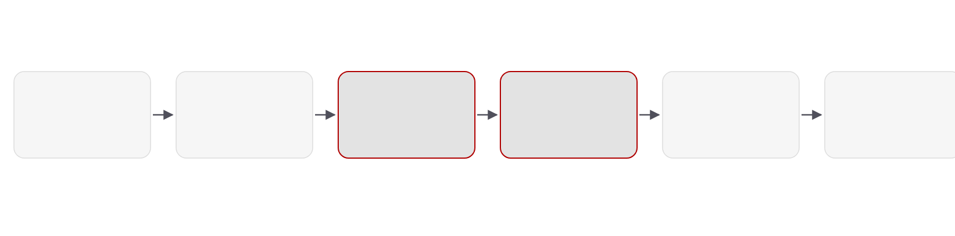
Design
6 / 40
The kernel transformation pipeline
Qiskit circuit
Parse
Encode
Generate
Package
Run
user code, unchanged
gate set check
three tensors → HDF5
CUDA-Q kernel
Podman / Shifter
Slurm · multi-GPU MPI
Q-GEAR automates the four middle stages.
python · nbdev · Apache-2.0 · github.com/gzquse/qgear
Simulation · Q-GEAR
Notes:
End to end, the pipeline has six stages, and Q-GEAR automates the four in the middle. The two highlighted stages, encoding and kernel generation, are the contribution; packaging in Podman or Shifter containers is what makes the result reproducible on Perlmutter's Slurm scheduler.

Slide 7
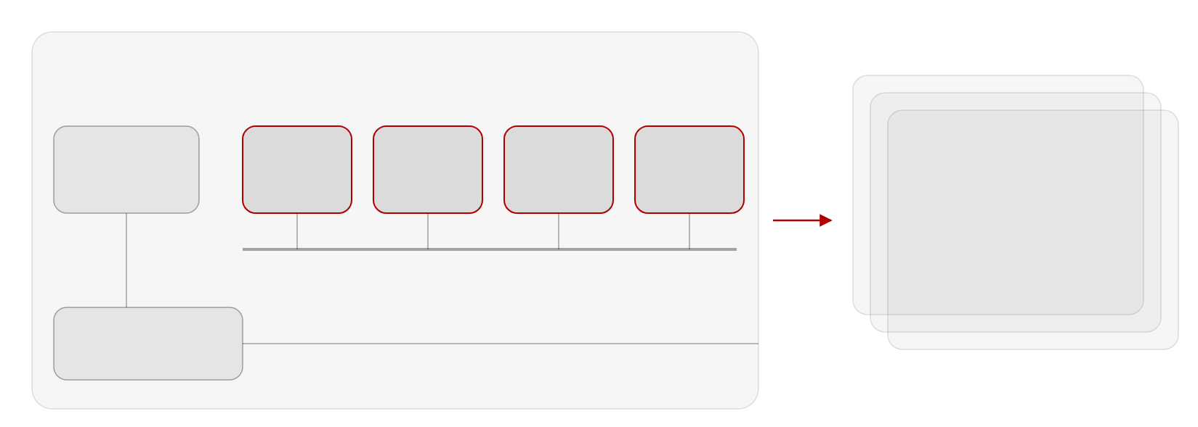
Deployment
7 / 40
One node to a thousand GPUs
Perlmutter GPU node
1 × AMD EPYC CPU · 4 × NVIDIA A100 (40 GB) · NVLink · Slingshot NIC
CPU
A100 #0
A100 #1
A100 #2
A100 #3
… × 256 nodes
AMD EPYC
40 GB
40 GB
40 GB
40 GB
1,024 A100 GPUs · MPI
42-qubit state vector in
aggregate GPU memory
NVLink · state vector sharded across the four GPUs (CUDA-Q multi-GPU)
≈100% GPU utilization
Slingshot NIC
to other nodes
Simulation · Q-GEAR
Notes:
Each Perlmutter GPU node has four 40-gigabyte A100s connected by NVLink, and CUDA-Q's multi-GPU backend shards the state vector across them. Beyond one node, MPI over the Slingshot interconnect lets us aggregate memory across nodes: 256 nodes give 1,024 GPUs, which is where the 42-qubit runs happened at close to full GPU utilization.

Slide 8
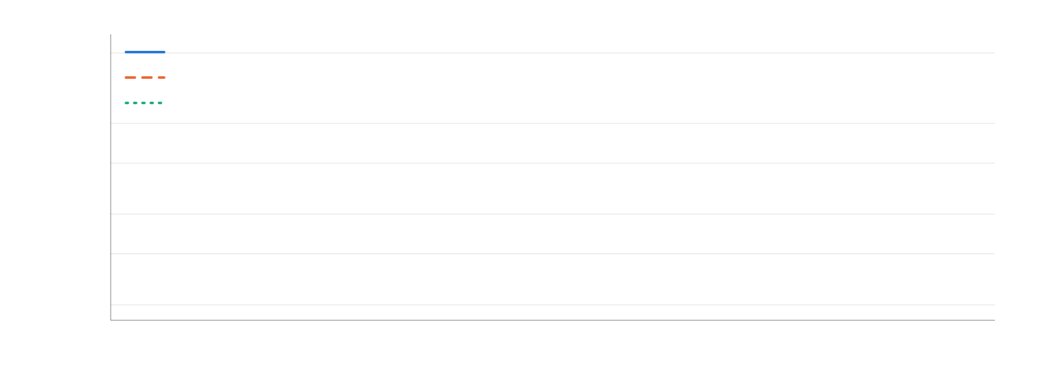
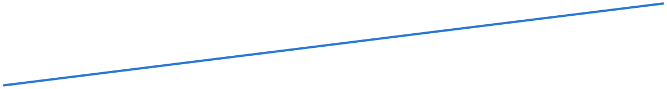
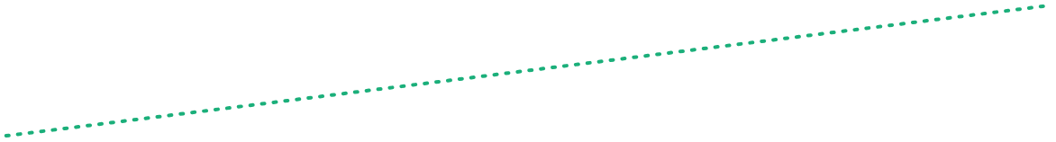

Results
8 / 40
Hours become minutes
wall time, random CX-block circuit (log scale)
≈24 h
24 h
CPU node (128 cores)
1 × A100 (40 GB)
4 × A100 (MPI)
1 h
10 min
≈1 min
1 min
10 s
1 s
28
30
32
34
qubits
Anchors: 34 q ≈ 24 h (CPU) vs ≈ 1 min (4 × A100); ≈400× on one A100. Lines follow 2ⁿ scaling; intermediate points illustrative.
Simulation · Q-GEAR
Notes:
This is the headline scaling result. The 34-qubit random circuit that takes a day on the CPU node runs in about a minute on four A100s within one node. A single A100 is roughly four hundred times faster than the CPU but tops out at 32 qubits because of its 40 gigabytes. The lines between the reported anchor points follow the two-to-the-n scaling law and are illustrative.

Slide 9
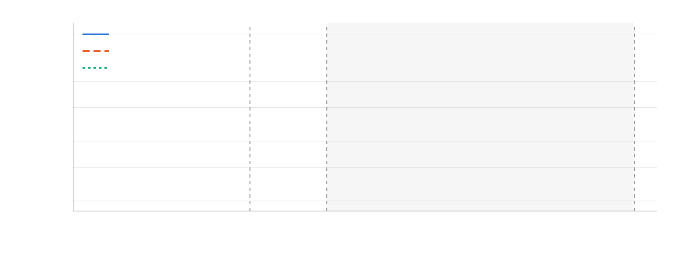
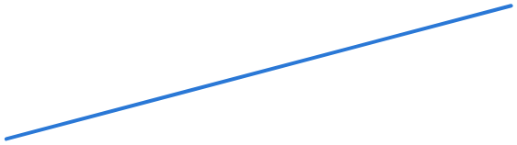


Results
9 / 40
42 qubits on 1,024 A100s
wall time, random CX-block circuit (log scale)
≈24 h
24 h
CPU node (128 cores)
1 × A100 (40 GB)
4 × A100 (MPI)
1 h
10 min
multi-node CUDA-Q (MPI)
≈1 min
up to 1,024 × A100 · ≈100% GPU utilization
1 min
10 s
34 q · 4 × A100 (one node)
1 s
32 q · 1 × A100 (40 GB)
42 q · 1,024 × A100
28
30
32
34
36
38
40
42
qubits
Axis extended to the largest run: 42 qubits on 1,024 A100s (CUDA-Q MPI, ≈100% GPU utilization).
Simulation · Q-GEAR
Notes:
Extending the axis shows the reach of each configuration: 32 qubits on one GPU, 34 on one node, and 42 qubits across 1,024 GPUs using CUDA-Q's MPI backend. GPU utilization stayed close to one hundred percent, which is the practical evidence that the containerized pipeline is not leaving the hardware idle.

Slide 10
Takeaway · benchmark suite
10 / 40
42 qubits, program unchanged
Benchmark
Qubits
Two-qubit gates
Reported result
Random CX-block circuits
28–34
100 – 10,000
≈1 min on 4 × A100 vs ≈24 h on CPU · ≈400× on one A100
Quantum Fourier transform
≤ 22
—
same pipeline, program unchanged
QCrank image encoding
small images
—
→ 100× speed-up
Largest run
42
—
1,024 × A100 · ≈100% GPU utilization
Reused downstream: validates the DEAL circuits before hardware · evaluator inside RubriQ’s training loop
Simulation · Q-GEAR
01
Simulation
02
Algorithms
03
Data encoding
04
Synthesis
05
Trust
Notes:
To summarize Chapter III: the same Qiskit program reaches 42 qubits, and the benchmark table shows the three circuit families we timed. The framework is not a one-off: it validated the DEAL circuits in the next chapter before they went to hardware, and it is the simulator inside RubriQ's reinforcement-learning loop in Chapter VI.

Slide 11
11 / 40
Layer 2 · Noise
DEAL & QAWA
Hardware-aware optimization on noisy devices
DEAL: Guo, Rayan, Hu, Pan · IEEE QCE 2025 · arXiv:2504.04021 · QAWA: Guo, Balewski, Hu, Khan, Pan · arXiv:2511.07676
Algorithms · DEAL & QAWA
01
Simulation
02
Algorithms
03
Data encoding
04
Synthesis
05
Trust
Notes:
Layer two: algorithms on noisy hardware. Two papers: DEAL, published at IEEE QCE 2025, replaces black-box QAOA angle search with a direct mapping from the problem; QAWA proposes a data-traceable oracle so that QAOA outputs can be interpreted without tomography. Both answer RQ2.

Slide 12
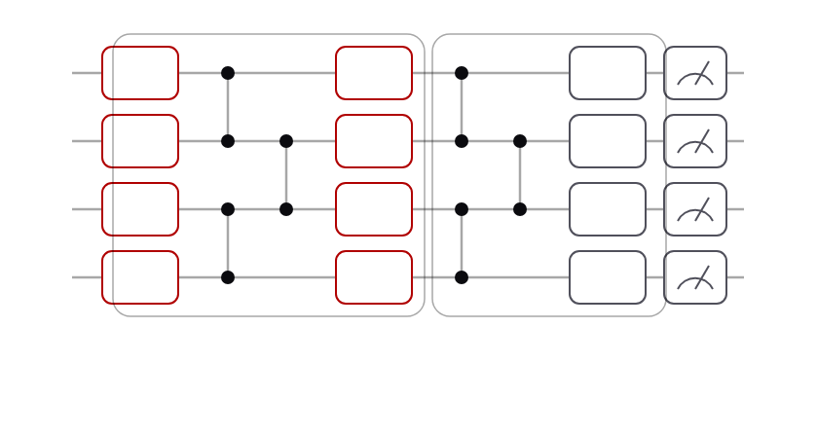
DEAL · Direct Entanglement Ansatz Learning
12 / 40
Read the angles off the problem
Direct angle mapping
Angles from the QUBO coefficients — no optimizer loop
q0
RY
RZ
RX
q1
RY
RZ
RX
Entanglement-based ansatz
Echoed cross-resonance gates within the device’s CZ budget
q2
RY
RZ
RX
q3
RY
RZ
RX
angles from QUBO coefficients Qᵢᵢ, Qᵢⱼ
Adaptive digital ZNE
echoed cross-resonance entanglers
20 qubits · 10 layers on IBM Torino (133 q) and IBM Marrakesh (156 q)
Delay / identity gates vs crosstalk; Bayesian layer choice
Algorithms · DEAL & QAWA
Notes:
DEAL has three parts. First, the angles are read directly off the QUBO coefficients, so there is no optimizer loop on hardware. Second, the entangling structure is chosen for the device, using echoed cross-resonance gates. Third, an adaptive digital zero-noise extrapolation cleans up the result. The circuits are twenty qubits and up to ten layers on the Heron processors Torino and Marrakesh.

Slide 13
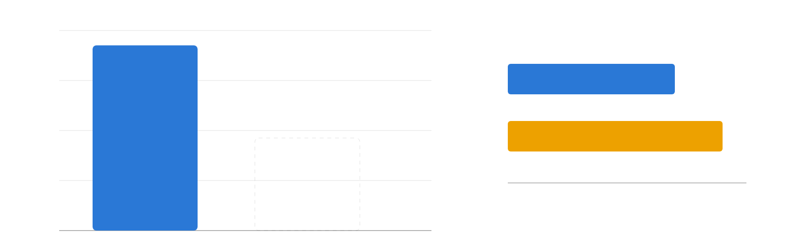
Results · hardware
13 / 40
DEAL beats vanilla QAOA on Heron-1
success-rate gain of DEAL over QAOA at layer 10 (percentage points)
+16
+14.81 pts
layers needed for the same success rate
DEAL
+12
7 layers
QAOA
+8
9 layers
+4
0
2
4
6
8
10
circuit layers p
+0
Torino · Heron-1 · 133 q
Heron-2 · next
20 qubits, 10 layers; success = reaching the ground-state energy. TSP, knapsack and MaxCut instances; lower variance too.
Algorithms · DEAL & QAWA
Notes:
On IBM Torino, a 133-qubit Heron-1, DEAL reaches the ground-state energy 14.8 percentage points more often than vanilla QAOA at ten layers, with lower variance; on the right, seven DEAL layers match what QAOA needs nine for, which matters because each layer spends part of the forty-CZ budget. The Heron-2 repeat (Marrakesh, +7.4 points) is in the backup slides. Every one of these circuits was validated with the Q-GEAR GPU path before it went to hardware.

Slide 14
Takeaway
14 / 40
Structure beats search
Problem structure sets the angles (DEAL) and the oracle (QAWA) — no black-box search on the QPU
Device structure sets the ansatz: ECR entanglers · ≈41–43 CZ budget · adaptive ZNE
Heron results: +14.81 / +7.40 pts success at layer 10 · 7 layers for 9 · +5.4% portfolio
Next: make the data these algorithms consume cheap to load
Algorithms · DEAL & QAWA
01
Simulation
02
Algorithms
03
Data encoding
04
Synthesis
05
Trust
Notes:
The takeaway for RQ2 is that structure beats search. Structure from the problem gives the angles and the oracle; structure from the device gives the ansatz and the error mitigation. The measured numbers are modest but real hardware results, and they set up the next layer: if data loading is cheap, these algorithms can consume real data.

Slide 15
15 / 40
Layer 3 · Data
Quantum learning
Vectorized encodings for quantum learning
QPIE · Quantum Sci. Technol. 10 (2025) · VQT · AAAI Symposium Series 7 (2025) · ShardQ · arXiv:2511.05492 · NNQA · arXiv:2603.27297
Data · Quantum learning
01
Simulation
02
Algorithms
03
Data encoding
04
Synthesis
05
Trust
Notes:
Layer three is the data interface, and it is the largest chapter: four papers. QPIE is a hybrid network published in Quantum Science and Technology; VQT is a quantum transformer from the AAAI Symposium Series; ShardQ cuts and knits encoding circuits; and NNQA compiles trained polynomial networks into exact quantum arithmetic. All four answer RQ3.

Slide 16
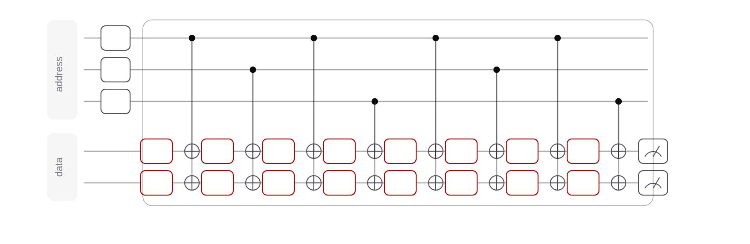
Building block
16 / 40
QCrank: vectorized data encoding
a0
H
a1
H
a2
H
d0
RY
RY
RY
RY
RY
RY
RY
RY
d1
RY
RY
RY
RY
RY
RY
RY
RY
θ0
θ1
θ2
θ3
θ4
θ5
θ6
θ7
N = 2ⁿᵃ · n_d values · Θ(N) CNOTs · all addresses in parallel
uniformly controlled rotations: 2ⁿᵃ angles per data qubit
Address qubits index the values; data qubits carry them as angles. Shared by Q-GEAR, QPIE, VQT, ShardQ, QAWA. A 1,000-pixel image: 9 + 2 qubits.
Data · Quantum learning
Notes:
QCrank, due to Balewski and colleagues at Berkeley Lab, is the encoding this chapter builds on. Address qubits in uniform superposition index the values; each data qubit carries two-to-the-n-a values as rotation angles through a uniformly controlled rotation. The circuit is linear in the number of values and processes all addresses in parallel, which is what makes vectorized arithmetic possible. A thousand-pixel image needs nine address and two data qubits.

Slide 17
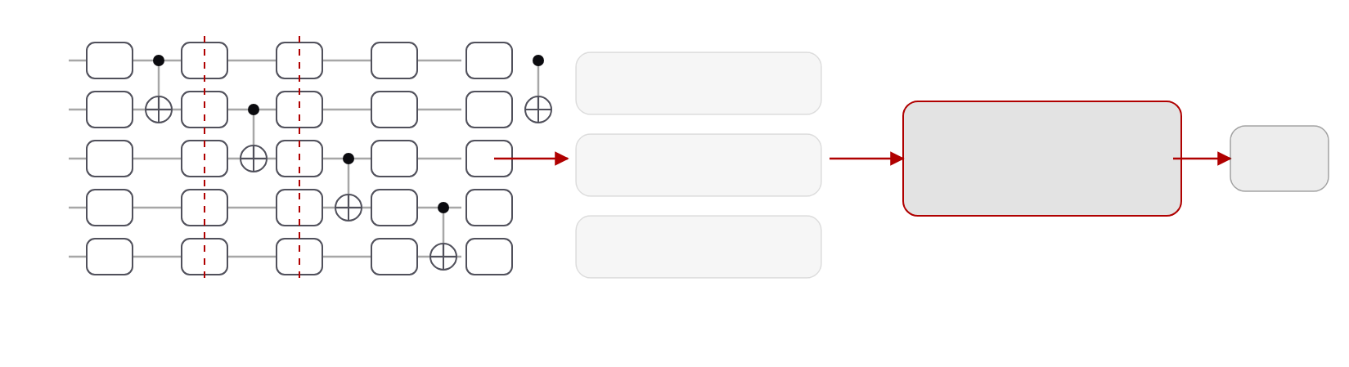
ShardQ · Circuit partitioning and reintegration
17 / 40
Cut where the hardware is worst
q0
RY
RY
RY
RY
RY
sub-circuit 1
q1
RY
RY
RY
RY
RY
global QPD knitting
ŷ
q2
RY
RY
RY
RY
RY
sub-circuit 2
O(3²ᵏ) sampling overhead
q3
RY
RY
RY
RY
RY
q4
RY
RY
RY
RY
RY
sub-circuit 3
cut 1
cut 2
MPS compiler · bounded bond dimension
1.5 M shots per sub-circuit
QCrank encoding circuit · SparseCut picks gate cuts by qubit distance and calibrated CZ error · O(|G| log |G|)
≈15%
0.79 → 0.90
15 s · 24 h
lower RMSE vs standard transpilation, IBM Heron-2/3
image-encoding fidelity, 5 address qubits (0.75 → 0.88 at 7)
knitting: ≤2 cuts on one A100 · 4 cuts on four GPU nodes
Data · Quantum learning
Notes:
ShardQ makes the loader hardware-compatible. The deterministic SparseCut algorithm chooses gate cuts using physical qubit distance and calibrated error rates; sub-circuits are compiled with a bounded-bond-dimension MPS compiler; and the outputs are knitted back with a global quasi-probability reconstruction rather than pairwise. On Heron this cuts RMSE by about fifteen percent and lifts image-encoding fidelity from 0.79 to 0.90. The knitting itself is HPC work: two cuts take fifteen seconds on one A100, four cuts a day on four GPU nodes.

Slide 18
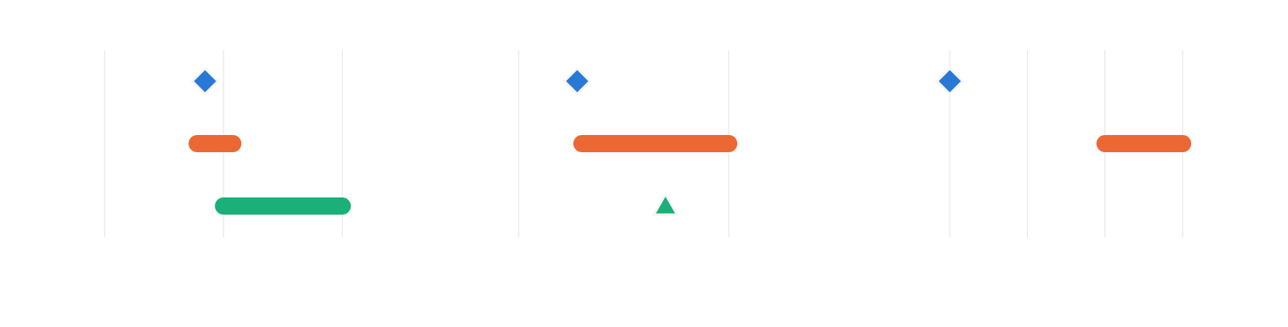
NNQA · Neural-Native Quantum Arithmetic
18 / 40
Compile, do not search
qubits
circuit depth
circuit executions
NNQA
7
NNQA
19
NNQA
1
VQE
6–12
VQE
20–100
VQE
100–1000
QSP
10–100
QSP
50
QSP
not reported
1
10
100
10
100
1
10
100
1000
resource model for a degree-6 polynomial (log scales) · NNQA runs once with 4,096 shots
>99.5% accuracy up to degree 35
36 qubits · depth 70 (IonQ Forte-1 stress test)
RMSE ≤ 0.017 · correlation > 0.999 for degrees 1–30
pass rates 74–86% Heron-3 · 92–99% Forte-1
universal-approximation theorem
Data · Quantum learning
Notes:
NNQA closes the trainability corner by not training on the QPU at all. A polynomial neural network is trained classically on Perlmutter, then compiled exactly into native unitary blocks for weighted sums and products on real-valued encoded states. A degree-6 polynomial needs seven qubits, five CNOTs and depth nineteen, run once, where VQE needs hundreds of executions. On Heron-3, Nighthawk and IonQ Forte-1 it holds above 99.5 percent accuracy up to degree 35, and we prove a universal-approximation theorem for the construction.

Slide 19
Takeaway
19 / 40
Vectorize, then learn
One encoding, four uses: QPIE blocks · VQT attention · ShardQ cuts · NNQA arithmetic
Shot-efficient: VQDP O(log(B·T²)) vs O(B·T²·d) · NNQA runs once
Hardware-compatible: fidelity 0.79 → 0.90 · ran on Heron, Aria-1, Forte-1
Trainable: learnable heads keep gradients alive · NNQA needs no on-device training
Data · Quantum learning
01
Simulation
02
Algorithms
03
Data encoding
04
Synthesis
05
Trust
Notes:
One encoding, four uses: vectorized loading is what makes attention shot-efficient, what ShardQ cuts to fit the hardware, and what NNQA compiles into. QPIE and VQT — the hybrid network and the quantum transformer — are in the dissertation and the backup material; the two I showed are the ones where the HPC side does real work: GPU knitting of cut circuits, and polynomial networks trained on Perlmutter and compiled exactly into circuits.

Slide 20
20 / 40
Layer 4 · Synthesis
Synthesis & cost
Learned synthesis and honest cost accounting
RubriQ · Guo, Pan · arXiv:2607.07554 · under review, npj Quantum Information · Nonlinear waves · Guo, Dsouza, Khan, Chopra, Lineswala, Pan · arXiv:2608.21647
Synthesis & cost
01
Simulation
02
Algorithms
03
Data encoding
04
Synthesis
05
Trust
Notes:
Layer four: synthesis and cost. RubriQ uses a language model fine-tuned by reinforcement learning, with a programmatic rubric as the reward, to synthesize circuits toward fault-tolerant resource budgets. The second paper is the honest-accounting half of RQ4: what nonlinear-wave simulation really costs when every step must read the field.

Slide 21
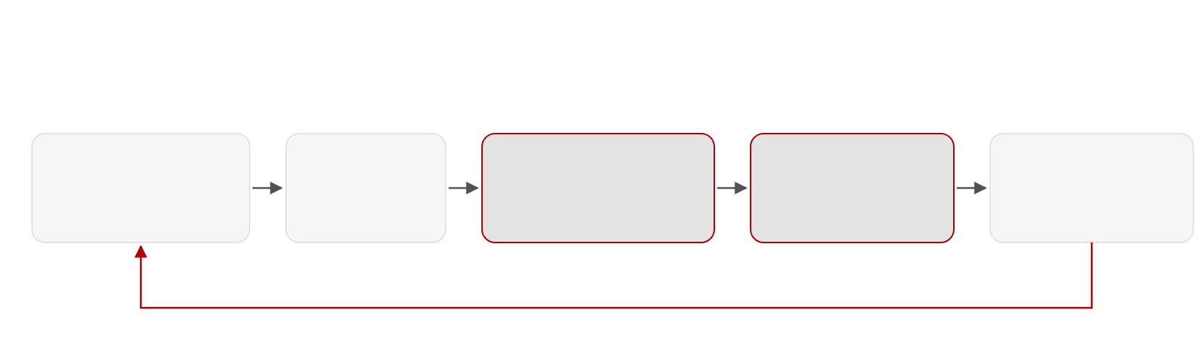
RubriQ · Rubric-guided GRPO
21 / 40
Synthesis as code generation
NERSC Perlmutter · DeepSpeed ZeRO-2 over 4–8 A100 nodes · 85% strong-scaling efficiency on 8 GPUs
Qwen2.5-Coder · DeepSeek-Coder-V2-Lite · Llama-3.1-8B · StarCoder2-15B
LLM policy
parse
CUDA-Q simulate
rubric reward
GRPO update
7B coder · LoRA r = 64
recovers ≈60%
GPU fidelity (Q-GEAR path)
5 programmatic terms
group 8 · T 0.8 · top-p 0.95
policy improves by comparing a group of 8 generated circuits against each other, no value network
Synthesis & cost
Notes:
RubriQ frames fault-tolerant synthesis as code generation. A seven-billion-parameter coder with LoRA adapters proposes circuits; they are parsed, simulated with CUDA-Q on the GPU, scored by a rubric, and the policy is updated with Group Relative Policy Optimization, which compares eight samples against each other instead of learning a value network. Training runs on Perlmutter with DeepSpeed across up to eight A100 nodes at 85 percent strong-scaling efficiency.

Slide 22
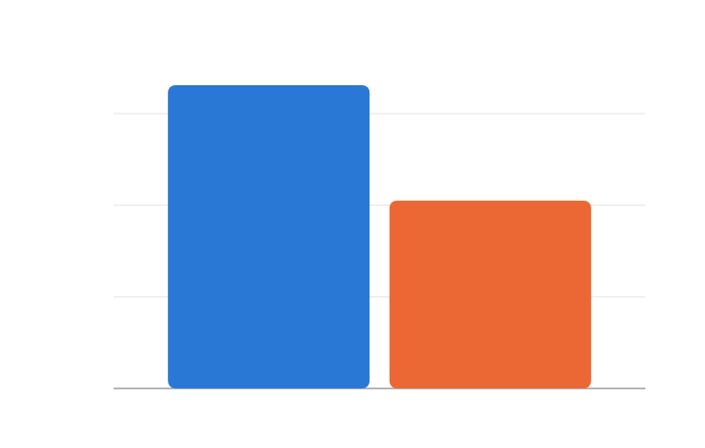
RubriQ · Results
22 / 40
Deeper compression, fewer violations
mean T-gate compression on 1,500 benchmark circuits
<1%
3.31×
96%
3×
constraint violations · 5× fewer than best baseline
2.05×
correctness
2×
2–3×
85%
1×
faster convergence · fewer simulator calls
strong-scaling efficiency, 8 GPUs
0×
RubriQ
sparse-reward RL
1,500 circuits: QFT, QPE, Hamiltonian simulation, data encoding. Validated on IBM Heron-3 and IonQ Forte.
Synthesis & cost
Notes:
On 1,500 benchmark circuits spanning QFT, phase estimation, Hamiltonian simulation and data encoding, RubriQ compresses T-gate counts by 3.31 times on average against 2.05 for sparse-reward RL, keeps hardware-constraint violations under one percent, and reports 96 percent correctness. The synthesized circuits were validated on Heron-3 and IonQ Forte, so this is not only a simulator result.

Slide 23
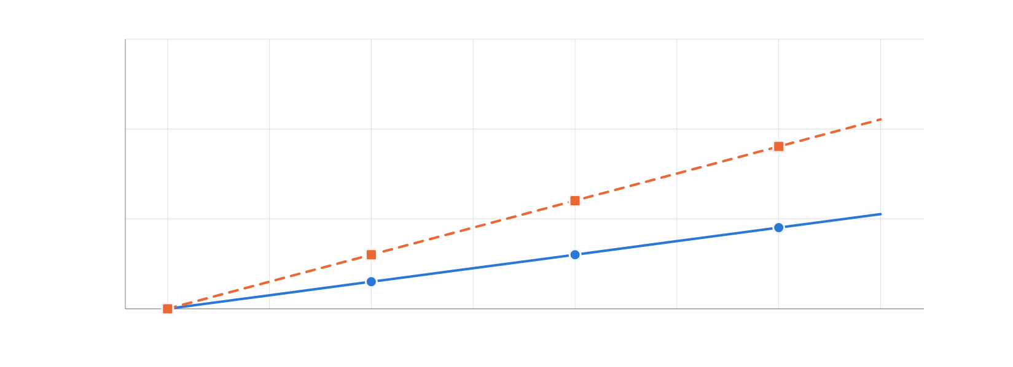
Nonlinear waves · Cost model
23 / 40
Where the quantum step loses
relative cost per time step (log)
10⁶
quantum step · depth Θ(N) × shots S(N)
10⁴
10²
classical update · O(N·d)
1
32
64
128
256
512
1024
2048
4096
grid points N = 2ⁿ
Schematic from the cost model: depth Θ(N) × shots S(N) per step vs O(N·d) classical, normalized at N = 32. Not measured wall time.
Synthesis & cost
Notes:
The conclusion is negative but quantitative. Because every step reads the full field, the quantum cost per step, depth times shots, grows faster than the classical polynomial update as N grows, so the hybrid scheme cannot deliver an end-to-end advantage. What it does deliver is the target: a coherent, measurement-free nonlinear update is what any future advantage claim must beat. This chart is the schematic scaling from the model, not measured wall time.

Slide 24
Takeaway
24 / 40
Honest accounting
Grounded reward works: rubric + GPU simulation → 3.31× T-gate compression, <1% violations
HPC inside the loop: CUDA-Q evaluation (Q-GEAR path) + DeepSpeed on Perlmutter
Count everything: measurement + reload every step → no end-to-end advantage for nonlinear waves
Both stated as budgets: T-gates · shots × depth
Synthesis & cost
01
Simulation
02
Algorithms
03
Data encoding
04
Synthesis
05
Trust
Notes:
RQ4 has a two-part answer. Learned synthesis produces budget-respecting circuits when the reward is grounded in simulation and hardware constraints. And honest accounting, charging every measurement and reload, shows where quantum advantage does not exist yet, which is as important to write down as where it does.

Slide 25
25 / 40
Layer 5 · Trust
QEC audit
Auditing structured randomness for quantum error correction under a bounded cloud fault model
Guo, Lawrence, Wang, Kuang, Pan · arXiv:2608.26600 · artifact: anonymous.4open.science/r/usenix_qec_hse
Trust · QEC audit
01
Simulation
02
Algorithms
03
Data encoding
04
Synthesis
05
Trust
Notes:
Layer five: trust. This chapter, with coauthors from Lightrider and Quantropi, treats the error-correction encoder on a shared cloud QPU as a security surface and asks how randomness should be used and audited. It is the first half of the answer to RQ5.

Slide 26
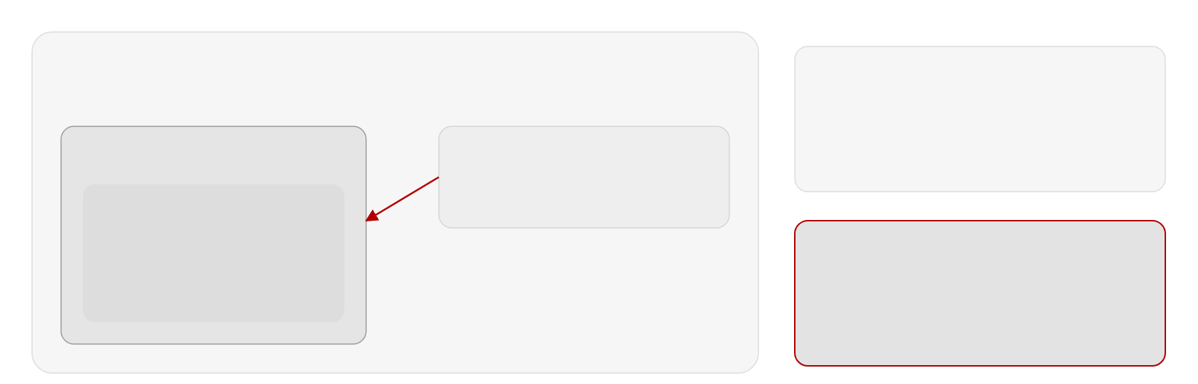
Threat model
26 / 40
A public encoder is a reusable target
shared cloud QPU
bounded cloud fault model: weight-one Pauli faults, all 3n locations enumerated
fixed public encoder
your job
same E every run → reusable target
co-tenant adversary
adversary picks the fault after learning E
[[n,k,d]] encoder E
same chip, same time
|ψ⟩ → E|ψ⟩|0…0⟩
injects one Pauli fault
syndrome check → accept / reject
learns the public encoder,
reseeded encoder
logical qubit
then chooses where to strike
fresh seed per run → fault map changes
fault must be fixed before the seed is known
Trust · QEC audit
Notes:
The setting is a shared cloud processor: your error-corrected job runs next to a co-tenant who can inject a single Pauli fault. If the encoder circuit is fixed and public, the adversary can learn exactly which physical fault produces a harmful logical action that the syndrome check will not catch, and reuse it every run. If the encoder is reseeded per run, the fault has to be chosen before the seed is known. The fault model is deliberately bounded: weight-one Paulis, all three-n locations enumerated.

Slide 27
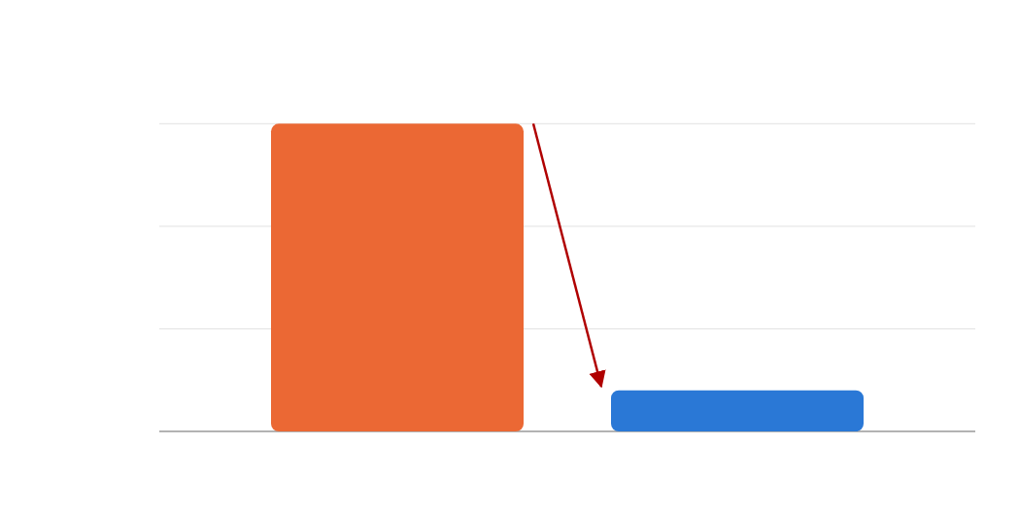
Results
27 / 40
Reseeding removes 86.7% of the harm
mean accepted logical disturbance · [[5,1,3]] code · weight-one Pauli faults
RESULT
0.150 → 0.020
0.150
the pre-chosen fault is now caught by syndrome rejection
0.15
−86.7%
VALID ENCODERS
0.10
18.5%
of sampled HSE circuits meet the exact QEC conditions
0.05
0.020
SCALING
0.00
Stim · n = 17
fixed public encoder
reseeded encoder
gate-level, p₁ = 10⁻³, p₂ = 10⁻² · trend confirmed
fault chosen after learning E
fault fixed before the seed
Trust · QEC audit
Notes:
With the five-qubit code and every weight-one fault enumerated, a fixed public encoder gives a mean accepted logical disturbance of 0.150. Reseeding the encoder per run brings it to 0.020, an 86.7 percent reduction, and the reduction is attributable to rejection: with a fresh encoder the pre-chosen fault is caught by the syndrome check most of the time. Gate-level Stim simulations at 17 qubits confirm the trend. The seed is the only secret, which is where the post-quantum module in the backup slides comes in.

Slide 28
Closing
28 / 40
Five questions, five answers
01 · Scale
02 · Noise
03 · Data
04 · Synthesis
05 · Trust
Simulation
Algorithms
Data encoding
Synthesis
Trust
Structure beats search · +14.81 pts · 7 layers for 9 · O(n) oracle
One vectorized encoding → shot-efficient, hardware-compatible, trainable
Grounded RL · 3.31× T-gate compression · honest budgets
42 qubits on 1,024 A100s · ≈400× · Qiskit unchanged
Reseeding −86.7% disturbance · FIPS 140-3 PQC module
Closing
Notes:
Back to the stack, now with the answers. Scale: exact simulation reaches 42 qubits on 1,024 A100s, about 400 times faster than a CPU node, with the Qiskit program unchanged. Noise: angles read from the problem and ansätze shaped by the device beat black-box search, plus an O(n) traceable oracle. Data: vectorized QCrank-style encodings make learning shot-efficient, hardware-compatible and trainable across QPIE, VQT, ShardQ and NNQA. Synthesis: rubric-grounded RL synthesizes budget-respecting circuits, and honest accounting shows where advantage is absent. Trust: reseeded HSE encoders cut accepted logical disturbance by 86.7 percent, and a FIPS 140-3 PQC module supplies the seeds and signatures. Scale: 42 qubits, program unchanged. Noise: structure beats search on real Heron hardware. Data: one vectorized encoding underlies four learning systems. Synthesis: grounded rewards and honest budgets. Trust: reseeded encoders and a validated cryptography module. Together they are the co-designed stack of the thesis statement.

Slide 29
Closing · What I would build at ORNL
29 / 40
Where this stack meets OLCF
FRONTIER-SCALE
QCUP CAMPAIGNS
HYBRID WORKFLOWS
TRUST
Same program, leadership scale
Simulate first, then run
HPC in the loop
Across the facility boundary
Simulator-in-the-loop training (RubriQ), measure–update–reload solvers, and cost models that say when the QPU step pays off
Backend-agnostic HDF5 encoding · a HIP/ROCm kernel target beside CUDA-Q · the same Slurm/MPI containers on MI250X nodes
DEAL, VQT and NNQA campaigns map onto QCUP access (IBM, IonQ, Quantinuum), with Frontier as the pre-flight simulator
Reseeded QEC encoders and a FIPS 140-3 PQC module for jobs, seeds and results crossing the facility boundary
Precedent at NERSC: two ERCAP allocations · Podman/Shifter containers on Perlmutter · 1,024-GPU runs · Q-GEAR reused in three of the projects shown today.
Closing
Notes:
This is what I would bring to OLCF. First, Frontier-scale simulation: Q-GEAR's three-tensor HDF5 encoding does not care which GPU runs it, so the port is a HIP kernel generator next to the CUDA-Q one and the same containerized Slurm/MPI workflow we ran at NERSC, on Frontier's MI250X nodes. Second, hardware campaigns: the DEAL, VQT and NNQA experiments were all cloud-QPU campaigns validated in simulation first; the Quantum Computing User Program gives the same pattern with Frontier as the pre-flight simulator. Third, hybrid workflows: RubriQ's simulator-in-the-loop training and the measure–update–reload solvers are HPC-in-the-loop workflows, and the cost model tells us honestly when the QPU step is worth it. Fourth, trust: once jobs cross between a leadership system and cloud QPUs, the reseeded encoders and the post-quantum module are what make the results attributable. The NERSC record — two ERCAP allocations, containers on Perlmutter, thousand-GPU runs — is the precedent.

Slide 30
Limitations
30 / 40
What these results do not show
42 qubits is simulation, not hardware — largest hardware runs: 20-qubit optimization, 36-qubit arithmetic
Hardware gains are device- and calibration-specific — +14.81 Torino vs +7.40 Marrakesh
Learning benchmarks are small — VQT 12.9 perplexity behind nanoGPT; no advantage claimed
QEC audit at code-capacity scale — [[5,1,3]], weight-one faults, Stim n = 17
Six of ten papers are preprints — numbers may change in review
Closing
Notes:
I want to be explicit about limits. The 42-qubit result is simulation: Q-GEAR's scaling is a statement about HPC reach, and the largest hardware runs are 20-qubit optimization circuits and 36-qubit arithmetic stress tests. The hardware gains depend on device and calibration cycle: DEAL gains 14.81 points on Torino but 7.40 on Marrakesh, VQT's RMSE ranges from 0.059 on Kingston to 0.155 on Aria-1, and repeats across calibration cycles are limited. The learning benchmarks are small, Moon, Spiral, MNIST and the Brown corpus, and VQT remains 12.9 perplexity points behind a 125K-parameter nanoGPT. The audit covers the five-qubit code with weight-one faults and Stim at 17 qubits; surface-code distances and correlated faults are future work. And six of the ten papers, ShardQ, QAWA, NNQA, RubriQ, nonlinear waves and the QEC audit, are still preprints. The hardware gains depend on which device and which calibration cycle we hit. The learning benchmarks are small and I claim no advantage there. The security audit is at five-qubit-code scale. And six of the ten papers are still preprints. These are the boundaries within which the answers hold.

Slide 31
Acknowledgments
31 / 40
This work had many hands
ADVISOR · CHAIR
COAUTHORS
Dr. Ziwen Pan
Alex Khan · Wenshuo Hu · Victor S. Sheng · Jie Li · Yong Chen · Steven Rayan · Kewen Xiao · Shabnam Jabeen · Anthony Lawrence · Renyu Wang · Randy Kuang · Viraj Dsouza · Abhishek Chopra · Rut Lineswala
Computer Science, Texas Tech University
FUNDING & FACILITIES
NERSC / LBNL
DOE Office of Science · NERSC DDR-ERCAP0034486 / 0034385 · TTU HPCC · UMD QLab · Xanadu
Jan Balewski
HPC deployment · QCrank · Perlmutter allocations
HARDWARE ACCESS
IBM Quantum · IonQ · Amazon Braket · NVIDIA A100 (NERSC, TTU)
Closing
Notes:
None of this was solo work. My advisor Ziwen Pan at Texas Tech; Jan Balewski at NERSC, whose encodings and allocations run through half the chapters; coauthors across seven institutions; the DOE Office of Science and NERSC ERCAP awards, the TTU HPC center, UMD QLab and Xanadu; and the hardware providers, IBM Quantum and IonQ. Thank you.

Slide 32
32 / 40
Thank you
Questions?
Ziqing Guo · ziqguo@ttu.edu · github.com/gzquse · ORCID 0009-0006-3999-2221
Questions
Notes:
Thank you. I am happy to take questions; backup slides follow with the hardware table, the Q-GEAR gate mapping, the DEAL pseudo-code and the VQT hardware configurations.

Slide 33
Backup · Publications
33 / 40
Ten papers, one software release
#
Title
Authors
Venue
1
Q-GEAR: improving quantum simulation framework
Guo, Balewski, Pan
ACM ICPP 2025 · arXiv:2504.03967
2
QPIE: quantum parallel information exchange network with transfer learning
Guo, Khan, Sheng, Jabeen, Pan
Quantum Sci. Technol. 10 (2025) · arXiv:2504.04235
3
DEAL: direct entanglement ansatz learning with ZNE on superconducting qubits
Guo, Rayan, Hu, Pan
IEEE QCE 2025 · arXiv:2504.04021
4
VQT: vectorized attention with learnable encoding for quantum transformer
Guo, Pan, Khan, Balewski
AAAI Symposium Series 7 (2025) · arXiv:2508.18464
5
ShardQ: quantum data representation via circuit partitioning and reintegration
Guo, Balewski, Xiao, Pan
arXiv:2511.05492 (2025)
6
QAWA: quantum approximate walk algorithm
Guo, Balewski, Hu, Khan, Pan
arXiv:2511.07676 (2025)
7
NNQA: Neural-native quantum arithmetic for end-to-end polynomial synthesis
Guo, Li, Chen, Pan
arXiv:2603.27297 (2026)
8
RubriQ: Rubric-guided GRPO for constraint-aware quantum circuit synthesis
Guo, Pan
arXiv:2607.07554 (2026) · under review, npj Quantum Information
9
Measurement and reload costs in direct quantum simulation of nonlinear waves
Guo, Dsouza, Khan, Chopra, Lineswala, Pan
arXiv:2608.21647 (2026)
10
Auditing structured randomness for QEC under a bounded cloud fault model
Guo, Lawrence, Wang, Kuang, Pan
arXiv:2608.26600 (2026)
11
Light Rider Inc. QPC SDK v1.0.0 (software)
Guo
Zenodo 10.5281/zenodo.21895102 (2026)
Backup
Notes:
The complete list, in chronological order. Four peer-reviewed publications in 2025, six preprints in 2025 and 2026, and the software release. All code is public on GitHub under gzquse, with archived artifacts on Zenodo for RubriQ, the nonlinear-wave solver and the QPC SDK.

Slide 34
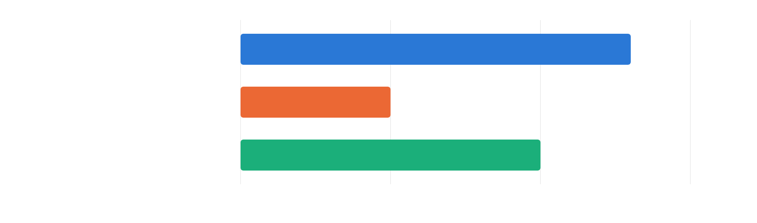
Backup · Q-GEAR speed-ups
34 / 40
Two orders of magnitude faster
speed-up (log scale)
vs CPU node (2 × EPYC 7763), one A100
≈400×
vs Qiskit Aer GPU / PennyLane Lightning
≈10×
QCrank image encoding, small images
→100×
1×
10×
100×
1000×
Random CX-block circuits (28–34 q, 100–10,000 gates) · QFT ≤ 22 q · QCrank image encoding.
Backup
Notes:
Across the benchmark suite the GPU path is about two orders of magnitude faster than the CPU node and about an order of magnitude faster than the existing GPU simulators, Aer GPU and Lightning, with essentially no code changes for the user. On QCrank image-encoding circuits, which matter for Chapter V, the speed-up approaches a hundredfold for small images.

Slide 35
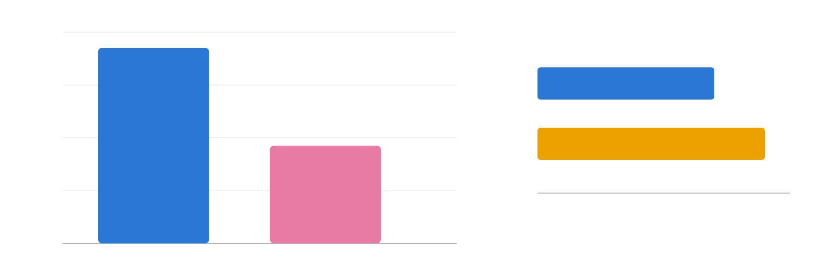
Backup · DEAL on Heron-2
35 / 40
…and on Heron-2
success-rate gain of DEAL over QAOA at layer 10 (percentage points)
+16
+14.81 pts
layers needed for the same success rate
DEAL
+12
7 layers
QAOA
+8
+7.40 pts
9 layers
+4
0
2
4
6
8
10
circuit layers p
+0
Torino · Heron-1 · 133 q
Marrakesh · Heron-2 · 156 q
IBM Marrakesh (156-qubit Heron-2): +7.40 pts at layer 10. Both devices degrade beyond ≈41–43 CZ gates.
Backup
Notes:
The second device, the 156-qubit Marrakesh, confirms the direction with a smaller gain of 7.4 points. The gap between the two devices is itself informative: the benefit of the direct mapping shrinks as the device gets closer to the CZ budget, which is why the adaptive layer selection is part of the method.

Slide 36
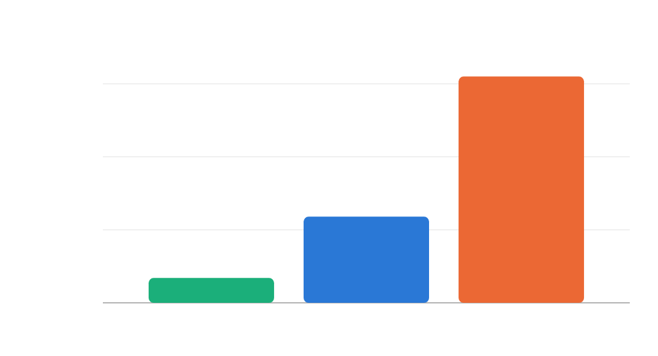
Backup · VQT on hardware
36 / 40
Attention estimated on real QPUs
RMSE of the attention estimate (lower is better)
0.155
0.15
HARDWARE RUNS
4–9 qubits
batches 4–128 · 10K–320K shots · CNOT depth 5–129
0.10
0.059
GAP TO IDEAL
0.05
0.017 → 0.059 → 0.155
0.017
ideal simulator, IBM Kingston, IonQ Aria-1
0.00
ideal simulator
IBM Kingston
IonQ Aria-1
batch 32
batch 32
batch 8
Backup
Notes:
The primitives run on real hardware. The ideal simulator gives an RMSE of 0.017 at batch 32; IBM Kingston reaches 0.059 at the same batch, and IonQ Aria-1 0.155 at batch 8. Circuits used four to nine qubits and up to 320 thousand shots, with CNOT depth from 5 to 129, so the deeper configurations are already probing the depth budget from Chapter IV.

Slide 37
Backup · Standards mapping
37 / 40
Where the audit meets the standards
Standard
Governs today
What the QEC audit needs
FIPS 140-3
module boundary · self-tests
validated boundary around seed generation and encoder sampling
SP 800-90A
approved DRBGs
per-run HSE seed from an approved DRBG
FIPS 203 · ML-KEM
post-quantum key encapsulation
seeds and jobs protected in transit
FIPS 204 · ML-DSA
FIPS 205 · SLH-DSA
post-quantum signatures
attest which encoder ran
Backup
Notes:
The paper closes by placing the audit next to the standards that already govern classical randomness. FIPS 140-3 defines the module boundary and self-tests; SP 800-90A defines approved random-bit generators, which is where the seeds must come from; and the three 2024 post-quantum standards protect the seeds, jobs and results in transit. That mapping is the bridge into Chapter VIII.

Slide 38
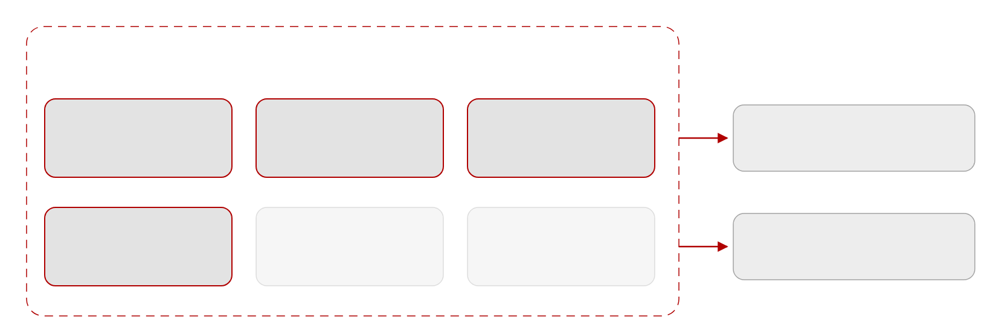
Backup · QPC SDK
38 / 40
One boundary for keys and seeds
FIPS 140-3 module boundary · Light Rider QPC SDK v1.0.0
consumers
Linux x86_64 · 1.1 MB · CC-BY-4.0 · Zenodo, Aug 2026
ML-KEM
ML-DSA
SLH-DSA
signed jobs
FIPS 203 · key encapsulation
FIPS 204 · lattice signatures
FIPS 205 · hash signatures
encapsulated · cloud QPU · HPC center
DRBG
self-tests
module search
seeds → HSE encoder
SP 800-90A · seeds
power-up & conditional
discover & select algorithms
reseeded QEC (Chapter VII)
Backup
Notes:
The module implements the three 2024 NIST standards, ML-KEM for key encapsulation and ML-DSA and SLH-DSA for signatures, together with an SP 800-90A random-bit generator, self-tests and a module-search feature for discovering and selecting algorithms. Two consumers matter for this dissertation: signed and encapsulated jobs to cloud QPUs, and DRBG seeds for the reseeded encoders of Chapter VII. It is a 1.1-megabyte Linux release archived on Zenodo.

Slide 39
Backup · B1
39 / 40
Hardware used in this dissertation
Device
Type
Qubits
Calibration figure reported
Used in
IBM Torino
Heron-1, superconducting
133
—
DEAL (Ch. IV)
IBM Marrakesh
Heron-2, superconducting
156
—
DEAL (Ch. IV), ShardQ (Ch. V)
IBM Pittsburgh
Heron-3, superconducting
156
1.46 × 10⁻³ median CZ error
QAWA (Ch. IV), ShardQ (Ch. V)
IBM Boston
Heron-3, superconducting
156
—
NNQA (Ch. V)
IBM Kingston
Heron, superconducting
—
—
VQT (Ch. V), NNQA
IBM Miami
Nighthawk, superconducting
—
—
NNQA (Ch. V)
IonQ Aria-1
trapped ion
—
—
QPIE, VQT (Ch. V)
IonQ Forte / Forte-1
trapped ion
36
—
NNQA, RubriQ validation (Ch. V, VI)
Amazon Braket SV1
state-vector simulator
—
—
QPIE (Ch. V)
NERSC Perlmutter
A100 40 GB / 80 GB nodes
—
—
Q-GEAR, ShardQ, NNQA training, RubriQ (Ch. III, V, VI)
Per-device T1/T2 and error tables are in the individual papers; dashes mark values not reproduced here.
Backup
Notes:
Backup: the hardware table. Ten backends across IBM Heron and Nighthawk processors, IonQ trapped-ion systems, the Braket simulator and Perlmutter. Where the papers state a calibration figure I reproduce it; otherwise the cell is a dash.

Slide 40
Backup · B5
40 / 40
Reproducibility and artifacts
Work
Repository / archive
Contents
Q-GEAR
github.com/gzquse/qgear · gzquse/cudaq-perlmutter
nbdev package, Apache-2.0, 241 commits; multi-node CUDA-Q scripts for Perlmutter
QPIE
github.com/gzquse/QPIE_datacircuit
PennyLane Dockerfile, PyTorch 24.06 Shifter container, inference scripts
DEAL
github.com/gzquse/DEAL_QUBO
distributed training, D-Wave Leap baseline, Qiskit GPU kernel, IBM job tracking
VQT
github.com/gzquse/quantum-transformer · gzquse/paper_AAAI2025-quantum · gzquse/vectorized_encoding
model code, figure reproduction, Mathematica derivations
ShardQ · QAWA · NNQA
github.com/gzquse/ShardQ_v2 · gzquse/qawa_data_circ · gzquse/nnqa
SparseCut and MPS knitting (MIT); QAWA_v2.py; NNQA toolkit and cloud jobs
RubriQ
github.com/gzquse/rubriq-artifact · Zenodo 10.5281/zenodo.21284556
GRPO fine-tuning, 21 evaluator tests; archived artifact, CC-BY-4.0
Nonlinear waves
Zenodo 10.5281/zenodo.21245905 (SplitStepQUDE)
code and data for the split-step solver, CC-BY-4.0 / Apache-2.0
QEC audit
anonymous.4open.science/r/usenix_qec_hse-32FE · gzquse/ExploreQEC_mar
containerized, seeded, deterministic audit; Stim/Qiskit/Guppy toolboxes
QPC SDK
Zenodo 10.5281/zenodo.21895102
v1.0.0, Linux x86_64, 1.1 MB, CC-BY-4.0
Backup
Notes:
Backup: where everything lives. Every chapter has a public repository, and three artifacts are archived on Zenodo with DOIs. The QEC audit artifact is containerized and seeded so that the reported numbers are deterministic.

