Slide 1

Texas Tech University
Department of Computer Science
Quantum Computing and Circuit Simulation
Ziqing Guo
Thesis Committee: Dr. Ziwen Pan (Research Advisor)
Professor Zihao Zhan · Dr. Susan Mengel · Dr. Lu Wei
Dean’s representative: Dr. Anne E. V. Gorden
Notes:
Good morning, and thank you to the committee for being here: Dr. Pan, Dr. Zhan, Dr. Mengel, Dr. Wei, and Dr. Gorden representing the Graduate School. My dissertation argues that useful quantum computation is delivered by a co-designed stack, not by a quantum processor alone. Over the next fifty minutes I will walk through five layers of that stack and the ten papers behind them.

Slide 2
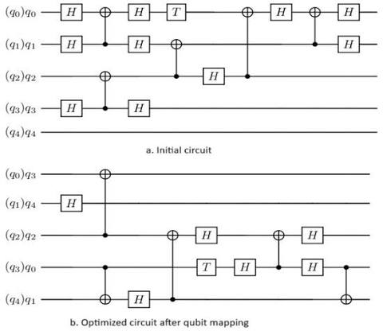


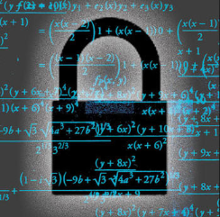
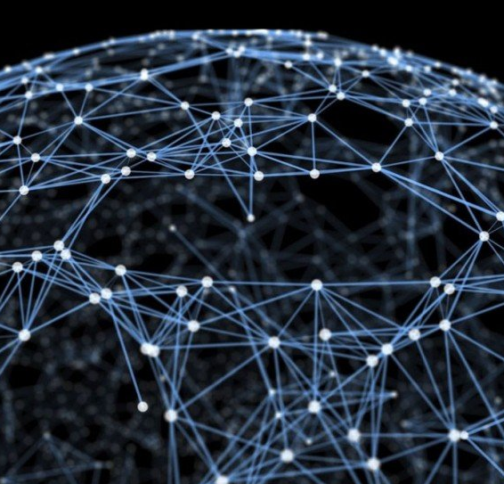
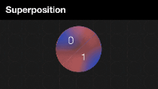
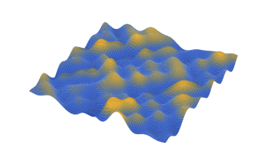
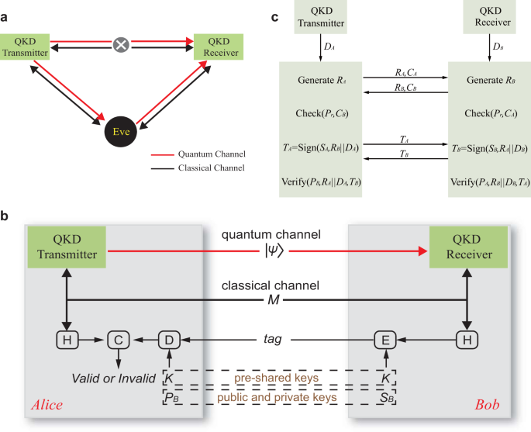
2 / 68
Computing in Quantum
Notes:
This is the thesis in one sentence, taken verbatim from the dissertation. The word to underline is co-designed: HPC is not a stopgap until hardware improves, it is a permanent part of how quantum programs are developed, run and trusted. Each of the following sections adds one layer to that stack.

Slide 3
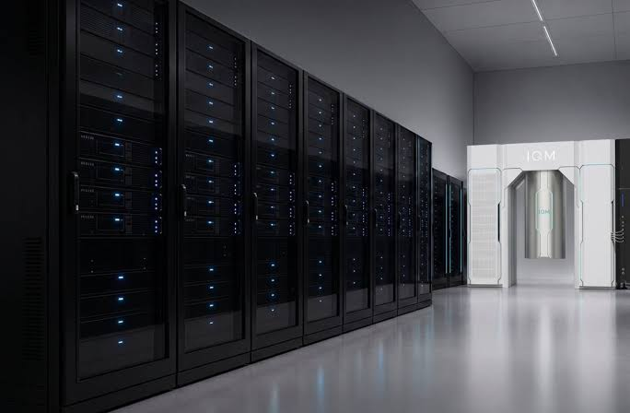
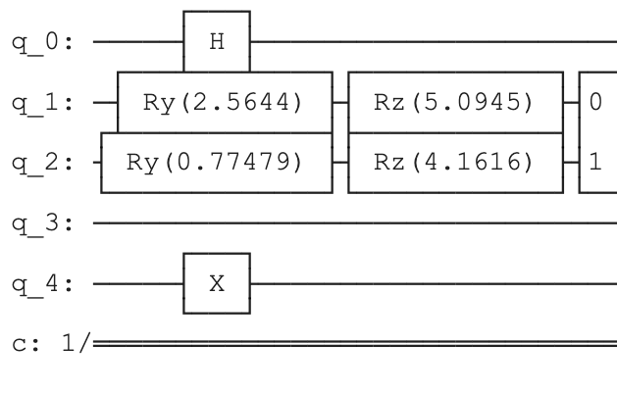
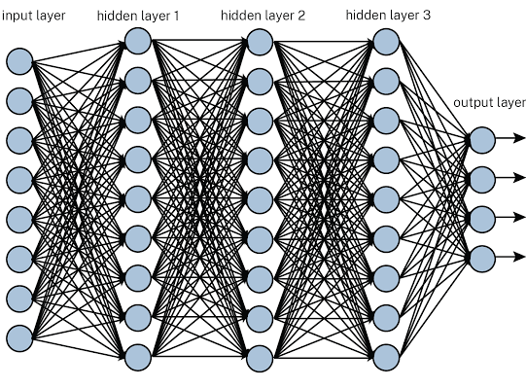
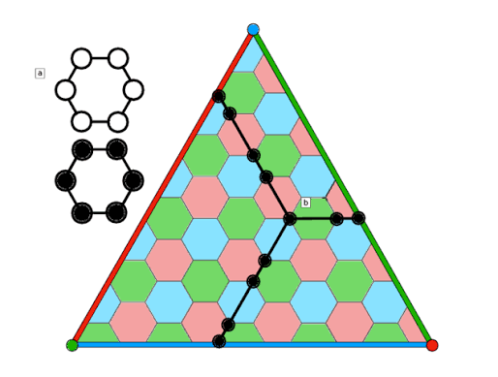
Five layers around the QPU
3 / 68
01 · RQ1 · Scale
02 · RQ2 · Noise
03 · RQ3 · Data
04 · RQ4 · Synthesis
05 · RQ5 · Trust
Simulation
Algorithms
LLMs
Synthesis
Trust
GPU simulation beyond hardware reach
Structure from problem and device, not black-box search
AI/HPC synthesis within fault-tolerant budgets
Auditable QEC and post-quantum cryptography
Introduction
Notes:
These five cards are the map for the whole talk. Simulation: GPU-accelerated simulation to develop, verify and calibrate circuits at scales the hardware cannot yet reach. Algorithms: hardware-aware design that replaces black-box variational optimization with structure from the problem and the device. Data encoding: structured, vectorized encodings that make the classical–quantum interface efficient and learnable. Synthesis: AI/HPC-driven synthesis toward fault-tolerant resource budgets. Trust: security-aware error correction and post-quantum cryptography on shared cloud hardware. they will come back as a small rail on every section divider so you always know where we are. Layers one and two are about scale and noise, layer three is the data interface, layer four is synthesis and cost, and layer five is trust. Each layer maps onto exactly one research question.

Slide 4
Agenda
4 / 68
Where we are going
I–II
Motivation
Four walls · five questions
III
Simulation
Q-GEAR · Qiskit → CUDA-Q on Perlmutter
IV
Algorithms
DEAL · QAWA on IBM Heron
V
Data encoding
QPIE · VQT · ShardQ · NNQA
VI
Synthesis
RubriQ · measure–reload cost accounting
VII–VIII
Trust
QEC randomness audit · PQC module
IX
Closing
Answers · limits · next steps
Introduction
Notes:
The agenda follows the chapter order of the dissertation. I will spend the most time on Chapters III and V, which carry the largest experimental results, and keep the security chapters compact. Backup slides hold the hardware tables and pseudo-code if the committee wants detail.

Slide 5
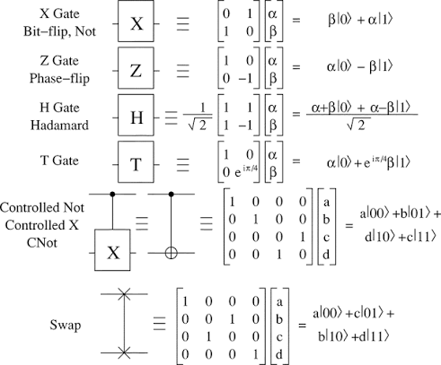
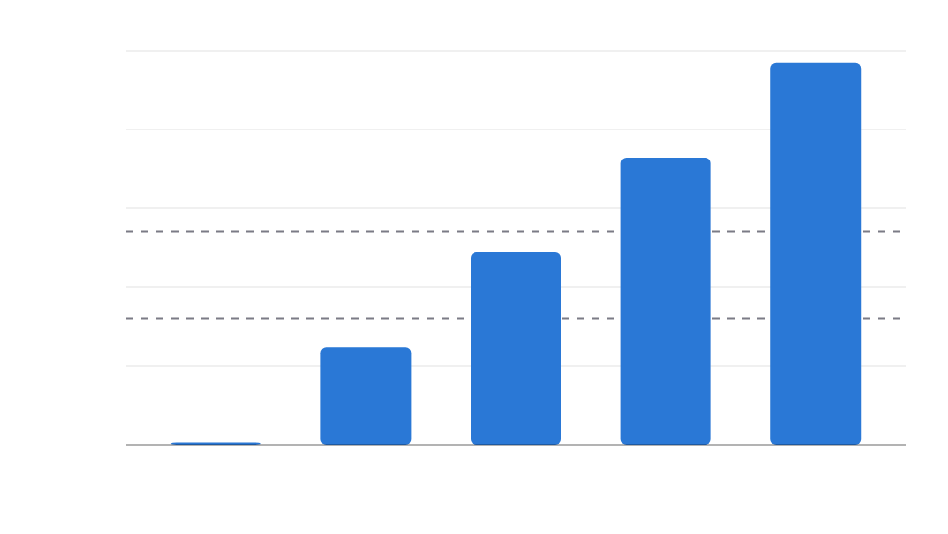
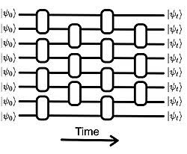
gate-based quantum computing
5 / 68
Background: classical QC simulation
state-vector memory (2ⁿ × 16 B, log scale)
2^{n} × 16 B
100 TB
70 TB
10 TB
4.4 TB
state-vector memory doubles with every qubit
1 TB
CPU node · 512 GB
275 GB
100 GB
A100 · 40 GB
42 q ≈ 70 TB
17 GB
10 GB
one 40 GB A100: 32 qubits · one CPU node: 34 qubits in ≈24 h
1.1 GB
1 GB
26
30
34
38
42
qubits n
Nielsen, Michael A., and Isaac L. Chuang. Quantum computation and quantum information. Vol. 1. Cambridge: Cambridge university press, 2000.
Introduction
Notes:
Exact state-vector simulation is the reference tool for developing and verifying circuits, but its memory doubles per qubit. At 42 qubits the state alone is about seventy terabytes in double precision, far beyond any single node. The question for RQ1 is how far HPC can push this and whether a Qiskit program can use that capability without being rewritten.

Slide 6
Motivation · Noise
6 / 68
Noise punishes depth and iteration
Gates cost fidelity; optimizer steps cost shots.
1.46×10⁻³
≈41–43
10²–10³
median CZ error, IBM Heron-3 (best device used)
CZ gates before 20-qubit circuits degrade on Heron
executions per polynomial fit, black-box VQE — vs 1 for NNQA
Statevector
Density matrices
Tensor networks (MPS)
Stablizer pauli frame tracking / extended stablizers
Introduction
Notes:
The second wall is noise. Even on the best Heron processor we used, the median two-qubit error is about one and a half per mille, so a 20-qubit optimization circuit stops improving after roughly forty CZ gates. Black-box variational loops multiply this cost by hundreds of executions. RQ2 asks how to exploit problem and hardware structure instead.

Slide 7
Motivation · Data and trust
7 / 68
Two walls that are easy to forget
RQ3 · DATA
RQ5 · TRUST
The classical–quantum data interface
Trust on shared cloud QPUs
Load N values: Θ(N) CNOTs · read n-qubit correlations: O(n²) measurements
A fixed, public QEC encoder is a reusable target · no standard audits QEC randomness
How to load ”quantum data”; in other way how do we make quantum computing useful?
QPU is noisy what are the results looks like?
Introduction
Notes:
Two further walls motivate the later chapters. The data interface: loading N values needs Θ(N) CNOTs even with a vectorized QCrank-style loader, and reading n-qubit correlations back by tomography needs O(n²) measurements, so getting data into and out of a QPU dominates the cost of quantum learning. And trust: once error-corrected computation runs on shared cloud hardware, a fixed public encoder gives a co-located fault-injection adversary a reusable target. FIPS 140-3 and SP 800-90A govern classical randomness, but nothing yet audits the randomness inside quantum error correction. These motivate RQ3 and RQ5.

Slide 8
Five research questions
8 / 68
What this dissertation asks
Simulation
How far can HPC push exact simulation — without rewriting the program?
RQ1 · Scale
Algorithms
Can NISQ optimization use problem and device structure instead of black-box search?
RQ2 · Noise
Data encoding
How should data enter and leave a QPU so learning is shot-efficient, hardware-compatible, trainable?
RQ3 · Data
Synthesis
Can learned synthesis meet fault-tolerant budgets — and what does honest accounting say?
RQ4 · Synthesis
Trust
How do we audit and secure error-corrected computation on shared cloud QPUs?
RQ5 · Trust
Trace back to my research
Introduction
Notes:
The five research questions, abridged on the slide; verbatim from the dissertation: RQ1 — How far can classical HPC push exact circuit simulation, and how do we make that capability usable without rewriting quantum programs? RQ2 — How can optimization algorithms on NISQ devices exploit problem and hardware structure instead of black-box parameter search? RQ3 — How should classical data enter and leave a quantum processor so that learning models are shot-efficient, hardware-compatible and trainable? RQ4 — Can learned, HPC-scale synthesis produce circuits that respect fault-tolerant resource budgets, and what does honest cost accounting say about end-to-end quantum advantage? RQ5 — How do we make error-corrected computation on shared cloud QPUs auditable and secure, and how does that connect to post-quantum cryptography standards? Each one is answered by one chapter, and I will return to this list at the end with the answers.

Slide 9
Contributions at a glance
9 / 68
Ten papers, one software release
III
Simulation
Q-GEAR · 42 qubits on 1,024 A100s · ≈400× vs CPU
IV
Algorithms
DEAL · QAWA · direct angles, adaptive ZNE, O(n) traceable oracle
V
Data encoding
QPIE · VQT · ShardQ · NNQA · vectorized encodings
VI
Synthesis
RubriQ · 3.31× T-gate compression · nonlinear-wave cost model
VII–VIII
Trust
QEC audit · −86.7% disturbance · FIPS 140-3 PQC module
ICPP ’25
QST 2025
IEEE QCE ’25
AAAI Symposium ’25
6 arXiv preprints 2025–26
Zenodo software release 2026
Introduction
Notes:
Ten papers and preprints plus one software release map onto the five layers. Four are peer-reviewed and published, at ICPP, Quantum Science and Technology, IEEE QCE and the AAAI Symposium Series; six are preprints from 2025 and 2026, one of them under review at npj Quantum Information. Let me now go layer by layer.

Slide 10
10 / 68
HPC previous work about large scale simulation how do we leverage?
Chapter III · RQ1 Scale
Q-GEAR
GPU-accelerated circuit simulation at HPC scale
Guo, Balewski, Pan · ACM ICPP 2025 · arXiv:2504.03967 · github.com/gzquse/qgear
III · Q-GEAR
01
Simulation
02
Algorithms
03
Data encoding
04
Synthesis
05
Trust
Notes:
Layer one: simulation. Q-GEAR, published at ICPP 2025 with Jan Balewski from NERSC, is the framework that lets a Qiskit circuit run on NVIDIA GPUs at Perlmutter scale without a rewrite. This chapter answers RQ1.

Slide 11
Problem
11 / 68
Same circuit, new hardware, no rewrite
Researchers write Qiskit. Fast simulators want something else.
CPU BASELINE
GPU SIMULATORS
GOAL
2× AMD EPYC 7763
Fast, but fragmented
Transform, containerize, scale
128 cores · 512 GB · 34 qubits ≈ 24 h
CUDA-Q, Aer GPU, Lightning — each wants its own program
Keep Qiskit · generate CUDA-Q kernels · containers for Slurm on Perlmutter
III · Q-GEAR
Notes:
The starting point is practical. Our baseline CPU node, two EPYC 7763 processors with half a terabyte of memory, needs a day for a 34-qubit random circuit. GPU simulators are much faster, but each expects a different program. Q-GEAR's goal is to keep the Qiskit program and automate the rest.

Slide 12
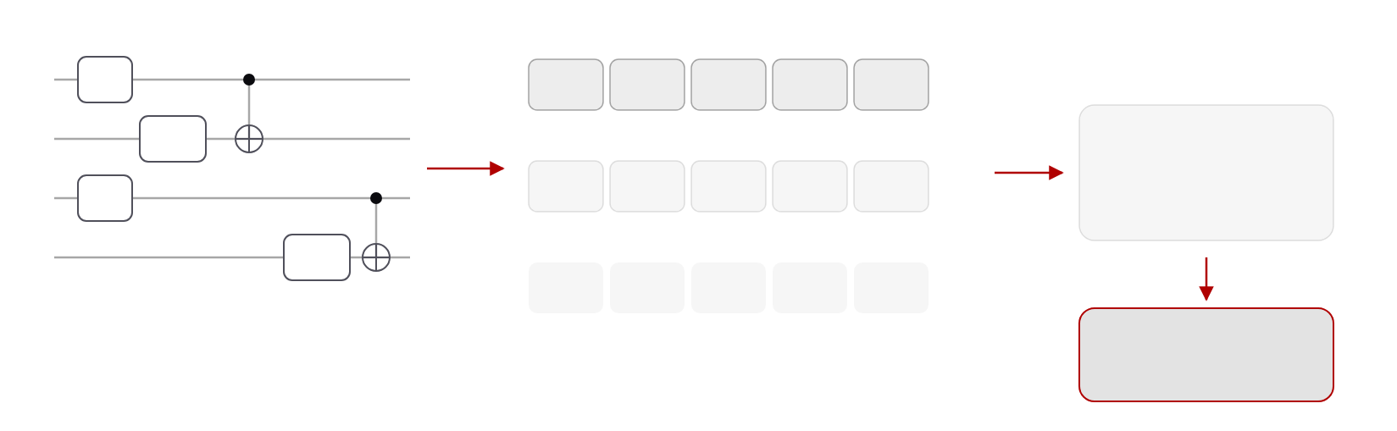
Design
12 / 68
Circuits become three tensors
gate-type tensor
int · which gate
q0
H
H
RY
CX
RZ
CX
…
q1
RY
qubit-index tensor
int · control / target
HDF5 file
q2
H
0
1
0,1
3
2,3
…
portable, versioned
parameter tensor
float · rotation angles
q3
RZ
–
θ₁
–
θ₂
–
…
Qiskit circuit (H, RY, RZ, U3, CX, CP, SWAP, measure)
CUDA-Q kernel
generated per circuit
Supported gates: H, RY, RZ, U3, CX, CP, SWAP, measure.
III · Q-GEAR
Notes:
The transformation starts by flattening the circuit into three aligned tensors: which gate, which qubits, and which angles. The encoding is stored in HDF5, so the same file can drive a CPU run, a single-GPU run, or a thousand-GPU run. From it we generate a CUDA-Q kernel automatically for the gate set shown at the bottom.

Slide 13
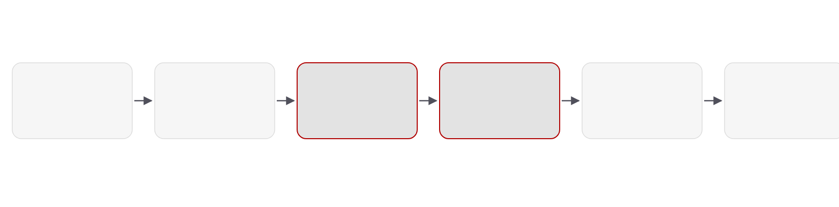
Design
13 / 68
The kernel transformation pipeline
Qiskit circuit
Parse
Encode
Generate
Package
Run
user code, unchanged
gate set check
three tensors → HDF5
CUDA-Q kernel
Podman / Shifter
Slurm · multi-GPU MPI
Q-GEAR automates the four middle stages.
python · nbdev · Apache-2.0 · github.com/gzquse/qgear
III · Q-GEAR
Notes:
End to end, the pipeline has six stages, and Q-GEAR automates the four in the middle. The two highlighted stages, encoding and kernel generation, are the contribution; packaging in Podman or Shifter containers is what makes the result reproducible on Perlmutter's Slurm scheduler.

Slide 14
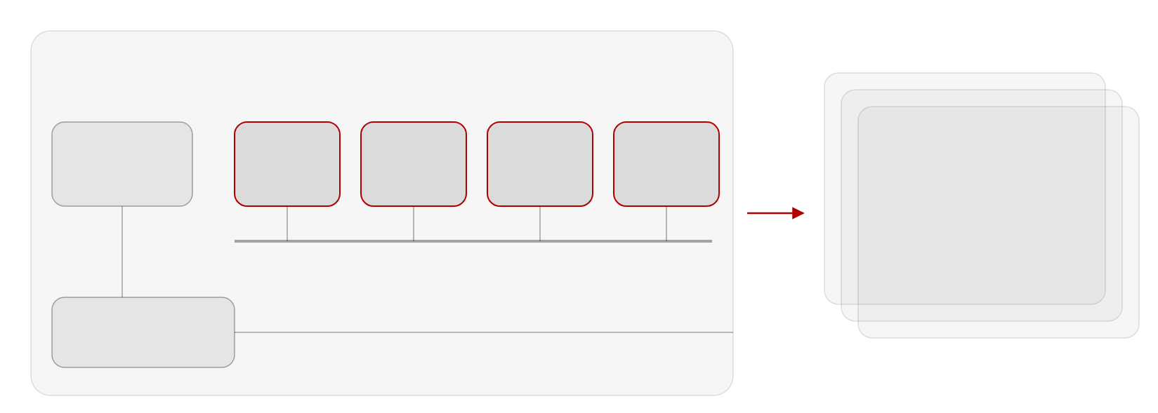
Deployment
14 / 68
One node to a thousand GPUs
Perlmutter GPU node
1 × AMD EPYC CPU · 4 × NVIDIA A100 (40 GB) · NVLink · Slingshot NIC
CPU
A100 #0
A100 #1
A100 #2
A100 #3
… × 256 nodes
AMD EPYC
40 GB
40 GB
40 GB
40 GB
1,024 A100 GPUs · MPI
42-qubit state vector in
aggregate GPU memory
NVLink · state vector sharded across the four GPUs (CUDA-Q multi-GPU)
≈100% GPU utilization
Slingshot NIC
to other nodes
III · Q-GEAR
Notes:
Each Perlmutter GPU node has four 40-gigabyte A100s connected by NVLink, and CUDA-Q's multi-GPU backend shards the state vector across them. Beyond one node, MPI over the Slingshot interconnect lets us aggregate memory across nodes: 256 nodes give 1,024 GPUs, which is where the 42-qubit runs happened at close to full GPU utilization.

Slide 15
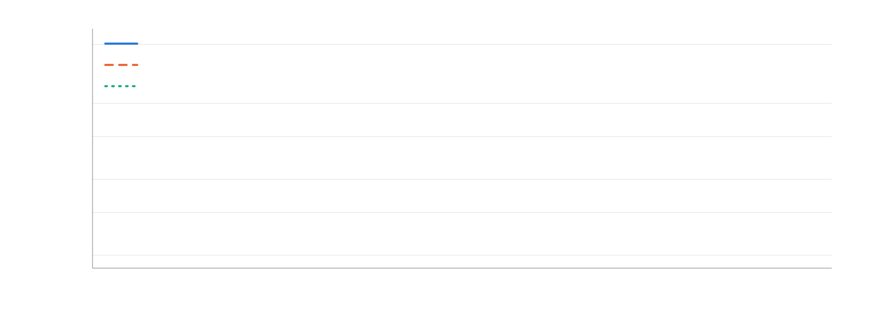
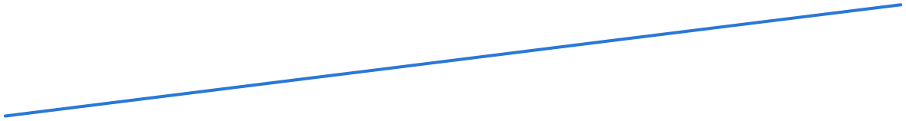
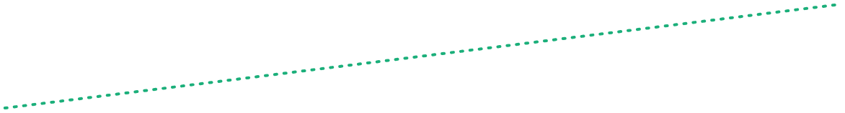

Results
15 / 68
Hours become minutes
wall time, random CX-block circuit (log scale)
≈24 h
24 h
CPU node (128 cores)
1 × A100 (40 GB)
4 × A100 (MPI)
1 h
10 min
≈1 min
1 min
10 s
1 s
28
30
32
34
qubits
Anchors: 34 q ≈ 24 h (CPU) vs ≈ 1 min (4 × A100); ≈400× on one A100. Lines follow 2ⁿ scaling; intermediate points illustrative.
III · Q-GEAR
Notes:
This is the headline scaling result. The 34-qubit random circuit that takes a day on the CPU node runs in about a minute on four A100s within one node. A single A100 is roughly four hundred times faster than the CPU but tops out at 32 qubits because of its 40 gigabytes. The lines between the reported anchor points follow the two-to-the-n scaling law and are illustrative.

Slide 16
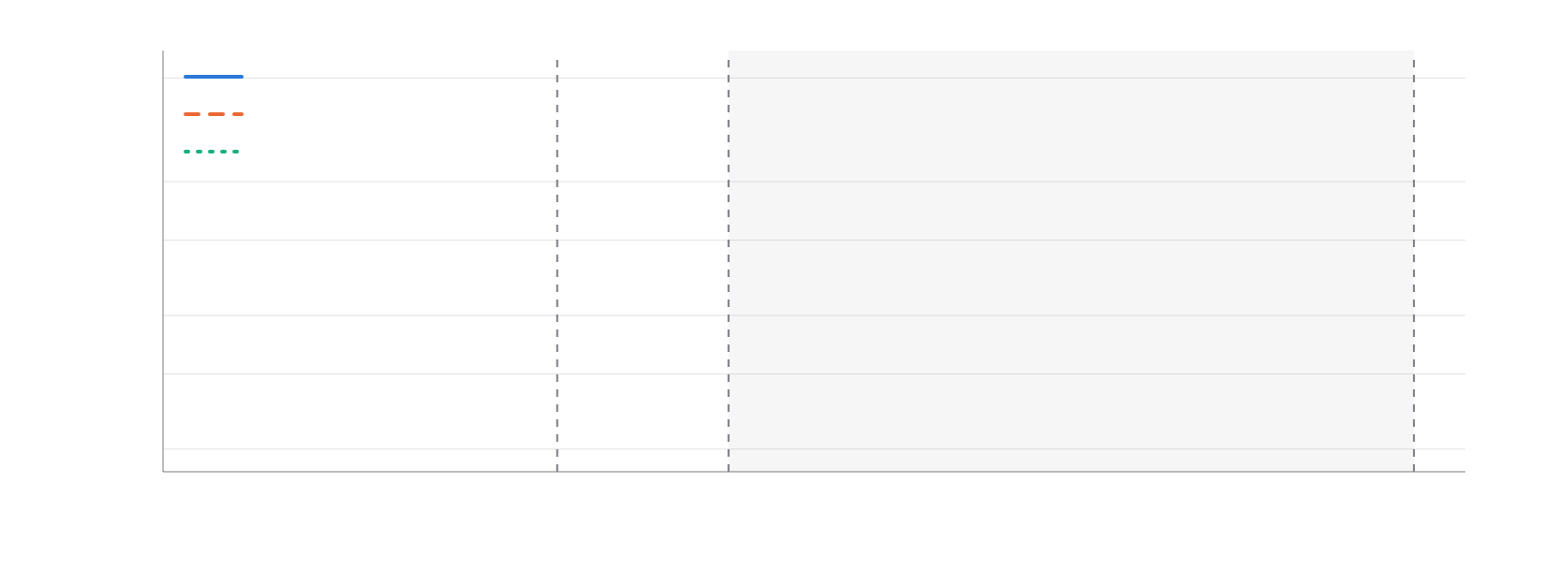
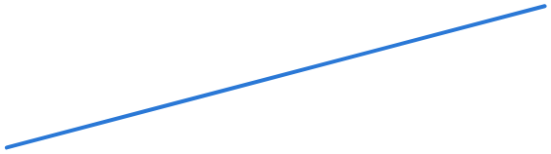
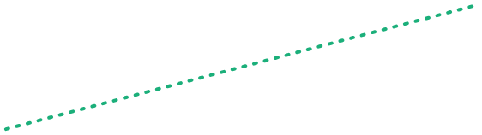

Results
16 / 68
42 qubits on 1,024 A100s
wall time, random CX-block circuit (log scale)
≈24 h
24 h
CPU node (128 cores)
1 × A100 (40 GB)
4 × A100 (MPI)
1 h
10 min
multi-node CUDA-Q (MPI)
≈1 min
up to 1,024 × A100 · ≈100% GPU utilization
1 min
10 s
34 q · 4 × A100 (one node)
1 s
32 q · 1 × A100 (40 GB)
42 q · 1,024 × A100
28
30
32
34
36
38
40
42
qubits
Axis extended to the largest run: 42 qubits on 1,024 A100s (CUDA-Q MPI, ≈100% GPU utilization).
III · Q-GEAR
Notes:
Extending the axis shows the reach of each configuration: 32 qubits on one GPU, 34 on one node, and 42 qubits across 1,024 GPUs using CUDA-Q's MPI backend. GPU utilization stayed close to one hundred percent, which is the practical evidence that the containerized pipeline is not leaving the hardware idle.

Slide 17
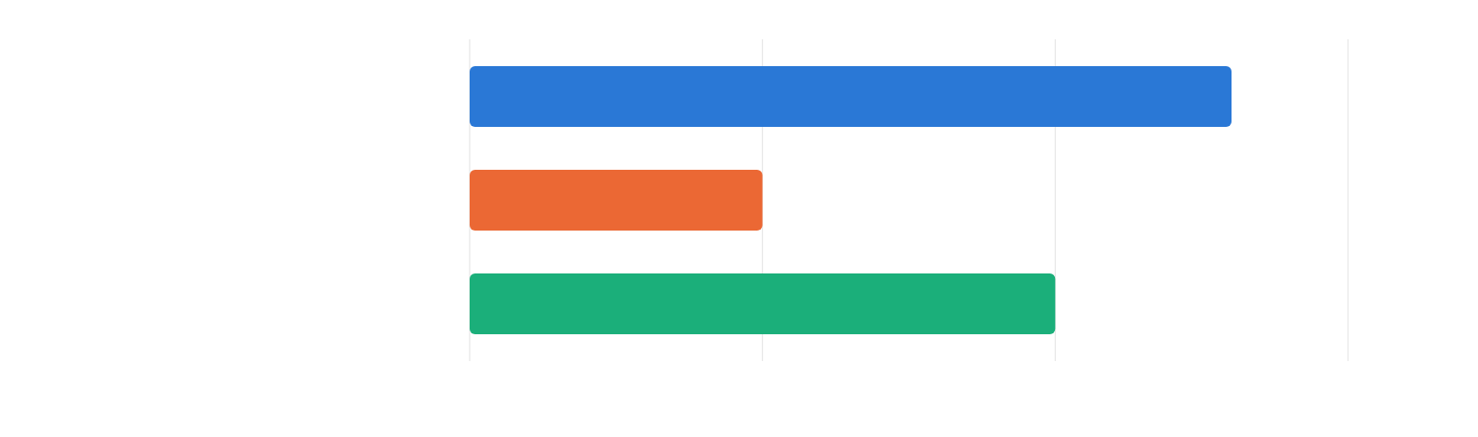
Results
17 / 68
Two orders of magnitude faster
speed-up (log scale)
vs CPU node (2 × EPYC 7763), one A100
≈400×
vs Qiskit Aer GPU / PennyLane Lightning
≈10×
QCrank image encoding, small images
→100×
1×
10×
100×
1000×
Why it is faster CUDA-Q + Podman HPC
Random CX-block circuits (28–34 q, 100–10,000 gates) · QFT ≤ 22 q · QCrank image encoding.
III · Q-GEAR
Notes:
Across the benchmark suite the GPU path is about two orders of magnitude faster than the CPU node and about an order of magnitude faster than the existing GPU simulators, Aer GPU and Lightning, with essentially no code changes for the user. On QCrank image-encoding circuits, which matter for Chapter V, the speed-up approaches a hundredfold for small images.

Slide 18
Benchmark suite and takeaway
18 / 68
RQ1: 42 qubits, program unchanged
Benchmark
Qubits
Two-qubit gates
Reported result
Random CX-block circuits
28–34
100 – 10,000
≈1 min on 4 × A100 vs ≈24 h on CPU · ≈400× on one A100
Quantum Fourier transform
≤ 22
—
same pipeline, program unchanged
QCrank image encoding
small images
—
→ 100× speed-up
Largest run
42
—
1,024 × A100 · ≈100% GPU utilization
Reused downstream: validates DEAL circuits (Ch. IV) · evaluator inside RubriQ (Ch. VI)
III · Q-GEAR
01
Simulation
02
Algorithms
03
Data encoding
04
Synthesis
05
Trust
Notes:
To summarize Chapter III: the same Qiskit program reaches 42 qubits, and the benchmark table shows the three circuit families we timed. The framework is not a one-off: it validated the DEAL circuits in the next chapter before they went to hardware, and it is the simulator inside RubriQ's reinforcement-learning loop in Chapter VI.

Slide 19
28 / 68
Chapter V · RQ3 Data
Quantum Information thoery
Vectorized encodings for quantum learning
QPIE · Quantum Sci. Technol. 10 (2025) · VQT · AAAI Symposium Series 7 (2025) · ShardQ · arXiv:2511.05492 · NNQA · arXiv:2603.27297
V · Quantum learning
01
Simulation
02
Algorithms
03
Data encoding
04
Synthesis
05
Trust
Notes:
Layer three is the data interface, and it is the largest chapter: four papers. QPIE is a hybrid network published in Quantum Science and Technology; VQT is a quantum transformer from the AAAI Symposium Series; ShardQ cuts and knits encoding circuits; and NNQA compiles trained polynomial networks into exact quantum arithmetic. All four answer RQ3.

Slide 20
Problem
29 / 68
Getting data in and out is the cost
Shot-efficient, hardware-compatible, trainable — at the same time.
SHOT-EFFICIENT
HARDWARE-COMPATIBLE
TRAINABLE
Reading out costs shots
Loading costs depth
Gradients must exist
Variance p(1−p)/S per value · attention needs B·T² values
Θ(N) CNOTs for N values · deep loaders must be cut and mitigated
Barren plateaus · parameters from classical training or learnable heads
V · Quantum learning
Notes:
The data interface has three requirements that pull against each other. Readout costs shots: every estimated value carries shot variance p(1−p)/S, and attention over B sequences of length T means B·T² values, which cannot be estimated one by one. Loading costs circuit depth: a vectorized QCrank loader needs Θ(N) CNOTs for N values, and on Heron with ≈1.5×10⁻³ CZ error deep loaders must be cut, compiled and mitigated. And training needs gradients that do not vanish: barren plateaus and black-box ansätze make training fragile, so we want parameters that come from classical training or learnable, well-conditioned heads. The four papers in this chapter each take one corner of that triangle, and they share one building block: the QCrank vectorized encoding, which I will show first.

Slide 21
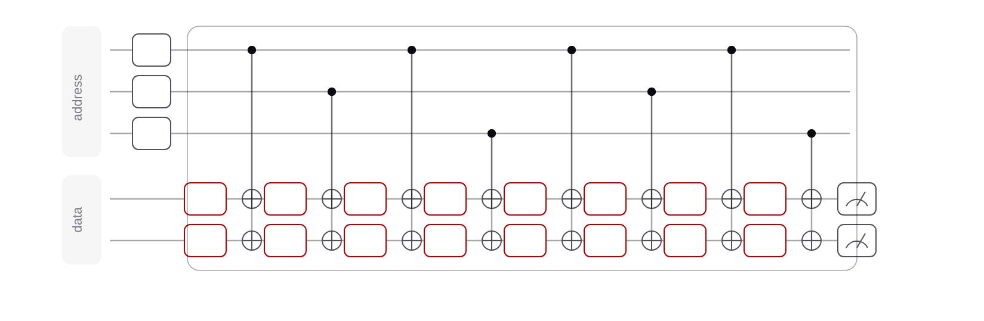
Building block
30 / 68
QCrank: vectorized data encoding
a0
H
a1
H
a2
H
d0
RY
RY
RY
RY
RY
RY
RY
RY
d1
RY
RY
RY
RY
RY
RY
RY
RY
θ0
θ1
θ2
θ3
θ4
θ5
θ6
θ7
N = 2ⁿᵃ · n_d values · Θ(N) CNOTs · all addresses in parallel
uniformly controlled rotations: 2ⁿᵃ angles per data qubit
Address qubits index the values; data qubits carry them as angles. Shared by Q-GEAR, QPIE, VQT, ShardQ, QAWA. A 1,000-pixel image: 9 + 2 qubits.
V · Quantum learning
Notes:
QCrank, due to Balewski and colleagues at Berkeley Lab, is the encoding this chapter builds on. Address qubits in uniform superposition index the values; each data qubit carries two-to-the-n-a values as rotation angles through a uniformly controlled rotation. The circuit is linear in the number of values and processes all addresses in parallel, which is what makes vectorized arithmetic possible. A thousand-pixel image needs nine address and two data qubits.

Slide 22
Quantum arithemetic

Slide 23
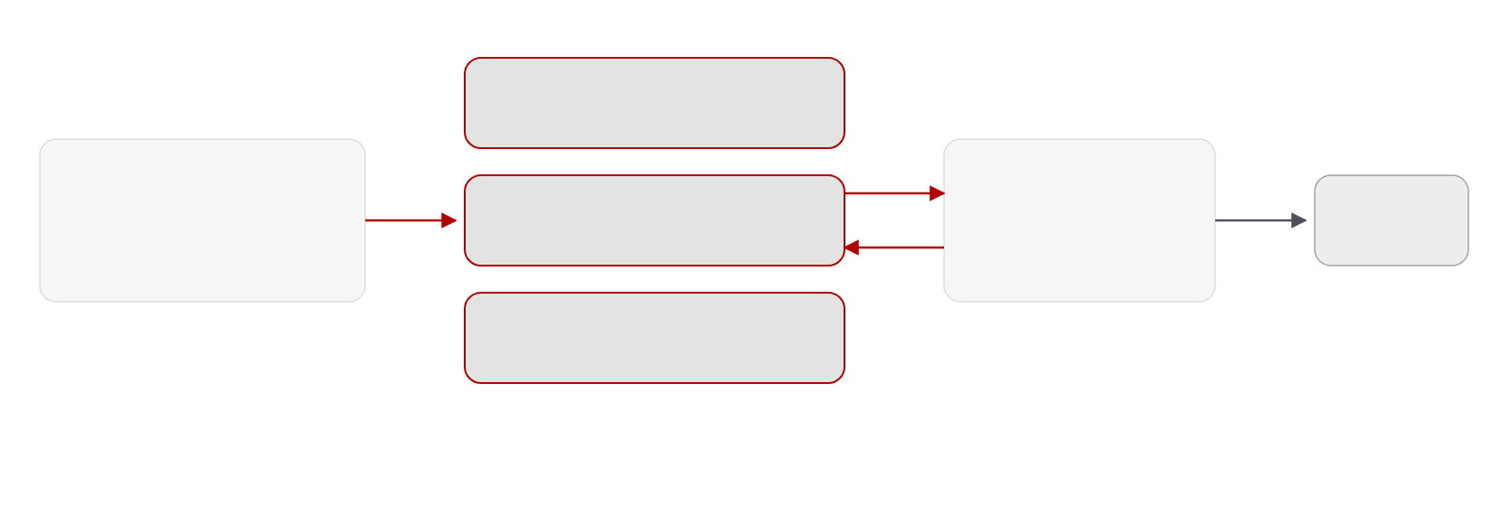
QPIE · Quantum Parallel Information Exchange
31 / 68
A non-sequential hybrid network
variational circuit block 1
10 data + 2 ancilla qubits · non-Clifford gates
in parallel
pretrained classical network
variational circuit block 2
classical branch
output
frozen features · parameters
10 data + 2 ancilla qubits · non-Clifford gates
dense layers
information exchange
variational circuit block 3
10 data + 2 ancilla qubits · non-Clifford gates
up to 28 qubits
gradient selection
parameter-shift rule on QPUs (Braket SV1, IonQ Aria-1) · adjoint differentiation on GPU simulators (A100, up to 30× faster)
V · Quantum learning
Notes:
QPIE is a hybrid network in which the pretrained classical parameters are fed in parallel into several variational circuit blocks, and information is exchanged between the quantum and classical branches rather than stacked sequentially. The gradient rule switches with the backend: parameter shift on real QPUs, adjoint differentiation on GPU simulators, which was up to thirty times faster. Circuits reached 28 qubits.

Slide 24
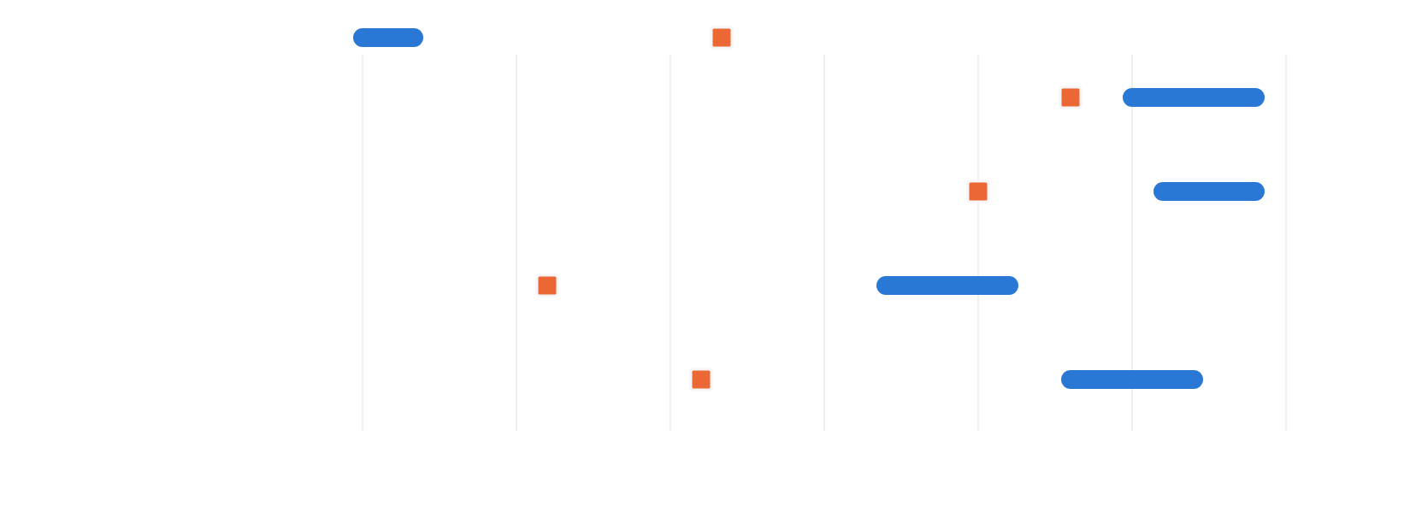
QPIE · Results
32 / 68
Higher accuracy on every benchmark
QPIE (range over runs)
classical transfer-learning baseline
0.93
Moon
0.95–0.99
0.90
Spiral
0.96–0.99
0.76
Brain-tumor MRI
0.87–0.91
0.81
MNIST
0.93–0.97
0.70
0.75
0.80
0.85
0.90
0.95
1.00
test accuracy
Also: ≈88% faster convergence on NARMA5/10 · Fisher eigenvalues ≈16 vs ≈7 (classical).
V · Quantum learning
Notes:
On four benchmarks QPIE beats the classical transfer-learning baseline: the ranges are over repeated runs. The largest gains are on the harder sets, brain-tumor MRI and MNIST, where the baseline sits at 0.76 and 0.81. On stochastic time series the model converged about 88 percent faster within a hundred steps, and the Fisher-information spectrum is less biased, which is our explanation for the trainability.

Slide 25
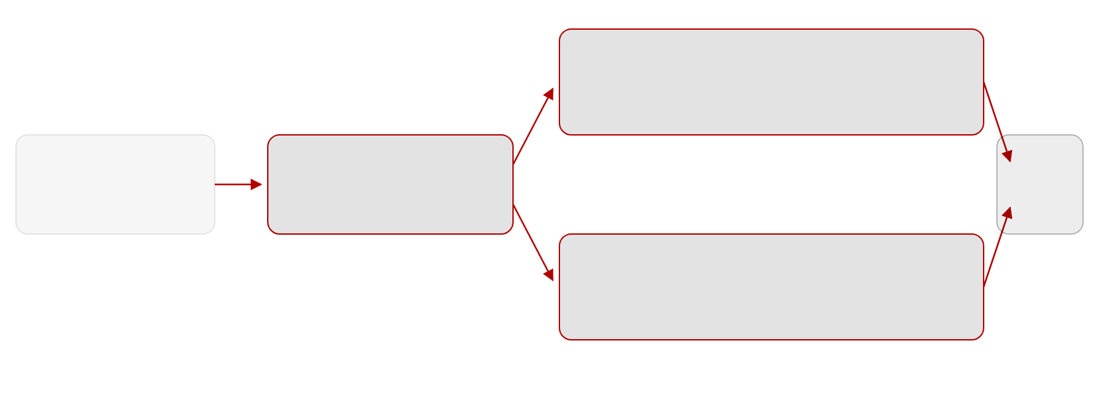
VQT · Vectorized Quantum Transformer
33 / 68
Two shot-efficient primitives
VQDP · vectorized quantum dot product
the whole masked attention matrix in one estimate
O(log(B·T²) · shots) vs O(B·T²·d) classically
token embeddings
QCrank block encoding
output
B sequences × T tokens × d
vectorized · Θ(N) CNOTs
gradient-free
VNQE · vectorized nonlinear encoder
tanh projection head + expressive quantum head
makes the encoding learnable
attention error < 1.2% with 3.0 M shots · variance bound for VQDP proved in the appendix
V · Quantum learning
Notes:
VQT replaces classical self-attention with two primitives built on the same vectorized encoding. The vectorized quantum dot product estimates the whole masked attention matrix at once, with a shot cost logarithmic in the batch-times-sequence-squared size instead of linear. The vectorized nonlinear encoder makes the encoding learnable through a tanh projection head and an expressive quantum head. Attention error stays under 1.2 percent with three million shots, and the appendix proves a variance bound.

Slide 26
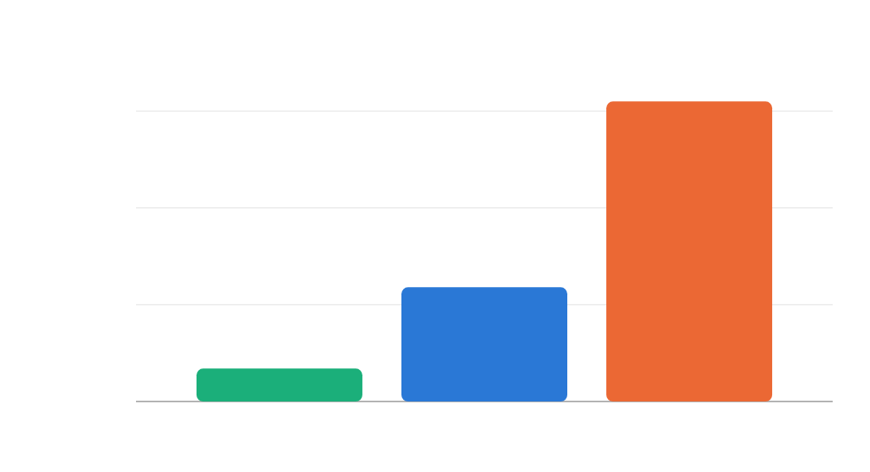
VQT · Hardware
34 / 68
Attention estimated on real QPUs
RMSE of the attention estimate (lower is better)
0.155
0.15
HARDWARE RUNS
4–9 qubits
batches 4–128 · 10K–320K shots · CNOT depth 5–129
0.10
0.059
GAP TO IDEAL
0.05
0.017 → 0.059 → 0.155
0.017
ideal simulator, IBM Kingston, IonQ Aria-1
0.00
ideal simulator
IBM Kingston
IonQ Aria-1
batch 32
batch 32
batch 8
V · Quantum learning
Notes:
The primitives run on real hardware. The ideal simulator gives an RMSE of 0.017 at batch 32; IBM Kingston reaches 0.059 at the same batch, and IonQ Aria-1 0.155 at batch 8. Circuits used four to nine qubits and up to 320 thousand shots, with CNOT depth from 5 to 129, so the deeper configurations are already probing the depth budget from Chapter IV.

Slide 27



VQT · Language modelling
35 / 68
Language modelling, Brown corpus
nanoGPT · 125K params · classical
92.5
Q-LSTM
125.3
Quixer
117.1
Hybrid QT
127.6
VQT · 6 qubits · this work
105.4
0
20
40
60
80
100
120
140
perplexity on the Brown corpus (lower is better)
VQT perplexity 105.4 · nanoGPT 92.5. Colour = model family.
V · Quantum learning
Notes:
Finally a language-modelling test on the Brown corpus. In the order the paper lists them: a 125-thousand-parameter nanoGPT is the classical reference at perplexity 92.5, three prior quantum models sit between 117 and 128, and the six-qubit VQT reaches 105.4. Let me sort these.

Slide 28
VQT · Language modelling
36 / 68
12.9 points behind nanoGPT
nanoGPT · 125K params · classical
92.5
VQT · 6 qubits · this work
105.4
Quixer
117.1
Q-LSTM
125.3
Hybrid QT
127.6
0
20
40
60
80
100
120
140
perplexity on the Brown corpus (lower is better)
Six qubits. VQT beats Q-LSTM 125.3 · Quixer 117.1 · hybrid QT 127.6.
V · Quantum learning
Notes:
Sorted, the picture is clear: VQT is the best of the quantum models and the only one within 13 perplexity points of the classical reference. I do not claim quantum advantage here; the claim is that the vectorized primitives make a quantum transformer trainable and hardware-runnable at all.

Slide 29
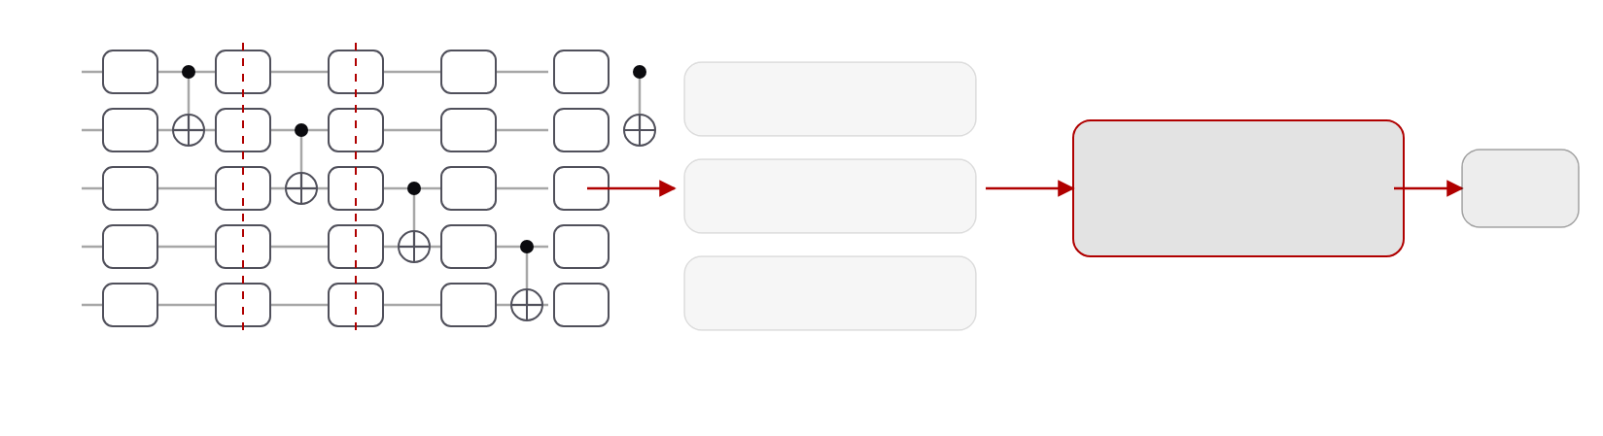
ShardQ · Circuit partitioning and reintegration
37 / 68
Cut where the hardware is worst
q0
RY
RY
RY
RY
RY
sub-circuit 1
q1
RY
RY
RY
RY
RY
global QPD knitting
ŷ
q2
RY
RY
RY
RY
RY
sub-circuit 2
O(3²ᵏ) sampling overhead
q3
RY
RY
RY
RY
RY
q4
RY
RY
RY
RY
RY
sub-circuit 3
cut 1
cut 2
MPS compiler · bounded bond dimension
1.5 M shots per sub-circuit
QCrank encoding circuit · SparseCut picks gate cuts by qubit distance and calibrated CZ error · O(|G| log |G|)
≈15%
0.79 → 0.90
15 s · 24 h
lower RMSE vs standard transpilation, IBM Heron-2/3
image-encoding fidelity, 5 address qubits (0.75 → 0.88 at 7)
knitting: ≤2 cuts on one A100 · 4 cuts on four GPU nodes
V · Quantum learning
Notes:
ShardQ makes the loader hardware-compatible. The deterministic SparseCut algorithm chooses gate cuts using physical qubit distance and calibrated error rates; sub-circuits are compiled with a bounded-bond-dimension MPS compiler; and the outputs are knitted back with a global quasi-probability reconstruction rather than pairwise. On Heron this cuts RMSE by about fifteen percent and lifts image-encoding fidelity from 0.79 to 0.90. The knitting itself is HPC work: two cuts take fifteen seconds on one A100, four cuts a day on four GPU nodes.

Slide 30
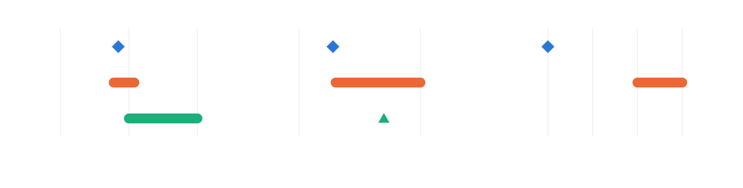
NNQA · Neural-Native Quantum Arithmetic
38 / 68
Compile, do not search
qubits
circuit depth
circuit executions
NNQA
7
NNQA
19
NNQA
1
VQE
6–12
VQE
20–100
VQE
100–1000
QSP
10–100
QSP
50
QSP
not reported
1
10
100
10
100
1
10
100
1000
resource model for a degree-6 polynomial (log scales) · NNQA runs once with 4,096 shots
>99.5% accuracy up to degree 35
36 qubits · depth 70 (IonQ Forte-1 stress test)
RMSE ≤ 0.017 · correlation > 0.999 for degrees 1–30
pass rates 74–86% Heron-3 · 92–99% Forte-1
universal-approximation theorem
V · Quantum learning
Notes:
NNQA closes the trainability corner by not training on the QPU at all. A polynomial neural network is trained classically on Perlmutter, then compiled exactly into native unitary blocks for weighted sums and products on real-valued encoded states. A degree-6 polynomial needs seven qubits, five CNOTs and depth nineteen, run once, where VQE needs hundreds of executions. On Heron-3, Nighthawk and IonQ Forte-1 it holds above 99.5 percent accuracy up to degree 35, and we prove a universal-approximation theorem for the construction.

Slide 31
Takeaway
39 / 68
RQ3: vectorize, then learn
One encoding, four uses: QPIE blocks · VQT attention · ShardQ cuts · NNQA arithmetic
Shot-efficient: VQDP O(log(B·T²)) vs O(B·T²·d) · NNQA runs once
Hardware-compatible: fidelity 0.79 → 0.90 · ran on Heron, Aria-1, Forte-1
Trainable: learnable heads keep gradients alive · NNQA needs no on-device training
V · Quantum learning
01
Simulation
02
Algorithms
03
Data encoding
04
Synthesis
05
Trust
Notes:
To close the chapter: one encoding, four uses. Vectorized loading is what makes attention shot-efficient, what ShardQ cuts to fit the hardware, and what NNQA compiles into. Together they answer RQ3 on all three counts: shot-efficient, hardware-compatible and trainable.

Slide 32
19 / 68
Quantum utiltity? QAOA for optimization
classical NP problems.
Chapter IV · RQ2 Noise
DEAL & QAWA
Hardware-aware optimization on noisy devices
DEAL: Guo, Rayan, Hu, Pan · IEEE QCE 2025 · arXiv:2504.04021 · QAWA: Guo, Balewski, Hu, Khan, Pan · arXiv:2511.07676
IV · DEAL & QAWA
01
Simulation
02
Algorithms
03
Data encoding
04
Synthesis
05
Trust
Notes:
Layer two: algorithms on noisy hardware. Two papers: DEAL, published at IEEE QCE 2025, replaces black-box QAOA angle search with a direct mapping from the problem; QAWA proposes a data-traceable oracle so that QAOA outputs can be interpreted without tomography. Both answer RQ2.

Slide 33
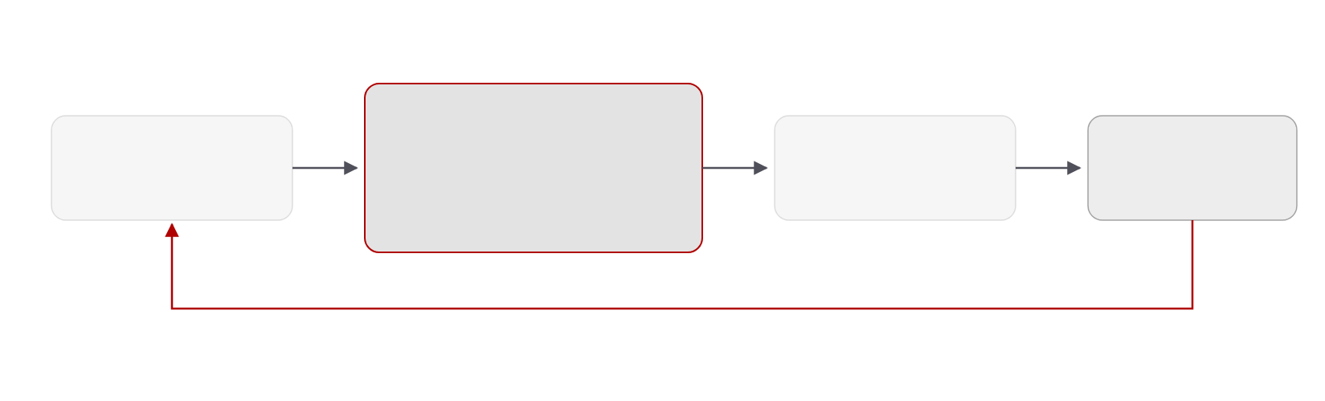
Problem
20 / 68
QAOA treats the device as a black box
parameters (γ, β)
QAOA circuit
measure
optimizer
p layers · 2p angles
cost layer · mixer layer · × p
shots → ⟨H⟩
black box
repeat hundreds of times · each pass costs shots × depth
on IBM Heron the 20-qubit circuits degrade after ≈41–43 CZ gates
IV · DEAL & QAWA
Notes:
Vanilla QAOA searches its angles by repeatedly running the circuit and handing the expectation value to a classical optimizer. Every iteration costs shots times depth, the landscape is flat in places, and none of this uses what we know about the problem coefficients or the device. On Heron the twenty-qubit circuits stop improving after roughly forty CZ gates, so depth is a hard budget.

Slide 34
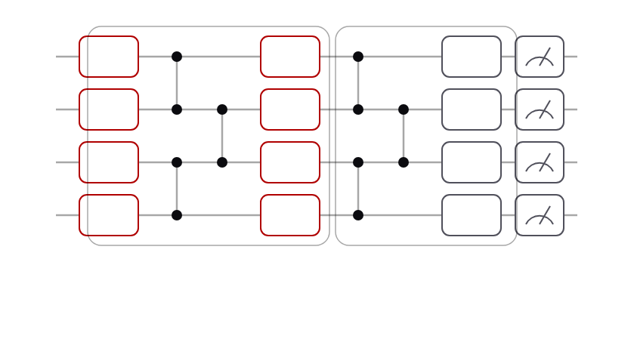
DEAL · Direct Entanglement Ansatz Learning
21 / 68
Read the angles off the problem
Direct angle mapping
Angles from the QUBO coefficients — no optimizer loop
q0
RY
RZ
RX
q1
RY
RZ
RX
Entanglement-based ansatz
Echoed cross-resonance gates within the device’s CZ budget
q2
RY
RZ
RX
q3
RY
RZ
RX
angles from QUBO coefficients Qᵢᵢ, Qᵢⱼ
Adaptive digital ZNE
echoed cross-resonance entanglers
20 qubits · 10 layers on IBM Torino (133 q) and IBM Marrakesh (156 q)
Delay / identity gates vs crosstalk; Bayesian layer choice
IV · DEAL & QAWA
Notes:
DEAL has three parts. First, the angles are read directly off the QUBO coefficients, so there is no optimizer loop on hardware. Second, the entangling structure is chosen for the device, using echoed cross-resonance gates. Third, an adaptive digital zero-noise extrapolation cleans up the result. The circuits are twenty qubits and up to ten layers on the Heron processors Torino and Marrakesh.

Slide 35
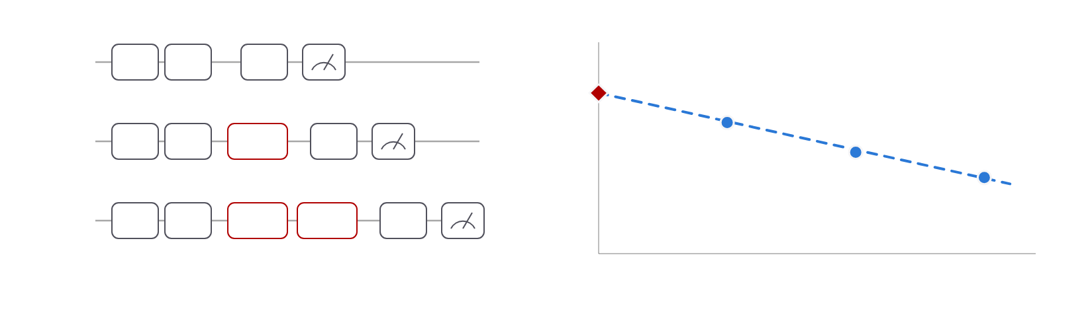
DEAL · Error mitigation
22 / 68
Adaptive zero-noise extrapolation
⟨H⟩ (schematic)
λ = 1
U
V
U†
zero-noise estimate
λ = 2
U
V
I·δt
U†
λ = 3
U
V
I·δt
I·δt
U†
QNRE: quantum noise-limited relative error
0
1
2
3
identity / delay gates scale the effective noise λ without changing the logic
noise scale λ
Schematic. Accuracy reported as QNRE; layer count by Bayesian optimization.
IV · DEAL & QAWA
Notes:
Digital ZNE runs the same logical circuit at several noise scales by inserting identity or delay gates, then extrapolates the expectation value back to zero noise. The adaptive part is that the insertion pattern targets crosstalk and coherence, the two dominant error sources on these devices. We quantify the residual with a quantum noise-limited relative error and choose the number of layers by Bayesian optimization.

Slide 36




Results · hardware
23 / 68
DEAL beats vanilla QAOA on Heron-1
success-rate gain of DEAL over QAOA at layer 10 (percentage points)
+16
+14.81 pts
layers needed for the same success rate
DEAL
+12
7 layers
QAOA
+8
9 layers
+4
0
2
4
6
8
10
circuit layers p
+0
Torino · Heron-1 · 133 q
Heron-2 · next
20 qubits, 10 layers; success = reaching the ground-state energy. TSP, knapsack and MaxCut instances; lower variance too.
IV · DEAL & QAWA
Notes:
On IBM Torino, a 133-qubit Heron-1, DEAL reaches the ground-state energy 14.8 percentage points more often than vanilla QAOA at ten layers, with lower variance. On the right, the depth trade: DEAL at seven layers matches what QAOA needs nine layers for, which matters because each layer spends part of the forty-CZ budget.

Slide 37

Results · hardware
24 / 68
…and on Heron-2
success-rate gain of DEAL over QAOA at layer 10 (percentage points)
+16
+14.81 pts
layers needed for the same success rate
DEAL
+12
7 layers
QAOA
+8
+7.40 pts
9 layers
+4
0
2
4
6
8
10
circuit layers p
+0
Torino · Heron-1 · 133 q
Marrakesh · Heron-2 · 156 q
IBM Marrakesh (156-qubit Heron-2): +7.40 pts at layer 10. Both devices degrade beyond ≈41–43 CZ gates.
IV · DEAL & QAWA
Notes:
The second device, the 156-qubit Marrakesh, confirms the direction with a smaller gain of 7.4 points. The gap between the two devices is itself informative: the benefit of the direct mapping shrinks as the device gets closer to the CZ budget, which is why the adaptive layer selection is part of the method.

Slide 38
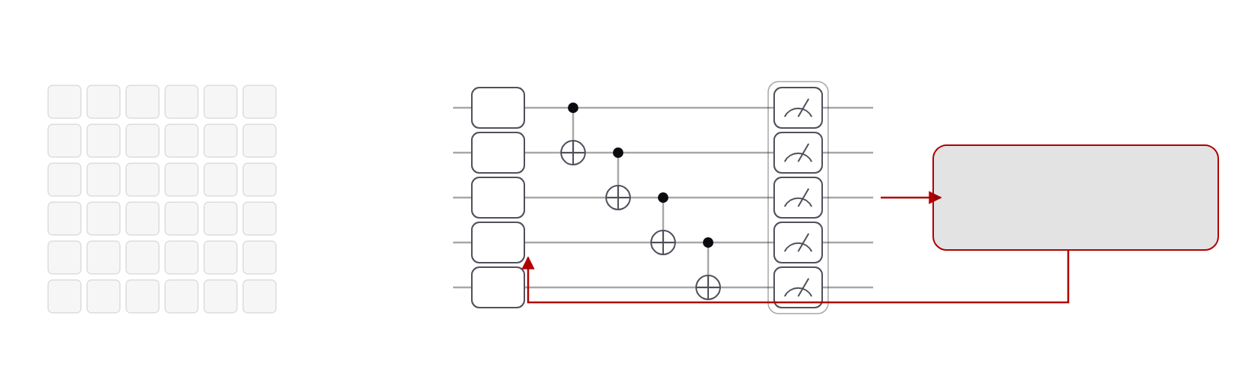
QAWA · Quantum Approximate Walk Algorithm
25 / 68
A data-traceable oracle in O(n) depth
full state tomography
QAWA data-traceable oracle
O(n²) measurements for n-qubit correlations
O(n) CNOT depth · mid-circuit measurement · classical preprocessing
q0
RY
q1
RY
classical preprocessing
q2
RY
correlation patterns
q3
RY
q4
RY
n = 6 → 36 settings
approximate walk learning: re-encode learned patterns into the next shallow circuit
A classical trace of what the circuit encodes: interpretable without tomography, verifiable in polynomial time.
IV · DEAL & QAWA
Notes:
QAWA attacks interpretability. Reading n-qubit correlations by tomography costs order n-squared measurement settings. The QAWA oracle instead grows linearly in CNOT depth with the qubit count and keeps a classical trace of what it encodes; mid-circuit measurement data are preprocessed classically and fed back into the next shallow circuit. The result is a walk that learns approximate solution patterns whose quality can be verified in polynomial time.

Slide 39
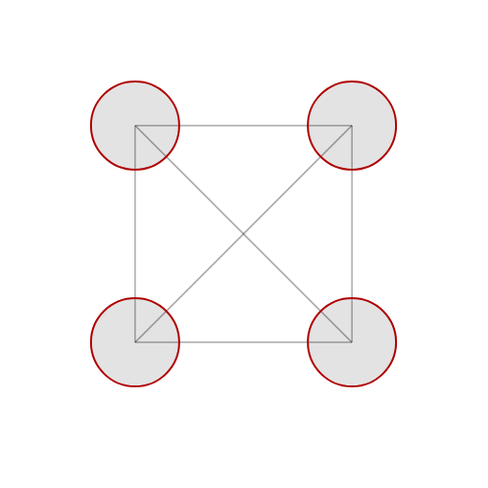
QAWA · Results
26 / 68
A portfolio copula on a Heron QPU
0.01
+5.4%
+8.1%
AAPL
MSFT
KL divergence after ≈75 iterations; all six pairwise correlations learned
over the baseline portfolio, ibm_pittsburgh
above the noise floor — no extra optimizer iterations
XOM
JNJ
IBM Pittsburgh · 156-qubit Heron
8,192 shots × 20 runs
4 assets · 6 pairwise correlations recovered
Qiskit 2.2 + Aer HPC backend
IV · DEAL & QAWA
Notes:
The demonstration is a four-asset portfolio: Apple, Microsoft, Johnson and Johnson and Exxon. The distributed walk recovers all six pairwise correlation coefficients, with the KL divergence converging to about one hundredth in seventy-five iterations. On the 156-qubit Pittsburgh processor, with eight thousand shots over twenty runs, the learned portfolio is 5.4 percent better than the baseline and 8.1 percent above the noise floor, without extra optimizer iterations.

Slide 40
Takeaway
27 / 68
RQ2: structure beats search
Problem structure sets the angles (DEAL) and the oracle (QAWA) — no black-box search on the QPU
Device structure sets the ansatz: ECR entanglers · ≈41–43 CZ budget · adaptive ZNE
Heron results: +14.81 / +7.40 pts success at layer 10 · 7 layers for 9 · +5.4% portfolio
Next: make the data these algorithms consume cheap to load (Ch. V)
IV · DEAL & QAWA
01
Simulation
02
Algorithms
03
Data encoding
04
Synthesis
05
Trust
Notes:
The takeaway for RQ2 is that structure beats search. Structure from the problem gives the angles and the oracle; structure from the device gives the ansatz and the error mitigation. The measured numbers are modest but real hardware results, and they set up the next layer: if data loading is cheap, these algorithms can consume real data.

Slide 41
Scott Aarrason Can QC really beats Classical algo?
LLM intro from background -> modern LLM -> harness engineering

Slide 42
40 / 68
Chapter VI · RQ4 Synthesis
Synthesis & cost
Learned synthesis and honest cost accounting
RubriQ · Guo, Pan · arXiv:2607.07554 · under review, npj Quantum Information · Nonlinear waves · Guo, Dsouza, Khan, Chopra, Lineswala, Pan · arXiv:2608.21647
VI · Synthesis & cost
01
Simulation
02
Algorithms
03
Data encoding
04
Synthesis
05
Trust
Notes:
Layer four: synthesis and cost. RubriQ uses a language model fine-tuned by reinforcement learning, with a programmatic rubric as the reward, to synthesize circuits toward fault-tolerant resource budgets. The second paper is the honest-accounting half of RQ4: what nonlinear-wave simulation really costs when every step must read the field.

Slide 43
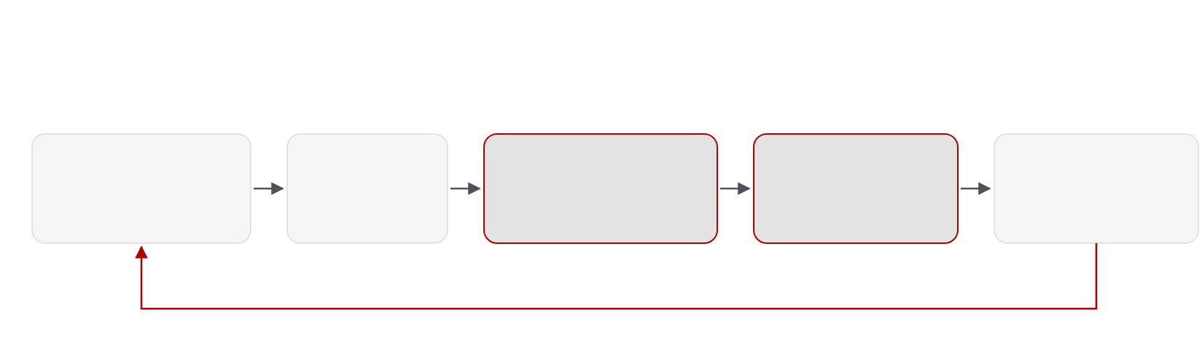
RubriQ · Rubric-guided GRPO
41 / 68
Synthesis as code generation
NERSC Perlmutter · DeepSpeed ZeRO-2 over 4–8 A100 nodes · 85% strong-scaling efficiency on 8 GPUs
Qwen2.5-Coder · DeepSeek-Coder-V2-Lite · Llama-3.1-8B · StarCoder2-15B
LLM policy
parse
CUDA-Q simulate
rubric reward
GRPO update
7B coder · LoRA r = 64
recovers ≈60%
GPU fidelity (Q-GEAR path)
5 programmatic terms
group 8 · T 0.8 · top-p 0.95
policy improves by comparing a group of 8 generated circuits against each other, no value network
VI · Synthesis & cost
Notes:
RubriQ frames fault-tolerant synthesis as code generation. A seven-billion-parameter coder with LoRA adapters proposes circuits; they are parsed, simulated with CUDA-Q on the GPU, scored by a rubric, and the policy is updated with Group Relative Policy Optimization, which compares eight samples against each other instead of learning a value network. Training runs on Perlmutter with DeepSpeed across up to eight A100 nodes at 85 percent strong-scaling efficiency.

Slide 44
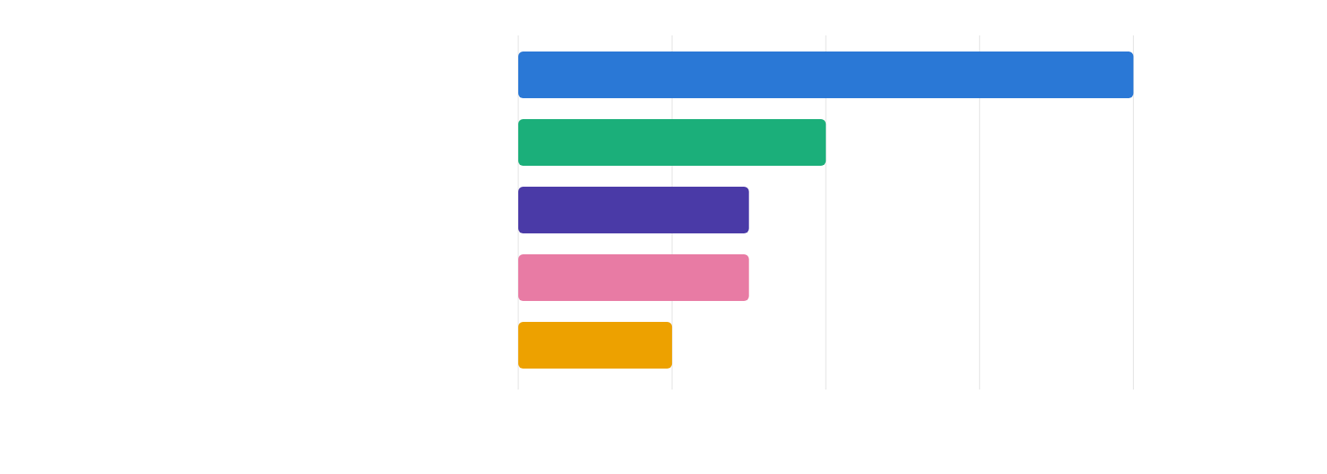
RubriQ · The reward
42 / 68
A programmatic, grounded rubric
fidelity to the target unitary
0.40
Clifford correctness
0.20
hardware-topology compliance
0.15
T-gate count
0.15
efficiency
0.10
0.00
0.10
0.20
0.30
0.40
rubric weight (sums to 1.00) · every term is computed by a program, not a judge model
VI · Synthesis & cost
Notes:
The reward is the contribution. Each of the five terms is a program: fidelity from the CUDA-Q simulation carries 40 percent of the weight; Clifford correctness 20; topology compliance and T-gate count 15 each; efficiency 10. Because the rubric is dense and grounded, the policy gets a signal on every sample, which is why it converges two to three times faster than sparse-reward RL with two to three times fewer simulator calls.

Slide 45
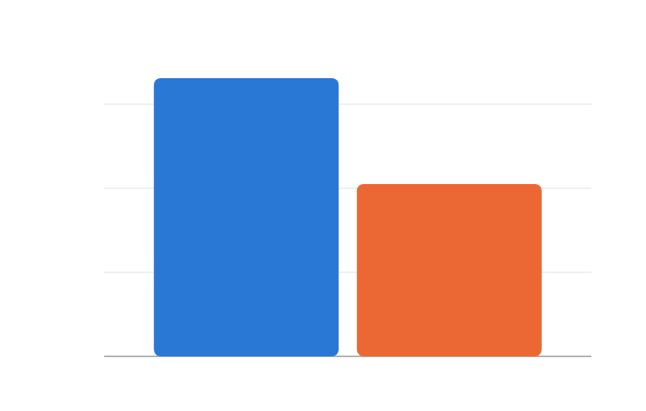
RubriQ · Results
43 / 68
Deeper compression, fewer violations
mean T-gate compression on 1,500 benchmark circuits
<1%
3.31×
96%
3×
constraint violations · 5× fewer than best baseline
2.05×
correctness
2×
2–3×
85%
1×
faster convergence · fewer simulator calls
strong-scaling efficiency, 8 GPUs
0×
RubriQ
sparse-reward RL
1,500 circuits: QFT, QPE, Hamiltonian simulation, data encoding. Validated on IBM Heron-3 and IonQ Forte.
VI · Synthesis & cost
Notes:
On 1,500 benchmark circuits spanning QFT, phase estimation, Hamiltonian simulation and data encoding, RubriQ compresses T-gate counts by 3.31 times on average against 2.05 for sparse-reward RL, keeps hardware-constraint violations under one percent, and reports 96 percent correctness. The synthesized circuits were validated on Heron-3 and IonQ Forte, so this is not only a simulator result.

Slide 46
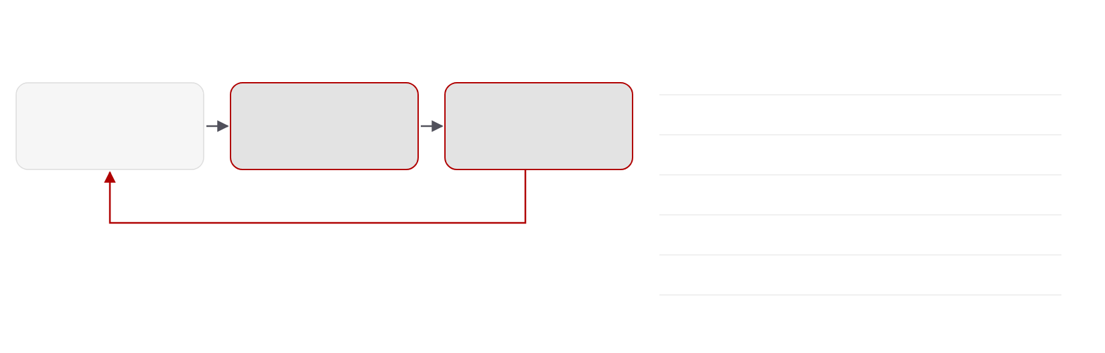
Nonlinear waves · Honest accounting
44 / 68
Measure, update, reload — every step
hybrid split-step solver · NLSE and Burgers
single cost-and-error model
shot variance
p(1−p) / S
measure
update classically
reload
truncation error
θ^(d+1) / (d+1)!
S shots
degree-d polynomial
Θ(N) CNOTs
norm-defect threshold
0.02
nonlinear phase per step
θ = κ|ψ|²Δt < 1
every Strang step
controller adapts
Δt · d ∈ {2, 4, 6} · S
measure in the computational basis · update with O(N·d) classical arithmetic
reload latency
≈1.6 µs at N = 32
reload with the QCrank loader · coherent QFT kernel, n(n−1)/2 two-qubit gates
field on N = 2ⁿ grid points, n qubits
κ = 50, T = 0.48 → fidelity ≈ 0.95 · kernels validated on IBM Heron
VI · Synthesis & cost
Notes:
The second paper asks what it costs to simulate the nonlinear Schrödinger and viscous Burgers equations when the nonlinearity needs the field values themselves. Instead of hiding that in a linear embedding, we build a hybrid Strang split-step solver that measures the field, updates it classically with a degree-d polynomial, and reloads it with the vectorized loader at every step. Shots, gates and truncation all live in one cost-and-error model, with a controller that keeps the nonlinear phase per step below one.

Slide 47
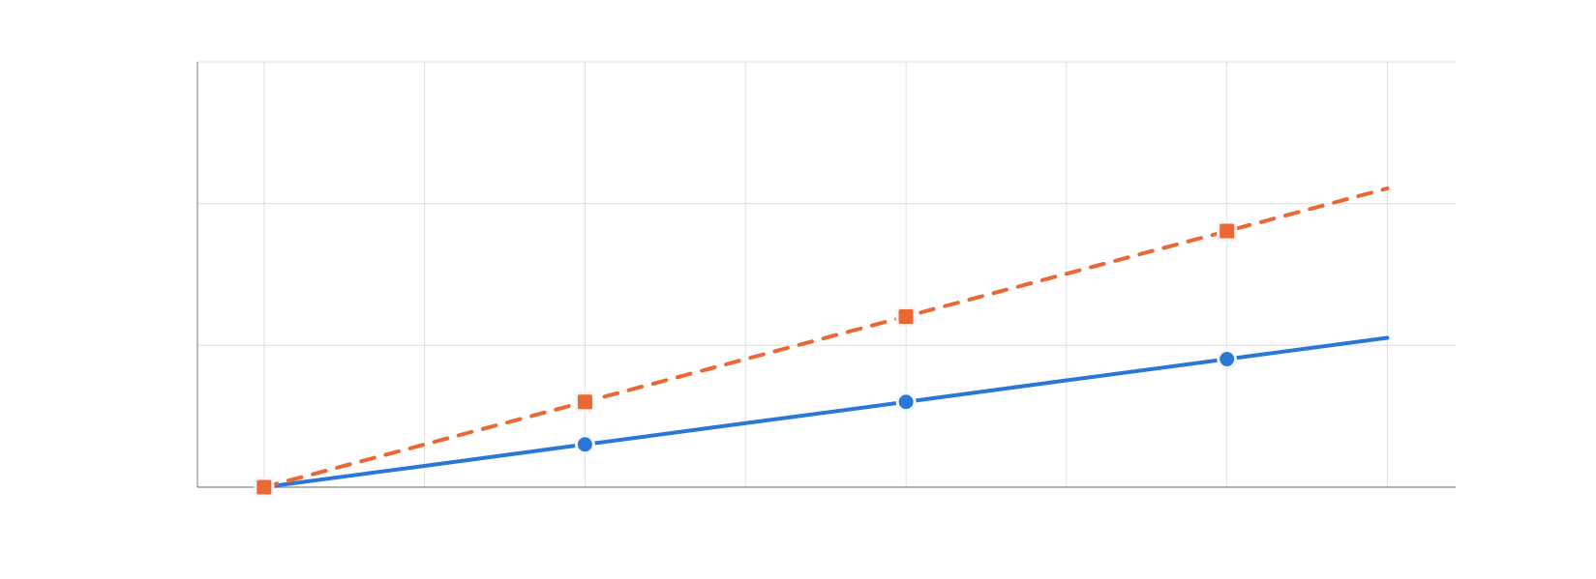
Nonlinear waves · Cost model
45 / 68
Where the quantum step loses
relative cost per time step (log)
10⁶
quantum step · depth Θ(N) × shots S(N)
10⁴
10²
classical update · O(N·d)
1
32
64
128
256
512
1024
2048
4096
grid points N = 2ⁿ
Schematic from the cost model: depth Θ(N) × shots S(N) per step vs O(N·d) classical, normalized at N = 32. Not measured wall time.
VI · Synthesis & cost
Notes:
The conclusion is negative but quantitative. Because every step reads the full field, the quantum cost per step, depth times shots, grows faster than the classical polynomial update as N grows, so the hybrid scheme cannot deliver an end-to-end advantage. What it does deliver is the target: a coherent, measurement-free nonlinear update is what any future advantage claim must beat. This chart is the schematic scaling from the model, not measured wall time.

Slide 48
Takeaway
46 / 68
RQ4: honest accounting
Grounded reward works: rubric + GPU simulation → 3.31× T-gate compression, <1% violations
HPC inside the loop: CUDA-Q evaluation (Q-GEAR path) + DeepSpeed on Perlmutter
Count everything: measurement + reload every step → no end-to-end advantage for nonlinear waves
Both stated as budgets: T-gates · shots × depth
VI · Synthesis & cost
01
Simulation
02
Algorithms
03
Data encoding
04
Synthesis
05
Trust
Notes:
RQ4 has a two-part answer. Learned synthesis produces budget-respecting circuits when the reward is grounded in simulation and hardware constraints. And honest accounting, charging every measurement and reload, shows where quantum advantage does not exist yet, which is as important to write down as where it does.

Slide 49
47 / 68
Chapter VII · RQ5 Trust
QEC audit
Auditing structured randomness for quantum error correction under a bounded cloud fault model
Guo, Lawrence, Wang, Kuang, Pan · arXiv:2608.26600 · artifact: anonymous.4open.science/r/usenix_qec_hse
VII · QEC audit
01
Simulation
02
Algorithms
03
Data encoding
04
Synthesis
05
Trust
Notes:
Layer five: trust. This chapter, with coauthors from Lightrider and Quantropi, treats the error-correction encoder on a shared cloud QPU as a security surface and asks how randomness should be used and audited. It is the first half of the answer to RQ5.

Slide 50
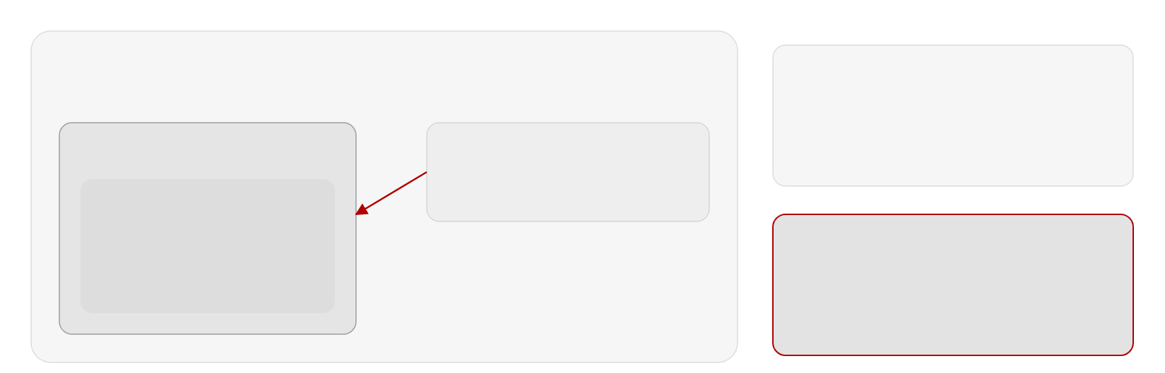
Threat model
48 / 68
A public encoder is a reusable target
shared cloud QPU
bounded cloud fault model: weight-one Pauli faults, all 3n locations enumerated
fixed public encoder
your job
same E every run → reusable target
co-tenant adversary
adversary picks the fault after learning E
[[n,k,d]] encoder E
same chip, same time
|ψ⟩ → E|ψ⟩|0…0⟩
injects one Pauli fault
syndrome check → accept / reject
learns the public encoder,
reseeded encoder
logical qubit
then chooses where to strike
fresh seed per run → fault map changes
fault must be fixed before the seed is known
VII · QEC audit
Notes:
The setting is a shared cloud processor: your error-corrected job runs next to a co-tenant who can inject a single Pauli fault. If the encoder circuit is fixed and public, the adversary can learn exactly which physical fault produces a harmful logical action that the syndrome check will not catch, and reuse it every run. If the encoder is reseeded per run, the fault has to be chosen before the seed is known. The fault model is deliberately bounded: weight-one Paulis, all three-n locations enumerated.

Slide 51
Definition
49 / 68
Accepted logical disturbance
Accepted logical disturbance = harmful logical action that survives syndrome rejection, weighted by acceptance probability. Rejected faults and trivially acting faults cost nothing.
BASELINE
SUBSTITUTE
AUDIT
Haar-random encoders
Seeded Clifford ensemble
Two adversary orders
Exact expectation derived — ideal, exponentially costly
Polynomial-cost Hadamard-structured ensemble (HSE) from a seed
Fault after seeing the encoder (fixed) vs before the seed (reseeded)
VII · QEC audit
Notes:
The central definition is accepted logical disturbance. In full: the accepted logical disturbance of an encoder under a fault is the acceptance-weighted measure of the harmful logical action that survives syndrome-based rejection; faults that are rejected do no harm, faults that are accepted and act trivially do no harm, and only accepted faults with non-trivial logical action count. It weights harmful logical action by the probability that the syndrome check accepts the run, so a fault that is caught costs nothing and a fault that slips through with trivial action costs nothing. We derive its exact expectation for Haar-random encoders as the reference, and then audit a cheap, seeded Clifford ensemble against the same measure under the two adversary orders.

Slide 52
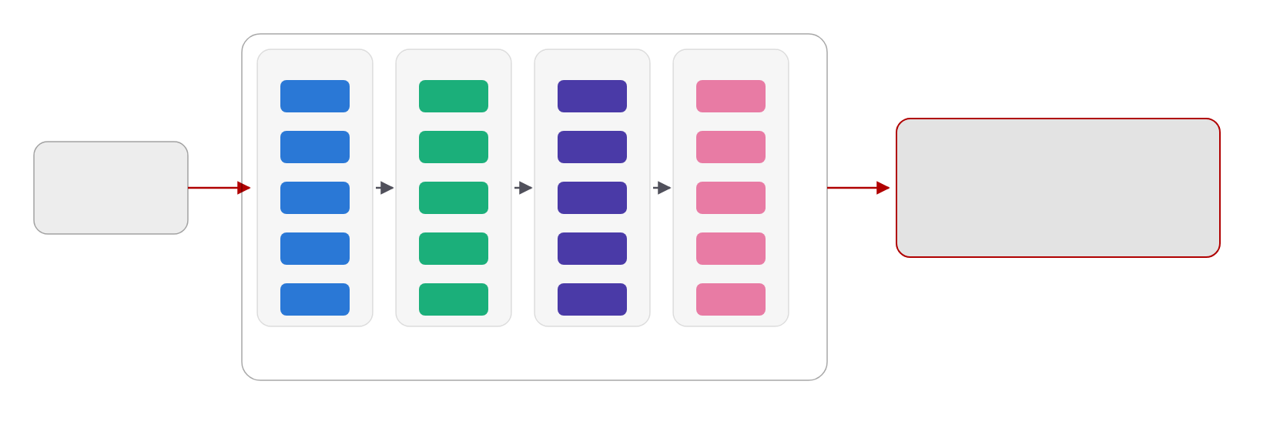
Hadamard-structured ensemble
50 / 68
Seeded structure instead of Haar
H
S
π
CX
H
S
π
CX
seed
seeded Clifford encoder
from a DRBG
H
S
π
CX
polynomial cost
H
S
π
CX
H
S
π
CX
18.5% of samples satisfy the exact QEC conditions
vs Haar-random encoders: exponential cost
Hadamard layer
phase layer
permutation layer
CNOT layer
× depth d
VII · QEC audit
Notes:
The Hadamard-structured ensemble is built from a seed: Hadamard, phase, permutation and CNOT layers, repeated to depth d, all Clifford and therefore cheap to sample and simulate. Not every sample is a valid encoder; 18.5 percent of the sampled circuits satisfy the exact error-correction conditions for the code, and those are the ones the audit uses. The seed is the only secret, which is what connects this chapter to the cryptography module in the next.

Slide 53


Results
51 / 68
Fixed encoder: the adversary wins
mean accepted logical disturbance · [[5,1,3]] code · weight-one Pauli faults
0.150
SETTING
0.15
[[5,1,3]] code
all 3n = 15 weight-one Paulis · adversary sees the encoder first
0.10
RESULT
0.05
0.150
mean accepted logical disturbance, fixed public encoder
0.00
fixed public encoder
fault chosen after learning E
VII · QEC audit
Notes:
With the five-qubit code and every weight-one fault enumerated, a fixed public encoder lets the adversary pick the fault after learning the circuit, and the mean accepted logical disturbance is 0.150. That is the number to beat.

Slide 54
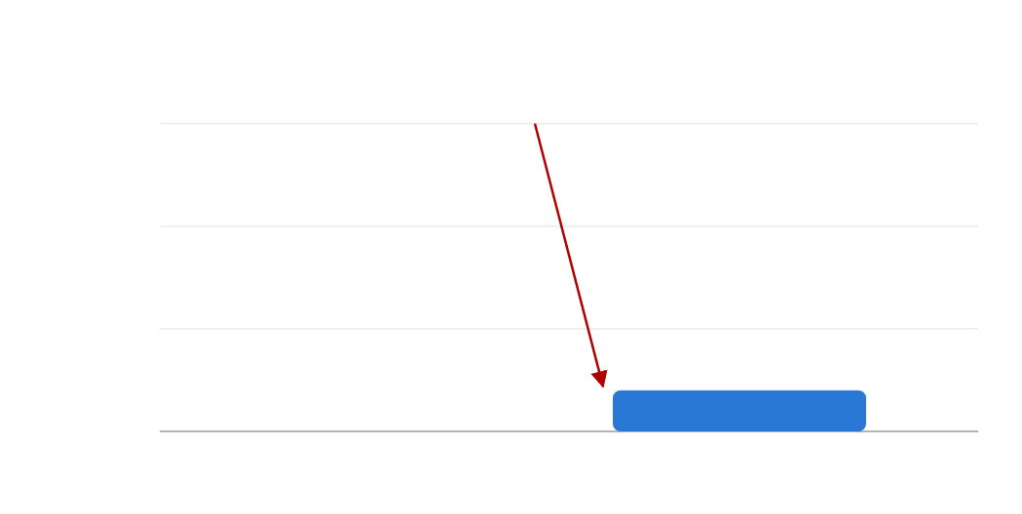
Results
52 / 68
Reseeding removes 86.7% of the harm
mean accepted logical disturbance · [[5,1,3]] code · weight-one Pauli faults
RESULT
0.150 → 0.020
0.150
the pre-chosen fault is now caught by syndrome rejection
0.15
−86.7%
VALID ENCODERS
0.10
18.5%
of sampled HSE circuits meet the exact QEC conditions
0.05
0.020
SCALING
0.00
Stim · n = 17
fixed public encoder
reseeded encoder
gate-level, p₁ = 10⁻³, p₂ = 10⁻² · trend confirmed
fault chosen after learning E
fault fixed before the seed
VII · QEC audit
Notes:
Reseeding per run brings the same measure down to 0.020, an 86.7 percent reduction, and the reduction is attributable to rejection: with a fresh encoder the pre-chosen fault is caught by the syndrome check most of the time. Gate-level Stim simulations at 17 qubits with realistic depolarizing rates confirm the scaling. Only 18.5 percent of sampled ensemble members are valid encoders, which is a cost the audit makes explicit.

Slide 55
Standards mapping
53 / 68
Where the audit meets the standards
Standard
Governs today
What the QEC audit needs
FIPS 140-3
module boundary · self-tests
validated boundary around seed generation and encoder sampling
SP 800-90A
approved DRBGs
per-run HSE seed from an approved DRBG
FIPS 203 · ML-KEM
post-quantum key encapsulation
seeds and jobs protected in transit
FIPS 204 · ML-DSA
FIPS 205 · SLH-DSA
post-quantum signatures
attest which encoder ran
VII · QEC audit
01
Simulation
02
Algorithms
03
Data encoding
04
Synthesis
05
Trust
Notes:
The paper closes by placing the audit next to the standards that already govern classical randomness. FIPS 140-3 defines the module boundary and self-tests; SP 800-90A defines approved random-bit generators, which is where the seeds must come from; and the three 2024 post-quantum standards protect the seeds, jobs and results in transit. That mapping is the bridge into Chapter VIII.

Slide 56
54 / 68
Chapter VIII · RQ5 Trust
Post-quantum stack
Toward a post-quantum-secure quantum stack
Light Rider Inc. QPC SDK v1.0.0 · Zenodo 10.5281/zenodo.21895102 · FIPS 140-3 post-quantum cryptography module with module search
VIII · Post-quantum stack
01
Simulation
02
Algorithms
03
Data encoding
04
Synthesis
05
Trust
Notes:
Chapter VIII completes layer five with software rather than a paper: the Light Rider QPC SDK, a FIPS 140-3 style post-quantum cryptography module released on Zenodo in August 2026. It supplies the primitives the audit in Chapter VII asks for.

Slide 57
Why the quantum stack needs PQC
55 / 68
Our machine breaks its own keys
THE THREAT
THE CHANNEL
THE LINK TO CHAPTER VII
Shor’s algorithm
Cloud QPU jobs are classical traffic
Seeds need a validated source
2048-bit RSA in ≈8 h with 20 M noisy qubits (Gidney–Ekerå). This stack builds toward that machine.
Circuits, seeds, results travel classically to IBM, IonQ, HPC — harvest now, decrypt later
Approved DRBG (SP 800-90A) inside a FIPS 140-3 boundary · attestable encoder
VIII · Post-quantum stack
Notes:
Three reasons the quantum stack itself needs post-quantum cryptography. The machines we are scaling toward are the ones that break RSA and elliptic curves: factoring and discrete logarithms fall to a large fault-tolerant machine, and Gidney and Ekerå estimate 2048-bit RSA in about eight hours with twenty million noisy qubits. Cloud quantum jobs are classical network traffic that can be harvested today and decrypted later. And, most directly, the reseeded encoders of Chapter VII are only as trustworthy as the random-bit generator and the module boundary behind them.

Slide 58
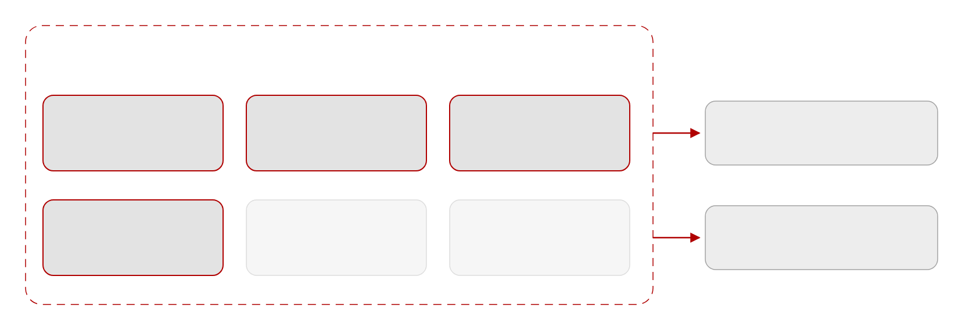
QPC SDK
56 / 68
One boundary for keys and seeds
FIPS 140-3 module boundary · Light Rider QPC SDK v1.0.0
consumers
Linux x86_64 · 1.1 MB · CC-BY-4.0 · Zenodo, Aug 2026
ML-KEM
ML-DSA
SLH-DSA
signed jobs
FIPS 203 · key encapsulation
FIPS 204 · lattice signatures
FIPS 205 · hash signatures
encapsulated · cloud QPU · HPC center
DRBG
self-tests
module search
seeds → HSE encoder
SP 800-90A · seeds
power-up & conditional
discover & select algorithms
reseeded QEC (Chapter VII)
VIII · Post-quantum stack
Notes:
The module implements the three 2024 NIST standards, ML-KEM for key encapsulation and ML-DSA and SLH-DSA for signatures, together with an SP 800-90A random-bit generator, self-tests and a module-search feature for discovering and selecting algorithms. Two consumers matter for this dissertation: signed and encapsulated jobs to cloud QPUs, and DRBG seeds for the reseeded encoders of Chapter VII. It is a 1.1-megabyte Linux release archived on Zenodo.

Slide 59
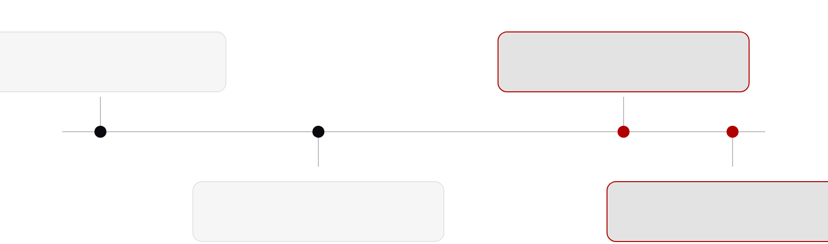
NIST timeline
57 / 68
The standards this stack builds on
2015
Aug 2024
SP 800-90A Rev. 1 · DRBGs
FIPS 203 · 204 · 205
NIST PQC workshops begin
ML-KEM · ML-DSA · SLH-DSA
→ migration
2019
2026
FIPS 140-3
this work
module security requirements
QEC randomness audit · QPC SDK v1.0.0
Tracked automatically by gzquse/quantum_news-NIST.
VIII · Post-quantum stack
01
Simulation
02
Algorithms
03
Data encoding
04
Synthesis
05
Trust
Notes:
For context, the standards timeline. The random-bit-generator recommendation and the first NIST post-quantum workshops date from 2015; FIPS 140-3 arrived in 2019; and the three post-quantum standards were finalized in August 2024. This dissertation's audit and module sit in 2026, on the migration side of that line. We track changes to the NIST timeline automatically in a small open-source watcher.

Slide 60
Conclusion
58 / 68
Five questions, five answers
01 · RQ1 · Scale
02 · RQ2 · Noise
03 · RQ3 · Data
04 · RQ4 · Synthesis
05 · RQ5 · Trust
Simulation
Algorithms
Data encoding
Synthesis
Trust
Structure beats search · +14.81 pts · 7 layers for 9 · O(n) oracle
One vectorized encoding → shot-efficient, hardware-compatible, trainable
Grounded RL · 3.31× T-gate compression · honest budgets
42 qubits on 1,024 A100s · ≈400× · Qiskit unchanged
Reseeding −86.7% disturbance · FIPS 140-3 PQC module
IX · Conclusion
Notes:
Back to the stack, now with the answers. Scale: exact simulation reaches 42 qubits on 1,024 A100s, about 400 times faster than a CPU node, with the Qiskit program unchanged. Noise: angles read from the problem and ansätze shaped by the device beat black-box search, plus an O(n) traceable oracle. Data: vectorized QCrank-style encodings make learning shot-efficient, hardware-compatible and trainable across QPIE, VQT, ShardQ and NNQA. Synthesis: rubric-grounded RL synthesizes budget-respecting circuits, and honest accounting shows where advantage is absent. Trust: reseeded HSE encoders cut accepted logical disturbance by 86.7 percent, and a FIPS 140-3 PQC module supplies the seeds and signatures. Scale: 42 qubits, program unchanged. Noise: structure beats search on real Heron hardware. Data: one vectorized encoding underlies four learning systems. Synthesis: grounded rewards and honest budgets. Trust: reseeded encoders and a validated cryptography module. Together they are the co-designed stack of the thesis statement.

Slide 61
59 / 68
Summary
Large scale quantum circuit simulation to understand fault tolerant quantum qubits
Introduce current real quantum processing units (QPU) results
Showed Useful and current application using Quantum arithemetic Algorithms
Demonstrated Large Lanagague Models (LLMs) for quantum circuit synthesis
Quantum Error Correction for Cloud Security
IX · Conclusion
Notes:
I want to be explicit about limits. The 42-qubit result is simulation: Q-GEAR's scaling is a statement about HPC reach, and the largest hardware runs are 20-qubit optimization circuits and 36-qubit arithmetic stress tests. The hardware gains depend on device and calibration cycle: DEAL gains 14.81 points on Torino but 7.40 on Marrakesh, VQT's RMSE ranges from 0.059 on Kingston to 0.155 on Aria-1, and repeats across calibration cycles are limited. The learning benchmarks are small, Moon, Spiral, MNIST and the Brown corpus, and VQT remains 12.9 perplexity points behind a 125K-parameter nanoGPT. The audit covers the five-qubit code with weight-one faults and Stim at 17 qubits; surface-code distances and correlated faults are future work. And six of the ten papers, ShardQ, QAWA, NNQA, RubriQ, nonlinear waves and the QEC audit, are still preprints. The hardware gains depend on which device and which calibration cycle we hit. The learning benchmarks are small and I claim no advantage there. The security audit is at five-qubit-code scale. And six of the ten papers are still preprints. These are the boundaries within which the answers hold.

Slide 62
Future work
60 / 68
Next steps for each layer
III
Simulation
more Qiskit gates · tensor-network backends · Perlmutter successor
IV
Algorithms
larger QUBOs · dynamic circuits · oracles beyond portfolios
V
Data encoding
longer VQT contexts · higher-degree NNQA · calibration-aware cuts
VI
Synthesis
QEC-aware rubrics · a coherent, measurement-free nonlinear update
VII–VIII
Trust
surface & bivariate-bicycle codes · correlated faults · audit ∘ PQC module
IX · Conclusion
Notes:
Future work follows the same five layers. Broader gate coverage and new backends for the simulator; dynamic circuits for the optimizers; longer contexts and error-corrected loaders for learning; QEC-aware rubrics and the coherent nonlinear update for synthesis; and, for trust, scaling the audit to bivariate-bicycle and surface codes and composing it formally with the cryptography module.

Slide 63
Publications
61 / 68
Ten papers, one software release
#
Title
Authors
Venue
1
Q-GEAR: improving quantum simulation framework
Guo, Balewski, Pan
ACM ICPP 2025 · arXiv:2504.03967
2
QPIE: quantum parallel information exchange network with transfer learning
Guo, Khan, Sheng, Jabeen, Pan
Quantum Sci. Technol. 10 (2025) · arXiv:2504.04235
3
DEAL: direct entanglement ansatz learning with ZNE on superconducting qubits
Guo, Rayan, Hu, Pan
IEEE QCE 2025 · arXiv:2504.04021
4
VQT: vectorized attention with learnable encoding for quantum transformer
Guo, Pan, Khan, Balewski
AAAI Symposium Series 7 (2025) · arXiv:2508.18464
5
ShardQ: quantum data representation via circuit partitioning and reintegration
Guo, Balewski, Xiao, Pan
IEEE transaction on Quantum Engineering (2025)
6
QAWA: quantum approximate walk algorithm
Guo, Balewski, Hu, Khan, Pan
arXiv:2511.07676 (2025)
7
NNQA: Neural-native quantum arithmetic for end-to-end polynomial synthesis
Guo, Li, Chen, Pan
arXiv:2603.27297 (2026)
8
RubriQ: Rubric-guided GRPO for constraint-aware quantum circuit synthesis
Guo, Pan
arXiv:2607.07554 (2026) · under review, npj Quantum Information
9
Measurement and reload costs in direct quantum simulation of nonlinear waves
Guo, Dsouza, Khan, Chopra, Lineswala, Pan
arXiv:2608.21647 (2026)
10
Auditing structured randomness for QEC under a bounded cloud fault model
Guo, Lawrence, Wang, Kuang, Pan
arXiv:2608.26600 (2026)
11
Light Rider Inc. QPC SDK v1.0.0 (software)
Guo
Zenodo 10.5281/zenodo.21895102 (2026)
IX · Conclusion
Notes:
The complete list, in chronological order. Four peer-reviewed publications in 2025, six preprints in 2025 and 2026, and the software release. All code is public on GitHub under gzquse, with archived artifacts on Zenodo for RubriQ, the nonlinear-wave solver and the QPC SDK.

Slide 64
Acknowledgments
62 / 68
This work had many hands
ADVISOR · CHAIR
COAUTHORS
Dr. Ziwen Pan
Alex Khan · Wenshuo Hu · Victor S. Sheng · Jie Li · Yong Chen · Steven Rayan · Kewen Xiao · Shabnam Jabeen · Anthony Lawrence · Renyu Wang · Randy Kuang · Viraj Dsouza · Abhishek Chopra · Rut Lineswala
Computer Science, Texas Tech University
COMMITTEE
Dr. Zihao Zhan · Dr. Susan Mengel · Dr. Lu Wei
Dean’s representative: Dr. Anne E. V. Gorden
FUNDING & FACILITIES
DOE Office of Science · NERSC DDR-ERCAP0034486 / 0034385 · TTU HPCC · UMD QLab · Xanadu
NERSC / LBNL
Jan Balewski
HARDWARE ACCESS
HPC deployment · QCrank · Perlmutter allocations
IBM Quantum · IonQ · Amazon Braket · NVIDIA A100 (NERSC, TTU)
IX · Conclusion
Notes:
None of this was solo work. My advisor and chair Dr. Ziwen Pan; my committee, Dr. Zihao Zhan, Dr. Susan Mengel and Dr. Lu Wei, and Dr. Anne Gorden representing the Graduate School; Jan Balewski at NERSC, whose encodings and allocations run through half the chapters; coauthors across seven institutions (UMD QLab / BosonQ Psi, TTU, U. Saskatchewan, RIT, UMD, Lightrider, Quantropi); the DOE Office of Science and NERSC ERCAP awards, the TTU HPC center, UMD QLab and Xanadu's Braket credits; and the hardware providers: IBM Quantum (Torino, Marrakesh, Pittsburgh, Boston, Kingston, Miami), IonQ (Aria-1, Forte-1), Amazon Braket SV1. Thank you.

Slide 65
63 / 68
Thank you
Questions?
Ziqing Guo · ziqguo@ttu.edu · github.com/gzquse · ORCID 0009-0006-3999-2221
Questions
Notes:
Thank you. I am happy to take questions; backup slides follow with the hardware table, the Q-GEAR gate mapping, the DEAL pseudo-code and the VQT hardware configurations.

Slide 66
Backup · B1
64 / 68
Hardware used in this dissertation
Device
Type
Qubits
Calibration figure reported
Used in
IBM Torino
Heron-1, superconducting
133
—
DEAL (Ch. IV)
IBM Marrakesh
Heron-2, superconducting
156
—
DEAL (Ch. IV), ShardQ (Ch. V)
IBM Pittsburgh
Heron-3, superconducting
156
1.46 × 10⁻³ median CZ error
QAWA (Ch. IV), ShardQ (Ch. V)
IBM Boston
Heron-3, superconducting
156
—
NNQA (Ch. V)
IBM Kingston
Heron, superconducting
—
—
VQT (Ch. V), NNQA
IBM Miami
Nighthawk, superconducting
—
—
NNQA (Ch. V)
IonQ Aria-1
trapped ion
—
—
QPIE, VQT (Ch. V)
IonQ Forte / Forte-1
trapped ion
36
—
NNQA, RubriQ validation (Ch. V, VI)
Amazon Braket SV1
state-vector simulator
—
—
QPIE (Ch. V)
NERSC Perlmutter
A100 40 GB / 80 GB nodes
—
—
Q-GEAR, ShardQ, NNQA training, RubriQ (Ch. III, V, VI)
Per-device T1/T2 and error tables are in the individual papers; dashes mark values not reproduced here.
Backup
Notes:
Backup: the hardware table. Ten backends across IBM Heron and Nighthawk processors, IonQ trapped-ion systems, the Braket simulator and Perlmutter. Where the papers state a calibration figure I reproduce it; otherwise the cell is a dash.

Slide 67
Backup · B2
65 / 68
Q-GEAR gate mapping
Qiskit gate
Parameters
CUDA-Q kernel operation
ENCODING
h
—
h(q)
Each gate becomes one row across the three tensors: gate id, qubit indices (control, target), and parameters. Unused parameter slots are left empty.
ry
θ
ry(θ, q)
rz
φ
rz(φ, q)
u3
θ, φ, λ
u3(θ, φ, λ, q)
STORAGE
cx
—
x.ctrl(c, t)
Tensors are written to HDF5 with the circuit metadata (qubit count, shots, seed) so a run is reproducible on CPU, one GPU or 1,024 GPUs.
cp
λ
r1.ctrl(λ, c, t)
swap
—
swap(a, b)
measure
—
mz(q)
NOTE
Operation names follow the CUDA-Q Python API; the exact emitted code is in the qgear repository.
Backup
Notes:
Backup: the gate mapping. The eight supported Qiskit operations and the CUDA-Q kernel operations they become, plus the tensor row layout and the HDF5 metadata that make a run reproducible at any scale.

Slide 68
Backup · B3
66 / 68
DEAL, in pseudo-code
# Direct Entanglement Ansatz Learning (DEAL) — sketch
input QUBO matrix Q (n = 20), device coupling map, CZ budget ≈ 41–43
output bitstring x*, energy E*
γ, β ← direct_map(Q) # angles from Qᵢᵢ, Qᵢⱼ; no optimizer
p ← bayes_select_layers(Q, budget) # 7 layers ≈ QAOA at 9
for λ in noise_scales: # adaptive digital ZNE
C ← entangling_ansatz(γ, β, p, coupling_map) # echoed cross-resonance
C ← insert_delays(C, λ) # crosstalk / coherence control
E[λ] ← run(C, shots)
E* ← extrapolate(E, λ → 0)
x* ← argmin_sample(C)
QNRE ← |E* − E_exact| / noise_limit # reported metric
INSTANCES
Travelling salesman, knapsack and MaxCut; Table II optima 8.795 / 7.468, 39.167 and 14.184.
VALIDATION
20-qubit circuits were simulated with the Q-GEAR GPU path before submission to IBM Torino and Marrakesh.
CODE
github.com/gzquse/DEAL_QUBO
Backup
Notes:
Backup: DEAL as pseudo-code. The two things to notice are that the angles come from a direct map of the QUBO matrix with no optimizer loop, and that the zero-noise extrapolation wraps the whole circuit family rather than a single circuit.

Slide 69
Backup · B4
67 / 68
VQT hardware configurations
Backend
Type
Batch
RMSE
Notes
Ideal simulator
noiseless
32
0.017
reference for the attention estimate
IBM Kingston
Heron, superconducting
32
0.059
parameter-free VQDP head
IonQ Aria-1
trapped ion
8
0.155
smaller batch within the 4–128 range
4–9 qubits
batches 4–128
10K–320K shots
CNOT depth 5–129
attention error < 1.2% at 3.0 M shots
Brown corpus: perplexity 105.4, loss 1.12
Aggregate ranges are as reported across all hardware runs; per-run configurations are in gzquse/paper_AAAI2025-quantum (figC_resHW.py, data_ionq/).
Backup
Notes:
Backup: the VQT hardware configurations. Three backends, the batch size for each, and the RMSE of the attention estimate, with the aggregate shot, depth and qubit ranges below. Per-run configurations are in the figure-reproduction repository.

Slide 70
Backup · B5
68 / 68
Reproducibility and artifacts
Work
Repository / archive
Contents
Q-GEAR
github.com/gzquse/qgear · gzquse/cudaq-perlmutter
nbdev package, Apache-2.0, 241 commits; multi-node CUDA-Q scripts for Perlmutter
QPIE
github.com/gzquse/QPIE_datacircuit
PennyLane Dockerfile, PyTorch 24.06 Shifter container, inference scripts
DEAL
github.com/gzquse/DEAL_QUBO
distributed training, D-Wave Leap baseline, Qiskit GPU kernel, IBM job tracking
VQT
github.com/gzquse/quantum-transformer · gzquse/paper_AAAI2025-quantum · gzquse/vectorized_encoding
model code, figure reproduction, Mathematica derivations
ShardQ · QAWA · NNQA
github.com/gzquse/ShardQ_v2 · gzquse/qawa_data_circ · gzquse/nnqa
SparseCut and MPS knitting (MIT); QAWA_v2.py; NNQA toolkit and cloud jobs
RubriQ
github.com/gzquse/rubriq-artifact · Zenodo 10.5281/zenodo.21284556
GRPO fine-tuning, 21 evaluator tests; archived artifact, CC-BY-4.0
Nonlinear waves
Zenodo 10.5281/zenodo.21245905 (SplitStepQUDE)
code and data for the split-step solver, CC-BY-4.0 / Apache-2.0
QEC audit
anonymous.4open.science/r/usenix_qec_hse-32FE · gzquse/ExploreQEC_mar
containerized, seeded, deterministic audit; Stim/Qiskit/Guppy toolboxes
QPC SDK
Zenodo 10.5281/zenodo.21895102
v1.0.0, Linux x86_64, 1.1 MB, CC-BY-4.0
Backup
Notes:
Backup: where everything lives. Every chapter has a public repository, and three artifacts are archived on Zenodo with DOIs. The QEC audit artifact is containerized and seeded so that the reported numbers are deterministic.

