Slide 1
Monte Carlo Simulations using MATLAB
Vincent Leclercq, Application engineer
Email : vincent.leclercq@mathworks.fr

Slide 2

Agenda
Principles and uses cases for Monte Carlo methods
Using MATLAB toolbox for Monte Carlo simulations
Develop you own Monte Carlo engine
A quick overview of Variance reduction technics

Slide 3
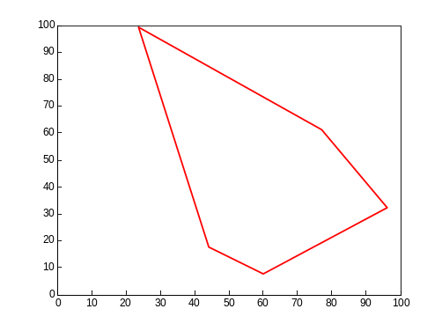
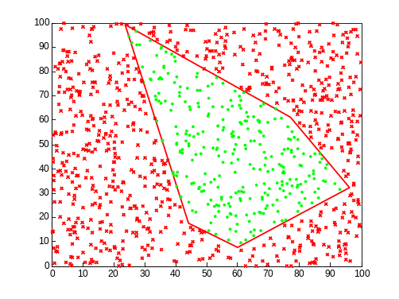
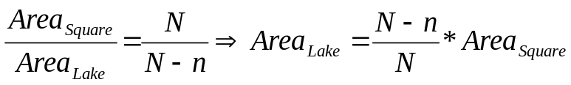
An simple example
Compute the area of a lake
  We shot N cannon balls
    n balls out of the “lake”
    N- n balls in the lake
  One gets

Slide 4
Take outs
Results depends on :
  random number generation (Mersenne Twister)
  Number of simulations

Slide 5
Typical uses cases of Monte carlo in finance
Derivatives pricing
Risk
Structurer
Stochastic Asset Liability Management
…

Slide 6
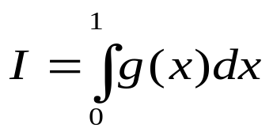

General Principles
Estimation technique based on the simulation of a great number of random variables
Let’s consider
This can be seen as the expectation , with U being a uniform random variable on (0,1), ie U~(0,1)
We can estimate tis expectation using an empiric mean from random draws

Slide 7
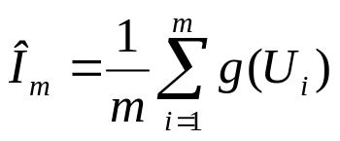
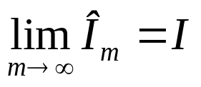
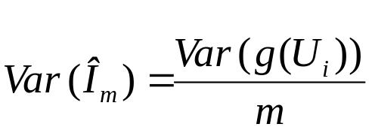
General Principles, continued
We need to generate a sequence {U_{i}} of random samples, which are independent (iid)
Then we can compute the empiric mean:
From the law of Great Numbers, one gets :
  Variance :
  Confidence interval : using a Gaussian approximation

Slide 8
Good points and drawbacks
Good points
  Various application areas
  Few hypothesis
  Easy to develop
Drawbacks
  Dependency to random number generator
  Big variability (accuracy)
  Computation time

Slide 9
Why MATLAB ?
Efficiency :
  1 000 000 paths in less than 1 s
  25 times fastest thanExcel
State of the Art Algorithms
  Mersenne Twister
  Linear algebra
Lots of statistical distributions supported (+ than 20)
Easy deployment

Slide 10
Agenda
Principles and uses cases for Monte Carlo methods
Using MATLAB toolbox for Monte Carlo simulations
Develop you own Monte Carlo engine
A quick overview of Variance reduction technics

Slide 11
Which tools for Monte Carlo simulations ?
MATLAB : Core linear algebra engine, matrix factorisation, …
Statistics toolbox : Random numbers, copulas, …
Financial toolbox :
    Portsim :” Monte Carlo simulation of correlated asset returns”
GARCH Toolbox
    garchsim

Slide 12
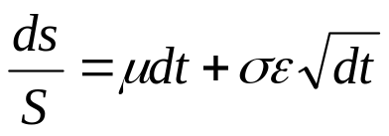
Financial toolbox : portsim
On a time interval, performances are driven by the following equation :
Time basis must be consistent for input parameters (drift and volatility)
  Annual time basis -> dt in years
  Daily time basis -> dt in days

Slide 13
Demo 1:
Geometric brownian motion
Lognormality of equity prices
Historical data input
Drift and volatility
  Annually or Daily
Simulate 10 000 paths on one year.
Compare results

Slide 14
Demo 2:
Use the previous paths to price aVanilla option
Apply the option payoff
  Vanilla -> No path dependancy
Compute the call price for different strikes
Compute the confidence intervals

Slide 15
GARCH Toolbox : garchsim
Stochastic Volatility
Simulations of Auto Regressive models / GARCH
  “Perform Monte Carlo simulation of univariate returns, innovations,and conditional volatilities”
Fitting (Adjust the model, garchfit function) and Simulation
Simulation , several possibilities:
  Use of historic data (bootstrapping)
    See Market Risk Using Bootstrapping and Filtered Historical Simulation
  Use of random variables

Slide 16
Agenda
Principles and uses cases for Monte Carlo methods
Using MATLAB toolbox for Monte Carlo simulations
Develop you own Monte Carlo engine
A quick overview of Variance reduction technics

Slide 17
What do I need for Monte Carlo ?
A good random number generator
  Rand, randn -> several chocie possible for random number generation
  Random (more than 20 distributions), copularnd -> Statistics toolbox
Linear algebra functions:
  Cholesky factorization
  cumsum

Slide 18
Process
Generate Random numbers
  Directly from the statistical distribution
  Through a uniform law
    -> Allow the use of quasi random number generation
Apply the model (volatility, …)
Computation of the empiric mean
Confidence interval estimation

Slide 19
Demo
Correlated Equities Simulation
Input :
  Time : NDays
  Number of different paths : NSimulation
  Number of Assets : 2, NAssets with correlation
    We know :
      Volatility
      Correlations
Output :
  Matrice de NDays* NSimulation*NAssets
  Preserved Correlations

Slide 20
Agenda
Principles and uses cases for Monte Carlo methods
Using MATLAB toolbox for Monte Carlo simulations
Develop you own Monte Carlo engine
A quick overview of Variance reduction technics

Slide 21
Variance Reduction
Why ?
  Slow Convergence of Monte Carlo pricing
  Need a great number of paths
Solution :
  Use if various variance reduction methods
  Several possible methods

Slide 22
Variance Reduction : Overview
Antithetic Variables
  Efficient, easy to implement
  Efficiency depends of the option (ex : Butterfly)
Control Variables
  Use of a variable correlated to the one we want to estimate
  Ex : Vanilla option Pricing
    We canuse the close formula (Hulll) in order to compute the variance and the expected return of the underlying at maturity
    We need to estimate the covariance between our control variable (the underlying) and the variable we want to estimate (option price)

Slide 23
Variance Reduction Overview (2/3)
Quasi Monte Carlo
  Use of low discrepancy sequences
    “quasi random” sequences
    Halton sequences, Sobol sequences, …
  Better Accuracy

Slide 24
Variance Reduction Overview (3/3)
Variance reduction using conditionning
  Principle:
        Var(E[X]) < Var(E[X |Y])
  Example : As You Like It option,
    At time T1, one can exercise a put or call at time T2, with a given strike
    At time T1, one can use Black Scholes closed formula to compute the call and put price -> Reduced Variance
Other techniques :
  Importance sampling
  Stratified sampling

Slide 25
Demonstration
Vanilla option pricing using Variance Reduction
Several methodology used
  Antithetic Variables
  Quasi Monte Carlo (Halton / Sobol)
  Control Variable
Results comparison

Slide 26
Variance Reduction, Key takeouts
Efficient, Generic method
Confidence intervals
Variance Reduction technics should be used wisely, depending on the product to price
  Example : Antithetic for options Butterfly lead to an increase of the variance
Lots of research papers

Slide 27
General Conclusion
MATLAB allow users to quickly develop and test advanced Monte Carlo simulation
Very generic solution
New : a complete framework Monte Carlo simulation of Stochastic Differential Equations

Slide 28
Bibliography used
Paolo Brandimarte, Numerical Methods in finance and Economics, A MATLAB ®-based introduction, Second Edition
  Several MATLAB examples
Paul Glasserman, Monte Carlo Methods in Financial Engineering
Quasi-Monte Carlo Simulation
  http://www.puc-rio.br/marco.ind/quasi_mc.html

Slide 29
Questions ?

