Slide 1
Cooking with NOA
Luc Nies
Tom vd Poll
Stef Janssen
Guido Zuidhof

Slide 2
Cooking assisstant
Giving step by step recipe guiding
Comprehend simple cooking-related questions
Suitable for any age

Slide 3
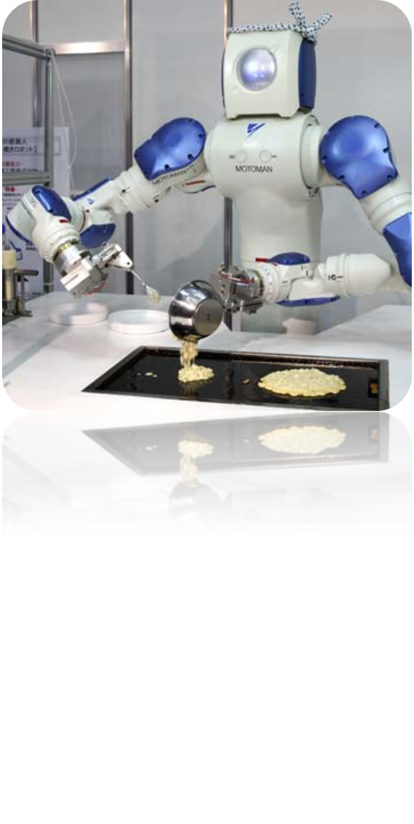
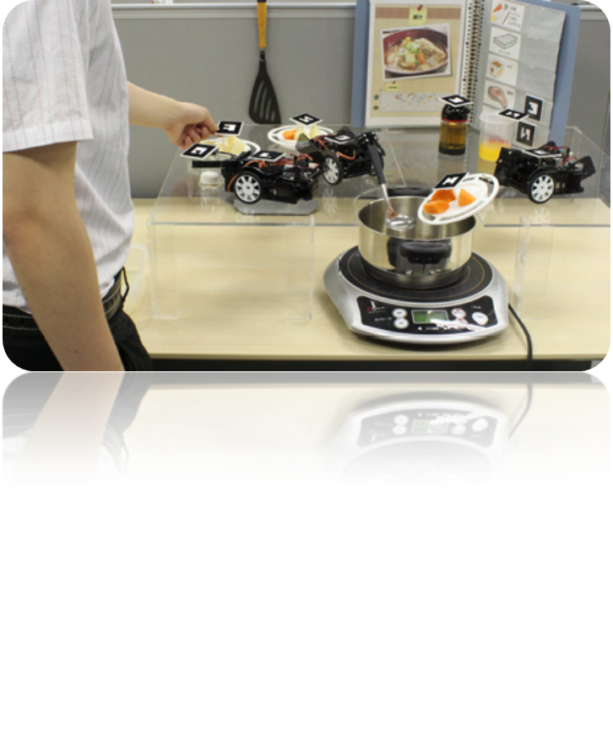
Robot cook VS robot cooking assistant
Already existing robotic cooks:
  Sugiura, 2010
  Savory pancake robot
Human degraded to assistant
Completely replaces human

Slide 4
Our cooking assistant
Cooking is fun!
Helps learning the best recipies
Focus on HRI

Slide 5
Questions?

