Slide 1
Project
Yang Yang
Zhejiang University
Teaching Assistant：Jintao Su

Slide 2
Node Classification Task
The citation network datasets “Cora”, “CiteSeer” and “PubMed” from the “Revisiting Semi-Supervised Learning with Graph Embeddings” paper. Nodes represent documents and edges represent citation links.
Dataset | #Classes | #Nodes | #Edges
CORA | 7 | 2708 | 5429
CITESEER | 6 | 3312 | 4732

Slide 3
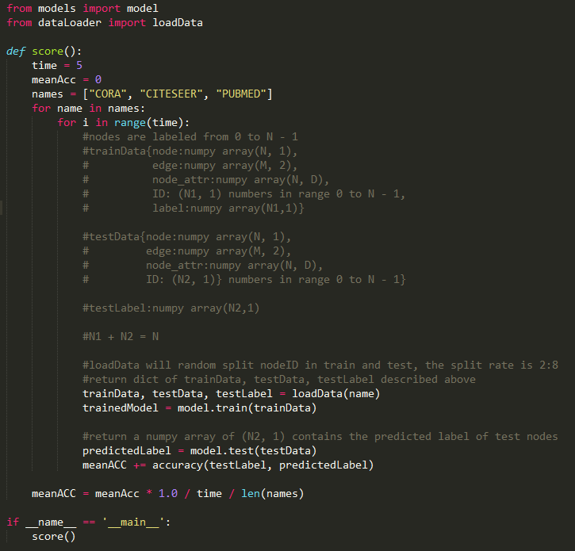
Performance Test Details
Write train, test loadData interface in evaluate.py
Run evaluate.py to get the performance score

Slide 4
Tools/Packages
Python
Pytorch 1.6.0
https://pytorch.org/get-started/previous-versions/
Anaconda
Cuda 10.1
Pytorch-geometric
https://pytorch-geometric.readthedocs.io/en/latest/index.html
https://pytorch-geometric.com/whl/torch-1.6.0.html

Slide 5
Grade（100）
Documents（50）
Algorithms, framwork, finalResult(meanACC)
Be clear
Codes（25）
Readability
Completeness
Performance（25）
$$Max(60, 100−\left(ACC_{max}−ACC_{yours}\right))$$
The code can not run. (60)
Utilizing test label or full datasets to train model. (60)

Slide 6
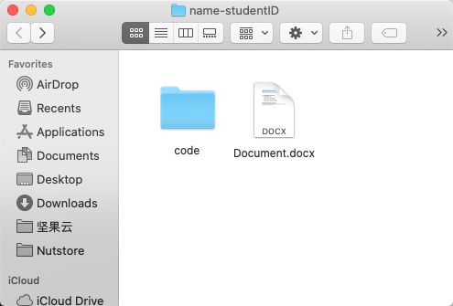
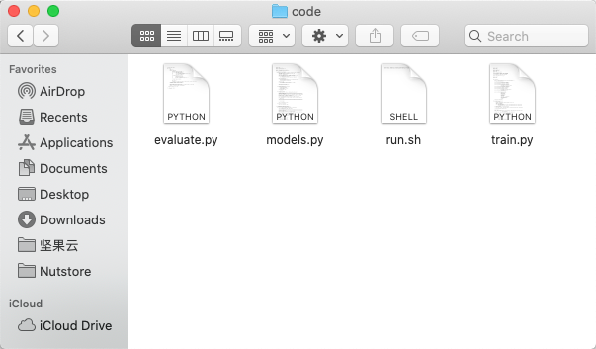
Submit
Code
Documents
Delete data directory
Compressed as zip submit to jtsu@zju.edu.cn

