Slide 1
Overview
System Programming in C
Baojian Hua
bjhua@ustc.edu.cn

Slide 2
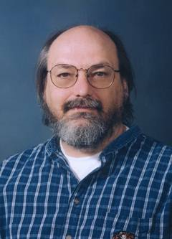
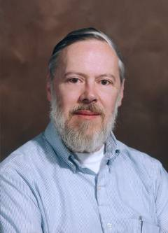
The C Programming Language
Capsule history:
BCPL → B → C → K&R C → ANSI C → C99
1960 1970 1972 1978 1988
LISP → Smalltalk → C++ → Java
1960’s 1970’s 1980’s 1994
C#
2000
ACM图灵奖得主：
“在C和Unix上的贡献”

Slide 3
The C Programming Language
C is a system programming language
Originally invented to write Unix
later Linux and Windows
Data types and control structures close to low-level machines
So you know system deeper, you program better
Pros and cons:
Can do whatever you want: flexible and powerful
Can do whatever you do NOT want: shoot yourself in the foot

Slide 4
What is this course about?
System programming in C:
C is the most widely-used system language
OS kernels, network stack, compiler, DB, …
C is low-level
Device driver, embedded (real-time) system, …
Closely related with architectures
Motivating ideas for other languages
C++/Java/C# etc.

Slide 5
What is this course about?
System interfaces
POSIX interfaces
As implemented by almost all operating systems
And build interesting applications on top of such interfaces

Slide 6
Course Topics
50-60:
Programming languages
60-70:
Uni-processor
70-80:
Networking
90-00:
Multi-core
00-10:
Cloud
10-~:
AI
…
Topics:
language tools (compiler, assemblers, linkers, loaders)
Topics:
multi-process
Topics:
Networking programming
Topics:
Concurrency
Topics:
Distribution
Topics:
Hetergerous

Slide 7
Goal of this course
Solid C programming skill:
C is crucial for CS
Foundations for later computer courses
System programming skills
Be experienced system programmers
Familiarize you with computational thinking
e.g.: abstraction (ADT), recursion

Slide 8
How this course works?

Slide 9
Administrivia
Instructor:
Hua, Baojian
TAs:
Ma, Jingnan
Xu, Hao
Zhao, Jiacheng

Slide 10
Course Home Page
Home page
https://csslab-ustc.github.io/courses/sysprog/
Course administrivia
Lecture notes
Lab
Resources
Check course home page frequently

Slide 11
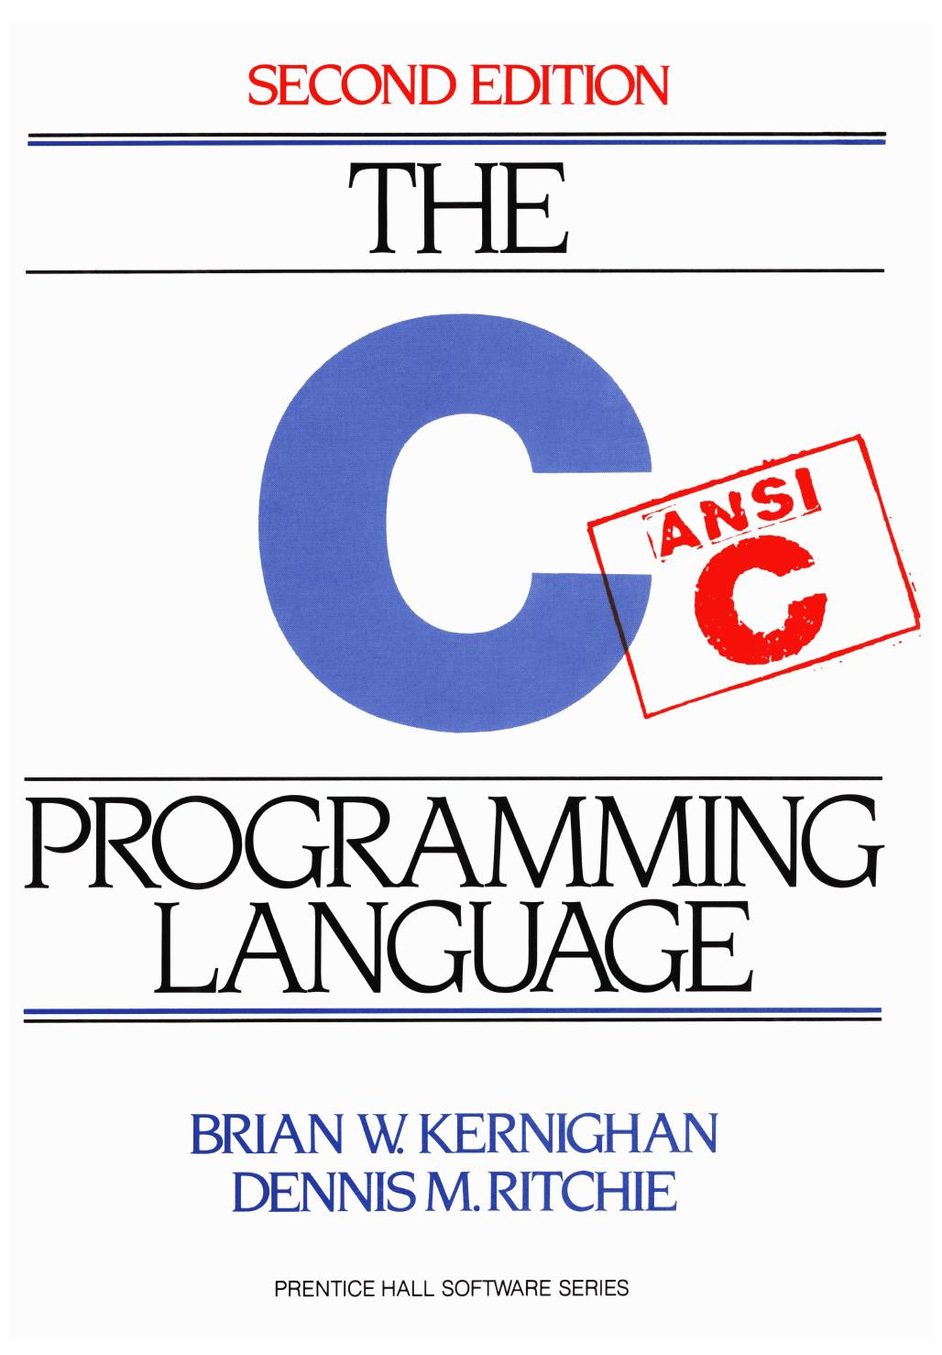
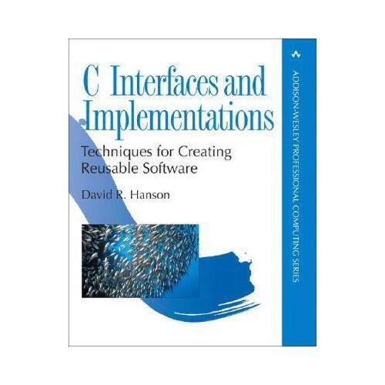
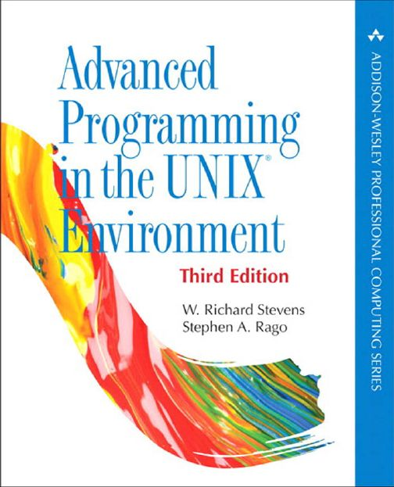
Textbooks and References
The C Programming Language (Second Edition) . Kernighan and Ritchie, 1988.
C Interface and Implementation, 2002.
Unix System Programming. Rietchard Stevens.

Slide 12
Labs
There are 6 labs (tentative)
Each consists of some required problems and optional problems (Optional)
Optional assignments are not required, but highly recommended
Solve them independently
Late homework will not be accepted

Slide 13
Labs
No. | Topic | Goal
0 | Software setup | Install the required tools
1 | Compiler | Learn how the tools work
2 | Shell | Learn multi-process programming
3 | Concurrent Objects | Learn multi-threaded concurrent programming
4 | Network sniffer | Learn socket programming
5 | MapReduce | Learn distributed programming
6 | Debugger | Learn software security analysis

Slide 14
Test and Evaluation
No test :-)
Scores
80%: labs
20%: class attending
No one should fail!

Slide 15
Learning by Doing
Get your hands dirty

Slide 16
Any questions?

