Slide 1
System Programming in C 2022-Fall
Review Lecture 01

Slide 2
课程回顾
lec1 Overview
lec2 Character Input and Output
Basic character input and output
lec3 Declarations and Expressions
Variables
Operators
Expressions
lec4 Control Flow
lec5 Functions
lec6 Pointers and Arrays

Slide 3
Overview
C语言特性：
C is a system programming language
flexible and powerful
课程重点：
Modular C programming
System interfaces

Slide 4
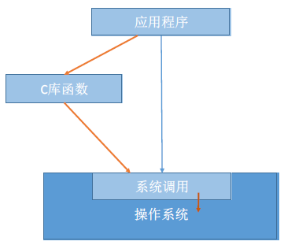
Character Input and Output
Including the Standard Input/Output (stdio) library
#include <stdio.h>
Read a single character
int getchar();
Write a single character
int putchar(int c);

Slide 5
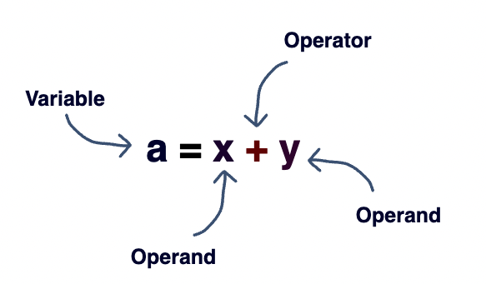
Declarations and Expressions
中缀形式的声明，如int a[]; Java用的是int[] a;
表达式：操作数和运算符的组合

Slide 6
Variables
使用前定义
初始化不等于赋值
int x, y, z; double f; char c = ‘c’;
定义变量时最好进行初始化
int *p;
*p = 5;
xxxx 5

Slide 7
Operators
算术运算符没有溢出检测
没有真正意义上的布尔值
布尔运算符的短路计算规则
x = 9;
if ((3>2) || (x=8));
使用if (!a){…} 而不是if (0 == a){…}

Slide 8
Type Conversion (Cast)
double
float
long
unsigned
int
char
低精度到高精度是安全的

Slide 9
Control-flow
工程
控制程序执行的顺序
C中控制流结构：
顺序
选择
循环
语句：表达式+分号
x = 9;
printf (“hello, world\n”);
块：语句的列表
以{开头，以}结尾
模块
函数
语句（控制流）
表达式

Slide 10
Branch
If-else
if(expression)
statement1
else
statement2
If
if(expression)
statement
Else-If
Switch
switch(expression) {
case const-expr: statements
case const-expr: statements
default: statements
}
if(x == 17)
printf(“in the true branch\n”);
else
printf(“in the false branch\n”);
if(17 == x)
printf(“in the true branch\n”);
else
printf(“in the false branch\n”);

Slide 11
Loop
while & do...while
while(expression)
statement
for
for(expr1; expr2; expr3)
statement
break
continue
goto
goto label;
...
label: statement;
for(…){
for(…){
if(error)
goto handler;
}
}
handler:
error handling code;

Slide 12
Functions
Program
…
file1
filen
…
…
function1
functionm
function1
functionn

Slide 13
External Variables
variable definitions
variable declarations
// file1.c
int i;
float j[10];
int f(){
…;
}
// file2.c
extern int i;
extern float j[];
int g(){
i = 9;
…;
}
gcc
gcc
file1.o
file2.o
ld
a.out

Slide 14
External Variables
优点
数据共享
缺点
模糊了函数和模块之间的联系
涉及链接器的原理

Slide 15
Header Files
// area.c
#include “area.h”
double area(int r){
double pi = 3.14;
double f = pi *r *r;
return f;
}
// area.h
double area(int r);
// main.c
#include “area.h”
int main(){
double f;
f = area (5);
return 0;
}

Slide 16
Conditional Inclusion
#ifndef 标识符 #define 标识符 替换列表 //... #endif
// f1.h
#include “x.h”
...
// f2.h
#include “x.h”
...
// f.c
#include “f1.h”
#include “f2.h”
...
#ifndef _HEADNAME_H_ #define _HEADNAME_H_ //头文件内容 #endif

Slide 17
Pointers
内存模型
int x = 88;
int *p;
p = &x;
p = (int *)1000;
*p = 99;
?
1000
x=99
x=88
p
?
1004
?
1008
?
1012
?
1016

Slide 18
Pointers and Function Arguments
按值调用策略
指针作为函数参数
访问调用者的数据
修改参数的值
隐式的返回数据
void swap (int *x, int *y)
{
int temp;
temp = *x;
*x = *y;
*y = temp;
}
// and a call:
swap (&a, &b);

Slide 19
Arrays
内存模型
int a[5];
int *p;
p = &(a[0]);
a
?
0
?
1
p
?
2
?
3
?
4

Slide 20
Function pointers
int sum (int x, int y)
{
int temp;
temp = x + y;
return temp;
}
int main ()
{
int (*f1)(int, int);
int (*f2)(int, int);
f1 = &sum;
f2 = sum;
f1 (3, 4);
(*f2) (7, 8);
return 0;
}
f1
1000
sum:
temp=x+y
1004
f2
return temp
1008
?
1012
?
1016

Slide 21
Function pointers
Function pointers make functions first-class:
assignment
passed as arguments, returned as results
stored in data structures

Slide 22
Function as Arguments
回调函数
void qsort(void *base, size_t nitems, size_t size,
int (*compar)(const void *, const void*))
int compare (const void * a, const void * b){
return ( *(int*)a - *(int*)b );
}
int main (){
int values[] = { 40, 10, 100, 90, 20, 25 };
qsort (values, 6, sizeof(int), compare);
return 0;
}

Slide 23
Function as Return Values
int (*f(int)) (int, int);
int (*f(int kind)) (int, int)
{
switch (kind) {
case 0:
return sum;
case 1:
return mult;
default:
error (“…”);
return NULL;
};
}

Slide 24
Functions Stored in Data Structures
// As the function name is just a pointer, so it
// is possible to store functions in any other
// data structures.
// For instance:
int (*A[3])(int, int);
// declares a 3-element array A, with each slot a
// function of type “int * int -> int”.
// Sample operations on this array A:
A[0] = sum;
A[1] = mult;
A[2] = div;
// … and a call:
A[1](8, 9);
A
sum
mult
div

