Slide 1


Mobility-Aware Dynamic Taxi Ridesharing
Zhidan Liu, Zengyang Gong, Jiangzhou Li, Kaishun Wu
Shenzhen University, Shenzhen, China
23. April, 2020
Notes:
Good XXX everyone, I am Zengyang gong from Shenzhen University, China
Today I’ll present our work “Mobility-Aware Dynamic Taxi Ridesharing”

Slide 2
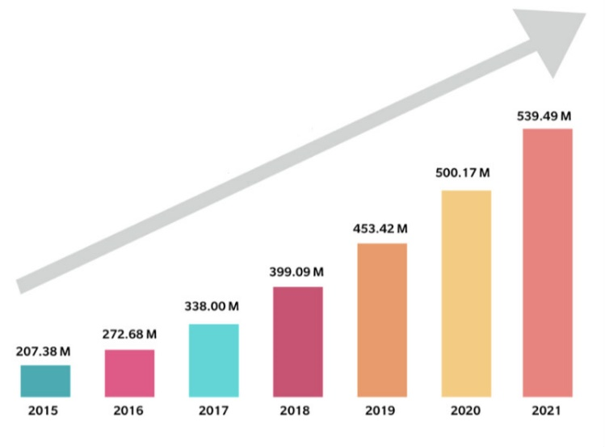

Ridesharing
Ridesharing allows multiple passengers with the similar itineraries and time schedules to share a vehicle.
It benefits many parts, e.g., alleviating traffic congestion, reducing energy consumption, etc.
Ridesharing becomes popular worldwide.
Notes:
[1]https://www.poparide.com/blog/ridesharing-vs-ridehailing/
Our paper is about ridesharing. Ridesharing means multiple passengers with the similar origins, destinations and schedules share one vehicle. And they also share the travel cost equally. Besides that, ridesharing can also alleviate traffic congestion and reduce energy consumption.
Because of the tremendous benefits of ridesharing, it becomes promising and attract more and more users

Slide 3

Taxi Ridesharing
Taxi is an important transportation mode in all cities.
Taxis are widely available in a city, and are operating in 7x24.
Taxis can be either booked online, or hailed along the street.
Taxi ridesharing becomes promising ^{[1-3]} .
[1] S. Ma, Y. Zheng, O. Wolfson, et al. Real-time city-scale taxi ridesharing. IEEE Transactions on Knowledge and Data Engineering, 27(7):1782–1795, 2015.
[2] Q. Ma, Z. Cao, K. Liu, and X. Miao. QA-Share: toward an efficient QoS-aware dispatching approach for urban taxi-sharing. ACM Transactions on Sensor Networks, 16(2):1–21, 2020.
[3] W. Zhang, A. Shemshadi, Q. Z. Sheng, Y. L. Qin, X. Xu, and J. Yang. A user-oriented taxi ridesharing system with large-scale urban GPS sensor data. IEEE Transactions on Big Data, 1(1):1–14, 2019.
Notes:
In the meanwhile, because taxi is an important transportation mode in cities, taxi ridesharing also attract many researchers

Slide 4
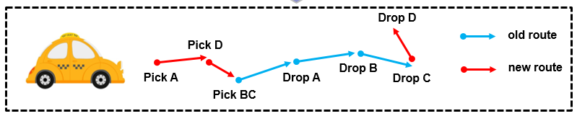

Modeling of taxi ridesharing systems
Ride Request $r_{i}=<t_{r_{i}},o_{r_{i}},d_{r_{i}},e_{r_{i}}>$
$o_{r_{i}},d_{r_{i}}$: origin and destination
$t_{r_{i}}$, $e_{r_{i}}$: release time and delivery deadline
Taxi Status $t_{j}=<loc_{t_{j}},S_{t_{j}},R_{t_{j}}>$
$loc_{t_{j}}$: current location
$S_{t_{j}}$ : taxi schedule, a sequence of origins and destinations
$R_{t_{j}}$ : taxi travel route
Taxi ridesharing is dynamic and challenging, since requests are generated on the fly and taxi schedules are continuously updated.
Notes:
And then, we first introduce some basic concepts in our work.
The i_th ride request is denoted by r_i, where o,d is the origin and destination of this passenger. t and e are the release time and deadline respectively.
The request must be delivered to destination before deadline.
Then the j_th taxi in the city is defined as t_j, with a location loc, a schedule s and a route R.
The schedule is a list of pick-up or drop-off locations of passengers.
The taxi route is generated according to taxi schedule, which indicates the travel path for any two locations in
Schedule.
Taxis are distributed all over the city, and because of the popularity of mobility apps like uber and didi, passengers can submit their requests at anywhere and anytime if they want. Taxi ridesharing is highly dynamic, and this problem is NP-hard

Slide 5
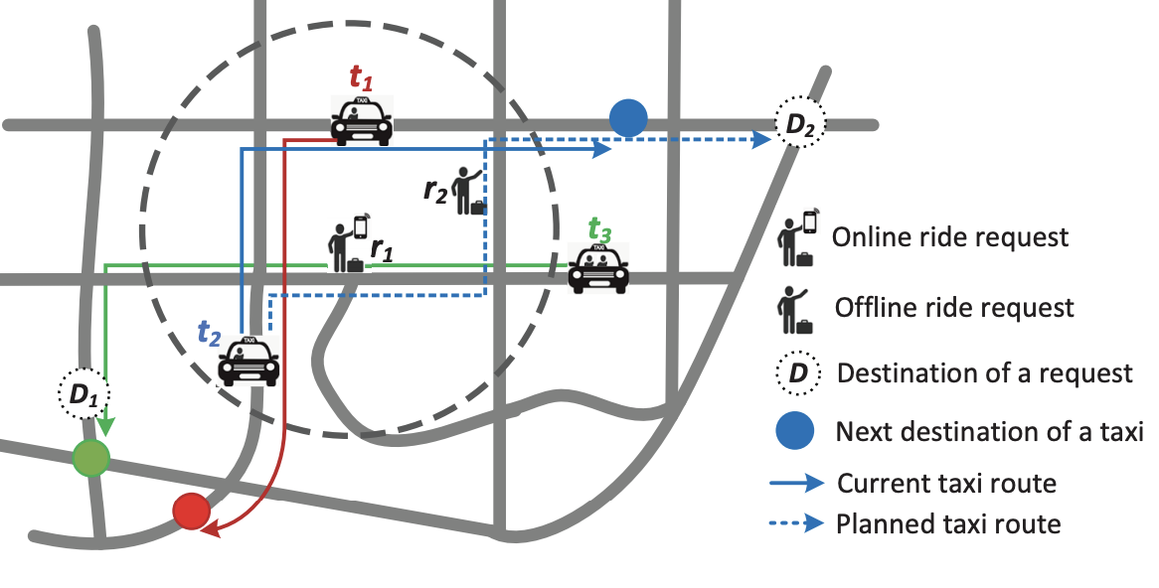

Existing solutions
Existing systems ^{[1-5]} process a ride request in two stages
Candidate taxi searching
E.g., $t_{1}$ and $t_{2}$ for $r_{1}$
Ridesharing routing
Updating schedule/route
[1] S. Ma, Y. Zheng, O. Wolfson, et al. Real-time city-scale taxi ridesharing. IEEE Transactions on Knowledge and Data Engineering, 27(7):1782– 1795, 2015.
[4] N. Ta, G. Li, T. Zhao, J. Feng, H. Ma, and Z. Gong. An efficient ridesharing framework for maximizing shared route. IEEE Transactions on Knowledge and Data Engineering, 2018.
[5] Y. Xu, Y. Tong, Y. Shi, Q. Tao, K. Xu, and W. Li. An efficient insertion operator in dynamic ridesharing services. In IEEE ICDE, 2019.
Notes:
Recently, there are some works about ridesharing have been published. They usually solve this problem in two steps, candidate taxis searching and ridesharing routing. Specifically, for this example, when passengers r_1 submit his request, ridesharing system return taxi t_1 and t_2 as the candidate taxis to serve him, because these two taxis are in the searching radius around his origin. And in the second step, ridesharing system traverse the candidate taxis to find a taxi with the minimal detour cost to serve r_1

Slide 6
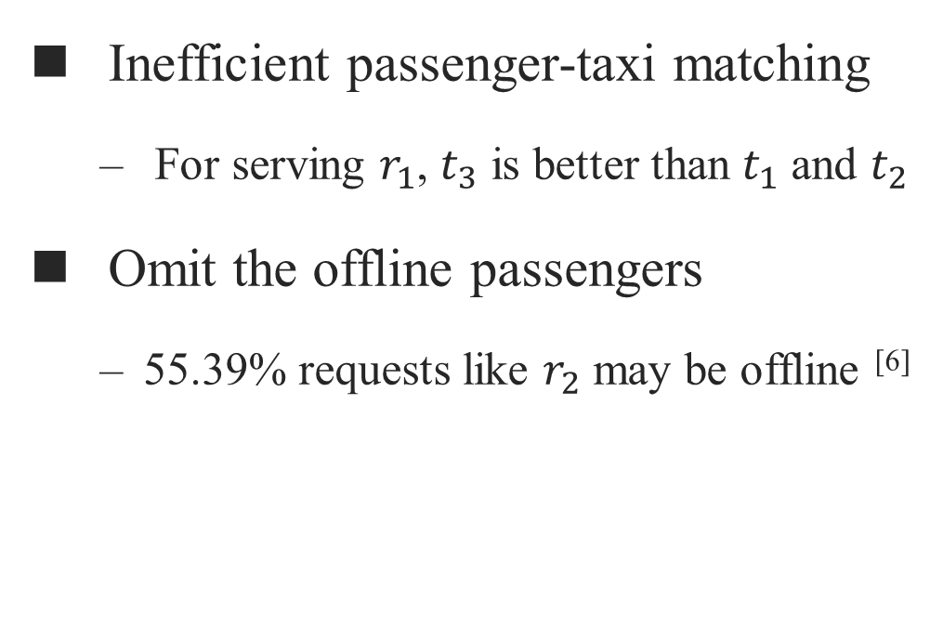
Limitations of existing solutions
Inefficient passenger-taxi matching
For serving $r_{1}$, $t_{3}$ is better than $t_{1}$ and $t_{2}$
Omit the offline passengers
55.39% requests like $r_{2}$ may be offline ^{[6]}
[6] Taxi service research report. http://www.transformcn.com/Topics/ 2018-08/02/b7944fb3-1b99-4840-89d7-eecaaec67bea.pdf.
Notes:
These works may not work well in the realworld, because these works have some obvious limitations. For example, in the first step, r_1’s destination or travel direction is not taken into consideration.
Taxi t_1 and t_2’s traveling direction is quite different with r_1’s traveling direction, may involve unnecessary extensive computations.
But taxi t_3 can serve r_1 without detour cost, but t_3 is not in the candidate taxis of r_1.
Besides that, since passenger r_2 who hail a taxi at roadside does not explicitly report his request, no taxi will serve r_2 according to all existing works.

Slide 7
Problem statement
The mobility-aware taxi ridesharing (MTR) problem
Given:
A road network G
A set of taxis T
A set of requests R, including online and offline requests to predict
Calculate the schedule/route for each taxi, so as to
Maximize the number of served ride requests
Minimize the total detour cost
Constraints:
Capacity of each taxi
Delivery deadline of each request
Notes:
Finally, we define the mobility-aware taxi ridesharing problem.
Given both the online and offline ride requests in the city, and taxis.
Our goals are maximized the number of served ride requests while the total detour cost is minimized.
And at the same time, the arrangement between taxi and ride request should meet two constraints.

Slide 8
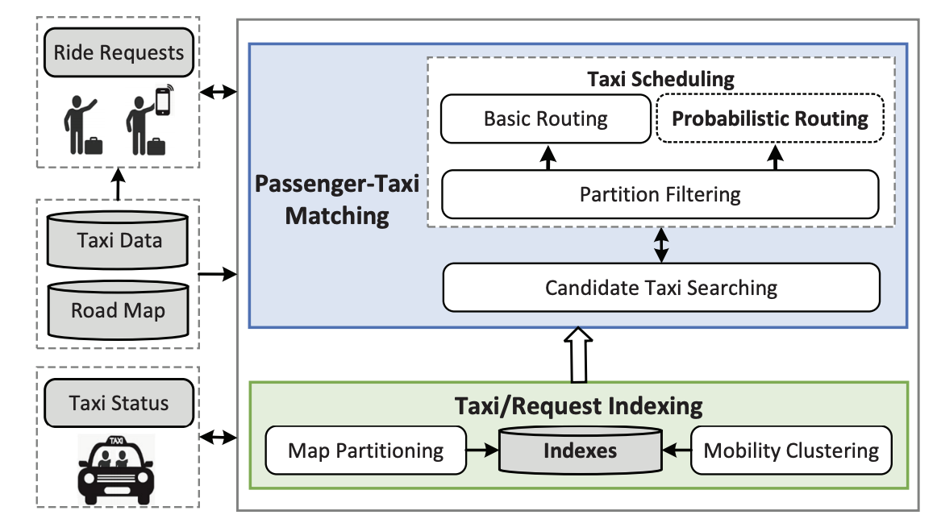
Our solution: mT-Share
Notes:
Then I will introduce our solutions to solve mobility-aware taxi ridesharing problem
Our ridesharing system architecture is illustrated in this picture.
mT-Share consists of two major modules, Taxi/Request Indexing and Passenger-Taxi Matching.
Specifically, the Taxi/Request Indexing module makes use of mobility patterns and map partitions to index and track the taxis and requests.
Built on such indexes, the Passenger-Taxi Matching module searches candidate taxis and determines the best taxi to serve a ride request.
Both basic routing and probabilistic routing are supported by our system, and probabilistic routing is specially devised to allow a taxi to meet suitable offline ride requests with high probability
Then I will introduce each part of mT-Share

Slide 9

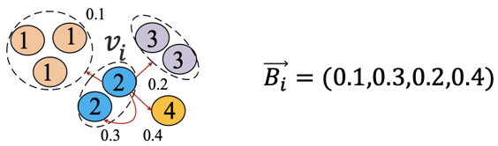
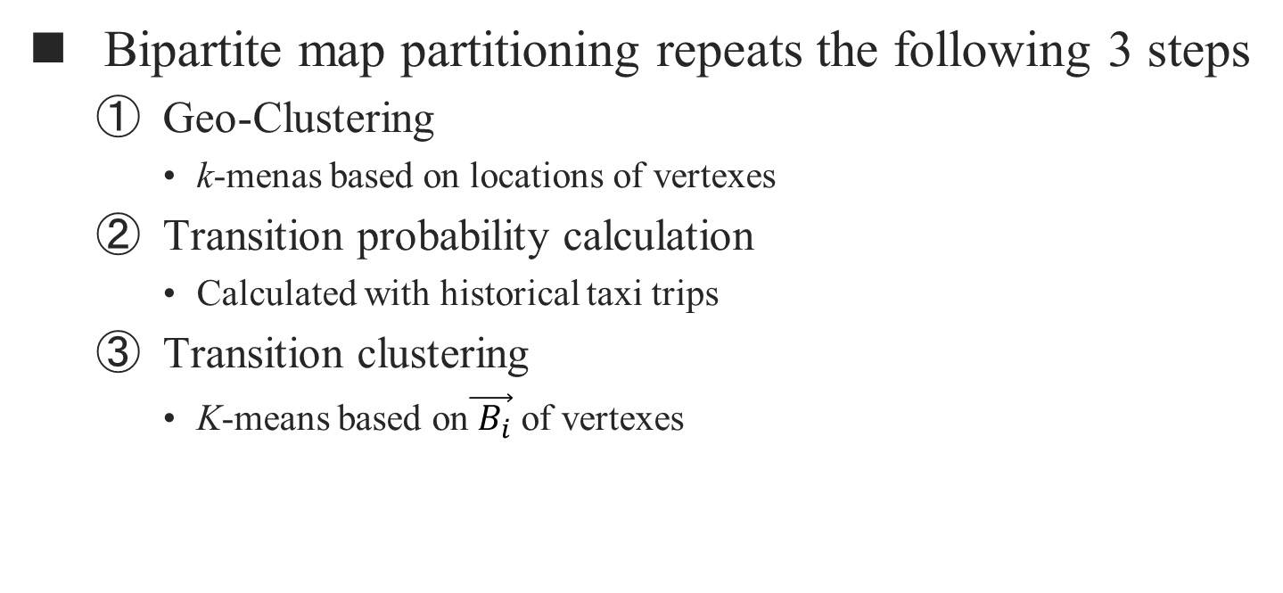
Taxi/request indexing
Bipartite map partitioning repeats the following 3 steps
Geo-Clustering
k-menas based on locations of vertexes
Transition probability calculation
Calculated with historical taxi trips
Transition clustering
K-means based on$\vec{{ B}_{i}}$ of vertexes
Notes:
//Different from existing works only using spatial grids of the road network to index taxis and requests.
//Our system makes use of both geographical locations and travel directions of taxis and requests for better //indexing
In Taxi/Request Indexing part, we first use a bipartite map partitioning to groups road network vertices into clusters.
In the first step Geo-clustering, we use k-means to group vertices based on their longitude and latitude, then we calculate the probability of ride requests traveling from each vertex to each clusters get from Geo-clustering, and then build a probability vector for each vertex, and then we use another k-means to group vertices based on their probability vector.
For example, at this picture, after geo-clustering, we can get 4 groups of vertices, ride request start from vertex v_i in group 2, has the probability travel to group1,2,3,4 as 0.1,0.2,0.3,0.4 from historical taxi data. Then we use the K-means to group vertices again as probability vector as the feature of each vertex.

Slide 10
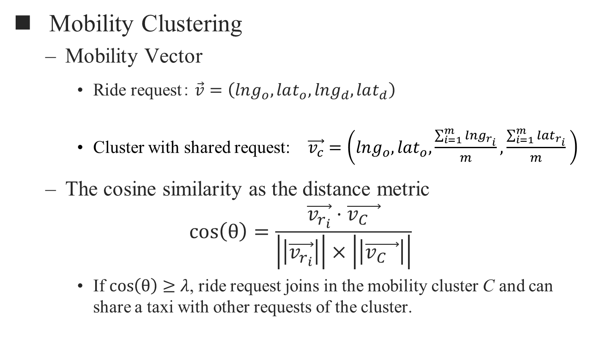
Taxi/request indexing
Mobility Clustering
Mobility Vector
Ride request： $\vec{v}=\left(lng_{o}, lat_{o},lng_{d}, lat_{d}\right)$
Cluster with shared request: $\vec{v_{c}}=\left(lng_{o},lat_{o},\frac{\sum_{i=1}^{m}{{lng}_{r_{i}}}}{m},\frac{\sum_{i=1}^{m}{{lat}_{r_{i}}}}{m} \right)$
The cosine similarity as the distance metric
$$\cos\left(θ\right)=\frac{\vec{v_{r_{i}}}⋅\vec{v_{C_{}}}}{\left|\left|\vec{v_{r_{i}}}\right|\right|×\left|\left|\vec{v_{C_{}}}\right|\right|}$$
If $\cos\left(θ\right)$ $≥$ $λ$, ride request joins in the mobility cluster C and can share a taxi with other requests of the cluster.

Slide 11
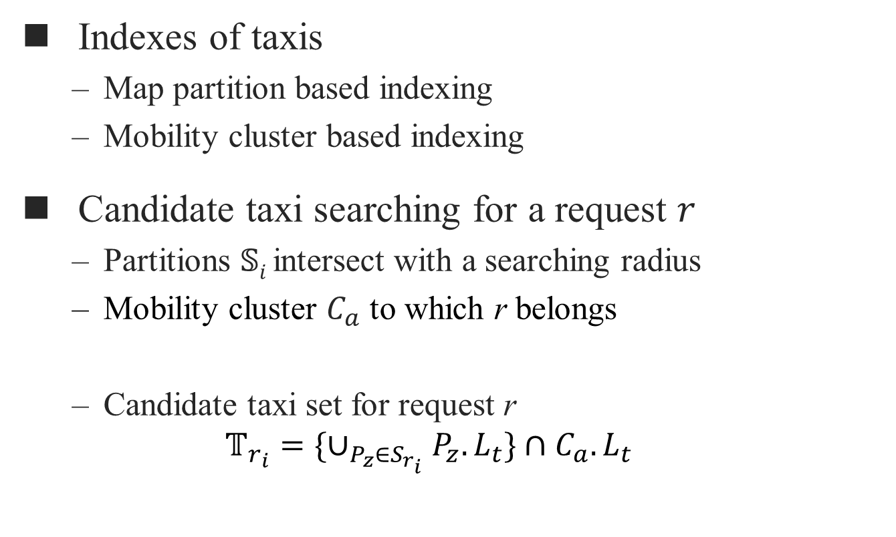
Candidate taxi searching
Indexes of taxis
Map partition based indexing
Mobility cluster based indexing
Candidate taxi searching for a request $r$
Partitions $𝕊i$intersect with a searching radius
Mobility cluster $C_{a}$ to which r belongs
Candidate taxi set for request r
$$𝕋_{r_{i}}=\{∪_{P_{z}∈S_{r_{i}}}P_{z}.L_{t}\}∩C_{a}.L_{t}$$
Notes:
Based on the map partition and mobility cluster in the city.
For each ride request r_i, we can first retrieve taxis in the partitions near his origin and then according his mobility vector, we can also easily find a mobility cluster he belongs.
Then we can determine the candidate taxi set can serve r_i is the intersection taxi set from two taxi sets, one is the taxi set in the map partitions and the other is the taxi set in the mobility cluster.

Slide 12
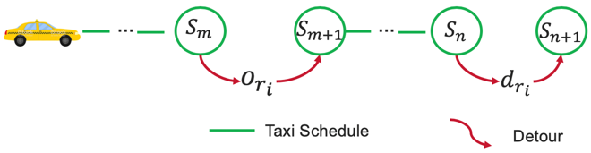
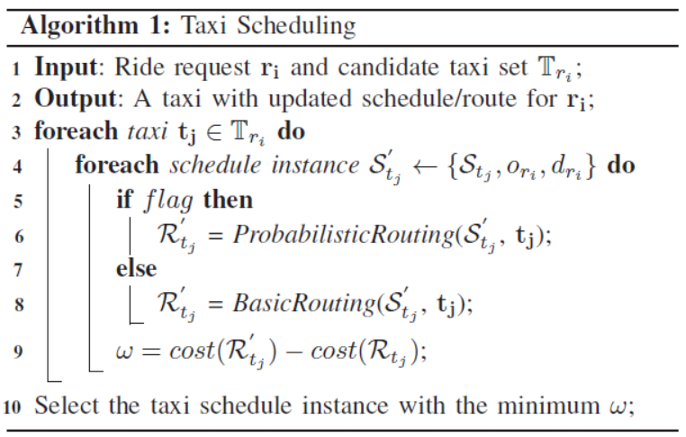
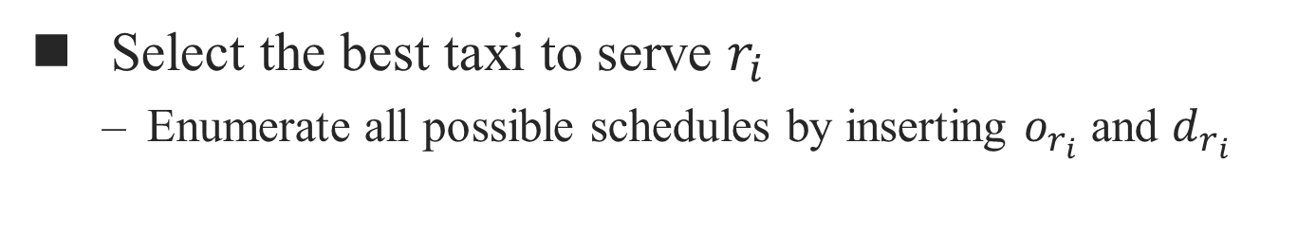
Taxi scheduling
Select the best taxi to serve $r_{i}$
Enumerate all possible schedules by inserting $o_{r_{i}}$ and $d_{r_{i}}$
Notes:
After getting the candidate taxi set， we use taxi scheduling to find a taxi to serve r_i.
Given a taxi schedule, taxi scheduling aims to find the appropriate location to insert the new request origin and destination.
Specially,if a taxi has sufficient empty seats while there are few online ride requests right now, the taxi driver can enable probabilistic routing that will plan a route to meet the suitable offline ride requests with high probability, otherwise we choose basic routing to find a shorteset path

Slide 13
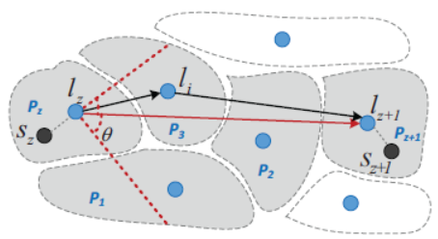
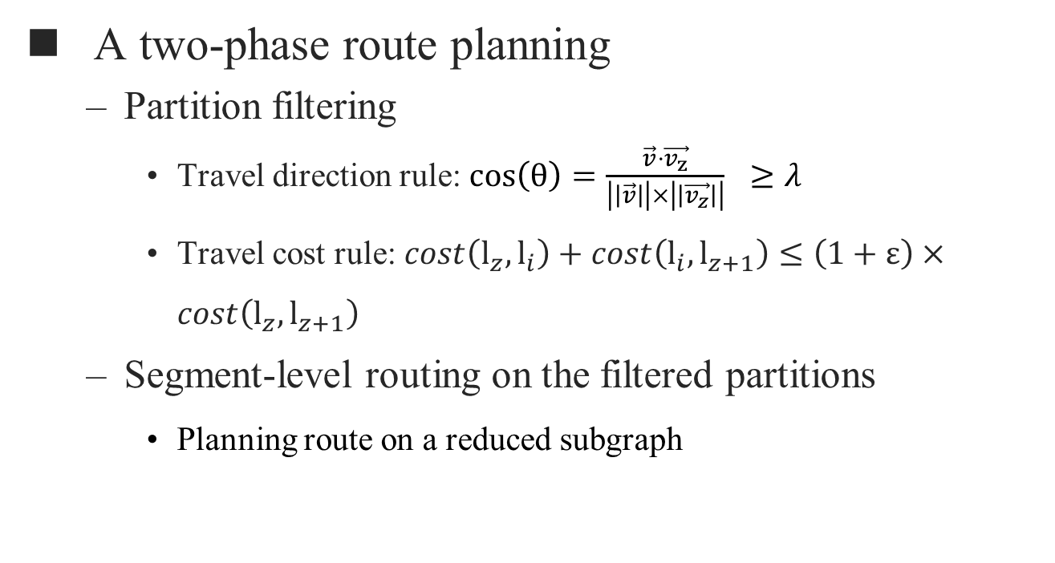
Route planning
A two-phase route planning
Partition filtering
Travel direction rule: $\cos\left(θ\right)=\frac{\vec{v}⋅\vec{v_{z}}}{\left|\left|\vec{v}\right|\right|×\left|\left|\vec{v_{z}}\right|\right|} ≥λ$
Travel cost rule: $cost\left(l_{z},l_{i}\right)+cost\left(l_{i},l_{z+1}\right)≤\left(1+ε\right)×cost\left(l_{z},l_{z+1}\right)$
Segment-level routing on the filtered partitions
Planning route on a reduced subgraph
Notes:
Since route planning is usually the efficiency bottleneck of taxi scheduling, mT-Share proposes a two-phase route planning to optimize both basic routing and probabilistic routing.
Given a schedule instance S, mT-Share plans the route for each consecutive event pair (sz, sz+1) ∈ S tj through two phases
Partition filtering that reduces the searching space based on travel direction rule and travel cost rule for route planning and segment-level routing that returns the final travel path on a much smaller subgraph

Slide 14
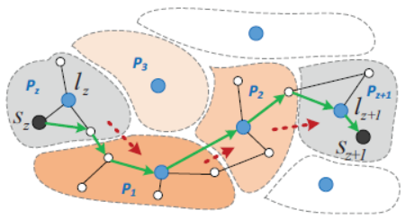
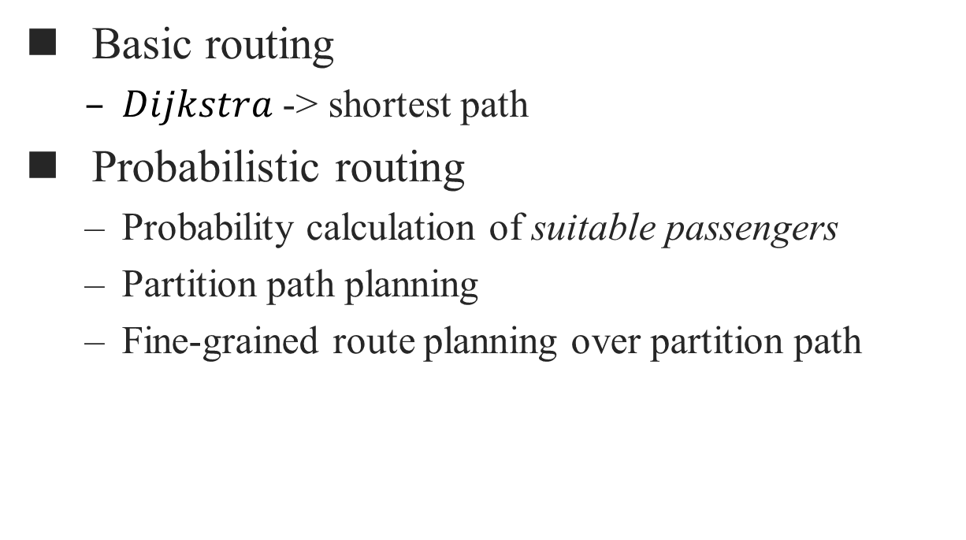
Segment-level routing
Basic routing
$Dijkstra$ -> shortest path
Probabilistic routing
Probability calculation of suitable passengers
Partition path planning
Fine-grained route planning over partition path
Notes:
After filtering, basic routing and probabilistic routing are executed efficiencily.
As for basic routing, it uses Dijkstra to find the shortest path between two road vertex.
As for probabilistic routing It supports a taxi to opportunistically encounter suitable offline ride requests who has similar direction as the given taxi, it first calculated a partition path with the maximum probability of meeting suitable offline ride requests, and then we try to get a shortest path in the partition path.

Slide 15
Experimental setup
Dataset
7065907 taxi transactions from Chengdu City, 01/11/2016-31/11/2016, released by Didi GAIA^{[7]}
Road Network graph: 214,440 vertices & 466,330 edges
Simulation scenarios
Peak scenario: 8:00AM-9:00AM in a workday, with the most requests, i.e., 29,534.
Non-peak scenario: 10:00AM-11:00AM in a weekend with 15480 requests and 5000 are randomly selected to be the offline requests.
[7] Gaia initiative. https://outreach.didichuxing.com/research/opendata.
Notes:
We evaluate our system on a public dataset.
The taxi data from chengdu city ,china consists more than 7 Million trasactions.
And the road net work consists of more than 20 thousands vertices and 40 thousands edges
We evaluate mt-share in two scenarios, peak and non-peak. In non-peak scenario, we randomly selected 5000 requests to be offline

Slide 16
Experimental setup
Compared schemes
No-Sharing
T-Share from ^{[1]}
pGreedyDP ^{[8]}
mT-Sharepro (enabling the probabilistic routing)
Performance metrics
Number of served requests
Response time
Detour time
[1] S. Ma, Y. Zheng, O. Wolfson, et al. Real-time city-scale taxi ridesharing. IEEE Transactions on Knowledge and Data Engineering, 27(7):1782– 1795, 2015.
[8] Y. Tong, Y. Zeng, Z. Zhou, L. Chen, J. Ye, and K. Xu. A unified approach to route planning for shared mobility. Proceedings of the VLDB Endowment, 11(11):1633–1646, 2018.

Slide 17
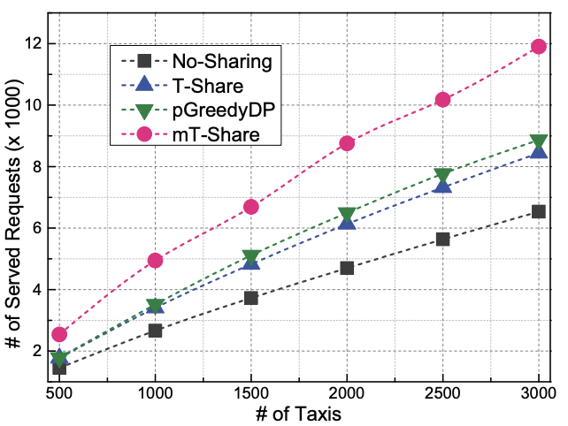
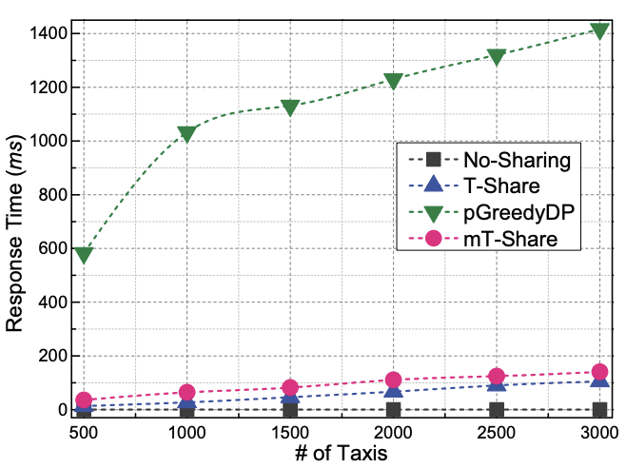
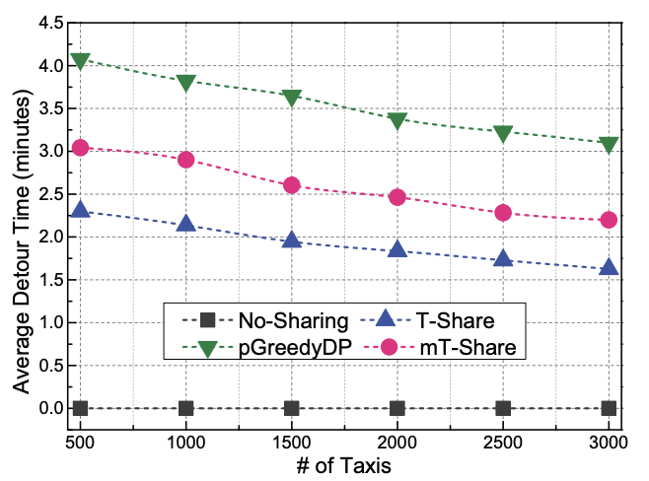
Results in peak-scenario
# of Served Requests
Response time
Detour time
mT-Share responses a ride request within 35 ∼ 140 ms, and serves 42% and 36% more ride requests than T-Share and pGreedyDP.

Slide 18
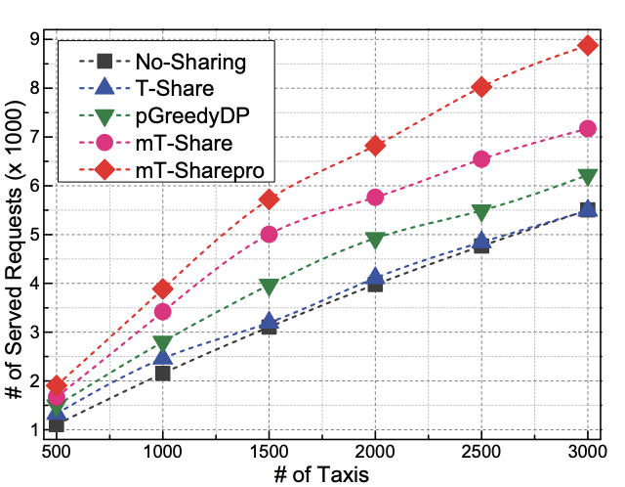
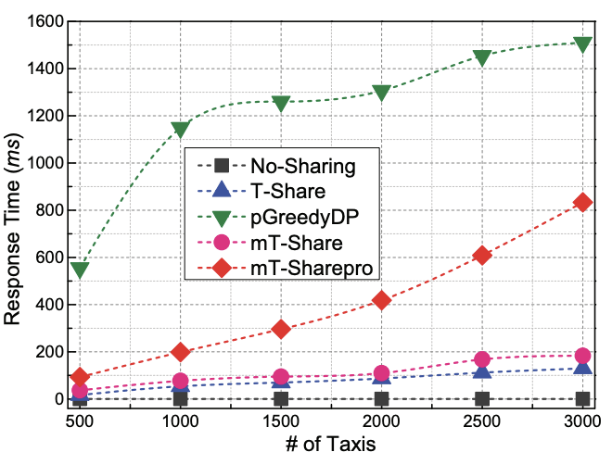
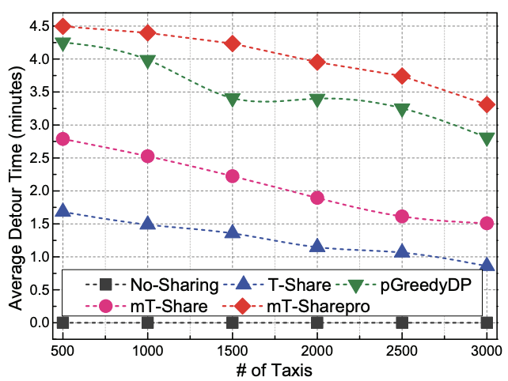
Results in non-peak scenario
# of Served Requests
Response time
Detour time
Because of the probabilistic routing, mT-Sharepro can server 13% ~ 24% more offline ride requests than T-Share and pGreedyDP.

Slide 19
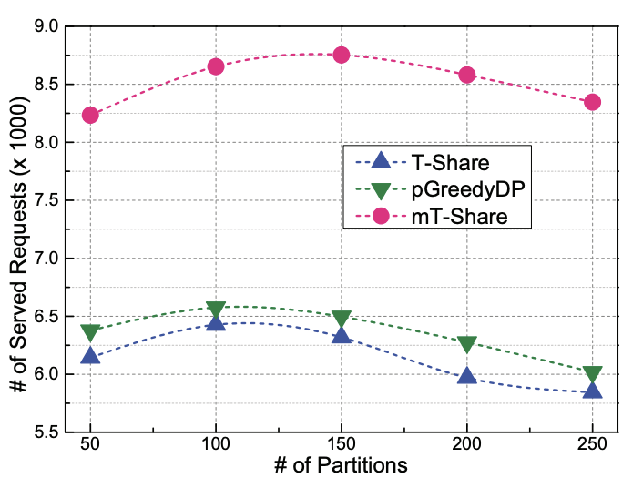
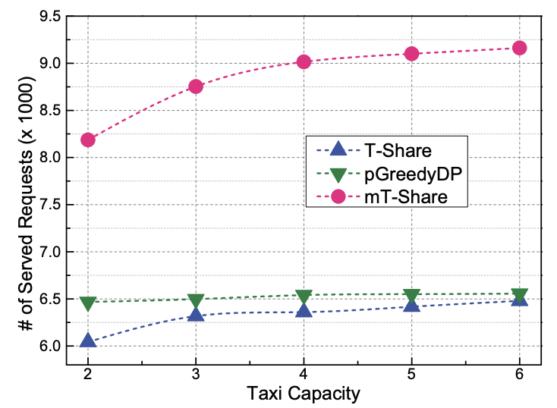
Experiments on parameter settings
Impact of Partition Number
Impact of Capacity
Both too small or oversize partitions will result in a reduced candidate taxi set, and thus affect the ridesharing performance.
mT-Share benefits a lot from the larger taxi capacity, while the impact on pGreedyDP is limited.

Slide 20
Conclusion
We consider a novel moility-aware taxi ridesharing problem to serve both offline and online ride requests.
We propose a novel scheme named mT-Share to improve existing works by fully exploiting the mobility information of taxis and requests.
Experiments on real-world taxi data show that mT-Share can serve 42% and 62% more ride requests in the peak and non-peak hours than state-of-the-art methods.

Slide 21
Thank You! Q & A

Slide 22
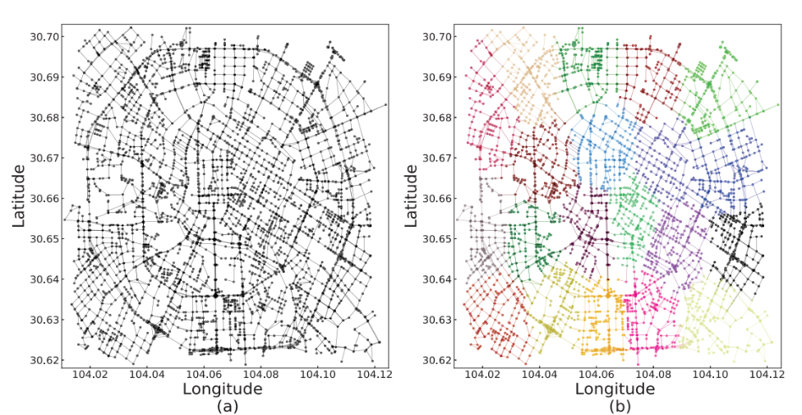
Backup: road network and map partitions
Road network of Chengdu city from OSM

Slide 23
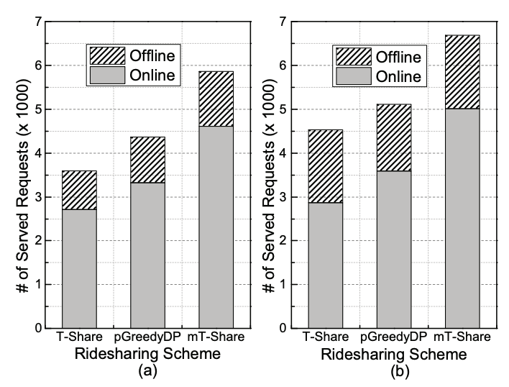
Backup: impact of routing scheme
Combine basic routing or probabilistic routing with T-Share, pGreedyDP, and mT-Share
With probabilistic routing, T-Share, pGreedyDP, and mT-Share can serve 89%, 46%, and 34% more offline ride requests.

