Slide 1

CPS 4982 – Big Data Analytics
Lecture 1: Big Data Basics
Dr. Changjiang Zhang

Slide 2

Content
What is big data
Sources of big data
Characteristics of big data
Opportunities and challenges
Storage of big data
Processing of big data
Analysis of big data
https://www.youtube.com/watch?v=bAyrObl7TYE
Notes:
Social media, such as Facebook, Twittter, Tiktok, You Tube, QQ, Wechat, etc. and E-commence: Amazon, Alibaba, Jingdong, etc. Smart phone

Slide 3
What is Big Data
Big data refers to data that is too large to store on one machine. It has to be saved on hundreds or thousands of PCs. Data of such scale is called big data.
Big data refers to extensive and complex data sets that exceed the capabilities of traditional data processing tools, typically measured in petabytes and zettabytes.
A single computer is no longer capable of processing big data due to insufficient memory and storage space.
Where do these data come from?
Byte = 8位(bit) 1KB( Kilobyte，千字节)=1024B 1MB( Megabyte，兆字节)=1024KB 1GB( Gigabyte，吉字节，千兆)=1024MB 1TB( Terabyte，万亿字节，太字节)=1024GB 1PB( Petabyte，千万亿字节，拍字节)=1024TB 1EB( Exabyte，百亿亿字节，艾字节)=1024PB 1 ZB(Zettabyte，十万亿亿字节，泽字节)=1024EB 1YB( Yottabyte，一亿亿亿字节，尧字节)=1024ZB BB( Brontobyte，千亿亿亿字节)=1024YB

Slide 4
The Sources of Big Data
These data come from many sources, such as:
Social networking sites: Facebook, Google, and LinkedIn. All these sites generate a huge amount of data on a day-to-day basis, as they have billions of users worldwide.
E-commerce sites: Sites like Amazon, Flipkart, Alibaba, and Jingdong generate a huge amount of logs from which users’ buying trends can be traced.
Weather Station: All the weather stations and satellites give a very huge amount of data, which is stored and manipulated to forecast weather.
Telecom company: Telecom giants like Airtel, Vodafone, China Mobile, China Telecom, etc. study user trends and accordingly publish their plans, and for this, they store the data of its million users.
Share Market: Stock exchanges across the world generate a huge amount of data through their daily transaction.

Slide 5
The Sources of Big Data
Banking, securities, and insurance data
Scientific research data (meteorology, astronomy, geology, physics, etc.)
Various conference papers and journal articles
Biological and medical data (clinical medical data)
Smart manufacturing enterprise production data
Traffic data (surveillance camera video)
Web page information
Email
Social media data(text, images, videos, etc.)
E-commerce data (products, user orders, reviews, etc.)
Etc.
The speed at which data is generated is accelerating, posing significant challenges to the collection, storage, and processing of massive amounts of data.

Slide 6
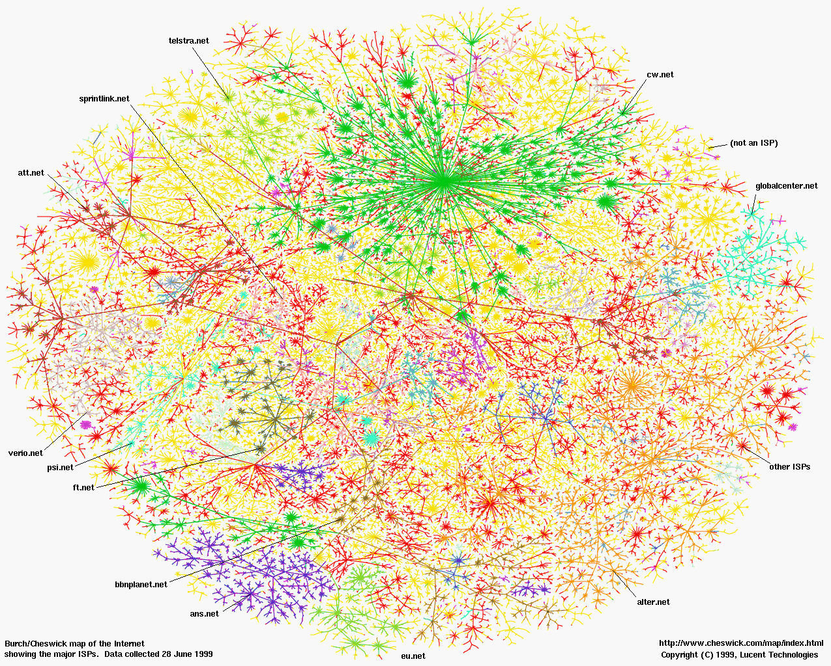
How many websites globally
Year | All Websites | Active Websites
2025 | 1.16 Billion | 199 Million
2024 | 1.08 Billion | 192 Million
2023 | 1.13 Billion | 203 Million
2022 | 1.17 Billion | 199 Million
2021 | 1.20 Billion | 200 Million
2020 | 1.30 Billion | 189 Million

Slide 7
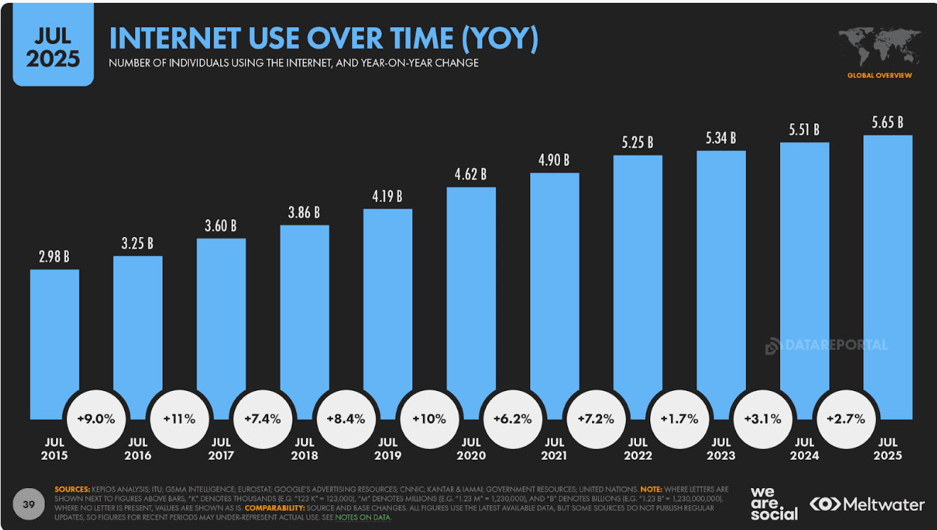
Global internet users
The number of global internet users 5.65 billion in 2025.

Slide 8
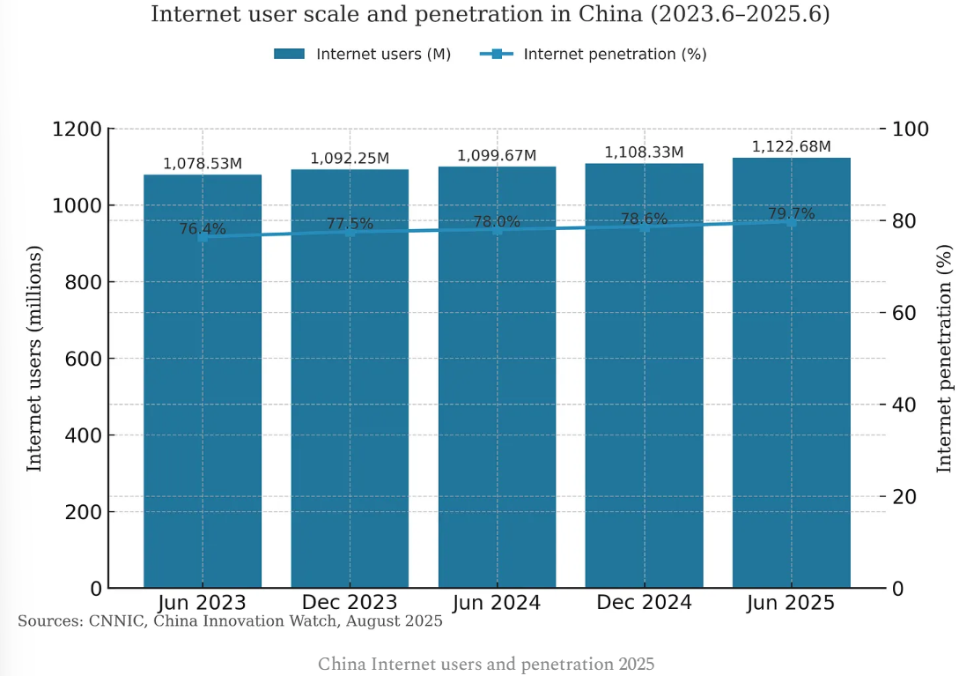
Chinese internet users

Slide 9
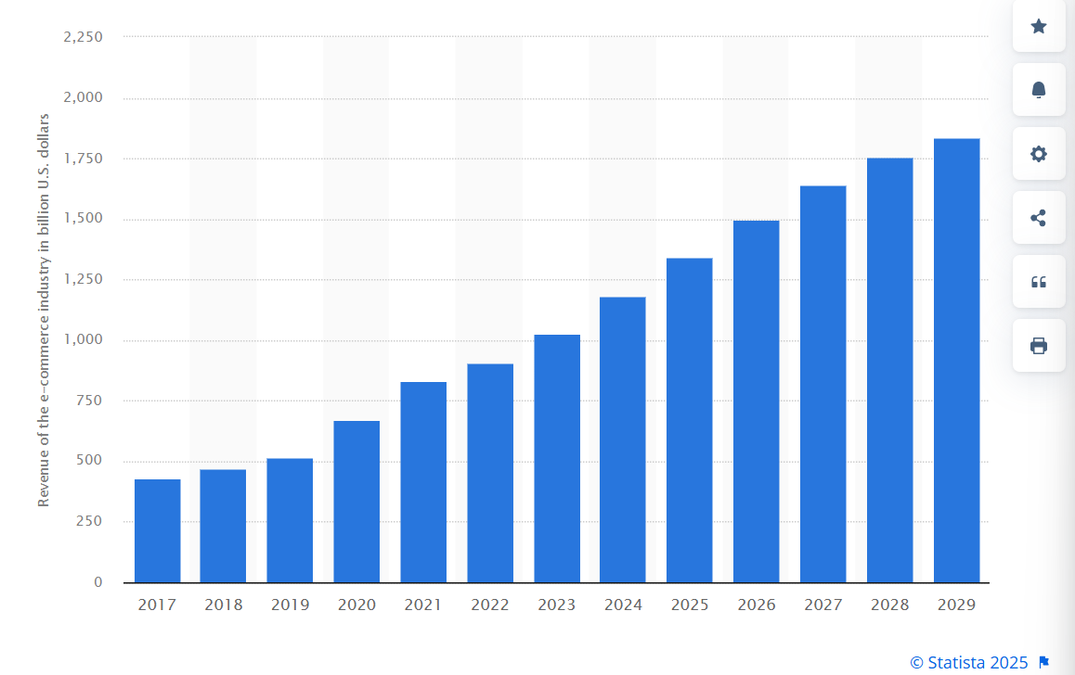
U.S. e-commerce data

Slide 10
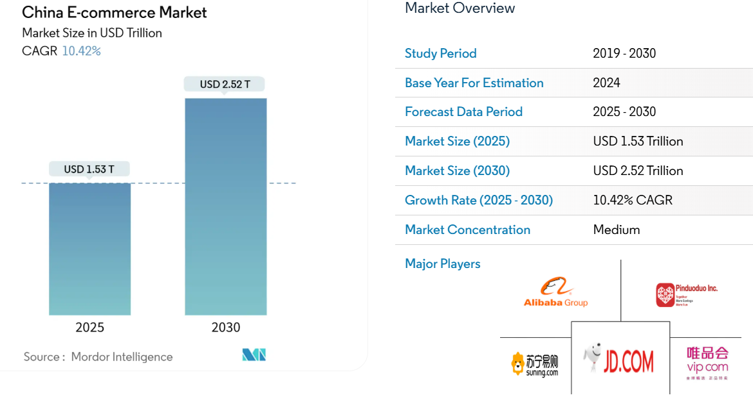
China E-commerce data

Slide 11
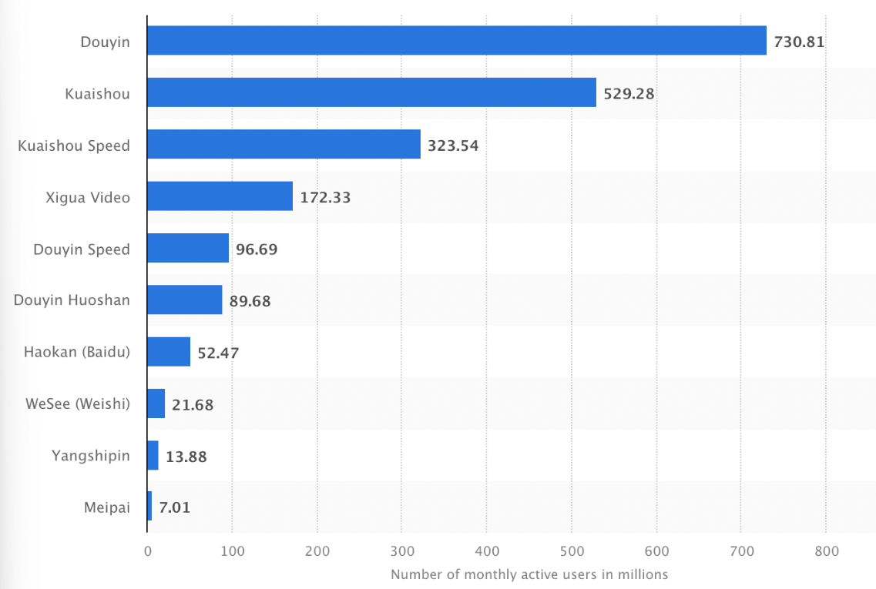
Chinese social media data
抖音
快手
西瓜视频

Slide 12
TikTok Data
Metric | Value (2025)
Global Monthly Active Users | 1.59 billion
User Growth (YoY) | +6.8%
Largest Market | United States
Fastest Growing Market | Indonesia
Gender Split (Global Avg) | 54% female, 46% male
Key Age Group | 18–24 (39% of users)
Region | Monthly Active Users | Stats
Asia-Pacific | 835 million | Fastest growth in Indonesia and Philippines
North America | 198 million | Highest average ad spend per user
Europe | 214 million | Germany and UK are leading markets
Latin America | 172 million | Brazil remains TikTok’s top LATAM market
Middle East/Africa | 141 million | High youth penetration and video sharing rates

Slide 13
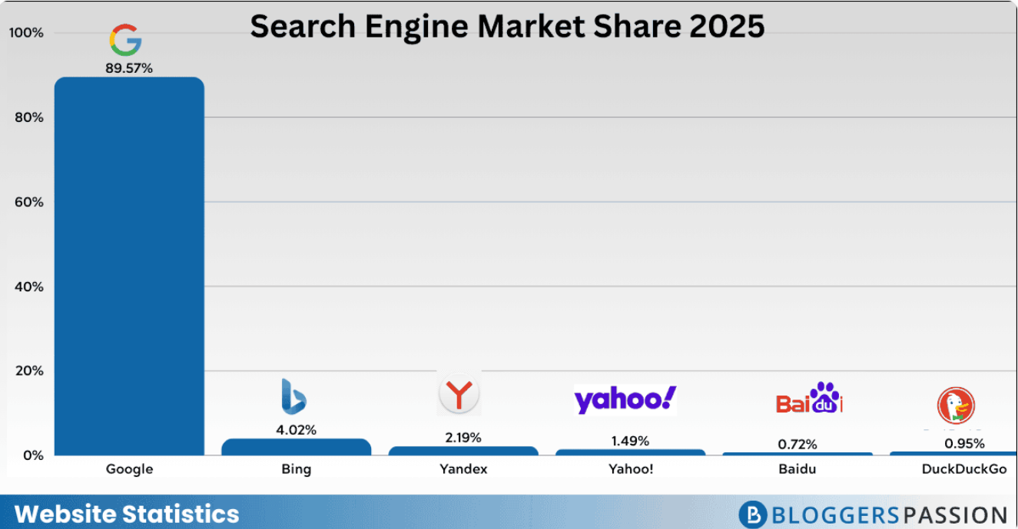
Search engine data

Slide 14
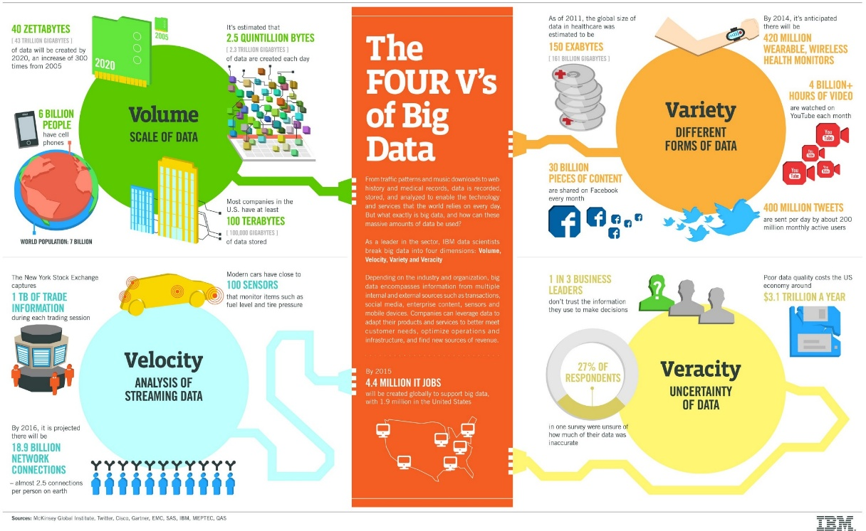
The characteristics of big data
  5 Vs
    Volume
    Variety
    Velocity
    Veracity
    Value

Slide 15
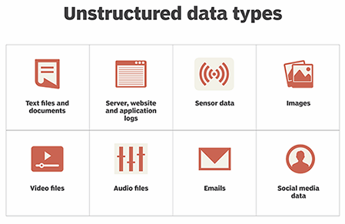
The characteristics of big data
90% of the data was created in the past 3 years
80% of the data has no structure or a complex structure, hard to process
  Images
  Streaming records
  Videos, sensor records
  GPS tracking details
Traditional systems are useful in working with structured data (limited as well), but they can’t manage such a large amount of unstructured data.
Question:
  How to store big data in order to access/process it efficiently?
  How to find useful info from big data

Slide 16
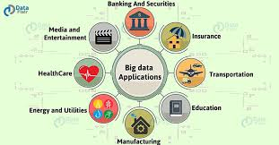
Why care about big data
We need big data to make smarter and more calculated decisions in whatever field we are working in.
These decisions range from guessing the preferences of consumers to preventing fraud activities well in advance.
Professionals in every field may find reasons for analyzing big data.
Top 10 Big Data Applications
Banking and Securities
Communication, Media and Entertainment
Healthcare
Education
Manufacturing and Natural Resources
Government
Insurance
Retail and Wholesale trade
Transportation
Energy and Utilities

Slide 17
Opportunities and challenges
Opportunities
Machine learning and AI
Intelligent devices (autonomous driving systems, drones, embodied robots, and unmanned surface vehicles)
Smart City
Personalized medicine, precision medicine
Personalized teaching
The Fourth Industrial Revolution

Slide 18
Opportunities and challenges
challenges
Data Capturing
Data Transmission
Data Visualization
Data privacy
Data security
Data quality issues
Data processing issues

Slide 19
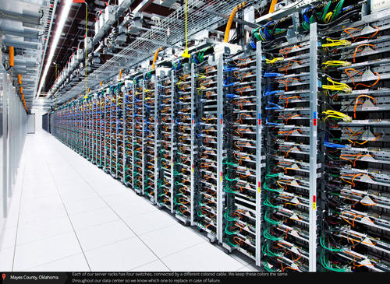
Storage of big data
Distributed file system (Apache HDFS）
Cluster
Data Centers
  Amazon data centers
  Google data centers
  Alibaba data centers
  Tencent data centers
  Huawei data centers
  …

Slide 20
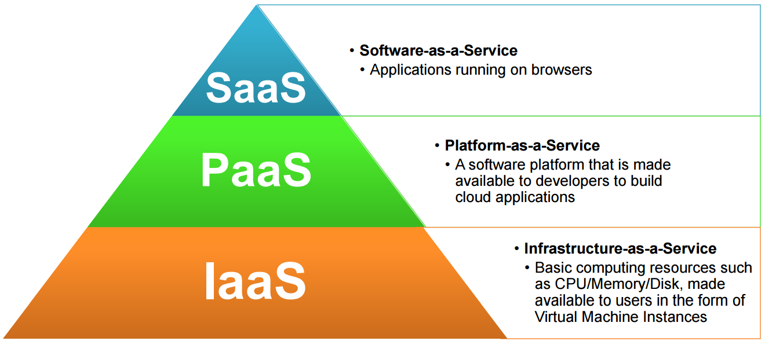
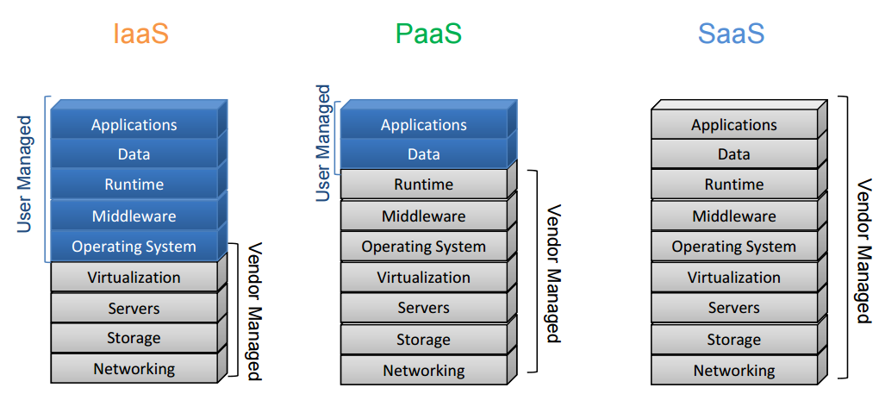
Big data processing
Distributed Processing （Hadoop Map-Reduce/Spark）
Cloud computing
Cloud Service Models

Slide 21
Big data processing
Cloud infrastructure
Public: Microsoft Azure, Google Cloud, Amazon EC2, 阿里云，腾讯云，华为云等
Private: For enterprises/corporations with large-scale IT
Hybrid: (企业云+租用公有云服务)

Slide 22
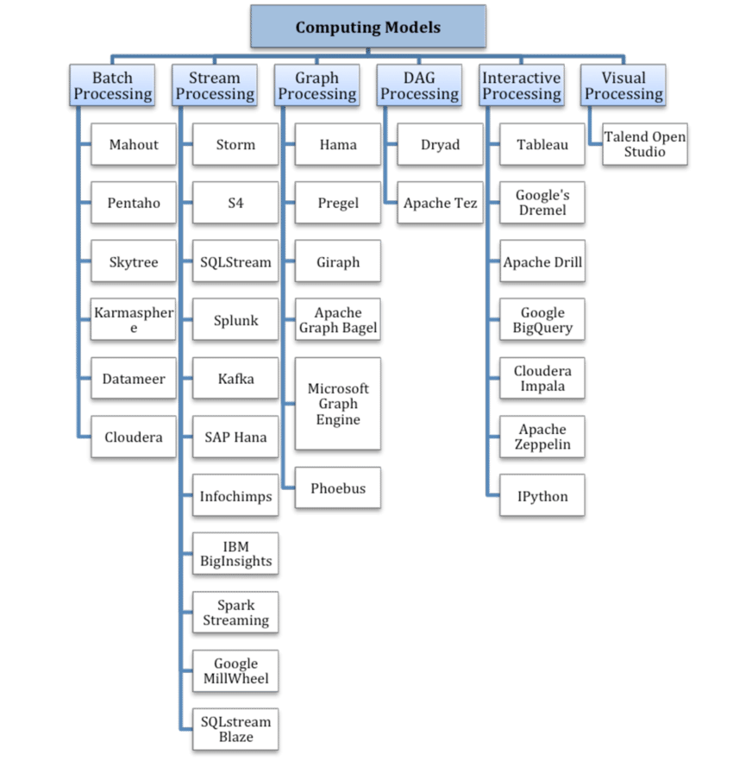
Big data processing
Computing Models

Slide 23
Big data processing
Computing Models
Computing model | Problems to solve | Representative products
Batch processing | Batch processing for large-scale data | MapReduce、Spark
Stream processing | real-time computing for stream data | Spark, Storm、S4、Flume、Streams、Puma、DStream、Super Mario、
Graph processing | for processing large-scale graph structured data | Pregel、GraphX、Giraph、PowerGraph、Hama、GoldenOr
Interactive processing | storage management and query analysis for large-scale data | Dremel、Hive、Cassandra、Impala

Slide 24
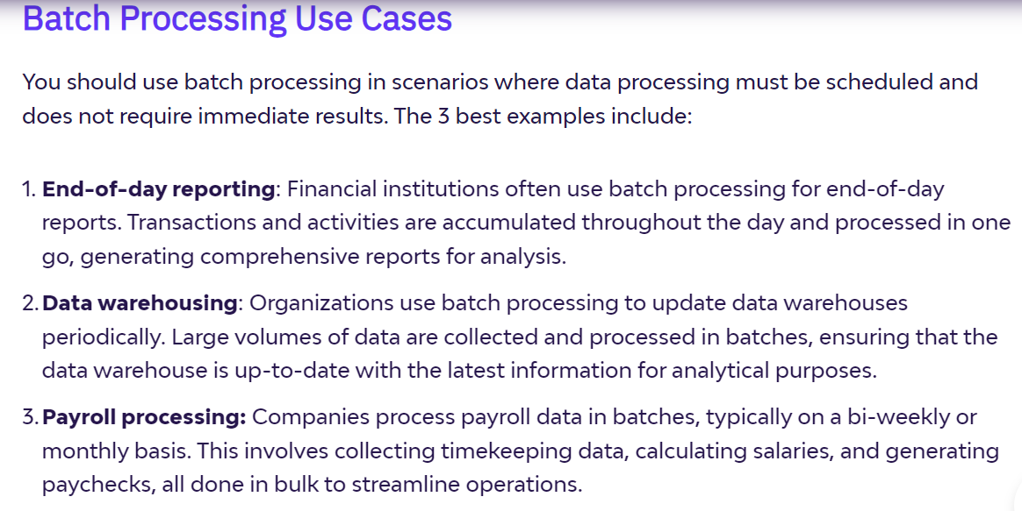
Big data processing

Slide 25
Big data processing
Stream processing is the processing of data in real time; use this method for scenarios where immediate data processing is important.
Moreover, stream processing permits real-time analytics and decision-making, making it perfect for applications like fraud detection, network monitoring, and live updates.
Stream Processing Use Cases
Fraud detection: Stream processing allows financial institutions to monitor transactions in real time. This helps identify and flag suspicious activities immediately, effectively preventing fraud.
Network Monitoring: In network management, stream processing enables you to monitor your network traffic constantly. This real-time analysis helps in quickly detecting and addressing any anomalies or issues, ensuring smooth network operations.
Predictive Maintenance: Industries use stream processing to monitor equipment health in real time. As a result, potential issues can be detected and addressed before they lead to equipment failure, which saves costs and improves efficiency.
Intrusion Detection: In cybersecurity, stream processing helps in real-time detection of unauthorized access or activities within a network. The detection allows for swift action to mitigate potential security threats.

Slide 26
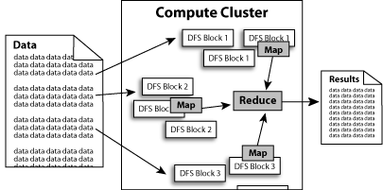
Big data processing framework
MapReduce is a framework for parallel processing of big data, launched by Google in 2002;
Apache Hadoop implements the functionality of Google's MapReduce;
  Main idea: Divide big data applications into many small modules and have multiple machines collaborate to complete them;
  The Hadoop Distributed File System backs up the same data to multiple machines to enhance reliability;
  Each machine is only responsible for processing the data stored within it;
  A cluster used for big data applications may involve tens of thousands of computers.

Slide 27
Introduction to Hadoop
DFS (Distributed File System)
YARN (resource management)
MapReduce (processing framework)
Spark (processing framework)
HBase (NoSQL database)
Hive (similar to SQL data query)
Other Modules: Zookeeper, Impala, Oozie, etc.
Spark, Storm, Tez, etc.
HBase
Non-relational Database
Pig
Scripting
Hive
SQL Like Query
MapReduce
Distributed Processing
Others
Distributed Processing
Yarn
Resource Manager
HDFS Distributed File System (Storage)

Slide 28
Hadoop Distributed File System
The file directory structure and data blocks are stored separately on different machines.
The directory structure is hosted on the NameNode and the standby NameNode.
The data is stored on different DataNodes.
The same data blocks are backed up and stored on several different DataNodes.
Client
NameNode
Secondary NameNode
DataNode
DataNode
DataNode
DataNode
DataNode
DataNode
DataNode
DataNode

Slide 29
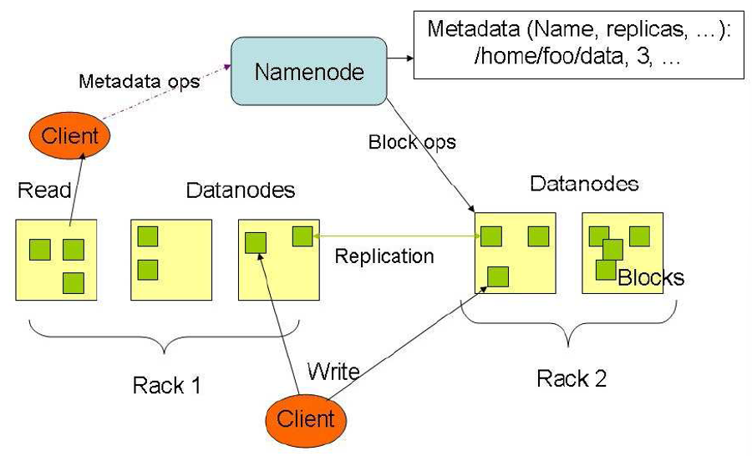
Hadoop Distributed File System
When reading a data block, first obtain the location information of the data from the NameNode, and then read the data from the DataNodes.
When writing data blocks, several backups should be made and stored on Datanodes in different racks.

Slide 30
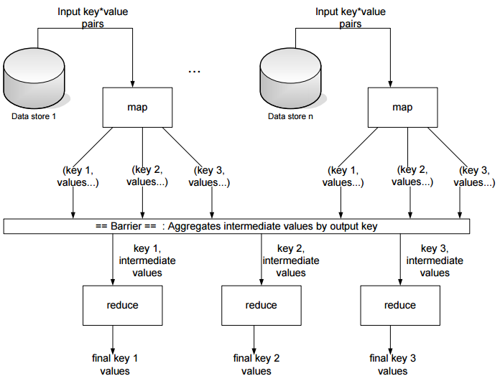
MapReduce program operation

Slide 31
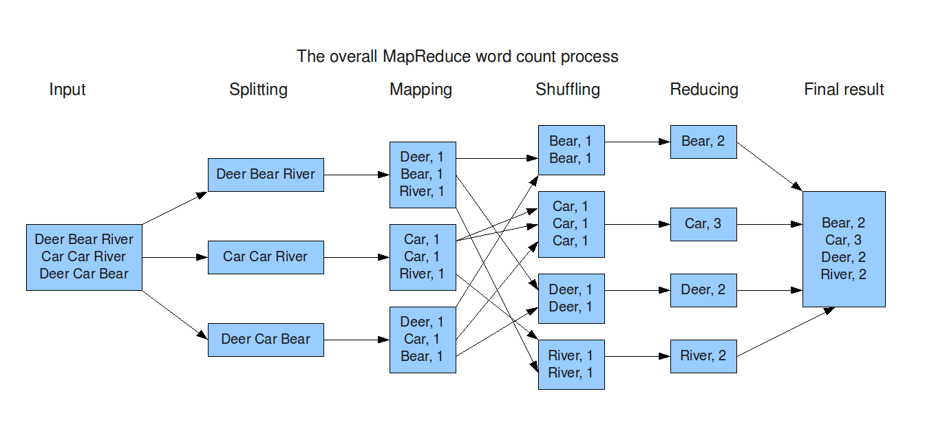
Word Count Example

Slide 32
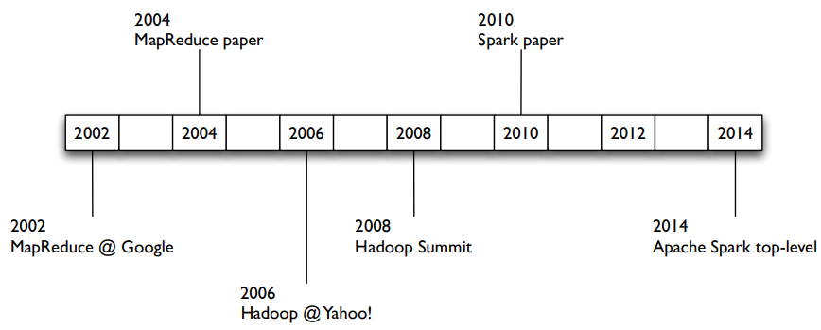
Big Data Framework- Spark
Spark has extended the MapReduce computing model:
  Support iterative algorithms, such as ML and AI algorithms
  Support interactive information inquiry

Slide 33
Word Count Program
MapReduce Java program
Spark Python program
import org.apache.hadoop.conf.Configuration;
import org.apache.hadoop.fs.FileSystem;
import org.apache.hadoop.fs.Path;
import org.apache.hadoop.io.IntWritable;
import org.apache.hadoop.io.Text;
import org.apache.hadoop.mapreduce.lib.output.FileOutputFormat;
import org.apache.hadoop.mapreduce.Job;
import org.apache.hadoop.mapreduce.Mapper;
import org.apache.hadoop.mapreduce.Reducer;
import org.apache.hadoop.mapreduce.lib.input.FileInputFormat;
import org.apache.log4j.BasicConfigurator;
import java.io.IOException;
import java.util.StringTokenizer;
public class WordCount {
public static void main(String[] args) throws Exception {
BasicConfigurator.configure(); //configure log4j environment
Configuration conf = new Configuration();
FileSystem hdfs = FileSystem.get(conf);
Job job = Job.getInstance(conf, “WordCount");
job.setJarByClass(WordCount.class);
job.setMapperClass(WCMapper.class);
job.setCombinerClass(WCReducer.class);
job.setReducerClass(WCReducer.class);
job.setOutputKeyClass(Text.class);
job.setOutputValueClass(IntWritable.class);
job.setNumReduceTasks(2);
FileInputFormat.addInputPath(job, new Path(args[0]));
Path outpath = new Path(args[1]);
if(hdfs.exists(outpath))
hdfs.delete(outpath, true);
FileOutputFormat.setOutPath(job, outpath);
System.exit(job.waitForCompletion(true) ? 0 : 1);
}
public static class WCMapper extends Mapper<Object, Text, Text, IntWritable>{
private final static IntWritable one = new IntWritable(1);
private Text word = new Text();
public void map(Object key, Text value, Context context ) throws IOException, InterruptedException {
StringTokenizer itr = new StringTokenizer(value.toString());
while (itr.hasMoreTokens()) {
word.set(itr.nextToken());
context.write(word, one);
}
}
}
public static class WCReducer extends Reducer<Text,IntWritable,Text,IntWritable> {
private IntWritable result = new IntWritable();
public void reduce(Text key, Iterable<IntWritable> values, Context context )
throws IOException, InterruptedException {
int sum = 0;
for (IntWritable val : values) {
sum += val.get();
}
result.set(sum);
context.write(key, result);
}
}
}
from pyspark.sql import SparkSession
spark = SparkSession.builder.master('local').appName('WCApp').getOrCreate()
sc = spark.sparkContext
import re
rdd_data = sc.wholeTextFiles('data/iitfidf')
numFiles = rdd_data.count()
wordcount = rdd_data2.flatMap(lambda x: [((i.lower()), 1) for i in re.split('\W+', x[1])]) \
.reduceByKey(lambda a, b: a + b).sortBy(lambda x: x[1], ascending=False)
wordcount.collect()
  Conclusion: Spark is better than MapReduce
    Improve programming efficiency
    Support ML and AI training algorithms
    Provide more operations.

Slide 34
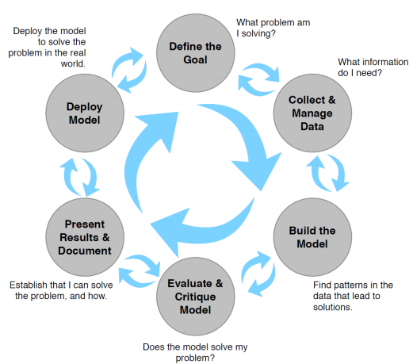
Analysis of big data

Slide 35
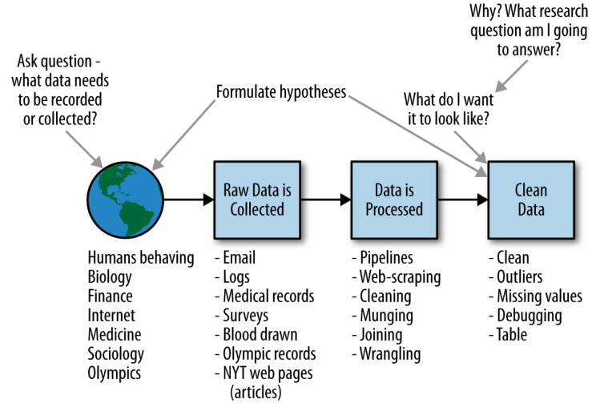
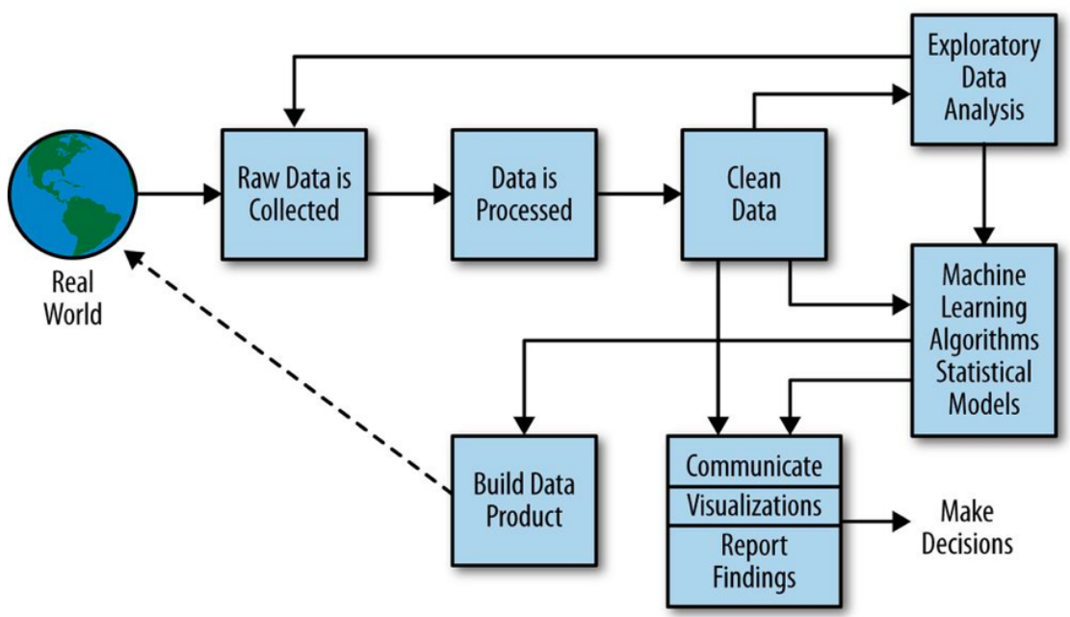
Analysis of big data

Slide 36
Analysis of big data
Analysis methods:
  Classification and prediction
  Clustering
  Outlier detection
  Relationship mining
  Social network analysis
  Process mining
  Text mining
  Data visualization

Slide 37
Related Software
Python and Libraries(Install Anaconda)
Hadoop (optional)
PySpark
  It is a Spark library for running Python applications
  Using PySpark, we can run apps in parallel on a distributed cluster.

Slide 38
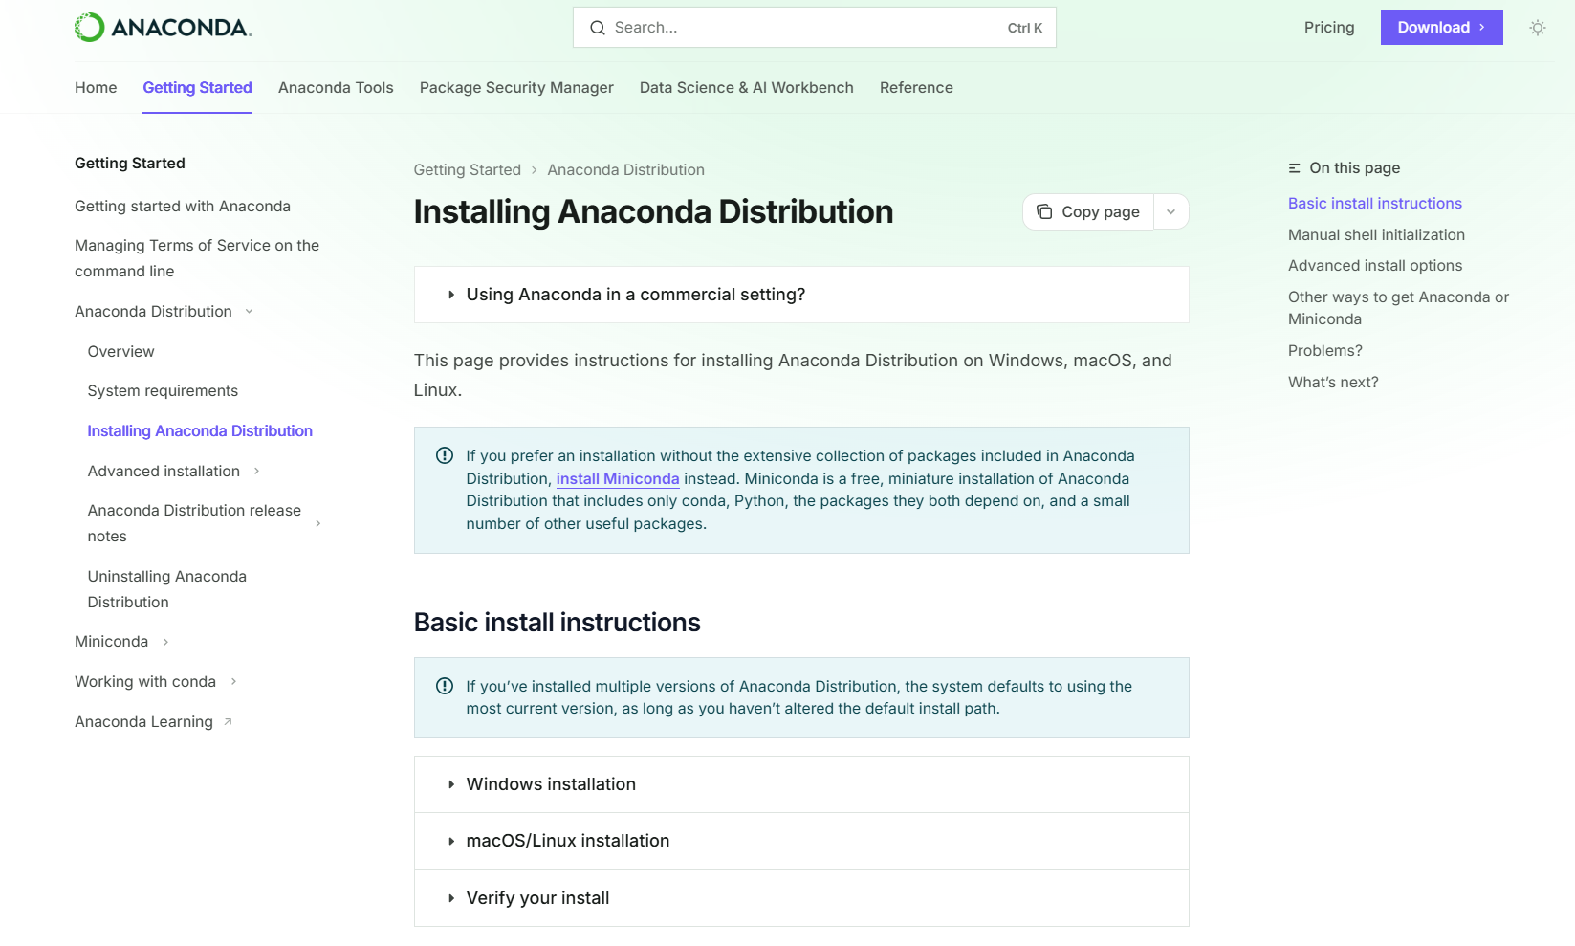
Install Python and Libraries
Install anaconda
https://docs.continuum.io/anaconda/install/

Slide 39
PySpark Installation
Install PySpark:
  pip install pyspark
You can use Jupyter Notebook or PyCharm IDE for programming and testing a Spark program on your laptop
Deploy your program on a Spark cluster.

