Slide 1
CPS 4982 – Big Data Analysis
Lecture 2 Linux Commands
Dr. Changjiang Zhang

Slide 2
Linux Shell
A shell is a computer program that interprets the commands you type and sends them to the OS. It provides a programming environment consisting of environment variables.
Several shells.
  The Bourne shell (sh): was a new Unix shell by Stephen Bourne at Bell Labs.
  Almquist shell (ash): written as a BSD-licensed replacement for the Bourne Shell
  Debian Almquist shell (dash): a modern replacement for ash in Debian and Ubuntu
  Bourne-Again shell (bash): written as part of the GNU Project to provide a superset of Bourne Shell functionality. This shell can be found installed and is the default interactive shell for users on most Linux systems.
  Korn shell (ksh): written by David Korn based on the Bourne shell sources while working at Bell Labs.
  C shell (csh): was modeled on the C programming language, including the control structures and the expression grammar. It was written by Bill Joy as a graduate student at the University of California, Berkeley, and was widely distributed with BSD Unix.
  Z shell (zsh): a relatively modern shell that is backward compatible with bash. Its been the default shell in macOS since 10.15 Catalina.
  tcsh: a Unix shell based on and compatible with the C shell (csh). It is essentially the C shell with programmable command-line completion, command-line editing, and a few other features.

Slide 3
What exactly is a “shell”?
After logging in, We start a program called the shell
The shell interprets commands the user types and manages their execution
    The shell communicates with the kernel of the operating system
    The most popular shells are: tcsh, csh, ksh, and bash
    The differences are most times subtle
    For this tutorial, we are using bash
Shell commands are CASE SENSITIVE!

Slide 4
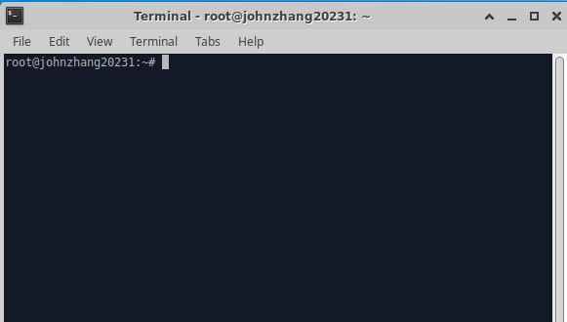
Open up a terminal:
The “prompt”
The host
The current directory (“path”)

Slide 5
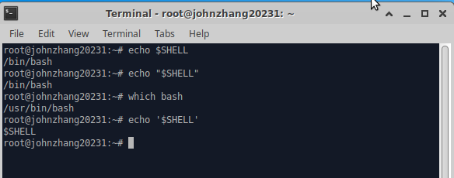
Linux Shell
The most popular Linux shell is BASH.
To determine(find out) your shell type:
  echo $SHELL (shell prints contents of env)
  echo “$SHELL” (shell still processes env. variable)
  echo ‘$SHELL’ (shell treats env. variable as simple literal)
To determine the path to the shell program, type:
  which bash

Slide 6
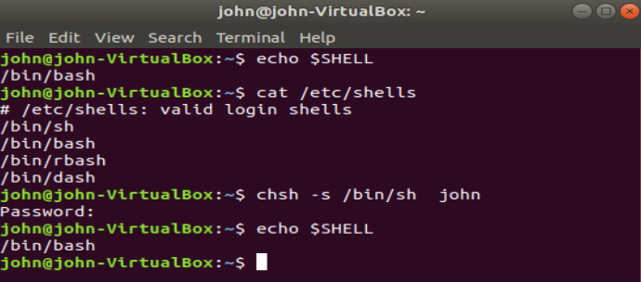
Linux Shell
Valid login shells info are saved in /etc/shells
cat /etc/shells
Change the default login shell with “chsh” utility/command
chsh -s /path/to/shell user
For example: chsh -s /bin/bash john
rbash(restricted bash)

Slide 7
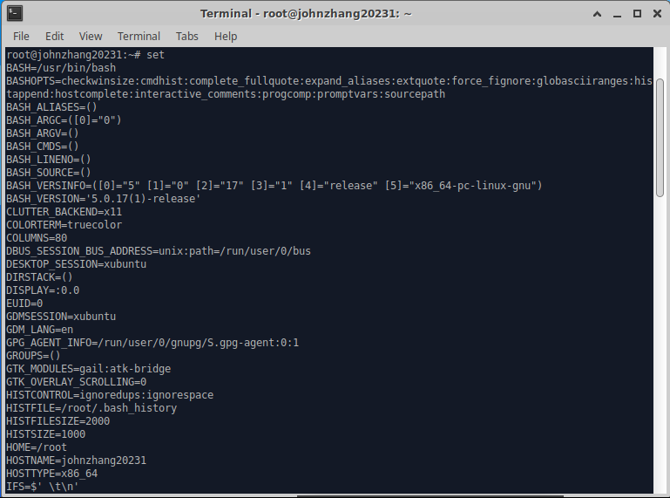
Linux Shell
The complete environment can be printed with set command.

Slide 8
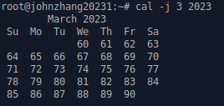
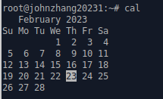
Linux Command
Command has three parts:
  command options and parameters.
Example:
  cal –j 3 2023.
  “cal” is the command,
  “-j” is an option,
  “3” and “2023” are parameters.
  cal

Slide 9
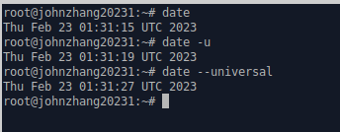
Linux Command
Command option has long and short forms.
Example:
  date
  date -u #short form
  date --universal #long form

Slide 10
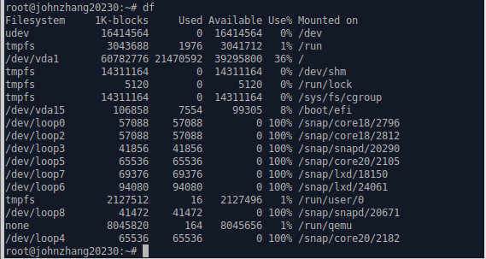
Linux Command
To check the free space on your disk drives:
  df

Slide 11

Linux Command
To display the amount of free main memory:
  free
To ending a terminal session:
  exit

Slide 12
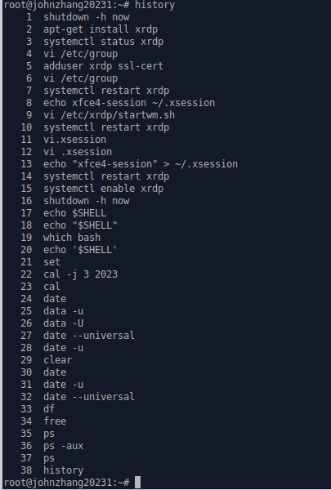
Command History
Try the history command

Slide 13
Command History
history | Output a list of previously entered command lines
!! | Re-execute the most recent command line (csh, tcsh, and bash)
!## | Re-execute the command number ### (csh, tcsh, and bash)
!xxx | Re-execute the last command that begins with xxx (csh, tcsh, and bash)
r | Re-execute the most recent command line (ksh)
r ## | Re-execute the command number ###(ksh)
r xxx | Re-execute the last command that begins with xxx (ksh)
Choose from the command history by using the up ↑ and down ↓ arrow keys
Use left ← and right → arrow to edit the command
Try the <Del> and <Backspace> keys

Slide 14

Help with Commands
Get or set hostname
  hostname --help
  man hostname
  info hostname (gives the same or most information, but must be paged)
And “Yes,” you can always Google it

Slide 15
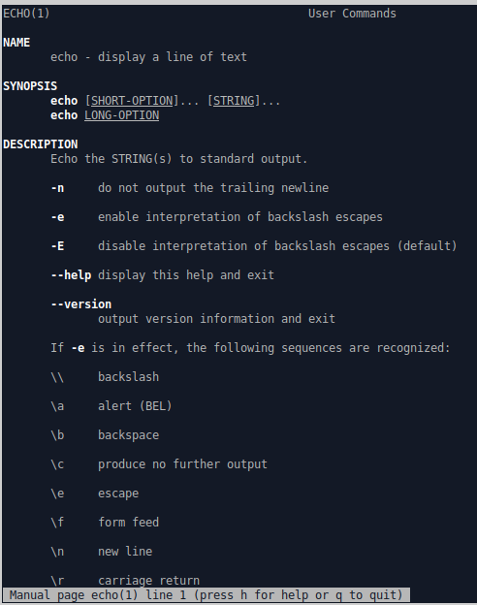
Help for Command
Whenever you need help with a command
man <command>
man echo

Slide 16
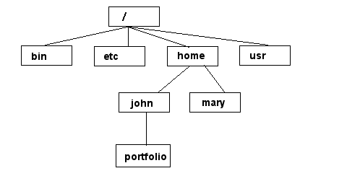
Unix/Linux File System
NOTE: Unix file names
are CASE SENSITIVE!
/home/mary/
/home/john/portfolio/
The Path

Slide 17
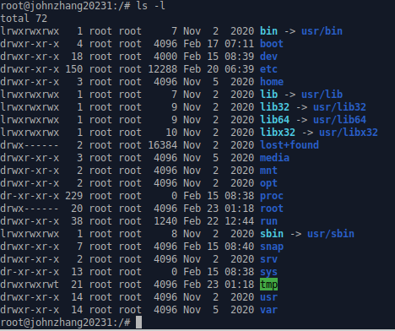
Unix/Linux File System
To find out your Linux file system, you can use cd and ls commands

Slide 18

Linux Command
To find your current working directory:
  pwd

Slide 19
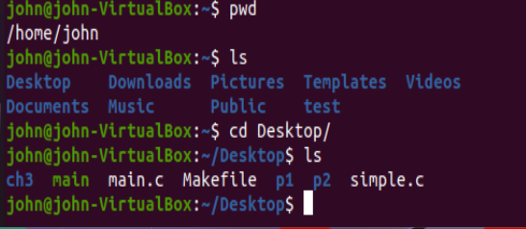
Linux Command
To change to a specific directory:
  cd <some_path>

Slide 20
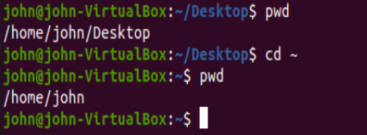
Linux Command
To change to your home directory:
  cd ~

Slide 21
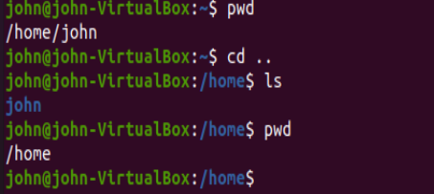
Linux Command
To change to your parent directory:
  cd ..

Slide 22
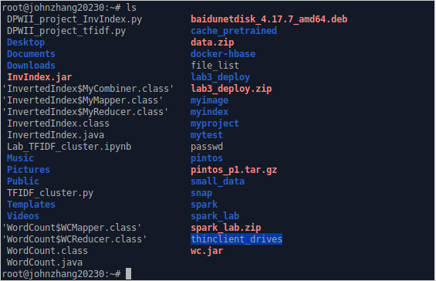
Linux Command
To list directory content:
  ls

Slide 23
Command: ls
ls has many options
  -l lists files and folders with associated permissions
  -t sort by modification time, newest first
  -S sort by size
  -h list file sizes in human-readable format
  -r reverse the order
  -a list all files including the dots and hidden files
  -i print the index number (inode) of each file
  -F List files and directories, with a forward slash (/) at the end of each directory
“man ls” for more options
Options can be combined: “ls -ltr”

Slide 24
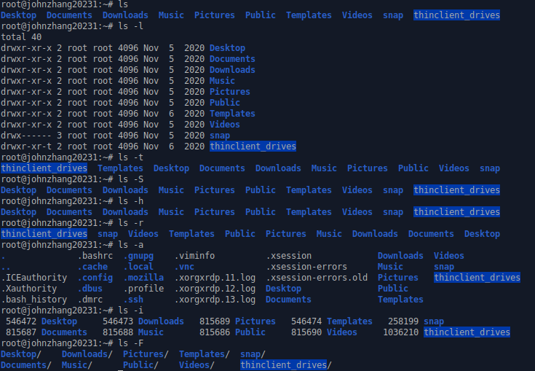
Command: ls
ls -l

Slide 25
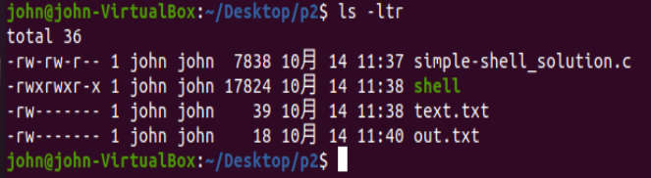
Linux Command
List files by time in reverse order with long listing
  ls -ltr

Slide 26
General Syntax: *
“*” can be used as a wildcard in Unix/Linux
Find out all python code in the current directory:
Regular Expression (regex, re) is very important for CLI and pipe/filter architecture!

Slide 27
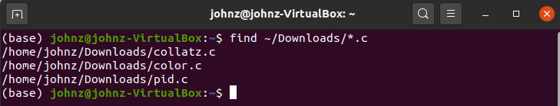
Linux Command
To search for files in a directory hierarchy :
  find ~/Downloads/*.c

Slide 28

Linux Command
To determine file type:
  file filename

Slide 29


Linux Command
To create a new directory:
  mkdir directory_name

Slide 30

Linux Command
To remove an empty directory:
  rmdir directory_name

Slide 31
Creating files in Unix/Linux
Requires the use of an Text Editor
Various Editors:
  nano / pico
  vi
  emacs

Slide 32
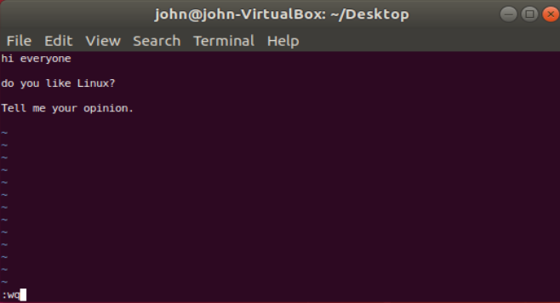
Creating/Editing a file using vi
vi demo
Insert text: type i/a first to enter insert mode
click esc key to stop insertion
To save file type :wq
click <enter>

Slide 33
Displaying a file Content
Various ways to display a file in Unix
cat : shows the contents of a file, all at once
more : shows the contents of a file, screen by screen
less : also shows the contents of a file, screen by screen
head : used to show so many lines form the top of a file
tail : used to show so many lines form the bottom of a file
more filename
cat file1
head filename
tail filename
less filename

Slide 34
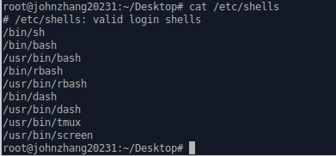
Command: cat
Dumps an entire file to standard output
Good for displaying short, simple files

Slide 35
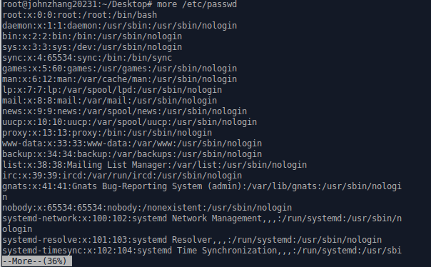
Command: more
“more” displays a large file contents on the screen

Slide 36
Command: more
“more” displays a large file contents on the screen
more filename | Display file’s contents on the screen
SAPCEBAR | Advance one screen
ENTER | Advance one line
b | Go back toward the top of the file one screen
/xxx | Go forward to the first target (xxx) and display the page
n | Go to the next target (xxx)
q | Quit more

Slide 37
Command: less
“less” displays a file, allowing forward/backward movement within it
  return scrolls forward one line, space one page
  y scrolls back one line, b one page
use “/” to search for a string
Press q to quit
less /etc/passwd

Slide 38
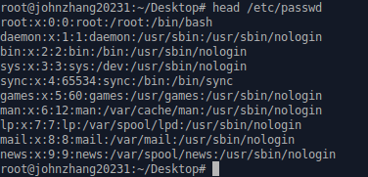
Command: head
“head” displays the top part of a file
By default it shows the first 10 lines
-n option allows you to change that
“head -50 file.txt” displays the first 50 lines of file.txt
head filename | Display the first 10 lines of filename

Slide 39
Commands on file operations
Copying a file: cp
Move or rename a file: mv
Remove/delete a file: rm
Change file timestamp or create an empty new file: touch
Sort the contents of the file filename: sort
Remove duplicate adjacent lines from filename: uniq
Determine file type: file
sort filename
uniq filename
touch file1
file filename

Slide 40

Linux Command
To copy files:
  cp
copy the passwd file from the /etc directory to the current working directory.
cp /etc/passwd .

Slide 41
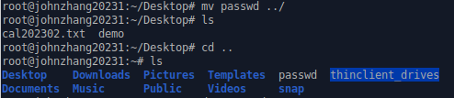

Linux Command
To move and rename files:
  mv
Move a file to its parent directory
mv filename ../
Rename a filename
mv oldname newname

Slide 42
Linux Command
To remove Files and directories:
  rm [option] item
where item is one or more files or directories
Option | Long option | Meaning
-i | --interative | Before deleting an existing file, prompt the user for confirmation. If this option is not specified, rm will silently delete files.
-r | --recursive | Recursively delete directories. This means that if a directory being deleted has subdirectories, delete them too. To delete a directory, this option must be specified.
-f | --force | Ignore nonexistent files and do not prompt. This overrides the --interactive option.
-v | --verbose | Display informative messages as the deletion is performed.

Slide 43
Command: rm
To remove files “recursively”: rm –r
Used to remove all files and directories
Be very careful, deletions are permanent in Unix/Linux

Slide 44
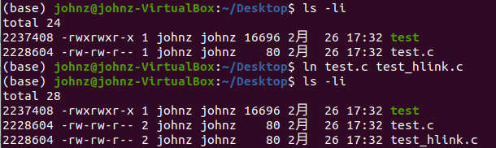
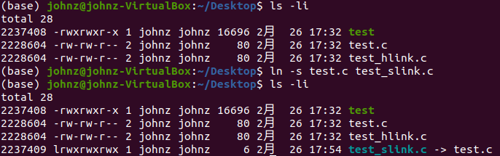
Linux Command
To create either hard or symbolic links:
  ln
To create a hard link:
ln file link
To create a symbolic link:
ln -s item slink
where item is either a file or a directory.

Slide 45
File permissions
Each file in Unix/Linux has an associated permission level
This allows the user to prevent others from reading/writing/executing their files or directories
Use “ls -l filename” to find the permission level of that file

Slide 46
Permission levels
“r” means “read only” permission
“w” means “write” permission
“x” means “execute” permission
  In case of directory, “x” grants permission to list directory contents

Slide 47
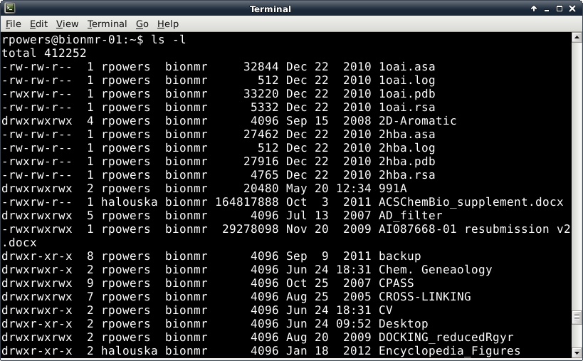
Permissions
You can’t read, write, edit or execute a file without permission!
Size of file in kilobytes
Directory
File Owner
Filename
Number of files in Directory
Group Owner belongs to
File Date or Time Stamp

Slide 48
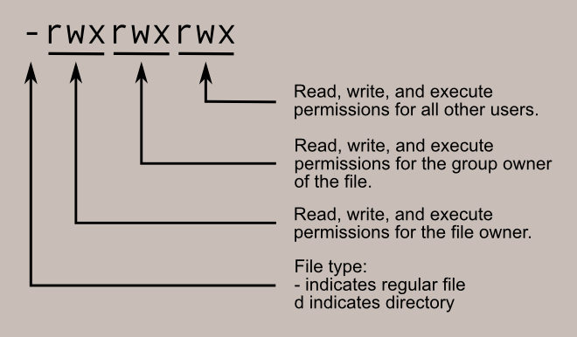
Permissions
Reading and understanding permissions
Permissions

Slide 49
Permissions
Where did the 755 come from in the chmod command?
Think of the permission settings as a series of bits :
rwx rwx rwx = 111 111 111
rw- rw- rw- = 110 110 110
rwx --- --- = 111 000 000
and so on...
rwx = 111 in binary = 7
rw- = 110 in binary = 6
r-x = 101 in binary = 5
r-- = 100 in binary = 4
-xx = 011 in binary = 3
-x- = 010 in binary = 2
--x = 001 in binary = 1
--- = 000 in binary = 0

Slide 50
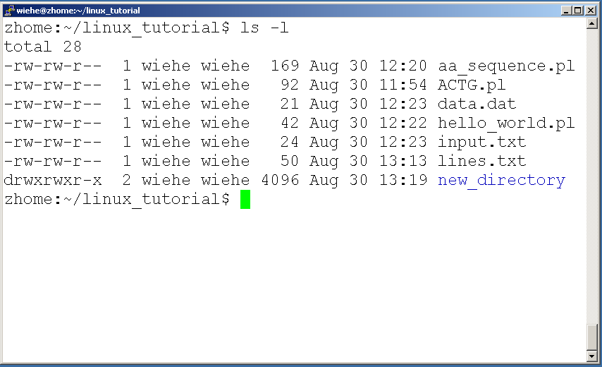
File Permissions
User (you)

Slide 51
File Permissions
Group

Slide 52
File Permissions
“The World”

Slide 53
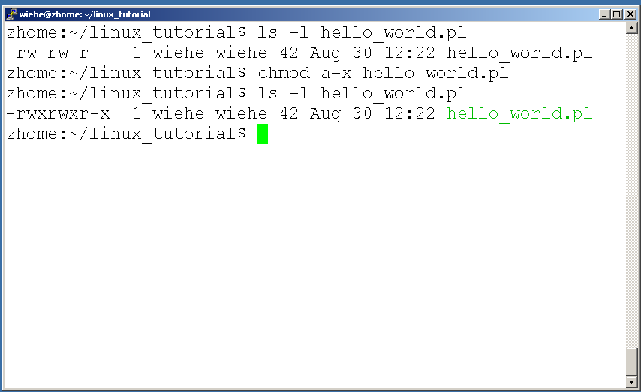
Command: chmod
If you own the file, you can change it’s permissions with “chmod” command
  Syntax: chmod [user/group/others/all]+[permission] [file(s)]
  Below we grant execute permission to all:

Slide 54
Running a program (a.k.a. a job)
Make sure the program has executable permissions
Use “./” to run the program

Slide 55

Running a program: an example
Create a sample c file of hello world first using vi
  $vi hello.c
  Press i
  #include <stdio.h>
  int main() {
  printf(“Hello World!\n”);
  return 0;
  }
  :wq <press esc>
Compile it to create an executable code
  $gcc –o hello hello.c
Run the file
  ./hello
Install GCC in Ubuntu
sudo apt update
sudo apt upgrade
sudo apt install build-essential

Slide 56

Ending a program
To end a foreground program use “ctrl-c”.
  $ sleep 100
  Ctrl – c

Slide 57
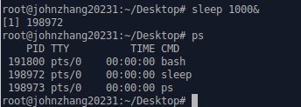
Command: ps
To view the processes that you’re running:
ps | Lists processes that you own
ps –l | Generates a long listing of your processes
ps –f | Outputs a full listing of processes that you own
ps –u login | Lists processes that are owned by the user whose login ID is login
ps –t nn | Lists processes that are associated with the workstation tty
ps –ef | Prints information about all processes
ps –aux | Prints information about all processes

Slide 58
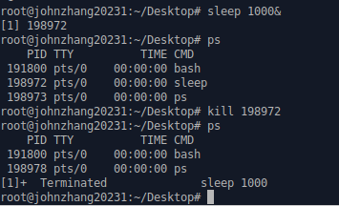
Command: kill
To terminate a process use “kill”
  $kill pid
kill PID | Terminates a process by sending a software terminate signal
kill -1 PID | Hangs up communication links to a process
kill -2 PID | Ends a process by sending a process interrupt signal
kill -3 PID | Brings a process to a conclusion by issuing a process quit signal
kill -6 PID | Instructs a process to end by issuing the Abort Process signal
kill -15 PID | Instructs a process to end by issuing the software termination signal
kill -9 PID | Kills a process.

Slide 59
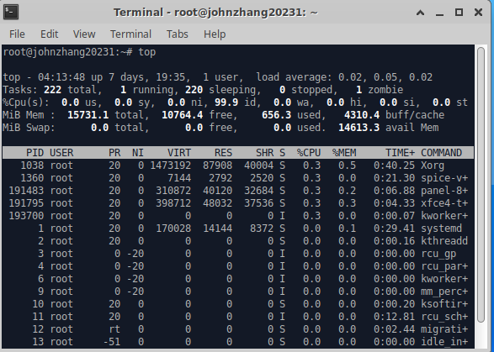
Command: top
To view the CPU usage of all processes:

Slide 60
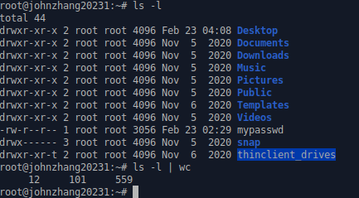
Input/Output Redirection(“piping”)
| (pipe) - passes output of one Linux command to the input of a second command
  Example: ls |wc (wc – counts the number of characters, words and lines)
  Not limited to just one pipe, can string multiple pipes together

Slide 61
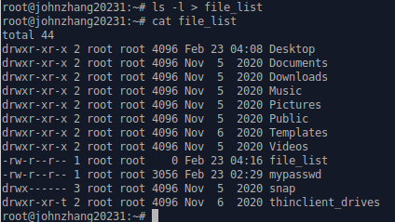

Input/Output Redirection(“piping”)
>, < - redirection of files
  command > filename – output of command (or program) is sent to a file called filename instead of being displayed on the screen
      Example: ls –l > file_list
  command < filename – the file filename is the input to the command or program
      Example: wc < file_list

Slide 62
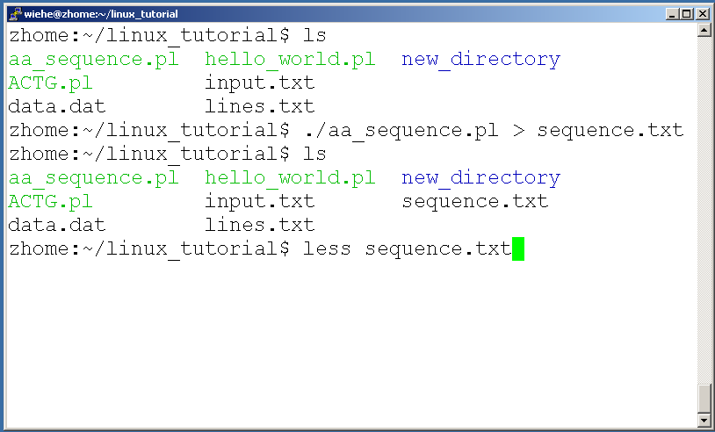
A few examples of piping

Slide 63
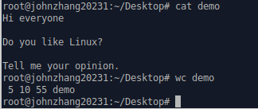
Command: wc
To count the characters, words, and lines in a file use “wc”
The first column in the output is lines, the second is words, and the last is characters
wc filename | Count the lines, words, characters in filename
wc –l filename | Count the lines in filename, including empty lines
wc –c filename | Count the characters in filename
wc –w filename | Count the words in filename

Slide 64
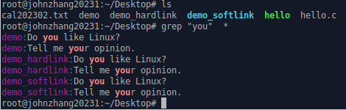
Command: grep
To search files in a directory for a specific string use “grep”
grep word filename | Search for lines containing a particular word (or pattern) in filename

Slide 65
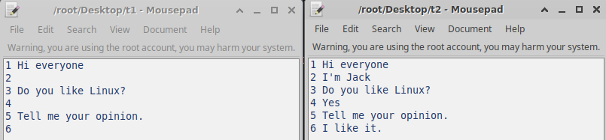
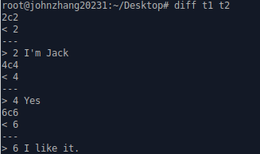
Command: diff
To compare to files for differences use “diff”
diff file1 file2 | Show lines that are different in each file and how to modify the first file to match the second file.

Slide 66
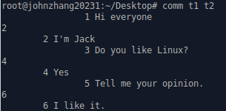
Command: comm
To compare two files use “comm”
comm file1 file2 | Compare file1 and file2 and show the lines common and unique in each of two files

Slide 67

ssh
ssh is used to securely log in to remote systems
ssh [username]@[hostname]
Try:
ssh yourusername@localhost
You may got this error in your Ubuntu system:
To fix this error, you need to install openssh-server
  $ sudo apt install openssh-server
Try again:
ssh yourusername@localhost

Slide 68
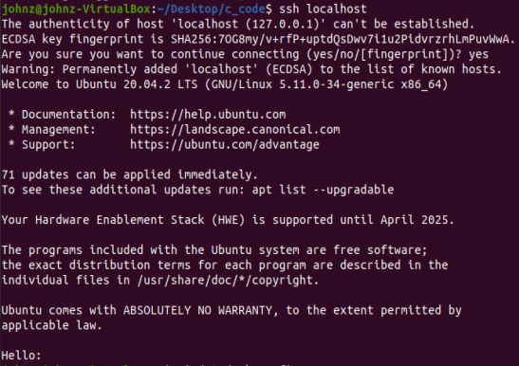
ssh cont.
You can type yes to continue
If you don’t want to type yes next time, you can append the following two lines to /etc/ssh/ssh_config (see next page)
StrictHostKeyChecking no
UserKnownHostsFile /dev/null

Slide 69
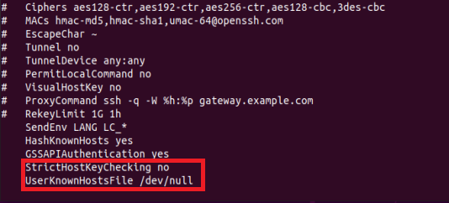
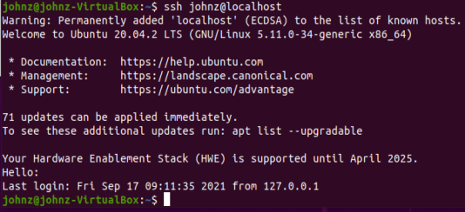
ssh
$ sudo chmod 666 /etc/ssh/ssh_config
vi /etc/ssh/ssh_config
$ ssh yourusername@localhost

Slide 70
scp
scp is used to copy files to/from remote systems, syntax is similar to cp:
  scp [local path] [usernme]@[hostname]:[remote file path]
Suppose you have a file (hello.txt) in your current directory, Try:
  scp hello.txt yourusername@localhost:scp-test.txt
scp-test.txt will be copied in your current directory
  If you add remote file path, you can copy files to a remote computer. For example use –r to copy the whole contents of a directory to a remote computer:
$ scp –r /root/hadoop/ root@johnzhang:~

Slide 71
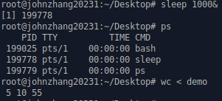
Background Computations
For long computations, don’t want the process directly associated with the window or shell
  Window must remain open and active during computation
  Window is “locked” until the program is finished
  Computations will be stopped if the window is closed
  A intense calculation can overwhelm the shell environment, leading to the window crashing or even slow down your computer
  Output displays on window can be lost, lock window or crash computer
Instead, submit your “job” to the “background”
  Lowers the calculations priority to access the CPU
  Any interactive calculation has the highest priority
  Example:
    Background: sleep 1000 &
  interactive: wc < demo
Use ps to monitor bg jobs

Slide 72
Linux Command Summary
Network: ssh, scp, ping, telnet, nslookup, wget
Shells: BASH, TCSH, alias, watch, clear, history, chsh, echo, set, setenv, xargs
System Information: w, whoami, man, info, which, free, echo, date, cal, df
Command Information: man, info
Symbols: |, >, >>, <, &, >&, 2>&1, ;, ~, ., .., $!, !:<n>, !<n>
Filters: grep, egrep, more, less, head, tail
Hotkeys: <ctrl><c>, <ctrl><d>, <ctrl><z>
File System: ls, mkdir, cd, pwd, mv, ln, touch, cat, file, find, diff, cmp, /net/<hostname>/<path>, mount, du, df, chmod
Line Editors: awk, sed
File Editors: vi, vim, gvim, emacs
Process Management: ps, top, kill, killall, fg, bg
For a Complete List of Linux Commands and Explanations see
  http://linuxcommand.org/
  Or the book “Linux in a Nutshell”

Slide 73
Unix Web Resources
http://www.ee.surrey.ac.uk/Teaching/Unix/
http://www.ugu.com/sui/ugu/show?help.beginners
http://en.wikipedia.org/wiki/Unix

Slide 74
Assignment
Do the Linux Commands exercise on Canvas
Install Docker on your Ubuntu system
  Refer to the material (Install Docker Engine on Ubuntu) on Canvas

