Slide 1
CPS 4982 – Big Data Analytics
Lecture 3 Cloud Computing Basics
Dr. Changjiang Zhang

Slide 2
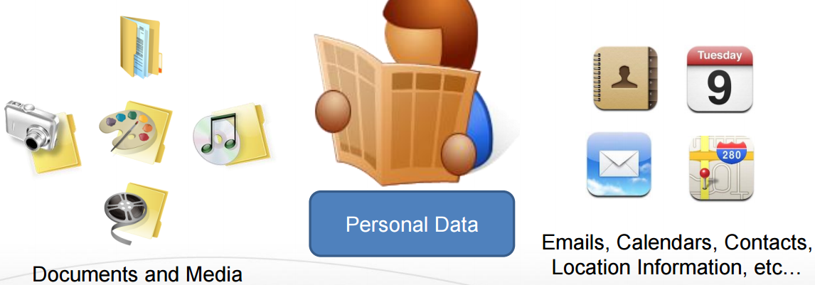
We Live in a World of Data…

Slide 3
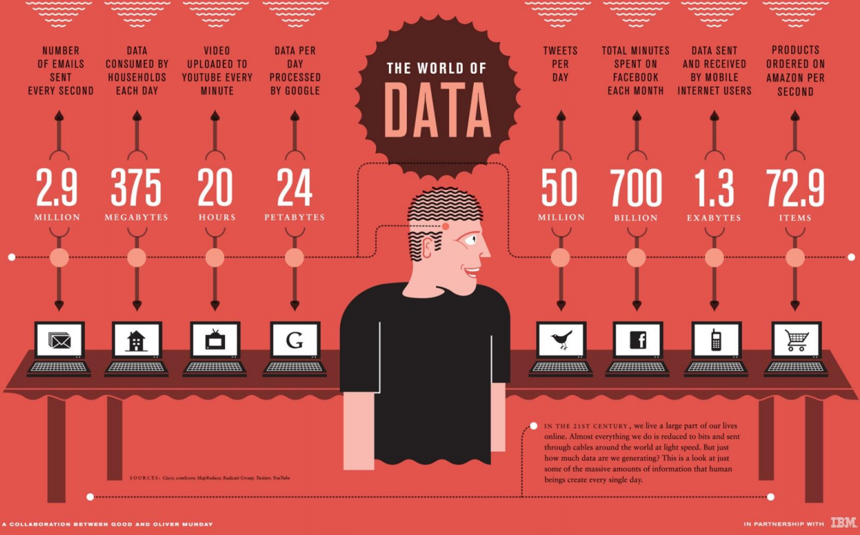
We Live in a World of Data…

Slide 4
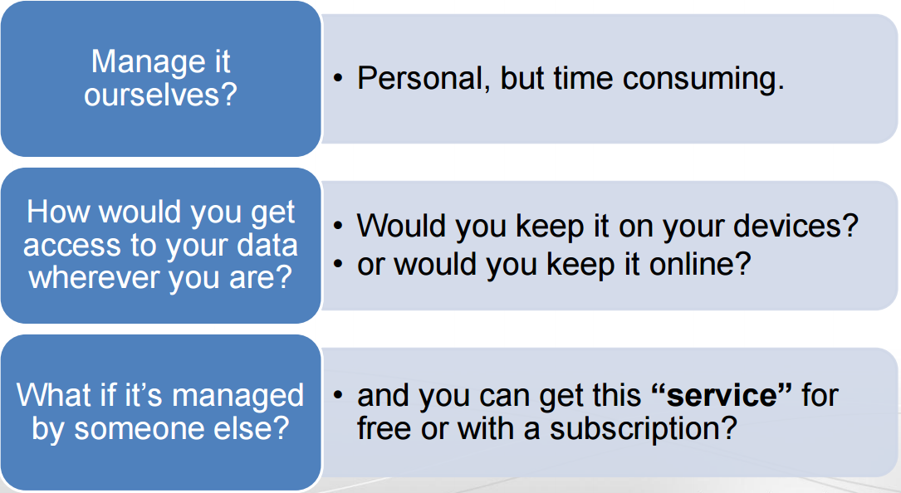
How to Manage Our Data?

Slide 5
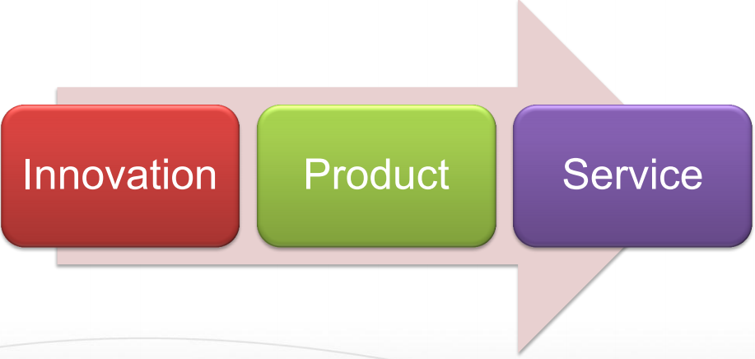
Has this Happened Before?

Slide 6
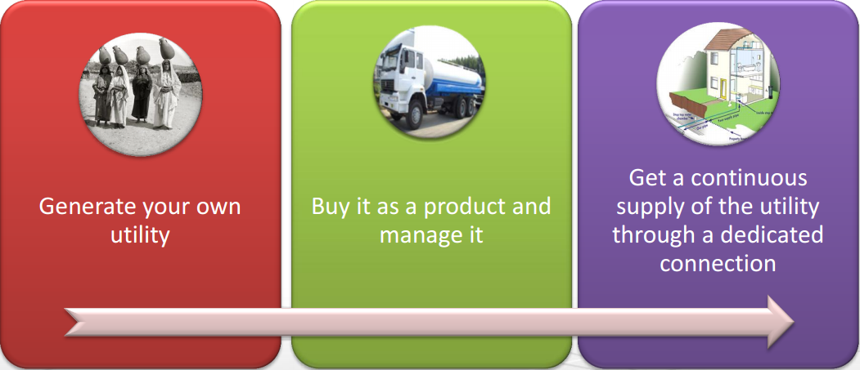
Evolution of Water Utility

Slide 7
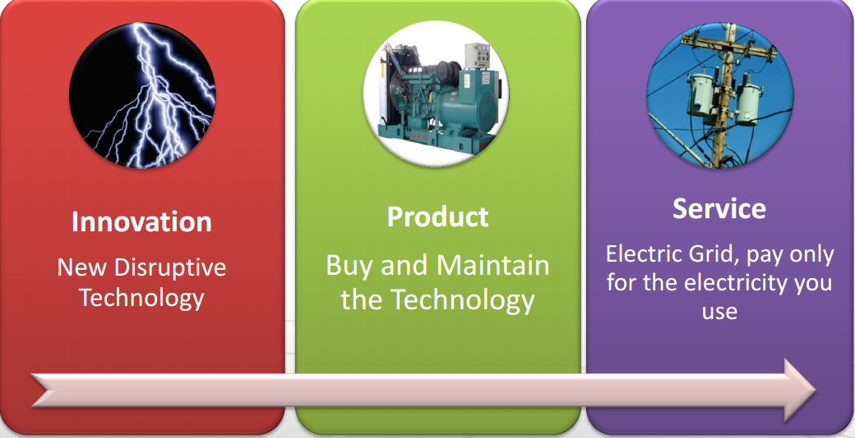
Evolution of Electricity Utility

Slide 8
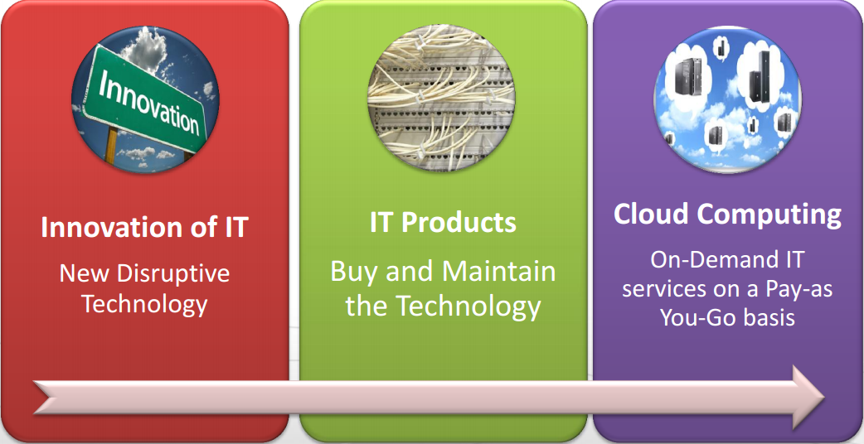
Do you still remember…
Cloud Computing is the transformation of IT from a product to a service

Slide 9
Requirements to Transform IT to a Service
Connectivity
  For moving data around
Interactivity
  Seamless interfaces
Reliability
  Failure will affect many people, not just one
Performance
  It should not be slower or less efficient than what people already have

Slide 10
Requirements to Transform IT to a Service Cont.
Pay-as-you-Go
  Should not pay an upfront fee for the service
Ease of Programmability
  Ease of development of complex services to users
Manage Large Amounts of Data
  Big Data
Efficiency
  Cost
  Power
Scalability & Elasticity
  Flexible and rapid response to changing user needs

Slide 11
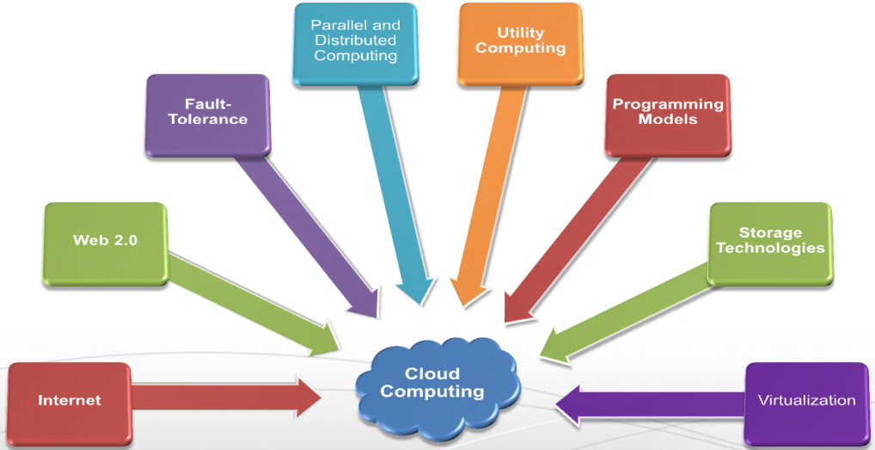
Combine the Enabling Technologies…
New technologies make cloud computing a reality

Slide 12
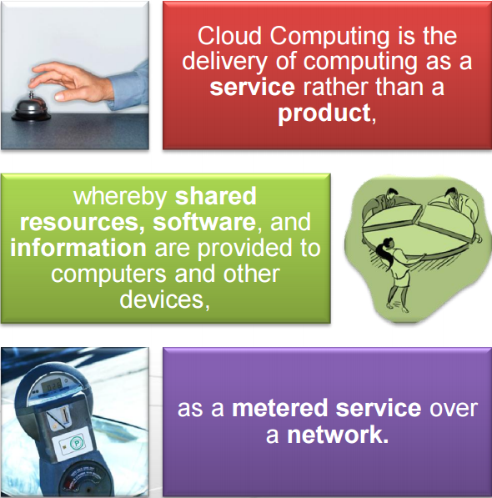
a more complete definition

Slide 13
NIST (National Institute of Standard and Technology) definition
Cloud Computing is a model for enabling ubiquitous, convenient, on-demand network access to a shared pool of configurable computing resources (e.g., networks, servers, storage, applications, and services) that can be rapidly provisioned and released with minimal management effort or service provider interaction

Slide 14
Cloud Computing Characteristics
Five Essential Characteristics
On-demand self-service
  A consumer can unilaterally provision computing capabilities, such as server time and network storage, as needed automatically
Broad network access
  Capabilities are available over the network and accessed through standard mechanisms that promote use by heterogeneous client platforms (e.g., mobile phones, tablets, laptops, and workstations).
Resource pooling
  Resources are pooled and dynamically assigned and reassigned according to consumer demand.
Rapid elasticity
  Capabilities can be elastically provisioned and released, in some cases automatically, to scale rapidly outward and inward commensurate with demand.
Measured service
  Cloud systems automatically control and optimize resource use by leveraging a metering capability at some level of abstraction appropriate to the type of service

Slide 15
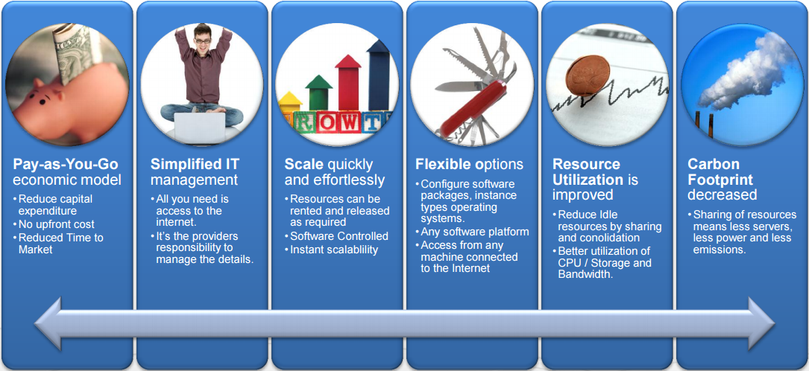
Why Cloud Computing?

Slide 16
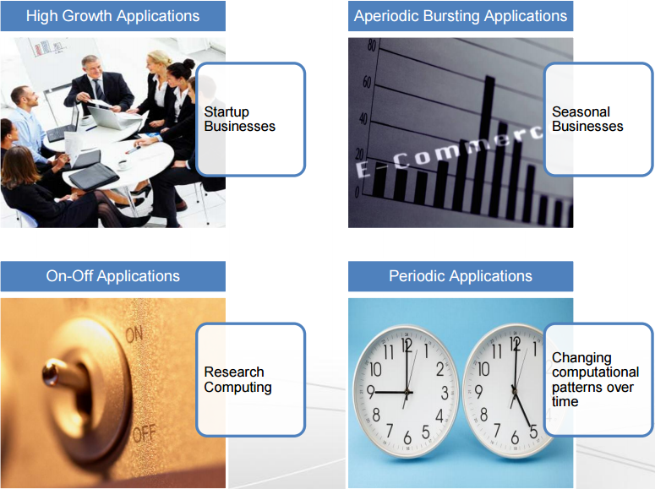
Applications Enabled by Cloud Computing

Slide 17
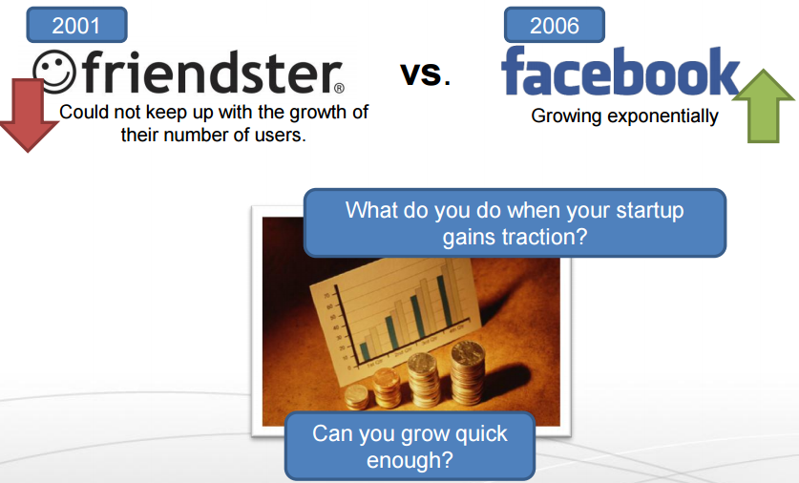
High Growth Applications
Friendster was a social networking service that allowed you to set up user profiles, connect with other people, and communicate with them.
Friendster failed because of site performance issues, rising competition, executive turnover, and due to extensive content moderation.
Founded in 2002, Friendster became the world’s most prominent social network for a short time. It was later overtaken by Myspace as well as Facebook and was ultimately shut down in June 2015.

Slide 18
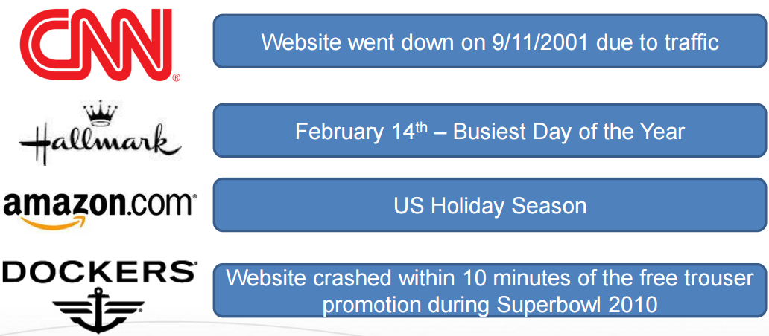
Aperiodic Bursting Applications
What if you design your website infrastructure to handle peak loads, wont it be idle during other times?

Slide 19
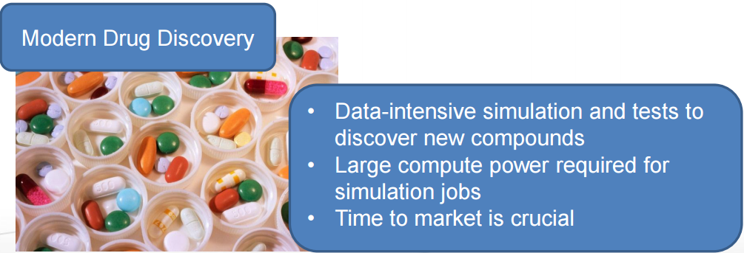
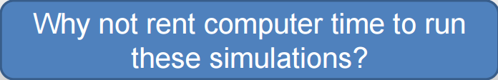
On-Off Applications
Researchers running large-scale scientific simulation using 1000s of computers.

Slide 20
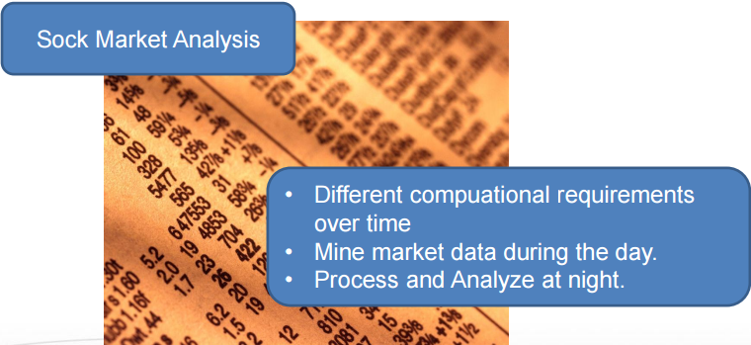

Periodic Applications
Stock market analysis

Slide 21
Technical Challenges
Reliability
Programming is tricky but improving
Tools are continuously evolving
Moving large data is still expensive
Security
Quality of Service (QoS)
Green computing
Internet Dependence

Slide 22
Cloud Introduction
Cloud Infrastructure
Service Models
The Cloud Stack
Types of Clouds
Cloud Computing Benefits

Slide 23
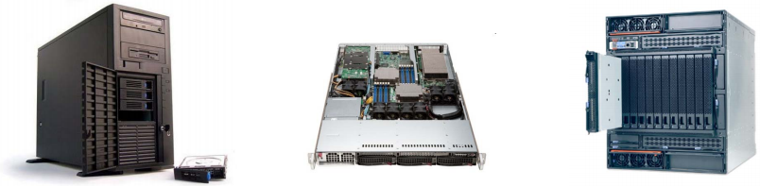
What is a Server?
Servers are computers that provide “services” to “clients”
They are typically designed for reliability and to service a large number of requests
Organizations typically require many physical servers to provide various services (Web, Email, Database, etc.)
Server hardware is becoming more powerful and compact

Slide 24
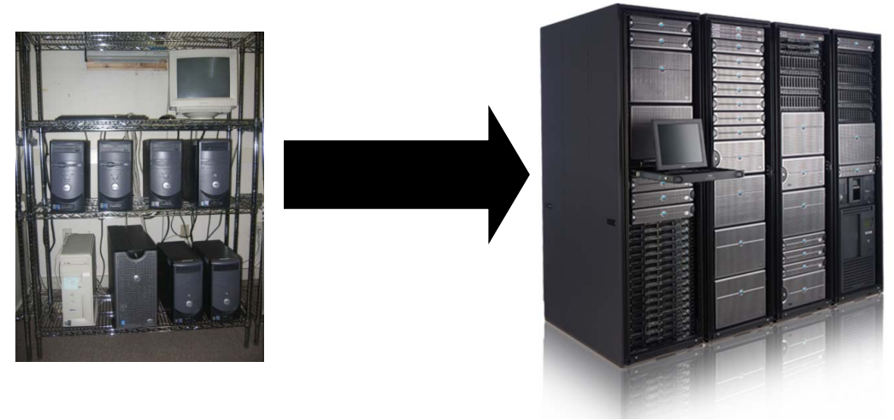
Compact Servers
Organizations would like to conserve the amount of floor space dedicated to their computer infrastructure
For large-scale installations, compact servers are used. This helps with:
  Floor Space
  Manageability
  Scalability
  Power and Cooling

Slide 25
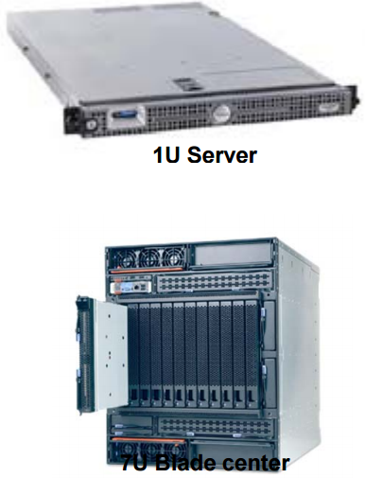
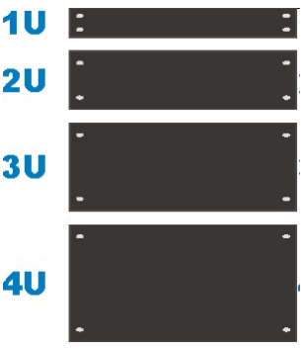
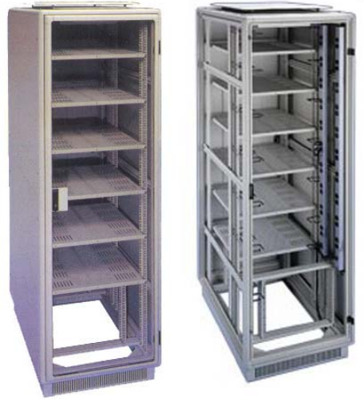
Racks
Equipment (e.g., servers) are typically placed in racks
Equipment are designed in a modular fashion to fit into rack units (1U, 2U etc.)
  1U = 1.75 inches (4.445cm)
  Width = 19 inches (48.26cm)
  1 inch = 2.54 cm, 1 foot = 12 inches
A single rack can hold up to 42 1U servers

Slide 26
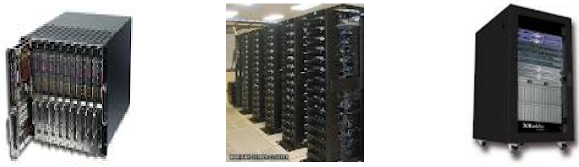
Blades and Blade Enclosures
A blade server is a stripped down computer with a modular design
A blade enclosure holds multiple blade servers and provides power, interfaces and cooling for the individual blade servers

Slide 27
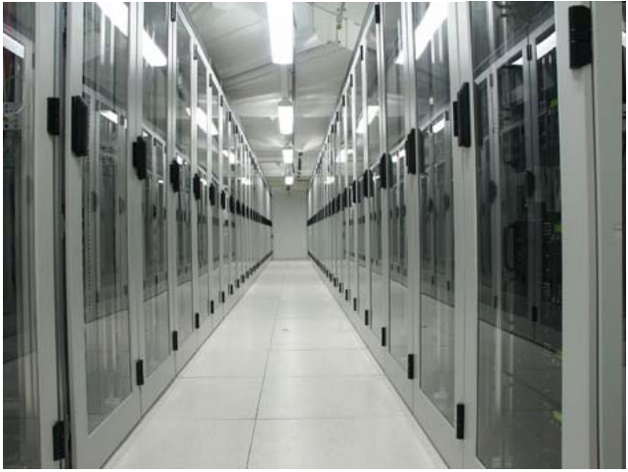
What is a Data Center?
A data center is a facility used to house computer systems and associated components, such as networking and storage systems, cooling, uninterruptable power supply(UPS), air filters…
A data center typically houses a large number of heterogeneous networked computer systems
A data center can occupy one room of a building, one or more floors, or an entire building

Slide 28
What is a Data Center?
Huge data centers, far larger than past systems
Very automated: far from where developers work. Often close to where power is generated
(ship bits... not watts)
Packed for high efficiency. Each machine hosts many applications (usually in lightweight virtual machines to provide isolation)
Scheduled to keep everything busy (but overloads hurt performance so we avoid them)

Slide 29
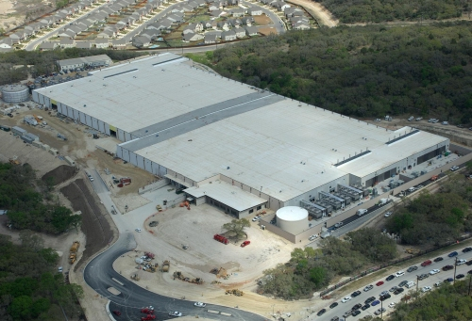
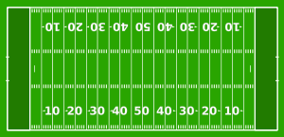
What is a Data Center?
Range in size from “edge” facilities to megascale.
Incredible economies of scale
  Approximate costs for a small size center (1K servers) and a larger, 50K server center.
Technology | Cost in small-sized Data Center | Cost in Large Data Center | Cloud Advantage
Network | $95 per Mbps/ month | $13 per Mbps/ month | 7.1
Storage | $2.20 per GB/ month | $0.40 per GB/ month | 5.7
Administration | ~140 servers/ Administrator | >1000 Servers/ Administrator | 7.1
120x53 yards
1yard = 0.9144 m
Each data center is
11.5 times
the size of a football field

Slide 30
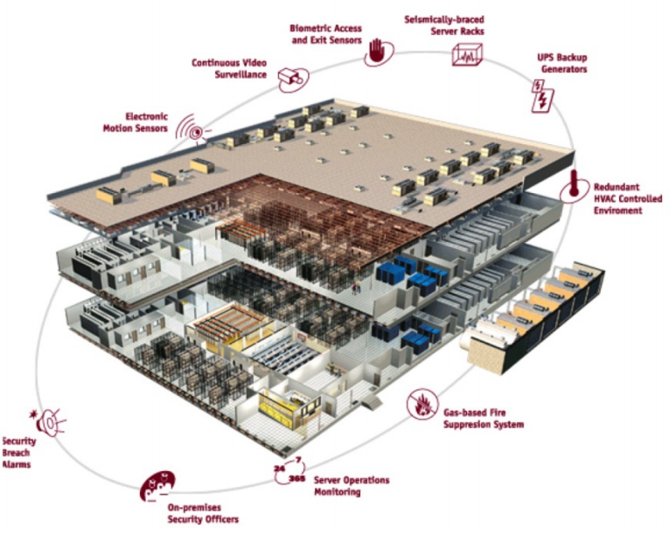
Data Center Components
Air conditioning
  Keep all components in the manufacturer’s recommended temperature range
Redundant Power
  UPS/Generators
  Multiple power feeds
Fire protection
Physical security
  CCTV/Access Control
Monitoring Systems
Connectivity
  Multiple ISPs/Leased Lines
Notes:
First hour stops here

Slide 31
Power in Data Centers
PUE = Power Utilization Efficiency = Total Power Consumption / Server Power Consumption
Pretty good data centers have efficiency of 1.7
  0.7 Watts lost for each 1W delivered to the servers
How can we reduce power costs?
  Create servers that use less power?
    Conventional server uses 200 to 500W
    Mostly a problem for scientists to tackle
  Reduce power usage of network gear?
    Total power consumed by switches amortizes to 10-20W per server
Any other method?

Slide 32
Utilization In Data Centers
Utilization of 10% to 30% is considered “good” in data centers
Causes:
  Uneven application fit:
    Each server has CPU, memory, and disk: most applications exhaust one resource, stranding the others
  Uncertainty in demand:
    Demand for a new service can spike quickly
  Risk management:
    Not having spare servers to meet application demands leads to failure

Slide 33
What About?
Maximize useful work per dollar spent – 59% of dollars are spent on servers with very low utilization (10%)
Turn the servers into a single large resource pool and let services “breathe” : dynamically expand and contract their footprint as needed
Two main requirements:
  Means for rapidly and dynamically satisfying application fluctuating resource needs
  Means for servers to quickly and reliably access shared and persistent data
    Data too large to copy during provisioning process
Virtualization
Parallel Programming Models & Distributed File Systems

Slide 34
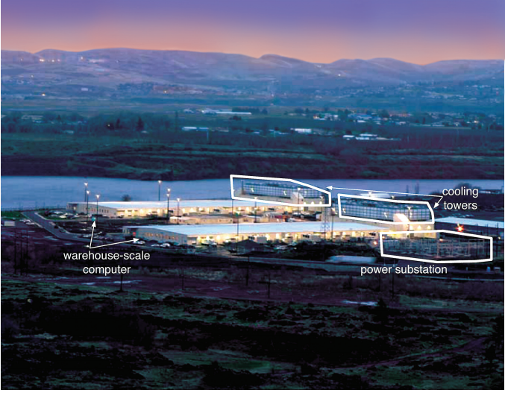
Cloud Computing is …
A data center hardware and software that the vendors use to offer the computing resources and services
Amazon AWS
Aliyun
MS Azure
Google Cloud
Huawei Yun
Tencent Yun
Etc.
Notes:
Second hour stops here

Slide 35
Lecture Outline
Cloud Infrastructure
Service Models
The Cloud Stack
Types of Clouds
Cloud Computing Benefits

Slide 36
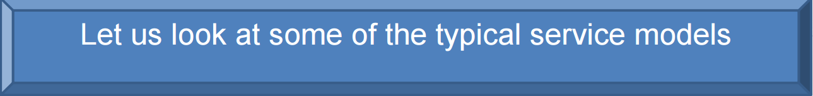
IT as a Service
How do you offer IT as a service?
Different users have different needs
Consider the needs of:
  Average End User
  Mobile Application Developer
  Enterprise System Architect

Slide 37
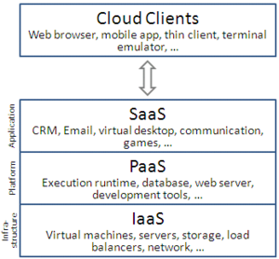
Cloud Service Models
Cloud computing service models arranged as layers in a stack
Notes:
CRM： customer relation management

Slide 38
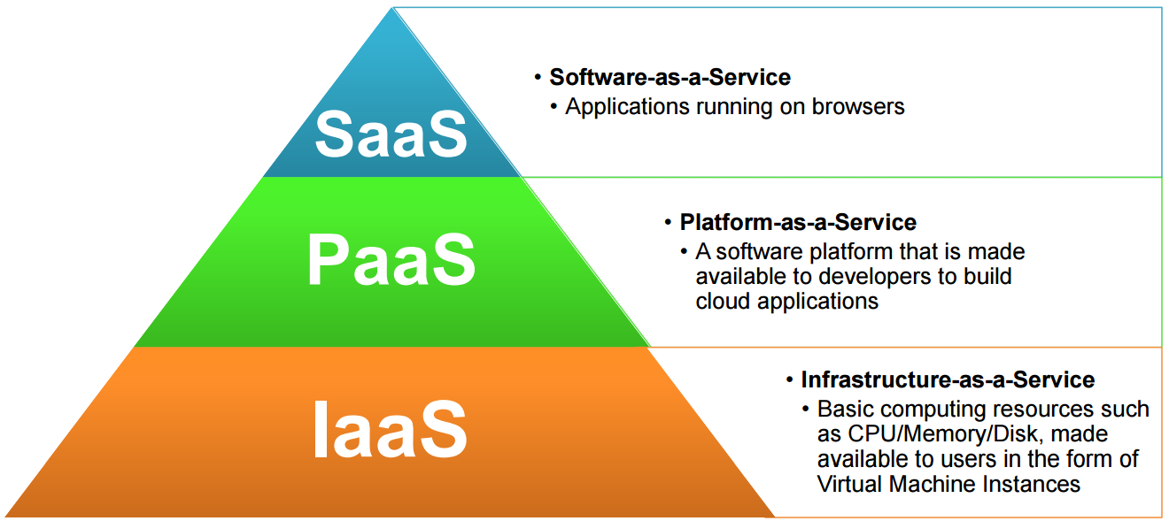
Cloud Service Models

Slide 39
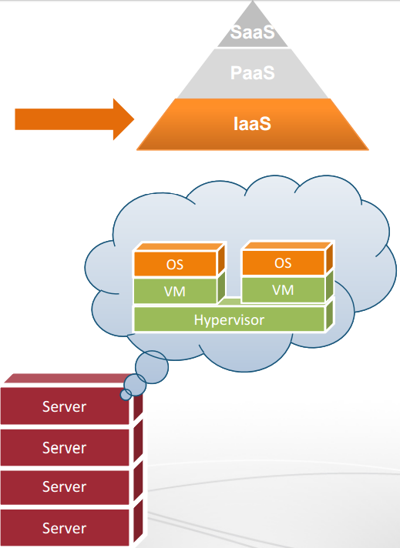
IaaS
The cloud provider leases to users Virtual Machine Instances (i.e., computer infrastructure) using the virtualization technology
The user has access to a standard Operating System environment and can install and configure all the layers above it
Cloud Provider

Slide 40
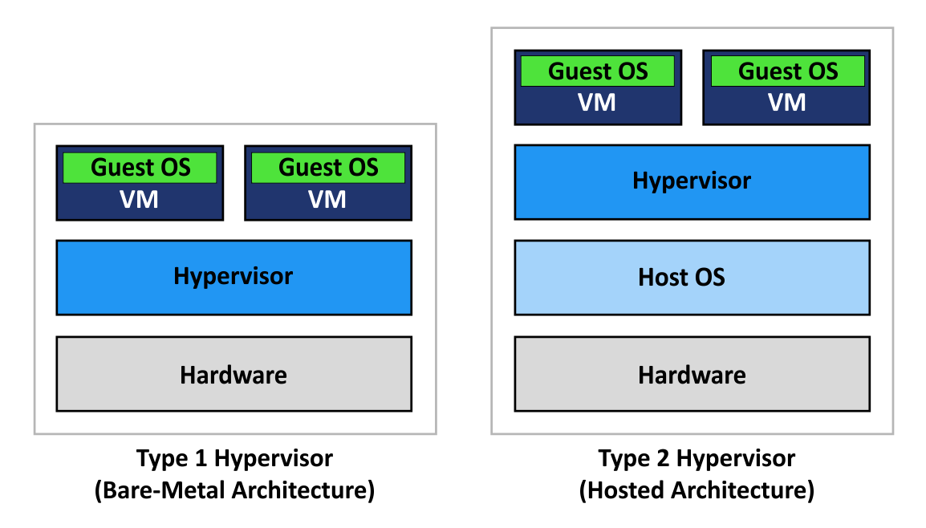
IaaS -- Hypervisor
A hypervisor (or virtual machine monitor, VMM, virtualizer) is computer software, firmware or hardware that creates and runs virtual machines. A computer on which a hypervisor runs one or more virtual machines is called a host machine, and each virtual machine is called a guest machine.
two types of hypervisor:
Type-1, native or bare-metal hypervisors
  run directly on the host's hardware to control the hardware and to manage guest operating systems. For this reason, they are sometimes called bare metal hypervisors.
Type-2 or hosted hypervisors
  run on a conventional operating system (OS) just as other computer programs do. A guest operating system runs as a process on the host. Type-2 hypervisors abstract guest operating systems from the host operating system. Parallels Desktop for Mac, QEMU, VirtualBox, VMware Player and VMware Workstation are examples of type-2 hypervisors.

Slide 41
IaaS
Infrastructure as a Service (IaaS) is a form of Cloud Computing which provides on-demand physical and virtual computing resources, storage, network, firewall, load balancers, etc.
To provide virtual computing resources, IaaS uses some form of Virtualization technologies and Hypervisor, like Xen, KVM, VMware ESX/ESXi, Hyper-V, etc.
TheXen VMM(virtual machine monitor) is an open-source project that is being developed in the computer laboratory of the University of Cambridge, UK. It enables us to create many virtual machines, each of which runs an instance of an operating system.
KVM (for Kernel-based Virtual Machine) is a full virtualization solution for Linux on x86 hardware containing virtualization extensions (Intel VT or AMD-V). It consists of a loadable kernel module, kvm.ko, that provides the core virtualization infrastructure and a processor specific module, kvm-intel.ko or kvm-amd.ko.
VMware ESXi is a bare metal hypervisor that installs easily on to your server and partitions it into multiple virtual machines.
Hyper-V, a native hypervisor written by Microsoft.

Slide 42
IaaS
IaaS is the backbone of all cloud services, providing the compute resources. After getting the compute resources, we provide other services on top of that.
Example
  Let's say that you want to have a set of 10 Linux systems with 4GB RAM each, and two Windows systems with 8GB each to deploy your software. You can go to any of the IaaS providers and request these systems. Generally, an IaaS provider creates the respective VMs in the background, puts them in the same internal network, and shares the credentials with you, thus allowing you to access them.
  Other than VMs, some IaaS providers offer bare-metal machines for provisioning.

Slide 43
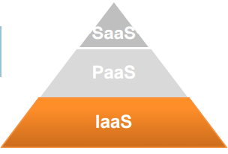
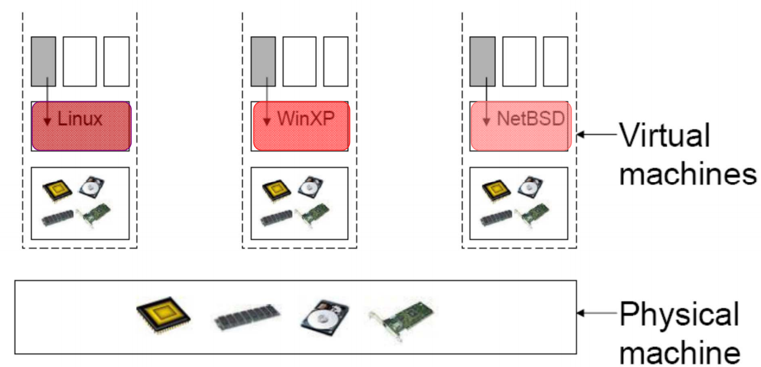
IaaS
The virtualization technology is a major enabler of IaaS
Hardware

Slide 44
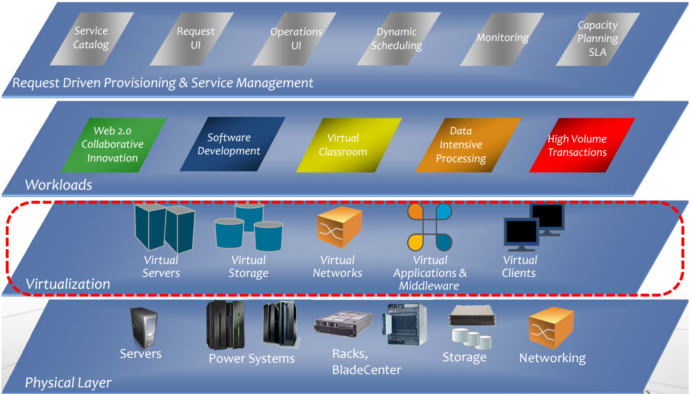
IaaS

Slide 45
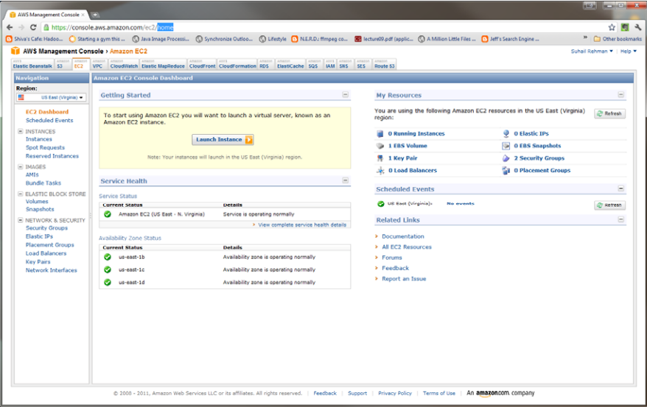
IaaS Example
Amazon Web Service Elastic Compute Cloud (EC2)
  uses mostly the XEN Hypervisor

Slide 46
IaaS Example
Amazon EC2 offers compute instances for different resources, which we can choose from depending on our need. Some examples of instances offered are the following:
  t2.nano: 512 MiB of memory, 1 vCPU, 3 CPU Credits/hour, EBS-only, 32 bit or 64-bit platform.
  c4.large: 3.75 GiB of memory, 2 vCPUs, 64-bit platform.
  d2.8xlarge: 244 GiB of memory, 36 vCPUs, 24 x 2000 GB of HDD-based instance storage, 64-bit platform, 10 Gigabit Ethernet.
Amazon EC2 provides some pre-configured images, called Amazon Machine Images (AMIs). These images can be used to quickly start instances. We can also create our own custom AMIs to boot our instances.
One important aspect to note is that Amazon supports configuring security and network access to our instances.

Slide 47
IaaS Example
With Amazon Elastic Block Store (EBS) we can attach/detach persistent storage to our instances.
EC2 supports the provisioning of dedicated hosts, which means we can get an entire physical machine for our use.
Amazon EC2 has many other features, allowing you to:
  Create an Elastic IP for remapping the Static IP address automatically
  Provision a Virtual Private Cloud for isolation
  Use CloudWatch for monitoring resources and applications
  Use Auto Scaling to dynamically resize your resources, etc.

Slide 48
IaaS Example
Some of the benefits of using Amazon EC2 are:
  It is an easy-to-use IaaS solution.
  It is flexible and scalable.
  It provides a secure and robust functionality for your compute resources.
  It enables automation.
  It is cost-effective: you only pay for the time and resources you use.
  It is designed to work in conjunction with other AWS components.

Slide 49
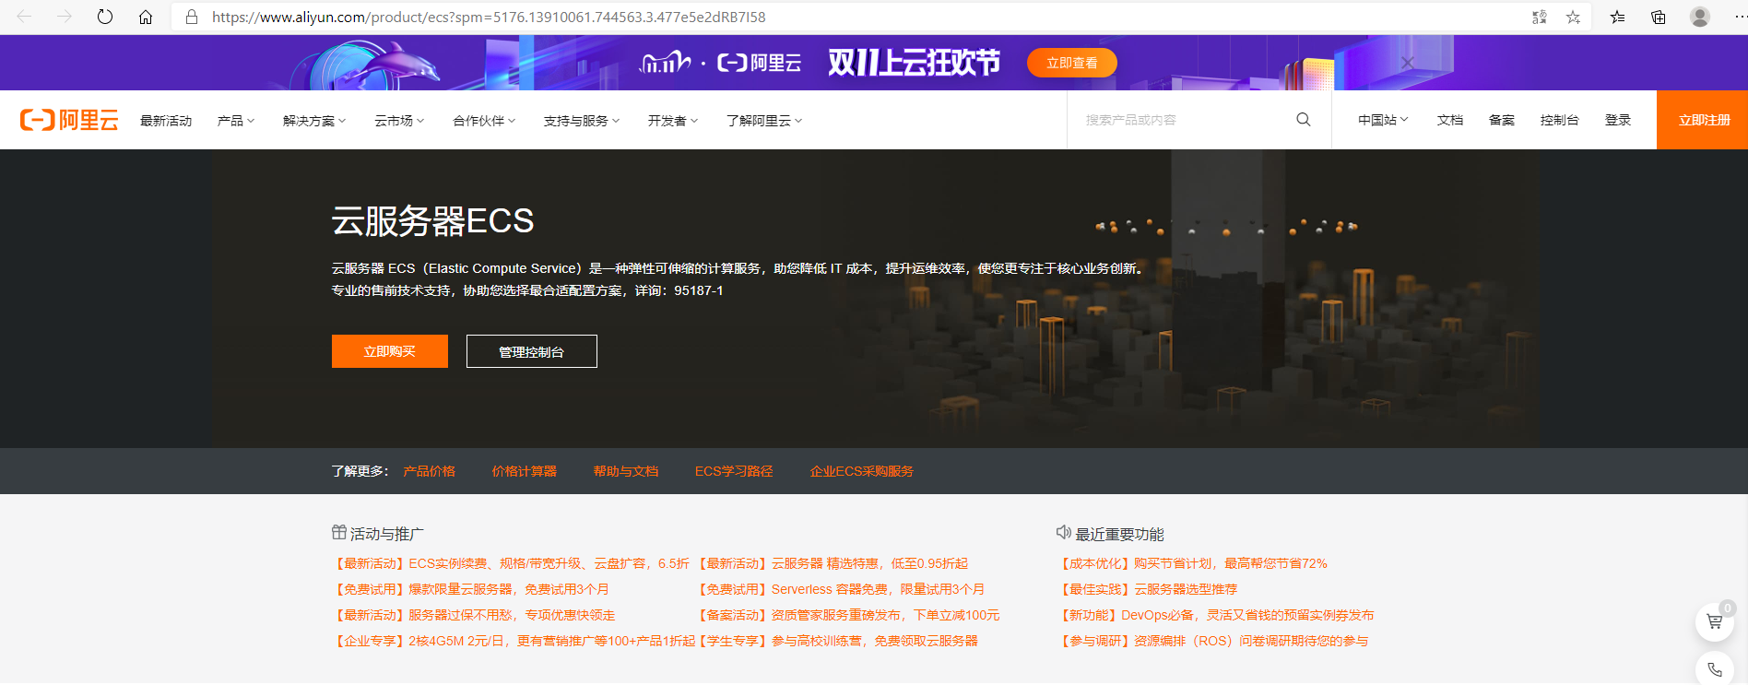
IaaS Example
Aliyun (ECS)

Slide 50
IaaS Examples
Microsoft Azure
  https://azure.microsoft.com/
Google cloud platform
  https://cloud.google.com/
DigitalOcean
  https://www.digitalocean.com/
Openstack
  http://www.openstack.org/

Slide 51
PaaS
As a developer, your objective is to create an application in the quickest, most effective way possible
You should not create applications using convoluted methods that may take a long time to complete
The user only sees the end product, not the development process

Slide 52
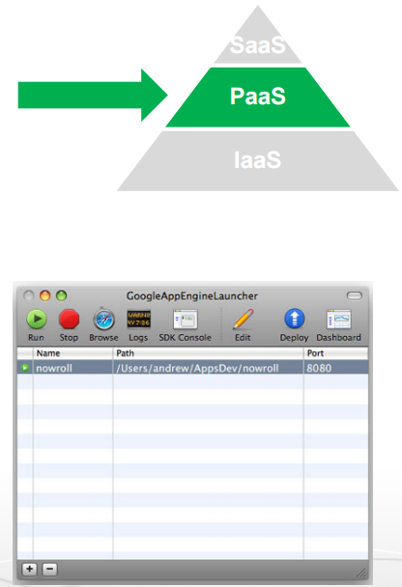
PaaS
Platform as a Service (PaaS) is a class of Cloud Computing services which allows its users to develop, run, and manage applications without worrying about the underlying infrastructure. With PaaS, users can simply focus on building their applications, which is a great help to developers.
We can either use PaaS services offered by different cloud computing providers like Amazon, Google, Azure, etc., or deploy it on-premise, using software like OpenShift Origin, Deis, etc.
PaaS can be deployed on top of IaaS, or, independently on VMs, bare-metal, and Containers.

Slide 53
PaaS
PaaS is a Cloud computing service that offers a platform for users to run applications on the Cloud
PaaS is a level above IaaS. PaaS does not require users to develop their own operating system environment
Ease of deployment: the platform takes care of the scaling for you
  IaaS may only provide hardware, and thus, clients must be in charge of load balancing and networking

Slide 54
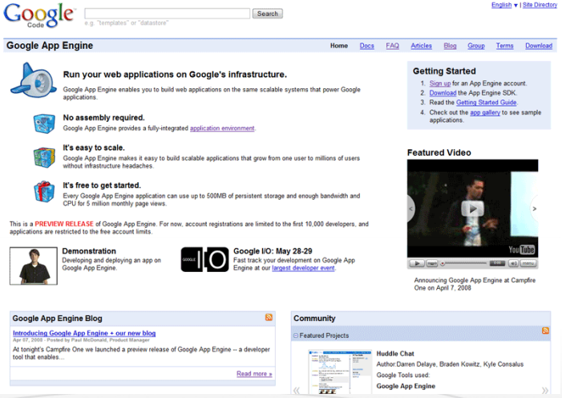
PaaS Example I
Google App Engine
Build web applications on Google’s Infrastructure

Slide 55
PaaS Example I
Google App Engine (GAE)
  GAE was developed by Google in 2008 as a PaaS
  It supports multi-tenancy and offers automatic scaling for web applications
  It supports Python, Java, and Go
  GAE supports Django web framework and the Grails web app framework
  GAE provides infrastructure tools that enable users to deploy code without worrying about infrastructure challenges such as deployment, failover, security or scalability
  Users of GAE can use App Engine Datastore, Google Cloud SQL, and Google Cloud Storage
  Users can also harness Google’s database technology, such as Bigtable

Slide 56
PaaS Example I
Google App Engine (GAE) case study
  BugSense - An application error-reporting service, it used GAE to maintain logs of bugs in software and analyze them
  Ubisoft - Used GAE to build its first web-based game, “From Dust,” on Chrome browser
  Claritics - A small social analytics company of 15 employees, used to analyze game data sets

Slide 57
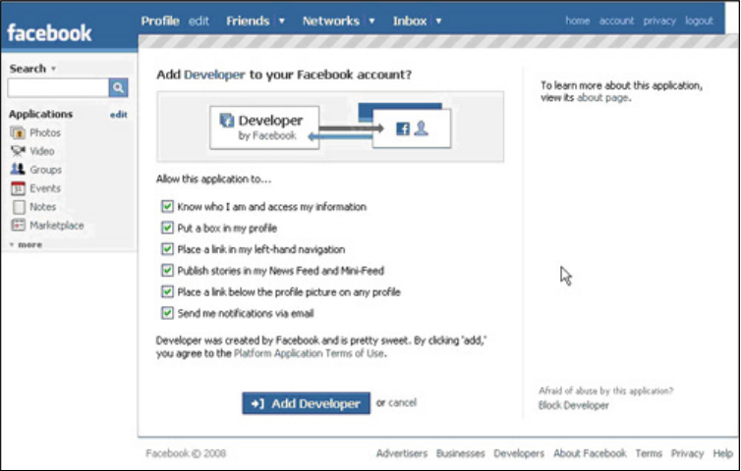
PaaS Example II
The Facebook Developer Platform
Set of APIs that allow you to create Facebook Applications

Slide 58
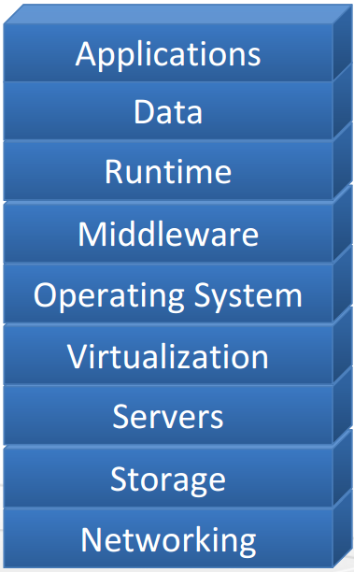
The Cloud Stack

Slide 59
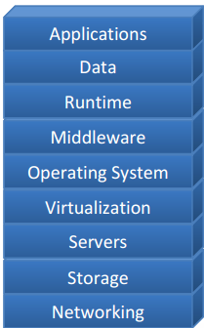
Applications
Cloud applications can range from Web
applications to scientific computational jobs

Slide 60
Data
Data Management
New generation cloud specific databases
and management systems
E.g., Hbase, Cassandra, Hive, Pig etc.

Slide 61
Runtime Environment
Runtime platforms to support cloud
programming models
E.g., MPI, MapReduce, Pregel etc.
Pregel is a parallel graph processing system based on BSP Model(Bulk Synchronous Parallel Computing Model)

Slide 62
Middleware for Clouds
Management platforms that enable:
  Resource Management
  Monitoring
  Provisioning
  Identity Management and Security
E.g. Hadoop YARN, HDFS

Slide 63
Operating Systems
Standard Operating Systems used in
Personal Computing
Packaged with libraries and software for
quick deployment and provisioning
E.g., Amazon Machine Images (AMI)
contain OS as well as required software
packages as a “snapshot” for instant
deployment

Slide 64
Virtualization
Key Component
Resource Virtualization
Amazon EC2 is based on the
Xen virtualization platform

Slide 65
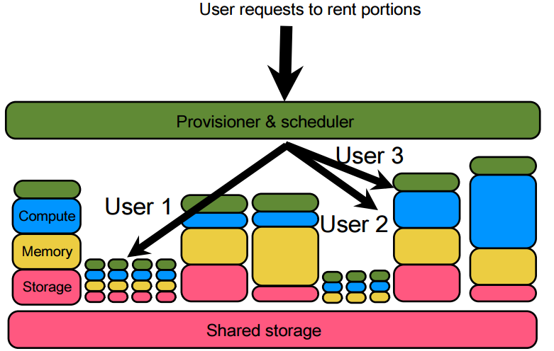
Cloud management

Slide 66
Cloud management
All resources should be well defined
Provide reasonably deterministic performance
Can be allocated and de-allocated on demand
Should provide some level of security guarantees through isolation

Slide 67
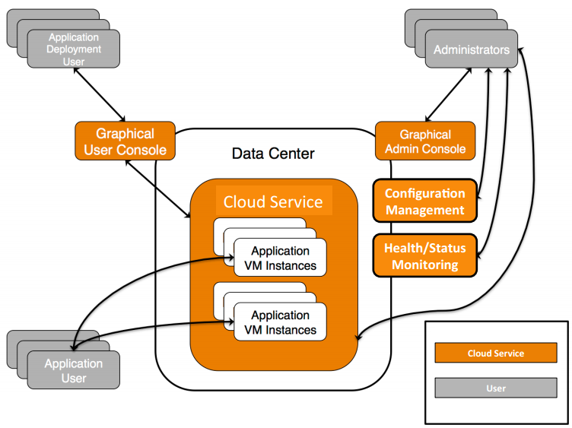
Cloud Users and Services

Slide 68
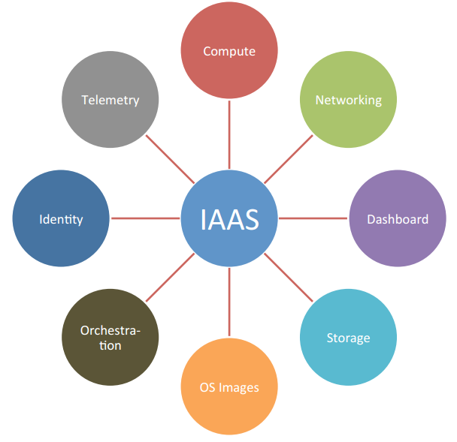
Services Needed for Cloud Management
Cloud
Management

Slide 69
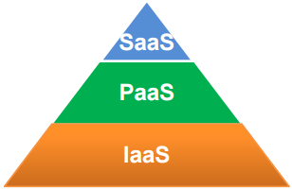
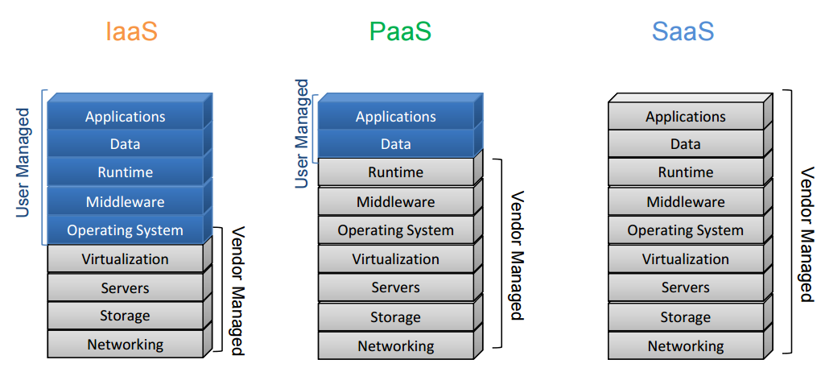
Cloud Service Layers

Slide 70
Lecture Outline
Cloud Infrastructure
Service Models of Cloud Computing
The Cloud Stack
Types of Clouds
Cloud computing benefits

Slide 71
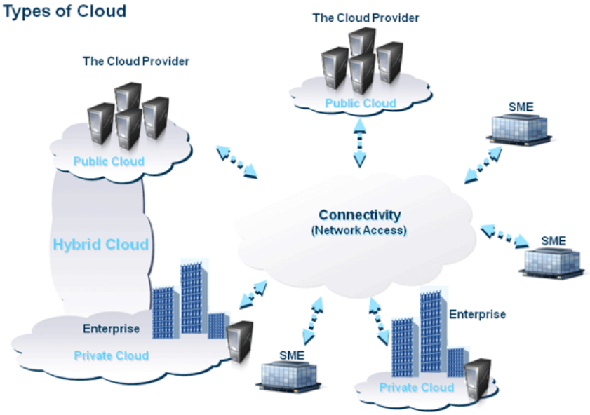
Types of Clouds (1/4)
Public
Private
Hybrid
SME = Small and Medium Enterprise

Slide 72
Types of Clouds (2/4)
Public (external) cloud
Open market for on demand computing and IT resources
Concerns: Limited SLA(Service-Level Agreement), reliability, availability, security, trust and confidence
Examples: Microsoft, Google, Amazon, …

Slide 73
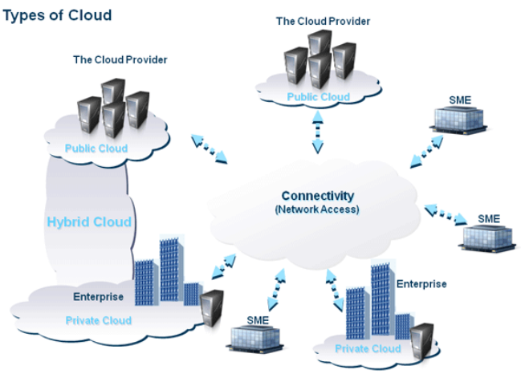
Types of Clouds (3/4)
Private (Internal) cloud
  For enterprises/corporations with large scale IT

Slide 74
Types of Clouds (4/4)
Hybrid cloud
  Extend the private cloud(s) by connecting it to other external cloud vendors to make use of their available cloud services
Cloud Burst
  Use the local cloud, and when you need more resources, burst into the public cloud

Slide 75
Lecture Outline
Cloud Infrastructure
Service Models of Cloud Computing
The Cloud Stack
Types of Clouds
Cloud computing benefits

Slide 76
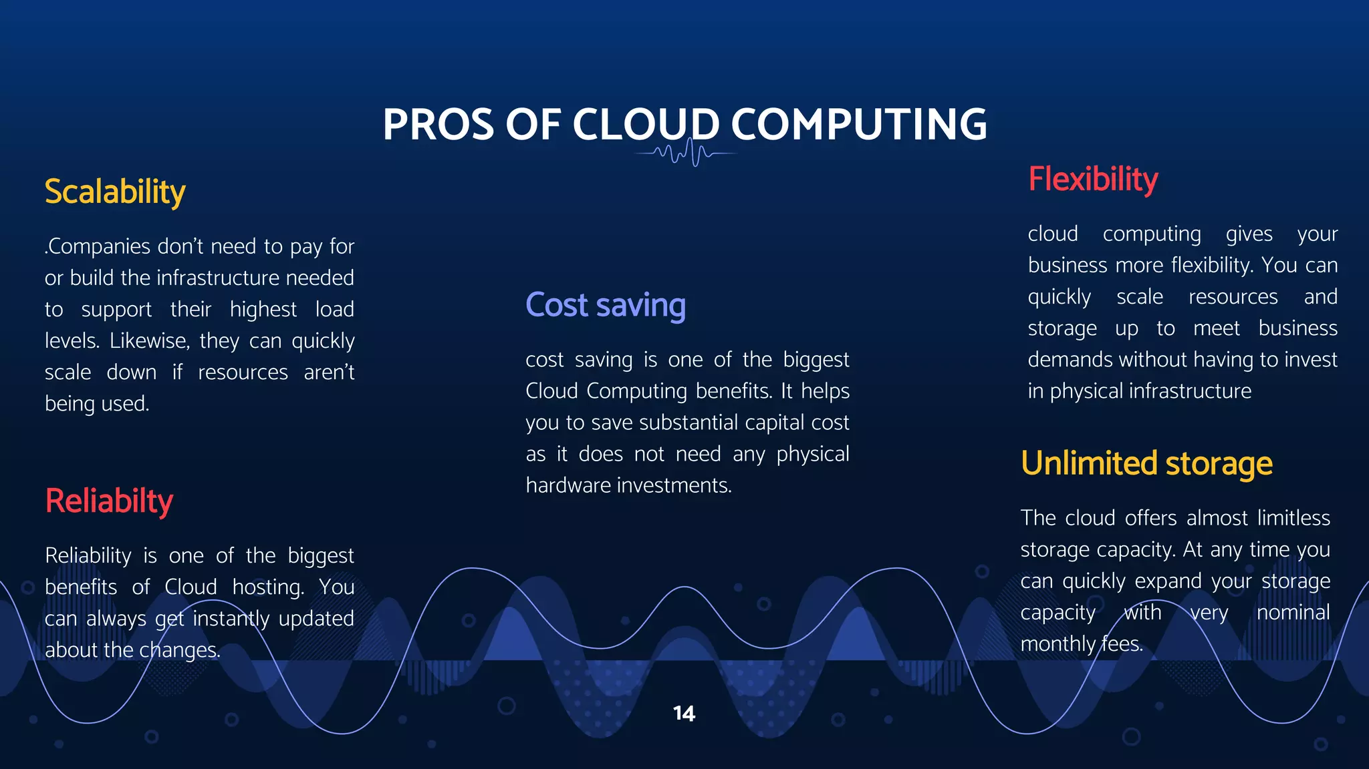
Why cloud computing?
In general:
  Big Data Applications
  Flexibility
  Scalability
  Customized to your current needs:
    Hardware
    Software
  Effect:
    Reduce Cost
    Reduce Maintenance
    High Utilization
    High Availability
    Reduced Carbon Footprint

Slide 77

Why cloud computing?
Flexibility
  Software: Any software platform
  Access: access resources from any machine connected to the Internet
  Deploy infrastructure from anywhere at anytime
    Software controls infrastructure

Slide 78


Why cloud computing?
Scalability
  Instant Control via software
    Add/cancel/rebuild resources instantly
  Start small, then scale your resources up/down as you need
  Illusion of infinite resources available on demand

Slide 79

Why cloud computing?
Customization
  Everything in your wish list
  Software platforms
  Storage
  Network bandwidth
  Speed

Slide 80

Why cloud computing?
Cost
  Pay as you go model
  Small/medium size companies can tap the infrastructure of corporate giants.
  Time to service/market
  No upfront cost

Slide 81

Why cloud computing?
Maintenance
  Reduce the size of a client’s IT department
  Is the responsibility of the cloud vendor
  This Includes:
    Software updates
    Security patches (安全补丁)
    Monitoring system’s health
    System backup

Slide 82
Why cloud computing?
Utilization
  Consolidation of a large number of resources
    CPU cycles
    Storage
    Network Bandwidth

Slide 83
Why cloud computing?
Availability
  Having access to software, platform, infrastructure from anywhere at any time
  All you need is a device connected to the internet
Reliability
  The system’s fault tolerance is managed by the cloud providers and users no longer need to worry about it.

Slide 84

Why NOT cloud computing?
Drawbacks
  Security
  Privacy
  Vendor lock-in
  Network-dependent Migration

Slide 85
Assignment
Set up a Hadoop instance on Ubuntu
  A single machine pseudo-distributed mode cluster with 1 datanode + 1 namenode + 1 resourcemanager
  Refer to the tutorial on Canvas
    Install Hadoop on Ubuntu.docx

