Slide 1
CPS 4982 – Big Data Analytics
Lecture 4 Hadoop Basics
Dr. Changjiang Zhang
Notes:
The Apache Hadoop software library is a framework that allows for the distributed processing of large data sets across clusters of computers using simple programming models. It is designed to scale up from single servers to thousands of machines, each offering local computation and storage.

Slide 2
Data Scalability Problems
B:billion
Search Engine
  10KB / doc * 2B docs = 200TB
  Reindex every 30 days: 200TB/30days = 6 TB/day
Log Processing / Data Warehousing
  0.5KB/events * 3B pageview events/day = 1.5TB/day
  100M users * 5 events * 100 feed/event * 0.1KB/feed = 5TB/day
Multipliers: 3 copies of data, 3-10 passes of raw data
Processing Speed (Single Machine)
  2-20MB/second * 86.4K seconds/day = 0.17-1.7 TB/day

Slide 3
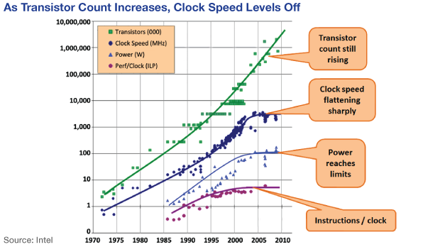
Data Scalability Problems

Slide 4
I/O throughput lags behind
Source: R1Soft, http://wiki.r1soft.com/pages/viewpage.action?pageId=3016608

Slide 5
I/O throughput lags behind
Source: R1Soft, http://wiki.r1soft.com/pages/viewpage.action?pageId=3016608

Slide 6
Other issues
Building a high-end supercomputer is much, much costly
Storing all data in one place adds the risk of hardware failures
  Never put all eggs in one basket!

Slide 7
Going Parallel/Distributed is the Only Way to Scale

Slide 8
Google datacenter
Lots of cheap, commodity PCs, each with a disk and CPU
  100s to 1000s of PCs in a cluster in the early days
High aggregate storage capacity
  No costly “big disk”
Spread processing across many machines
  High I/O bandwidth, proportional to the # of machines
  Parallel data processing

Slide 9
Google’s Solution
Google File System – SOSP’2003
MapReduce – OSDI’2004
Sawzall^{[1]} – Scientific Programming Journal’2005
Big Table – OSDI’2006
Chubby^{[2]} – OSDI’2006
[1] Sawzall is a programming language used for doing data analysis on a massive, distributed dataset.
Rob Pike, Sean Dorward, Robert Griesemer, Sean Quinlan: Interpreting the data: Parallel analysis with Sawzall. Scientific Programming 13(4): 277-298 (2005)
[2] The Chubby lock service for loosely-coupled distributed systems

Slide 10
Open Source World’s Solution
Google | Apache Open Source
Google File System | Hadoop Distributed File System (HDFS)
MapReduce | Hadoop MapReduce
Sawzall | Pig, Hive, JAQL
Big Table | Hadoop HBase, Cassandra
Chubby | Zookeeper

Slide 11
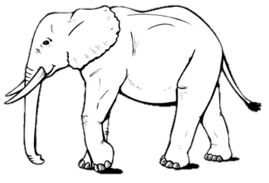



Hadoop Principle
Hadoop is basically a middleware platforms that manages a cluster of machines
I’m one big data set
The core components is a hadoop distributed file system (HDFS)
Files in HDFS are split into blocks that are scattered over the cluster
Hadoop
HDFS
The cluster can grow indefinitely simply by adding new nodes

Slide 12
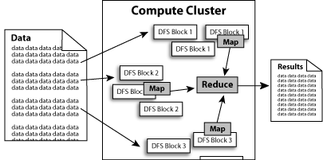
What does it do?
Hadoop implements Google’s MapReduce, using HDFS
MapReduce divides applications into many small blocks of work.
HDFS creates multiple replicas of data blocks for reliability, placing them on compute nodes around the cluster.
MapReduce can then process the data where it is located.
Hadoop’s target is to run on clusters of the order of 10,000-nodes.

Slide 13
Hadoop: Assumptions
It is written with large clusters of computers in mind and is built around the following assumptions:
  Hardware will fail.
  Processing will be run in batches. Thus there is an emphasis on high throughput as opposed to low latency.
  Applications that run on HDFS have large data sets. A typical file in HDFS is gigabytes to terabytes in size.
  It should provide high aggregate data bandwidth and scale to hundreds of nodes in a single cluster. It should support tens of millions of files in a single instance.
  Applications need a write-once-read-many access model.
  Moving Computation is Cheaper than Moving Data.
  Portability is important.

Slide 14

Hadoop History
Jan 2006 – Doug Cutting joins Yahoo
Feb 2006 – Hadoop splits out of Nutch, and Yahoo starts using it.
Dec 2006 – Yahoo creates a 100-node Webmap with Hadoop
Apr 2007 – Yahoo on a 1000-node cluster
Dec 2007 – Yahoo creates a 1000-node Webmap with Hadoop
Jan 2008 – Hadoop became a top-level Apache project
Sep 2008 – Hive added to Hadoop as a contributing project
Doug Cutting
According to its co-founders, Doug Cutting and Mike Cafarella, the idea of Hadoop was conceived in the Google File System paper that was published in October 2003. The concept was extended in the Google paper "MapReduce: Simplified Data Processing on Large Clusters". Development started on the Apache Nutch project, but was moved to the new Hadoop subproject in January 2006. Doug Cutting, who was working at Yahoo! at the time, named it after his son's toy elephant. The initial code that was factored out of Nutch consisted of about 5,000 lines of code for HDFS and about 6,000 lines of code for MapReduce.
https://en.wikipedia.org/wiki/Apache_Hadoop

Slide 15
Hadoop Introduction
Open Source Apache Project
  http://hadoop.apache.org/
  Book: http://oreilly.com/catalog/9780596521998/index.html
Written in Java
  Does work with other languages
Runs on
  Linux, Windows, and more
  Commodity hardware with a high failure rate
Hadoop: The Definitive Guide by Tom White
Current stable version: Hadoop 3.5.0

Slide 16
Current Status of Hadoop
Largest Cluster
  10000+ nodes (64 cores, 32TB disk)
Used by major companies/universities around the world
  Yahoo, Facebook, etc.
  Cloud Computing Donation from Google and IBM
Startup focusing on providing services for Hadoop
  Cloudera
https://www.cloudera.com/

Slide 17
Hadoop Ecosystem
Hadoop mainly has three components: HDFS, YARN, and MapReduce

Slide 18
Hadoop Components
Hadoop Distributed File System (HDFS)
Hadoop MapReduce
Contributes
  Hadoop Streaming
  Pig / JAQL^{[1]} / Hive^{[2]}
  Hbase^{[3]}
  Hama^{[4]} / Mahout^{[5]}
[1] Jaql is a functional, declarative query language that provides users with a simple, declarative syntax to process large sets of structured and nontraditional data. Jaql is primarily a query language for JavaScript Object Notation (JSON) data.
[2] Apache Hive data warehouse software facilitates reading, writing, and managing large datasets residing in distributed storage using SQL.
[3] HBase is the Hadoop database, a distributed, scalable, big data store. It is an open-source, distributed, versioned, non-relational database modeled after Google's Bigtable: A Distributed Storage System for Structured Data by Chang et al.
[4] Apache Hama was a framework for Big Data analytics based on the Bulk Synchronous Parallel paradigm.
[5] Apache Mahout: For creating scalable performant machine learning applications

Slide 19
Hadoop Components
Hadoop Distributed File System (HDFS)
HDFS stands for Hadoop Distributed File System.
HDFS is specially designed for storing huge datasets on commodity hardware.
Stores different types of data, i.e., structured, unstructured, and semi-structured, in a distributed way.
There are two components of HDFS -name node anddatanode. While there is only one NameNode, there can be multiple DataNodes.

Slide 20
Hadoop Components
YARN(Yet Another Resources Negotiator) : Resource Manager
YARN stands for Yet Another Resource Negotiator.
Performs all processing activities by allocating resources (RAM, memory, etc.) and scheduling tasks.
The most important component of YARN is
  Resource Manager: manages resources and schedules applications running on top of YARN.
  Node Manager: It is the slave of the YARN Architecture. Each Node Manager receives instructions from the Resource Manager and reports and handles containers on a single node. It manages the container lifecycle, node health, log management, and node and container resource usage
  Application Master: It is a framework-specific library that negotiates resources from the Resource Manager and works with the Node Manager to execute and monitor containers and their resource consumption.

Slide 21
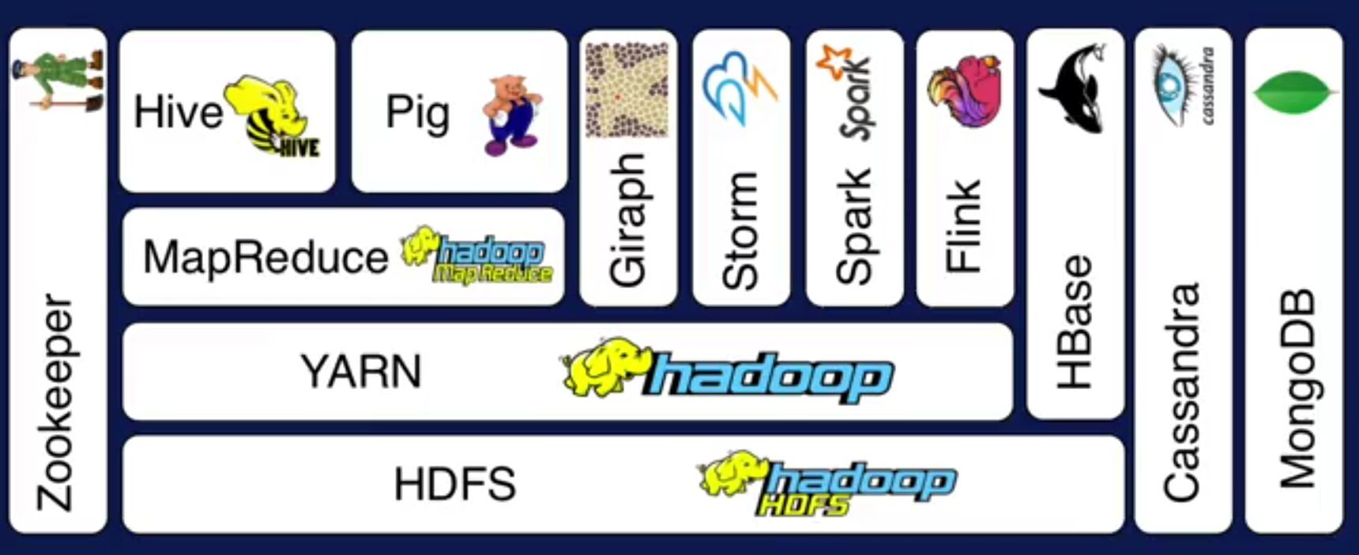
Hadoop Ecosystem

Slide 22
Hadoop Basic Modules
Hadoop Common
Hadoop Distributed File System (HDFS)
Hadoop YARN
Hadoop MapReduce
Other Modules: Zookeeper, Impala, Oozie, etc.
Spark, Storm, Tez, etc.
HBase
Non-relational Database
Pig
Scripting
Hive
SQL Like Query
MapReduce
Distributed Processing
Others
Distributed Processing
Yarn
Resource Manager
HDFS Distributed File System (Storage)

Slide 23
Hadoop HDFS
Hadoop distributed File System (based on Google File System (GFS) paper, 2004)
  Serves as the distributed file system for most tools in the Hadoop ecosystem
  Scalability for large data sets
  Reliability to cope with hardware failures
HDFS good for:
  Large files
  Streaming data
Not good for:
  Lots of small files
  Random access to files
  Low latency access
Single Hadoop cluster with 5000 servers and 250 petabytes of data
Notes:
Very Large Distributed File System
10K nodes, 100 million files, 10 PB
Assumes Commodity Hardware
Files are replicated to handle hardware failure
Detect failures and recovers from them
Optimized for Batch Processing
Data locations exposed so that computations can move to where data resides
Provides very high aggregate bandwidth

Slide 24
Goals of HDFS
Very Large Distributed File System
  10K nodes, 100 million files, 10 PB
Convenient Cluster Management
  Load balancing
  Node failures
  Cluster expansion
Optimized for Batch Processing
  Allow move computation to data
  Maximize throughput
Notes:
Very Large Distributed File System
10K nodes, 100 million files, 10 PB
Assumes Commodity Hardware
Files are replicated to handle hardware failure
Detect failures and recovers from them
Optimized for Batch Processing
Data locations exposed so that computations can move to where data resides
Provides very high aggregate bandwidth

Slide 25
Design of HDFS
Master-Slave design
Master Node
  Single NameNode for managing metadata
Slave Nodes
  Multiple DataNodes for storing data
Other
  Secondary NameNode as a backup
Notes:
Very Large Distributed File System
10K nodes, 100 million files, 10 PB
Assumes Commodity Hardware
Files are replicated to handle hardware failure
Detect failures and recovers from them
Optimized for Batch Processing
Data locations exposed so that computations can move to where data resides
Provides very high aggregate bandwidth

Slide 26
HDFS Architecture
NameNode keeps the metadata, the name, location and directory
DataNode provide storage for blocks of data
Client
NameNode
Secondary NameNode
DataNode
DataNode
DataNode
DataNode
DataNode
DataNode
DataNode
DataNode
Heartbeat, Cmd, Data
Notes:
Name node: single point of failure, so we have secondary name node.
Secondary name node: read transaction log from name node, and upload FSImage to name node.
Single name node avoids metadata conflict etc.
Data node: easy to join and leave cluster.
Heartbeat protocol.

Slide 27
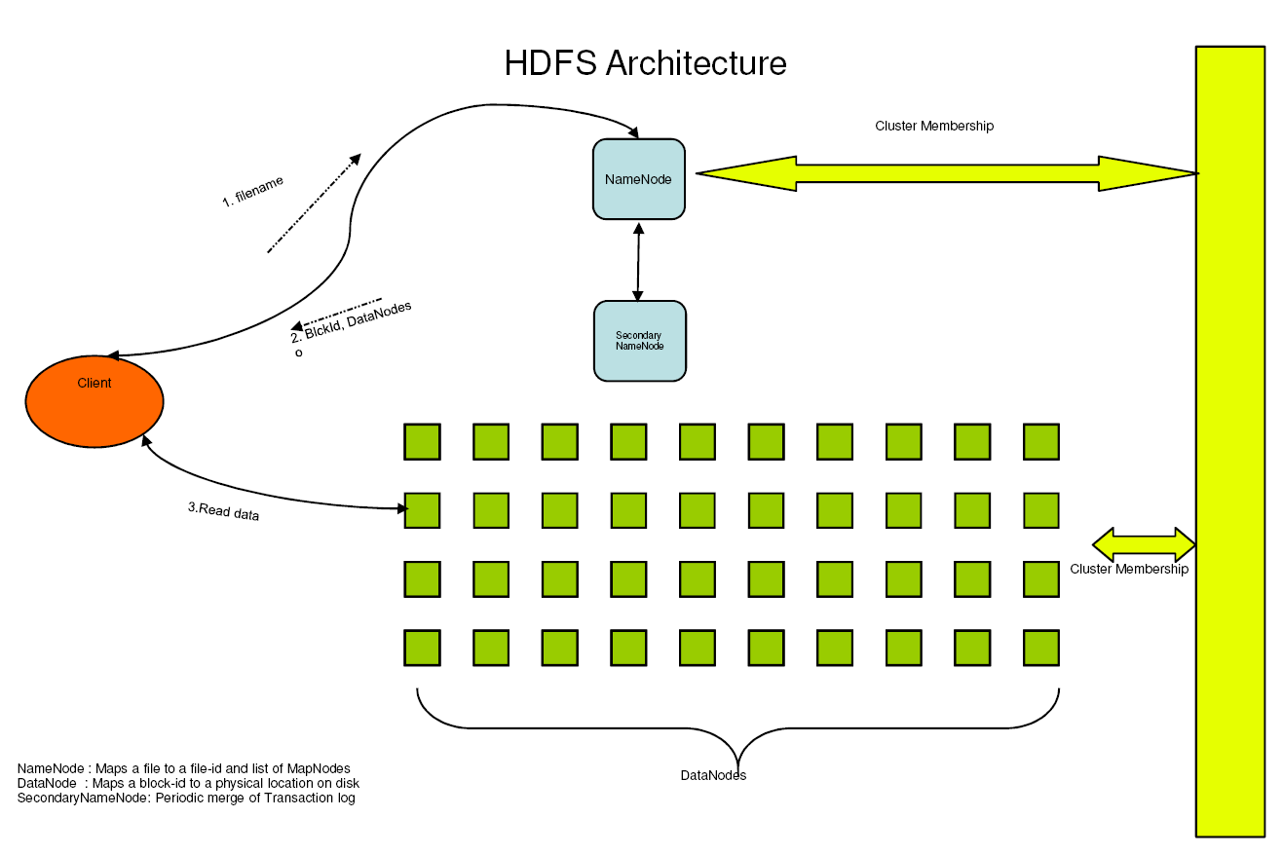
HDFS Architecture
http://hadoop.apache.org/docs/r1.2.1/hdfs_design.html
Notes:
Name node: single point of failure, so we have secondary name node.
Secondary name node: read transaction log from name node, and upload FSImage to name node.
Single name node avoids metadata conflict etc.
Data node: easy to join and leave cluster.
Heartbeat protocol.

Slide 28
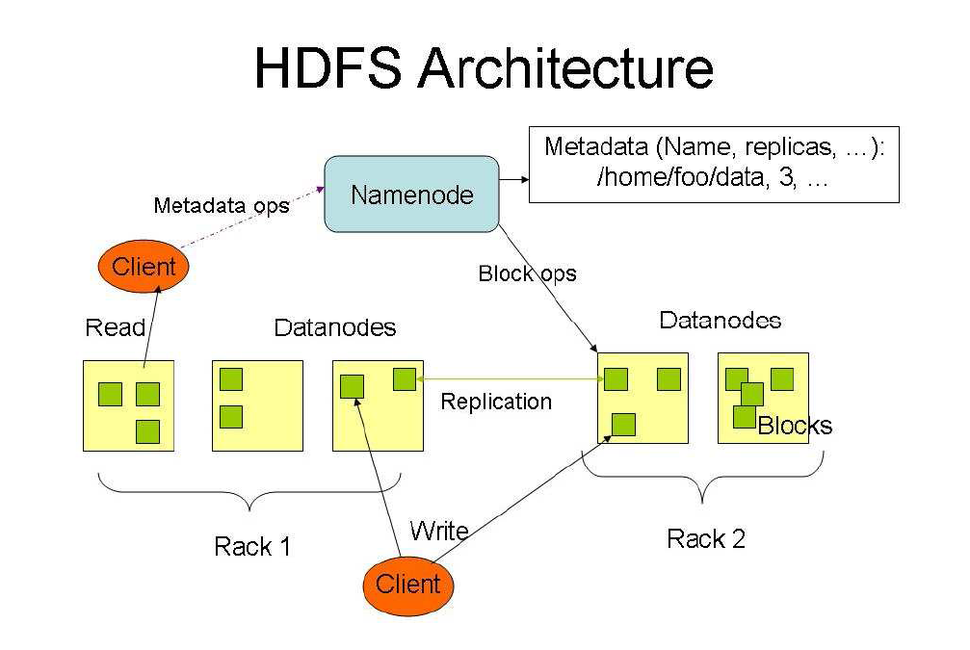
HDFS Architecture
http://hadoop.apache.org/docs/r1.2.1/hdfs_design.html
Notes:
HDFS has a master/slave architecture. An HDFS cluster consists of a single NameNode, a master server that manages the file system namespace and regulates access to files by clients. In addition, there are a number of DataNodes, usually one per node in the cluster, which manage storage attached to the nodes that they run on. HDFS exposes a file system namespace and allows user data to be stored in files. Internally, a file is split into one or more blocks and these blocks are stored in a set of DataNodes. The NameNode executes file system namespace operations like opening, closing, and renaming files and directories. It also determines the mapping of blocks to DataNodes. The DataN odes are responsible for serving read and write requests from the file system’s clients. The DataNodes also perform block creation, deletion, and replication upon instruction from the NameNode.
The NameNode and DataNode are pieces of software designed to run on commodity machines. These machines typically run a GNU/Linux operating system (OS). HDFS is built using the Java language; any machine that supports Java can run the NameNode or the DataNode software. Usage of the highly portable Java language means that HDFS can be deployed on a wide range of machines. A typical deployment has a dedicated machine that runs only the NameNode software. Each of the other machines in the cluster runs one instance of the DataNode software. The architecture does not preclude running multiple DataNodes on the same machine but in a real deployment that is rarely the case.
The existence of a single NameNode in a cluster greatly simplifies the architecture of the system. The NameNode is the arbitrator and repository for all HDFS metadata. The system is designed in such a way that user data never flows through the NameNode.

Slide 29
HDFS Architecture
What happens; if node(s) fail?
Replication of Blocks for fault tolerance
File
B1
B2
B3
B4
Node
Node
Node
Node
B1
B2
B4
B3
Node
Node
Node
Node
B1
B3
B1
B2
B4
Node
Node
Node
Node
B4
B3
B1
B2
Notes:
HDFS has a master/slave architecture. An HDFS cluster consists of a single NameNode, a master server that manages the file system namespace and regulates access to files by clients. In addition, there are a number of DataNodes, usually one per node in the cluster, which manage storage attached to the nodes that they run on. HDFS exposes a file system namespace and allows user data to be stored in files. Internally, a file is split into one or more blocks and these blocks are stored in a set of DataNodes. The NameNode executes file system namespace operations like opening, closing, and renaming files and directories. It also determines the mapping of blocks to DataNodes. The DataN odes are responsible for serving read and write requests from the file system’s clients. The DataNodes also perform block creation, deletion, and replication upon instruction from the NameNode.
The NameNode and DataNode are pieces of software designed to run on commodity machines. These machines typically run a GNU/Linux operating system (OS). HDFS is built using the Java language; any machine that supports Java can run the NameNode or the DataNode software. Usage of the highly portable Java language means that HDFS can be deployed on a wide range of machines. A typical deployment has a dedicated machine that runs only the NameNode software. Each of the other machines in the cluster runs one instance of the DataNode software. The architecture does not preclude running multiple DataNodes on the same machine but in a real deployment that is rarely the case.
The existence of a single NameNode in a cluster greatly simplifies the architecture of the system. The NameNode is the arbitrator and repository for all HDFS metadata. The system is designed in such a way that user data never flows through the NameNode.

Slide 30
HDFS Details
Data Coherency
  Write-once-read-many access model
  Client can only append to existing files
Files are broken up into blocks
  Typically 128 MB block size
  Hence makes HDFS good for storing larger files
HDFS blocks are replicated multiple times
  One block stored at multiple location, also at different racks (usually 3 times)
  This makes HDFS storage fault tolerant and faster to read
Intelligent Client
  Client can find location of blocks
  Client accesses data directly from DataNode

Slide 31
HDFS User Interface
Java API
  Java SE Development Kit 8 - Downloads (oracle.com)
Pyhdfs
  https://pypi.org/project/PyHDFS/
Command Line
http://hadoop.apache.org/docs/stable/hadoop-project-dist/hadoop-common/FileSystemShell.html

Slide 32
HDFS User Interface
  hdfs dfs –mkdir –p /usr/uic/hadoop/
    Create the directories under HDFS
  hdfs dfs -put ~/Desktop/test1.txt /user/uic/hadoop/test2.txt
  Upload a local file to a specified directory and rename it.
  hdfs dfs –cat /user/uic/hadoop/test2.txt
  View the contents of the file test2.txt in directory on HDFS
  hdfs dfs -ls /user/uic/hadoop/
    List the files under HDFS
  hdfs dfs -get /user/uic/hadoop/test2.txt ~/Desktop
    Copy the file from HDFS to local file system
  hdfs dfs -rm /user/uic/hadoop/test2.txt
  Delete the specified file from HDFS
  hdfs dfs -rm -r /user/uic/hadoop/wordcount/
  Delete the specified nonempty directory from HDFS
  hdfs dfs –rmdir /user/uic/hadoop
    Delete the specified directory from HDFS
  hdfs dfsadmin –report
    View basic statistics for HDFS
  hdfs dfsadmin -safemode leave
    Exit safe mode
  hdfs dfsadmin -safemode enter
    Enter safe mode

Slide 33
Apache Hadoop Wins Terabyte Sort Benchmark
(July 2008)
One of Yahoo's Hadoop clusters sorted 1 terabyte of data in 209 seconds, which beat the previous record of 297 seconds in the annual general purpose (daytona) terabyte sort benchmark. The sort benchmark specifies the input data (10 billion 100 byte records), which must be completely sorted and written to disk.
The sort used 1800 maps and 1800 reduces and allocated enough memory to buffers to hold the intermediate data in memory.
The cluster had 910 nodes; 2 quad core Xeons @ 2.0ghz per node; 4 SATA disks per node; 8G RAM per node; 1 gigabit ethernet on each node; 40 nodes per rack; 8 gigabit ethernet uplinks from each rack to the core; Red Hat Enterprise Linux Server Release 5.1 (kernel 2.6.18); Sun Java JDK 1.6.0_05-b13

Slide 34
Example Applications and Organizations using Hadoop
A9.com – Amazon: To build Amazon's product search indices; process millions of sessions daily for analytics, using both the Java and streaming APIs; clusters vary from 1 to 100 nodes.
Yahoo! : More than 100,000 CPUs in ~20,000 computers running Hadoop; biggest cluster: 2000 nodes (2*4cpu boxes with 4TB disk each); used to support research for Ad Systems and Web Search
AOL : Used for a variety of things ranging from statistics generation to running advanced algorithms for doing behavioral analysis and targeting; cluster size is 50 machines, Intel Xeon, dual processors, dual core, each with 16GB Ram and 800 GB hard-disk giving us a total of 37 TB HDFS capacity.
Facebook: To store copies of internal log and dimension data sources and use it as a source for reporting/analytics and machine learning; 320 machine cluster with 2,560 cores and about 1.3 PB raw storage;
FOX Interactive Media : 3 X 20 machine cluster (8 cores/machine, 2TB/machine storage) ; 10 machine cluster (8 cores/machine, 1TB/machine storage); Used for log analysis, data mining and machine learning
University of Nebraska Lincoln: one medium-sized Hadoop cluster (200TB) to store and serve physics data;

Slide 35
More Hadoop Applications
Adknowledge - to build the recommender system for behavioral targeting, plus other clickstream analytics; clusters vary from 50 to 200 nodes, mostly on EC2.
Contextweb - to store ad serving log and use it as a source for Ad optimizations/ Analytics/reporting/machine learning; 23 machine cluster with 184 cores and about 35TB raw storage. Each (commodity) node has 8 cores, 8GB RAM and 1.7 TB of storage.
Cornell University Web Lab: Generating web graphs on 100 nodes (dual 2.4GHz Xeon Processor, 2 GB RAM, 72GB Hard Drive)
NetSeer - Up to 1000 instances on Amazon EC2 ; Data storage in Amazon S3; Used for crawling, processing, serving and log analysis
The New York Times : Large scale image conversions ; EC2 to run hadoop on a large virtual cluster
Powerset / Microsoft - Natural Language Search; up to 400 instances on Amazon EC2 ; data storage in Amazon S3

Slide 36
Hadoop Limitations

Slide 37
Hadoop Lab1
Set up a Hadoop instance on Ubuntu
  A single machine pseudo-distributed mode cluster with 1 datanode + 1 namenode + 1 resourcemanager
  You can find the document Install Hadoop on Ubuntu.docx on Canvas

Slide 38

Hadoop Lab1
Install Java JDK 1.8
  sudo apt update
  sudo apt upgrade
  sudo apt install openjdk-8-jdk
Check Java version
  java -version

Slide 39
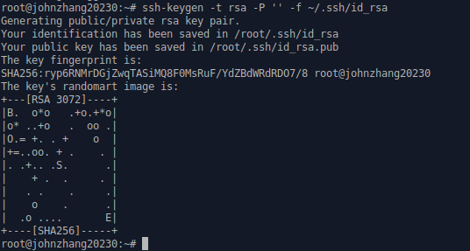
Hadoop Lab1
Install SSH and setting up certificate
  sudo apt install ssh
Generate ssh key
  ssh-keygen -t rsa -P '' -f ~/.ssh/id_rsa

Slide 40
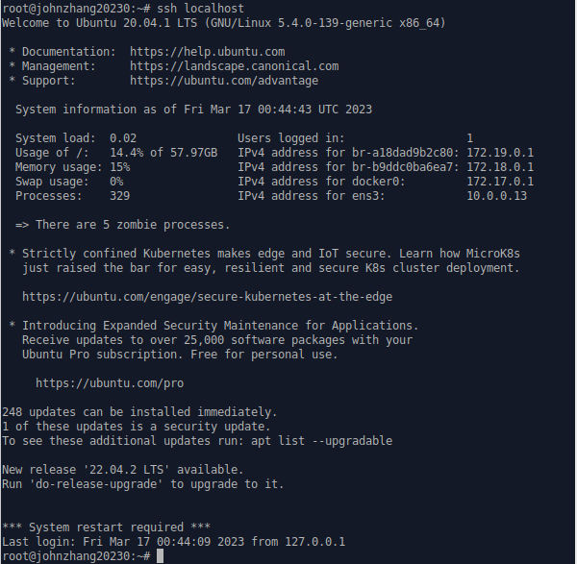
Hadoop Lab1
Enable SSH access to the machine with the key we just created.
  cat ~/.ssh/id_rsa.pub >> ~/.ssh/authorized_keys
Check if ssh works or not
  ssh localhost
ssh: connect to host localhost port 22: Connection refused
sudo ufw status
sudo ufw enable
sudo ufw allow 22
If bug is still there, try the following:
service sshd restart
ssh localhost

Slide 41
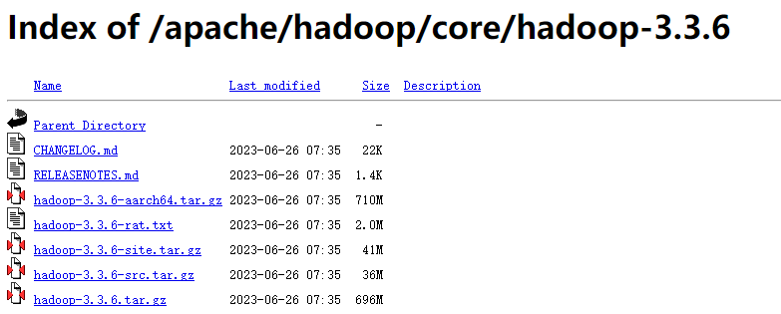
Hadoop Lab1
Install Hadoop to /usr/local/hadoop
Download Hadoop from Apache Mirrors https://mirrors.bfsu.edu.cn/apache/hadoop/core/hadoop-3.3.6/
Download hadoop-3.3.6.tar.gz

Slide 42
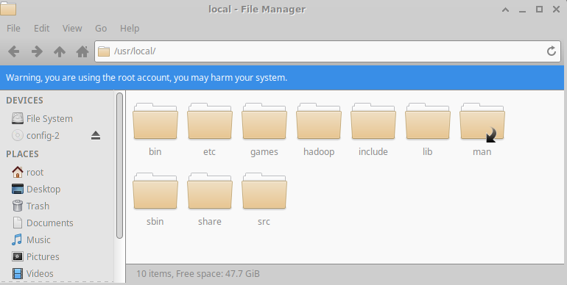
Hadoop Lab1
Suppose you save it in Downloads directory, now cd to this directory
$ cd ~/Downloads
Unzip it
$ tar -xzvf hadoop-3.3.6.tar.gz
Move hadoop files to the directory /usr/local
$ sudo mv hadoop-3.3.6 /usr/local/hadoop

Slide 43
Hadoop Lab1
Add some path info in bashrc file
vi ~/.bashrc
At the end of the file, add the following lines:
export JAVA_HOME=/usr/lib/jvm/java-8-openjdk-amd64
export HADOOP_HOME=/usr/local/hadoop
export PATH=$PATH:$JAVA_HOME/bin:$HADOOP_HOME/bin:$HADOOP_HOME/sbin
export HADOOP_CLASSPATH=$JAVA_HOME/lib/tools.jar
Save it and run it
$ source ~/.bashrc

Slide 44
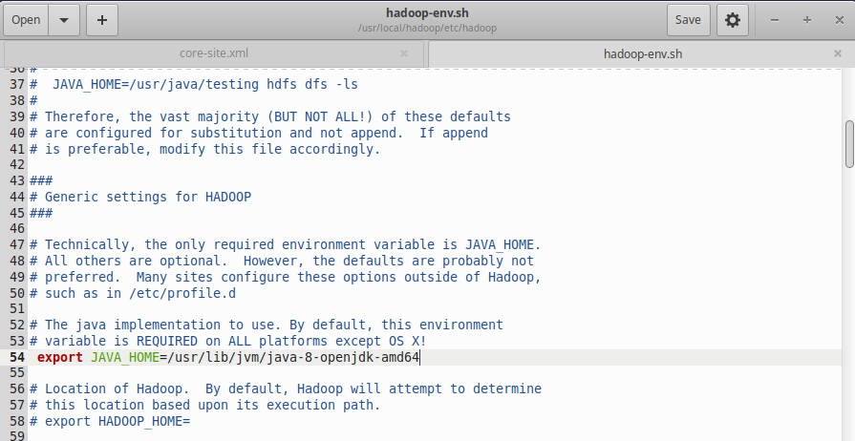
Hadoop Lab1
Configure Hadoop
Open hadoop-env.sh in /usr/local/hadoop/etc//hadoop, and add the JAVA_HOME in it:
export JAVA_HOME=/usr/lib/jvm/java-8-openjdk-amd64
Save it

Slide 45
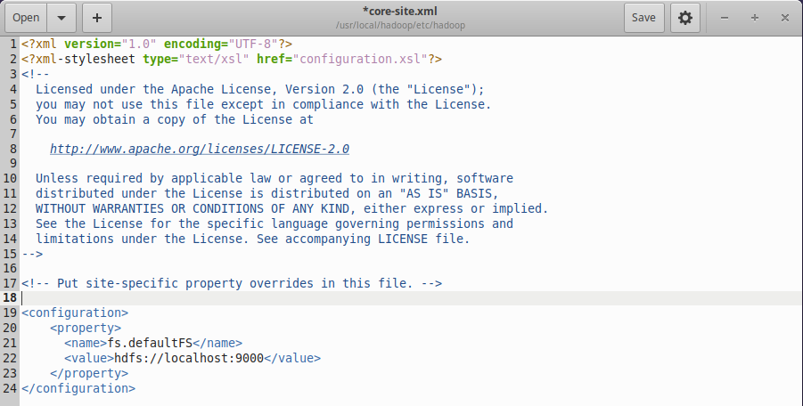
Hadoop Lab1
Configure core-site.xml in the folder /usr/local/hadoop/etc/hadoop
<configuration>
<property>
<name>fs.defaultFS</name>
<value>hdfs://localhost:9000</value>
</property>
</configuration>

Slide 46
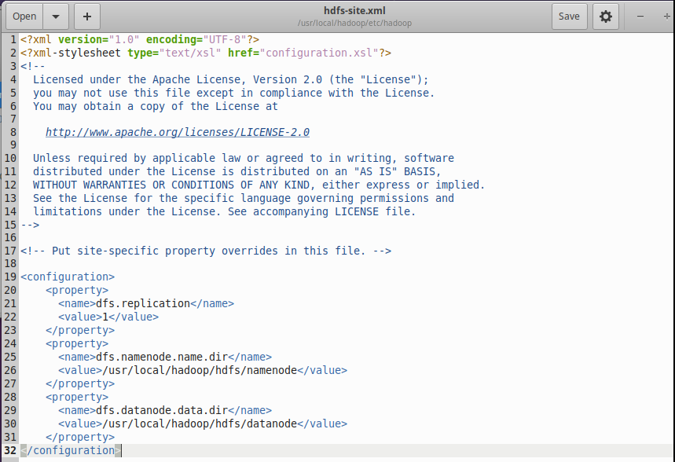
Hadoop Lab1
Configure hdfs-site.xml in the folder /usr/local/hadoop/etc/hadoop
<configuration>
<property>
<name>dfs.replication</name>
<value>1</value>
</property>
<property>
<name>dfs.namenode.name.dir</name>
<value>/usr/local/hadoop/hdfs/namenode</value>
</property>
<property>
<name>dfs.datanode.data.dir</name>
<value>/usr/local/hadoop/hdfs/datanode</value>
</property>
</configuration>

Slide 47
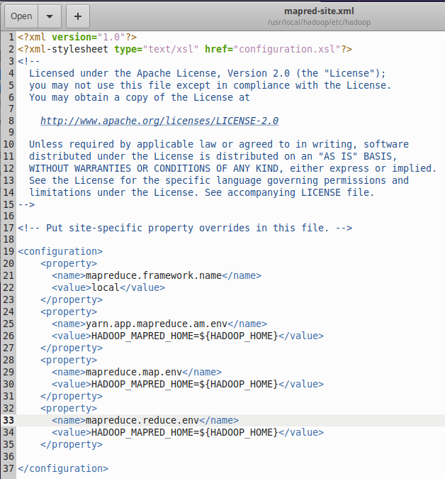
Hadoop Lab1
Configure mapred-site.xml in the folder /usr/local/hadoop/etc/hadoop
<configuration>
<property>
<name>mapreduce.framework.name</name>
<value>local</value>
</property>
<property>
<name>yarn.app.mapreduce.am.env</name>
<value>HADOOP_MAPRED_HOME=${HADOOP_HOME}</value>
</property>
<property>
<name>mapreduce.map.env</name>
<value>HADOOP_MAPRED_HOME=${HADOOP_HOME}</value>
</property>
<property>
<name>mapreduce.reduce.env</name>
<value>HADOOP_MAPRED_HOME=${HADOOP_HOME}</value>
</property>
</configuration>

Slide 48
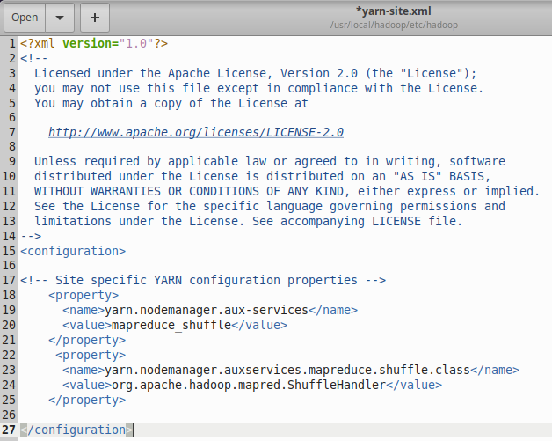
Hadoop Lab1
Configure yarn-site.xml in the folder /usr/local/hadoop/etc/hadoop
<configuration>
<property>
<name>yarn.nodemanager.aux-services</name>
<value>mapreduce_shuffle</value>
</property>
<property>
<name>yarn.nodemanager.auxservices.mapreduce.shuffle.class</name>
<value>org.apache.hadoop.mapred.ShuffleHandler</value>
</property>
</configuration>

Slide 49
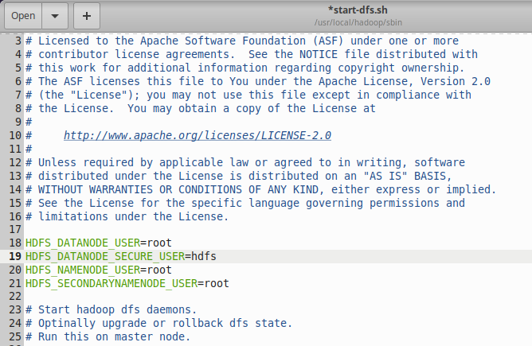
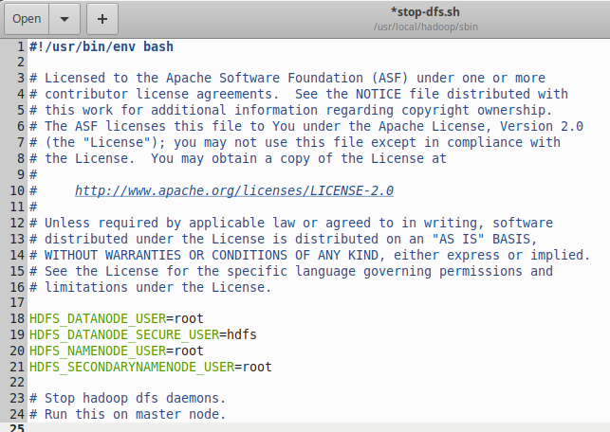
Hadoop Lab1
If you are a root user (for example, you are using Tencent Cloud instance to run hadoop), add the following to start-dfs.sh and stop-dfs.sh at the top.
( in /usr/local/hadoop/sbin)
  HDFS_DATANODE_USER=root
  HDFS_DATANODE_SECURE_USER=hdfs
  HDFS_NAMENODE_USER=root
  HDFS_SECONDARYNAMENODE_USER=root

Slide 50
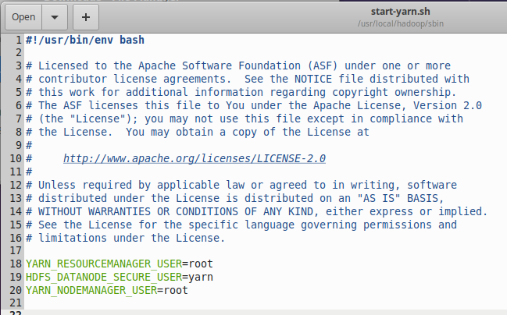
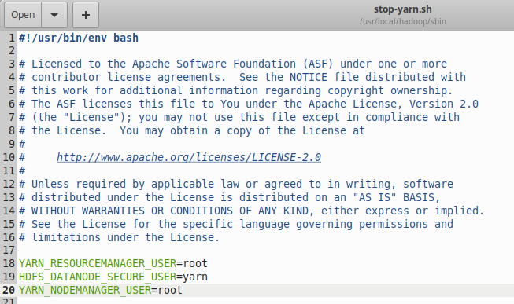
Hadoop Lab1
If you are a root user (for example, you are using Tencent cloud instance to run hadoop), Add the following to start-yarn.sh, and stop-yarn.sh
  YARN_RESOURCEMANAGER_USER=root
  HDFS_DATANODE_SECURE_USER=yarn
  YARN_NODEMANAGER_USER=root

Slide 51
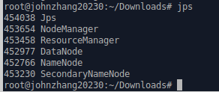
Hadoop Lab1
Format the Hadoop filesystem
$ hdfs namenode -format
a namenode directory is created in /usr/local/hadoop/hdfs
Start hadoop
$ start-dfs.sh
$ start-yarn.sh
A datanode directory is created in /usr/local/hadoop/hdfs
Check the status of the Hadoop components
$ jps

Slide 52
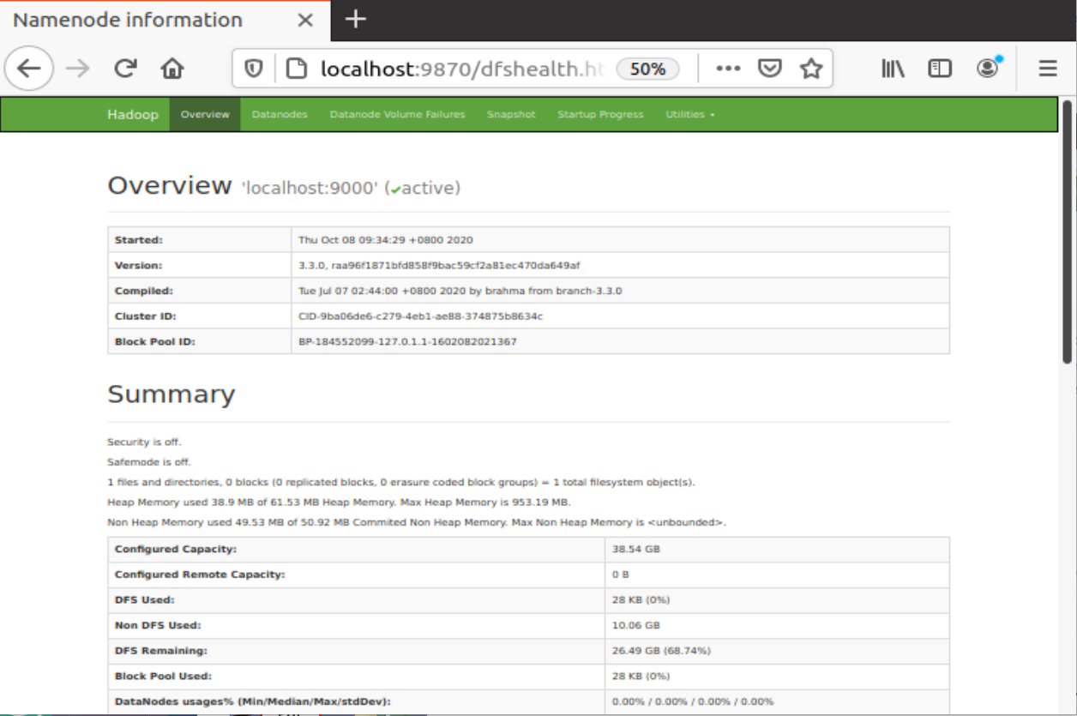
Hadoop Lab1
Check the status using web interface
http://localhost:9870

Slide 53
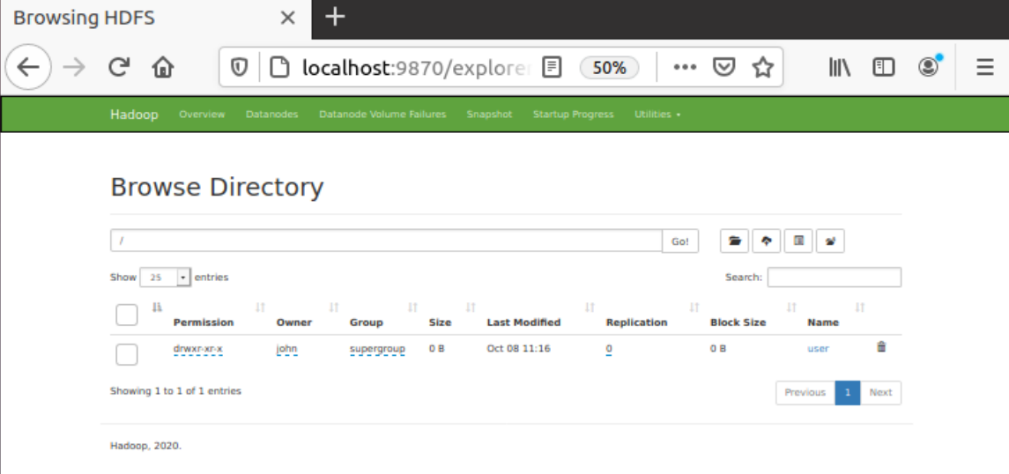
Hadoop Lab1
Testing MapReduce Job
  First, create a working directory in HDFS format
  You can access this directory from web interface. Go to web, select Utility and from dropdown select Browse the file system
$ hdfs dfs -mkdir /user

Slide 54
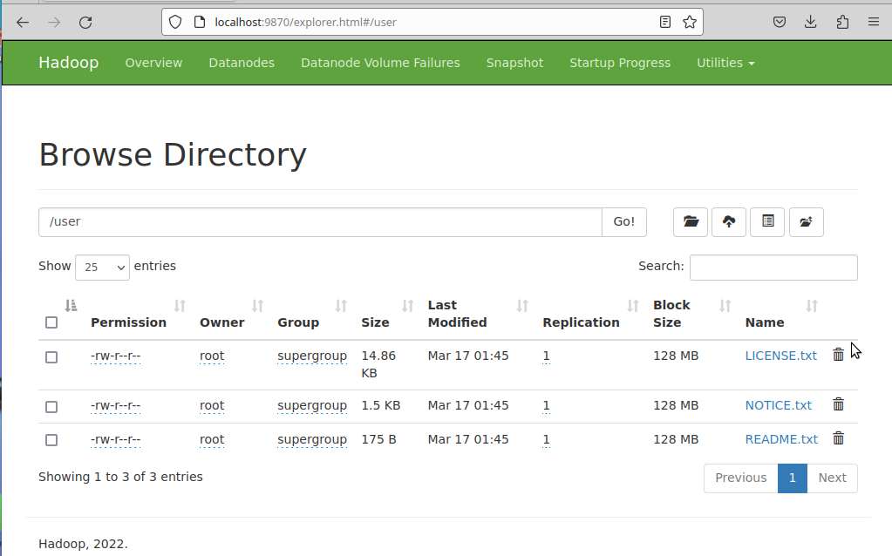
Hadoop Lab1
Testing MapReduce Job
  Add some test files to the directory. Let us pass all txt files from /usr/local/hadoop folder to our hdfs user folder.
  You can double check the files are added to the /user direcroty
$ hdfs dfs -put /usr/local/hadoop/*.txt /user

Slide 55
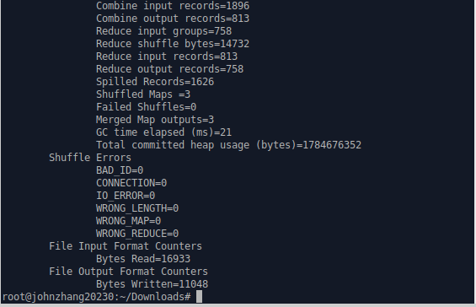
Hadoop Lab1
Testing MapReduce Job
  Run the MapReduce example job included in the Hadoop package.
$ hadoop jar /usr/local/hadoop/share/hadoop/mapreduce/hadoop-mapreduce-examples-3.3.6.jar wordcount /user /user/output

Slide 56
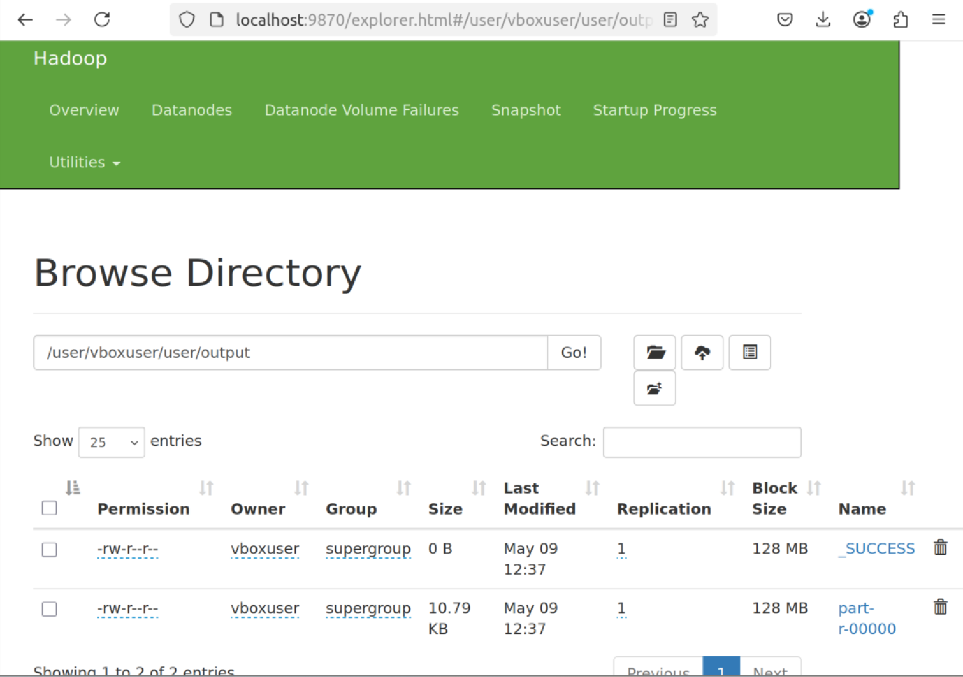
Hadoop Lab1
Testing MapReduce Job
  View the output file using the web interface

Slide 57
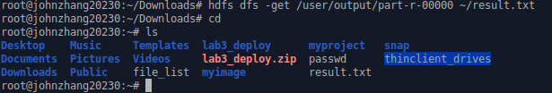
Hadoop Lab1
Testing MapReduce Job
  Copy the output file part-r-00000 to your home directory
$ hdfs dfs -get /user/output/part-r-00000 ~/result.txt
  Display the content of file result.txt
$ cat ~/result.txt

Slide 58
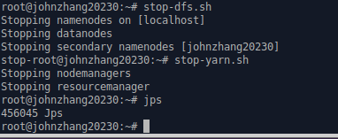
Hadoop Lab1
Stop hadoop
$ stop-dfs.sh
$ stop-yarn.sh

