Slide 1
CPS 4982 – Big Data Analytics
Lecture 5 MapReduce
Dr. Changjiang Zhang

Slide 2
Lecture Objective
Understand the origins of MapReduce
Explore the Hadoop API and Interface
Hands-on programs to dive into Hadoop

Slide 3
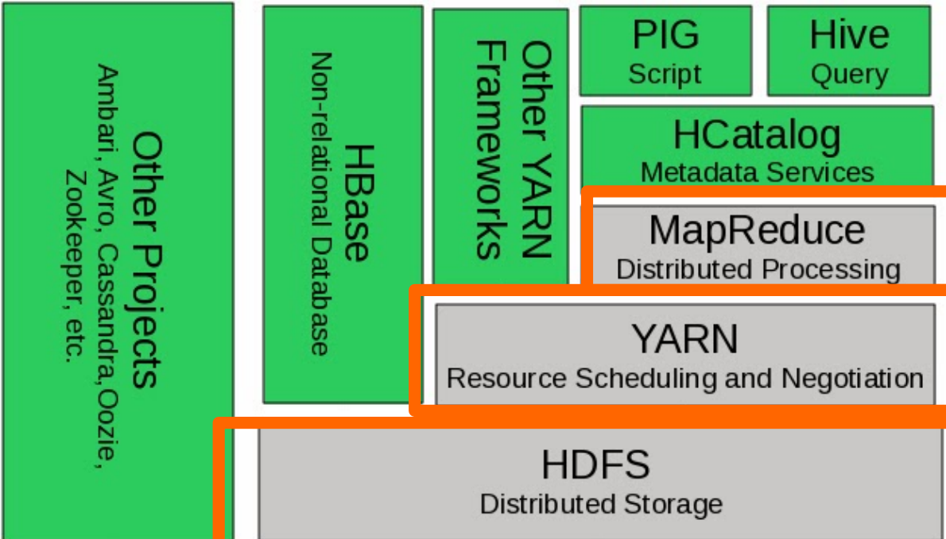
Hadoop Components
MapReduce is a programming model for parallel computing of large data sets proposed by Google.
Dean, Jeffrey & Ghemawat, Sanjay (2004). "MapReduce: Simplified Data Processing on Large Clusters". Retrieved Apr. 6, 2005

Slide 4
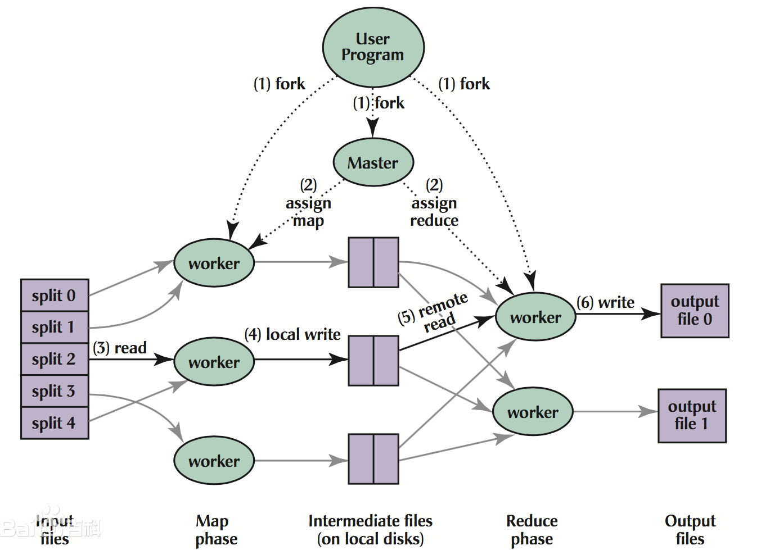
MapReduce Execution Overview
The execution process of MapReduce is as follows:
The user program calls the MapReduce library to split the input file into multiple data segments.
Create a large number of program replicas, with one designated as the master and the others as workers.
The master assigns tasks to idle workers.
The worker reads the input data fragment, executes the map function, generates intermediate results, and caches them.
The key-value pairs in the cache are divided into multiple regions by a partitioning function and written to local disks.
The reduce worker reads the intermediate data, sorts it, and then executes the reduce function to generate the final output.

Slide 5
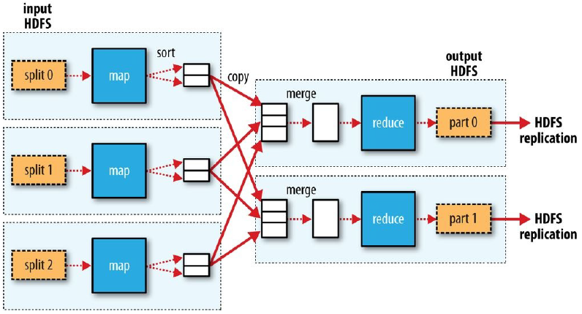
MapReduce Data Flow
Shuffle and Sort

Slide 6
MapReduce Features
Automatic Parallelization and Distribution of Work
Fault Tolerant
Status and Monitoring Tools
Clean Abstraction for Programmers

Slide 7
Typical Problem Solved by MapReduce
1. Read a lot of Data
2. MAP: extract what you need from each record
3. Shuffle and Sort
4. REDUCE: aggregate, summarize, filter, or transform
5. Write the results
Outline stays the same; Map and Reduce change to fit different problems
The model seems restrictive, but it is Turing-complete.
Multiple maps and reduces are needed to solve a complex problem
Turing-complete means that, in principle (though often not in practice), it can solve any computational problem.

Slide 8
Typical Problem Solved by MapReduce
Example
Data:
Date | Store | Product | Sales
2023-3-25 | Hong Kong | Iphone 15 red | 6000
2023-3-26 | Shenzhen | Mac pro | 20000
2023-3-26 | Shenzhen | The new Macbook | 8000
2023-3-27 | Zhuhai | Iphone cable | 260
Question:
What is the total sales value per store?

Slide 9
Typical Problem Solved by MapReduce
Example
Traditional way of doing it:
Using a hash table approach, key => value
Sum up all the values with the same key on one computer.
Question:
What is the problem with this approach?
Say we have 10 TB of record data
What can we do?
Mappers
Reducers

Slide 10
Programming Model
Users implement interfaces to the following two functions:
  map (in_key, in_value) → (out_key, intermediate_value list）
  reduce (out_key, intermediate_value list) → out_value list

Slide 11
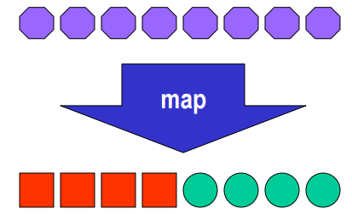
The Map Function
Records from the data source (lines out of files, rows of a database, etc.) are fed into the map function as key*value pairs:
  e.g., (filename, line).
map() produces (emits) one or more intermediate values along with an output key from the input.

Slide 12
Example – UpperCase Mapper
let map(k,v) =
emit(k.toUpper(),v.toUpper())
transform
(“abcd”, “efgh”)→(“ABCD”, “EFGH”)
(“wku”, “hadoop”)→(“WKU”, “HADOOP”)
(“foo”, “bar”)→(“FOO”, “BAR”)

Slide 13
Example – Filter Mapper
let map(k,v) =
if (v%2==0) then emit(k, v)
filter
(“foo”, 7)→(nothing)
(“test”, 10)→(“test”,10)

Slide 14
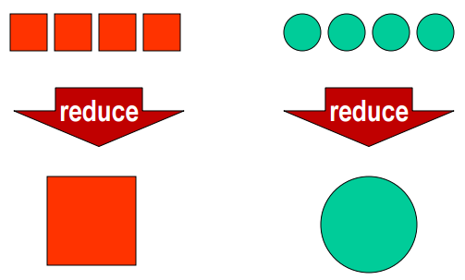
The Reduce Function
After the map phase is over, all the intermediate values for a given output key are combined together into a list
reduce() combines those intermediate values into one or more final values for that same output key

Slide 15
Example – Sum Reducer
let reduce(k, vals) =
{
sum = 0
foreach int v in vals:
sum += v
emit(k, sum)
}
(“A”, [42, 100, 312])→(“A”, 454)
(“B”, [12, 6, -2])→(“B”, 16)
let reduce(k, vals) =
{
max = 0
foreach int v in vals:
if max < v max = v
emit(k, max)
}
(“A”, [42, 100, 312])→(“A”, 312)
(“B”, [12, 6, -2])→(“B”, 12)

Slide 16
Example – Word Count
Input: Text files full of words
Output: For each word, count its occurrence
Map:
  Read the text word by word and for each “word” output
  (“word”, 1)
Reduce:
  emit (“word”, count (by adding all 1s together))

Slide 17
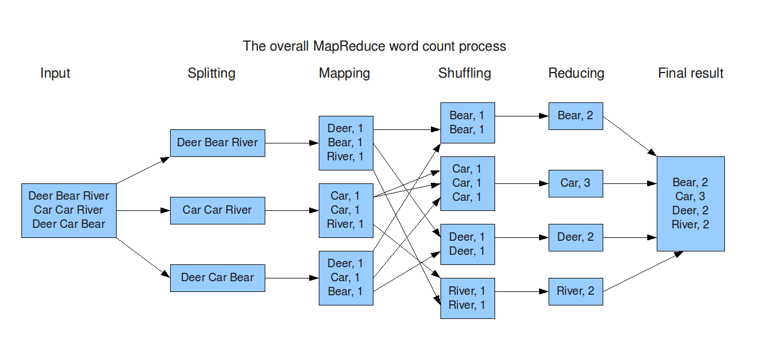
Example – Word Count

Slide 18
Example – Reverse Web-Link Graph
Input: Web graph: tuples (a,b) where (page a → page b)
Output: For each page, list of pages that link to it
Map:
  Process web log and for each (source, target), output (target, source)
Reduce:
  Emits <target, list(source))

Slide 19
Example – Distributed Grep
Input: large set of files
Output: lines that match a particular pattern or string
Map:
  Emits a line if it matches the supplied pattern
Reduce:
  Copies the intermediate data to output

Slide 20
Example – Count of URL access freq.
Input: Log of accessed URLs, e.g. from proxy server
Output: for each URL, % of total accesses for that URL
Map:
  Process web log and output (URL, 1)
Reduce:
  Emits (URL, URL_count)
Map2: //find the overall_count
  Processes (URL, URL_count) and outputs (1, (URL, URL_count))
Reduce2:
  Emits multiple (URL, URL_count/overall_count)

Slide 21
Example – Sort
Map task’s output is sorted (e.g., quicksort)
Reduce task’s input is sorted (e.g., mergesort)
Input: Series of (key, value) pairs
Output: Sorted (value)s
Map:
  (key, value) → (value, _)
Reduce:
  (key, value) → (key, value)

Slide 22
Parallelism
Map functions run in parallel and create intermediate values from each input data set
  The programmer must specify a proper input split (chunk) between mappers to enable parallelism
Reduce functions also run in parallel; each will work on different output keys
  The number of reducers is a key parameter that determines map-reduce performance
All values are processed independently
  The reduce phase cannot start until the map phase is finished.

Slide 23
CHOOSING THE NUMBER OF REDUCERS
The single-reducer default is not good. Almost all real-world jobs should set this to a larger number; otherwise, the job will be very slow since all the intermediate data flows through a single reduce task.
Choosing the number of reducers for a job is more of an art than a science. Increasing the number of reducers makes the reduce phase shorter, since you get more parallelism. However, if you take this too far, you can have lots of small files, which is suboptimal. One rule of thumb is to aim for reducers that each run for five minutes or so and produce at least one HDFS block’s worth of output.

Slide 24
Data Locality
Master program creates tasks based on the location of the data;
Tries to send map() tasks to the same machine or at least the same rack
Map() task inputs are divided into 128 MB blocks (same as HDFS/GFS) or at file boundaries.
Minimizes communication at the network level

Slide 25
Fault Tolerance
Master keeps track of the progress of each task and worker nodes
  If a node fails, it re-executes the completed as well as in-progress map tasks on other nodes that are alive
If particular input key/value pairs keep crashing
  Master blacklists them and skips them from re-execution
Tolerate small failures, allow the job to run on a best-effort basis
  For large datasets containing potentially millions of records, we don’t want to stop computation for a few records not processing correctly
  The user can set the failure tolerance level

Slide 26
Optimizations
Reduce tasks will start only after all the map operations are complete ‐ bottleneck
  Use a combiner (a mini‐reducer on the output of a map) to reduce the output and the amount of communication during sort and shuffle
  Speculative execution – New feature in Hadoop, enables multiple task attempts to run in parallel and use the results of the first one to finish
MapReduce programs are bound by the slowest element – the last mapper to finish or the time taken for the Reduce operations to finish.

Slide 27
Hadoop MapReduce
Hadoop：Implementation of Google’s MapReduce Programming Model
Express complex tasks in the form of Maps and Reduces to enable large‐scale processing of data
Functional programming meets distributed computing using batch processing of data
Benefits:
  Automatic Parallelization and Distribution of Data
  Fault Tolerance
  Status and Monitoring Tools
  Clean Programming Abstraction to help focus on the solving the problem

Slide 28
Hadoop MapReduce Terminology
Job
  Execution of a “complete” program (mapper and reducer) across an input data set
Task
  Execution of a single mapper or reducer on a slice of data (task in progress)
Task Attempt
  A particular instance of an attempt to execute a task on a machine or node

Slide 29
Example of Terminology
Wordcount on 20 files: One Job
The Job implies 20 map tasks for each file plus a few reducer tasks
There will be at least 20+ task attempts total. More task attempts if a node crashes, etc.

Slide 30
MapReduce Java Package Structure
Please refer to :
  http://hadoop.apache.org/docs/current/api/index.html
org.apache.hadoop.*
mapreduce – MapReduce API
conf – Job Configuration Utilities
io – Input/Output formats
fs – File System Handlers
util – Utilities for hadoop

Slide 31
Example1: word count
Create a project in IntelliJ IDEA, and modify pom.xml file as follows:
<?xml version="1.0" encoding="UTF-8"?>
<project xmlns="http://maven.apache.org/POM/4.0.0"
xmlns:xsi="http://www.w3.org/2001/XMLSchema-instance"
xsi:schemaLocation="http://maven.apache.org/POM/4.0.0 http://maven.apache.org/xsd/maven-4.0.0.xsd">
<modelVersion>4.0.0</modelVersion>
<groupId>org.example</groupId>
<artifactId>hadoop_tutorial</artifactId>
<version>1.0-SNAPSHOT</version>
<properties>
<hadoop.version>3.3.6</hadoop.version>
</properties>
<dependencies>
<dependency>
<groupId>org.apache.hadoop</groupId>
<artifactId>hadoop-common</artifactId>
<version>${hadoop.version}</version>
</dependency>
<dependency>
<groupId>org.apache.hadoop</groupId>
<artifactId>hadoop-hdfs</artifactId>
<version>${hadoop.version}</version>
</dependency>
<dependency>
<groupId>org.apache.hadoop</groupId>
<artifactId>hadoop-client</artifactId>
<version>${hadoop.version}</version>
</dependency>
</dependencies>
</project>

Slide 32
Example1: word count
Create a java class called WordCount.java
And copy the following code in the class
import org.apache.hadoop.conf.Configuration;
import org.apache.hadoop.fs.FileSystem;
import org.apache.hadoop.fs.Path;
import org.apache.hadoop.io.IntWritable;
import org.apache.hadoop.io.Text;
import org.apache.hadoop.mapreduce.lib.output.FileOutputFormat;
import org.apache.hadoop.mapreduce.Job;
import org.apache.hadoop.mapreduce.Mapper;
import org.apache.hadoop.mapreduce.Reducer;
import org.apache.hadoop.mapreduce.lib.input.FileInputFormat;
import org.apache.log4j.BasicConfigurator;
import java.io.IOException;
import java.util.StringTokenizer;

Slide 33
Example1: word count
public class WordCount {
public static void main(String[] args) throws Exception {
BasicConfigurator.configure(); //configure log4j environment
Configuration conf = new Configuration(); //hdfs-site.xml, and core-site.xml
FileSystem hdfs = FileSystem.get(conf);
Job job = Job.getInstance(conf, "WordCount");
job.setJarByClass(WordCount.class);
job.setMapperClass(WCMapper.class);
job.setCombinerClass(WCReducer.class);
job.setReducerClass(WCReducer.class);
job.setOutputKeyClass(Text.class);
job.setOutputValueClass(IntWritable.class);
//job.setNumReduceTasks(2);
FileInputFormat.addInputPath(job, new Path(args[0]));
//FileOutputFormat.setOutputPath(job, new Path(args[1]));
Path outpath = new Path(args[1]);
if(hdfs.exists(outpath))
hdfs.delete(outpath, true);
FileOutputFormat.setOutPath(job, outpath);
System.exit(job.waitForCompletion(true) ? 0 : 1);
}

Slide 34
Example1: word count
public static class WCMapper extends Mapper<Object, Text, Text, IntWritable>{
private final static IntWritable one = new IntWritable(1);
private Text word = new Text();
public void map(Object key, Text value, Context context ) throws IOException, InterruptedException {
StringTokenizer itr = new StringTokenizer(value.toString());
while (itr.hasMoreTokens()) {
word.set(itr.nextToken());
context.write(word, one);
}
}
}
public static class WCReducer extends Reducer<Text,IntWritable,Text,IntWritable> {
private IntWritable result = new IntWritable();
public void reduce(Text key, Iterable<IntWritable> values, Context context ) throws IOException, InterruptedException {
int sum = 0;
for (IntWritable val: values) {
sum += val.get();
}
result.set(sum);
context.write(key, result);
}
}
}

Slide 35
Example1: word count
Compile WordCount.java:
Suppose WordCount.java is downloaded in your home directory from iSpace and your current directory is your home directory
$ hadoop com.sun.tools.javac.Main WordCount.java
You may got an error:
Error: Could not find or load main class com.sun.tools.javac.Main
Solution:
Open bashrc file using vi
vi ~/.bashrc
To check if it is set correctly. Make sure it has the following four lines:
    export HADOOP_HOME=/usr/local/hadoop
    export JAVA_HOME=/usr/lib/jvm/java-8-openjdk-amd64
    export PATH=$PATH:$HADOOP_HOME/bin:$JAVA_HOME/bin:$HADOOP_HOME/sbin
    export HADOOP_CLASSPATH=$JAVA_HOME/lib/tools.jar
Type the command:
source ~/.bashrc
Then run the above compiling java command again.

Slide 36
Example1: word count
Create a jar file:
$ jar cf wc.jar WordCount*.class
Download two sample text-files from Canvas:
  File01.txt and file02.txt to your home directory
Start Hadoop if you haven’t started yet
$ start-dfs.sh
$ start-yarn.sh
Create a wordcount subdirectory under the user directory
$ hdfs dfs -mkdir –p /input/wc/

Slide 37
Example1: word count
Warnning!!!
When you create a directory in hdfs, you may got an error to say that your namenode is in safe mode.
You can type the following command to exit safe mode to fix this issue
$hdfs dfsadmin -safemode leave

Slide 38
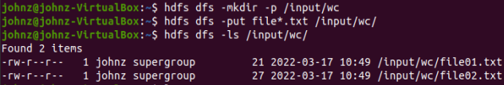
Example1: word count
Upload file01.txt and file02.txt from your home directory to hdfs directory:
$ hdfs dfs –put file0*.txt /input/wc/
Check if you upload correctly or not
$ hdfs dfs –ls /input/wc/
Check the content of file01.txt and file02.txt
$ hdfs dfs -cat /input/wc/file01.txt
$ hdfs dfs -cat /input/wc/file02.txt

Slide 39
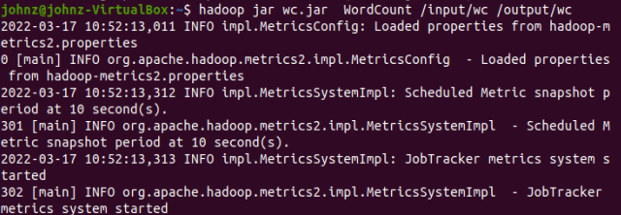
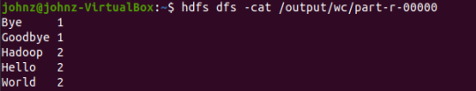
Example1: word count
Run the application:
$ hadoop jar wc.jar WordCount /input/wc /output/wc
Check the Output:
$ hdfs dfs -cat /output/wc/part-r-00000
Run stop-dfs.sh and stop-yarn.sh

Slide 40
A Simple Exercise
Let’s try to write a Hadoop program that counts the number of even and odd numbers in a list.
Input: Text File with integer values on each line
  1 3
  8 22
  10 12 31
Output: Text File Containing the number of even and odd numbers in the Input file
Main
  Same as word count
Mapper
  ? slightly different
Reducer
  ? same as word count
Notes:
Mapper ▪ Read each line, parse for integer and emit(“even/odd”,1);  Reducer ▪ Sum up all the values of each key (even/odd)

Slide 41
A Simple Exercise
Let’s try to write a Hadoop program that counts the number of even and odd numbers in a list.
Mapper Class
public static class myMapper extends Mapper<Object, Text, Text, IntWritable>{
private final static IntWritable one = new IntWritable(1);
private Text word = new Text();
public void map(Object key, Text value, Context context ) throws IOException, InterruptedException {
StringTokenizer itr = new StringTokenizer(value.toString());
while (itr.hasMoreTokens()) {
word.set(itr.nextToken());
int n = Integer.valueOf(String.valueOf(word));
if(n%2 == 0)
word = new Text("Even");
else
word = new Text("Odd");
context.write(word, one);
}
}
}
Notes:
Mapper ▪ Read each line, parse for integer and emit(“even/odd”,1);  Reducer ▪ Sum up all the values of each key (even/odd)

Slide 42
A Simple Exercise
Reduce CLass
public static class myReducer extends Reducer<Text,IntWritable,Text,IntWritable> {
private IntWritable result = new IntWritable();
public void reduce(Text key, Iterable<IntWritable> values, Context context ) throws IOException, InterruptedException {
int sum = 0;
for (IntWritable val: values) {
sum += val.get();
}
result.set(sum);
context.write(key, result);
}
}
}
Notes:
Mapper ▪ Read each line, parse for integer and emit(“even/odd”,1);  Reducer ▪ Sum up all the values of each key (even/odd)

Slide 43
Example2: Even Odd count
public class EvenOddCount {
public static void main(String[] args) throws Exception {
BasicConfigurator.configure(); //configure log4j environment
Configuration conf = new Configuration(); //hdfs-site.xml, and core-site.xml
FileSystem hdfs = FileSystem.get(conf);
Job job = Job.getInstance(conf, “EvenOddCount");
job.setJarByClass(EvenOddCount.class);
job.setMapperClass(myMapper.class);
job.setCombinerClass(myReducer.class);
job.setReducerClass(myReducer.class);
job.setOutputKeyClass(Text.class);
job.setOutputValueClass(IntWritable.class);
//job.setNumReduceTasks(2);
FileInputFormat.addInputPath(job, new Path(args[0]));
//FileOutputFormat.setOutputPath(job, new Path(args[1]));
Path outpath = new Path(args[1]);
if(hdfs.exists(outpath))
hdfs.delete(outpath, true);
FileOutputFormat.setOutPath(job, outpath);
System.exit(job.waitForCompletion(true) ? 0 : 1);
}

Slide 44
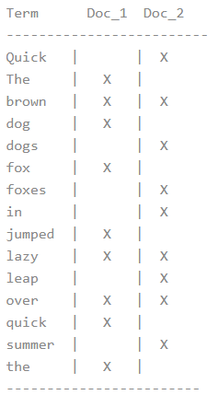
Example3: Inverted Index
Inverted Index | Elasticsearch: The Definitive Guide [2.x] | Elastic
An inverted index consists of a list of all the unique words that appear in any document, and for each word, a list of the documents in which it appears.
For example, let’s say we have two documents, each with a content field containing the following:
The quick brown fox jumped over the lazy dog
Quick brown foxes leap over lazy dogs in summer
To create an inverted index, we first split the content field of each document into separate words (which we call terms, or tokens), create a sorted list of all the unique terms, and then list in which document each term appears. The result looks something like this:
An inverted index can be used to search for documents that are relevant to the word. But we still have a lot to do to get a better match.
For example:
(1) tokenizing a block of text into individual terms suitable for use in an inverted index;
(2) normalizing these terms into a standard form to improve their “searchability,” or recall

Slide 45
Example3: Inverted Index
import org.apache.hadoop.conf.Configuration;
import org.apache.hadoop.fs.FileSystem;
import org.apache.hadoop.fs.Path;
import org.apache.hadoop.io.LongWritable;
import org.apache.hadoop.io.Text;
import org.apache.hadoop.mapreduce.Job;
import org.apache.hadoop.mapreduce.Mapper;
import org.apache.hadoop.mapreduce.Reducer;
import org.apache.hadoop.mapreduce.lib.input.FileInputFormat;
import org.apache.hadoop.mapreduce.lib.input.FileSplit;
import org.apache.hadoop.mapreduce.lib.output.FileOutputFormat;
import org.apache.log4j.BasicConfigurator;
import java.io.IOException;
import java.util.ArrayList;
import java.util.HashMap;
public class InvertedIndex {
public static class MyMapper extends Mapper<LongWritable, Text, Text, Text> {
}
public static class MyCombiner extends Reducer<Text, Text, Text, Text> {
protected void reduce(Text key, Iterable<Text> values, Context context)
throws IOException, InterruptedException {
}
public static class MyReducer extends Reducer<Text, Text, Text, Text> {
protected void reduce(Text key, Iterable<Text> values, Context context)
throws IOException, InterruptedException {
}
public static void main(String[] args) throws Exception {
}
}

Slide 46
Example3: Inverted Index
map class
public static class MyMapper extends Mapper<LongWritable, Text, Text, Text> {
private String pattern = "[^a-zA-Z]";//only find keyword with 26 English characters
@Override
protected void map(LongWritable key, Text value, Context context)
throws IOException, InterruptedException {
// get file name
FileSplit fileSplit = (FileSplit) context.getInputSplit();
// convert each line to a String
String line = value.toString();
// replace punctuation with spaces, only keep English words defined with the pattern
line = line.replaceAll(pattern, " ");
line = line.toLowerCase();
// split String to be individual words
String[] words = line.split(\\s+);
// initialize each word frequency as 1, let (word, fileName) be our key
// save word frequency 1 as Text, consistent with the output of Combiner
for (String word: words) {
if (word.length() > 0) {
context.write(new Text(word + "," + fileSplit.getPath().getName()), new Text("1"));
}
}
}
}

Slide 47
Example3: Inverted Index
combiner class
public static class MyCombiner extends Reducer<Text, Text, Text, Text> {
protected void reduce(Text key, Iterable<Text> values, Context context)
throws IOException, InterruptedException {
// initialize each word frequency to be 0
Integer count = 0;
// Accumulate same word within the same file
for (Text value : values) {
count += Integer.parseInt(value.toString());
}
// split word and filename in each key
// find the index of coma first in order to split them
Integer splitIndex = key.find(",");
// save as (count:filename) as value this time, use ":" as delimiter
context.write(
//key is a word
new Text(key.toString().substring(0, splitIndex)),
//value is count:filename
new Text(count + ":"+ key.toString().substring(splitIndex+1)));
}
}

Slide 48
Example3: Inverted Index
reducer class
public static class MyReducer extends Reducer<Text, Text, Text, Text> {
protected void reduce(Text key, Iterable<Text> values, Context context)
throws IOException, InterruptedException {
// save value (filename and word frequency) with a List
ArrayList<String> fileList = new ArrayList<String>();
// for the same word, save each key(filename+word frequency) to a List，
// and count plus 1
for (Text value : values) {
fileList.add(value.toString());
}
// todo: sort fileList, the inverted index
{
}
//save to output file
context.write(key, new Text(String.join("\t", fileList)));
}
}

Slide 49
Example3: Inverted Index
Main driver
public static void main(String[] args) throws Exception {
if (args.length != 2) {
System.err.println("Usage: InvertedIndex <input path> <output path>");
System.exit(-1);
}
BasicConfigurator.configure();
Configuration conf = new Configuration();
FileSystem fs = FileSystem.get(conf); //create a fs file system object
Job job = Job.getInstance(conf, "Inverted Index"); // create Job instance
job.setJarByClass(InvertedIndex.class); // set run Job class
job.setMapperClass(MyMapper.class); // set Mapper class
job.setCombinerClass(MyCombiner.class); // set Combiner class
job.setReducerClass(MyReducer.class); >// set Reducer class
job.setMapOutputKeyClass(Text.class); // set Map output <Key, value>
job.setOutputKeyClass(Text.class); // set Reduce output <Key, value>
job.setOutputValueClass(Text.class);
FileInputFormat.setInputPaths(job, new Path(args[0])); // set up input and output path
Path outpath = new Path(args[1]);
if(fs.exists(outpath)){
fs.delete(outpath, true);
}
FileOutputFormat.setOutputPath(job, outpath);
boolean b = job.waitForCompletion(true); // submit job
if(!b) {
System.out.println("Task failed!");
}
}

Slide 50
Example3: Inverted Index
Download InvertedIndex.java from iSpace to your home directory
Compile the java code
$ hadoop com.sun.tools.javac.Main InvertedIndex.java
Create a jar
$ jar cf InvertedIndex.jar InvertedIndex*.class
Start Hadoop first
$ start-dfs.sh
$ start-yarn.sh
Run code
$ hadoop jar InvertedIndex.jar InvertedIndex /input/wc /output/InvertedIndex

Slide 51
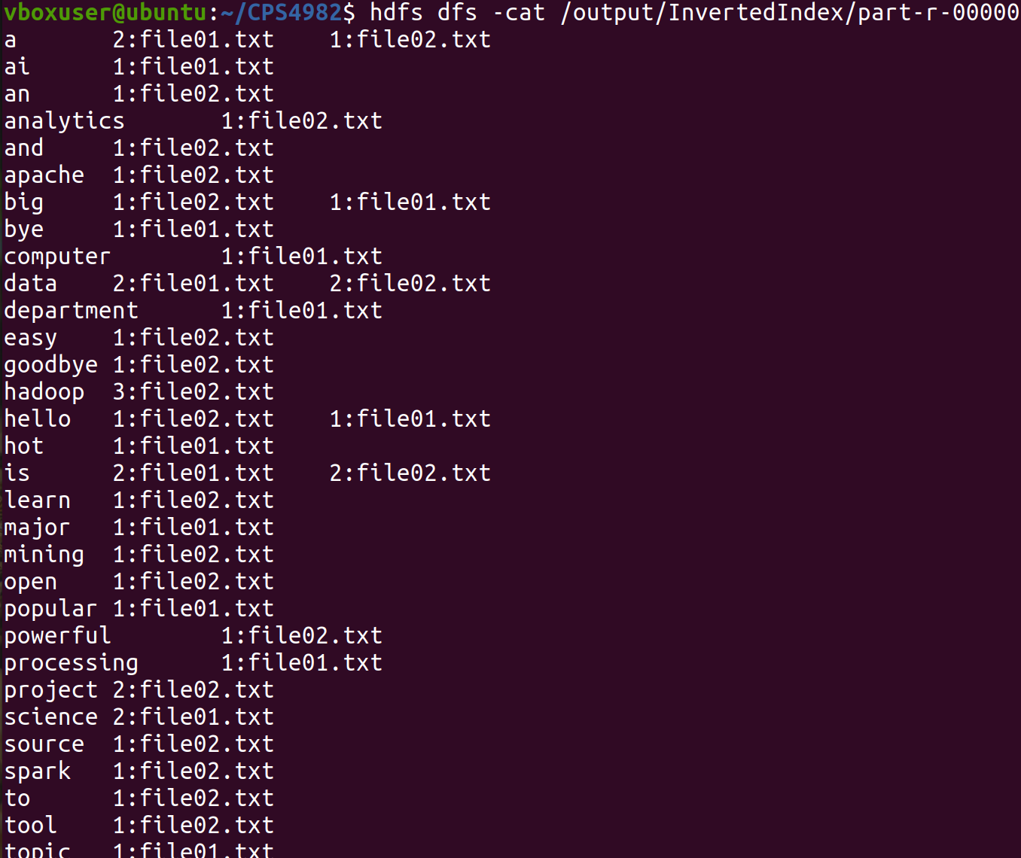
Example3: Inverted Index
Check the output result
$ hdfs dfs -cat /output/InvertedIndex/part-r-00000
file01.txt:
Hello World
Bye World
data science is a popular major
Big data processing
AI is a hot topic
Computer science department
file02.txt:
Hello Hadoop
Goodbye Hadoop
Spark is a powerful tool and easy to learn
Hadoop is an open-source project
Apache project
Big data analytics
Data mining

Slide 52
Example3: Inverted Index
Assignment:
Add more text files and upload them to /input/wc
Make changes to the MyReducer class and finish the sort fileList (undo part). You can use any sorting algorithm.
  Old fileList:
  {“1:file01.txt”, “2:file02.txt”, “4:file03.txt”}
  New fileList after sorting:
  {“4:file03.txt”, “2:file02.txt”, “1:file02.txt”}
Rerun the InvertedIndex code

Slide 53
How does a Job Execute in Hadoop 2.x+?
The YARN system has the following components:
  Global Resource Manager
  Node Manager
  Application-specific Application Master
  Scheduler
  Container
A container includes a subset of the total number of CPU cores and size of the main memory. An application will
run in set of containers. An Application Master instance will request resources from the Global Resource Manager.
The Scheduler will allocate the resources (containers) through the per-node Node Manager. The Node Manager will then report the usage of the individual containers to the Resource Manager.

Slide 54
How does a Job Execute in Hadoop 2?
The client submits the MapReduce job.
The YARN resource manager coordinates the allocation of computing resources on the cluster.
The YARN node managers launch and monitor the compute containers on machines in the cluster.
The MapReduce application master coordinates the tasks running the MapReduce job. The application master and the MapReduce tasks run in containers that are scheduled by the resource manager and managed by the node managers.
The distributed filesystem (normally HDFS) is used for sharing job files between the other entities.

Slide 55
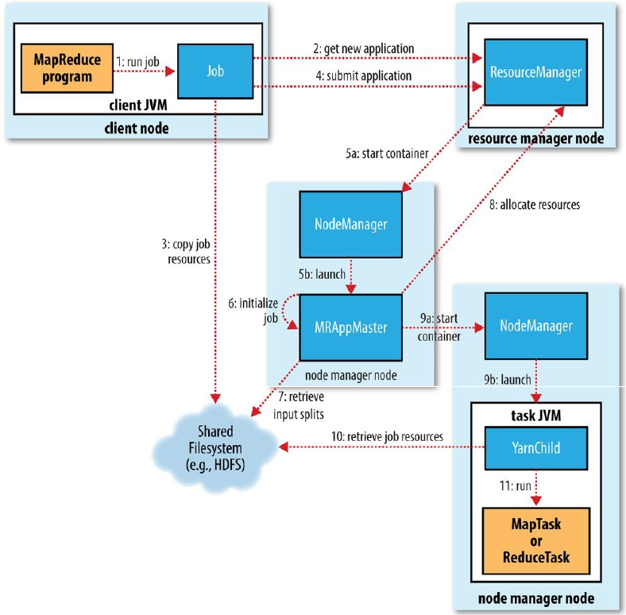
How does a Job Execute in Hadoop 2?

Slide 56
Job Configuration in Hadoop
Via the JobConf Object
Creates a JobConfigration XML file that will be packaged along with the Hadoop JAR file containing your program
You specify the Mapper, Reducer, Input and Output Files/Formats etc.
There are additional attributes that can be specified, each as XML attributes in the conf file.
The Hadoop system uses the job XML file along with other configuration parameters in the Framework (core‐site.xml etc.)

Slide 57
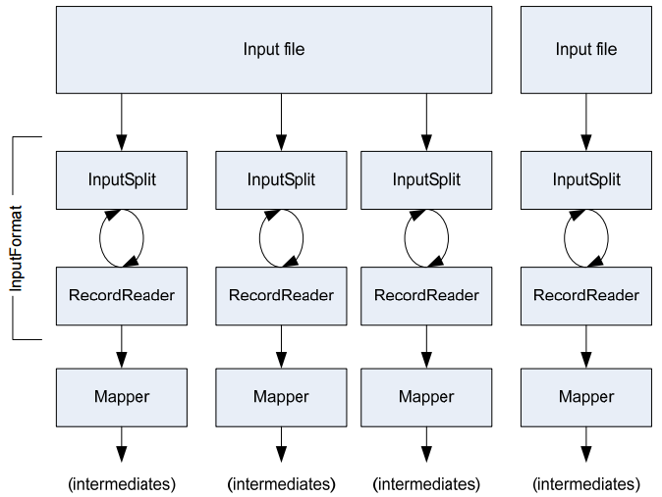
Data Flow from Input to Mappers

Slide 58
Handling Input
First we must specify an input file type
  Text Files – the basic file type in Hadoop, reads text files and provides input (key,value) pairs to the map tasks.
  Sequence Files – Binary format to store sets of key/value pairs in binary form. Supports compression as well.
  Map Files ‐ pairs of sorted input Sequence Files, one file (data) contains key/value pairs as records and the other (index) contains key/location pairs where location is the location of the key in the file data

Slide 59
Handling Input
A sequence file is a flat file consisting of binary key/value pairs. Based on the compression type, there are 3 different sequence file formats:
  Uncompressed format
  Record-compressed format
  Block-Compressed format
Advantages:
As binary files, these are more compact than text files
Provides optional support for compression at different levels – record, block.
Files can be split and processed in parallel
As HDFS and MapReduce are optimized for large files, Sequence Files can be used as containers for a large number of small files, thus solving Hadoop’s drawback of processing a huge number of small files.
Extensively used in MapReduce jobs as input and output formats. Internally, the temporary outputs of maps are also stored using the Sequence File format.
Limitations:
Similar to other Hadoop files, Sequence Files are append-only.
Only the Java API is available to interact with sequence files. Multi-Language support is not yet provided.

Slide 60
Handling Input
Input file is split into chunks using an InputSplit
  Default split occurs at 128MB and file boundaries
  You can specify your own InputSplit for your Input Formats
  One Map task for each InputSplit
A record is a (key,value) pair
  Read using the RecordReader class
  You can specify your own RecordReader for your own input formats
  Each InputFormat provides its own RecordReader implementation
  LineRecordReader – Reads a line from a text file
  KeyValueRecordReader – Used by KeyValueTextInputFormat

Slide 61
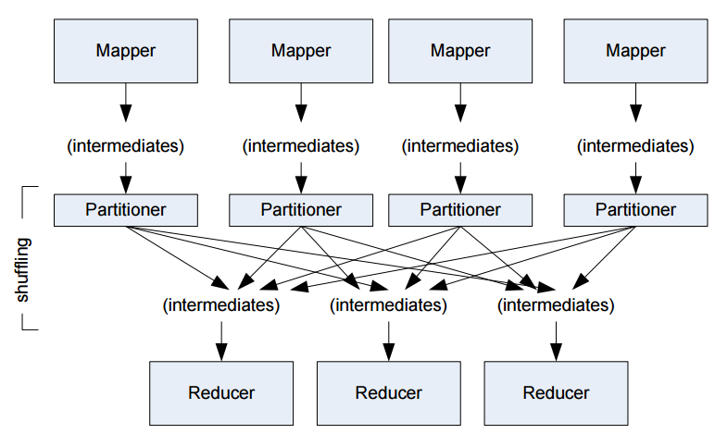
Data Flow from Mappers to Reducers

Slide 62
Reducer in Detail
Reduces a set of intermediate values which share a key to a smaller set
Shuffle
  Copies the sorted output from each mapper using HTTP across the network
Sort
  Sorts reduce inputs by keys
  Shuffle and sort phases occur simultaneously
  Secondary Sort using custom functions
Reduce
  Framework class Reduce for each key and collection of values

Slide 63
The Partitioner Class
Responsible for creating the partitions for the Sort and Shuffle Phase
Dictates what each reducer receives from each mapper
Can be used to create a “Global Order” of keys
Total partitions is same as number of map tasks

Slide 64
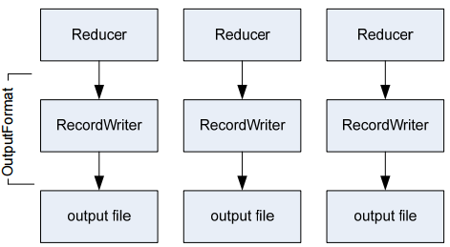
Handling Output
Each Reducer writes its own output file
  Uses a RecordWriter that is part of an OutputFormat object
  TextOutputFormat – Writes “key, val\n” strings to the output file
  SequenceFileOutputFormat – Uses a binary format to pack (k, v) pairs
  NullOutputFormat – Discards output

Slide 65
Optimizations for a MapReduce Job
Use a Combiner Function
Essentially a mini‐reducer that runs on a mapper’s output
Executed locally on each node after a map task
Helps in reducing data to be transferred during the shuffle phase
HDFS block size vs Mapper split size
Notes:
https://data-flair.training/blogs/hadoop-combiner-tutorial/
https://stackoverflow.com/questions/30549261/split-size-vs-block-size-in-hadoop
http://davidchang168.blogspot.com/2014/01/how-to-change-input-split-size.html

Slide 66
Conclusions
Basic overview of Hadoop and MapReduce
Introduction to the Hadoop framework to get you started on writing programs and code
For More Information
  Tom White: Hadoop : The Definitive Guide, 4th edition, O’Reilly Press
  Pro Apache Hadoop 2nd edition: Jason Venner

Slide 67
Appendix
Hadoop HDFS command | Comment
hdfs dfs –mkdir –p /user/ | Create a directory /user
hdfs dfs -put test1.txt /user/ | Upload a local file test1.txt to /user.
hdfs dfs –cat /user/test1.txt | View the contents of the file test1.txt in /user
hdfs dfs -ls /user/ | List the files under /user
hdfs dfs -get /user/test1.txt ~/Desktop | Copy the file test1.txt to your home desktop
hdfs dfs -rm /user/test1.txt | Delete the specified file test1.txt
hdfs dfs –mkdir –p /user/wc | Create a directory /user/wc
hdfs dfs –put *.txt /user/wc | Upload all .txt files from current local file system to /user/wc
hdfs dfs -rm -r /user/wc/ | Delete the specified nonempty directory wc
hdfs dfs –rmdir /user/test | Delete the specified empty directory test from HDFS
hdfs dfsadmin –report | View basic statistics of HDFS
hdfs dfsadmin -safemode leave | Exit safe mode
hdfs dfsadmin -safemode enter | Enter safe mode

Slide 68
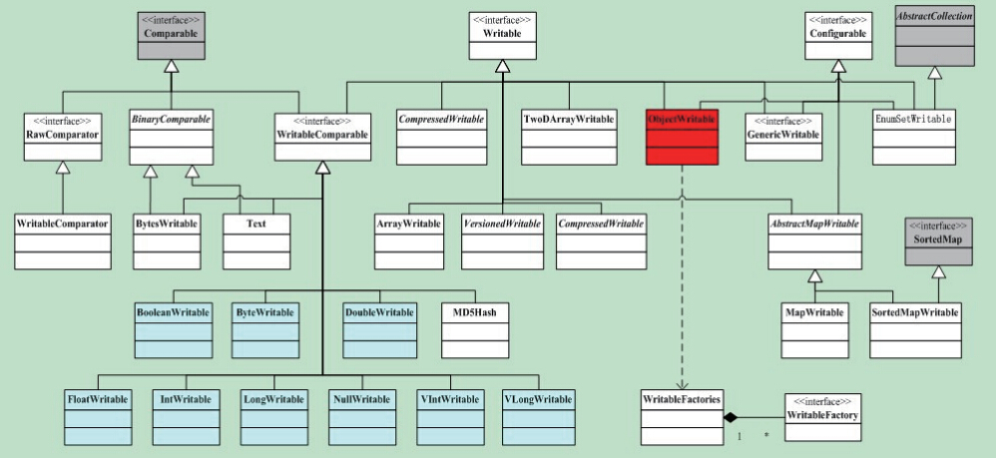
Appendix
org.apache.hadoop.io

Slide 69
Appendix
org.apache.hadoop.io
Java Data Type | Hadoop Writable | Size
boolean | BooleanWritable | 1
byte | ByteWritable | 1
int | IntWritable VIntWritable | 4 1～5
float | FloatWritable | 4
long | LongWritable VLongWritable | 8 1～9
double | DoubleWritable | 8

Slide 70
Assignment
Install Docker on your Ubuntu system
Refer to the tutorial on Canvas (Install Docker on Ubuntu.docx)

