Slide 1
CPS 4982 – Big Data Analytics
Lecture 7 NoSQL and HBASE
Dr. Changjiang Zhang

Slide 2
Abstract
NoSQL databases (either no-SQL or Not Only SQL) are currently a hot topic in some parts of computing. In fact, one website
(http://www.nosql-database.org/ ) lists over two hundred different NoSQL databases.
This presentation reviews the features common to the NoSQL databases and compares those features to the features and capabilities of SQL databases.
BIG DATA!

Slide 3
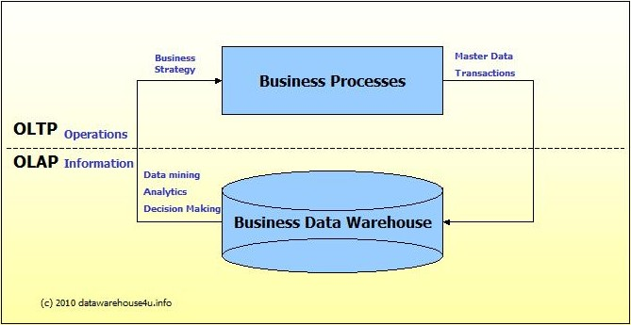
OLTP vs. OLAP
We can divide databases into transactional (OLTP) and analytical (OLAP). In general, we can assume that OLTP systems provide source data to data warehouses, whereas OLAP systems help to analyze it
OLTP(Online Transactional Processing)
OLAP(Online Analytical Processing)

Slide 4
OLTP vs. OLAP
 | OLTP | OLAP
Purpose | Capture and create data | Analyze data
Examples | Systems that run your business: CRM, finance, etc. | Data warehouses and data marts
Designed To | Deal efficiently with large volumes of transactions | Allow analysts to efficiently answer questions that require data from multiple source systems
Storage Term | Short-term or medium-term; the most recent year or most recent few years of data | Long-term, typically many years or the full history of the business

Slide 5
OLTP vs. OLAP
Example of OLTP system
An example of OLTP system is ATM center.
Assume that a couple has a joint account with a bank. One day both simultaneously reach different ATM centers at precisely the same time and want to withdraw total amount present in their bank account. However, the person that completes authentication process first will be able to get money. In this case, OLTP system makes sure that withdrawn amount will be never more than the amount present in the bank. The key to note here is that OLTP systems are optimized for transactional superiority instead data analysis.
Other examples of OLTP system are:
Online banking
Online airline ticket booking
Example of OLAP
Any Data warehouse system is an OLAP system. Uses of OLAP are as follows:
A company might compare their mobile phone sales in September with sales in October, then compare those results with another location which may be stored in a separate database.
Amazon analyzes purchases by its customers to come up with a personalized homepage with products which likely interest to their customer.

Slide 6
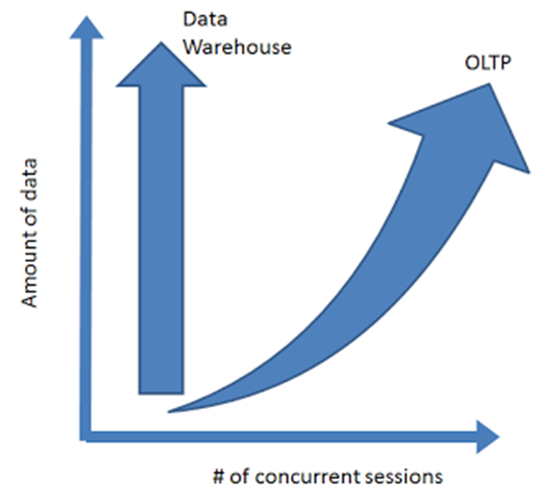
Challenges of Scale Differ

Slide 7
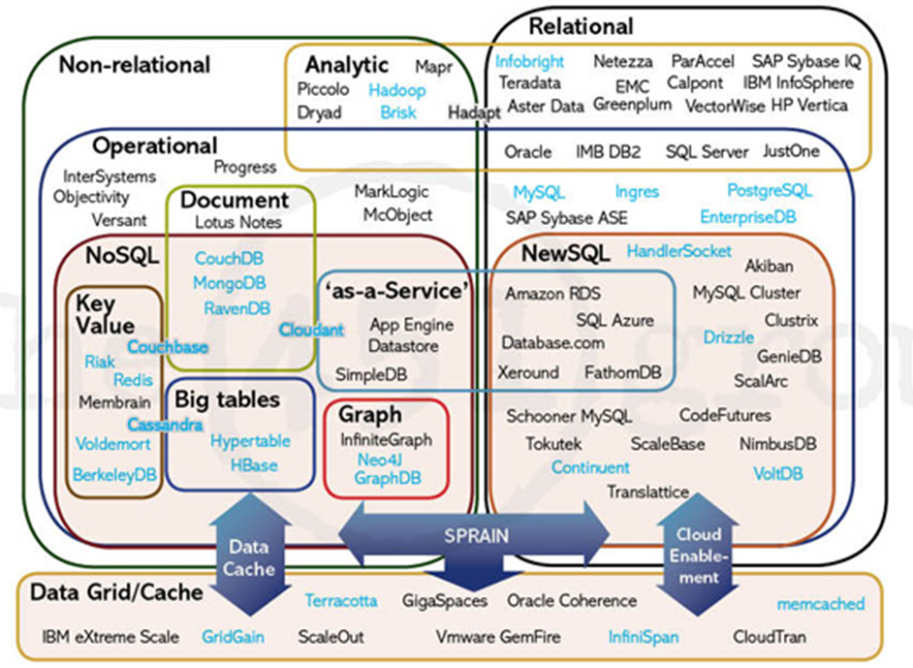

Slide 8
SQL Characteristics
Data stored in columns and tables
Relationships represented by data
Data Manipulation Language
Data Definition Language
Transactions
Abstraction from physical layer

Slide 9
SQL Physical Layer Abstraction
Applications specify what, not how
Query optimization engine
Physical layer can change without modifying applications
  Create indexes to support queries
  In Memory databases

Slide 10
Data Manipulation Language (DML)
Data manipulated with Select, Insert, Update, & Delete statements
    Select T1.Column1, T2.Column2 …
    From Table1, Table2 …
    Where T1.Column1 = T2.Column1 …
Data Aggregation
Compound statements/Nested Query
Functions and Procedures
Explicit transaction control

Slide 11
Data Definition Language
Schema defined at the start
  Create Table (Column1 Datatype1, Column2 Datatype 2, …)
Constraints to define and enforce relationships
    Primary Key
    Foreign Key
    etc.
Triggers to respond to Insert, Update, & Delete
Stored Modules/Procedures
Alter …
Drop …
Security and Access Control

Slide 12
Transactions – ACID Properties
Atomic – All of the work in a transaction completes (commit) or none of it completes
Consistent – A transaction transforms the database from one consistent state to another consistent state. Consistency is defined in terms of constraints.
Isolated – The results of any changes made during a transaction are not visible until the transaction has committed.
Durable – The results of a committed transaction survive failures

Slide 13
NoSQL Distinguishing Characteristics
Large data volumes
  Google’s “big data”
Scalable replication and distribution
  Potentially thousands of machines
  Potentially distributed around the world
Queries need to return answers quickly
Mostly query, few updates
Asynchronous Inserts & Updates
Schema-less
ACID (Atomic,Consistent, Isolated, Durable) are not needed – BASE(Basically Available, Soft state,Eventually Consistent)
CAP Theorem
Open source development
CAP Theorem:
In a distributed system，Consistency, Availability,Partition tolerance, can not be achieved simultaneously 。

Slide 14
Large-Scale Databases
When companies such as Google and Amazon were designing large-scale databases, 24/7 Availability was a key
  A few minutes of downtime means lost revenue
When horizontally scaling databases to 1000s of machines, the likelihood of a node or a network failure increases tremendously
In order to have strong guarantees on Availability and Partition Tolerance, they had to sacrifice “strict” Consistency (implied by the CAP theorem)

Slide 15

Trading-Off Consistency
Maintaining consistency should balance between the strictness of consistency versus availability/scalability
  Good-enough consistency depends on your application
Loose Consistency
Strict Consistency
Easier to implement, and is efficient
  Generally hard to implement, and is inefficient

Slide 16
Brewer’s CAP Theorem
A distributed system can support only two of the following characteristics:
  Consistency
  Availability
  Partition tolerance

Slide 17
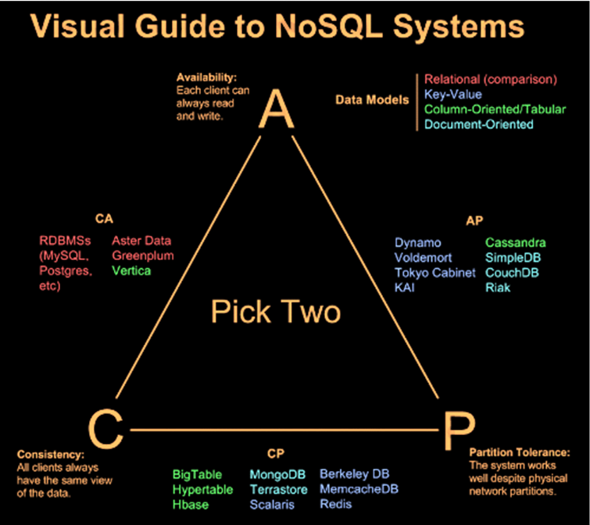

Slide 18
BASE Transactions
Acronym contrived to be the opposite of ACID
  Basically Available,
  Soft state,
  Eventually Consistent
Characteristics
  Weak consistency – stale data OK
  Availability first
  Best effort
  Approximate answers OK
  Aggressive (optimistic)
  Simpler and faster

Slide 19
NoSQL Definition
From www.nosql-database.org:
  Next Generation Databases mostly addressing some of the points: non-relational, distributed, open-source and horizontal scalable(involves adding more processing units/machines to the database).
  The original intention has been modern web-scale databases.
  The movement began early 2009 and is growing rapidly.
  Often more characteristics apply as: schema-free, easy replication support, simple API, eventually consistent / BASE, a huge data amount, and more.

Slide 20
NoSQL Products/Projects
http://www.nosql-database.org/
Lists 200+ NoSQL Databases
Hbase
Cassandra
CouchDB
MongoDB
StupidDB
Apache Flink

Slide 21
Types of NoSQL Databases
Here is a limited taxonomy of NoSQL databases:
NoSQL Databases
Document Stores
Graph Databases
Key-Value Stores
Columnar Databases

Slide 22
Document Stores
Documents are stored in some standard format or encoding (e.g., XML, JSON, PDF or Office Documents)
  These are typically referred to as Binary Large Objects (BLOBs)
Documents can be indexed
  This allows document stores to outperform traditional file systems
E.g., MongoDB and CouchDB (both can be queried using MapReduce)

Slide 23
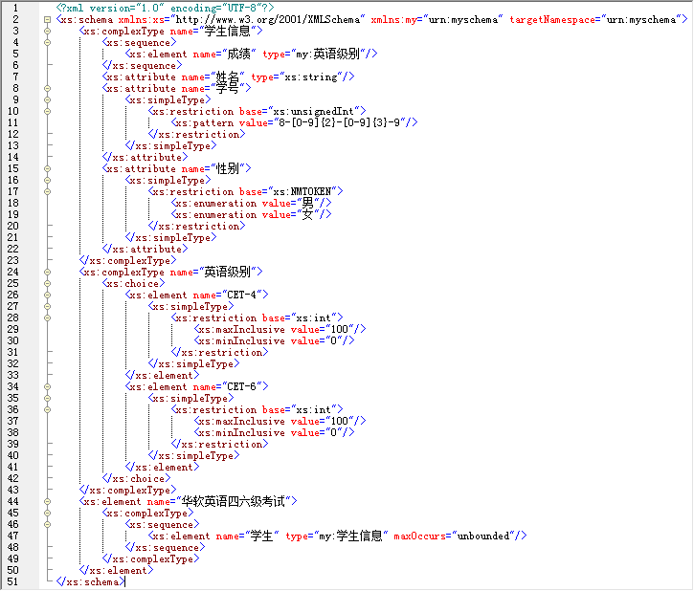
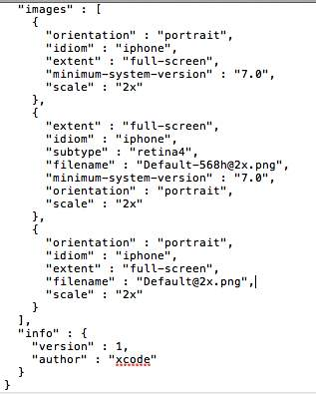
Document Stores
JSON format
XML format

Slide 24
Types of NoSQL Databases
Here is a limited taxonomy of NoSQL databases:
NoSQL Databases
Document Stores
Graph Databases
Key-Value Stores
Columnar Databases

Slide 25
Graph Databases
Data are represented as vertices and edges
Graph databases are powerful for graph-like queries (e.g., find the shortest path between two elements)
E.g., Neo4j and VertexDB
Id:100
Label: knows
Since: 2001/10/03
Id: 2
Name: Bob
Age: 22
Id:101
Label: knows
Since: 2001/10/03
Id: 1
Name: Alice
Age: 18
Id:105
Label: is_member
Since: 2011/02/14
Id:104
Label: Members
Id:103
Label: Members
Id: 3
Name: Chess
Type: Group
Id:102
Label: is_member
Since: 2005/07/01

Slide 26
Types of NoSQL Databases
Here is a limited taxonomy of NoSQL databases:
NoSQL Databases
Document Stores
Graph Databases
Key-Value Stores
Columnar Databases

Slide 27
Key-Value Stores
Keys are mapped to (possibly) more complex value (e.g., lists)
Keys can be stored in a hash table and can be distributed easily
Such stores typically support regular CRUD (create, read, update, and delete) operations
  That is, no joins and aggregate functions
E.g., Amazon DynamoDB and Apache Cassandra

Slide 28
Types of NoSQL Databases
Here is a limited taxonomy of NoSQL databases:
NoSQL Databases
Document Stores
Graph Databases
Key-Value Stores
Columnar Databases

Slide 29
Columnar Databases
Columnar databases are a hybrid of RDBMSs and Key-Value stores
  Values are stored in groups of zero or more columns, but in Column-Order (as opposed to Row-Order)
  Values are queried by matching keys
E.g., HBase and Vertica
Record 1
Column A
Column A = Group A
Alice
3
25
Bob
Alice
Bob
Carol
Alice
Bob
Carol
4
19
Carol
0
3
4
0
25
3
25
4
19
45
19
45
0
45
Column Family {B, C}
Row-Order
Columnar (or Column-Order)
Columnar with Locality Groups

Slide 30
Column Store Comments
More efficient than row (or document) store if:
  Retrievals access only some of the columns in a row/record/document

Slide 31
Other Non-SQL Databases
XML Databases
Codasyl (Conference on Data Systems Languages ) Databases
Object Oriented Databases
Multimodel Databases
Multidimensional Databases
Etc…

Slide 32
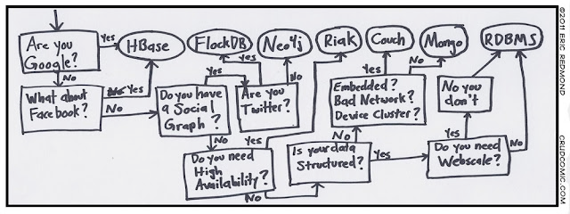

Slide 33
NoSQL Summary
ACID:
  Atomicity Consistency Isolation
  Durability
NoSQL databases reject:
  Overhead of ACID transactions
  “Complexity” of SQL
  Burden of up-front schema design
  Declarative query expression
Programmer responsible for
  Step-by-step procedural language

Slide 34
SQL vs NoSQL
SQL DB | NoSQL DB
Predefined Schema | No predefined Schema
Standard definition and interface language | Per-product definition and interface language
Tight consistency Well defined semantics | Getting an answer quickly is more important than getting a correct answer

Slide 35
NoSQL Disadvantages:
  Don’t fully support relational features
    no join, group by, order by operations
    no referential integrity constraints across partitions
  No declarative query language (e.g., SQL) → more programming
  Relaxed ACID (see CAP theorem) → fewer guarantees
  No easy integration with other applications that support SQL
The CAP theorem: A distributed system can deliver only two of three desired characteristics: consistency, availability, and partition tolerance.

Slide 36
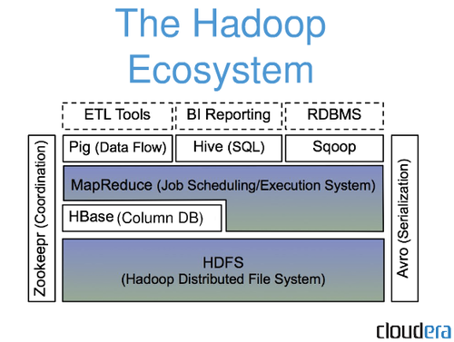

Example: HBASE
HBase is built on top of HDFS
HBase files are internally stored in HDFS

Slide 37
References
Fay Chang et al, Bigtable: A Distributed Storage System for Structured Data, OSDI 2006
  http://research.google.com/archive/bigtable.html
Introduction to Hbase Schema Design, Amandeep Khurana, Login; Magazine, 2012.
  https://www.usenix.org/publications/login/october-2012-volume-37-number-5/introduction-hbase-schema-design
Apache HBase Documentation
  http://hbase.apache.org
  https://hbase.apache.org/book.html#arch.overview
HBase Installation on Ubuntu (guru99.com)
https://github.com/apache/hbase
https://hbase.apache.org/docs/single-page

Slide 38
Google v.s. Open Source
Database | BigTable | HBase
File System | GFS | HDFS
Programming Model | MapReduce | Hadoop MapReduce
Coordination | Chubby | Zookeeper
Google has developed Chubby, a lock service for loosely coupled distributed systems
Apache ZooKeeper, which was created at Yahoo, is open-source software and can be used to perform distributed locks.

Slide 39
HBase Data Model
A database consists of multiple tables.
Each table consists of multiple rows, sorted by row key.
Each row contains a row key and one or more column families.
Each column family is defined when the table is created.
Column families can contain multiple columns. (family:column)
A cell is uniquely identified by (table,row,family:column).
A cell contains an uninterpreted array of bytes and a timestamp.

Slide 40
Data in Tabular Form
family
column
 | Name |  | Home |  | Office
Key | First | Last | Phone | Email | Phone | Email
101 | Florian | Krepsbach | 555-1212 | florian@ wobegon.org | 666-1212 | fk@phc.com
102 | Marilyn | Tollerud | 555-1213 |  | 666-1213
103 | Pastor | Inqvist |  |  | 555-1214 | inqvist@ wels.org

Slide 41
Data in Tabular Form
 | Name |  |  | Home |  | Office |  | Social
Key | First | Middle | Last | Phone | Email | Phone | Email | FacebookID
101 | Florian | Garfield | Krepsbach | 555-1212 | florian@ wobegon.org | 666-1212 | fk@phc.com
102 | Marilyn |  | Tollerud | 555-1213 |  | 666-1213
103 | Pastor |  | Inqvist |  |  | 555-1214 | inqvist@ wels.org
New columns can be added at runtime.
Column families cannot be added at runtime.

Slide 42
Don’t be fooled by the picture:
Hbase is really a sparse table.

Slide 43
Nested Data Representation
Table People ( Name, Home, Office )
{
101: {
Timestamp: T403;
Name: {First=“Florian”, Middle=“Garfield”, Last=“Krepsbach”},
Home: {Phone=“555-1212”, Email=“florian@wobegon.org”},
Office: {Phone=“666-1212”, Email=“fk@phc.com”}
},
102: {
Timestamp: T593;
Name: { First=“Marilyn”, Last=“Tollerud”},
Home: { Phone=“555-1213” },
Office: { Phone=“666-1213” }
},
103: {
Timestamp: T754;
Name: { First=“Pastor”, Last=“Inqvist”},
Office: { Phone=“555-1214”,Email=“inqvist@wels.org” }
},
…
}

Slide 44
Nested Data Representation
Retrieve data from HBase using GET
GET People:101
101: {
Timestamp: T403;
Name: {First=“Florian”, Middle=“Garfield”, Last=“Krepsbach”},
Home: {Phone=“555-1212”, Email=“florian@wobegon.org”},
Office: {Phone=“666-1212”, Email=“fk@phc.com”}
}
GET People:101:Name
People:101:Name: {First=“Florian”, Middle=“Garfield”, Last=“Krepsbach”}
GET People:101:Name:First
People:101:Name:First=“Florian”

Slide 45
Fundamental Operations
CREATE table, families
PUT table, rowid, family:column, value
PUT table, rowid, whole-row
GET table, rowid
SCAN table (WITH filters)
DROP table

Slide 46
Consistency Model
Atomicity: Entire rows are updated atomically or not at all.
Consistency:
  A GET is guaranteed to return a complete row that existed at some point in the table’s history. (Check the timestamp to be sure!)
  A SCAN must include all data written prior to the scan, and may include updates since it started.
Isolation: Not guaranteed outside a single row.
Durability: All successful writes have been made durable on disk.

Slide 47
HBase Physical Model
47

Slide 48
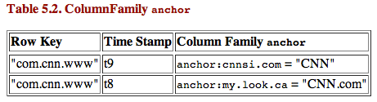
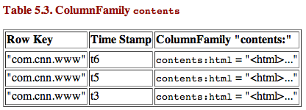
HBase Physical Model
Each column family is stored in a separate file (called HTables)
Key & Version numbers are replicated with each column family
Empty cells are not stored
HBase maintains a multi-level index on values:
<key, column family, column name, timestamp>
48

Slide 49
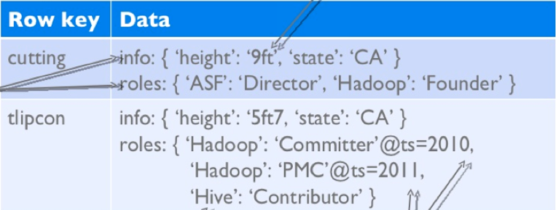
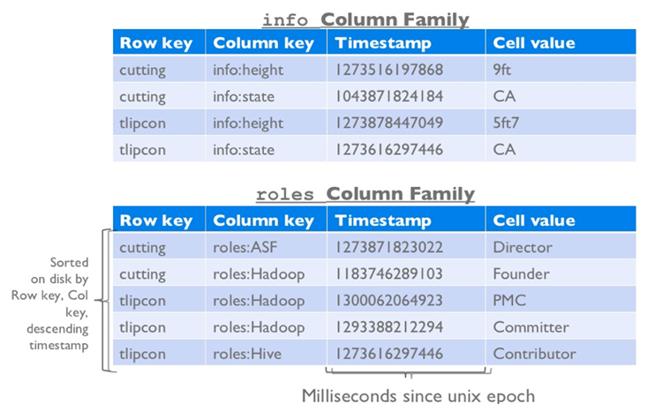
Example
Doug Cutting
Todd Lipcon
stored in a separate files
49

Slide 50
Column Families
Different Column families (sets of columns) may have different properties and access patterns
Configurable by Column Family(CF):
  Compression(none, gzip, LZO)
  Version retention policies
  Cache priority
CFs stored separately（in different files） on disk: access one without wasting IO on the other
50

Slide 51
HBase Regions
Each HTable (column family) is partitioned horizontally into regions
  (Regions are counterparts to HDFS blocks)
Each will be one region
51

Slide 52
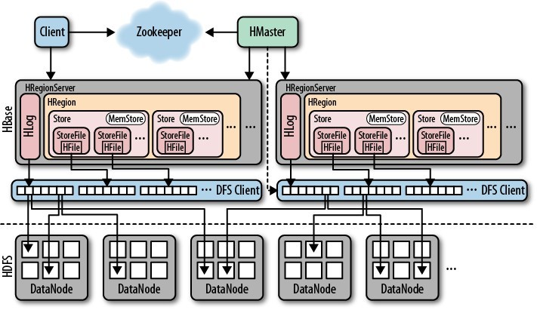
Hbase Architecture

Slide 53
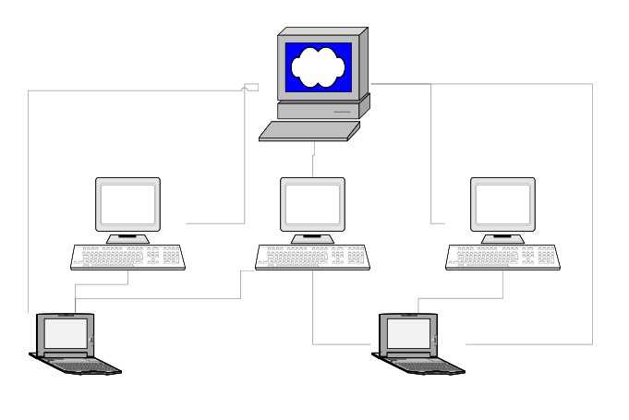
Three Major Components
The HBaseMaster
  One master
The HRegionServer
  Many region servers
The HBase client
53

Slide 54
HBase Components
Region
  A subset of a table’s rows, like horizontal range partitioning
  Automatically done
RegionServer (many slaves)
  Manages data regions
  Serves data for reads and writes (using a log)
Master
  Responsible for coordinating the slaves
  Assigns regions, detects failures
  Admin functions
54

Slide 55
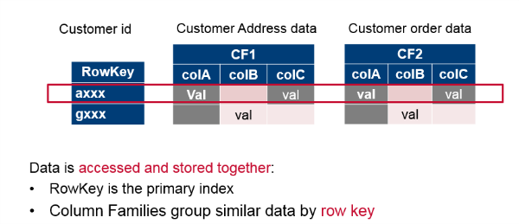
HBase Data Model
HBase is a column family-oriented database. It’s also row-oriented: each row is indexed by a key that you can use for lookup. Each column family groups like data (customer address, order) within rows.
55

Slide 56
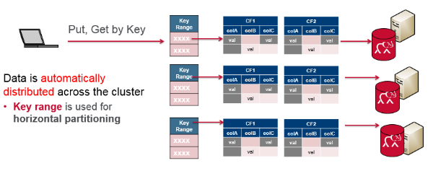
HBase Data Model
HBase is also a distributed database.
Grouping the data by key is central to running on a cluster. The key acts as the atomic unit for updates. Sharding(分片) distributes different data across multiple servers, and each server is the source for a subset of data.
56

Slide 57
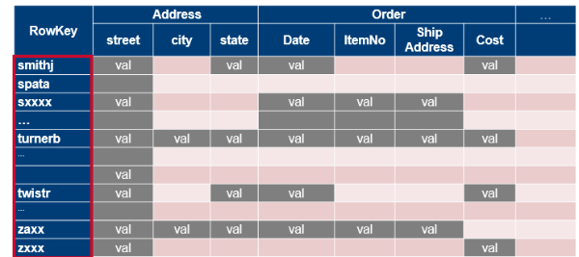
HBase Data Model
Data stored in HBase is located by its “rowkey.” This is like a primary key from a relational database. Records in HBase are stored in sorted order, according to rowkey. This is a fundamental tenet(宗旨) of HBase and is also a critical semantic used in HBase schema design.
57

Slide 58
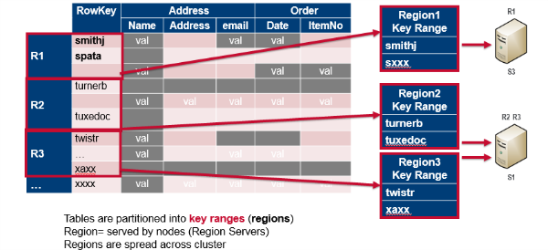
HBase Data Model
Tables are divided into sequences of rows, by key range, called regions. These regions are then assigned to the data nodes in the cluster called “Region Servers.”
58

Slide 59
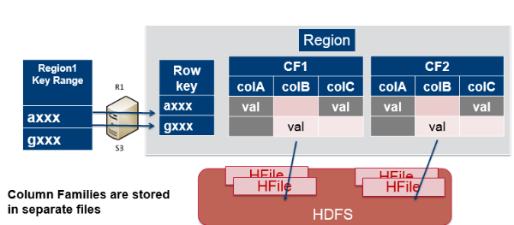
HBase Data Model
Column families are stored in separate files, which can be accessed separately.
59

Slide 60
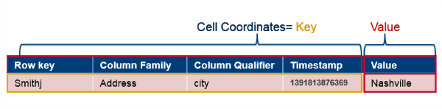
HBase Data Model
The data is stored in HBase table cells. The entire cell, with the added structural information, is called Key Value.
The key consists of the row key, column family name, column name, and timestamp.
60

Slide 61
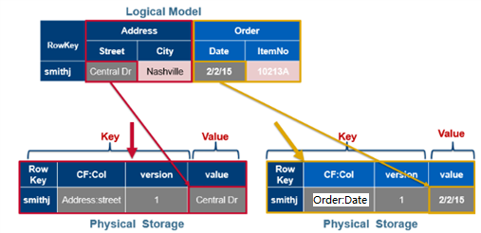
HBase Data Model
Logically, cells are stored in a table format, but physically, rows are stored as linear sets of cells containing all the key value information inside them.
61

Slide 62
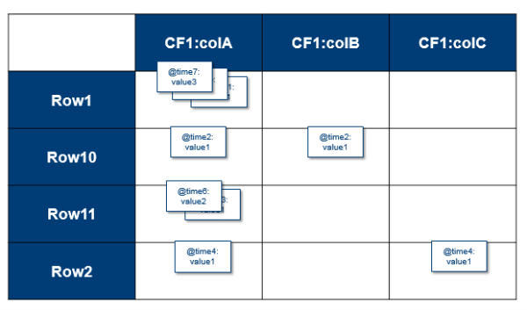
HBase Data Model
HBase tables are sparsely populated. If data doesn’t exist at a column, it’s not stored. Table cells are versioned uninterpreted arrays of bytes. You can use the timestamp or set up your own versioning system. For every coordinate row:family:column, there can be multiple versions of the value.
62

Slide 63
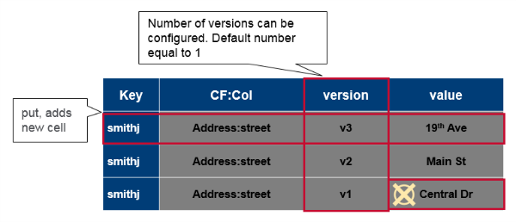
HBase Data Model
Versioning is built in. A put is both an insert (create) and an update, and each one gets its own version or timestamp.
Delete gets a tombstone marker. The tombstone marker prevents the data being returned in queries.
Get requests return specific version(s) based on parameters. If you do not specify any parameters, the most recent version is returned.
You can configure how many versions to keep and this is done per column family. The default is to keep up to three versions. When the max number of versions is exceeded, extra records（old timestamps） will be eventually removed.
63

Slide 64
Reference
https://www.corejavaguru.com/bigdata/hbase-tutorial/introduction
https://developpaper.com/deep-understanding-of-hbase-architecture-translation/
Apache HBase ™ Reference Guide
https://www.javatpoint.com/hadoop-tutorial

Slide 65
Exercise
Preparation
(Make sure you have installed docker and docker-compose on your Ubuntu system.)
Install docker-hbase project from github
git clone https://github.com/big-data-europe/docker-hbase
Deploy an standalone Hbase cluster
cd docker-hbase directory (you have downloaded from github)
  Start docker Hbase cluster
  docker-compose –f docker-compose-standalone.yml up –d
  Make sure the docker Hbase cluster is running
  docker ps

Slide 66
Exercise
Enter docker Hbase cluster shell
docker exec –it hbase bash
Connect to Hbase
hbase shell
Create a Hbase table
  create 'test', 'cf'
List info about Table
  list 'test'
Show details of the table
  describe 'test'
Insert some data into the test table
  put 'test', 'row1', 'cf:a', 'value1'
  put 'test', 'row2', 'cf:b', 'value2'
  put 'test', 'row3', 'cf:c', 'value3'

Slide 67
Exercise
Use scan command to show the data
  scan 'test'
Get a single row of data
  get 'test', 'row1'
Diable the table
  disable 'test'
Drop the test table
  drop 'test'
Exit the Hbase shell
  quit

Slide 68
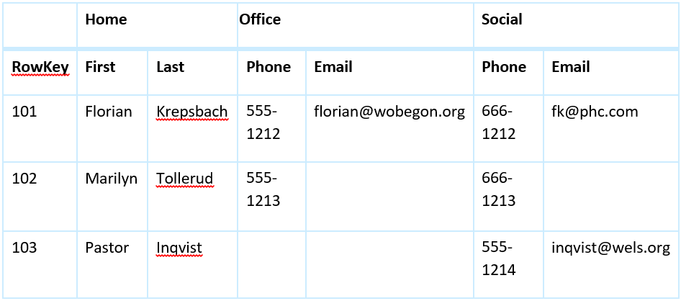
Exercise
Run Hbase again
  docker exerc –it hbase bash
  hbase shell
This time, you need to create a hbase table mytable to save the following data.
This table has three column families and three row keys. Use the commands you have learned to create mytable, and insert the data into the table and get the data from the table.

Slide 69
Exercise
Create a Hbase table
  create 'Mytable', 'Home', 'Office', 'Social'
  list 'Mytable'
Use put command to enter data to mytable one by one
Use scan command to show data in mytable

Slide 70
Assignment
Install PySpark on your Ubuntu System
Refer to the tutorial on Canvas (Install PySpark On Ubuntu 20.docx)

Slide 71
Assignment
Group Work
Option1: Ask ChatGPT
1. Build a three-node Hadoop cluster on three Windows 11 computers
2. Build a three-node Apache Spark cluster on three Windows 11 computers
Option 2: rent 3 cloud servers (4 core/8GB, 50 GB) or (8 core/16GB, 50GB) for two months
(Aliyun or Tencent ) to build a Hadoop cluster, later to build a Spark cluster.

