Slide 1
INTERNSHIP STUDIO INTERNSHIP FOR ETHICAL HACKING TASK-3

Slide 2
STEPS INVOLVED:
Use burpsuit for this method
Open Firefox and set the proxy setting as burpsuit proxy
Turn on intercept in burpsuit
In Firefox open the link http://testasp.vulnweb.com
Forward in intercept in burpsuit
Try the XSS script <script>alert(1)</> in search box
In burpsuit forward the response in intruder

Slide 3
In intruder section, post the XSS scripts and start attack
Check which XSS script that intruded, copy the response of it and paste it in Firefox browser to see how it works
Here <script>alert(1)</script> works and gives out an response of script injection

Slide 4
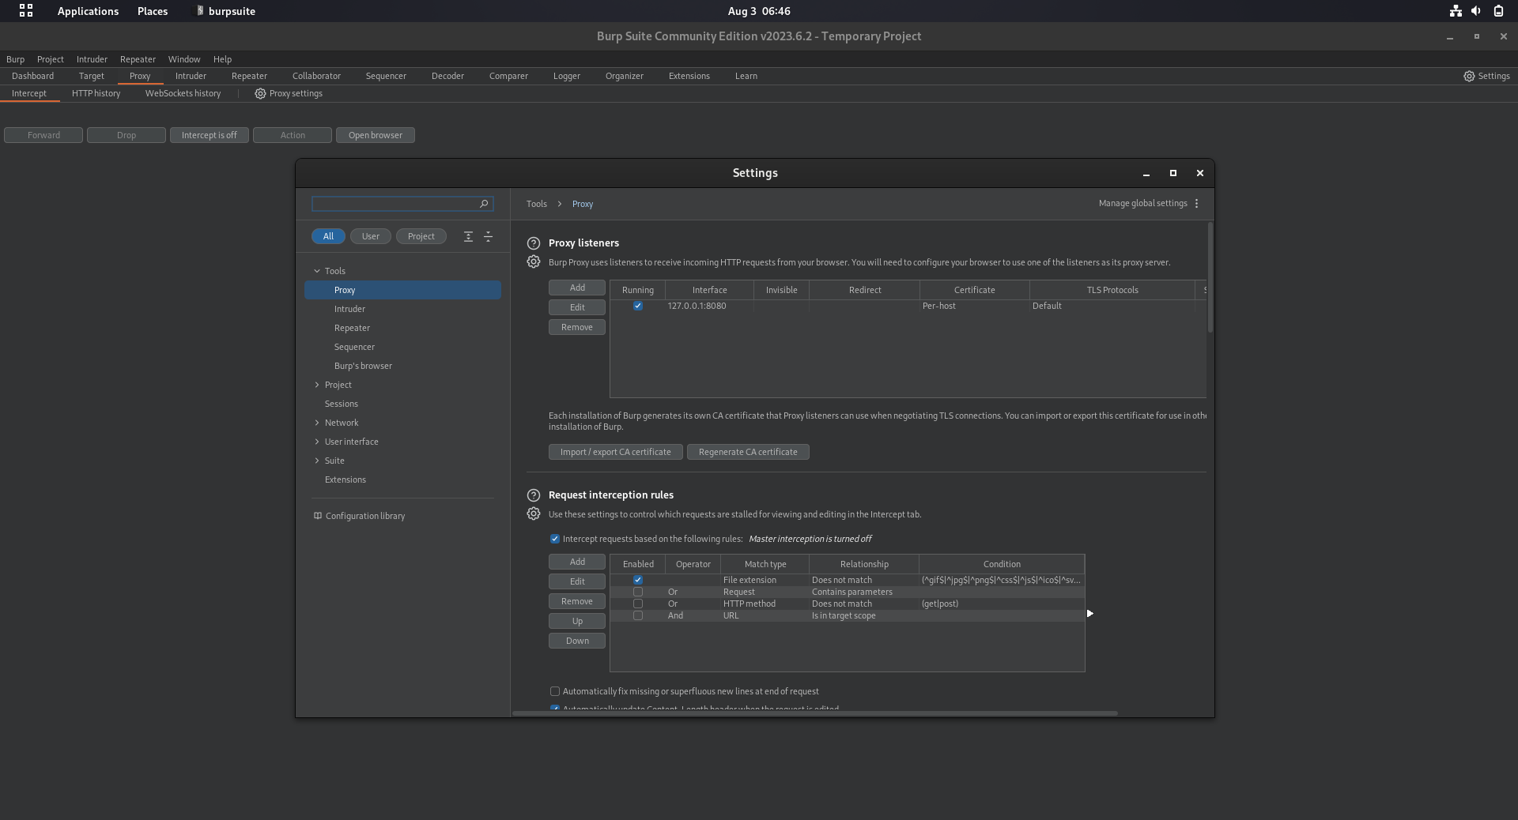

Slide 5
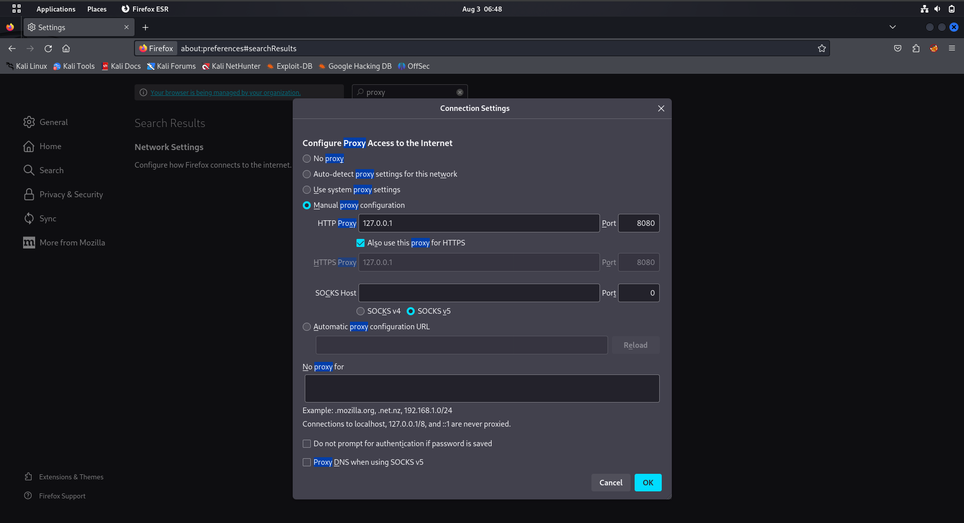

Slide 6
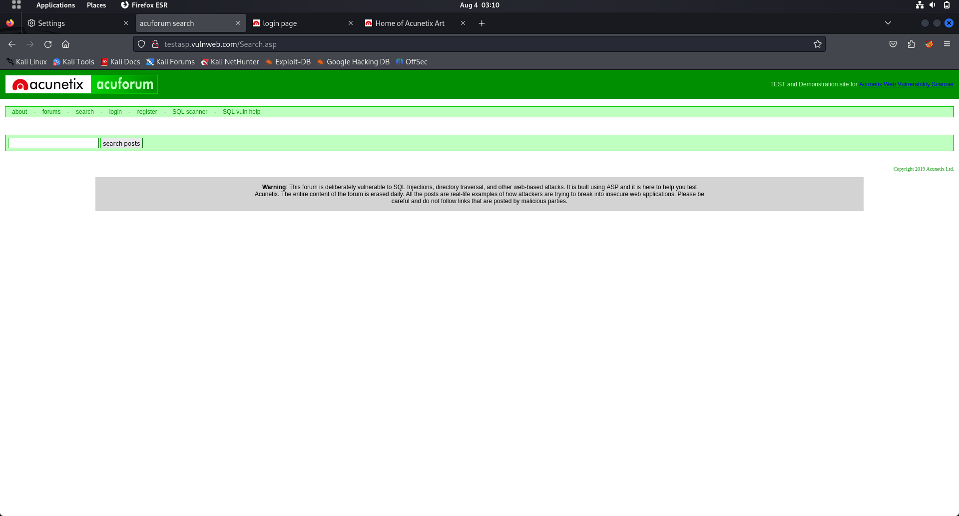

Slide 7
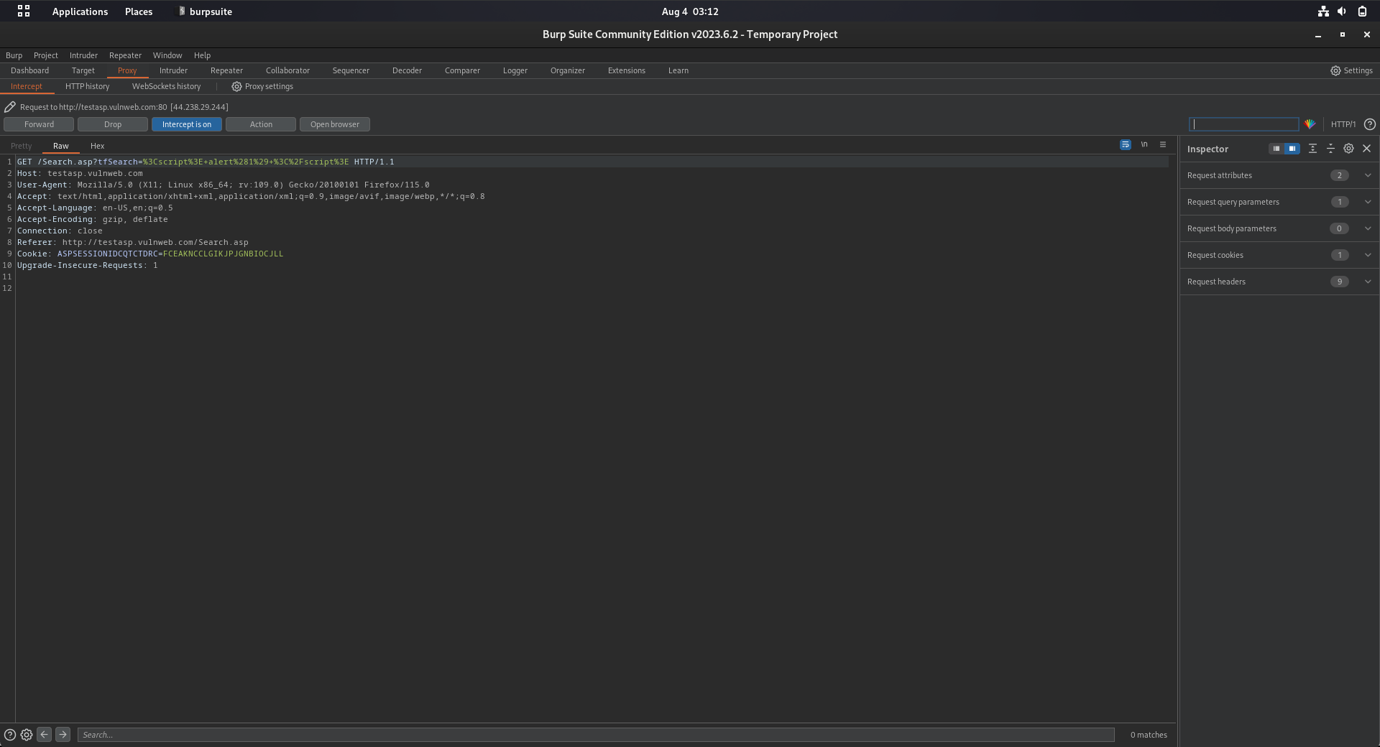

Slide 8
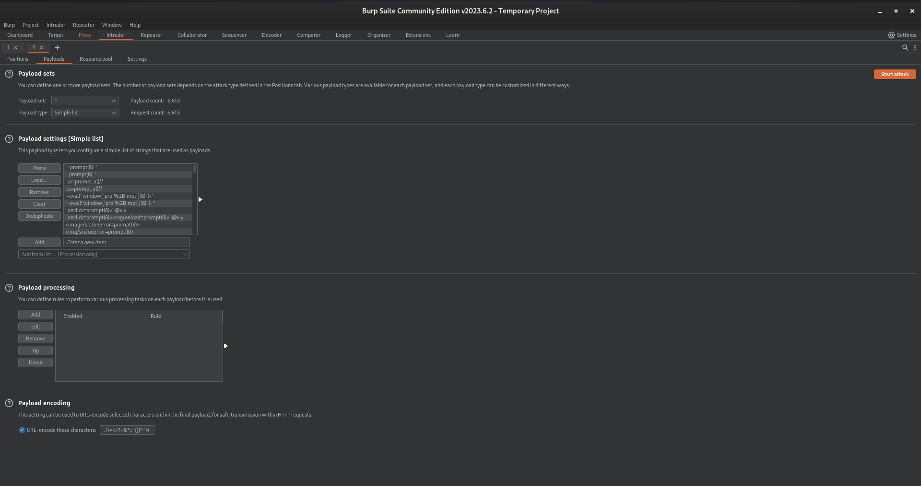

Slide 9
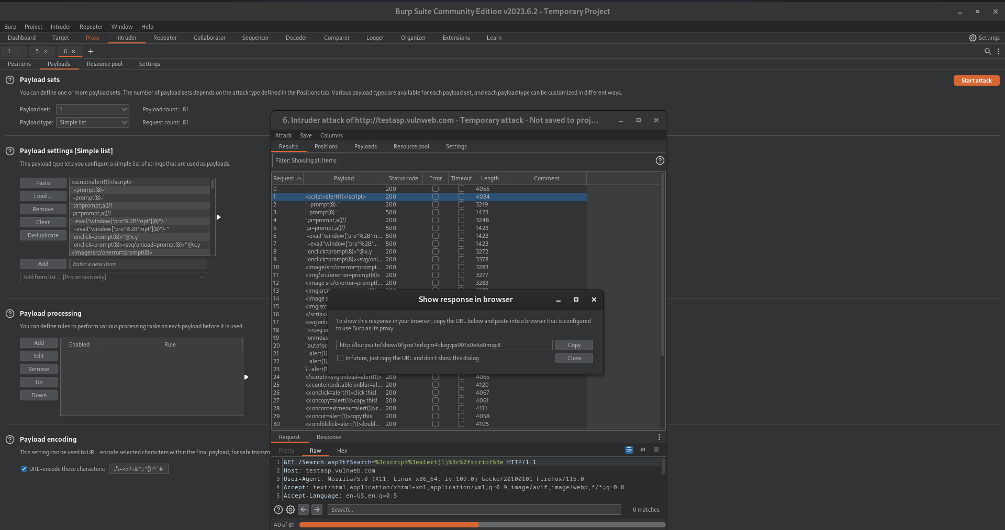

Slide 10
